Slide 1
Measuring ECN
Geoff Huston
Chief Scientist, APNIC

Slide 2
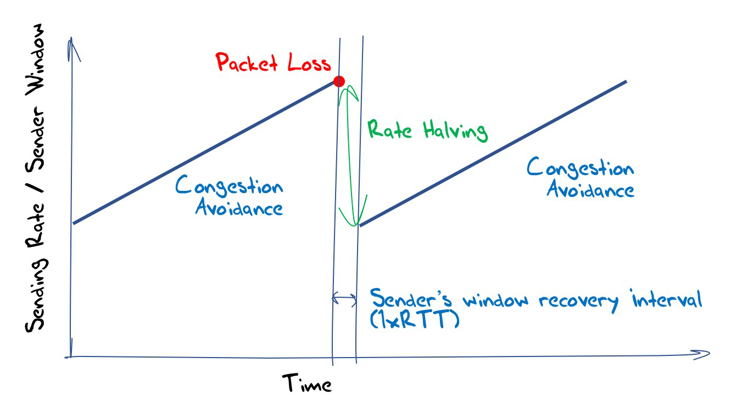
Loss-Based Congestion Control
Most of today’s network traffic uses an extremely simple algorithm that avoids networks collapsing under extreme overload:
  Continually increase the amount of data being pushed into the network
  Until a network queue overloads and the sender detects the consequent packet loss
  Halve the sending rate and do it again!

Slide 3
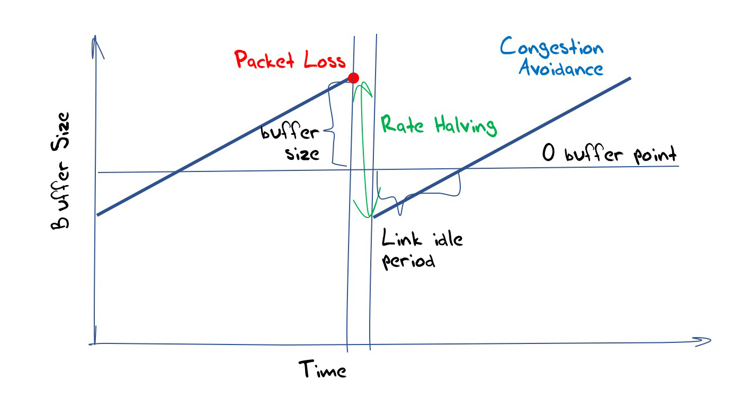
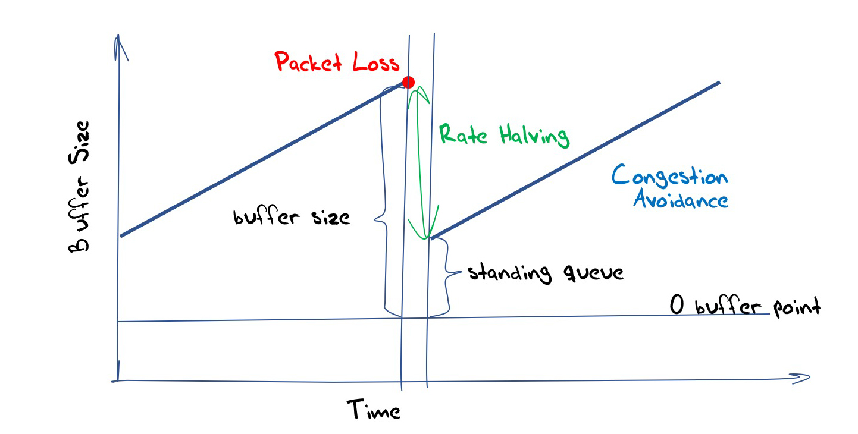
Refinements
Change the congestion avoidance inflation algorithm
Try to detect the difference between isolated damage packet loss and queue overload loss
Better understand the relationship between network buffers and protocol performance

Slide 4
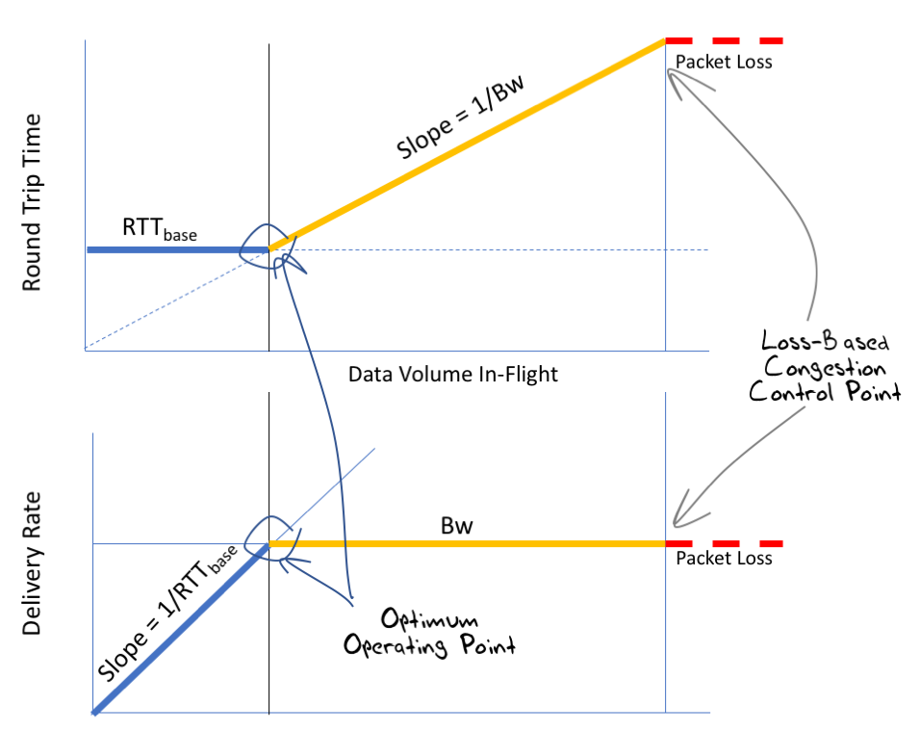
Is there a “better” way?
Trigger the congestion response at the onset of queue formation rather than at the point of catastrophic queue collapse

Slide 5
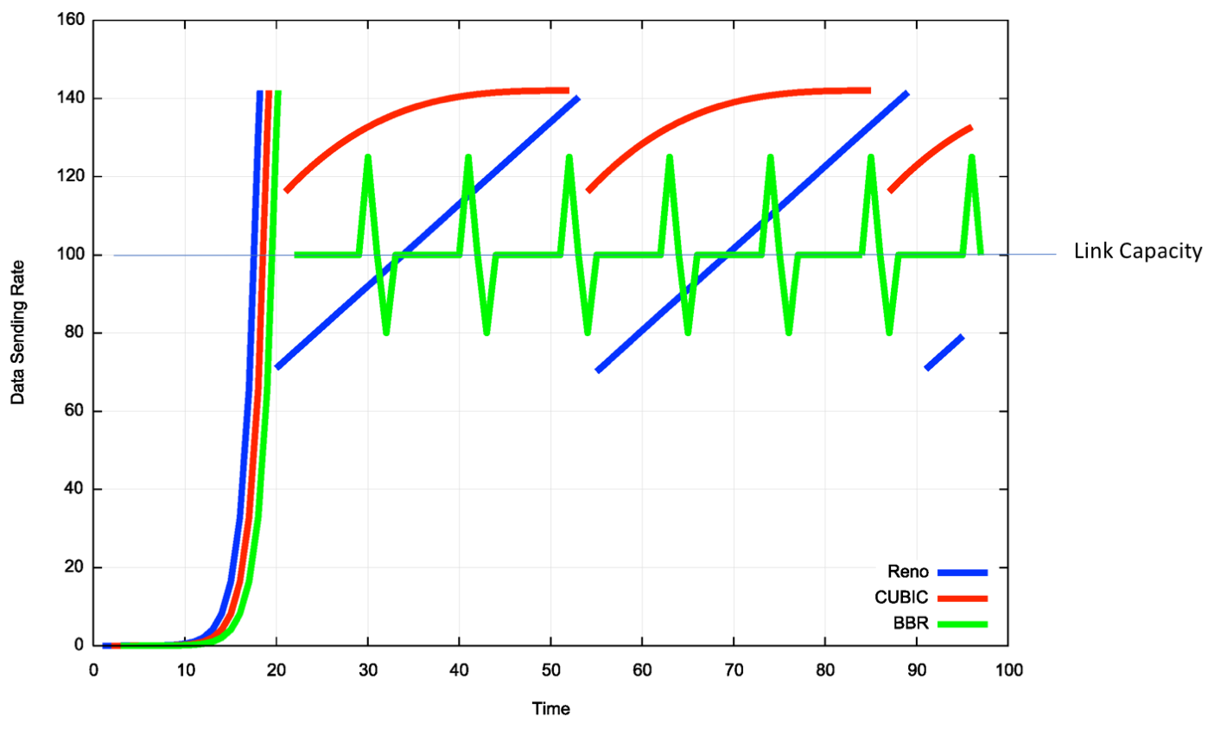
BBR
Detect queue formation through pulsed testing and delay sensitivity

Slide 6
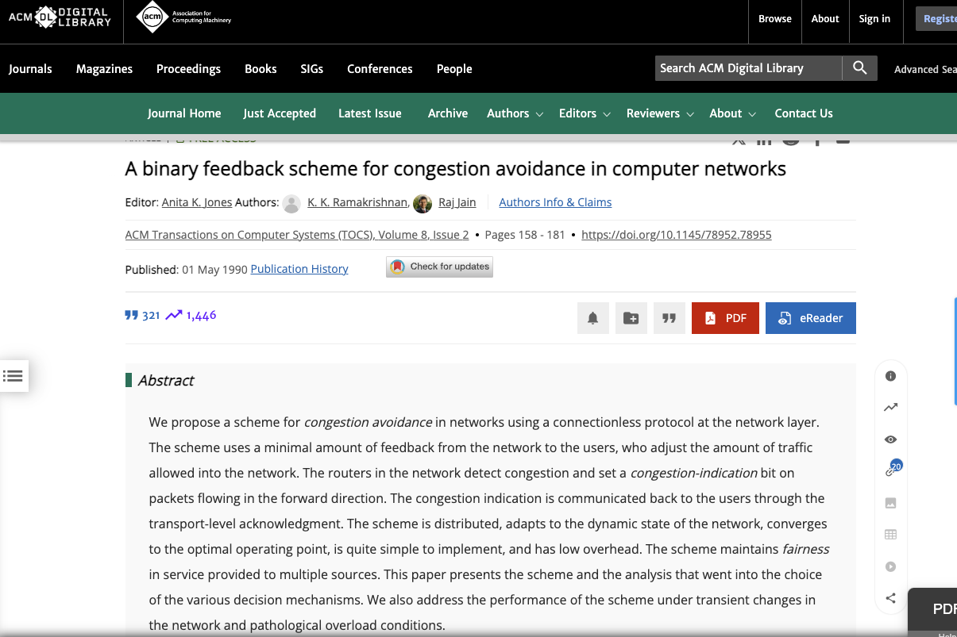
Or get the router to help!
May 1990!

Slide 7
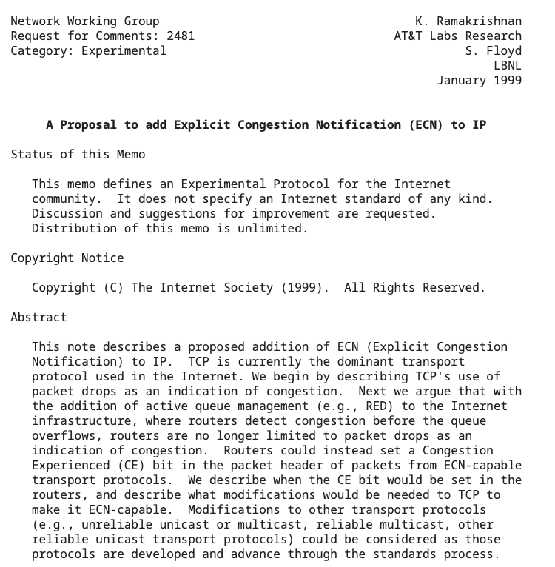
Or get the router to help!
January 1999!

Slide 8
Or get the router to help!
January 1999!

Slide 9
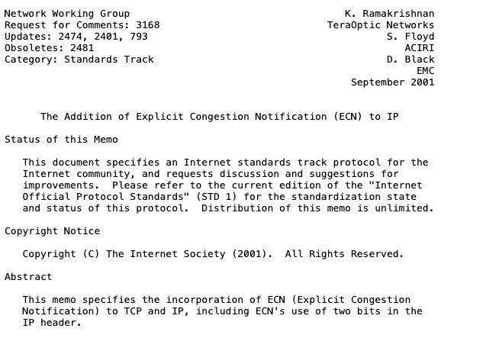
Or get the router to help!
September 2001!

Slide 10
Then …
Crickets!

Slide 11
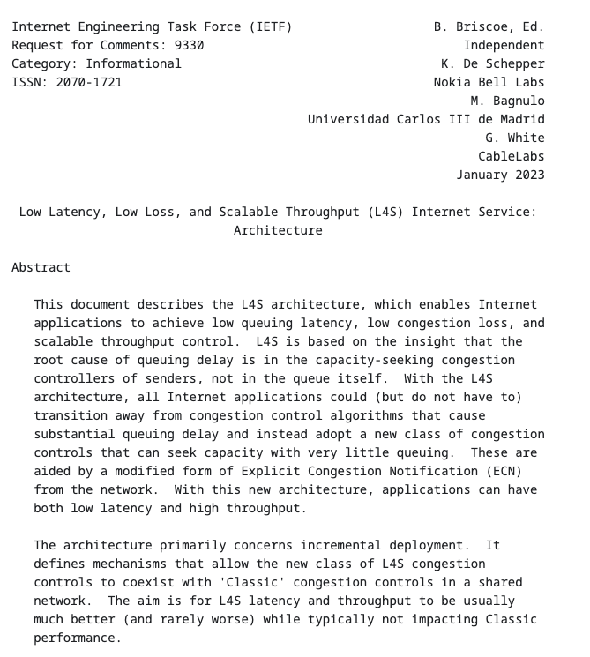
Until around 2022…
L4S!

Slide 12
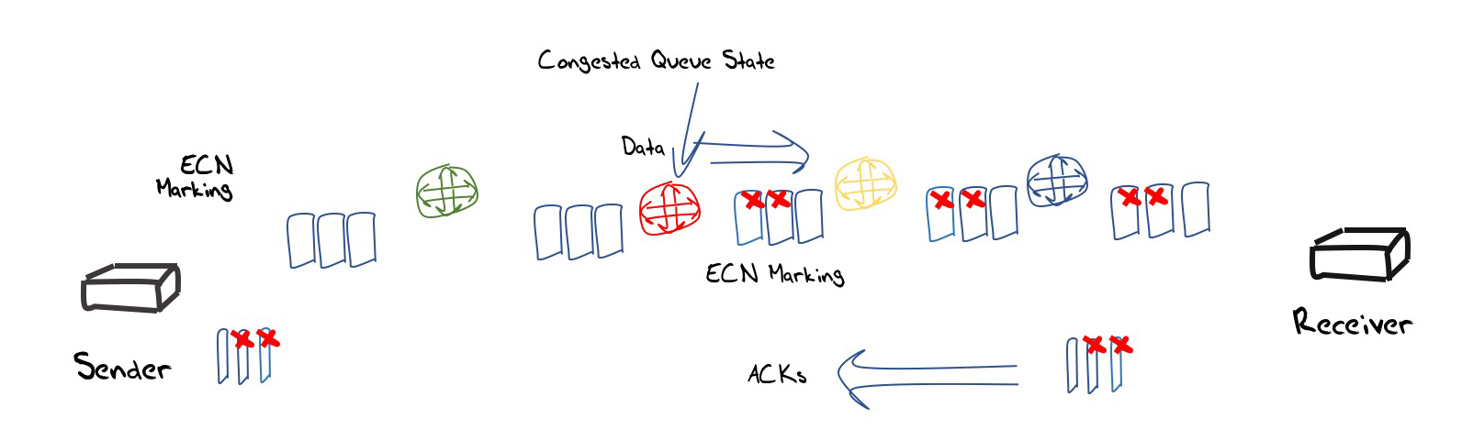
ECN Control Loop
IP
TCP
A router “marks” IP packets at the onset of queue formation with a bit signal
The Receiver echoes this bit up into the transport protocol reverse flow
The sender reduces its sending window size (and notifies the receiver that it was performed this window reduction)

Slide 13
ECN Control Loop
IP
TCP
A router “marks” IP packets at the onset of queue formation with a bit signal
The Receiver echoes this bit up into the transport protocol reverse flow
The sender reduces its sending window size (and notifies the receiver that it was performed this window reduction)

Slide 14
IP Header
0 0
ECN Bits
0 0 – Non-ECN Capable Transport
0 1 – ECN Capable TransporT
1 0 - ECN Capable Transport
1 1 – Congestion Experienced

Slide 15
TCP
ECE – receiver back to sender – CE received
CWR – sender to receiver – Congestion Window Reduced
SYN+ECE+CWR – ECN capable on session start
SYN+ACK+ECE – ECN capable response

Slide 16
ECN Measures
Packet Count (by remote IP addresses) for Feb/March 2025
0. IP Sources 303,545,388
IP ECT 6,815,753 (2.45% of sources)
IP CE 1,098,965 (16.12% of ECT sources)

Slide 17
ECN Measures
Packet Count (by remote IP addresses)
0. IP Sources 303,545,388
IP ECT 6,815,753 (2.45% of sources)
IP CE 1,098,965 (16.12% of ECT sources)
TCP ECN Opt 7,478,207 (2.46% of sources)
TCP ECE (Rec’d) 20,862 (0.27% of TCP sources)
TCP CWR (Rec’d) 335,209 (4.48% of TCP sources)

Slide 18
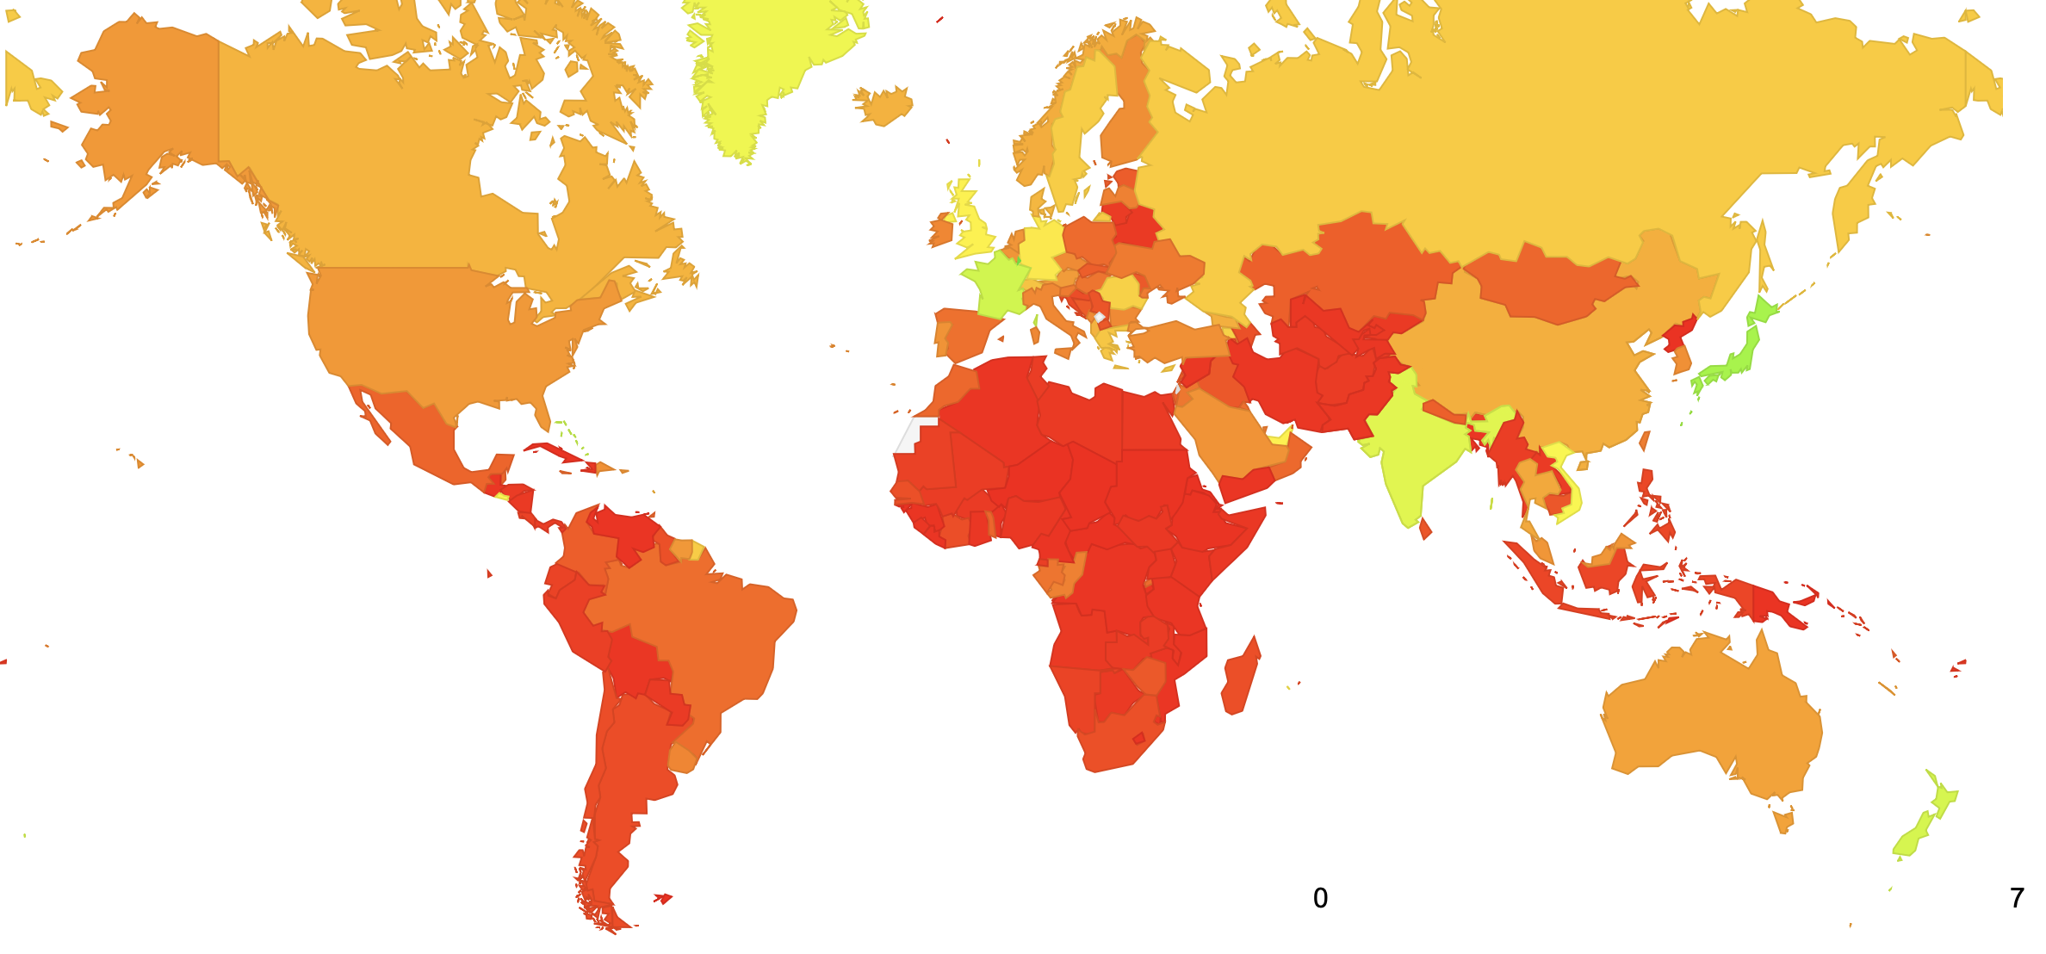
IP ECT by Country

Slide 19
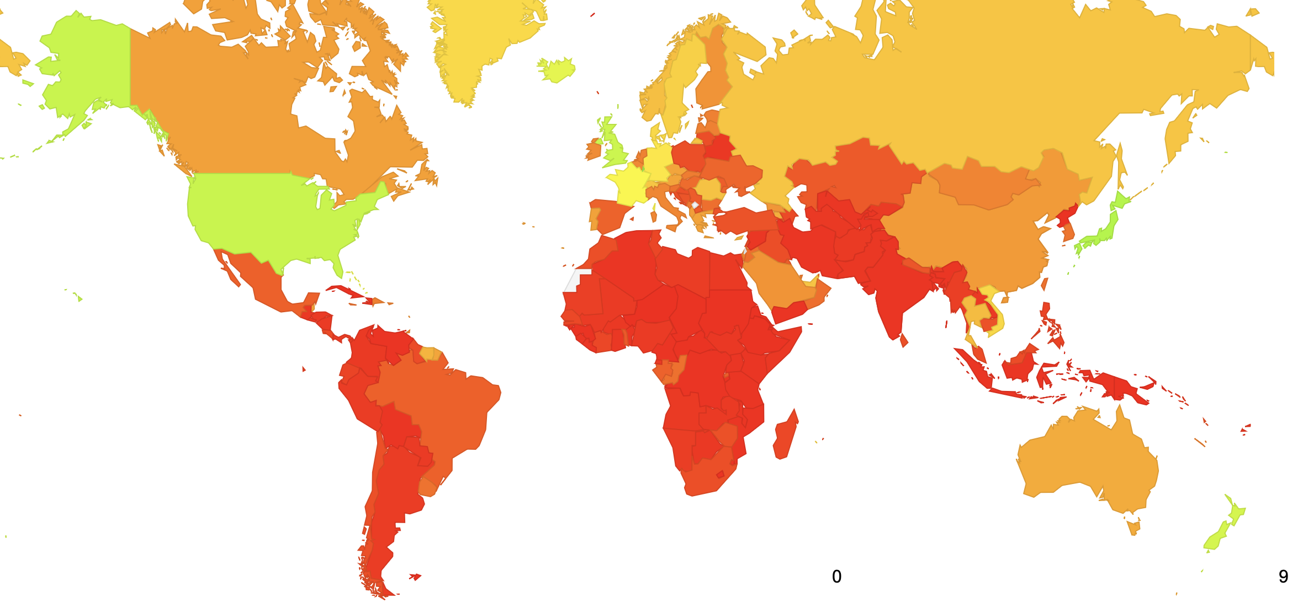
TCP ECN Option by Country

Slide 20
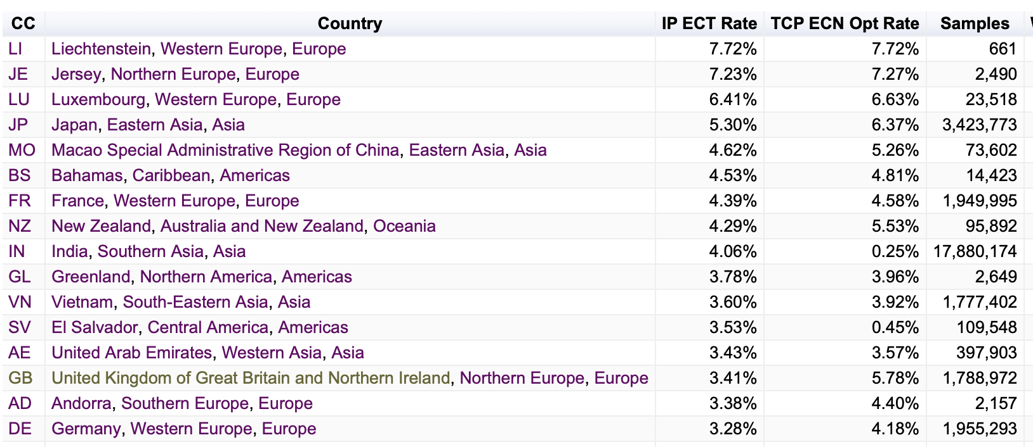
Country Table

Slide 21
Thanks!

