Slide 1
Is Infrastructure Security an Internet Market Failure?
Geoff Huston AM
APNIC Labs

Slide 2
Why is DNSSEC so hard?
Has it taken almost 30 years for DNSSEC to have signed about 10% of domain names?
Has it taken almost 30 years for just one third of users to perform DNSSEC validation?
And how much longer will it take for the rest of the unprotected name space to adopt DNSSEC?
  <insert your guess here!>

Slide 3
Why is Routing Security so hard?
Is deploying a secure framework for inter-domain routing security so hard?
Has the effort to define and adopt a framework for a secured routing system taking us decades?
  And we are still a fair distance from completing this work!

Slide 4
What’s going on?
In the deregulated world of the Internet are these extended failures to adopt secure technologies instances of market failure?

Slide 5
Is securing the infrastructure of the Internet a market failure?
Yes!

Slide 6
Thanks!

Slide 7
Whoa!
Not so fast!
What are we talking about with “infrastructure security”?
What is meant by “market failure?”
Is infrastructure security failing us?
What are the implications?
Can we improve this picture?

Slide 8
Infrastructure Security
For the Internet, the common infrastructure we are talking about are the realms of IP addresses, Routing, Names and named Service Connections
  Or “names, addresses and routing”
And security is the role of protecting the integrity of these realms
  Ensuring uniqueness of name and address tokens
  Ensuring the integrity of the association between a holder of these resources and the resources themselves
  Allowing a user to authenticate the validity of the use of an address or name

Slide 9
Market Failure and Public Good
Market failure is the economic situation defined by an inefficient distribution of goods and services in the free market. In market failure, the individual incentives for rational behaviour do not lead to rational outcomes for the group (Investopedia)
In economics, a public good is a good that is both non-excludable and non-rivalrous. Use by one person neither prevents access by other people, nor does it reduce availability to others. Therefore, the good can be used simultaneously by more than one person. (Wikipedia)

Slide 10
What’s the issue here?
The Internet operates in a largely deregulated environment which is dominated by market pressures
There is no forcing function to ensure that everyone adopts a security mechanism
  Whether you sign your domain name with DNSSEC is your choice
  Whether you generate ROAs for your route objects is your choice
The Internet relies on common perceptions of opportunity and cost to motivate adoption of technologies
  These are market forces, not regulatory imposts

Slide 11
Heterogenous Markets
In the absence of enforced universal adoption, we normally see discretionary partial adoption
  Everyone reacts to prevailing market pressures in their own way
  In terms of adoption of security mechanisms, the common result is that only a proportion of infrastructure elements will have security credentials associated with them
  If the common perception of benefit to cost is high then adoption rate will be high, and when the perception of benefit to cost is generally low then adoption will stall

Slide 12
Adoption is variable
Where there is no clear immediate and direct benefit to adoption then a consumer is likely to defer the cost of adoption
  This is the case irrespective of the broader social benefit that may accrue from general adoption
  “It’s in our common interest to adopt <x> to improve the security of our digital infrastructure but individually the incremental cost of adoption exceeds the perception of direct benefit”

Slide 13
Hypothetically …
Could a ISP charge its customers a premium if it had deployed a RPKI Route Origination Validation framework?
Could a DNS hosting service charge its customers more if it added DNSSEC front-end signing to its service?
This inability to monetize such investments in securing network infrastructure acts as a negative incentive for adoption

Slide 14
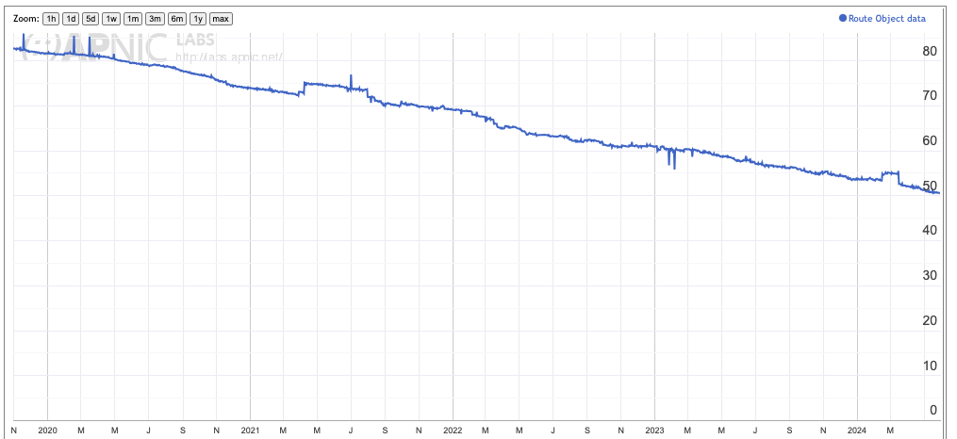
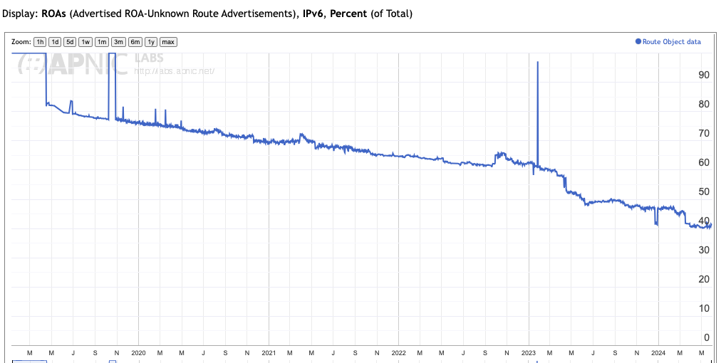
Routes without ROAs
Proportion of IPv4 Route Objects NOT covered by a ROA
Proportion of IPv6 Route Objects NOT covered by a ROA

Slide 15
Securing Routes
54% of all advertised route objects in the IPv4 space are not listed in any ROA
48% of all advertised route objects in the IPv6 space are not listed in any ROA
~0% of all BGP AS Paths are protected

Slide 16
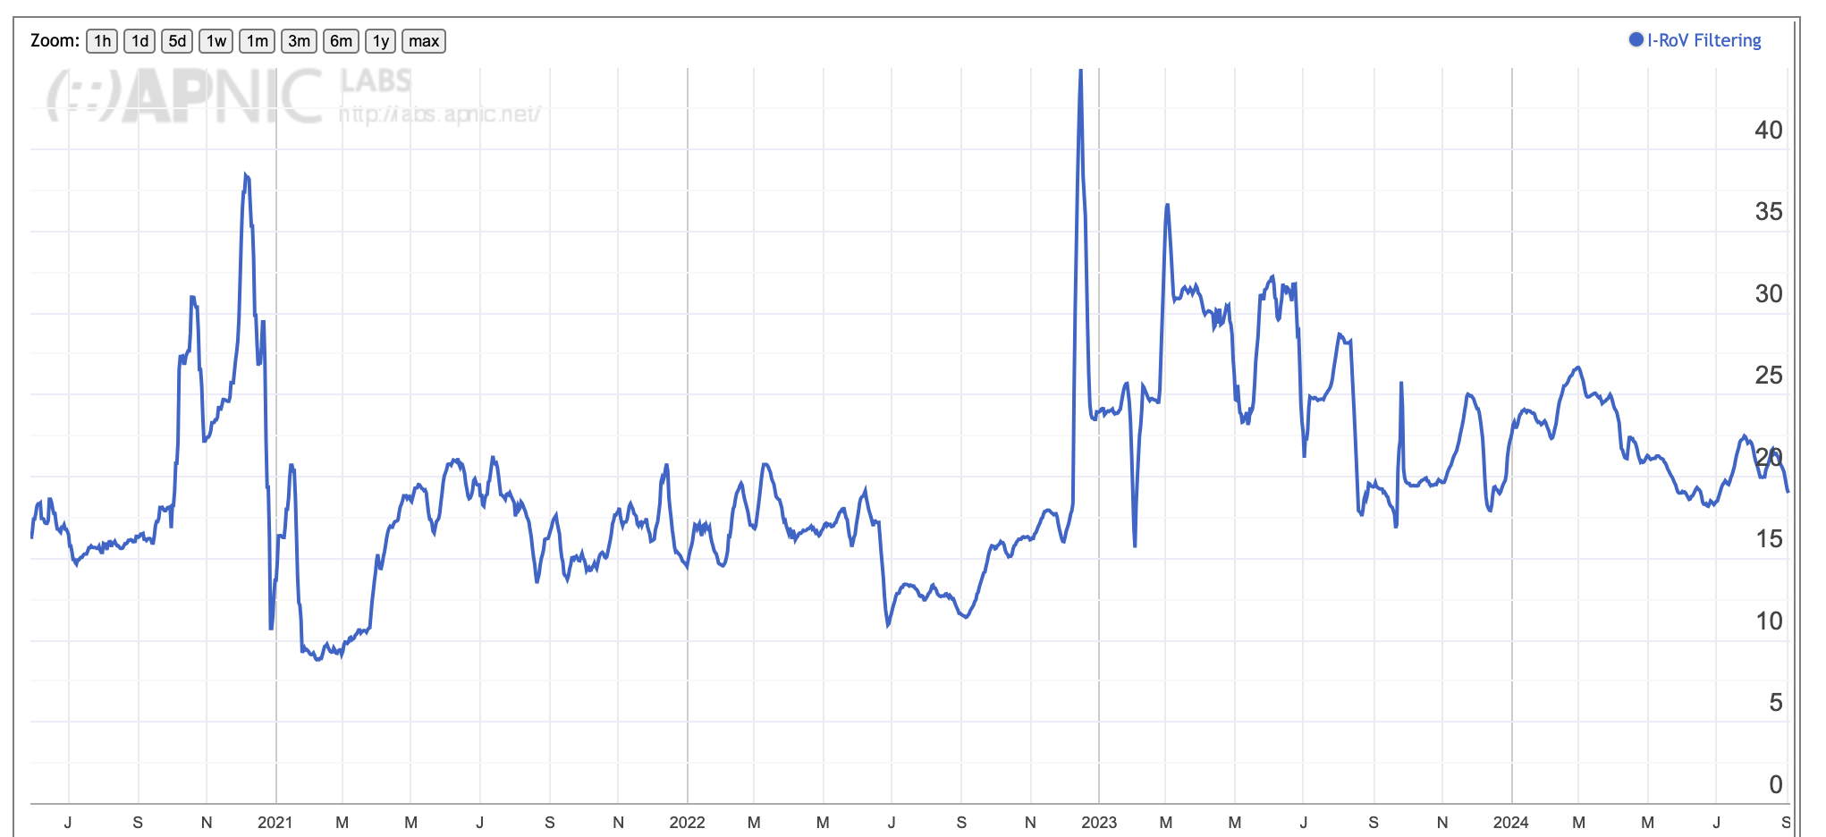
Route Origination Validation

Slide 17
Route Origination Validation
All those ROAs appear be to achieving ….
    Very little!

Slide 18
No DNSSEC Validation
Proportion of users who will accept a badly signed DNS result

Slide 19
Securing Names with DNSSEC
Some 70% of users are located behind recursive resolvers where there is no validation of DNSSEC credentials
Some 90% of domain names are not signed with DNSSEC
  (Tranco Top 1M names)

Slide 20
Securing Addressing
0% of address database entries are digitally signed
  Why do I constantly need to refer to an unsigned address registry to “prove” that this is my IP address?
  Why can’t I associate a public/private key pair with my addresses and use digitally signed attestations to assert my holding of addresses?
  If this ”works” for ROAs in a routing context, then why can’t I use the same address credentials in other contexts?

Slide 21
What should an application do?
In today’s Internet no application can count on the presence of a fully secured infrastructure
DNS queries generate unreliable answers
IP packets may be routed to unintended destinations

Slide 22
What should an application do?
The safest course of action in the face of partial adoption is to assume that these infrastructure services - the secured resolution of domain names to IP addresses, and the secured forwarding of packets to destination addresses is not reliably available
The application is unable to derive a consistent benefit from partial deployment of secured infrastructure

Slide 23
What should an application do?
Therefore, a well-engineered application has to invest in its own efforts to validate the authenticity of the service destination to which it is connecting and invest in protecting the integrity of the service transaction that is it undertaking
Which is a widespread feature of today’s Internet!

Slide 24
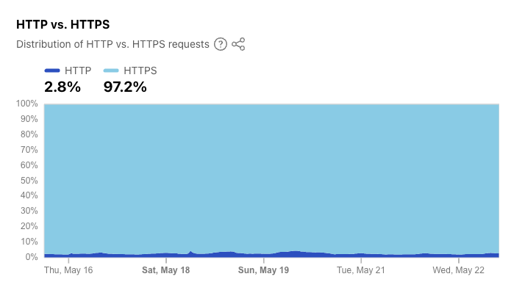
TLS as an Application-level security Response

Slide 25
Which means …
When an application is using TLS to assure itself of the authenticity of the service to which is is connecting, then what is the incremental value it places on the partial presence of infrastructure-based address and name security?

Slide 26
Which means …
When an application is using TLS to assure itself of the authenticity of the service to which is is connecting, then what is the incremental value it places on the partial presence of infrastructure-based address and name security?
Zero!

Slide 27
Internet Economics
The economic picture of the last 2 decades of the Internet is the shift of value UP the protocol stack
apps
$$$
apps
TCP Transport
Internal
Transport +
session security
QUIC and value transform
in the network stack
$$$
network
UDP Transport
network
media
media
1990’s
2020’s

Slide 28
Internet Economics
The economic picture of the last 2 decades of the Internet is the shift of value UP the protocol stack
The “value” of the Internet now lies in content and services, and the application frameworks that deliver them
Applications are now taking over many of the roles that were performed by the lower layers of the protocol stack
  QUIC is a good example of moving transport, flow control, and session integrity up from the common platform into the application itself
The lowers layers of the stack, including common infrastructure services, are being commoditized and stripped of intrinsic value

Slide 29
What does this mean?
The relationship between applications, hosts and networks has soured into mutual distrust and suspicion
The application now defends its integrity by wrapping up as much of the service transaction with encryption and indirection, and performing service authentication directly within the application
  QUIC (and MASQUE) is a visible part of this process of wrapping up traffic in encryption and redirection

Slide 30
What does this mean?
For the network operator there is little left to do at the common infrastructure level, and little money to do it with in any case!
For the infrastructure operator the same story of marginalisation applies
Who is left to invest in infrastructure security?
And who funds them?

Slide 31
What should we do?
Should we invest more money and effort into DNSSEC?
  Who funds such an effort and where would the funding be directed?
    DNSSEC-signing a zone entails higher operational effort by the zone operator - i.e. an increase in cost
    Validating a DNSSEC-signed response also invokes higher levels of operational effort on the part of the DNS resolver operator
  Or is this a case of misdirected effort with an assumption of funding that simply does not exist in the first place?

Slide 32
What should we do?
Invest more money and effort into the routing space and push for universal deployment of BGPSEC?
  Who funds such an effort and where would the funding be directed?
  Should we even care about routing security at all when most CDNs are now adjacent to most of the Internet user access networks?
    Most content and service delivery in today’s Internet is NOT routed!
  What are we trying to protect here in routing security and who has an economic interest in the outcomes of such measures?
    Or is TLS doing an adequate job for content and service operators?

Slide 33
Perhaps that’s too extreme
Let’s try and rephrase the problem statement…

Slide 34
Improving the situation
How can applications improve the assurance of the authenticity of the content and services that they access
  Third-Party CAs are the weak point of the entire TLS architecture – can we use a DNSSEC-like rooted trust hierarchy to remove the inherent vulnerability of so many trust points?
  Should we make more use of obfuscation approaches such as MASQUE to make more use of “semi-trusted” intermediaries that further obscure content and service transactions from the network?

Slide 35
What is happening?
Moore’s Law has a lot to answer for!
The original communications industry was an industry that was about rationing a scarce common public resource via pricing signals
The Internet replaced human endpoints with digital services
The constant opportunities of ever faster and cheaper digital processing meant that it was cheaper to bring a copy of the service closer to each user than it was to use the network to bring each user to the service
The role of the common network is being devalued as a common infrastructure resource and the value of content aggregation and distribution platforms have risen in its place

Slide 36
Why is this relevant?
Because the failure of common infrastructure security mechanisms to achieve universal adoption is reflective of a broader technology shift, and not a failure on the part of individual actors
Which means that the conventional response to market failures – regulatory imposts – become regressive imposts rather than helpful interventions when applied to common infrastructure

Slide 37
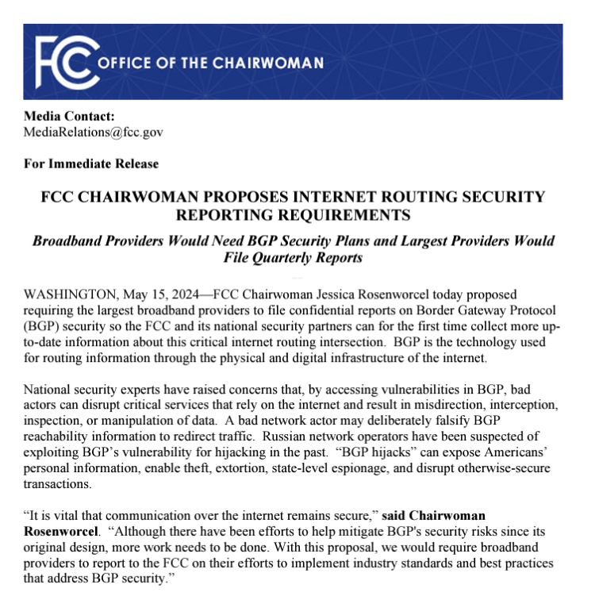
Such as…

Slide 38
What should we do?
Press on for the next 30 years, doing what we’ve been doing for the past 30 years?
What do we need to do to motivate every domain name to be DNSSEC-signed?
What do we need to do to make every network operator generate a comprehensive set of ROA credentials and run BGPSEC?
What do we need to do to get the registries to digitally sign every resource element in their registry?

Slide 39
Or should we be asking:
How can we improve service transactions and content access within the application space to assure users of the authenticity and accuracy of their transactions?

Slide 40
Thanks!

