Slide 1

Networking in the Penumbra
Geoff Huston AM
APNIC

Slide 2
The Trusted Network
Networks enjoyed a privileged position of being able to observe:
  Who is communicating with whom
  What they are saying to each other

Slide 3
The Trusted Network
Users have an expectation of privacy in their communications
  This expectation was often reinforced through regulatory measures intended to constrain public network operators from disclosing knowledge gained through network operation

Slide 4
The Erosion of Trust
Trust has been eroded by intrusive middleware that collects aggregate (and sometimes specific) data on user behaviours
  The general adoption of advertising revenue as a means of funding for service platforms acts as a major incentive to assemble detailed profiles of individual users: age, gender, location, educational level, marital status, income, interest, purchase history,…
  The better the profile, the higher the value of the user to the advertiser

Slide 5
The Erosion of Trust
This network position of trust was further eroded by leakage of the activities of US state-based actors performing various forms of mass surveillance on network users
  The Snowden Papers was a watershed moment for the Internet
  But it was by no means the first time, nor was it the last
  Large scale state-sponsored surveillance continues

Slide 6
So how did we react?

Slide 7
RFC 7258
Pervasive Monitoring is an attack on privacy:
  “The IETF community's technical assessment is that PM is an attack on the privacy of Internet users and organisations. The IETF community has expressed strong agreement that PM is an attack that needs to be mitigated where possible, via the design of protocols that make PM significantly more expensive or infeasible.”
RFC 7258 – May 2014

Slide 8
What did this IETF position mean for the Internet?

Slide 9
Changes to the Applications
Hiding Web Traffic
Shift to use TLS for all web transactions – HTTPS
  TLS authenticates the identity of the server to the client
    Is this service name authentic? Can the service operator demonstrate to the client that is has knowledge of the private part of the key pair that is associated with this DNS service name?
  Service transactions are encrypted
    TLS generates a session key used to encrypt all subsequent on-the-wire data

Slide 10
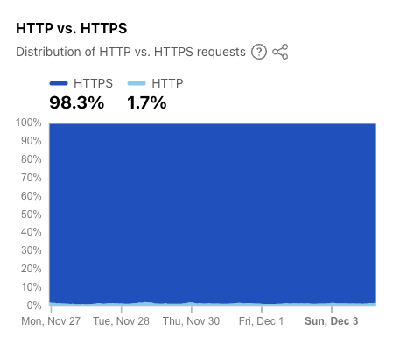
HTTPS Today
https://radar.cloudflare.com/adoption-and-usage

Slide 11
Changes to the Applications
Hiding the DNS
Hide the query and response in DNS resolution transactions from the network
The initial work has concentrated on hiding the DNS query names from the network by encrypting the DNS data exchanged
  DNS over TLS
  DNS over QUIC
  DNS over HTTPS/2 and DNS over HTTPS/3

Slide 12
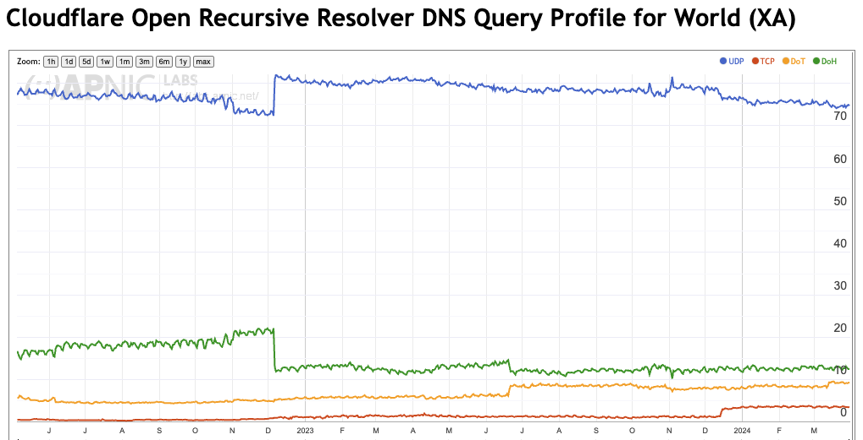
DoH, DOT Today
DNS over HTTPS
DNS over TLS
https://stats.labs.apnic.net/edns

Slide 13
Can we go further?
Can we hide the two ends from each other such that at no point in the network (and even at the server) are the two ends of the transaction visible at once?
Can we also selectively obscure the content of the transaction such that the endpoints and the content of the transaction are not simultaneously discoverable

Slide 14
MASQUE and Relays
With the use of 2-layer encryption and active relays then its possible to hide the endpoints from the network
There is no single network observation point that can put together the combination of the service identity and the identification of the two endpoints of the service transaction
Only the client endpoint knows its own identity and service, but does not know the identity used by the relay to present the service transaction to the server
The server may use the application-level identity of the client, but does not know the client’s network-level identity (IP address)
This technique can be used in DNS resolution and HTTPS transactions

Slide 15
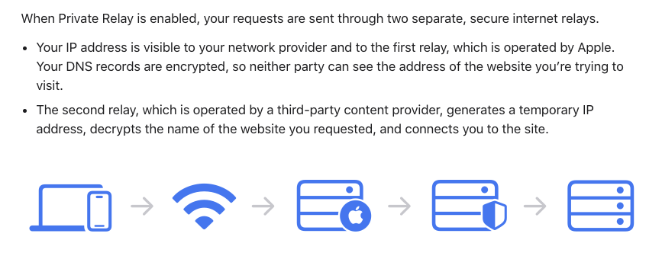
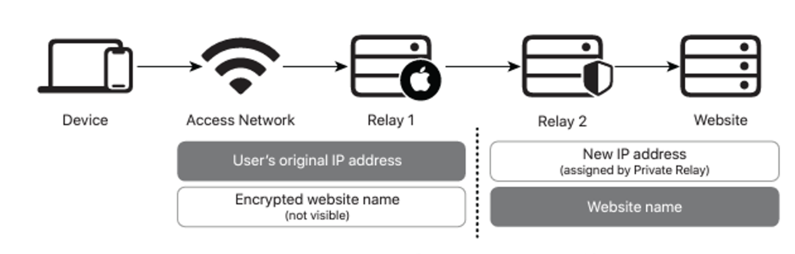
Apple Private Relay

Slide 16
Sealing up the Peepholes
Attention has turned to the Server Name Indication (SNI) field in the TLS handshake
  This is the one last part of TLS that is still shown in the clear
  Efforts to encrypt this field in a robust manner are being studied
  The most effective way to securely communicate the public key that is used to encrypt the SNI (and the entire ClientHello message) appears to be a TLSA record in the DNS (DANE) using DoT or DoH, using a DNSSEC-signed record
  A shortcut hack is to use a trusted intermediary
    (https://blog.cloudflare.com/announcing-encrypted-client-hello/)

Slide 17
Sealing up the Peepholes
And there‘s the the Online Certificate Status Protocol, which can expose the IP address of the client and the name of the service that they are visiting to the CA
  Which likely explains why Chrome browsers do not perform “live” certificate revocation checks, and rely instead on short validity periods for certificates*
* Which is probably just as bad, but in a different way!

Slide 18
Why are we doing this?

Slide 19

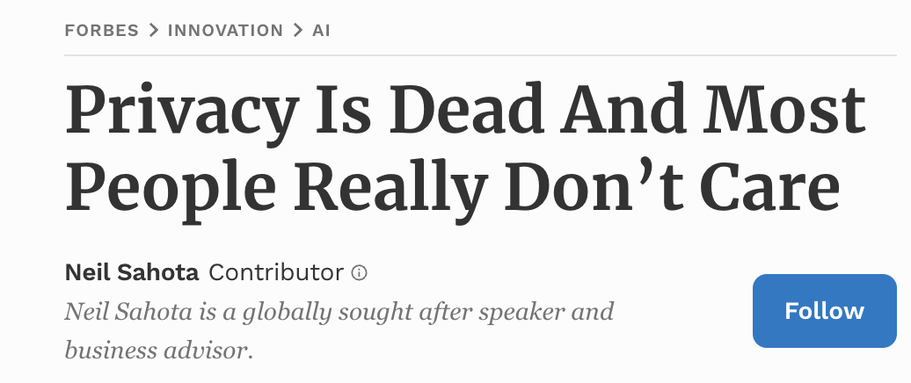
Who wants privacy?
Do users really care?
  Users cheerfully gave up email privacy in exchange for free email services
  Users happily tell Google Search way too much about themselves in exchange for instant answers
  In general, users will happily trade off privacy for access to services

Slide 20
If not users, then whom?

Slide 21
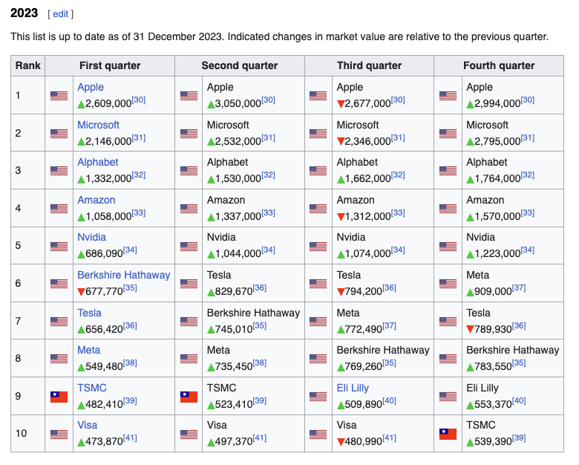
If not users, then whom?
The folk with the most to gain (or lose)!
https://en.wikipedia.org/wiki/List_of_public_corporations_by_market_capitalization

Slide 22
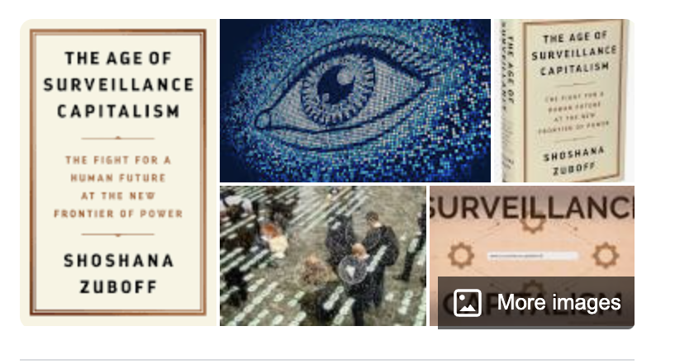

Surveillance Capitalism

Slide 23
Who cares about privacy?
None of the entities who spend large sums to assemble detailed profiles of users want to leak that data to their competitors
So, privacy is about protecting the core asset of gathering individual profiles of users from:
  Other services
  The common host platform
  Common Infrastructure services
  The network

Slide 24
Let me rephrase that:
We want to allow the application to operate in a mode that obscures its behaviour from:
  Other services
  The common host platform
  Common Infrastructure services
  The network

Slide 25
How do you do that?
By lifting out as much as you can from the lower levels of the protocol stack that are managed by common services and performing it within the application

Slide 26
So, how do you do that?

Slide 27
Transport Privacy
Which means we are looking at how to lift TCP out of the common parts of the host platform and and shift it across to the application
We need to change TCP!

Slide 28
Transport Surgery
How do you change TCP?
  TCP is a kernel function that is defined at the platform level
  Applications have no intrinsic ability to alter the TCP characteristics for the application on a customized basis
  You could try to define a new transport protocol (such as SCTP)
  But the deployed infrastructure (NATs) tends to discard all packets that are not protocol 6 (TCP) or protocol 17 (UDP)
  If you want to bypass kernel handling of TCP and get through existing network filters and middleware then you're forced into using UDP
  So, you change TCP by using UDP!

Slide 29
QUIC is the new TCP
QUIC
HTTP/3
HTTP/2
HTTP
Multi-stream
HTTP
TLS
Session Encryption
QUIC
Multi-stream
Encryption
Data stream integrity
Congestion Control
e2e encrypted
TCP
Data stream integrity
Congestion Control
e2e encrypted
UDP
IP

Slide 30
QUIC is:
A logical evolutionary step for transport services, providing more flexibility, faster connection setup, and a larger set of transport services
It’s what we should expect from a capable modern transport protocol!

Slide 31

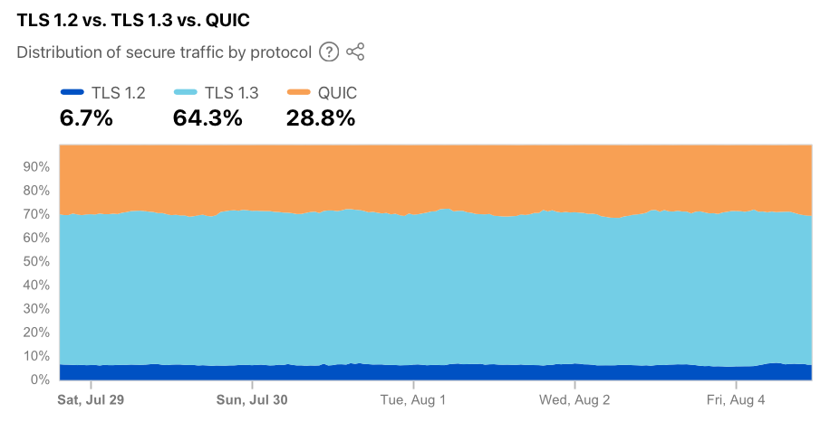
Cloudflare’s Numbers
Cloudflare report on observed use levels

Slide 32
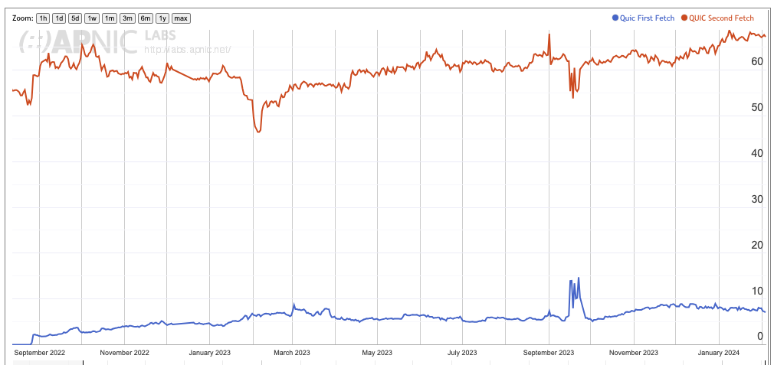
APNIC’s Numbers
APNIC reports on potential use levels
Subsequent Fetches – mainly Chrome clients
First Fetch – mainly Safari clients

Slide 33
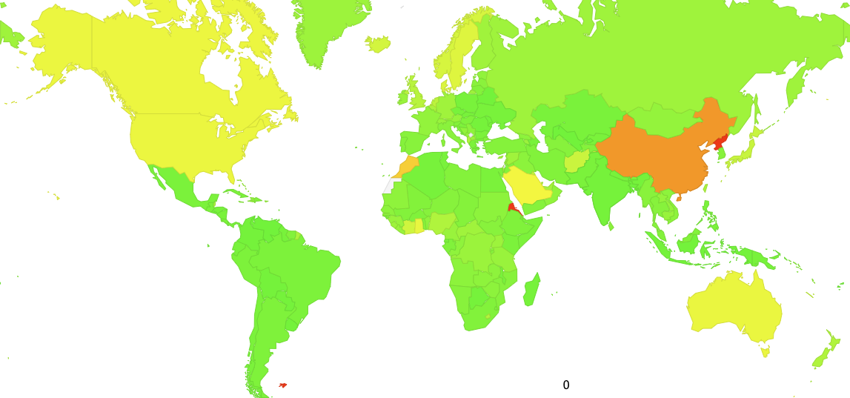
APNIC’s QUIC Numbers
100

Slide 34
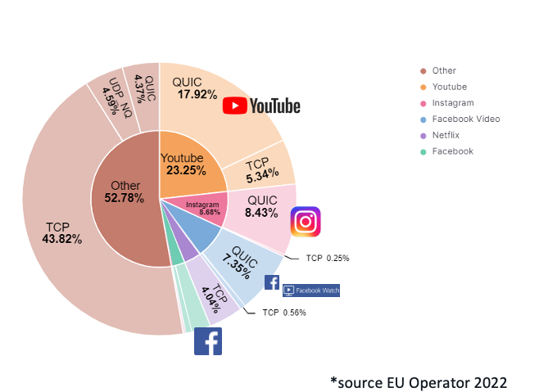
Cisco’s Numbers: Traffic Volume
Presentation to RIPE 86: The New Encrypted Protocol Stack and How to Deal with it – Bart van de Velde, Cisco

Slide 35
Why is QUIC important?
Because QUIC is faster
Because QUIC encrypts everything
  No visible transport control settings
  No visible Server Name Indication in the crypto-setup
  No visible traffic profile other than inter-packet timing
Because QUIC is an application capability
  QUIC can interact with the platform through the UDP API, so all of QUIC can be implemented within the application. This gives the application more control over its service outcomes and reduces external dependencies

Slide 36
What does this mean for TCP?
It’s not looking all that good for TCP’s prospects
QUIC not only does faster start up, but it supports multi-channel in a frictionless manner
QUIC resists network operator efforts to perform traffic shaping through direct manipulation of TCP control parameters
QUIC allows the application service provider to control the congestion behaviour of its sessions

Slide 37
The new Networking Space
QUIC is pushing both network carriage and host platform into commodity roles in networking and allowing applications to effectively customize the way in which they want to deliver services and dominating the entire networked environment
QUIC is the application’s view of what Transport should be!
apps
apps
$$$
TCP Transport
Internal
Transport +
session security
QUIC and value transform
in the network stack
$$$
network
UDP Transport
network
media
media

Slide 38
What does this mean for the Internet?
The relationship between applications, hosts and networks has soured into mutual distrust and suspicion
The application now defends its integrity by wrapping up as much of the service transaction with encryption and indirection
QUIC (and MASQUE) is an intrinsic part of this process of wrapping up traffic in encryption and redirection
For the network operator there is little left to see or do. It’s just packet shovelling!
And I suspect that there is no coming back from here!

Slide 39
What can a Network Operator Do?
When all customer traffic is completely obscured and encrypted?
  Traffic Shaping?
  Regulatory Requirements for traffic interception?
  Load Balancing / ECMP

Slide 40
The new Internet Space
“What you can’t dominate, you commoditise*”
Vertically integrated service providers have faded away into history - the deregulated competitive service industry continues to specialize rather than generalize at every level
Carriage is no longer an inescapable monopoly - massively replicated content can be used as a substitute for many carriage service elements
Control over the platform is no longer control over the user. Operating systems have been pushed back into a basic task scheduling role, while functions are being absorbed into the application space
* A related quote is Peter Thiel’s “Competition is for Losers!”

Slide 41
The new Internet Space
Each service has an ability to define its own operational behaviours that are intrinsic to that service
  Which is the antithesis of “interoperability”
We have managed to minimize and commoditize the common parts of the Internet and push the valued functionality and service delivery up into each application
Which means:
  “Standards for Interoperability” is dead!
  “Open” is a quaint historic notion!

Slide 42
The New Internet Space
The hyperscalers have won everything!

Slide 43
Thanks!

