Slide 1
Is the DNS ready for IPv6?
Geoff Huston AM
APNIC Labs

Slide 2
IETF Best Current Practice – BCP 91
RFC3901 – September 2004 “DNS IPv6 Transport Operational Guidelines”:
  Every recursive name server SHOULD be either IPv4-only or dual stack
  Every DNS zone SHOULD be served by at least one IPv4-reachable name server

Slide 3
IETF Best Current Practice – BCP 91
RFC3901 – September 2004 “DNS IPv6 Transport Operational Guidelines”:
  Every recursive name server SHOULD be either IPv4-only or dual stack
  Every DNS zone SHOULD be served by at least one IPv4-reachable name server
Which is saying as an IPv6 Operational guideline “you better keep IPv4 going”
The RFC actually says very little about IPv6!

Slide 4
Proposed: 3901bis
Current IETF draft proposed to update RFC3901 by saying:
  It is RECOMMENDED that are least two NS for a zone are dual stack name servers
  Every authoritative DNS zone SHOULD be served by at least one IPv6-reachable authoritative name server
Which is saying as an IPv6 Operational guideline “time to take IPv6 seriously” and NOT saying that servers need to keep IPv4 around– which is largely the opposite of the advice in RFC 3901!

Slide 5
The assumption behind 3901bis
That IPv6 is now a mature and well understood technology, and using IPv6 as the transport for the DNS is as efficient and as fast as using IPv4

Slide 6
The assumption behind 3901bis
That IPv6 is now a mature and well understood technology, and using IPv6 as the transport for the DNS is as efficient and as fast as using IPv4
Is this really true?

Slide 7
IPv6 and the DNS
How well is IPv6 supported in the DNS?
How does the DNS handle dual-stacked authoritative servers?
  Is there a “happy eyeballs” version of DNS server selection?
  Or is there a reverse bias to use IPv4?
If you placed authoritative servers on an IPv6-only service how many users would be able to reach you?
And what about DNSSEC?
  How well does IPv6 support large UDP packets?

Slide 8
A word or two about “how” to talk about the DNS
We really don’t understand what a “resolver” is!
  It could be a single platform running an instance of DNS resolver code
  It could be a collection of independent back-end systems with a load distributor front end facing clients
  It could be a hybrid collection where the back ends synchronise each other to emulate a common cache
  It is a stub, recursive, or forwarding resolver
  A resolver may have 1 client or millions of clients or anything in between
When we talk about “resolvers” it’s challenging to understand exactly what we are talking about!

Slide 9
Another word, this time about “how” to talk about DNS queries
We don’t understand what a query is!
  Which sounds silly, but the distributed resolution process causes a ‘fan out’ of queries as part of the resolution process when a single query may cause a number of ‘discovery’ queries to establish the identity of the authoritative server(s) for the name
  Resolvers all use their own timers for retransmission
  Queries have no “hop count” or “resolver path” attached
  there is no context to understand the reason for a query!
  Queries have a life of their own

Slide 10
APNIC’s DNS Experimental Rig
We use the ad network to “seed” DNS queries
We make parts of the name unique to each measurement
  That way the recursive resolvers have no cached data and are forced to query the authoritative server
We observe the recursive to authoritative query process by instrumenting the authoritative server, and match experiment placement records to the server’s DNS logs
Authoritative Server
Dual Stack
We insert “known” DNS queries into the stub resolver
We instrument the Authoritative Server
Recursive Resolver
Stub
Resolver

Slide 11
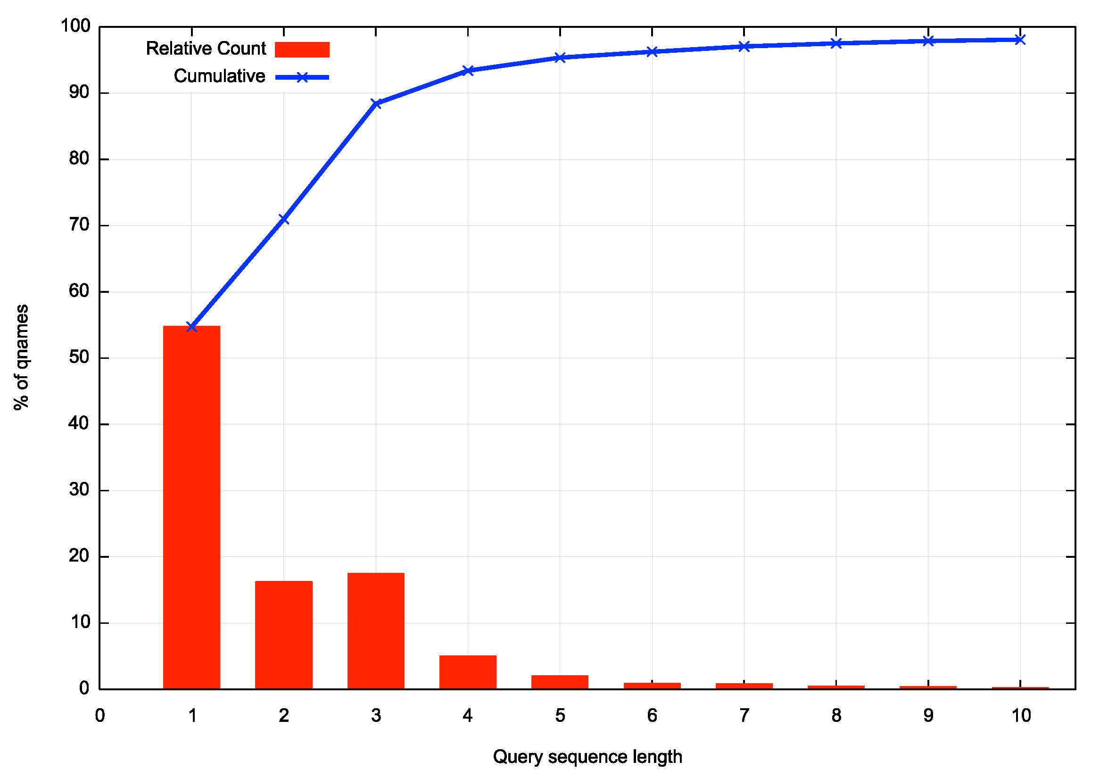
Also, the DNS is VERY noisy!
There are a lot of gratuitous DNS queries
  Some 46% of qnames are queried 2 or more times
  Some 30% are queried 3 or more times!

Slide 12
Dual Stack DNS
How well is IPv6 supported in the DNS?
How does the DNS handle dual-stacked authoritative servers?
  Is there a “happy eyeballs” version of DNS server selection?
  Or is there a reverse bias to use IPv4?
If you placed authoritative servers on an IPv6-only service how many users would be able to reach you?
And what about DNSSEC?
  How well does IPv6 support large UDP packets?

Slide 13
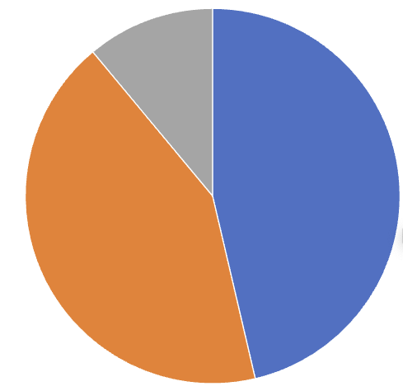
Dual Stack DNS
A “happy eyeballs*” DNS approach would be to prefer to use the IPv6 address of the authoritative server in preference to the IPv4 address
A “reverse bias” DNS approach would be to prefer to use the IPv4 address
Data collected Dec 23 – Jan 24 using 445M domain names
IPv6 Only
11%
IPv4 + IPv6
46%
IPv4 Only 43%

Slide 14
Dual Stack DNS
A “happy eyeballs*” DNS approach would be to prefer to use the IPv6 address of the authoritative server in preference to the IPv4 address
A “reverse bias” DNS approach would be to prefer to use the IPv4 address
Data collected Dec 23 – Jan 24 using 445M domain names
IPv6 Only
11%
Less than one half of all name resolution query sequences show both
protocols being used to query a name at the authoritative server
IPv4 + IPv6
46%
IPv4 Only 43%

Slide 15
Dual Stack DNS
V4 Only
A “happy eyeballs” DNS approach would be to prefer to use the IPv6 address of the authoritative server in preference to the IPv4 address and follow this initial query with a IPv4 query soon after
Happy Eyeballs?
V6-V4
V4-V6
V6 Only

Slide 16
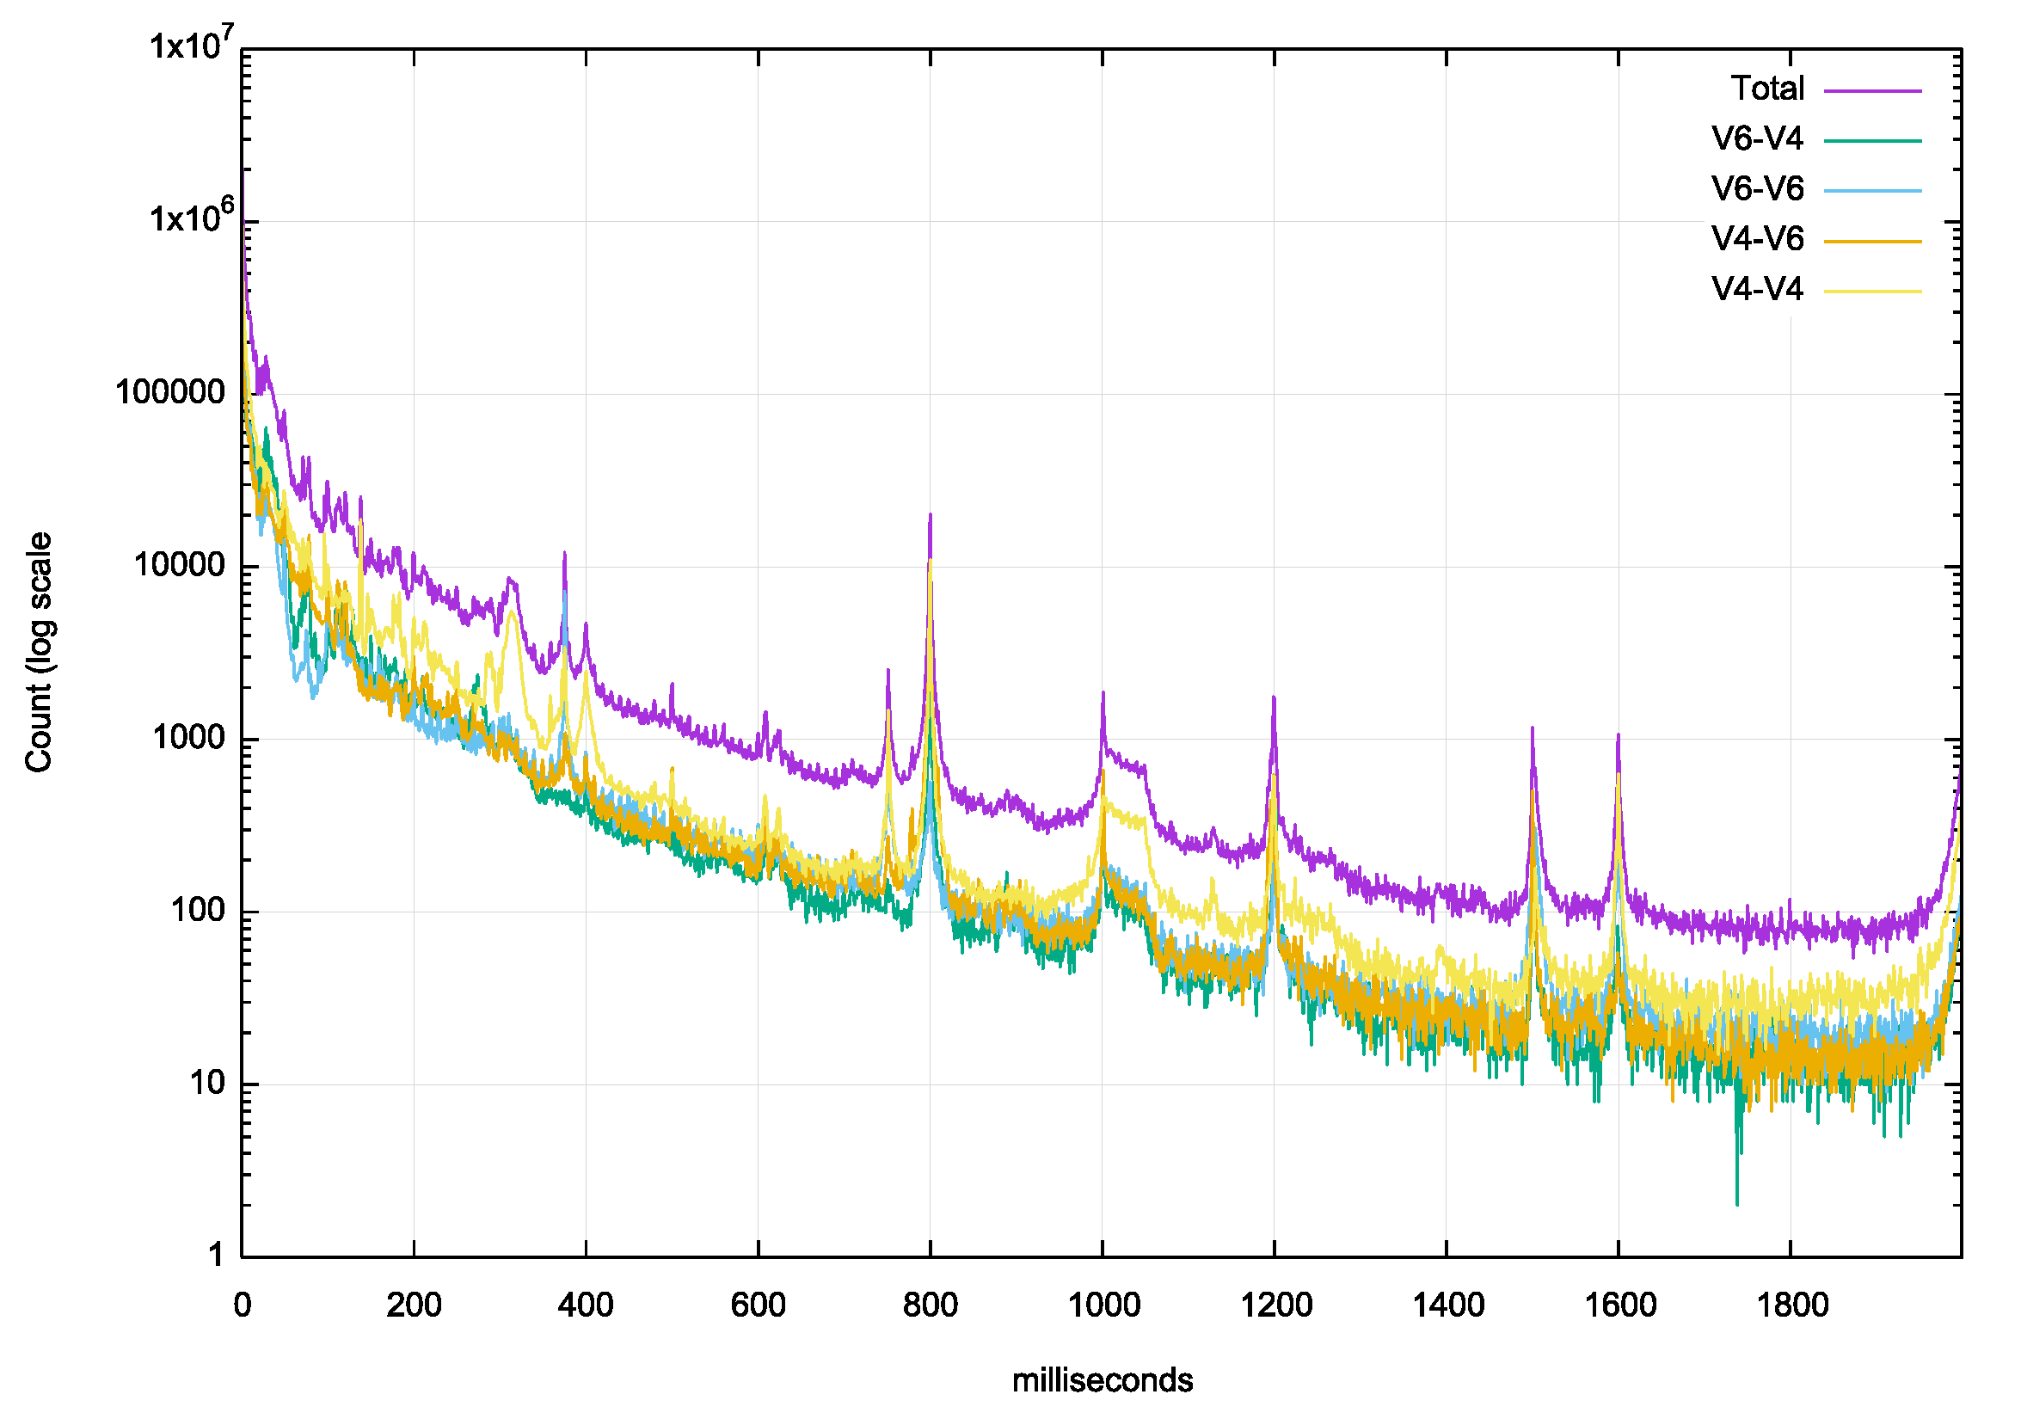
Dual Stack DNS
Delay between first 2 Queries
A “happy eyeballs” DNS approach would be minimise the delay between the initial 2 queries
Which is observed in the data, but we also see evidence of conventional DNS timeout values of 370ms, 400ms, 800ms and 1 sec
Is the high repeat query count in the first 50 ms due to resolver repeat or due to query duplication across multiple recursive resolvers?

Slide 17
Dual Stack DNS
How well is IPv6 supported in the DNS?
How does the DNS handle dual-stacked authoritative servers?
  Is there a “happy eyeballs” version of DNS server selection?
  Or is there a reverse bias to use IPv4?
If you placed authoritative servers on an IPv6-only service how many users would be able to reach you?
And what about DNSSEC?
  How well does IPv6 support large UDP packets?
No!
Probably!

Slide 18
Dual Stack DNS
How well is IPv6 supported in the DNS?
How does the DNS handle dual-stacked authoritative servers?
  Is there a “happy eyeballs” version of DNS server selection?
  Or is there a reverse bias to use IPv4?
If you placed authoritative servers on an IPv6-only service how many users would be able to reach you?
And what about DNSSEC?
  How well does IPv6 support large UDP packets?
No!
Probably!

Slide 19
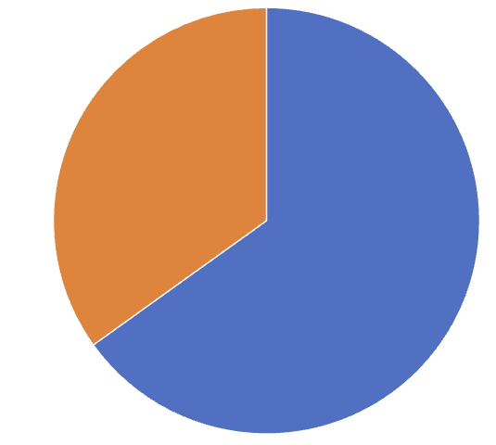
Dual Stack vs IPv6 only DNS
IPv6 Only Test
In this case the authoritative name server only has an IPv6 address
Of all the clients that are presented with an experiment (51M over 5 days) 65% of names are seen asking for the experiment name if the DNS server is reachable over IPv6 only
IPv6 – 65%
No query – 35%

Slide 20
Dual Stack vs IPv6 only DNS
Dual Stack
IPv6 Only Test
IPv6 Only
11%
IPv6 – 65%
IPv4 + IPv6
46%
IPv4 Only 43%
No query – 35%

Slide 21
Dual Stack vs IPv6 only DNS
Dual Stack
IPv6 Only Test
IPv6 Only
11%
IPv6 – 65%
IPv4 + IPv6
46%
IPv4 Only 43%
No query – 35%

Slide 22
Dual Stack DNS
How well is IPv6 supported in the DNS?
How does the DNS handle dual-stacked authoritative servers?
  Is there a “happy eyeballs” version of DNS server selection?
  Or is there a reverse bias to use IPv4?
If you placed authoritative servers on an IPv6-only service how many users would be able to reach you?
And what about DNSSEC?
  How well does IPv6 support large UDP packets?
No!
Probably!
Only 65%

Slide 23
Dual Stack DNS
How well is IPv6 supported in the DNS?
How does the DNS handle dual-stacked authoritative servers?
  Is there a “happy eyeballs” version of DNS server selection?
  Or is there a reverse bias to use IPv4?
If you placed authoritative servers on an IPv6-only service how many users would be able to reach you?
And what about DNSSEC?
  How well does IPv6 support large UDP packets?
No!
Probably!
Only 55%

Slide 24
IPv6 and Packet Fragmentation
IPv6 made two major changes to IP’s handling of packet fragmentation:
The fragmentation control header has been moved out of the IP header to become an extension header
  In other words, the UDP / TCP protocol header is pushed further into the packet and to find it you need to follow the header chain
The IPv4 ‘Don’t Fragment’ bit is jammed on in IPv6
  In the case of path MTU issues IPv6 routers should not perform fragmentation on the fly, but are required to pass an ICMPv6 PTB message back to the packet’s sender

Slide 25
Who uses Fragmentation anyway?
Well, the DNS is a good place to start looking!

Slide 26
Who uses large DNS packets anyway?
And the root zone DNS is a good place to start looking!

Slide 27
Who uses large DNS packets anyway?
.sl 3319
.pl 2193
.gdn 1954
.ve 1951
.uy 1951
.bg 1951
.xn--mgbx4cd0ab 1931
.africa 1897
.ad 1769
.ss 1715
.firmdale 1693
.xn--mgbah1a3hjkrd 1691
.xn--mgbt3dhd 1681
.ar 1675
.nowruz 1669
.beats 1667
.apple 1667
.shia 1665
.pars 1665
.tci 1663
.zm 1661
.td 1661
.si 1661
.na 1661
.ly 1661
.kw 1661
.ke 1661
.gy 1661
.lifestyle 1638
.living 1629
These folk do!
Size of dnssec-signed DNSKEY response for some gtlds in Nov-23

Slide 28
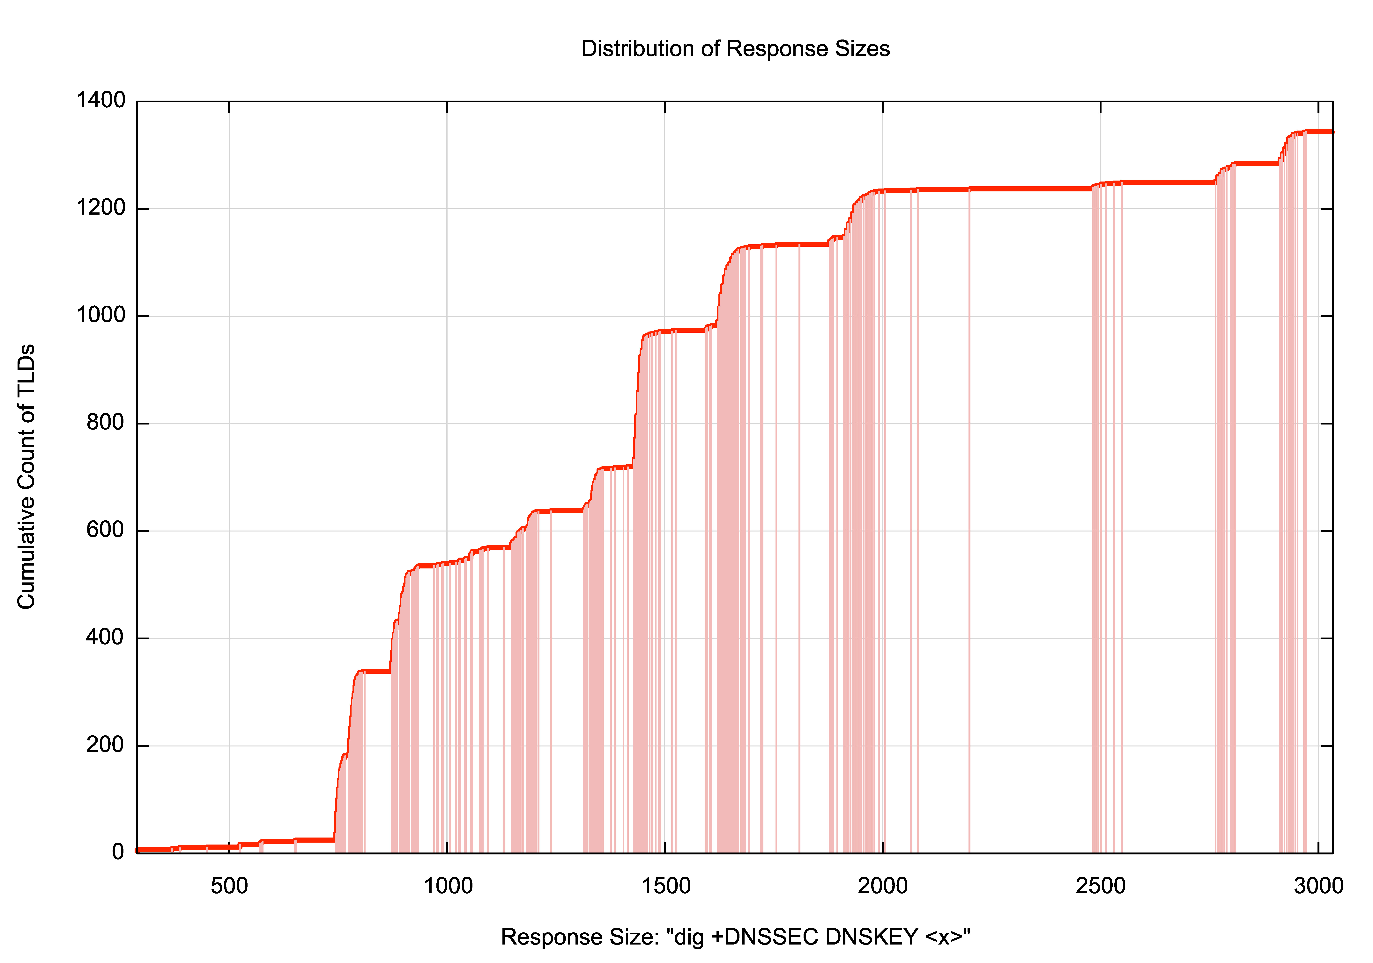
Who uses large DNS packets anyway?
Some 300 gtlds rely on fragmented UDP responses!

Slide 29
However…
UDP Fragmentation has its problems
  UDP trailing fragments in IPv4 and IPv6 may encounter fragment filtering rules on firewalls in front of resolvers
  Large UDP packets in IPv6 may encounter path MTU mismatch problems, and the ICMP6 Packet Too Big diagnostic message may be filtered.
    Even if it is delivered, the host may not process the message due to the lack of verification of the authenticity of the ICMP6 message.
    Because the protocol is UDP, receipt of an ICMP6 message will not cause retransmission of a re-framed packet.
  UDP fragments in IPv6 are implemented by Extension Headers. There is ample evidence of deployment of IPv6 switching equipment that unilaterally discards IPv6 packets with extension headers

Slide 30
Is this a problem for today’s IPv6 Internet?
Can we measure the extent to which users might be affected with this scenario of large DNS responses, DNS resolvers and IPv6?

Slide 31
Our Measurement Approach
We use an Online Ad platform to enroll endpoints to attempt to resolve a set of DNS names:
  Each endpoint is provided with a unique name string (to eliminate the effects of DNS caching)
  The DNS name is served from our authoritative servers
  Resolving the DNS name requires the user’s DNS resolvers to receive a fragmented IPv6 packet

Slide 32
V6, the DNS and Fragmented UDP
Total number of tests (DNS over UDP over IPv6): 32,951,595
Failure Rate in receiving a large response: 18,557,838
IPv6 Fragmentation Failure Rate: 56%
Data gathered 20 Dec 2023 – 9 Jan 2024

Slide 33
V6, the DNS and Fragmented UDP
Total number of tests (DNS over UDP over IPv6): 32,951,595
Failure Rate in receiving a large response: 18,557,838
IPv6 Fragmentation Failure Rate: 56%
That’s awesomely bad!
Data gathered 20 Dec 2023 – 9 Jan 2024

Slide 34
What to do?
Accepting a future IPv6-only Internet means we are going to have to take the problem of IPv6 Fragmentation seriously
  Because relying on IPv4 as a backup is a hack with an indeterminate future!
Which means that we need to figure out how to change the appalling drop rate for fragmented IPv6 packets both in the DNS and in end-to-end paths
  Should we try and fix the network problem or try to work around it?

Slide 35
DNS and UDP
The original DNS spec uses UDP with a maximum payload size of 512 octets (RFC 1035, sec 2.3.4)
RFC2671 defined an Extension Mechanism that included a buffer size parameter to permit DNS payloads in UDP larger than 512 (sec 2.3)
RFC 6891 proposed a buffer size of 4,096 as a “starting point” (sec 6.2.5) and proposed a fallback to a non-fragmented size before using truncation
If the response cannot fit in the UDP payload the responder sets the Truncation bit in its response, which signals to the querier that it should retry using TCP

Slide 36
DNS UDP Responder
If the response can fit within the EDNS Buffer size, then generate a UDP packet and let the network (IPv4) or host (IPv6) fragment the UDP packet as required
  But any received ICMPv6 Packet Too Big message will NOT cause re-transmission!
Otherwise set the TC bit

Slide 37
IPv6 and UDP
IPv6 will not allow routers to forward fragment
IPv6 relies on receiving a ICMP6 Packet Too Big message with a MTU size
  But its UDP, so there is no ACK timers and no stored packet to retransmit and no stored query to recompute the response
  All the original sender can do is take the returned MTU and store it as a destination-specific MTU value that is locally cached for an interval in the sending host’s forwarding table, and used for…
An IPv6 sender must perform outgoing packet fragmentation, using an inserted IPv6 Fragmentation Extension Header

Slide 38
IPv6 and UDP issues
ICMP6 messages are often blocked
ICMP6 messages cannot be validated
Anycast may result in misdirected ICMP6 messages
IPv6 Fragmented Packets are often dropped
A lost response means that the querier has to timeout
  DNS timeout timers range from ~400ms to 1 second!

Slide 39
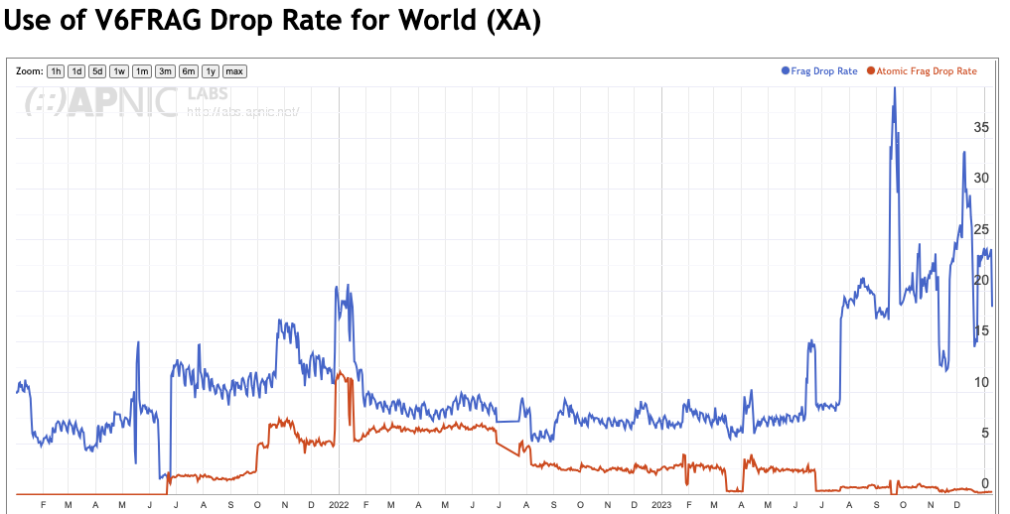
V6 Fragmentation Drop Rates

Slide 40
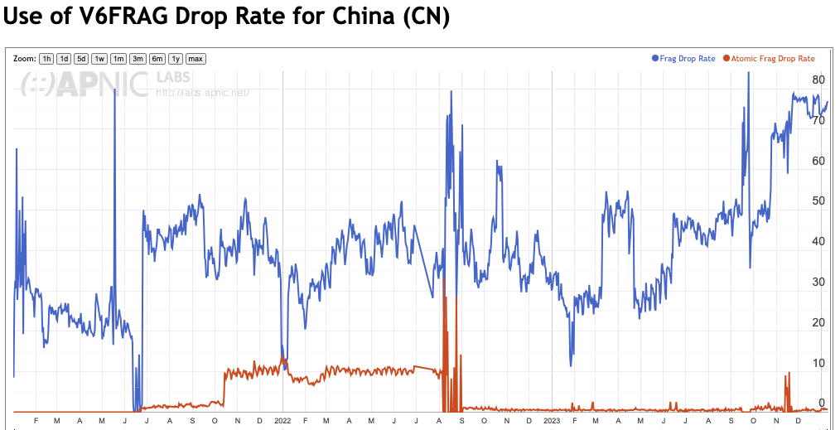
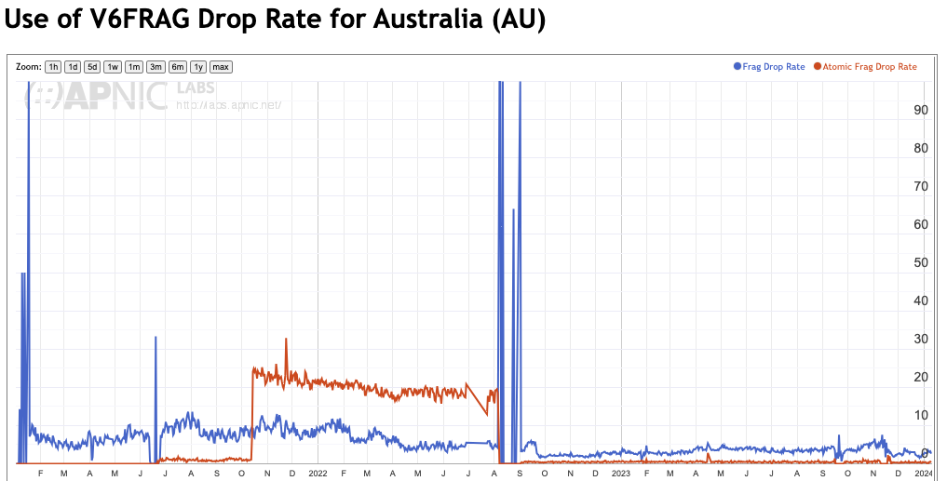
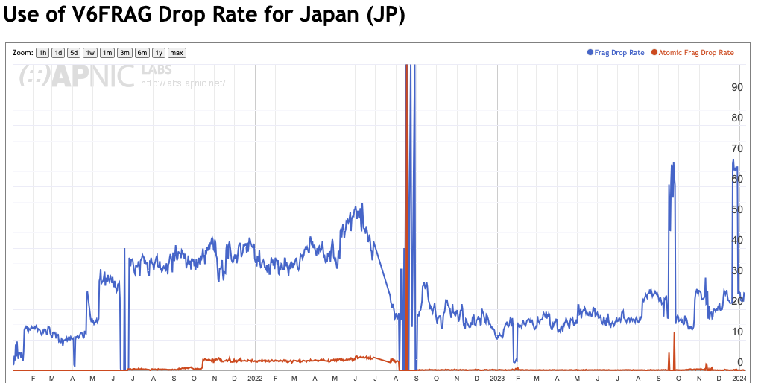
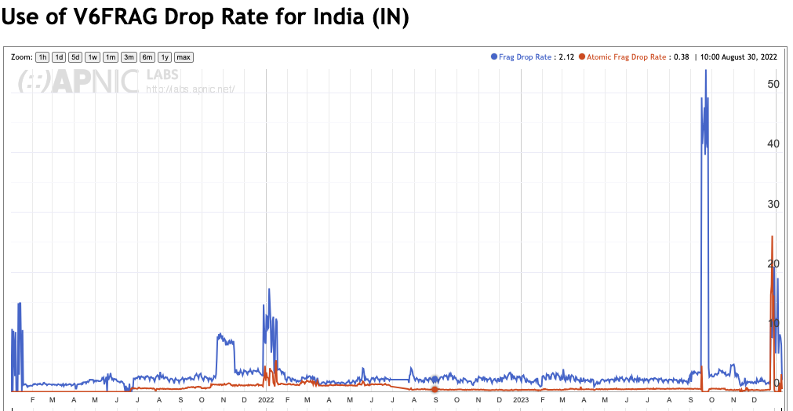
V6 Frag Drop is highly variable

Slide 41
What to do?
Set authoritative servers and recursive resolvers to override the EDNS Buffer Size in the query and respond with the TC bit set if the response is > 1232 bytes ?
Configure stub clients to use DoH ?
Revive the Additional Truncated Response draft? (https://datatracker.ietf.org/doc/html/draft-song-atr-large-resp-00)

Slide 42
What do the RFC’s say?

Slide 43
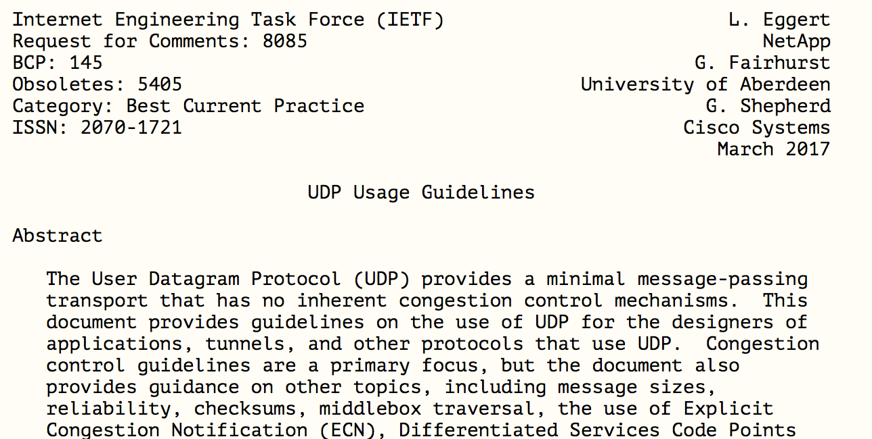
What do the RFC’s say?

Slide 44
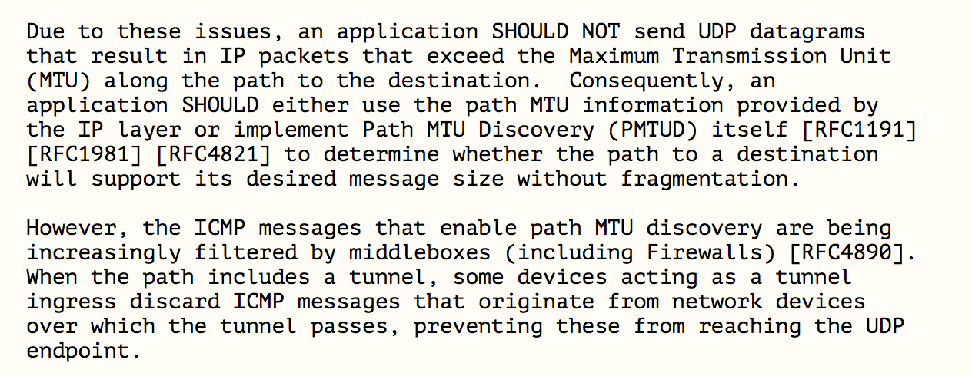
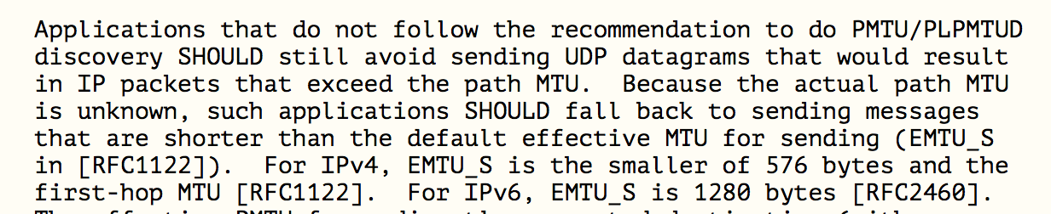
What do the RFC’s say?

Slide 45
What do the RFC’s say?
DON’T FRAGMENT!
This BCP is saying that using EDNS(0) in the DNS to signal the capability of accepting large fragmented DNS responses was unwise, and if a host/application does not know the path MTU, it should truncate at UDP at 1280 octets (and IPv4 should truncate at 512 octets!)

Slide 46

What can we do about it?
Fix it!
Get all the deployed routers, switches and firewalls and related network middleware to accept packets with IPv6 Fragmentation Headers

Slide 47

What can we do about it?
Change it!
Change the way in which IPv6 manages IP fragmentation and the use of Extension Headers as Fragmentation Control fields

Slide 48
What can we do about it?
Avoid it!
Change application behaviour to avoid the use of packet fragmentation completely

Slide 49
Large DNS Responses and IPv6
Change the transport protocol?
  DNS over TCP by default
  DoT by default
  DoH
  DoQUIC
  or
  Devise some new DNS framing protocol that uses multiple packets with firewall-friendly packet and protocol headers instead of IP fragmentation

Slide 50
Large DNS Responses and IPv6
Change the application protocol behaviour?
  Perform UDP MTU discovery using EDNS(0) UDP Buffer Size variations as a probe
  Shift Additional Records into additional explicit UDP query/response transactions rather than bloating the original DNS response
  Add a truncated minimal UDP response to trail a fragmented response (ATR)

Slide 51
Truncate and failover to TCP
Use an EDNS Buffer Size in queries to ensure that IPv6 responses are never fragmented
Large responses will be truncated
The truncation should trigger the querier to perform an immediate followup of the same query, using TCP
Which means that we are probably looking at working around the problem by changing the configuration of DNS queries and use an EDNS buffer size of 1232 octets
See https://dnsflagday.net/2020/

Slide 52
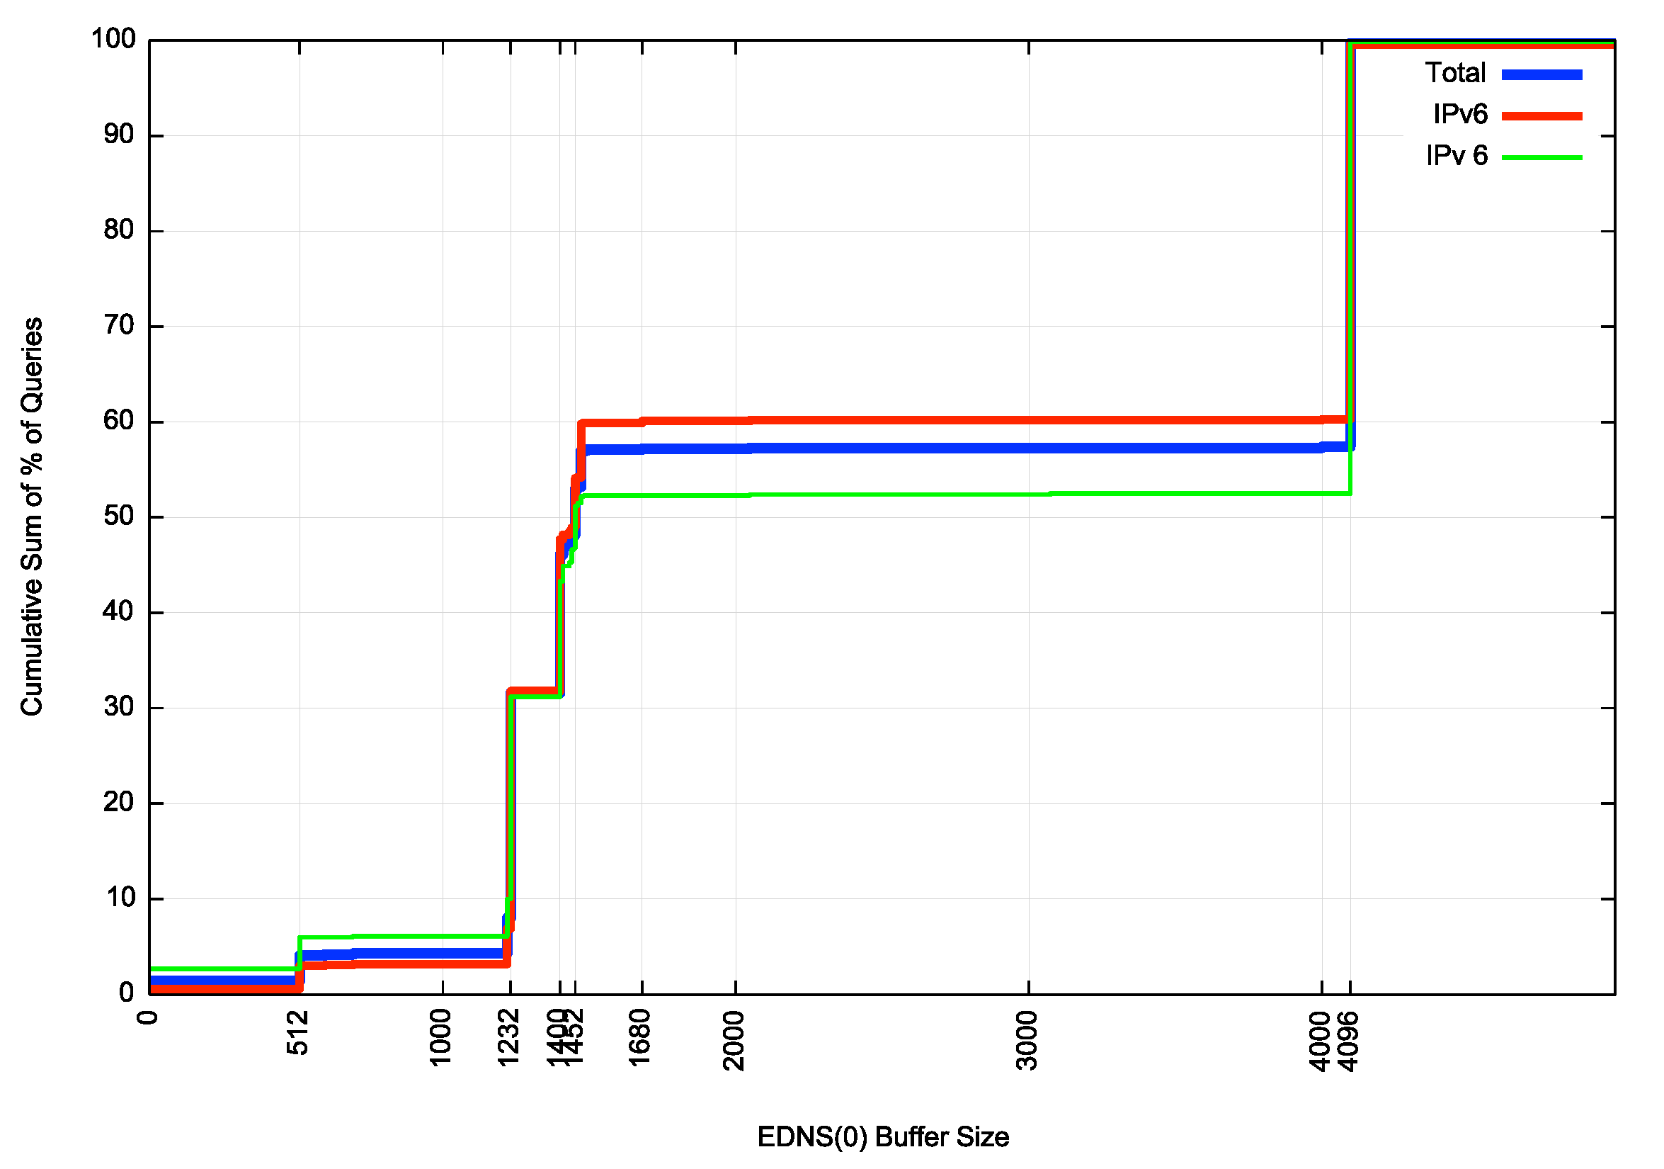
DNS Flag Day 2020 Uptake
We know what we can do to make this work well, but we seem to be reluctant to actually do it!
46% of IPv6 queries are still using 4096
Byte Buffer Size
69% of IPv6 queries are using a Buffer Size greater than 1232

Slide 53
Is the DNS ready for IPv6?
Not yet!

Slide 54
Thanks!

Slide 55
Bonus Slides on Truncation
Does Truncation “work”?
i.e.:
  Will resolvers ignore the answer section in UDP responses that have the truncation bit set?
  Will resolvers always re-query using TCP?

Slide 56
More measurements
Who reads the answer section in Truncated UDP responses?
Does IPv6 make this better or worse?

Slide 57
Its pretty good!
Very few resolvers read the answer section in truncated responses
Dual Stack:

Slide 58
Its pretty good!
Very few resolvers read the answer section in truncated responses
IPv6-Only:

Slide 59
Who Can’t do TCP?
What proportion of users sit behind non-TCP capable resolvers?
Does IPv6 make this better or worse?

Slide 60
Who can’t do TCP?
Dual Stack

Slide 61
Who can’t do TCP?
IPv6 only

