Slide 1
What happened to IP Addresses in 2023?
Geoff Huston AM
Chief Scientist, APNIC

Slide 2
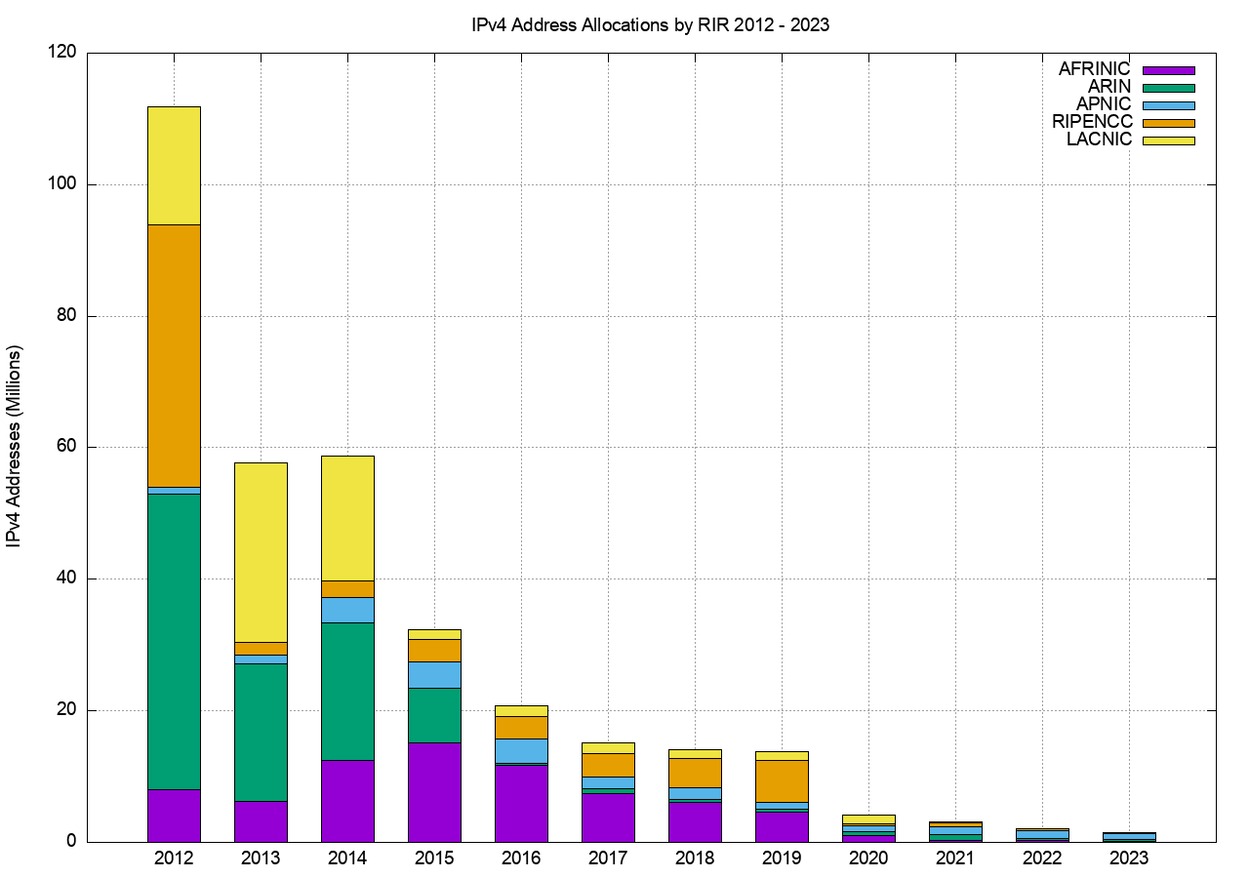
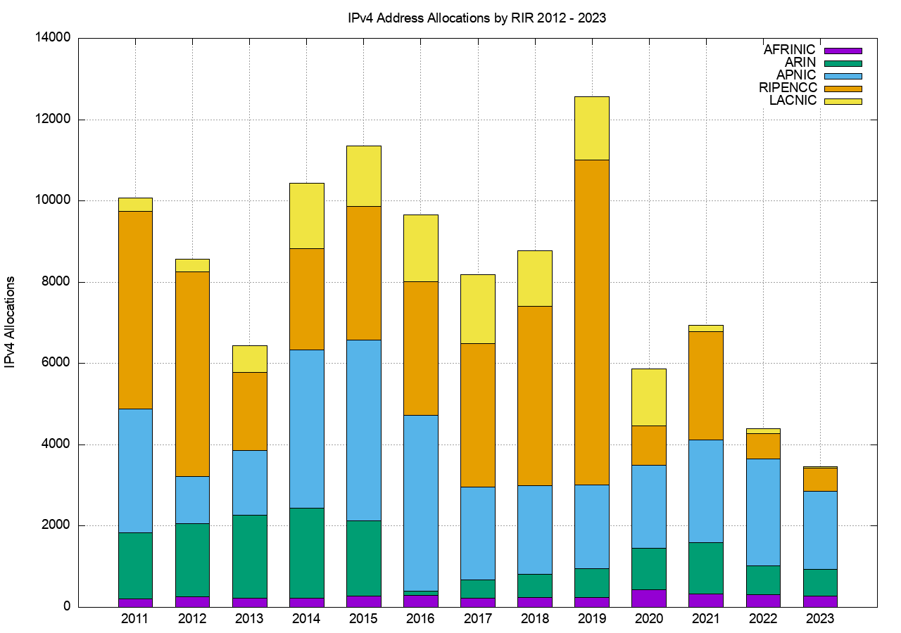
IPv4 Address Allocations
Addresses
Allocation Transactions
3,462 allocations
1.5M addresses

Slide 3
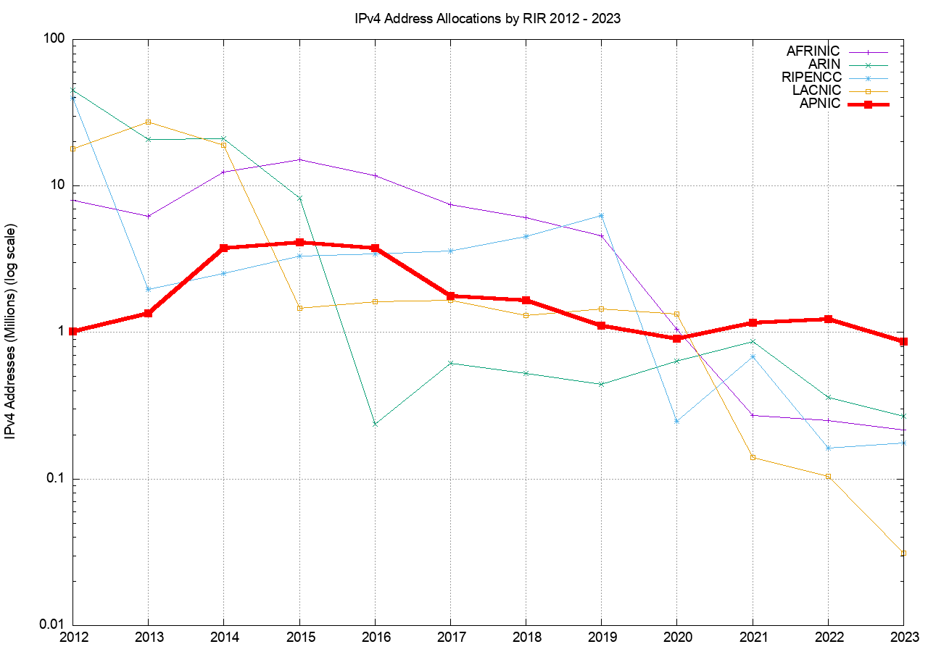
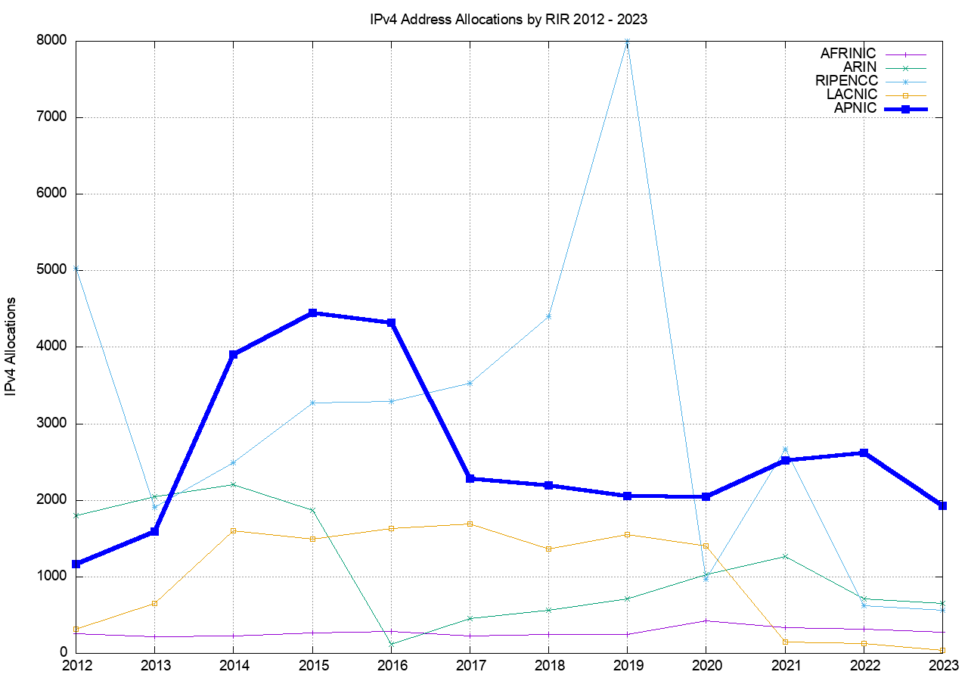
IPv4 Address Allocations
Addresses
Allocation Transactions
Notes:
APNIC had sustained a higher IPv4 address allocation rate, both in addresses and allocation transactions compared to the other RIRs over 2022

Slide 4
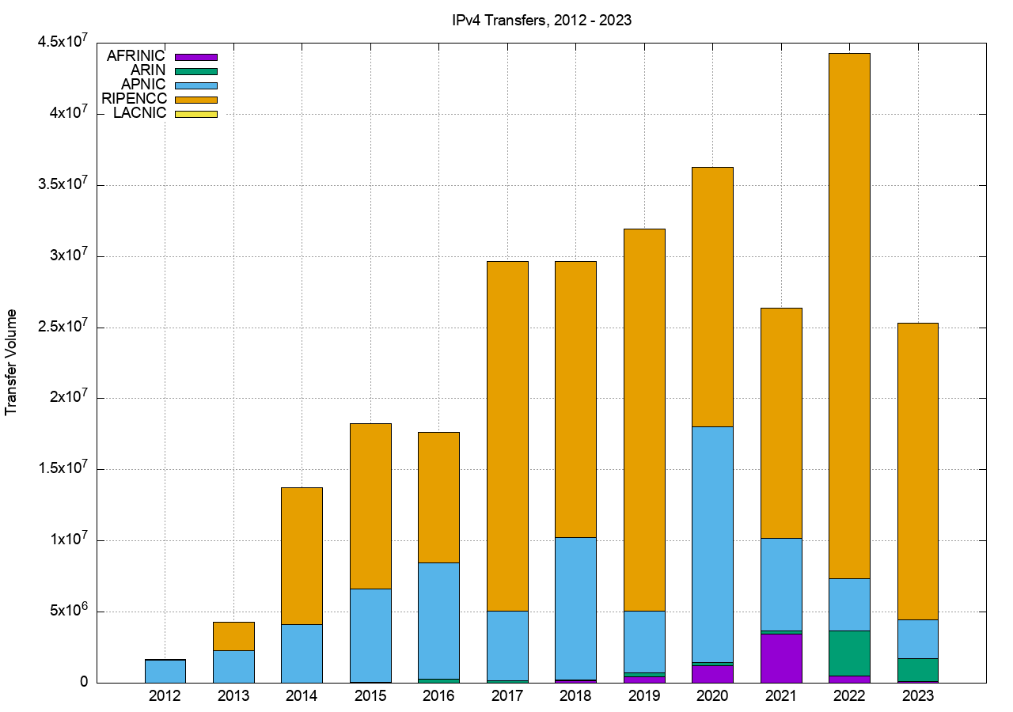
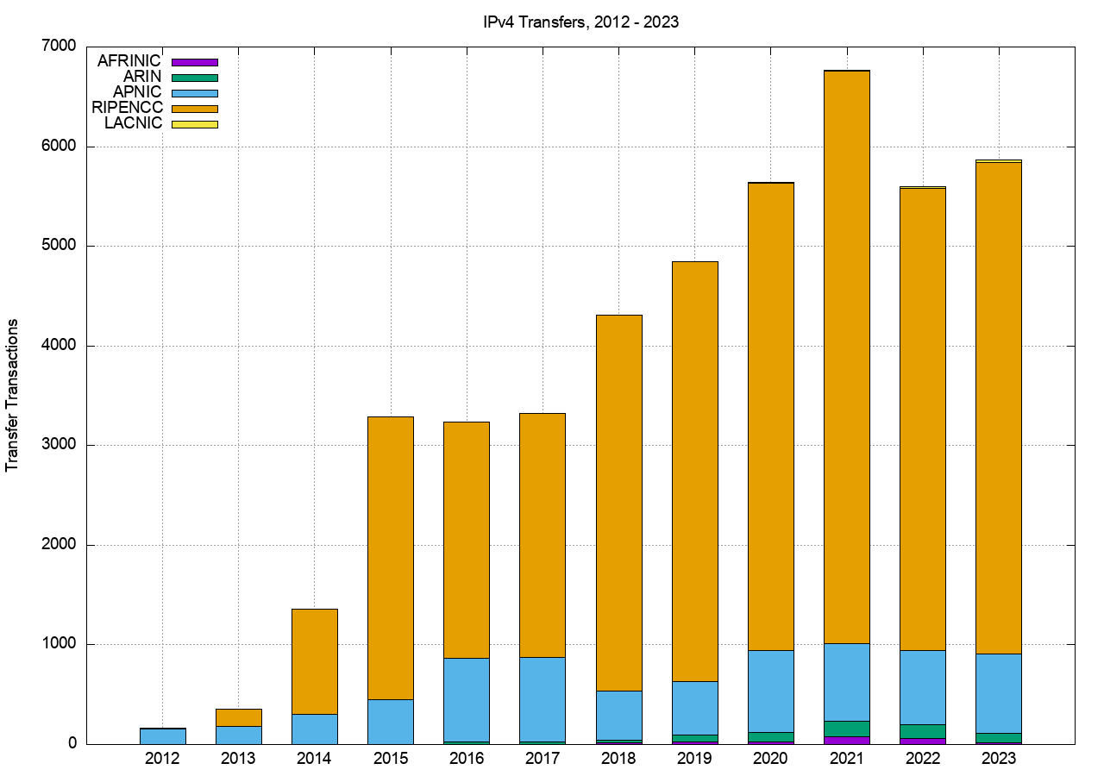
IPv4 Address Transfers
Addresses
Transfer Transactions
5,864 transactions
25.3M addresses

Slide 5
Who’s Selling and Who’s Buying
Selling
Buying

Slide 6
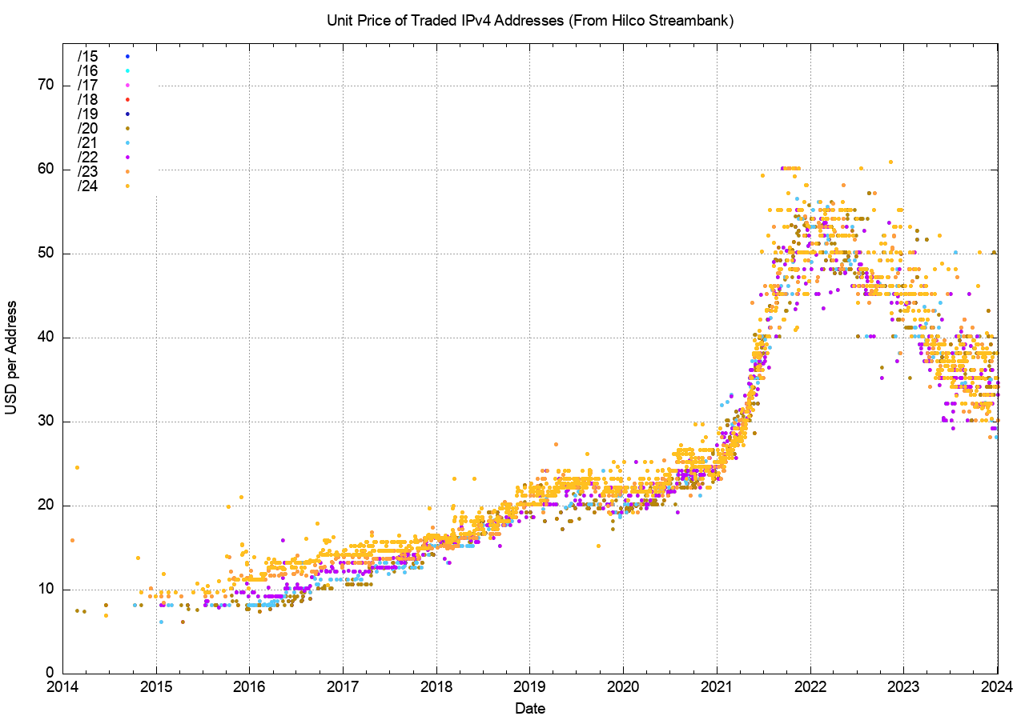
Transfer Pricing
The market price per address doubled across 2021 to peak at the start of 2022
The average price dropped by 35% since the 2022 peak
The variance in prices has increased significantly since 2022

Slide 7
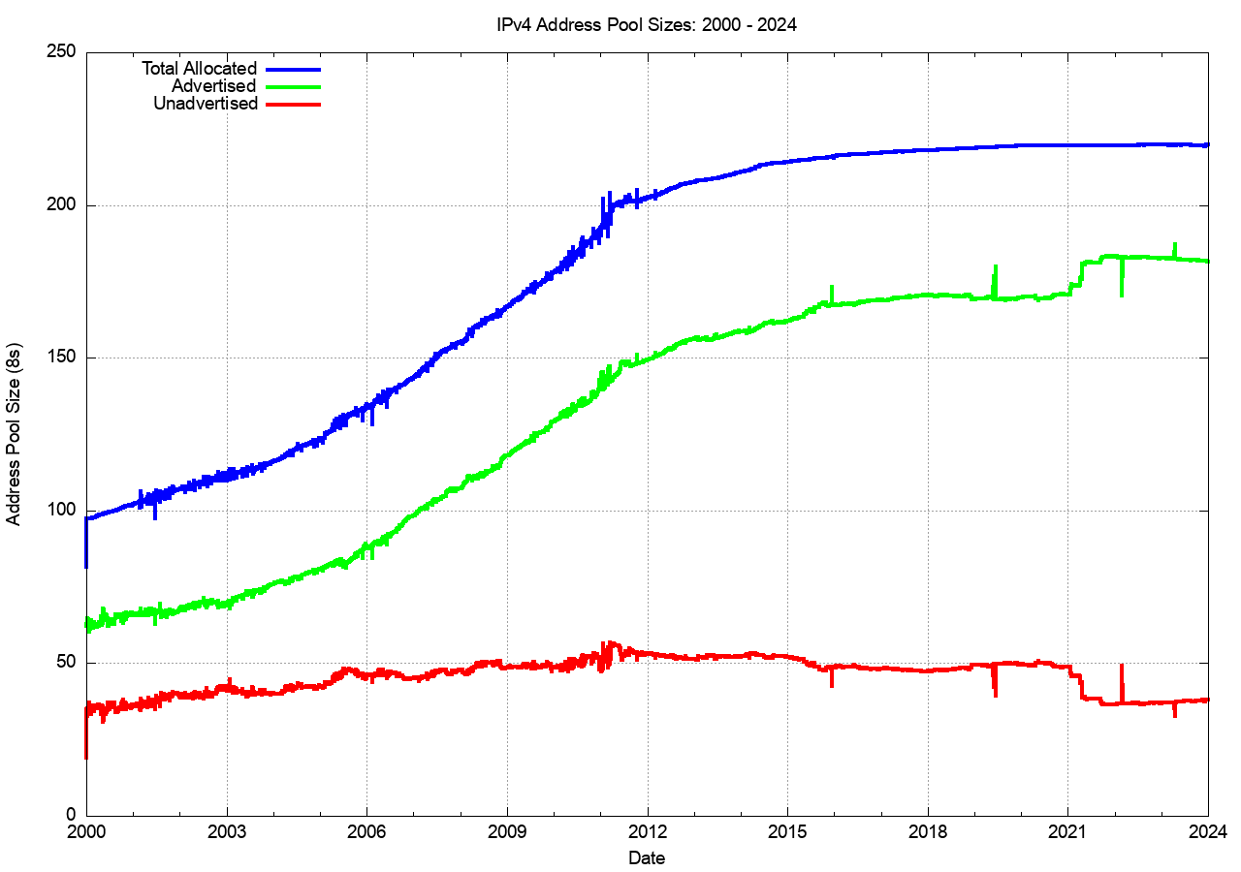
Are Transfers recovering unused addresses?
Allocated Address Pool
Advertised Address Pool
Unadvertised Address Pool

Slide 8
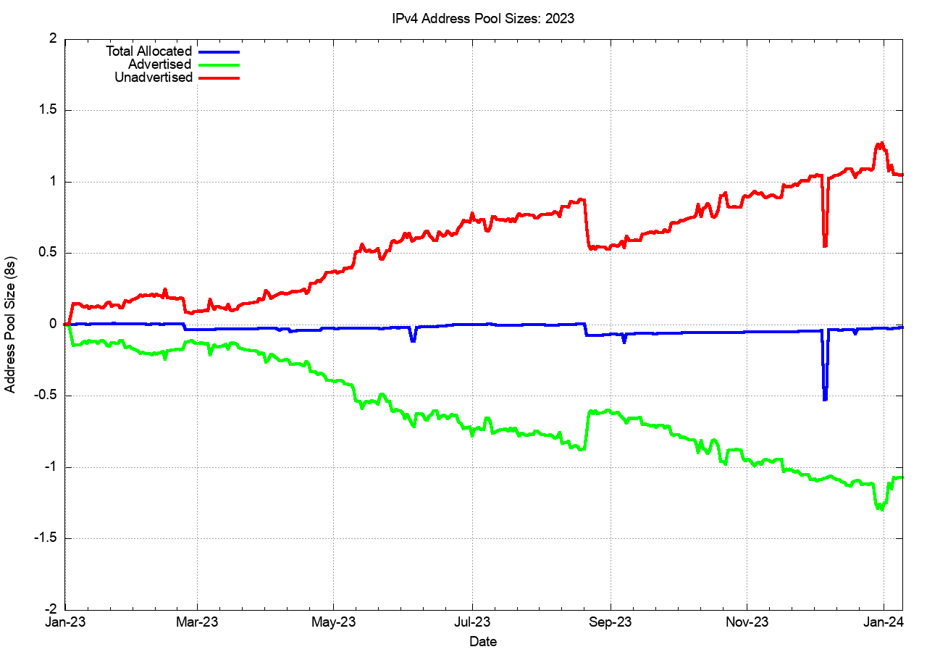
Are Transfers recovering unused addresses?
Unadvertised Address Pool
+19M addresses
Allocated Address Pool
-0.4 M addresses
Advertised Address Pool
-18.5M addresses

Slide 9
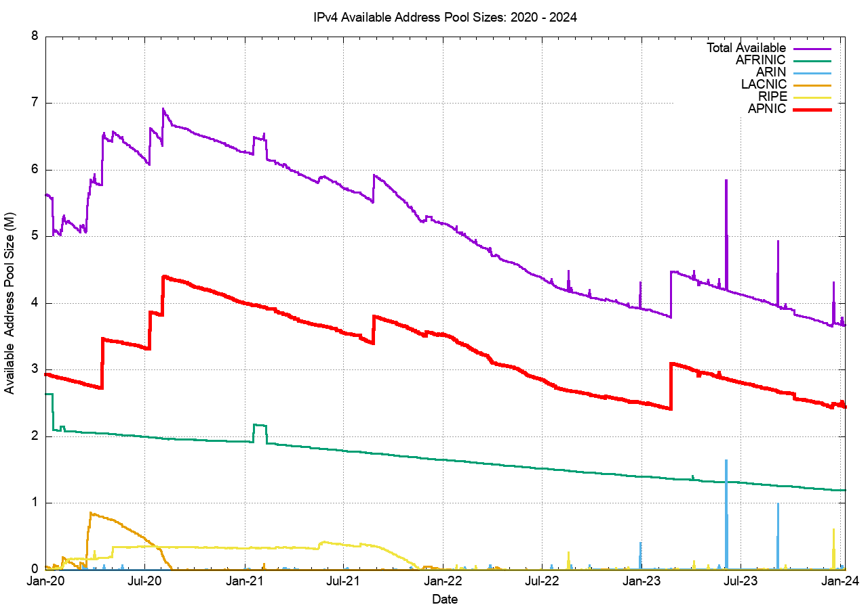
RIR “Available” Address Pools
Only APNIC and AfriNIC have residual available address pools
APNIC
AFRINIC
ARIN
LACNIC
RIPE NCC

Slide 10
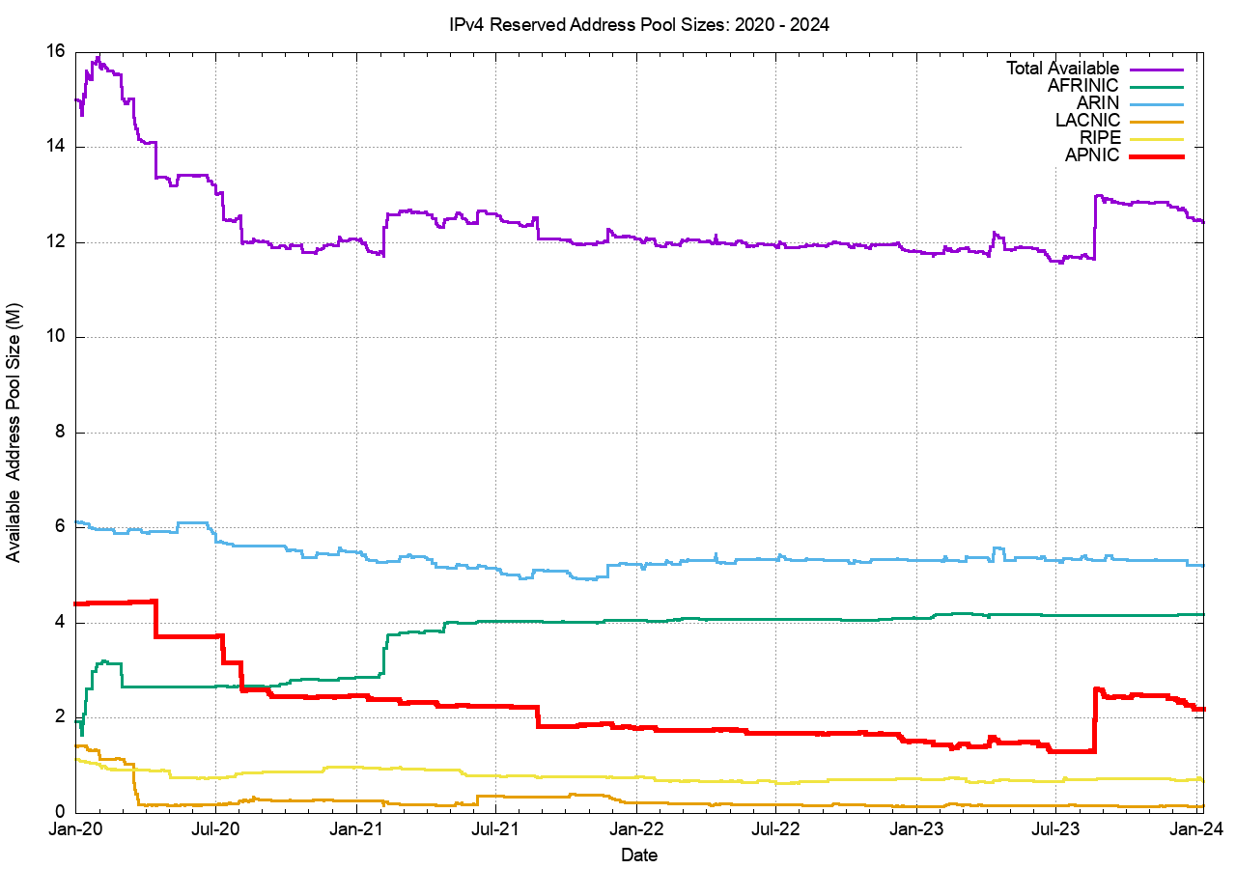
RIR “Reserved” Address Pools
ARIN
AFRINIC
APNIC
LACNIC
RIPE NCC

Slide 11
IPv4 in 2023
IPv4 scarcity pressure continues to fall across 2023:
  Signs of market saturation in many mature Internet markets
  More IPv6-accessible service deployments relieving IPv4 NAT pressures for ISPs
  Lower market prices for IPv4 addresses
  Lower pressure to release unadvertised addresses through the transfer market

Slide 12
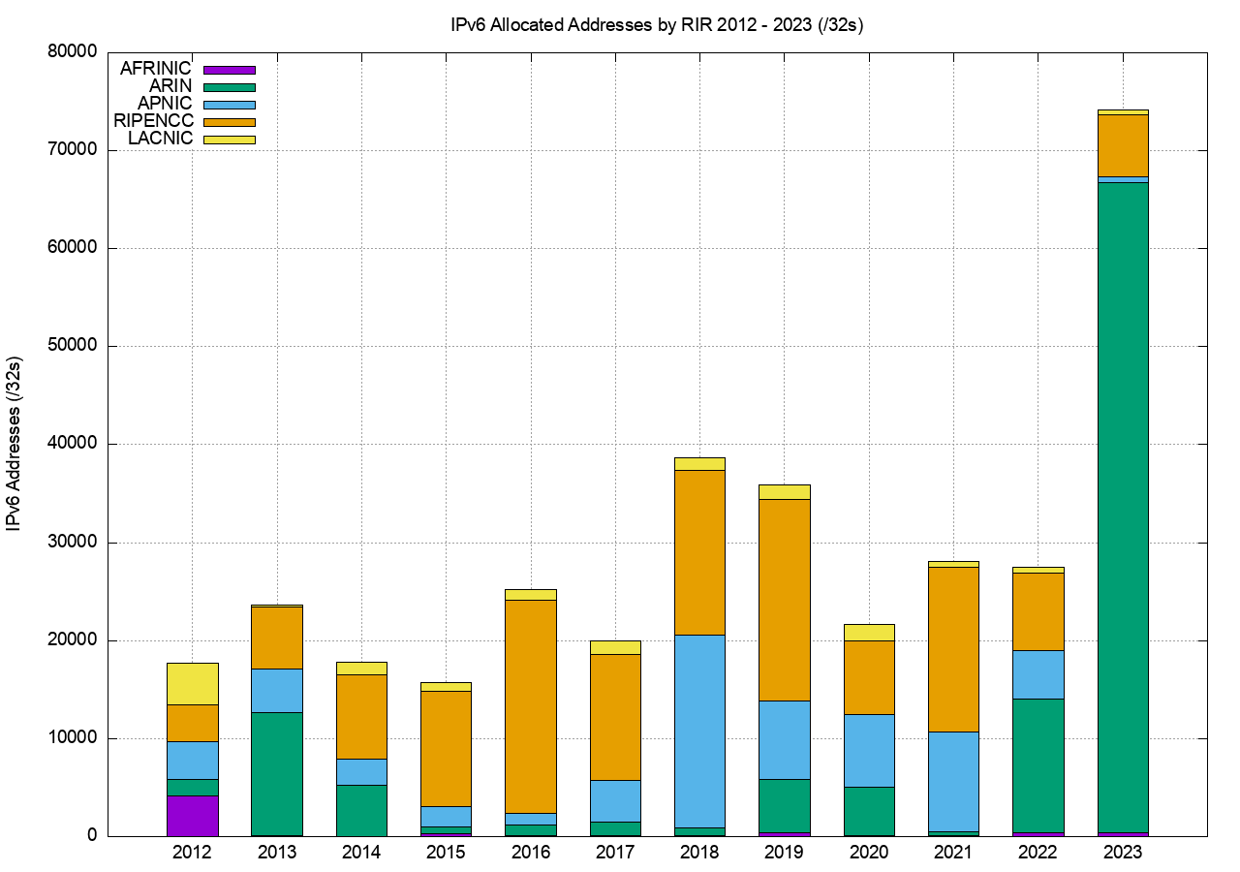
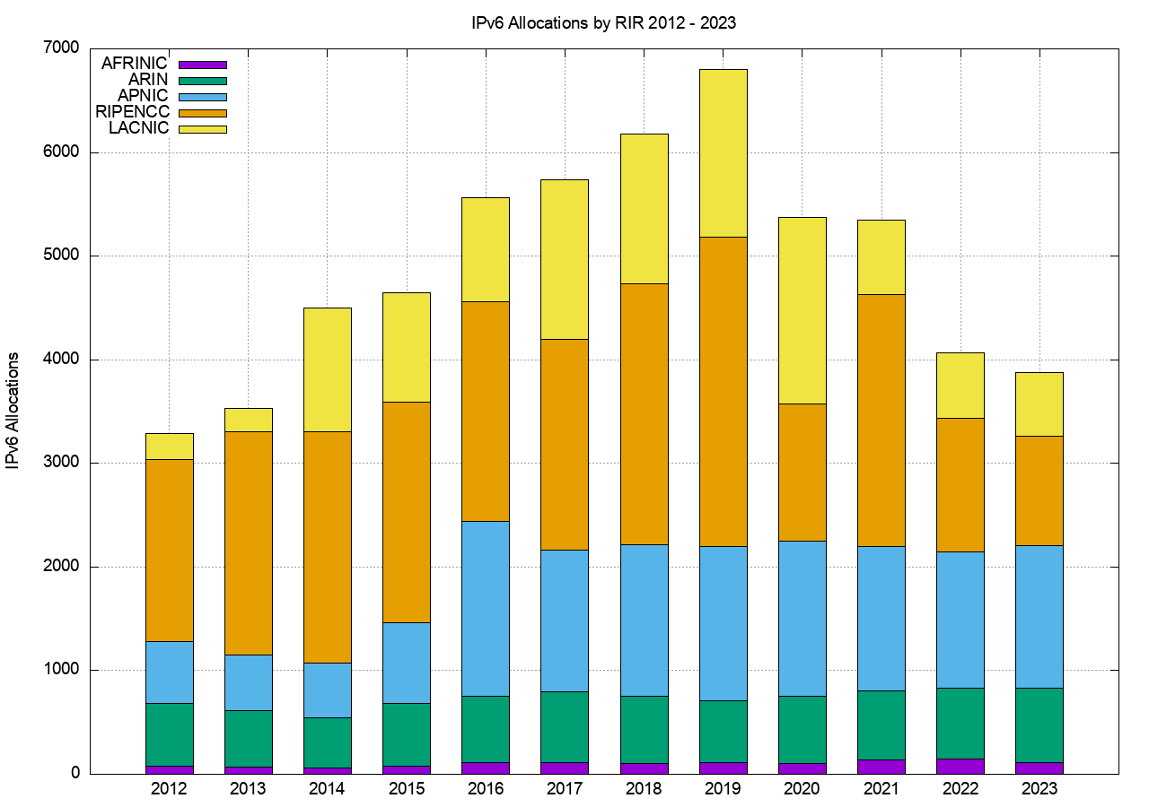
IPv6 Address Allocations
Addresses
Allocation Transactions
74,000 /32 addresses
3,900 allocations

Slide 13
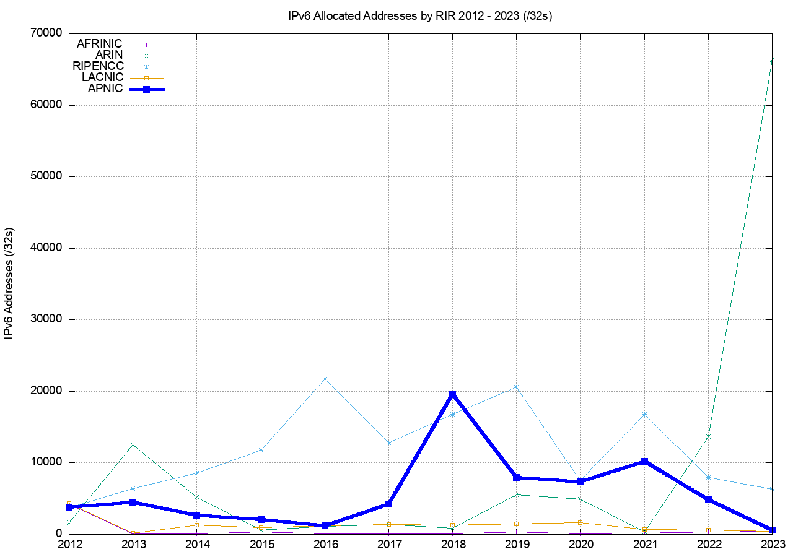
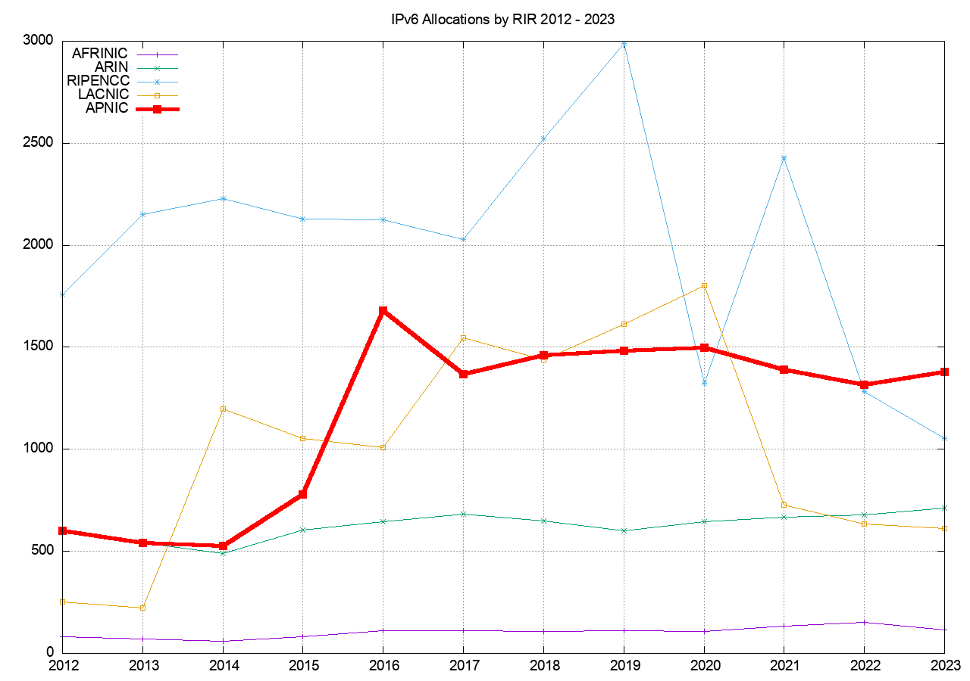
IPv6 Address Allocations
Addresses
Allocation Transactions

Slide 14
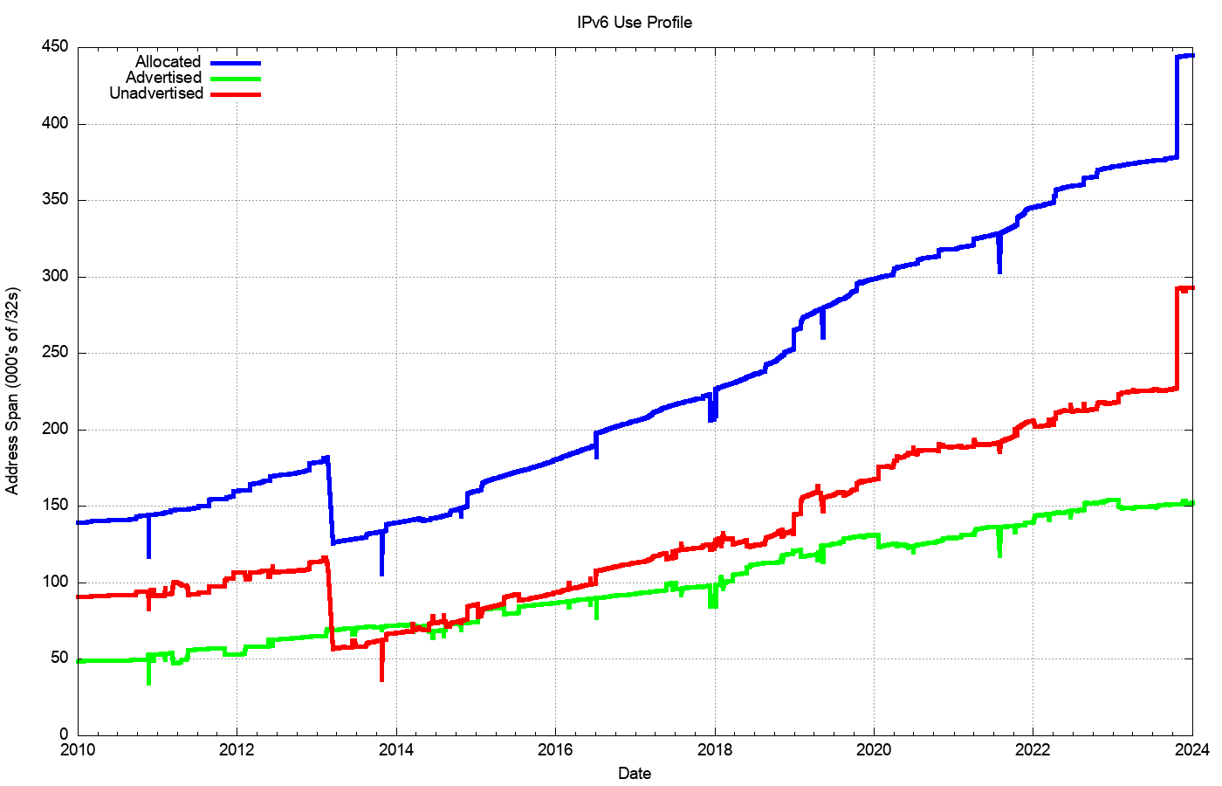
IPv6 Address Pools
Allocated Address Pool
Unadvertised Address Pool
Advertised Address Pool

Slide 15
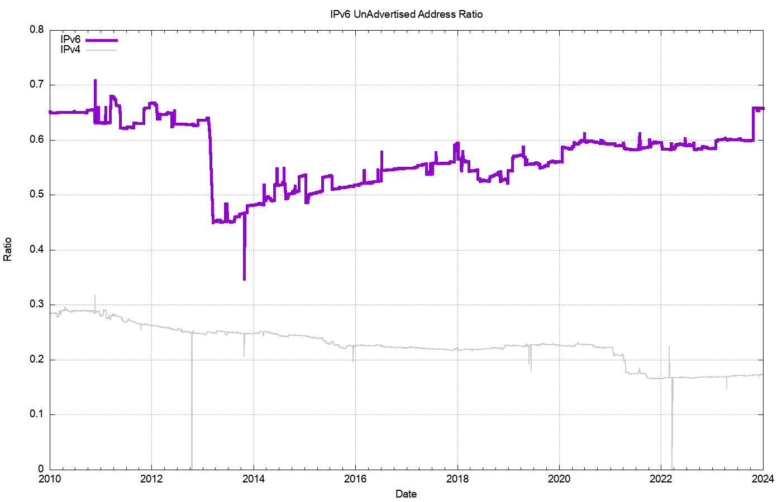
Unadvertised : Advertised Ratio
IPv6
IPv4

Slide 16
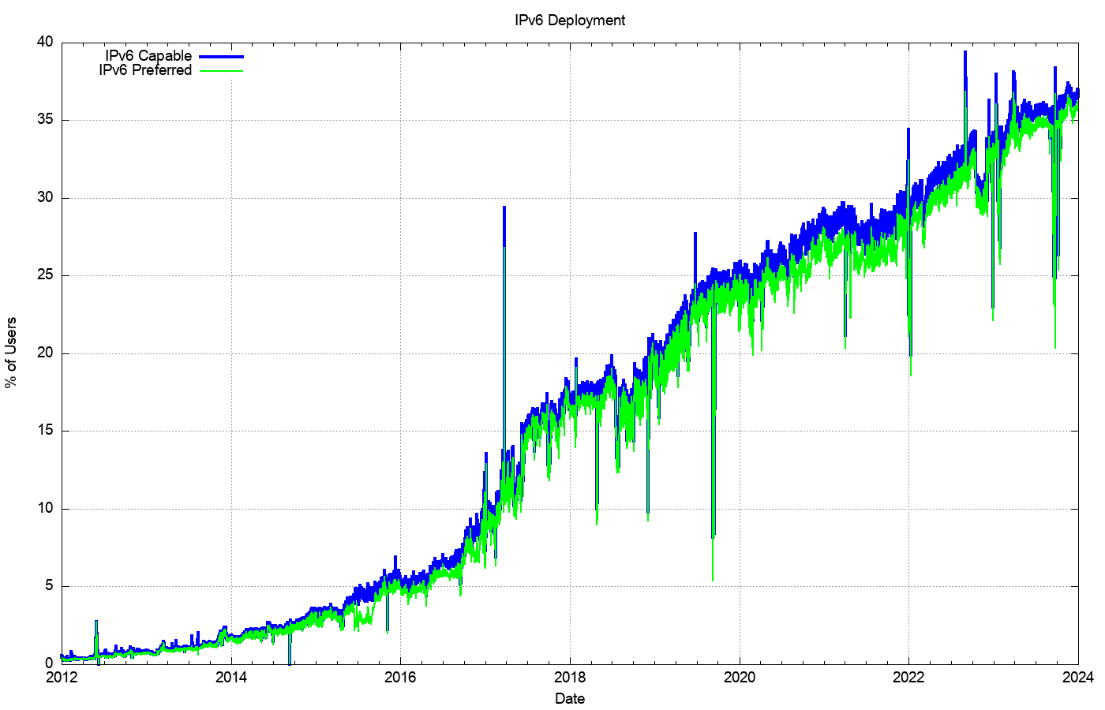
IPv6 Deployment

Slide 17
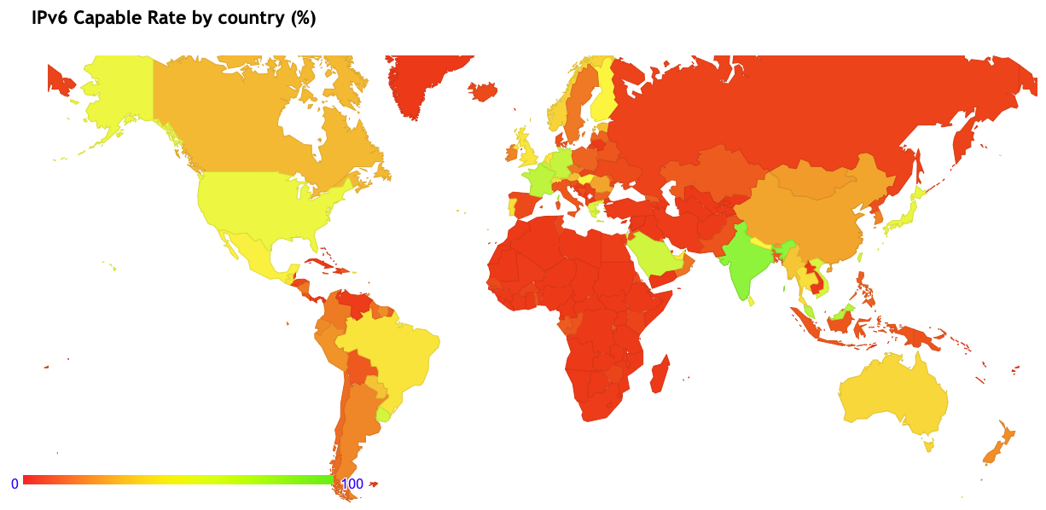
IPv6 Deployment

Slide 18
IPv6 in 2023
Steady IPv6 deployment in access networks is allowing more services to operate in dual stack mode - this is relieving pressure on the IPv4 address pools
Large address allocations in IPv6 mean that there is no pressure to deploy IPv6 using highly efficient deployments
IPv6 address consumption rates are tapering off – are we reaching a market saturation point?

Slide 19
Thanks!

