Slide 1
What’s an “IP Address” these days?
Geoff Huston AM
APNIC

Slide 2
Connected Devices
Connected IoT device count 2019 - 2030
https://www.statista.com/statistics/1183457/iot-connected-devices-worldwide/

Slide 3
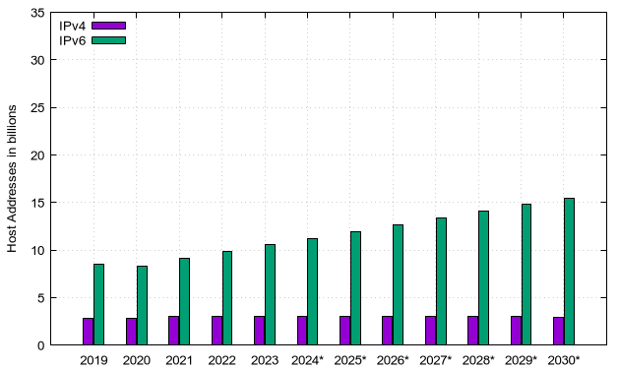
Addresses for Connected Devices
Connected IoT device count 2019 - 2030
Advertised Host Addresses 2019 - 2030
https://www.statista.com/statistics/1183457/iot-connected-devices-worldwide/
APNIC Data Projections

Slide 4
Addresses for Connected Devices
Connected IoT device count 2019 - 2030
Advertised Host Addresses 2019 - 2030
How are we bridging this widening gap?
https://www.statista.com/statistics/1183457/iot-connected-devices-worldwide/
APNIC Data Projections

Slide 5
What did we need from Addresses?
Identity:
WHO - Every unique end point has a unique address value
Location:
WHERE - Every unique address is associated with a location within the network
Reachability:
HOW – Every address informs the network how to direct packets towards it

Slide 6
What did we need from Addresses?
Identity:
WHO - Every unique end point has a unique address value
Location:
WHERE - Every unique address is associated with a location within the network
Reachability:
HOW – Every address informs the network how to direct packets towards it
The IP architecture uses an overloaded semantic framework for addresses

Slide 7
Running Short of Addresses
Address scarcity has been a feature of public Internet services from the outset
“sharing” a dial-up modem bank across a larger pool of subscribers
“sharing” a single connection service across a set of connected local computers
We responded to this scarcity by:
using common address pools and assigning addresses from the pool only when they were connected
Sharing a single external address across multiple internal devices (NATs)

Slide 8
Client/Server Architecture
The expansion of the computer industry into “low end” client devices motivated a change in the network service architecture to differentiate between clients and servers
Client platforms have no strict need for a persistent identity, and hence no strict need for a persistent address
This adoption of a client/server architecture has taken the pressure off the addressing system in having to provide a permanent unique IP address to every client

Slide 9
Clients
Only need a persistent address to use for the lifetime of a connection

Slide 10
Clients
Only need a persistent address to use for the lifetime of a connection
QUIC’s form of client address agility allows the client to be assigned a different external address each 2 x RTT interval
We’ve shifted session identification away from the old 5-tuple of addresses + ports to an application-level token

Slide 11
Servers
What’s the minimum address requirement for a multi-location service delivery platform?
1 anycast address
How does the platform differentiate between different hosted services?
The DNS
How do we identify service endpoints?
The DNS
How do we secure service identity?
DNS Name certificates!

Slide 12
Architectural Evolution
The 1980’s network architecture was an address-based architecture where every attached endpoint was uniquely addresses by its network attachment using a persistent address
Names were seen as an alias for addresses as part of the application-level framework intended to improve ease of use
Addresses were isomorphic to identity

Slide 13
Evolutionary Changes
We shifted to an asymmetric architecture of clients and servers
We dispensed with persistent network-wide level identity for clients and used local context addresses instead – clients do not have an address-level identity
We also dispensed with identity semantics for servers. The prevailing use of anycast service platforms implies that addresses are used for location and forwarding, but not for identity

Slide 14
Today’s Name-based Network
Today’s service network is a name-based network
Names provide identity, names underpin authenticity and security
Addresses retain the semantics of location and forwarding, but have largely dispensed with the role of endpoint identification

Slide 15
Some Questions
How well does IPv6 reflect this evolving network architecture that has shifted identity from addresses to names?

Slide 16
Some Questions
How well does IPv6 reflect this evolving network architecture that has shifted identity from addresses to names?
Anycast provides a local scope for replicated service platforms. Can anycast also allow local-scoped client-side addresses?

Slide 17
Some Questions
How well does IPv6 reflect this evolving network architecture that has shifted identity from addresses to names?
Anycast provides a local scope for replicated service platforms. Can anycast also allow local-scoped client-side addresses?
If every connected device does not need a permanent global address, then how many addresses do we need?

