Slide 1
DNS Centrality
Geoff Huston
APNIC Labs

Slide 2
The DNS…
Is a massive distributed system with no central locus of control
Both resolvers and servers are diverse and highly distributed
So why should we worry about centrality and concentration in the DNS?

Slide 3
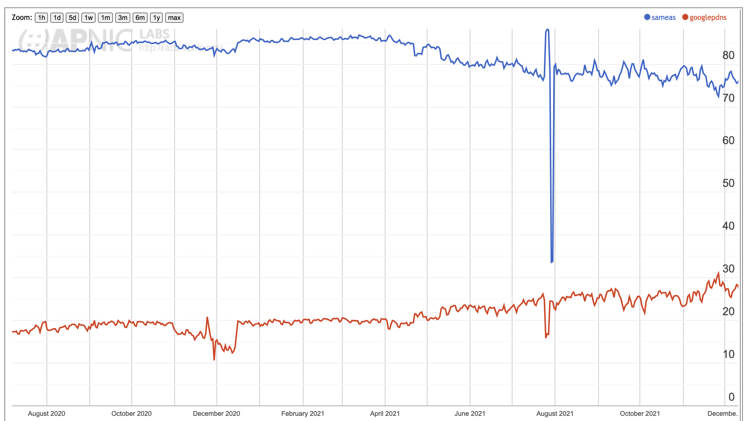
Resolver Concentration in EU
ISP Resolver
Google 8.8.8.8
share
December 2021

Slide 4
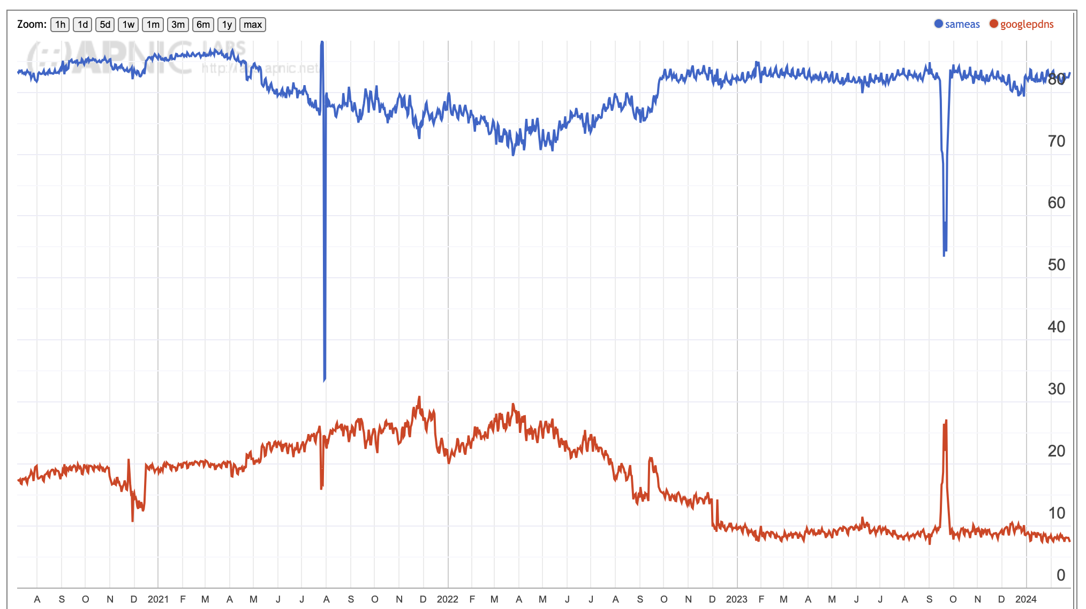
EU pressure on ISPs!
ISP Resolver
Google 8.8.8.8
share
Feb 2024

Slide 5
Concentration Measurements
Let’s look at the “market” of DNS open resolvers using the “all resolvers” measurements
  Single Entity Dominance:
    Google has 68.7% of the open DNS resolver market
  Four-Firm Concentration:
    Google, Cloudflare, 114DNS and OpenDNS have 91.6% market share
  HHI Index:
    49%
So the open resolver market sector is highly centralized.
But this open resolver activity represents only one third of the total resolution market, and the HHI Index of the open resolvers as a subset of the total resolution market is far lower, at 5%

Slide 6
Authoritative Servers
Data about the recursive-to-authoritative query set is hard to find
  Recursive resolvers sit in a privileged position in the DNS as they are exposed to both the identity of the stub resolver (the ‘user’) and the DNS names that they are querying
  So there are many caveats that apply to access to such data – and rightly so
At APNIC we have limited access to the data relating to the use of the 1.1.1.1 recursive resolver
  We don’t know who is querying, but we can see query names and query protocol
  The market share of Cloudflare’s open resolver service is around 3% of users which is a non-trivial resolver in the open resolver set (ranked #2 in terms of market share)

Slide 7
Centrality in Authoritative Servers?
One way to measure this is to look at the query-count weighted ranking of the DNS authoritative server providers
If an authoritative name server hosts a very popular domain name then it’s likely that the query count will be high
If a service operator hosts a large number of domains on its authoritative server infrastructure, then it’s likely that the query count will be high
So lets characterise the authoritative service hosting market by their query-based ‘market share’

Slide 8
Measurement Technique
Obtain a data set of 24 hours of query name data from the 1.1.1.1 resolver system
Group the query names
Resolve the names to find the “lowest” authoritative name server for the query name using a local resolution environment
Take the first name server name
Discard the query names
Resolve the name server names to IP address, and discard the name server names
Map the IP addresses to AS numbers, and discard the IP addresses
Group the query counts into AS numbers and rank by query share

Slide 9
Data Set
Rank | AS Number | Query Share | Cumulative Share | Name
56 | 31034 | 0.06% | 89.64% | Aruba, IT
57 | 20446 | 0.06% | 89.70% | Stackpath CDN, US
58 | 199524 | 0.06% | 89.76% | Gcore, LU
59 | 60068 | 0.05% | 89.82% | CDN77, GB
Here’s an extract of the resultant data set
The 24 hour data capture identified 26,971 unique AS numbers (out of a total of 75,000 unique AS numbers in the routing table)
While approximately one third of networks host at least one queried authoritative name server the top 50 ASNs have 89.2% of the query share.

Slide 10
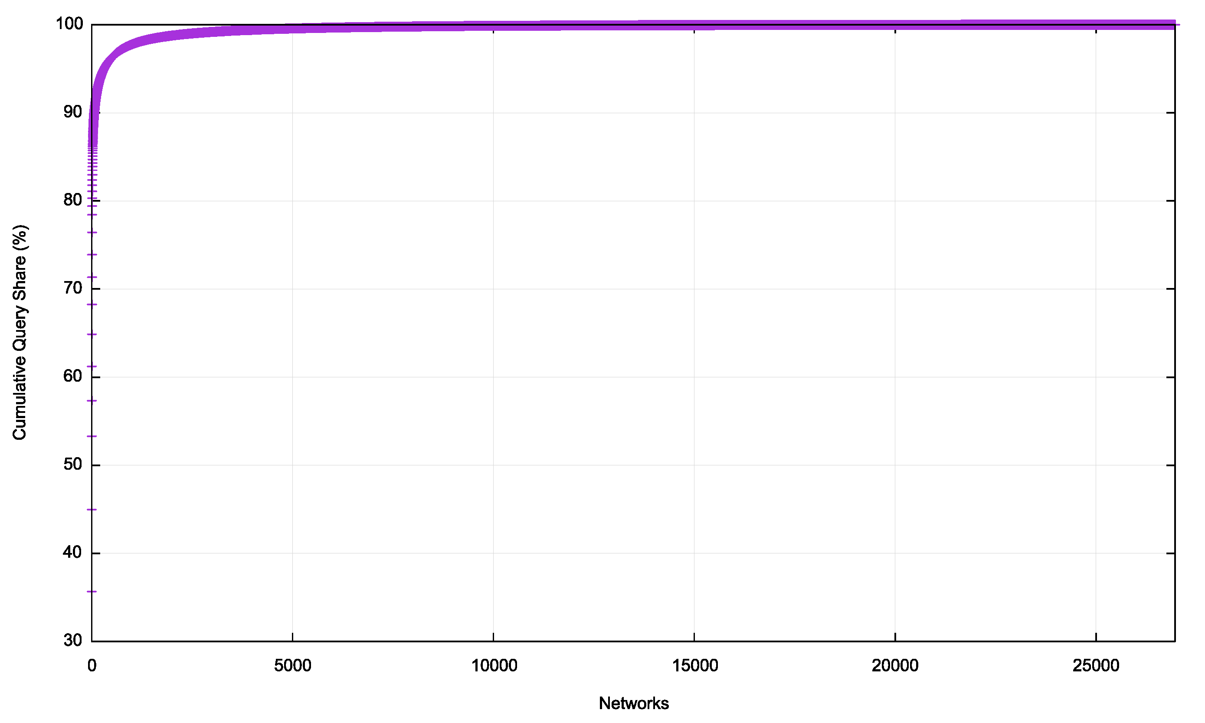
Cumulative Distribution

Slide 11
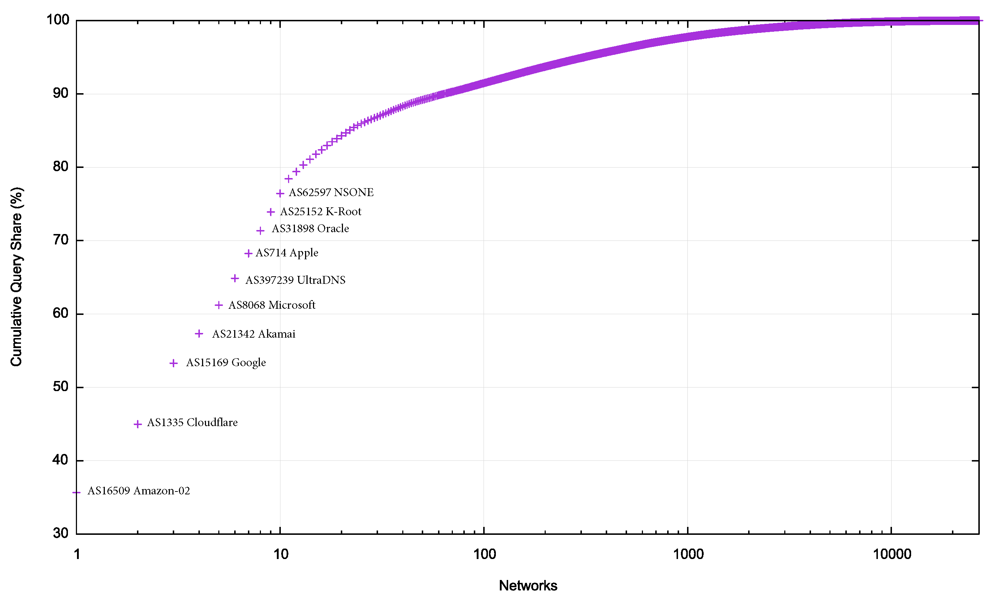
Cumulative Distribution

Slide 12
Top 10 Auth Server Networks
Rank | AS Number | Query Share | Cumulative Share | Name
1 | AS16509 | 35.7% | 35.7% | Amazon-02, US
2 | AS13335 | 9.3% | 45.0% | Cloudflare, US
3 | AS15169 | 8.3% | 53.3% | Google, US
4 | AS21342 | 4.0% | 57.3% | Akamai – ASN2, US
5 | AS8068 | 3.9% | 61.2% | Microsoft, US
6 | AS397239 | 3.7% | 64.9% | UltraDNS, US
7 | AS714 | 3.4% | 68.3% | Apple, US
8 | AS31898 | 3.1% | 71.4% | Oracle, US
9 | AS* | 2.5% | 73.9% | Root Server System
10 | AS62597 | 2.5% | 76.4% | NSONE, US

Slide 13
Concentration Measurements
Lets look at the “market” of DNS authoritative server providers using query-weighted ranking
  Single Entity Dominance:
    Amazon has 35.7% of the Authoritative Server market
  Four-Firm Concentration:
    Amazon, Cloudflare, Google, and Akamai have 57.3% market share
  HHI Index:
    15%
This appears to be a “moderately concentrated” market

Slide 14
Geopolitical Centrality?
There are 10 network entities who host the authoritative name servers that have a query share of three quarters of the recursive-to-authoritative DNS query volume
All 10 networks are attributed to US entities
Is this market for authoritative DNS services concentrated?

Slide 15
Thanks!

