Slide 1

Networking in the Penumbra
Geoff Huston AM
APNIC

Slide 2
The Trusted Network
Networks enjoyed a privileged position of being able to observe:
  Who is communicating with whom
  What they are saying to each other

Slide 3
The Trusted Network
Users have an expectation of privacy in their communications
  This expectation was often reinforced through regulatory measures intended to constrain public network operators from disclosing knowledge gained through network operation

Slide 4
The Erosion of Trust
Trust has been eroded by intrusive middleware that collects aggregate (and sometimes specific) data on user behaviours
  The general adoption of advertising revenue as a means of funding for service platforms act as a major incentive to assemble detailed profiles of individual users: age, gender, location, educational level, marital status, income, interest, purchase history,…
  The better the profile the higher the value of the user to the advertiser

Slide 5
The Erosion of Trust
This network position of trust was further eroded by leakage of the activities of US state-based actors performing various forms of mass surveillance on network users
  The Snowden Papers was a watershed moment for the Internet
  But it was by no means the first time, nor was it the last
  Large scale state-sponsored surveillance continues

Slide 6
So how did we react?

Slide 7
RFC 7258
Pervasive Monitoring is an attack on privacy
  “The IETF community's technical assessment is that PM is an attack on the privacy of Internet users and organisations. The IETF community has expressed strong agreement that PM is an attack that needs to be mitigated where possible, via the design of protocols that make PM significantly more expensive or infeasible.”
RFC 7258 – May 2014

Slide 8
What did this mean?

Slide 9
Changes to the Applications
Hiding the Web
Shift to use TLS for all web transactions – HTTPS
  TLS authenticates the identity of the server to the client
    Is this service name authentic? Can the service operator demonstrate to the client that is has knowledge of the private part of the key pair that is associated with this DNS service name?
  Service transactions are encrypted
    TLS generates a session key used to encrypt all subsequent on-the-wire data

Slide 10
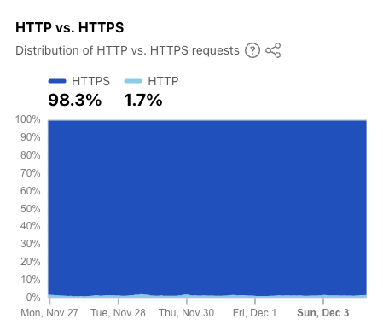
HTTPS Today
https://radar.cloudflare.com/adoption-and-usage

Slide 11
Changes to the Applications
Hiding the DNS
Hide the query and response in DNS resolution transactions from the network
The initial work has concentrated on hiding the DNS query names from the network by encrypting the DNS data exchanged
  DNS over TLS
  DNS over HTTPS/2 and DNS over HTTPS/3

Slide 12
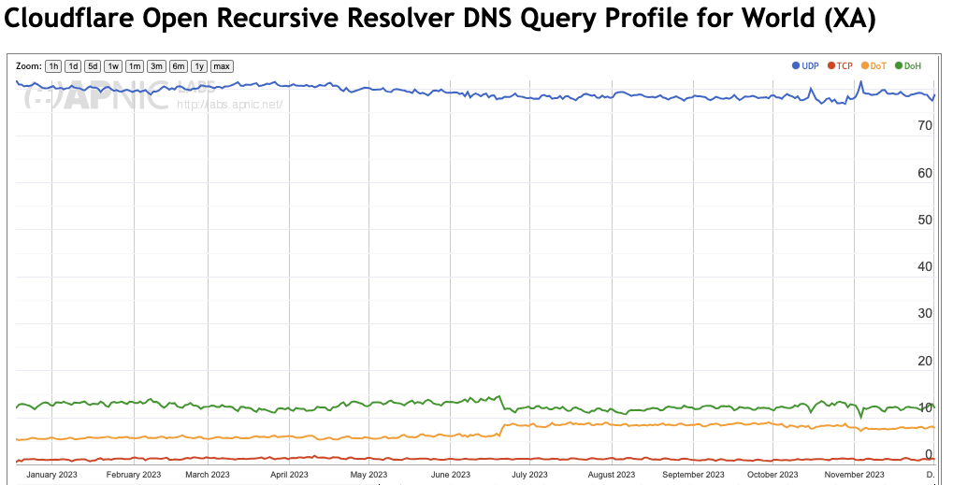
DoH, DOT Today
DNS over HTTPS
DNS over TLS
https://stats.labs.apnic.net/edns

Slide 13
Can we go further?
Can we hide the two ends from each other such that at no point in the network (and even at the server) are the two ends of the transaction visible at once?
Can we also selectively obscure the content of the transaction such that the endpoints and the content of the transaction are not simultaneously discoverable

Slide 14
MASQUE and Relays
With the use of 2-layer encryption and active relays then its possible to hide the endpoints from the network
There is no single network observation point that can put together the combination of the service identity and the identification of the two endpoints of the service transaction
Only the client endpoint knows its own identity and service, but does not know the identity used by the relay to present the service transaction to the server
The server may use the application-level identity of the client, but does not know the client’s network-level identity (IP address)
This technique can be used in DNS resolution and HTTPS transactions

Slide 15
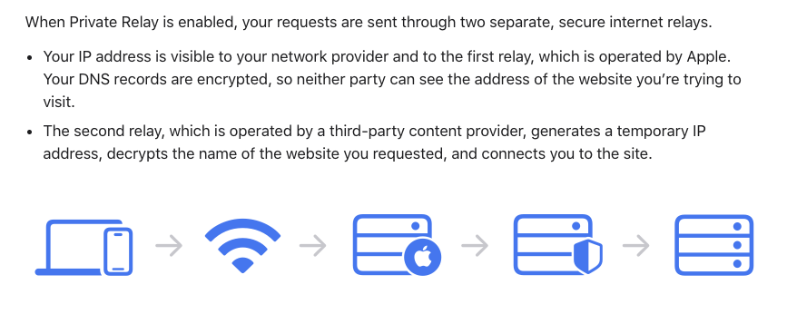
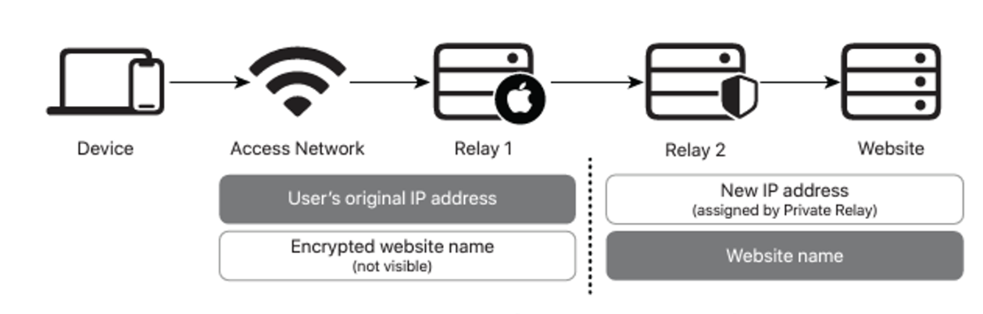
Apple Private Relay

Slide 16
Sealing up the Peepholes
Attention has turned to the Server Name Indication (SNI) field in the TLS handshake
  This is the one part of TLS that is still shown in the clear
  Efforts to encrypt this field in a robust manner are being studied
  The most effective way to securely communicate the public key that is used to encrypt the SNI (and the entire ClientHello message) appears to be a TLSA record in the DNS (DANE) using DoT or DoH, using a DNSSEC-signed record
  A shortcut hack is to use a trusted intermediary (https://blog.cloudflare.com/announcing-encrypted-client-hello/)

Slide 17
Sealing up the Peepholes
And there‘s the the Online Certificate Status Protocol, which exposes the IP address of the client and the name of the service that they are visiting
  Which likely explains why Chrome browsers do not perform “live” certificate revocation checks, and rely instead on short validity periods for certificates

Slide 18
Why are we doing this?

Slide 19


Who wants privacy?
Do users really care?
  Users cheerfully gave up email privacy in exchange for free email services
  Users happily tell Google Search way too much about themselves in exchange for instant answers
  In general, users will happily trade off privacy for access to services

Slide 20
If not users, then whom?

Slide 21
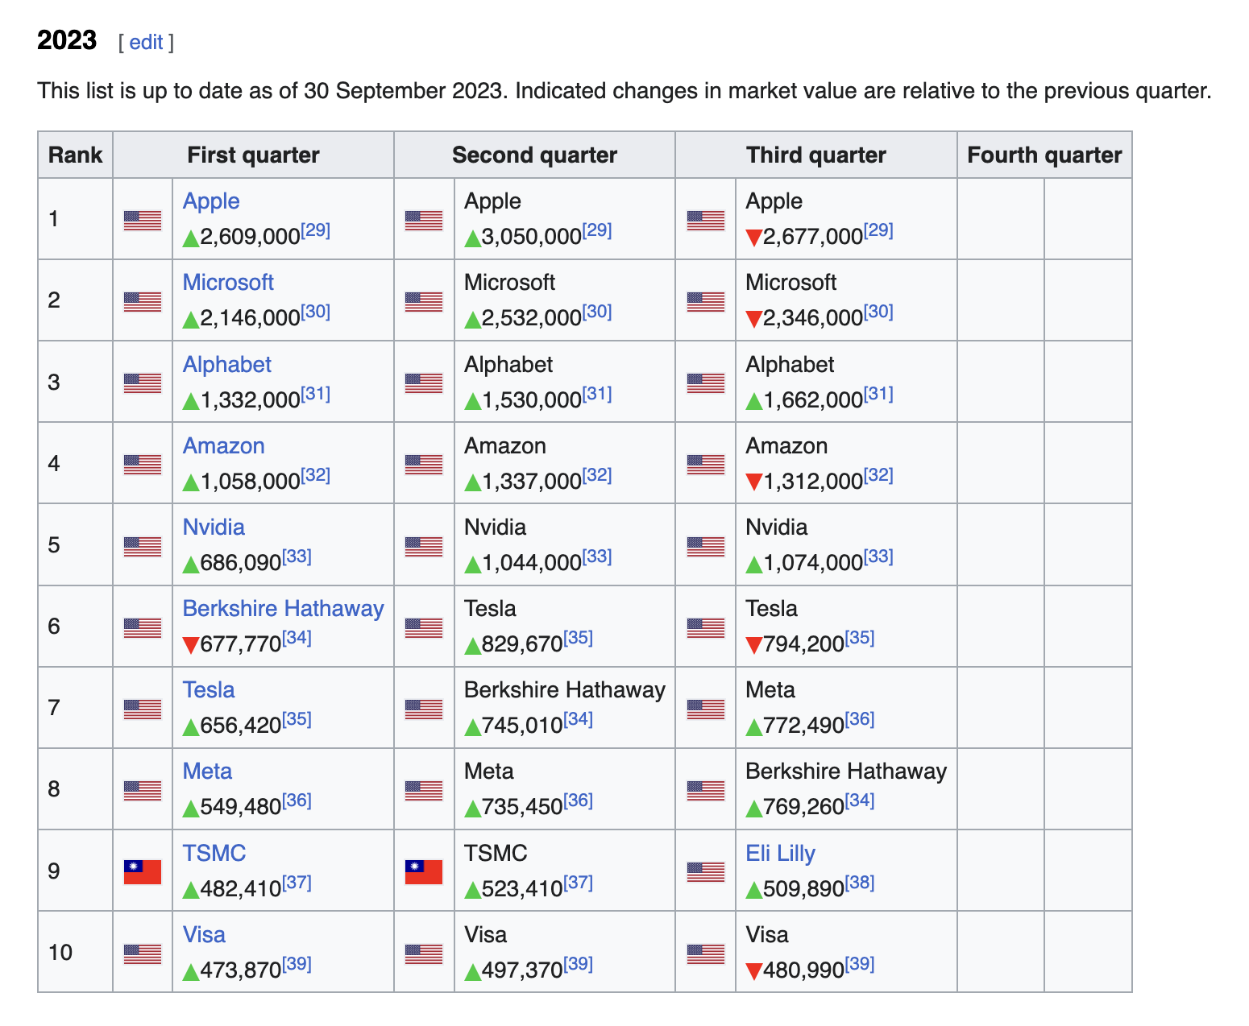
If not users, then whom?
The folk with the most to lose!

Slide 22



Slide 23
Who cares about privacy?
None of the entities who spend large sums to assemble detailed profiles of users want to leak that data to their competitors
So, privacy is about protecting the core asset of gathering individual profiles of users from:
  Other services
  The common host platform
  Common Infrastructure services
  The network

Slide 24
Let me rephrase that:
We want to allow the application to operate in a mode that obscures its behaviour from:
  Other services
  The common host platform
  Common Infrastructure services
  The network

Slide 25
How do you do that?
By lifting out as much as you can from the lower levels of the protocol stack that are managed by common services and performing it within the application

Slide 26
So, how do you do that?

Slide 27
Transport Privacy
Which means we are looking at how to lift TCP out of the common parts of the host platform and and shift it across to the application
We need to change TCP!

Slide 28
Transport Surgery
How do you change TCP?
  TCP is a kernel function that is defined at the platform level
  Applications have no intrinsic ability to alter the TCP characteristics for the application on a customized basis
  You could try to define a new transport protocol (such as SCTP)
  But the deployed infrastructure (NATs) tends to discard all packets that are not protocol 6 (TCP) or protocol 17 (UDP)
  If you want to bypass kernel handling of TCP and get through existing network filters and middleware then you're forced into using UDP
  So you change TCP by using QUIC!

Slide 29
QUIC is the new TCP
QUIC
HTTP/3
HTTP/2
HTTP
Multi-stream
HTTP
TLS
Session Encryption
QUIC
Multi-stream
Encryption
Data stream integrity
Congestion Control
e2e encrypted
TCP
Data stream integrity
Congestion Control
e2e encrypted
UDP
IP

Slide 30
TCP is..
A transport protocol that constructs a reliable full duplex adaptive streaming service on top of an unreliable IP datagram service
  Uses a coordinated state between the two end systems without any network intervention or mediation
  Uses a sliding window to allow lost data to be resent
  Uses ACK-clocking to regulate the sending behaviour to match network path capacity estimate

Slide 31
TCP isn’t…
Fully independent of the underlying platform’s transport services
Fully multi-stream (it has head-of-line blocking)
Fully multi-path (yes, MP-TCP exists, but there are some outstanding issues here!)
Address agile
Free from on-the-wire network intervention (TCP control parameters are sent in the clear)
Has e2e encryption as a second step / afterthought
Everything for everyone – it relies on the application to perform data framing and in-band control

Slide 32
QUIC is…
Constructed upon a transport level framing protocol that offers applications access to the basic IP datagram services offered by IP through the use of UDP
  All other transport services (data integrity, session control, congestion control, encryption) are shifted upwards in the protocol stack towards the application. A host platform may provide a QUIC API as part of the host library, but the application can also provide its own QUIC service independent of the host

Slide 33
QUIC is…
So much more than “encrypted TCP over UDP”
  Support for multi-stream multiplexing that avoids head-of-line blocking and exploits a shared congestion and encryption state
  Faster - Combines transport and encryption setup exchange in a single 3-way exchange at session start, and supports fast reopen
  Customisable - QUIC implementations can use individual flow controllers per flow
  QUIC places its transport control fields inside the encryption envelope, so QUIC features minimal exposure to the network
  Supports record and Remote Procedure Call service models as well as bit-streaming and datagram services

Slide 34
QUIC is address agile
NATs are potentially hostile to QUIC because of the outer UDP wrapper
  A NAT may rebind a QUIC session (shift the externally visible address/port of a host during a session), as NATs are not generally aware of UDP streaming states
QUIC uses a persistent “connection ID”
  If a host receives a QUIC frame with the same connection ID and a new source IP address / port it will send a challenge by way of a random value that should be echoed back. This is all performed within the e2e encryption envelope. That way a QUIC e2e session can map into new address/port associations on the fly

Slide 35
QUIC also…
Is IP fragmentation intolerant – QUIC uses PMTUD, or defaults to 1,200 octet UDP payloads
Never retransmits a QUIC packet – retransmitted data is sent in the next QUIC packet number – this avoids ambiguity about packet retransmission
Extends TCP SACK to 256 packet number ranges (up from 3 in TCP SACK)
Separately encrypts each QUIC packet – no inter-packet dependencies on decryption
May load multiple QUIC packets in a single UDP frame

Slide 36
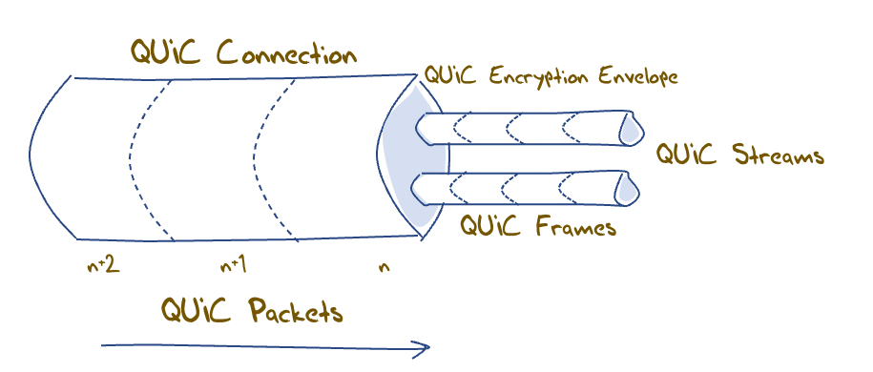
QUIC flow structuring
A QUIC connection is broken into “streams” which are reliable data flows – each stream performs stream-based loss recovery, congestion control, and relative stream scheduling for bandwidth allocation
QUIC also supports unreliable encrypted datagram delivery

Slide 37
QUIC and Remote Procedure Calls
By associating each RPC request/reply with a new stream, QUIC can support asynchronous RPC transactions using reliable messaging
  This can handle lost, mis-ordered and duplicated RPC messages without common blocking or throttling

Slide 38
QUIC and Load Balancing
This assumes that a front-end load balancer is capable of performing load balancing on UDP flows using the UDP connection 5-tuple
If the remote end performs NAT rebinding the load balancer will be thrown by this shift, and it has no direct visibility into the e2e session to uncover the connection ID
Using UDP to carry sustained high-volume streams may not match the internal optimisations used in server content delivery networks
Source Address A
Server A
NAT re-binding
Load Balancer
NAT
Server B
Source Address B

Slide 39
QUIC and Load Balancing
This assumes that a front-end load balancer is capable of performing load balancing on UDP flows using the UDP connection 5-tuple
If the remote end performs NAT rebinding the load balancer will be thrown by this shift, and it has no direct visibility into the e2e session to uncover the connection ID
Using UDP to carry sustained high-volume streams may not match the internal optimisations used in server content delivery networks
If we really want large scale QUIC with front-end load balancing and if we still need to tolerate NATs then we will need to think about how the end point can share the connection ID state with its front-end load balancer, or how to terminate the QUIC session in the front-end and use a second session to a selected server

Slide 40
QUIC and DOS
Very little lies outside the encryption envelope in QUIC
Which means all incoming packets addressed to the QUIC port need to be decrypted
But the QUIC session uses symmetric crypto so the packet decode overhead is far smaller than an asymmetric crypto load for the same packet rate
It’s not the best answer, but it’s not disastrous either!

Slide 41
QUIC is:
A logical evolutionary step for transport services, providing more flexibility, faster connection setup, and a larger set of transport services
It’s what we should expect from a capable modern transport protocol!

Slide 42
Triggering QUIC in HTTP
Use the DNS to trigger QUIC:
  Set up an HTTPS record for each server name, with value: alpn=“h3”
Use content-level controls to trigger QUIC:
  Add Alt-Svc: h3=“:443” to the HTML headers
  (This second method requires a subsequent query in a distinct HTTP session to allow the client to use the Alt-Svc capability.)

Slide 43
Triggering QUIC in HTTP
Use the DNS to trigger QUIC:
  Set up an HTTPS record for each server name, with value: alpn=“h3”
Use content-level controls to trigger QUIC:
  Add Alt-Svc: h3=“:443” to the HTML headers
First Fetch
Second Fetch

Slide 44
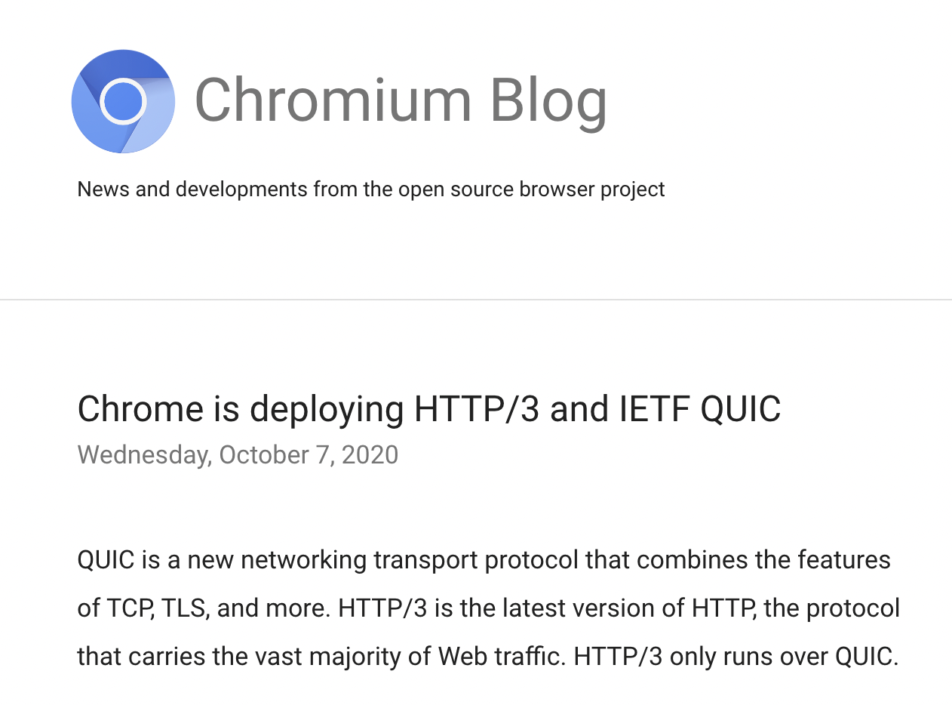
Setting Expectations
Chrome has a dominant share of browser instances - roughly, some 65%*
And Chrome has been supporting a switch to QUIC via the Alt-Svc directive since 2020
* Oberlo.com

Slide 45
Setting Expectations
Chrome has a dominant share of browser instances - roughly, some 65%*
And Chrome has been supporting a switch to QUIC via the Alt-Svc directive since 2020
And Apple Safari is now supporting QUIC, using the DNS SVCB apln directive
So a QUIC-aware server platform should be seeing some 85% of its sessions using QUIC – right?
* https://gs.statcounter.com/browser-market-share

Slide 46

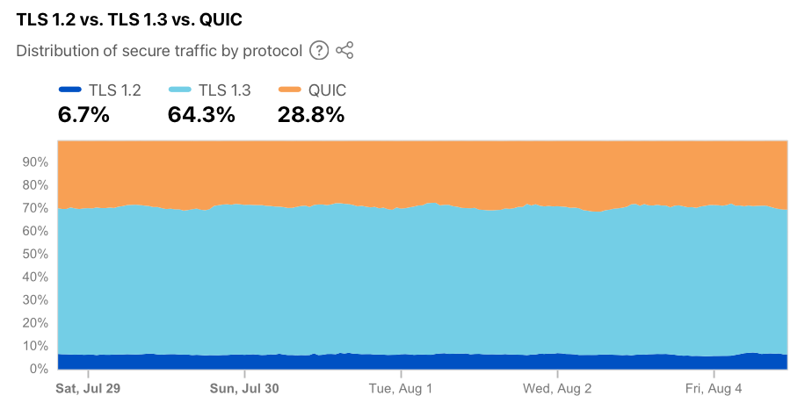
Cloudflare’s Numbers
Cloudflare reports a far lower level of QUIC use

Slide 47
APNIC’s QUIC measurement
We have configured a server to support QUIC sessions
We support both DNS and content triggers
The content trigger requires us to measure across multiple fetches within each measurement
  Which means that we need to carefully set the HTTP/2 session keepalive timer to make this work as intended

Slide 48
Server Session Keepalive Timers
After much searching under many rocks we were advised that a server keepalive timer value of 1 second is too small, as the server drops the QUIC connection too aggressively and the browser client then drops back to using HTTP/2
The default value of 65 seconds for the server keepalive interval seems to be too long
So we used a server keepalive value of 20 seconds…

Slide 49
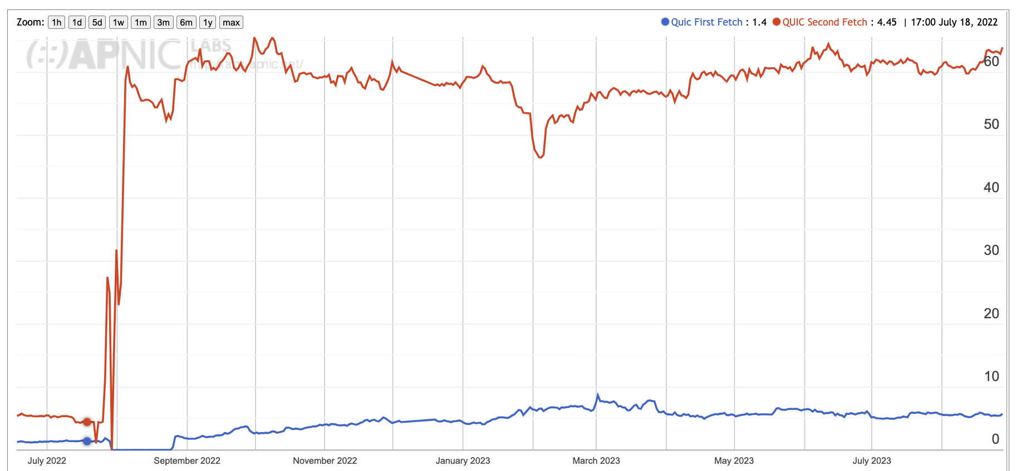
QUIC Use
Subsequent Fetches – mainly Chrome clients
First Fetch – mainly Safari clients
Playing with keepalive parameters!

Slide 50
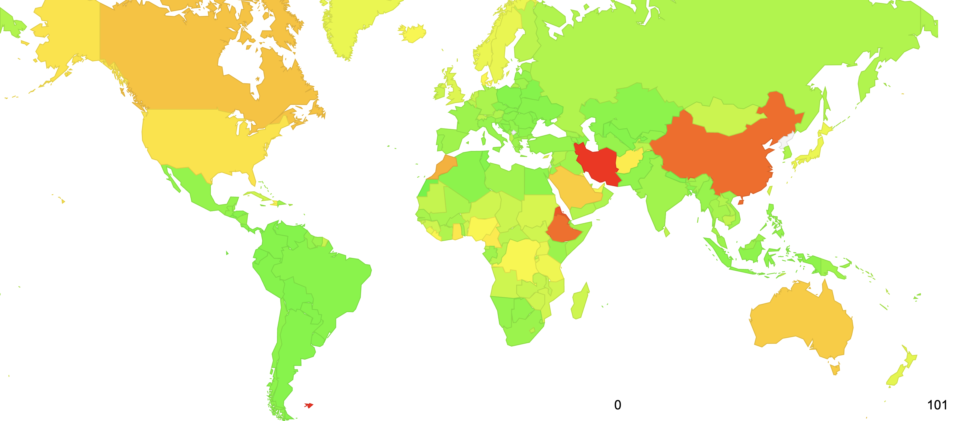
QUIC Use – July 2023

Slide 51
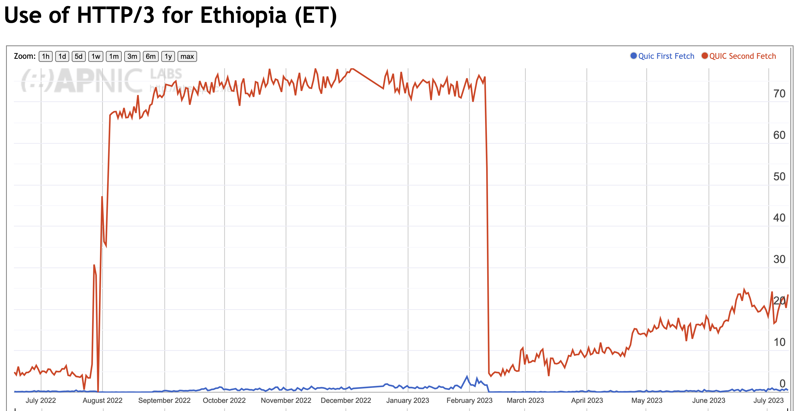
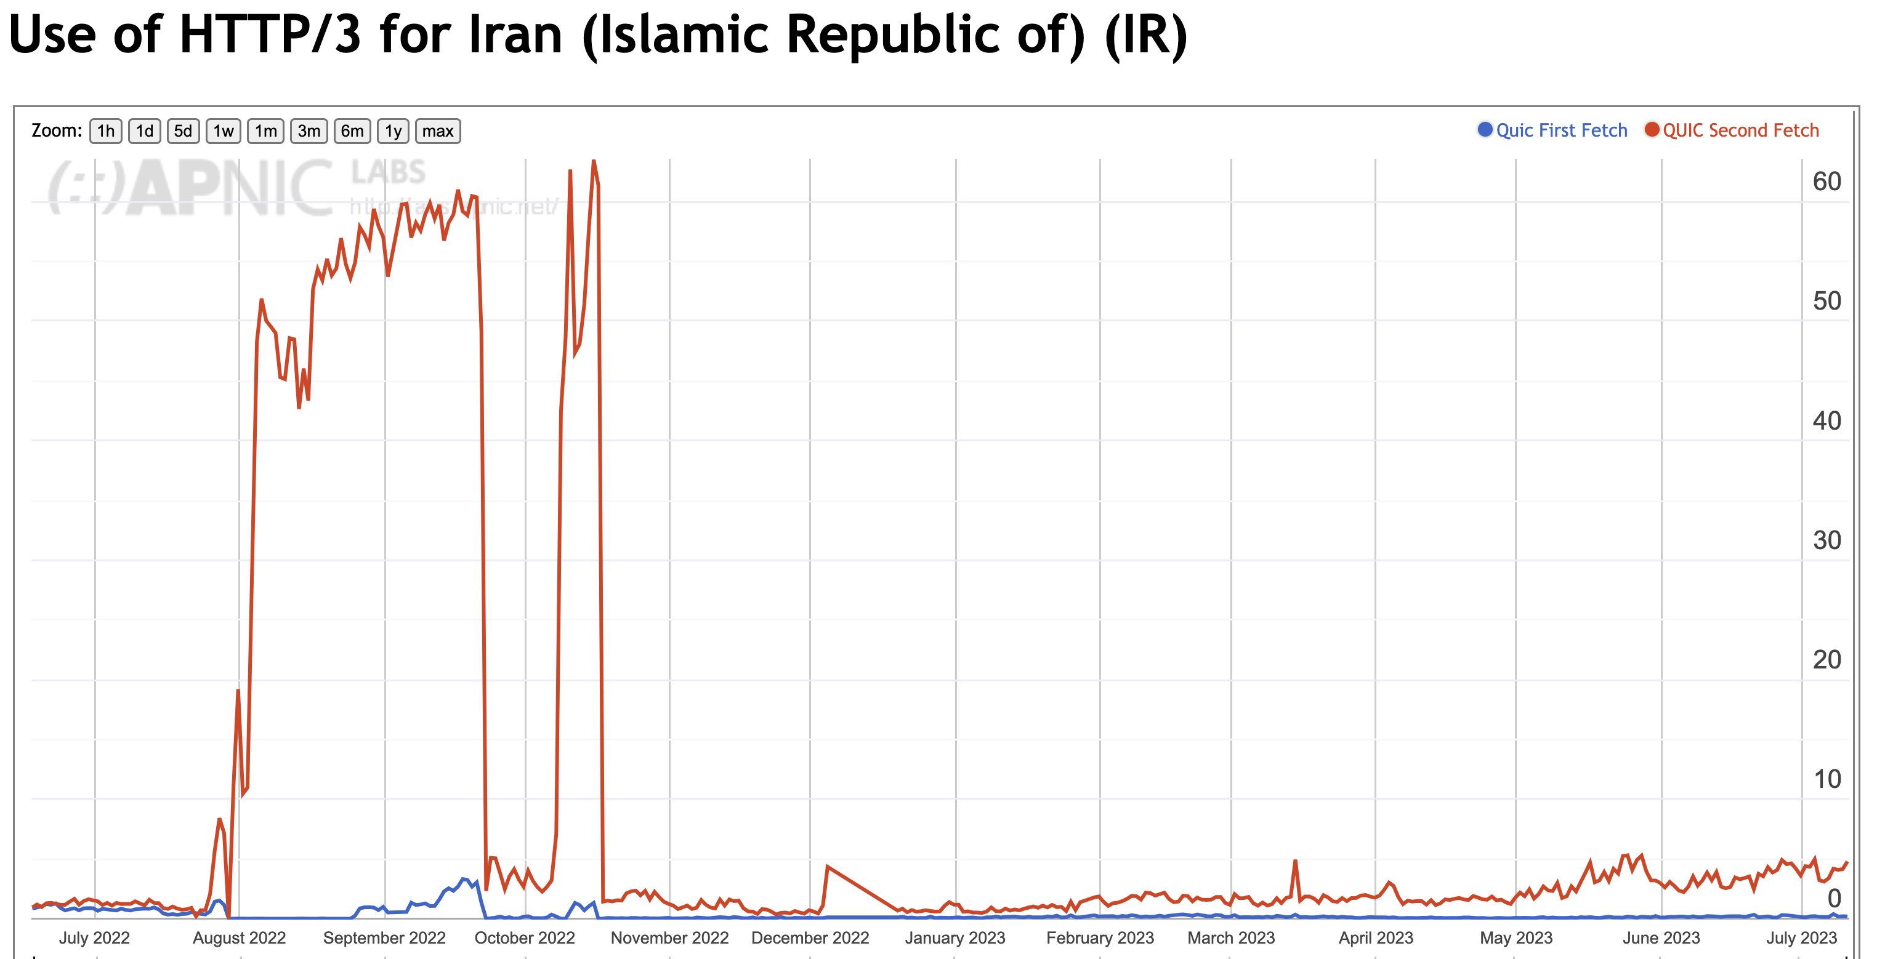
National Filtering of QUIC?

Slide 52
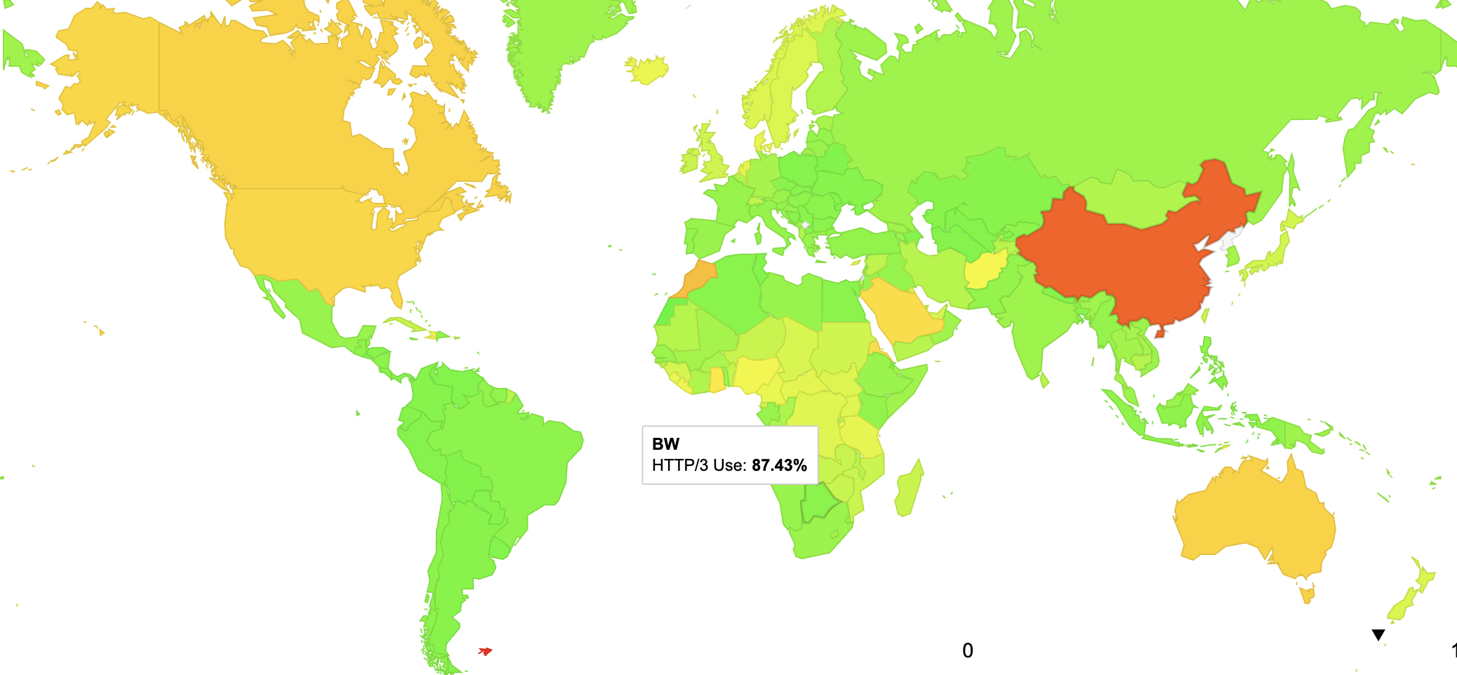
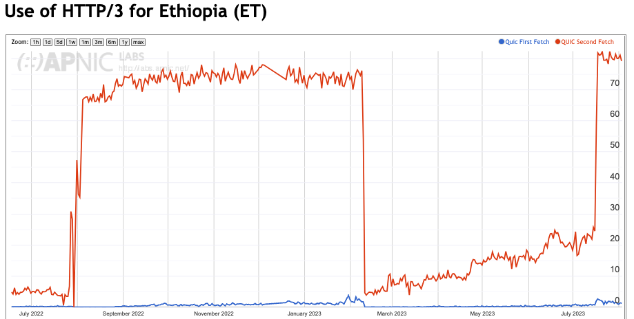
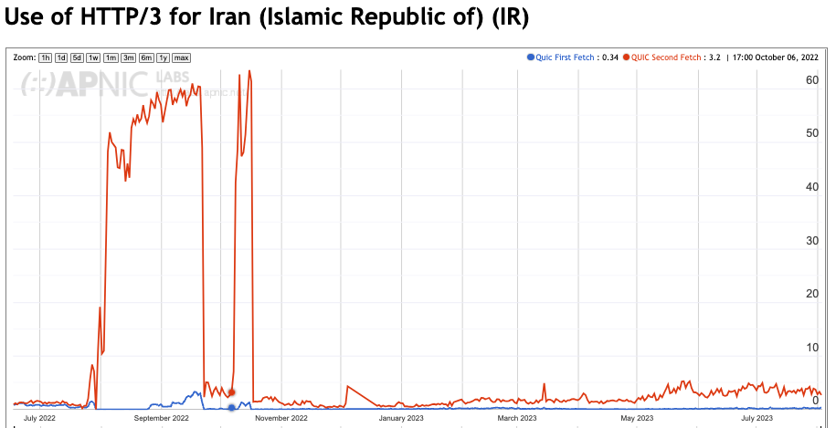
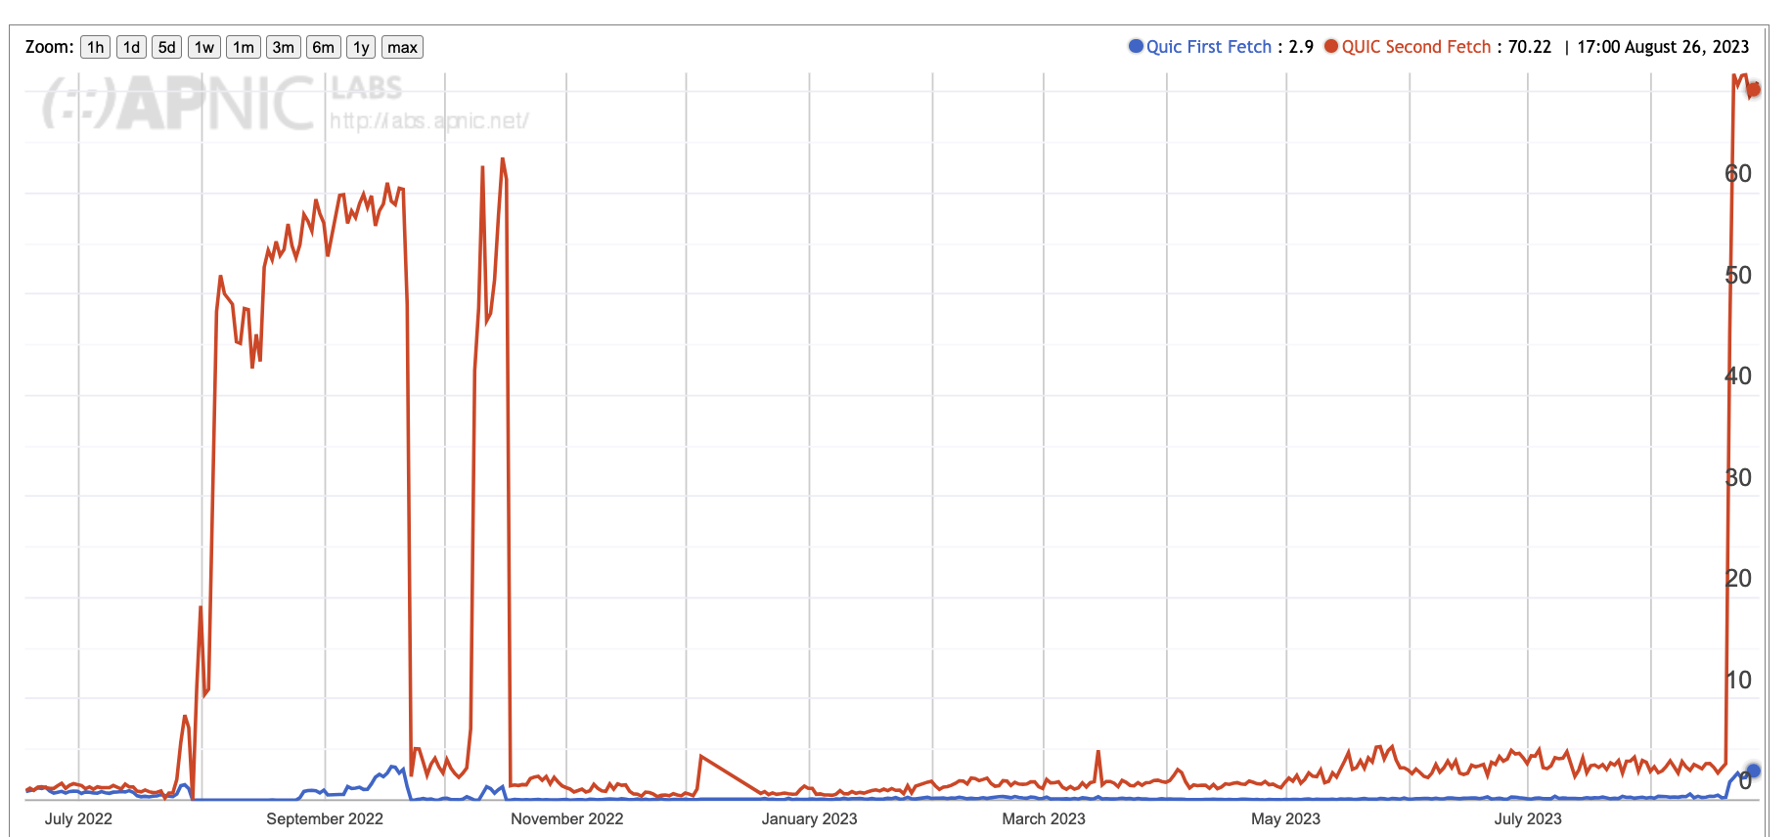
National Filtering of QUIC?

Slide 53
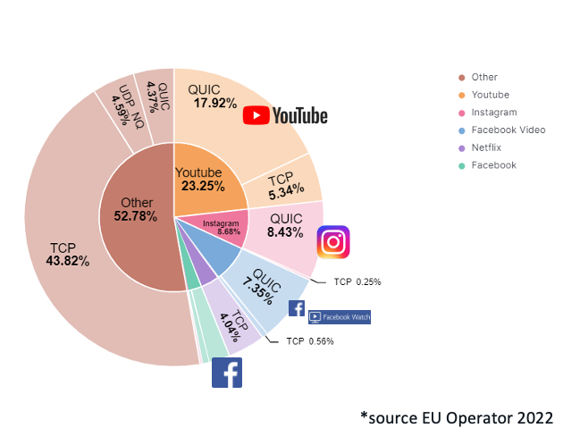
Other Measures: Network Traffic Volume
Presentation to RIPE 86: The New Encrypted Protocol Stack and How to Deal with it – Bart van de Velde, Cisco

Slide 54
Network Traffic Volume
Presentation to RIPE 86: The New Encrypted Protocol Stack and How to Deal with it – Bart van de Velde, Cisco

Slide 55
Measuring QUIC Performance
In this test (between the same endpoints) over a Starlink circuit, TCP CUBIC underperforms badly, while TCP BBR and QUIC both perform reasonably well

Slide 56
Why is QUIC important?
Because QUIC is fast
Because QUIC encrypts everything
  No visible transport control settings
  No visible Server Name Indication in the crypto-setup
  No visible traffic profile other than inter-packet timing
  And if you use a MASQUE-based VPN then there no residual visibility!
Because QUIC is an application capability
  QUIC can interact with the platform through the UDP API, so all of QUIC can be implemented within the application. This gives the application more control over its service outcomes and reduces external dependencies

Slide 57
What does this mean for TCP?
It’s not looking all that good for TCP’s prospects
QUIC not only does faster start up, but it supports multi-channel in a frictionless manner
QUIC resists network operator efforts to perform traffic shaping through direct manipulation of TCP control parameters
QUIC allows the application service provider to control the congestion behaviour of its sessions

Slide 58
What does this mean for TCP?
Normally you would expect any transition from TCP to QUIC to take forever
BUT:
QUIC gives benefit to adopters through more responsive web services
QUIC does a better job of hiding content, which is a benefit to the service operator
QUIC has fewer external dependencies
QUIC can be deployed on a piecemeal basis
So it all may be over for TCP in a very small number of years!

Slide 59
What does this mean for the Internet?
IP was a network protocol that provided services to attached devices
The network service model used by IP was minimal
  Packets may be dropped, fragmented, duplicated, corrupted and/or reordered on their path through the network
  It’s left to the edge systems to recover from this network behaviour.
Efforts to expand the network’s role have foundered
  QoS has just got nowhere!
  Various forms of source-directed forwarding are resisted by network operators who want control over traffic engineering
Networks took up a role of defending the network resource against aggressive application behaviour
Some networks enabled user surveillance
apps
TCP Transport
$$$
network
media

Slide 60
The new Networking Space
And this is why QUIC is so interesting – it is pushing both network carriage and host platform into commodity roles in networking and allowing applications to effectively customize the way in which they want to deliver services and dominating the entire networked environment
QUIC is the application’s view of what Transport should be!
apps
$$$
apps
TCP Transport
Internal
Transport +
session security
QUIC and value transform
in the network stack
network
UDP Transport
network
media
media

Slide 61
What does this mean for the Internet?
The relationship between applications, hosts and networks has soured into mutual distrust and suspicion
The application now defends its integrity by wrapping up as much of the service transaction with encryption and indirection
QUIC (and MASQUE) is an intrinsic part of this process of wrapping up traffic in encryption and redirection
For the network operator there is little left to see
And I suspect that there is no coming back from here!

Slide 62
What can a Network Operator Do?
When all customer traffic is completely obscured and encrypted?
  Traffic Shaping?
  Regulatory Requirements for traffic interception?
  Load Balancing / ECMP

Slide 63
The new Internet Space
“What you can’t dominate, you commoditise*”
Vertically integrated service providers have faded away into history - the deregulated competitive service industry continues to specialize rather than generalize at every level
Carriage is no longer an inescapable monopoly - massively replicated content can be used as a substitute for many carriage service elements
Control over the platform is no longer control over the user. Operating systems have been pushed back into a basic task scheduling role, while functions are being absorbed into the application space
* A related quote is Peter Thiel’s “Competition is for Losers!”

Slide 64
The new Internet Space
Each service has an ability to define its own operational behaviours that are intrinsic to that service
  Which is the anti-definition of “interoperability”
We have managed to minimize and commoditize the common parts of the Internet and push the valued functionality and service delivery up into each application
Which means:
  Standards for Interoperability is dead!
  Open is historic!
  The hyperscalers have won everything!

Slide 65
Thanks!

