Slide 1
Starlink Protocol Performance
Geoff Huston
APNIC

Slide 2
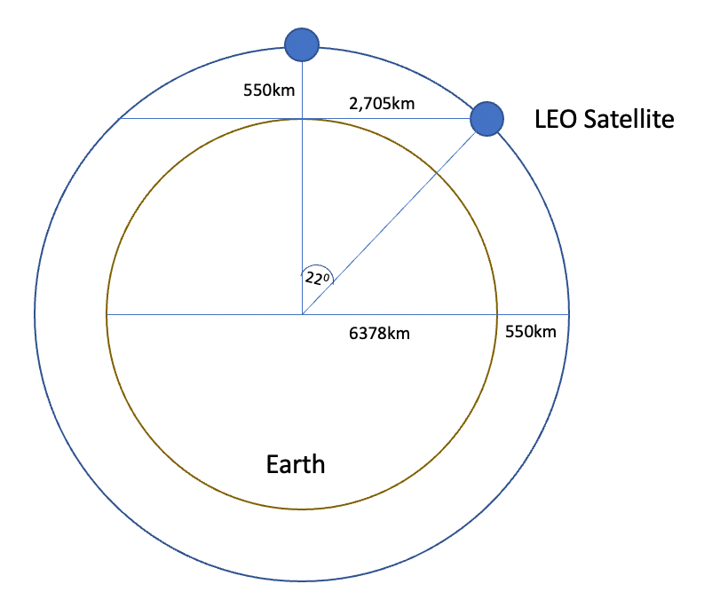
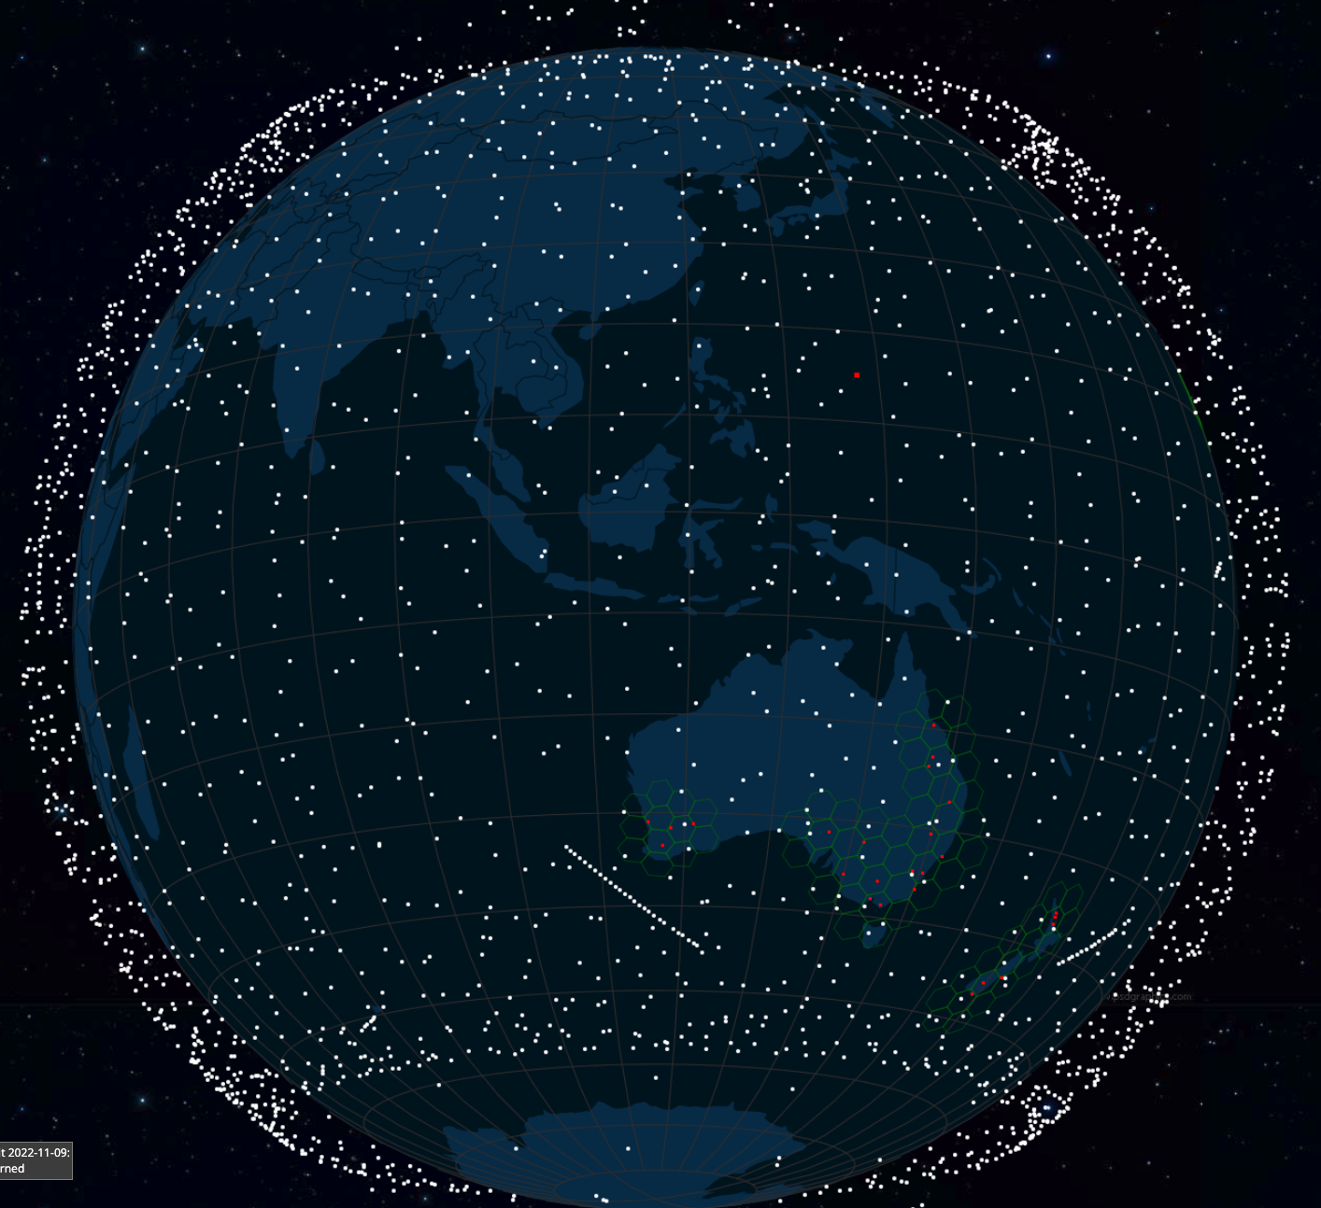
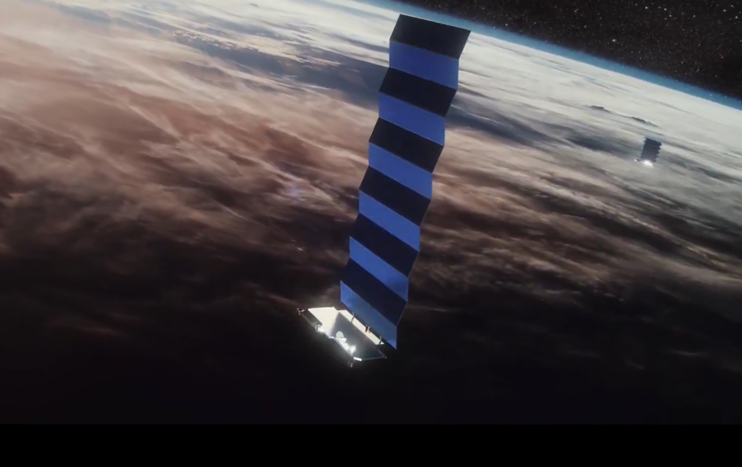
Low Earth Orbit
LEO satellites are stationed between 160km and 2,000km in altitude
High enough to stop them slowing down by “grazing” the denser parts of the earth’s ionosphere
Not so high that they lose the radiation protection afforded by the Inner Van Allen belt.
At a height of 550km, the minimum signal propagation delay to reach the satellite and back is 3.7ms, and at the horizon its 18ms, and at 25º its7.5ms
Image - spacex
screenshot from starwatch app

Slide 3
Starlink Constellation
If you use a minimum angle of elevation of 25º then at an altitude of 550km each satellite spans a terrestrial footprint of no more than ~900Km radius, or 2M K²
At a minimum, a LEO satellite constellation needs 500 satellites to provide coverage of all parts of the earth’s surface
For high quality coverage the constellation will need 6x-20x that number (or more!)

Slide 4
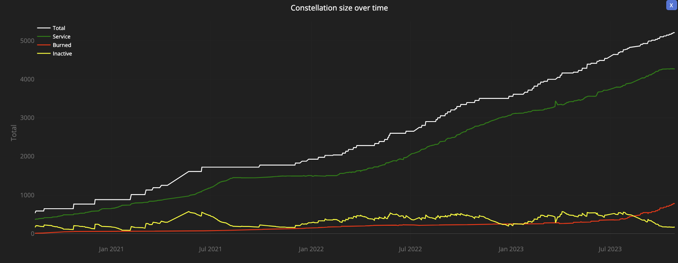
Starlink Constellation
4,276 in-service operational spacecraft, operating at an altitude of 550km
https://satellitemap.space/

Slide 5
Looking Up
Starlink tracks satellites with a minimum elevation of 25º.
There are between 30 – 50 visible Starlink satellites at any point on the surface between latitudes 56º North and South
Each satellite traverses the visible aperture for a maximum of ~3 minutes

Slide 6
Starlink Scheduling
A satellite is assigned to a user terminal in 15 second time slots
Tracking of a satellite (by phased array focussing) works across 11 degrees of arc per satellite in each 15 second slot
15 seconds
11º
client

Slide 7
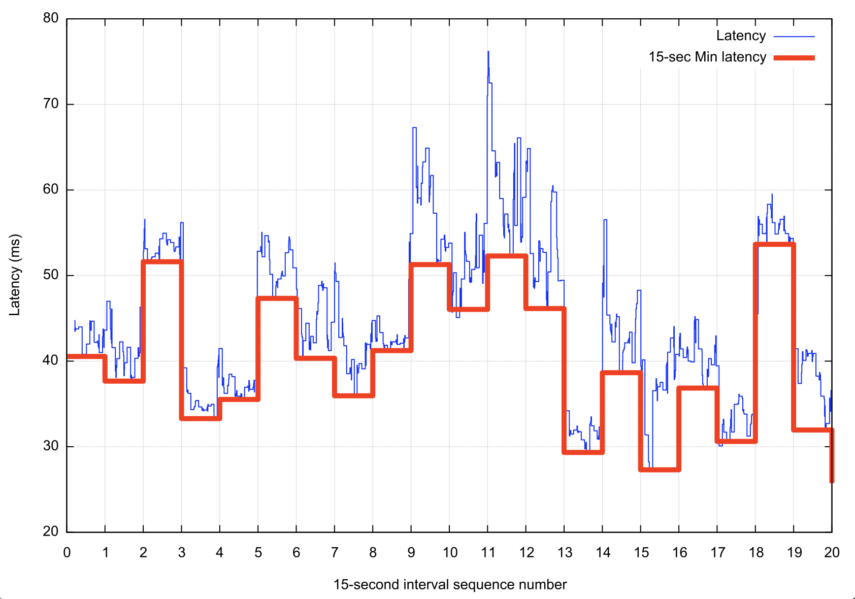
Starlink Scheduling
Latency changes on each satellite switch
If we take the minimum latency on each 15 second scheduling interval, we can expose the effects of the switching interval on latency
Across the 15 second interval there will be a drift in latency according to the satellite’s track and the distance relative to the two earth points
Other user traffic will also impact on latency, and also the effects of a large buffer in the user modem

Slide 8
Starlink Spot Beams
Each spacecraft 2,000 MHz of spectrum for user downlink and splits it into 8x channels of 250 MHz each
Each satellite has 3 downlink antennas and 1 uplink antennas, and each can do 8 beams x 2 polarizations, for a total of 48 beams down and 16 up.
“Unveiling Beamforming Strategies of Starlink LEO Satellites”
https://people.engineering.osu.edu/sites/default/files/2022-10/Kassas_Unveiling_Beamforming_Strategies_of_Starlink_LEO_Satellites.pdf

Slide 9
Starlink’s reports
$ starlink-grpc-tools/dish_grpc_text.py -v status
id: ut01000000-00000000-005dd555
hardware_version: rev3_proto2
software_version: 5a923943-5acb-4d05-ac58-dd93e72b7862.uterm.release
state: CONNECTED
uptime: 481674
snr:
seconds_to_first_nonempty_slot: 0.0
pop_ping_drop_rate: 0.0
downlink_throughput_bps: 16693.330078125
uplink_throughput_bps: 109127.3984375
pop_ping_latency_ms: 49.5
Alerts bit field: 0
fraction_obstructed: 0.04149007424712181
currently_obstructed: False
seconds_obstructed:
obstruction_duration: 1.9579976797103882
obstruction_interval: 540.0
direction_azimuth: -42.67951583862305
direction_elevation: 64.61225128173828
is_snr_above_noise_floor: True

Slide 10
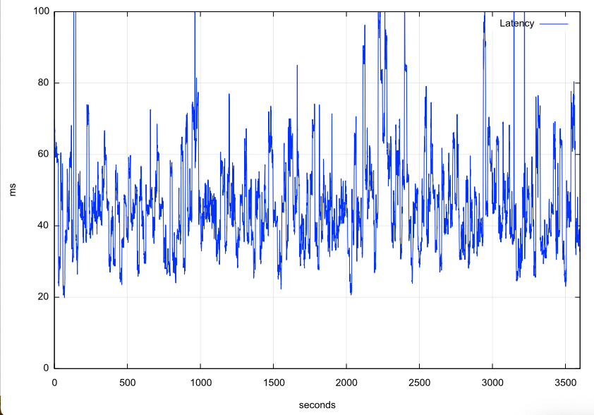
Reported Capacity & Latency

Slide 11
Reported Capacity & Latency

Slide 12
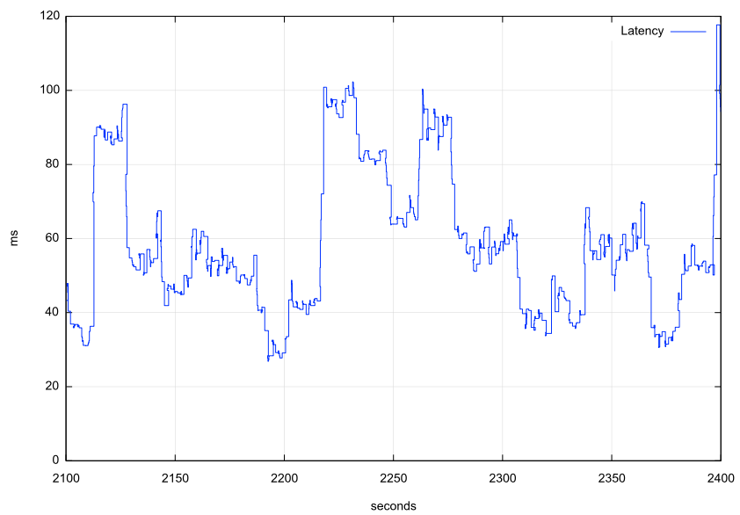
Reported Capacity & Latency
This is going to present some interesting issues for conventional TCP
TCP uses ACK pacing which means it attempts to optimize its sending rate over multiple RTT intervals
The variation in latency and capacity occurs at high frequency, which means that TCP control is going to struggle to optimise

Slide 13
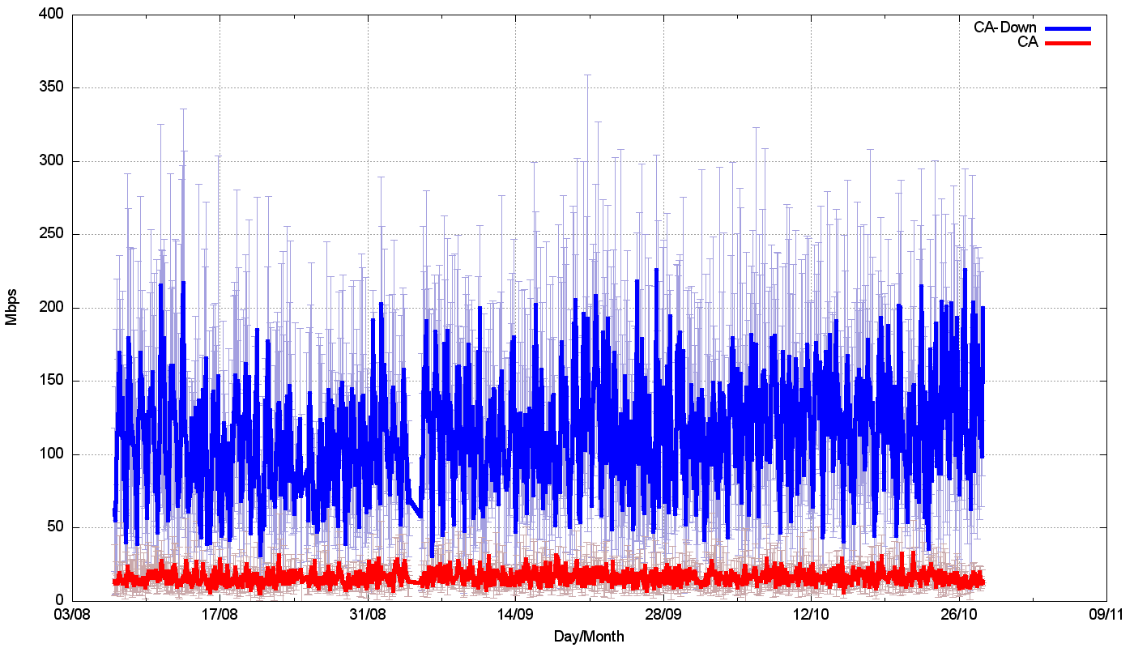
How well does all this work?
Speedtest measurements:
We should be able to get ~120Mbps out of a starlink connection. Right?

Slide 14
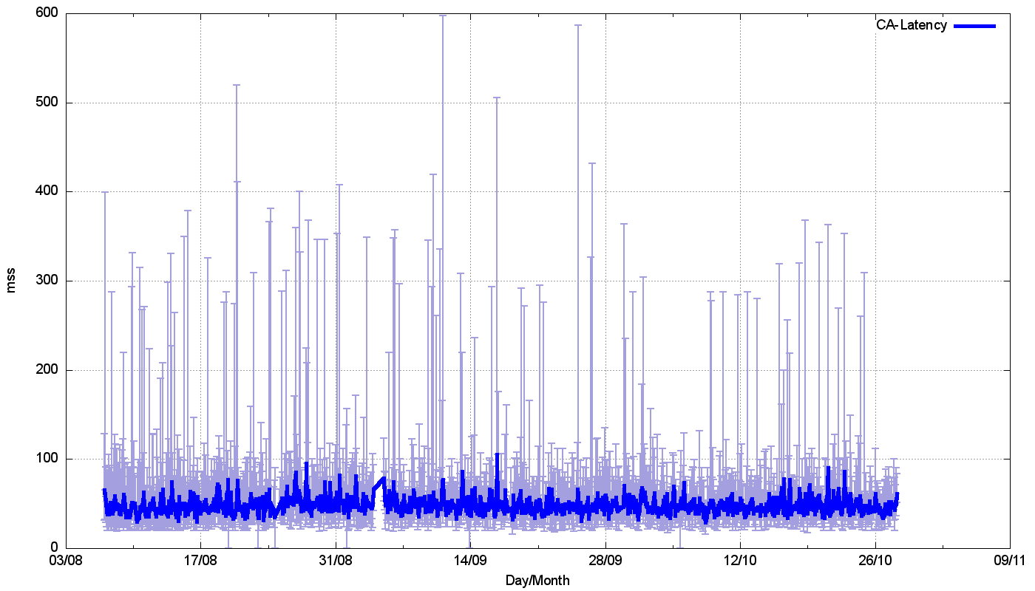
Link Characteristics
Speedtest Latency:

Slide 15
Link Characteristics
1-second ping
Highly unstable jitter
Micro-drops
24 Hours

Slide 16
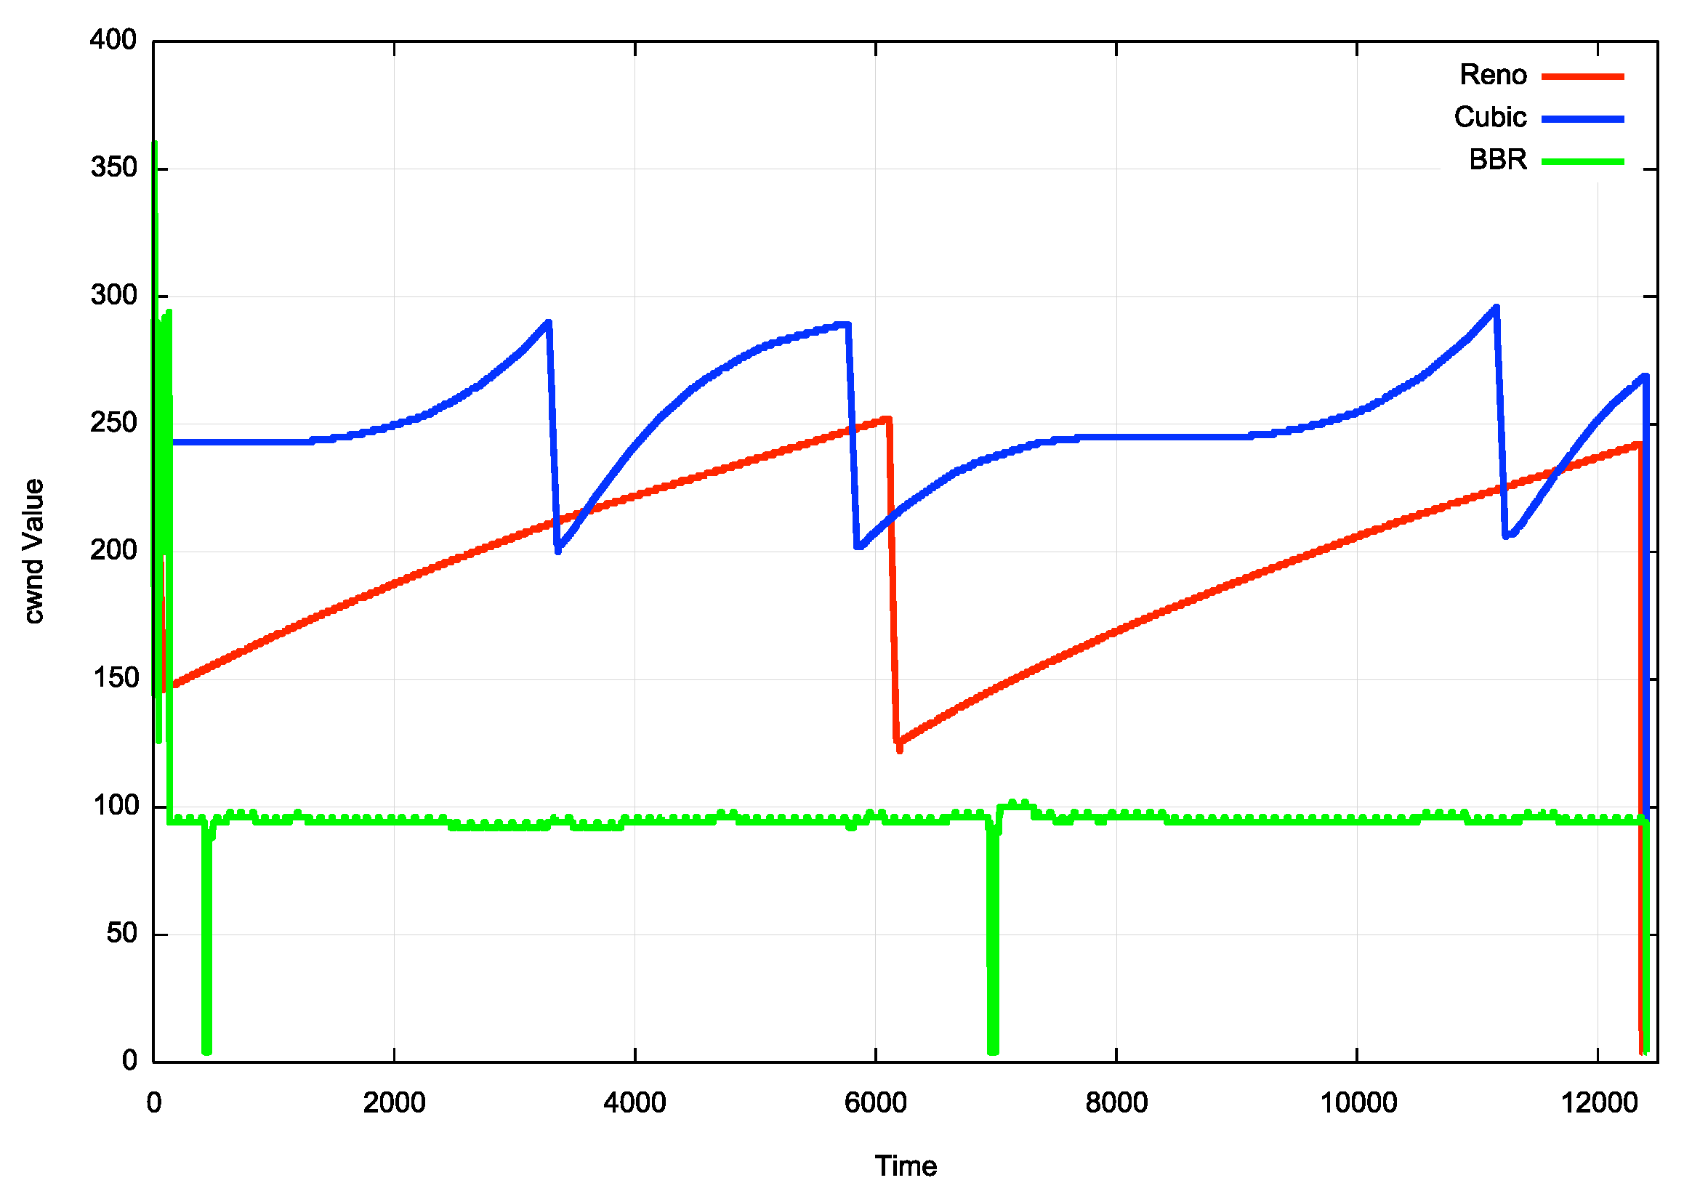
TCP Flow Control Algorithms
“Ideal” Flow behaviour for each protocol

Slide 17
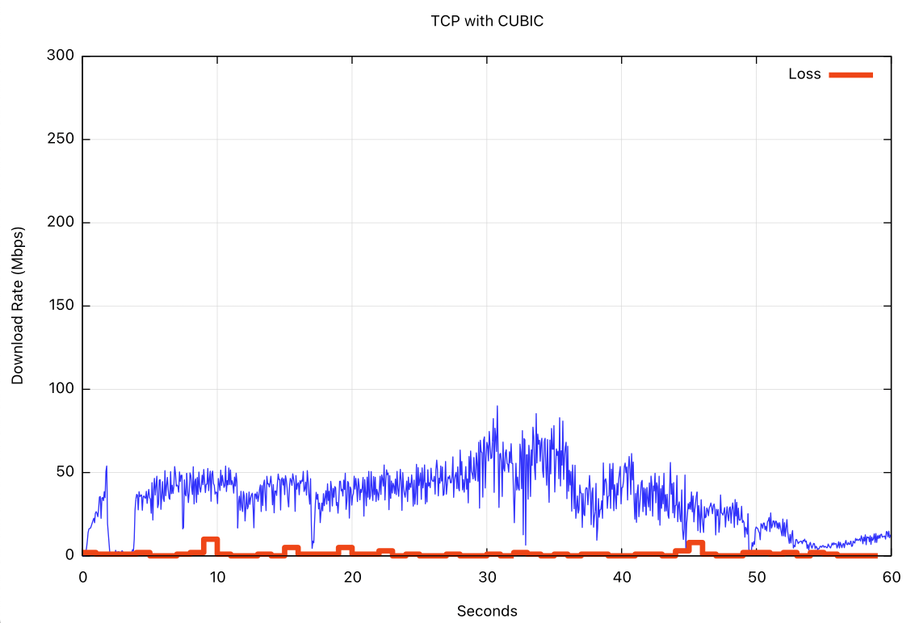
iperf3 – cubic, 60 seconds
CUBIC
Loss

Slide 18
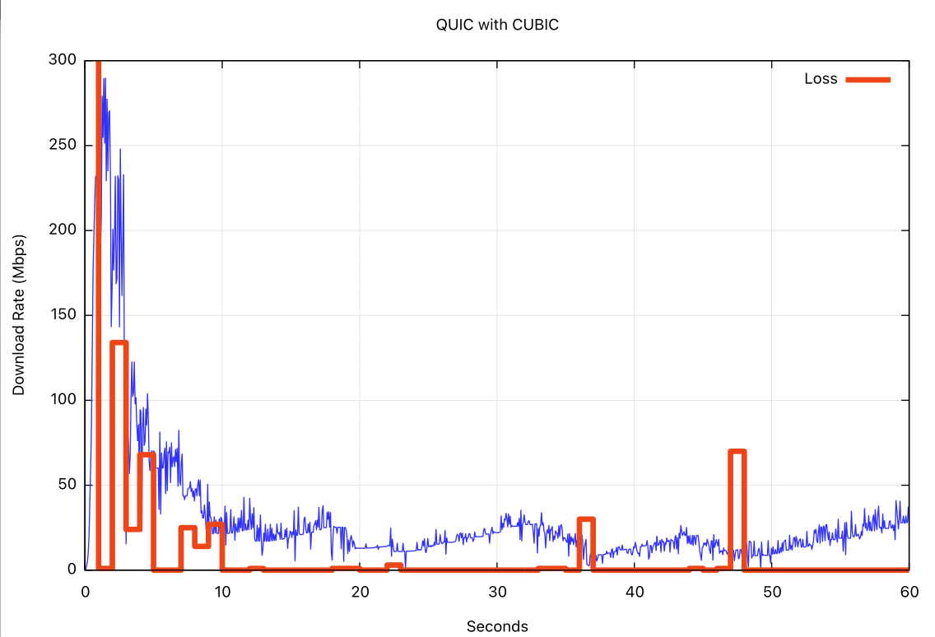
Qperf – quic (with cubic)
QUIC/CUBIC
Loss

Slide 19
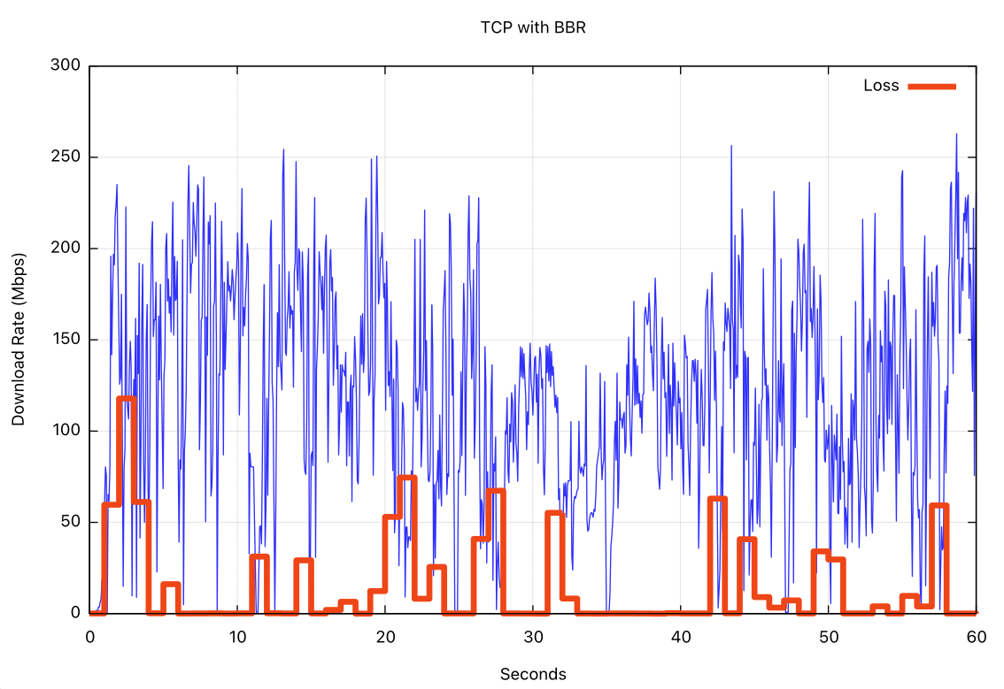
iperf3 - bbr
BBR
Loss

Slide 20
Cubic, Quic/Cubic, BBR

Slide 21
Protocol Considerations
Starlink services have two issues for transport protocols:
Very high jitter rates
High levels of micro-loss
Loss-based flow control algorithms will over-react and pull back the sending rate
Short transactions work well
Paced connections (voice, zoom) tend to work well most of the time
Bulk data transfer not so much
It’s better to use a conventional TCP control with a large SACK window or use loss-insensitive flow control algorithms, such as BBR, to get high transfer rate performance out of this service

Slide 22
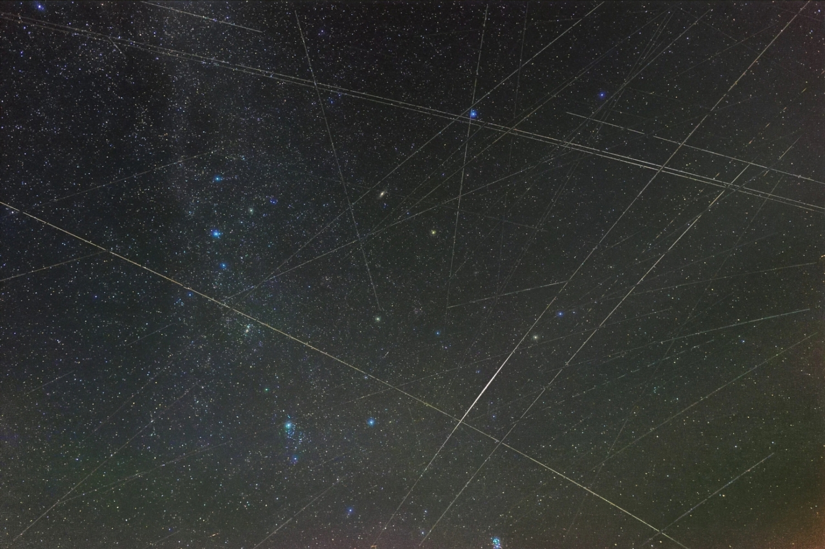
Questions?

