Slide 1
Goodbye TCP?
  Geoff Huston AM
  APNIC Labs

Slide 2
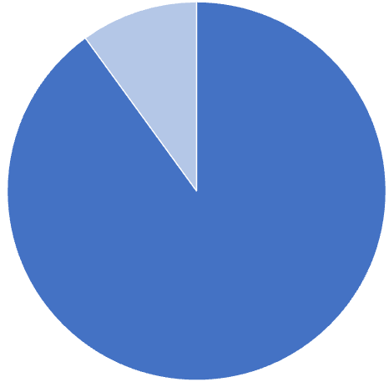

What have we done to the Internet?
More than 90% of all Internet traffic uses encrypted payloads

Slide 3
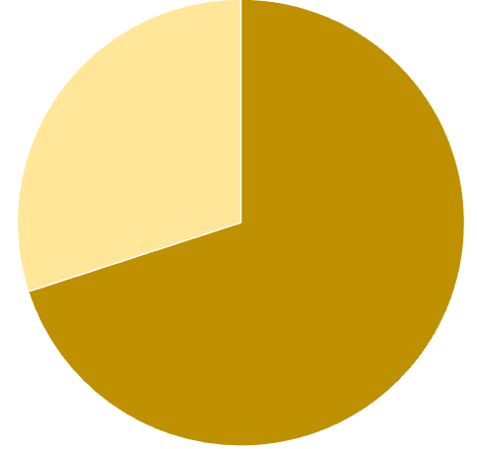

What have we done to the Internet?
More than 90% of all Internet traffic uses encrypted payloads
More than 70% of all Internet traffic is sourced from Cloud servers

Slide 4
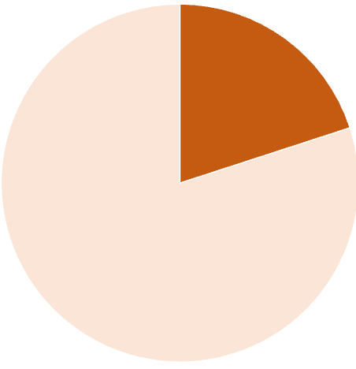
What have we done to the Internet?
More than 90% of all Internet traffic uses encrypted payloads
More than 70% of all Internet traffic is sourced from Cloud servers
More than 20% of all traffic by volume uses QUIC
Q
* https://ripe86.ripe.net/wp-content/uploads/presentations/49-The_New_Encyrpyted_Stack_RIPE.pdf

Slide 5
What have we done to the Internet?
More than 90% of all Internet traffic uses encrypted payloads
More than 70% of all Internet traffic is sourced from Cloud servers
More than 20% of all traffic by volume uses QUIC
Whatever is happening to TCP on the Internet?
Q
* https://ripe86.ripe.net/wp-content/uploads/presentations/49-The_New_Encyrpyted_Stack_RIPE.pdf

Slide 6
Why was the Internet Protocol so special?
What made it so radically different from other network protocols of the 1980’s?
Why are we still using IP today?
The answer is TCP!

Slide 7
TCP is..
A transport protocol that constructs a reliable full duplex adaptive streaming service constructed on top of an unreliable IP datagram service
  Uses a coordinated state between the two end systems without any network intervention or mediation
  Uses a sliding window to allow lost data to be resent
  Uses ACK-clocking to regulate the sending behaviour to match network path capacity estimate
  Has been tweaked to support* multi-stream and RPC transport models
* to some degree!

Slide 8
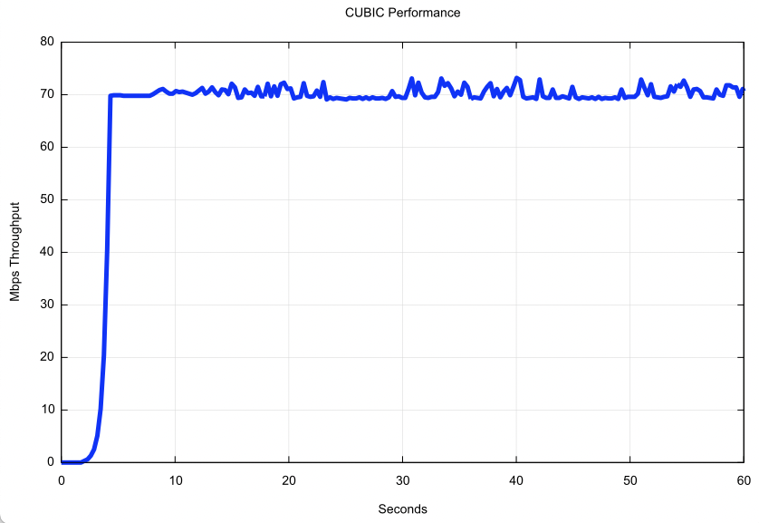
TCP is highly efficient
TCP will attempt to use all available network bandwidth
Path Capacity

Slide 9
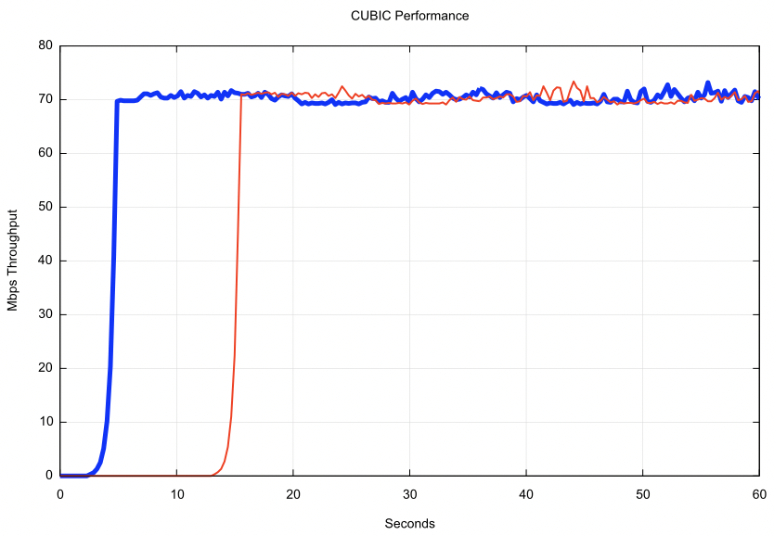
TCP is friendly!
TCP performs self-moderation to share available network capacity fairly across active TCP sessions

Slide 10
TCP is flexible
TCP behaviour is controlled by the server, not the client
The same client TCP engine can be used for a variety of server-side congestion control algorithms
  Reno – classic AIMD
  CUBIC
  BBR
  MulTCP
  …
Different servers can use different TCP behaviours to achieve different service outcomes

Slide 11
Pushing TCP harder
We have been prodding and poking at TCP for decades:
  T/TCP – TCP for Transactions which attempted to stash the payload and the response into the TCP handshake (since discarded due to its truly woeful security model!)
  Multipath TCP – spread TCP session traffic across multiple outbound interfaces to allow for host-based load sharing and session resiliency (largely abandoned after just one large scale implementation)
  Initial Window inflation – improve short flow performance by commencing the flow with a larger initial window size
  Cached TCP performance – cache the achieved TCP performance to a server and start the next TCP session in congestion avoidance, bypassing initial slow start
  ECN signalling – have the network mark packets when queries are forming in the network path, allowing hosts to react prior to packet loss events

Slide 12
But
There are some performance behaviours that you just can’t fix using TCP tweaking

Slide 13
TCP isn’t…
Fully independent of the underlying platform’s transport services
Fully multi-stream (TCP has head-of-line blocking)
Free from on-the-wire network intervention (TCP control parameters are sent in the clear)
Has e2e encryption as a second step / afterthought
Can’t support reliable datagram behaviour only with full session support
Relies on the application to perform data framing and in-band control
TCP isn’t everything for everyone

Slide 14
Choices:
Keep adjusting TCP at the edges and leave the basic TCP behaviour alone
or
Pull TCP functionality up into the application and implement more radical changes to the transport behaviour at the application level

Slide 15
QUIC is…
The second path!
Constructed upon a base datagram framing protocol through the use of UDP, placing all transport functions into the UDP payload
  All end-to-end transport services (data integrity, session control, congestion control, encryption) are shifted towards the application.
  A platform may provide a QUIC API, but the application can also provide its own service

Slide 16
QUIC is…
TLS transport layered over a UDP substrate
QUIC
HTTP/3
HTTP/2
HTTP
Multi-stream
HTTP
TLS
Session Encryption
QUIC
Multi-stream
Encryption
Data stream integrity
Congestion Control
e2e encrypted
TCP
Data stream integrity
Congestion Control
e2e encrypted
UDP
IP

Slide 17
QUIC is…
So much more than just “encrypted TCP over UDP”:
  More Flexible - Support for multi-stream multiplexing that avoids head-of-line blocking and exploits a shared congestion and encryption state
  Faster - Combines transport and encryption setup exchange in a single 3-way exchange
  Customisable - QUIC implementations can use individual flow controllers per flow
  QUIC places its transport control fields inside the encryption envelope, so QUIC has minimal exposure to the network
  Supports record and RPC service models as well as streaming and datagram

Slide 18
QUIC is…
Endpoint address agile
NATs are potentially hostile to QUIC because of the outer UDP wrapper
  A NAT may rebind (shift the externally visible address/port of a host during a session), as NATs are not generally aware of UDP streaming states
QUIC uses a persistent “connection ID”
  If a host receives a QUIC frame with the same connection ID and a new IP address / port it will send a challenge by way of a random value that should be echoed back. This is all performed within the e2e encryption envelope. That way a QUIC e2e session can map into new address/port associations on the fly

Slide 19
QUIC is…
IP fragmentation intolerant – QUIC uses PMTUD, or defaults to 1,200 octet UDP payloads
Never retransmits a QUIC packet – retransmitted data is sent in the next QUIC packet number – this avoids ambiguity about packet retransmission
Extends TCP SACK to 256 packet number ranges (up from 3)
Separately encrypts each QUIC packet
May load multiple QUIC packets in a single UDP frame (countering some forms of network level packet fingerprinting efforts)

Slide 20
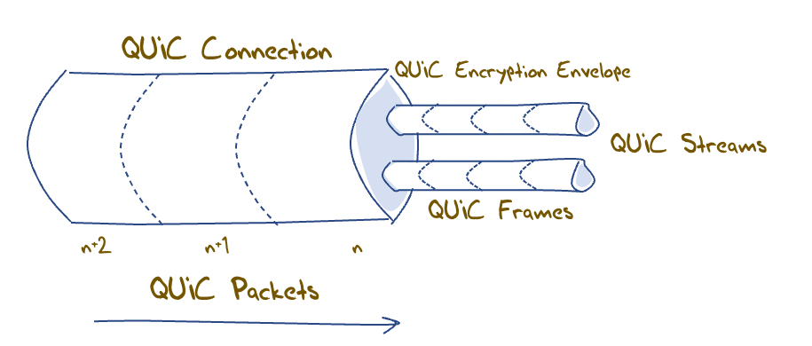
QUIC flow structuring
A QUIC connection is broken into “streams” which are reliable data flows – each stream performs stream-based loss recovery, congestion control, and relative stream scheduling for bandwidth allocation
QUIC also supports unreliable encrypted datagram delivery

Slide 21
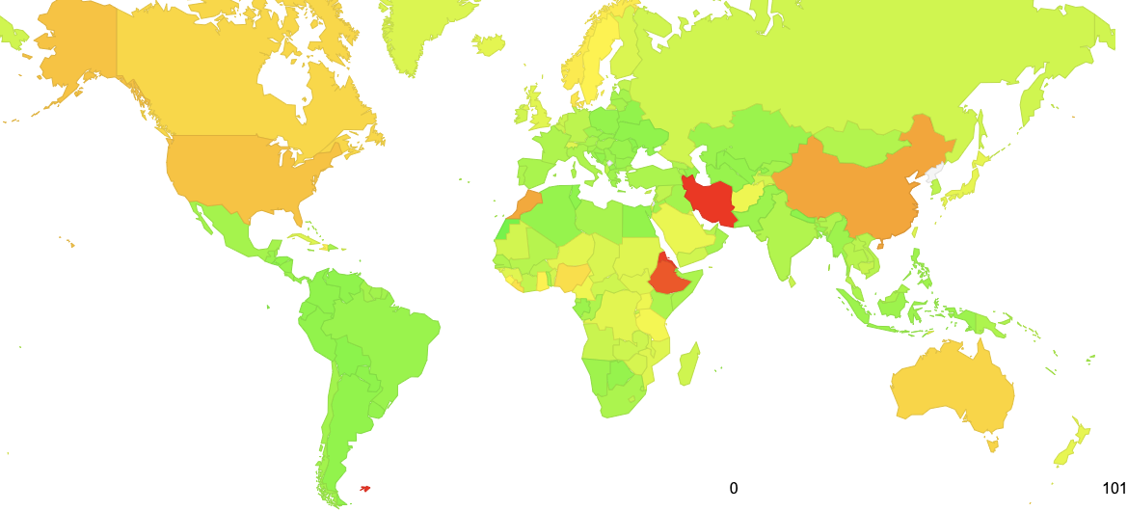
Where can we see QUIC capability today?
100%
https://stats.labs.apnic.net/quic
July 2023

Slide 22
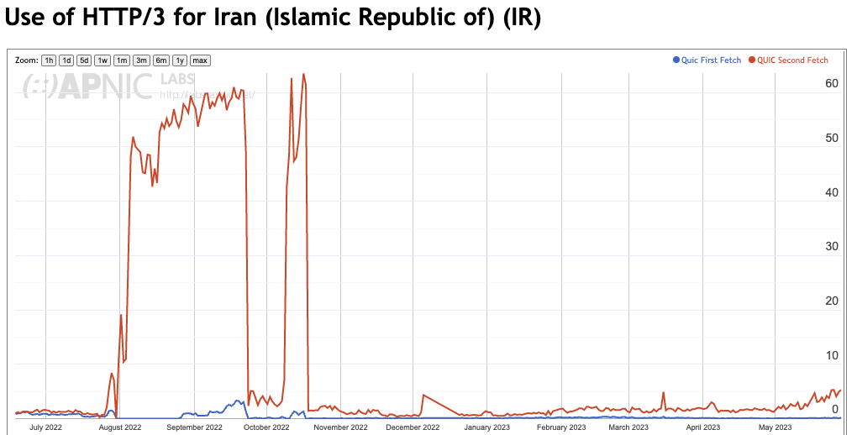
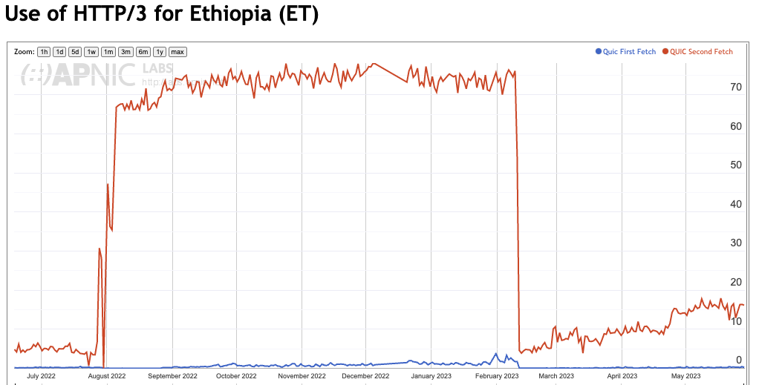
Almost Everywhere

Slide 23
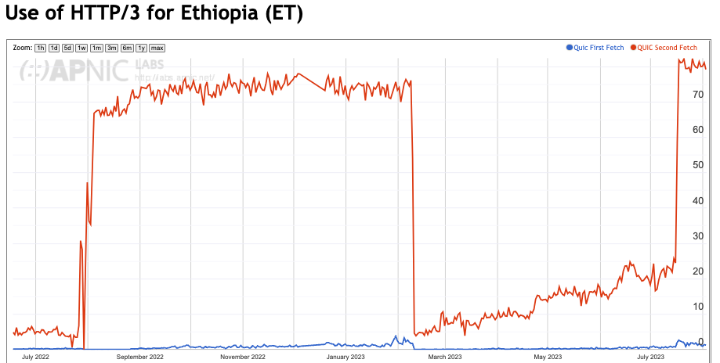
Almost Everywhere

Slide 24
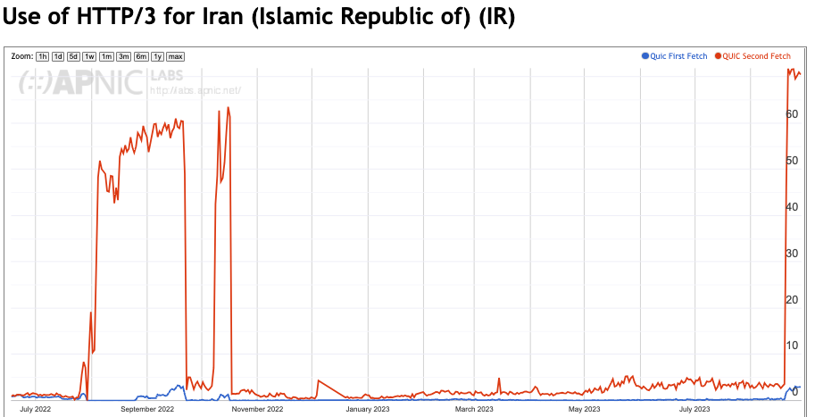
Almost Everywhere

Slide 25
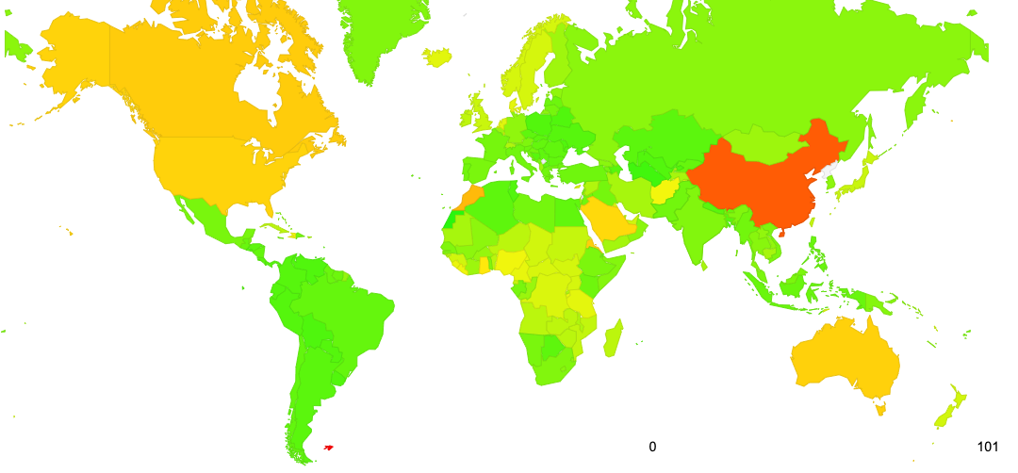
Almost Everywhere
100%
https://stats.labs.apnic.net/quic
September 2023

Slide 26
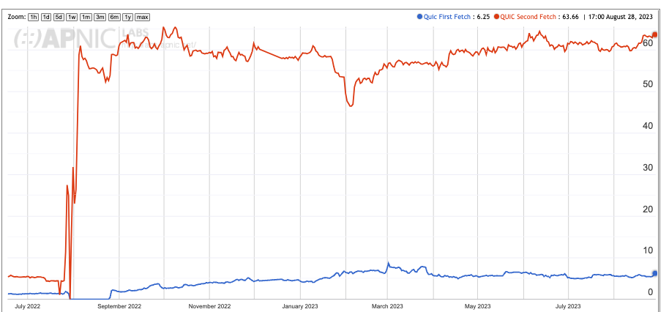
Overall Uptake

Slide 27
Measuring QUIC Use
This is a capability measure – how many users can use QUIC is the server advertises that is can serve web content using QUIC (HTTP/3)?
The measurement uses both HTTPS capability in the DNS (used by Apple Safari clients) and content-tagging with Alt-Svc directive (used by Chrome clients)

Slide 28
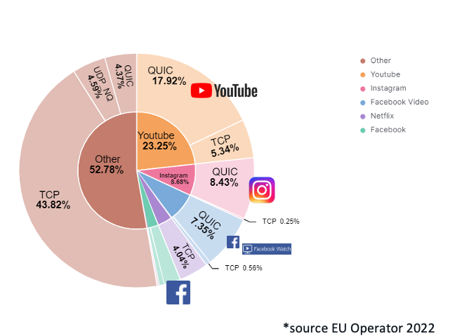
Other Measures: Network Traffic Volume
Presentation to RIPE 86: The New Encrypted Protocol Stack and How to Deal with it – Bart van de Velde, Cisco

Slide 29
Measuring QUIC Performance
In this test (between the same endpoints) over a Starlink circuit, TCP CUBIC underperforms badly, while TCP BBR and QUIC both perform reasonably well

Slide 30
Why is QUIC important?
Because QUIC encrypts everything
  No visible transport control settings
  No visible Server Name Indication in the crypto-setup
  No visible traffic profile other than inter-packet timing
  And if you use a MASQUE-based VPN then there no residual visibility!
Because QUIC is an application capability
  QUIC can interact with the platform through the UDP API, so all of QUIC can be implemented within the application. This gives the application more control over its service outcomes and reduces external dependencies

Slide 31
What does this mean for TCP?
It’s not looking all that good for TCP’s prospects
QUIC not only does faster start up, but it supports multi-channel in a frictionless manner
QUIC resists network operator efforts to perform traffic shaping through direct manipulation of TCP control parameters
QUIC allows the application service provider to control the congestion behaviour of its sessions

Slide 32
What does this mean for TCP?
Normally you would expect any transition from TCP to QUIC to take forever
BUT:
QUIC gives benefit to adopters through more responsive web services
QUIC does a better job of hiding content, which is a benefit to the service operator
QUIC has fewer external dependencies
QUIC can be deployed on a piecemeal basis
So it all may be over for TCP in a very small number of years!

Slide 33
What does this mean for the Internet?
IP was a network protocol that provided services to attached devices
The network service model used by IP was minimal
  Packets may be dropped, fragmented, duplicated, corrupted and/or reordered on their path through the network
  Its left to the edge systems to recover from this network behaviour.
Efforts to expand the network’s role have foundered
  QoS has just got nowhere!
  Various forms of source-directed forwarding are resisted by network operators who want control over traffic engineering
Networks took up a role of defending the network resource against aggressive application behaviour
Some networks enabled user surveillance
apps
TCP Transport
$$$
network
media

Slide 34
The new Network Space
And this is why QUIC is so interesting – it is pushing both carriage and platform into commodity roles in networking and allowing applications to effectively customize the way in which they want to deliver services and dominating the entire networked environment
QUIC is the application’s view of what Transport should be!
apps
$$$
apps
TCP Transport
Internal
Transport +
session security
QUIC and value transform
in the network stack
network
UDP Transport
network
media
media

Slide 35
What does this mean for the Internet?
The relationship between hosts and networks has soured into mutual distrust and suspicion
The application now defends its integrity by wrapping up as much of the service transaction with encryption and indirection
QUIC (and MASQUE) is an intrinsic part of this process of wrapping up traffic in encryption and redirection
For the network operator there is little left to see
And I suspect that there is no coming back from here!

Slide 36
What can a Network Operator Do?
When all customer traffic is completely obscured and encrypted?
  Traffic Shaping?
  Regulatory Requirements for traffic interception?
  Load Balancing / ECMP

Slide 37
The new Internet Space
“What you can’t dominate, you commoditise*”
Vertically integrated service providers have faded away into history - the deregulated competitive service industry continues to specialize rather than generalize at every level
Carriage is no longer an inescapable monopoly - massively replicated content can be used as a substitute for many carriage service elements
Control over the platform is no longer control over the user. Operating systems have been pushed back into a basic task scheduling role, while functions are being absorbed into the application space
* A related quote is Peter Thiel’s “Competition is for losers!”

Slide 38
Comments / Questions?

