Slide 1
Satellite Broadband in the Asia Pacific
Panel Session
Geoff Huston
APNIC

Slide 2
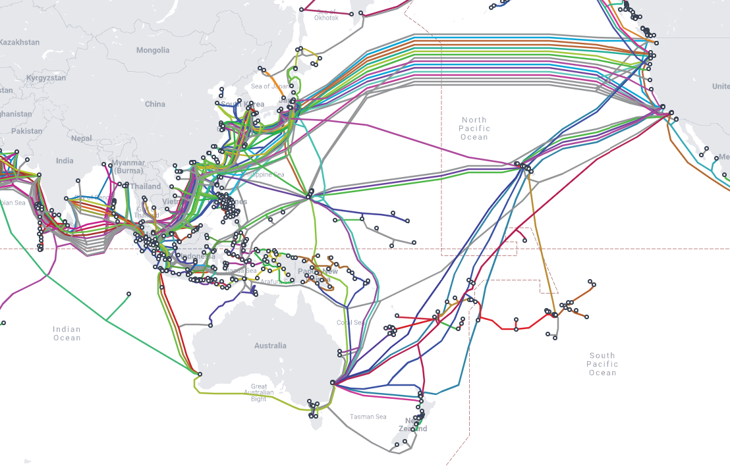
Why use Satellite services?
We have deployed so much undersea fibre in the past couple of decades! Why does the region need more capacity?
https://www.submarinecablemap.com/

Slide 3
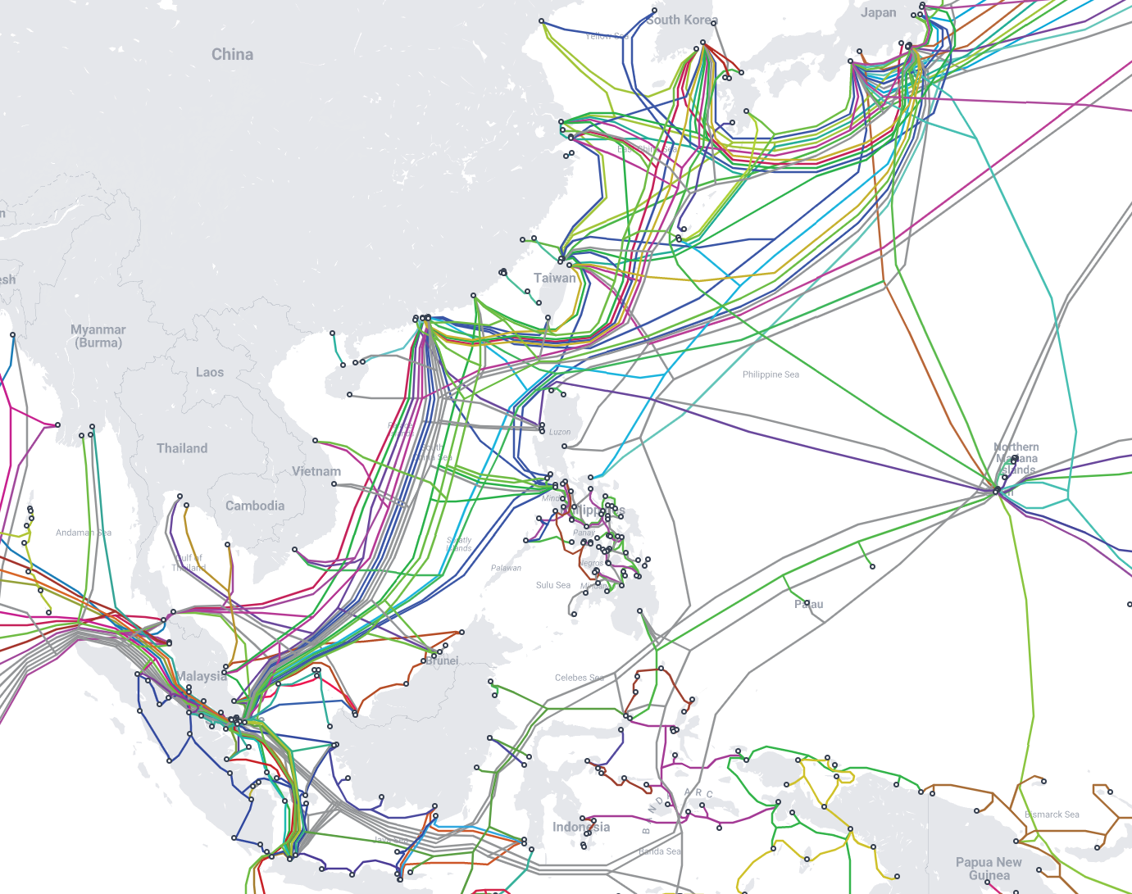
Submarine Route Choke Points
Hazards for submarine cables include:
Landings at busy port locations (Singapore, Hong Kong)
Shallow water (South China Sea)
Active Plate boundaries (Luzon Strait, Japan East Coast, Sunda Arc)
Political Tensions (Hong Kong, Shanghai, South China Sea)

Slide 4
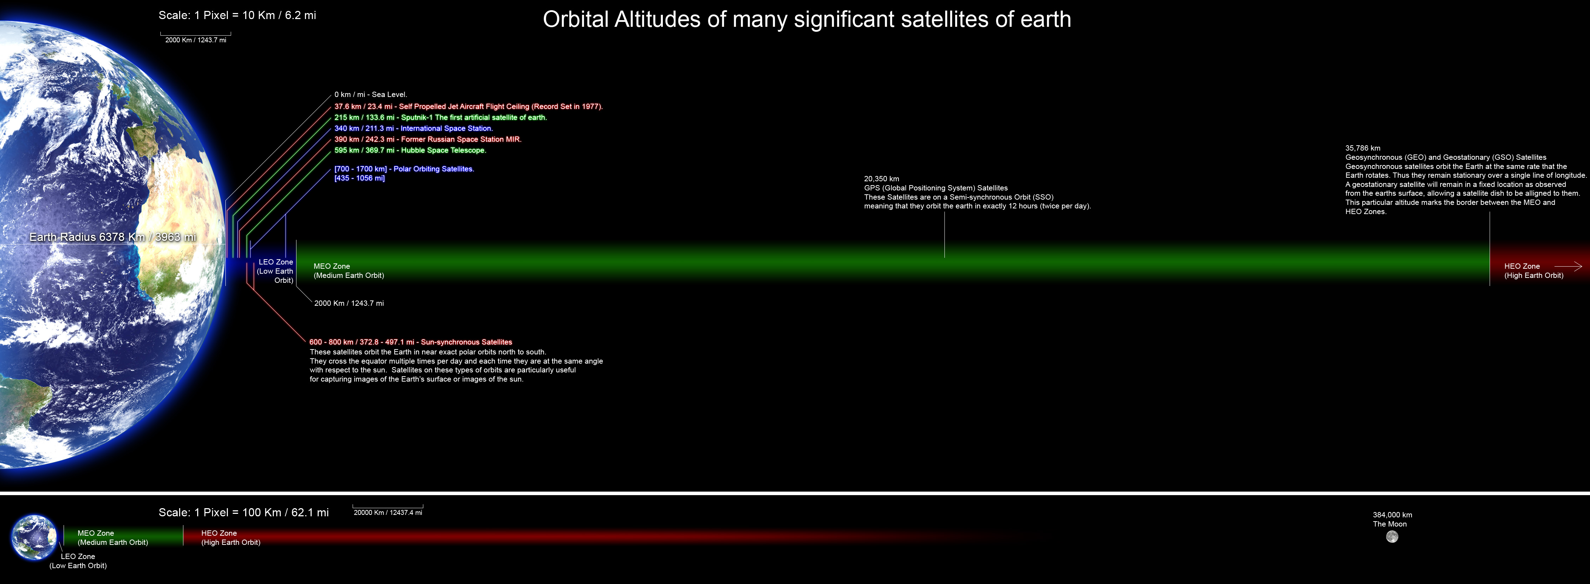
Satellites: GEOs and LEOs
https://commons.wikimedia.org/wiki/File:Orbitalaltitudes.jpg GNU Free Documentation License

Slide 5
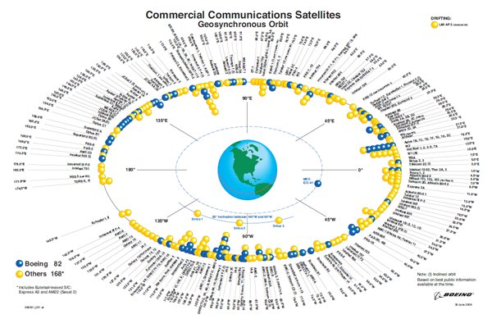
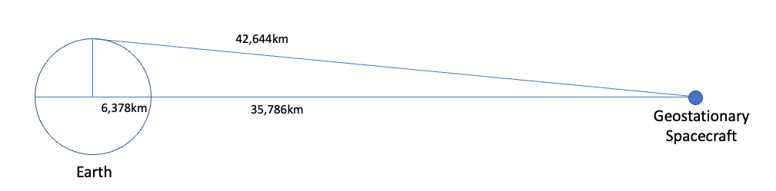
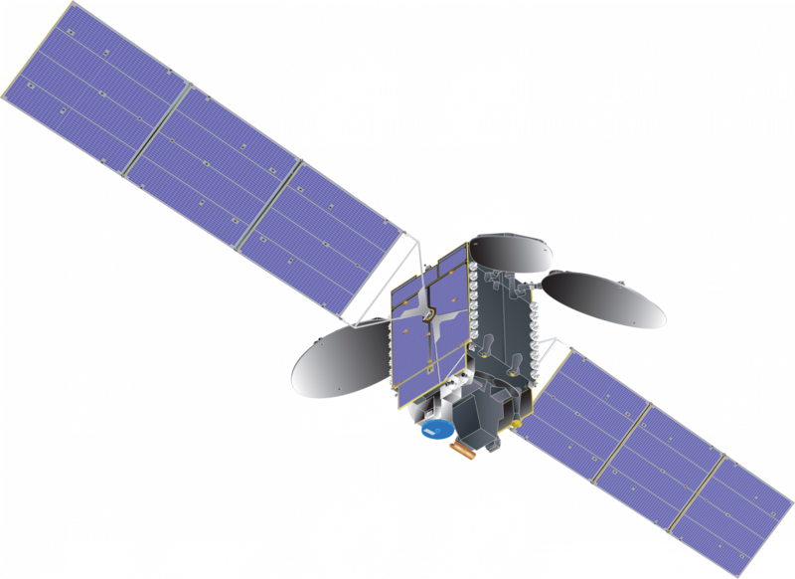
Geostationary Earth Orbit
At an altitude of 35,786km a satellite will orbit the earth with the same period as the earth’s rotation – from the earth it will appear to be stationary in the sky
https://commons.wikimedia.org/wiki/File:Communications_satellite_with_TEMPO_spacecraft_model.png – public domain
https://secure.boeingimages.com/archive/Commercial-Communications-Satellites-Orbit-2F3XC5KQCM9.html

Slide 6
GEO Services
Requires earth station investment
Limited capacity
  Limited orbital slots
  Constrained frequency allocation
High delay
  Challenging for network use
Remote Reach

Slide 7
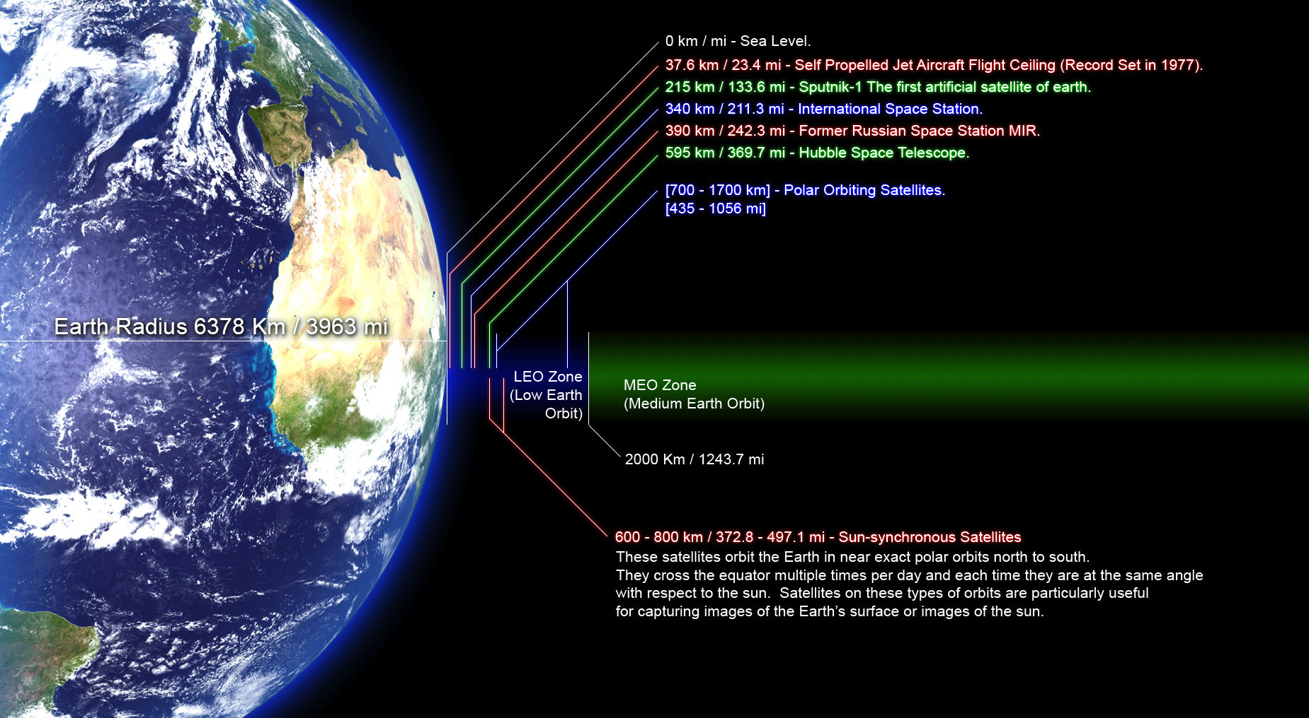
Low Earth Orbit
https://commons.wikimedia.org/wiki/File:Orbitalaltitudes.jpg GNU Free Documentation License

Slide 8
Leo Services
Historically high launch costs
  This has changed significantly with SpaceX reusable launch vehicles
High angular velocity, small footprint
  Requires active tracking and inter-satellite handover
  Requires a large constellation to provide continuous service
Regulatory hurdles
  Terrestrial licenses

Slide 9
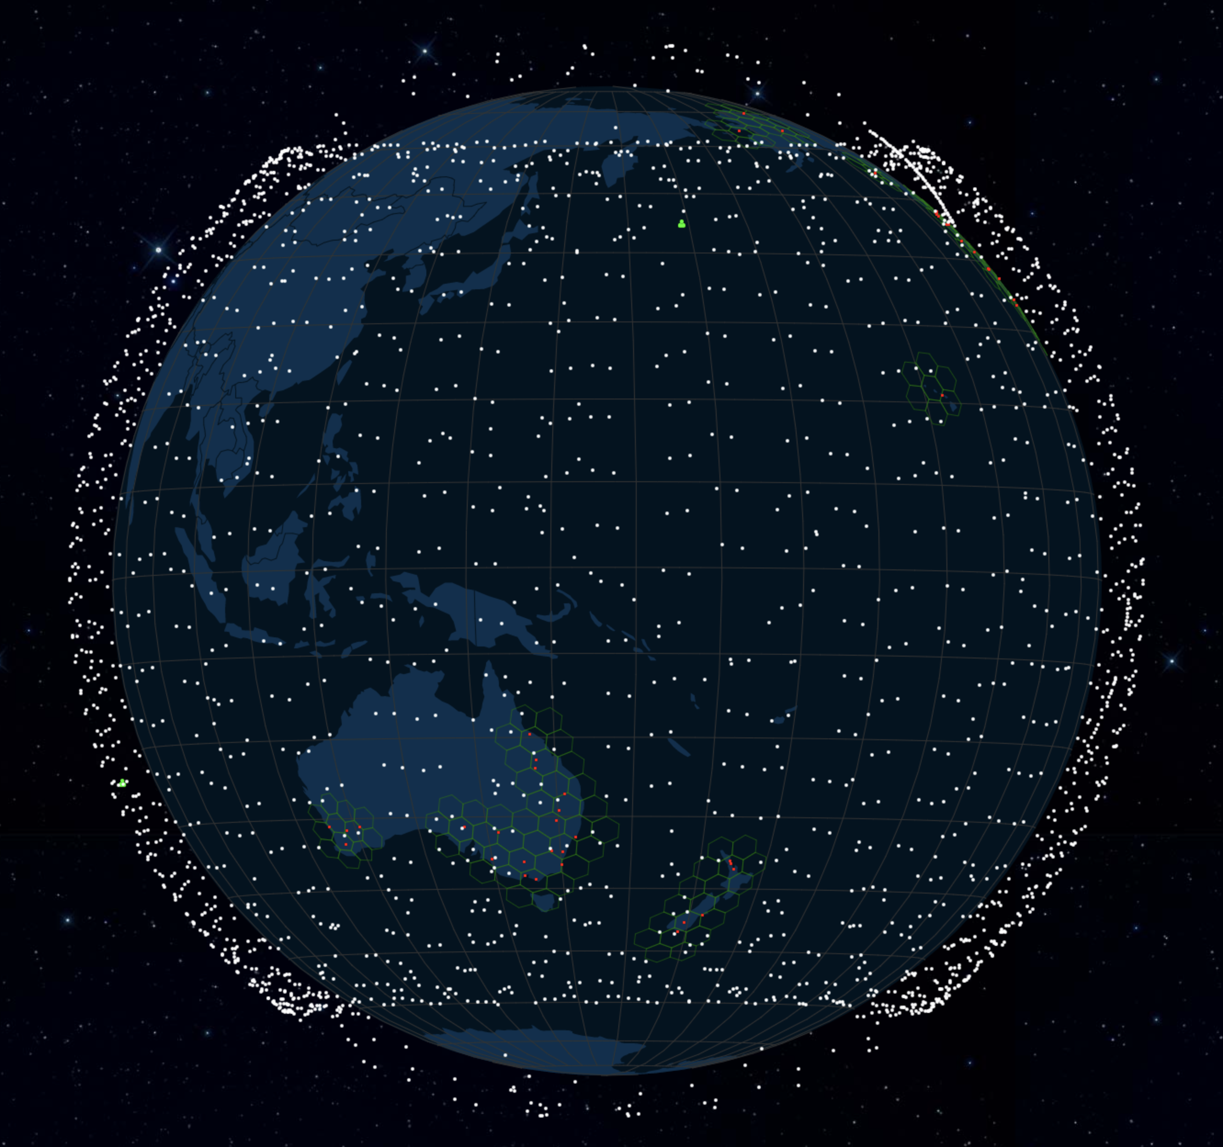
LEO Constellations: Starlink
3,773 satellites, 3,129 in service (Planned total: 12,000)
inclined orbit (53^{O}), 550km
Retail Services
Satellite-to-Satellite coming with V2 satellites
3,000
2,000
1,000
2023
2022
Starlink Satellite Map (from https://satellitemap.space)

Slide 10
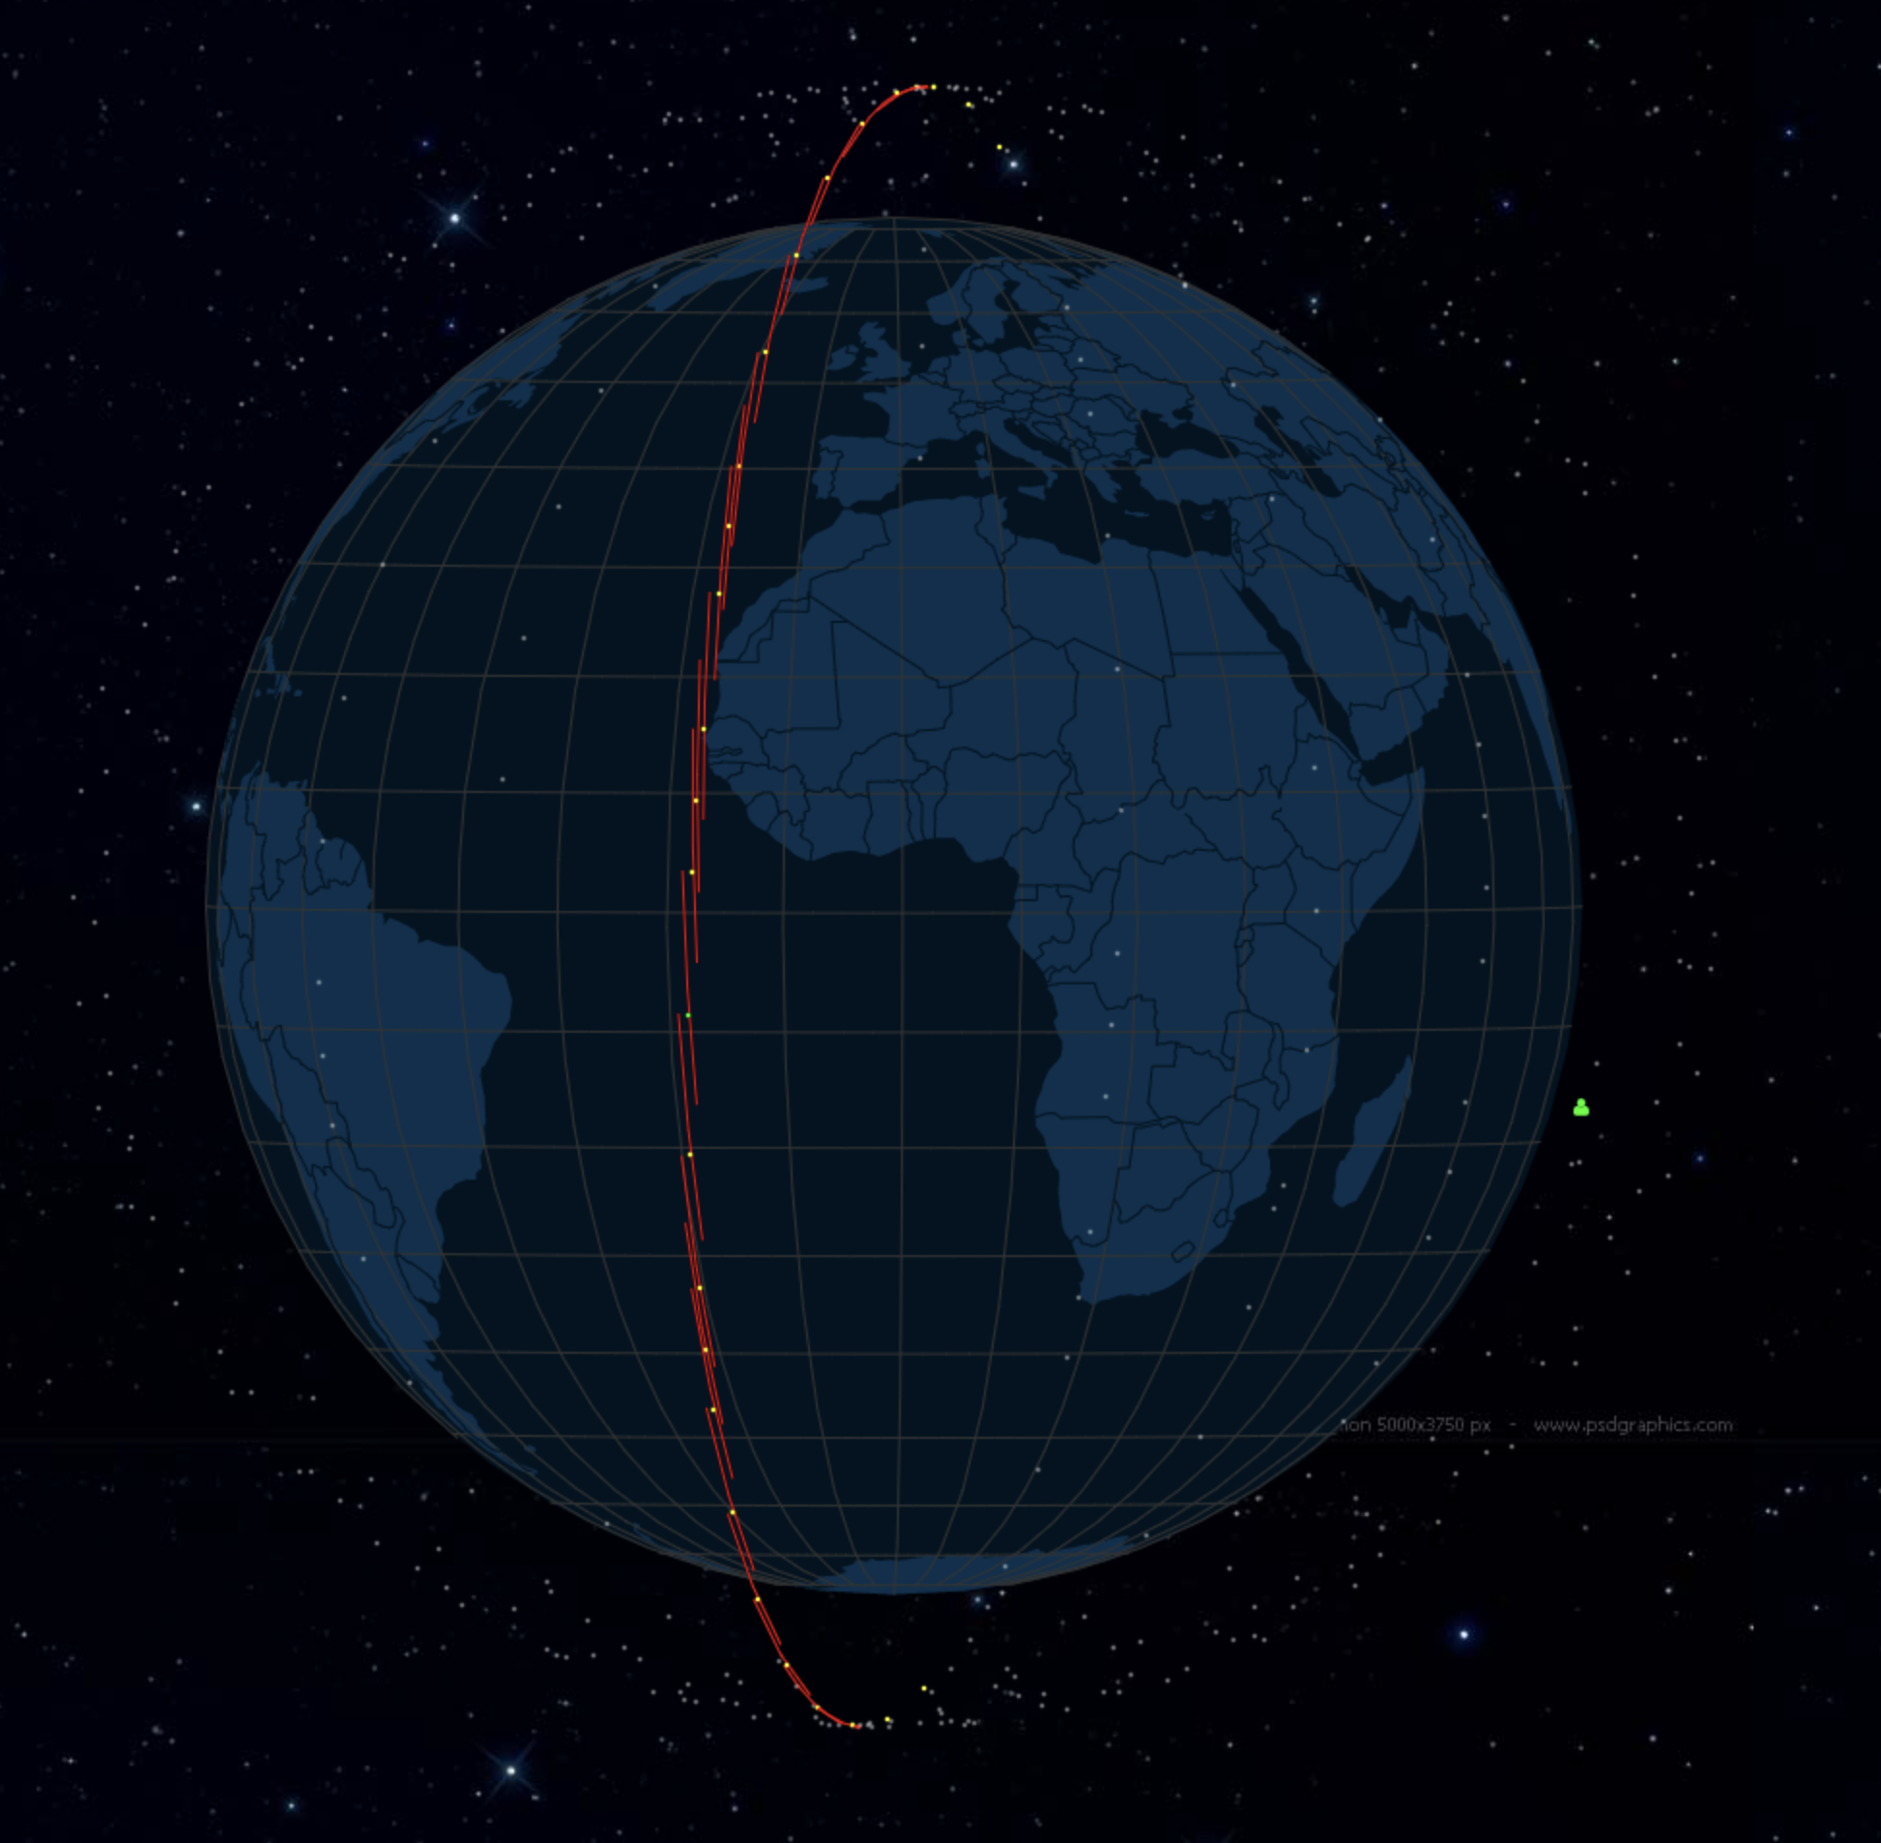
LEO Constellations: Oneweb
542 operational satellites (planned total: 648)
polar orbit, altitude: 1,200km, business and government clients

Slide 11
LEO Constellations: Project Kuiper (Amazon)
Currently still in planning
3,276 planned satellites, altitude: 590km,610km, 630km
Planned retail services

Slide 12
Others
China?
Others?

Slide 13
LEOs
It’s a big money play, and without the ability to make head roads into high value service markets its probably an exercise with no prospect of a positive cash flow
  Remember Iridium?
  And Oneweb has already gone bankrupt once!
Is this a niche market or a massive game changer for terrestrial access services?

Slide 14
Today’s Panel
Dan York, ISOC – overview of issues and concerns
Dr Ulrich Speidel, Univ Auckland – Pacific Experiences with satellite services
Mike Puchol, Africa Rural and Remote – challenging environments in Africa
Debopam Bhattacherjee, Microsoft Research – model of satellite-to-satellite SDN routing

