Slide 1

BGP in 2022
Geoff Huston
APNIC Labs

Slide 2
The Highlights
IPv4 FIB Summary
IPv6 FIB Summary
FIB Projections
Churn
Conclusions

Slide 3
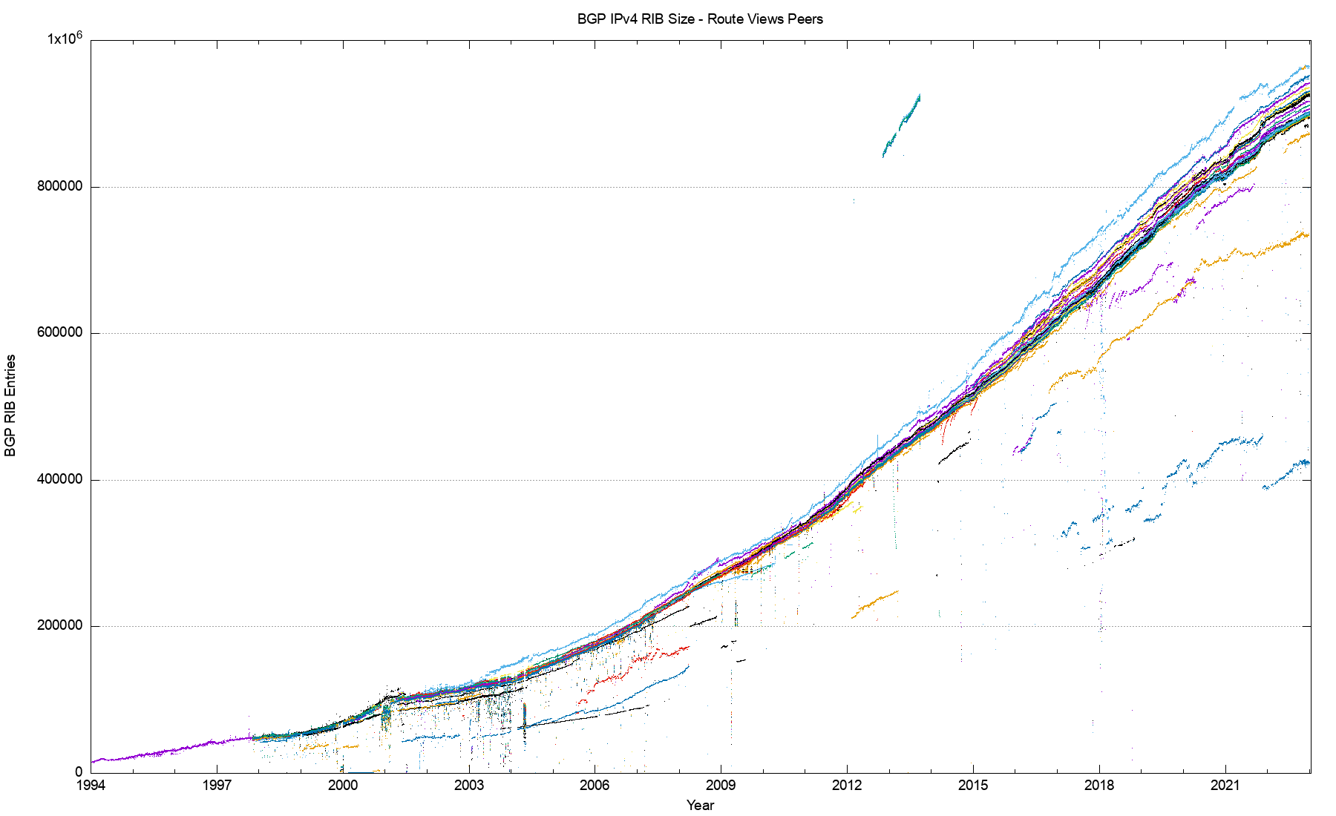
29 Years of Routing the Internet
This is a view pulled together from each of the routing peers of Route-Views
2011: Address Exhaustion
2005: Consumer Market
2001: The Great Internet
Boom and Bust
1994: Introduction of CIDR

Slide 4
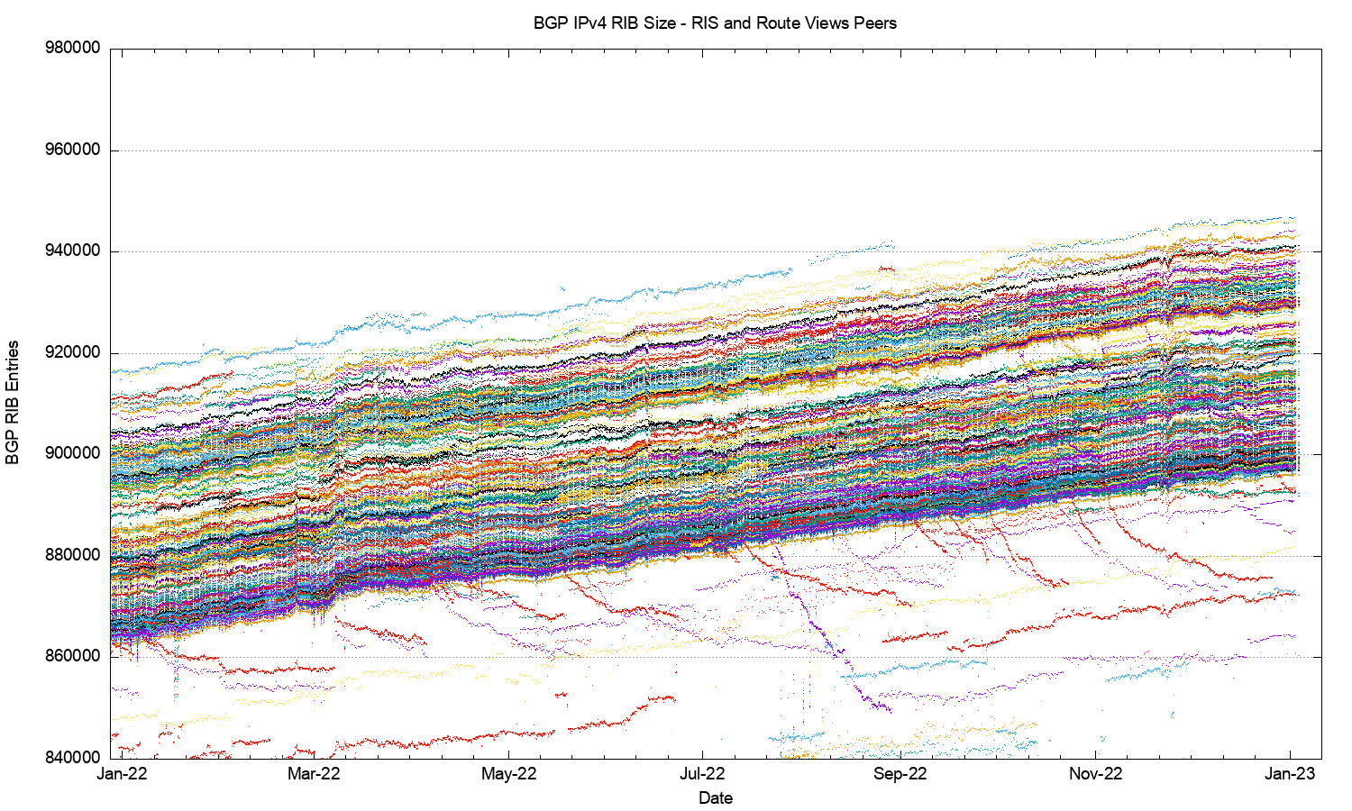
2022 in detail

Slide 5
2022 in detail
80K entry variation
Slight downtick?

Slide 6
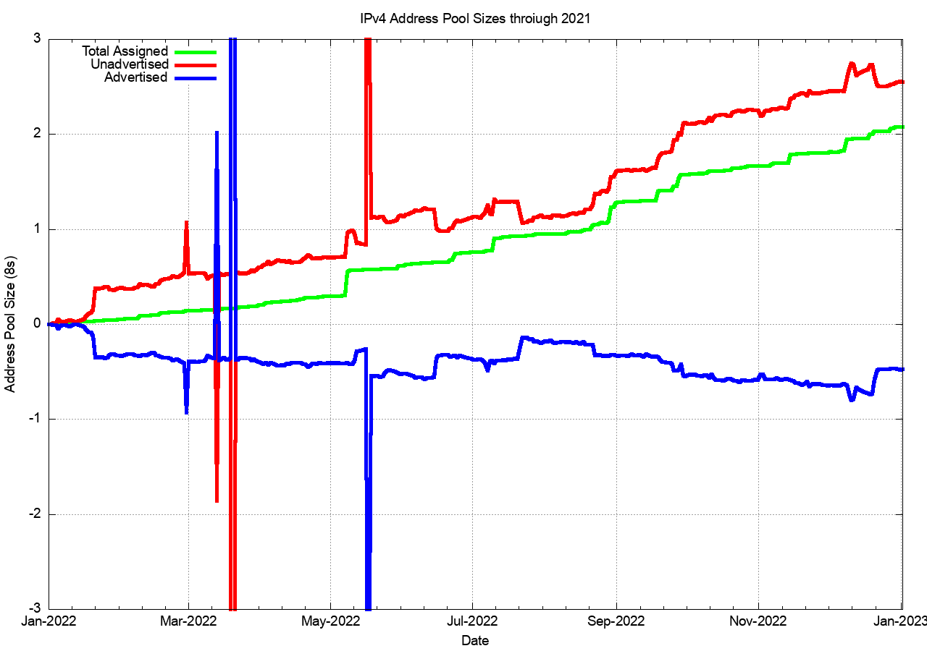
2022: Assigned vs Recovered
62M unadvertised
+9.5M delta
Change in UnAdvertised Addresses
3.7Ballocated
+1.5M delta
RIR Allocations
306M advertised
-8M delta
Change in the Advertised Address Pool

Slide 7
2022: Assigned vs Recovered
62M unadvertised
+9.5M delta
Change in UnAdvertised Addresses
3.7Ballocated
+1.5M delta
No “address recovery” occurred across 2022
A net of 8M addresses were withdrawn from the advertised network, and shifted to the unadvertised pool
The net change in the unadvertised pool was 9.5M addresses
RIR Allocations
306M advertised
-8M delta
Change in the Advertised Address Pool

Slide 8
What happened in 2022 in V4?
  From the look of the routing growth plots, the growth of the size of the IPv4 network is slowing down
  The number of entries in the IPv4 default-free zone reached 944,000 by the end of 2022
  The pace of growth of the routing table was slightly lower than the rolling 5-year average, with 36,000 new entries in 2022 (was 40,000 in 2021)
  The AS position was slightly lower with 1,400 new AS’s advertised in 2022 (was 2,400 in 2021)
  Transit relationships have not changed materially over 2022 for most networks
  The overall IPv4 routing growth trends slowed down through 2022

Slide 9
The Highlights
IPv4 FIB Summary
IPv6 FIB Summary
FIB Projections
Churn
Conclusions

Slide 10
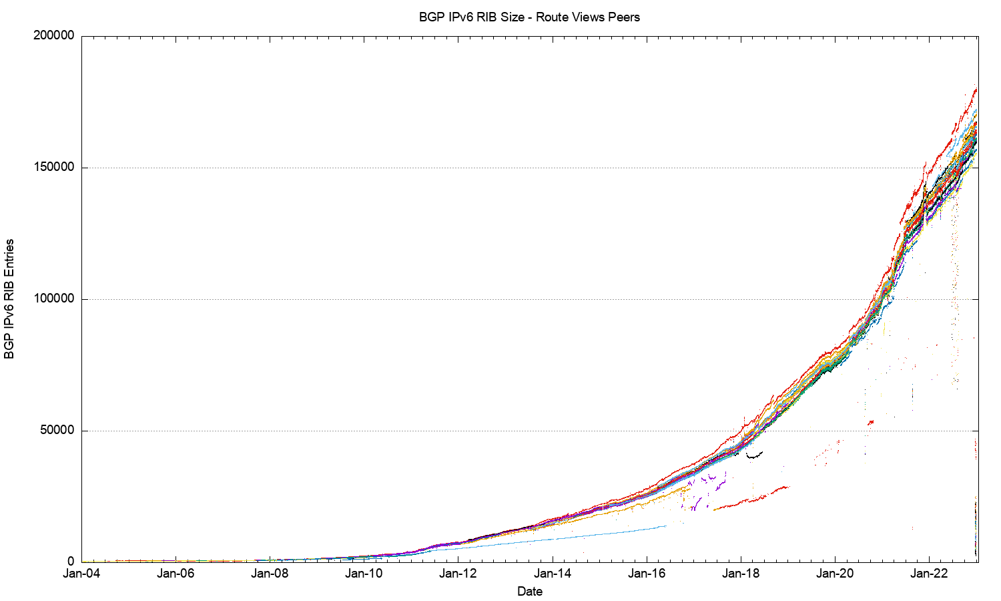
The Route-Views View of IPv6
IANA IPv4 Exhaustion

Slide 11
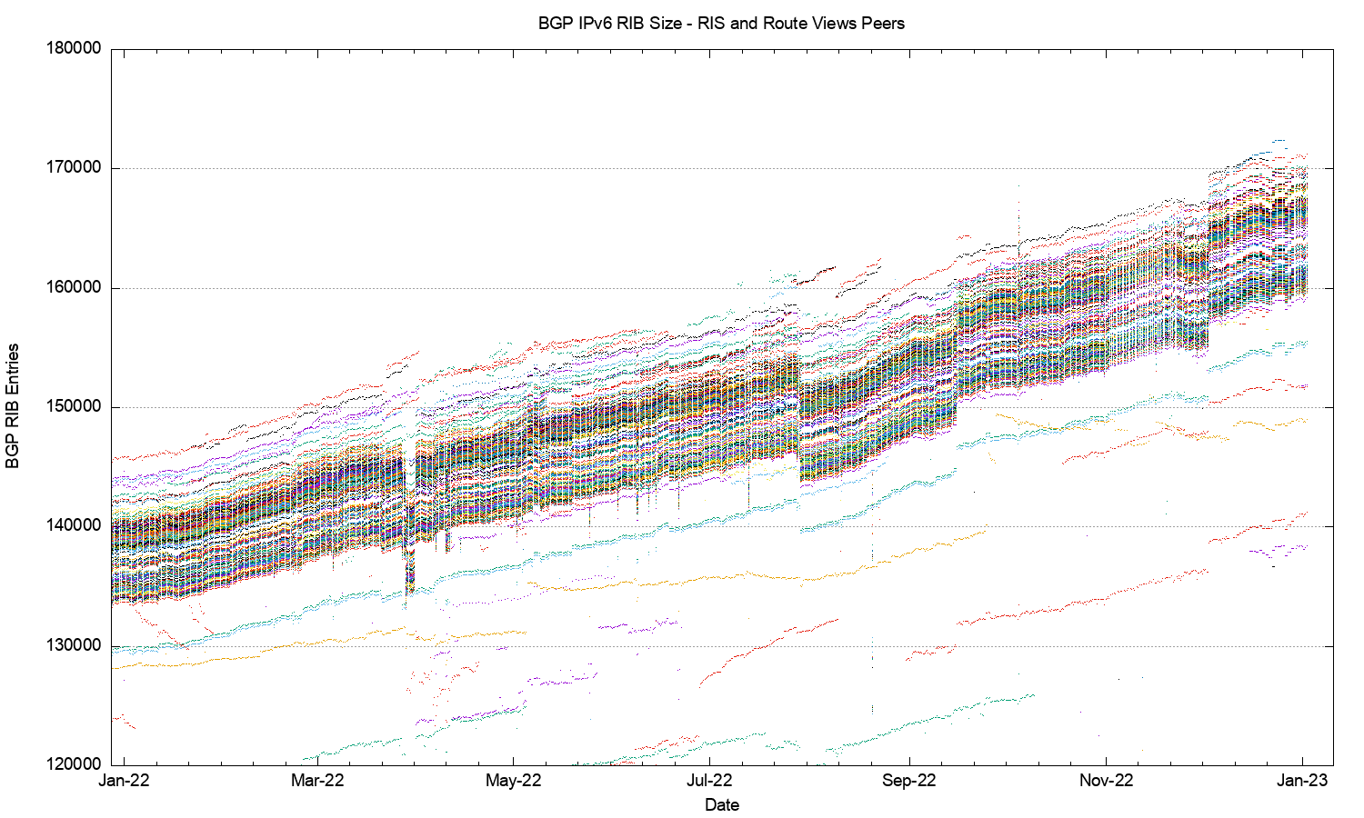
2022 in Detail

Slide 12
V6 in 2022
Overall IPv6 Internet growth in terms of BGP is still increasing, and is currently at some 35,000 route entries p.a.
  More use of /48 more specifics
  More networks advertising IPv6 prefixes

Slide 13
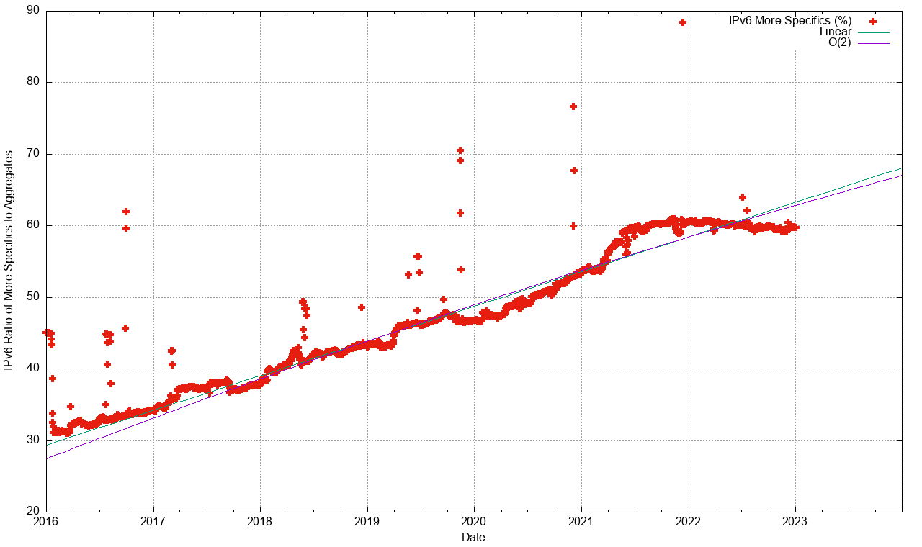
More Specifics in IPv6

Slide 14
More Specifics in IPv6
The relative number of more specifics in IPv6 at 60% is now at a higher level than
IPv4
50% of the IPv6 table is made up of /48 more specifics

Slide 15
The Highlights
IPv4 FIB Summary
IPv6 FIB Summary
FIB Projections
Churn
Conclusions

Slide 16
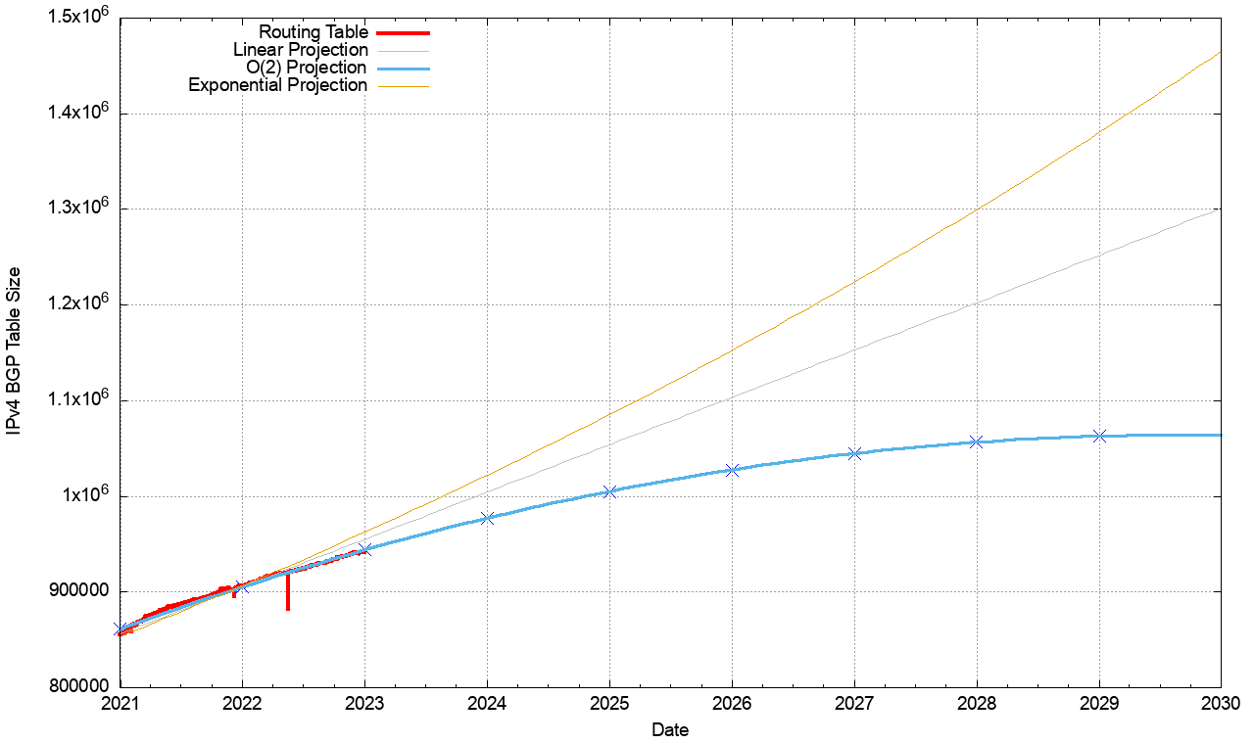
V4 BGP Table Size Predictions
Date RIB Size Prediction
Jan 2018 699,000
2019 760,000
2020 814,000
2021 866,000
2022 906,000
2023 942,000 944,000
2024 977,000
2025 1,005,000
2026 1,028,000
2027 1,045,000
2028 1,057,000

Slide 17
V4 BGP Table Size Predictions
Date RIB Size Prediction
Jan 2018 699,000
2019 760,000
2020 814,000
2021 866,000
2022 906,000
2023 942,000 944,000
2024 977,000
2025 1,005,000
2026 1,028,000
2027 1,045,000
2028 1,057,000
The best fit projection model is now less than linear
Here I’m using a polynomial function with a decreasing growth rate as a bext fit to the data
This model predicts the IPv4 FIB will peak at some 1.1M entries in 2030 (or thereabouts)

Slide 18
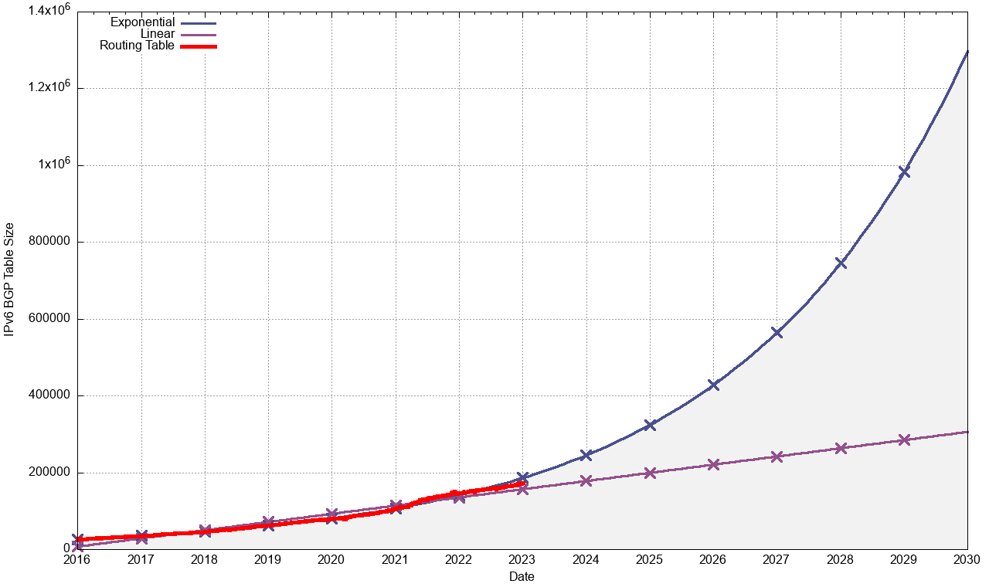
V6 BGP Table Size Predictions
Linear Exponential
Jan 2018 45,000
2019 62,000
2020 79,000
2021 104,000
2022 147,000
2023 172,000 185,000
2024 199,000 243,000
2025 226,000 320,000
2026 252,000 412,000
2027 279,000 554,000
2028 305,000 723,000
Note that the IPv6 tables are 128bits wide – i.e. 4x the size of the IPv4 tables!

Slide 19
V6 BGP Table Size Predictions
Linear Exponential
Jan 2018 45,000
2019 62,000
2020 79,000
2021 104,000
2022 147,000
2023 172,000 185,000
2024 199,000 243,000
2025 226,000 320,000
2026 252,000 412,000
2027 279,000 554,000
2028 305,000 723,000
The best fit model for the IPv6 FIB is still an exponential growth model, with a doubling factor every ~2 years
The underlying network growth is lower, and over half of the growth in this model is due to the continued intensive use of /48 more specifics
Note that the IPv6 tables are 128bits wide – i.e. 4x the size of the IPv4 tables!

Slide 20
BGP Table Growth
The absolute size of the IPv6 routing table is growing much faster than the IPv4 table
  These two tables will require the same storage/lookup size in around 1 year from now, given that each IPv6 entry is 4 times the bit size of an IPv4 entry
The good news …
  As long as we are prepared to live within the technical constraints of the current routing paradigm, the Internet’s use of BGP will continue to be viable for some time yet

Slide 21
The Highlights
IPv4 FIB Summary
IPv6 FIB Summary
FIB Projections
Churn
Conclusions

Slide 22
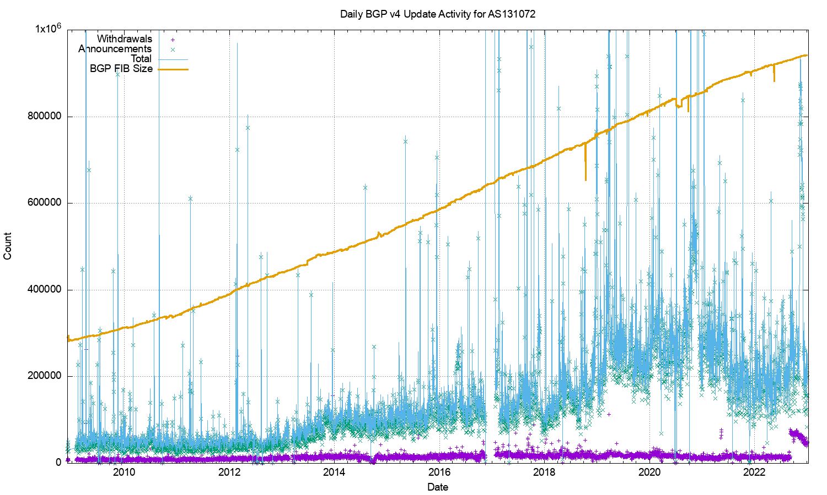
IPv4 BGP Updates – Daily Updates

Slide 23
IPv4 BGP Updates – Daily Updates
The IPv4 network is surprisingly stable
The number of withdrawals per day has been relatively steady for some 15 years (aside from some increase in 2022)
The number of updates per day has been relatively stable until 2019

Slide 24
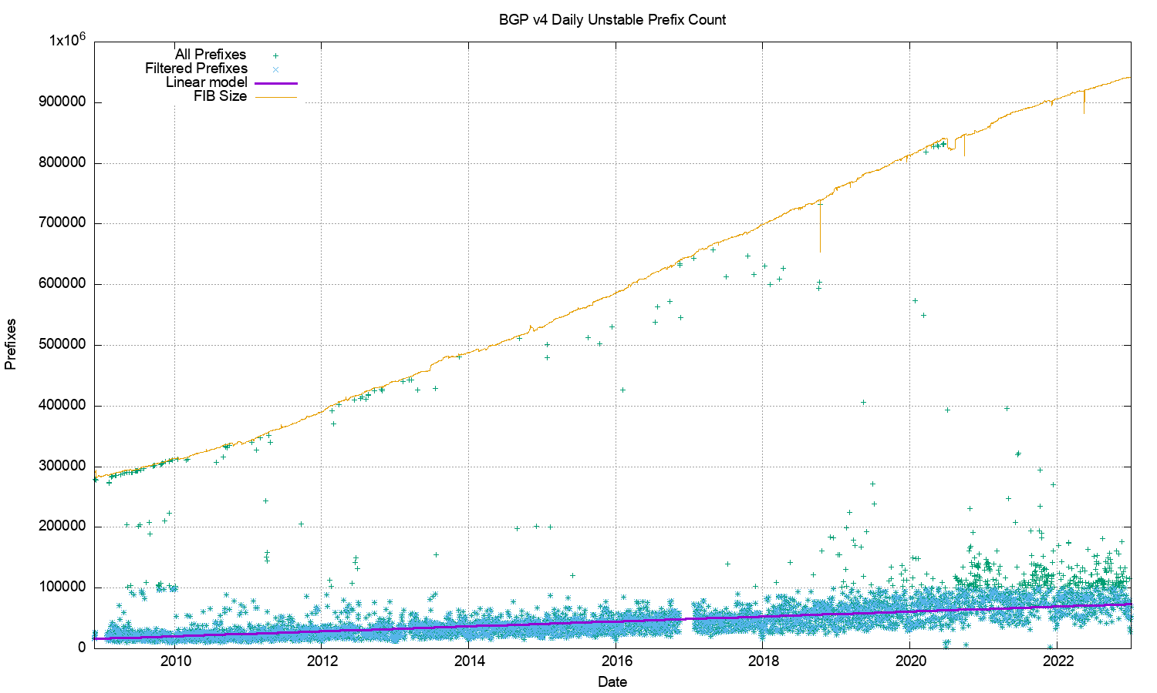
IPv4 Unstable Prefixes per Day

Slide 25
IPv4 Unstable Prefixes per Day
The number of prefixes that are the subject of updates has been slowly increasing over this 15 year period
The higher update count in recent years is due to more updates used by the routing system to converge, rather than a larger set of unstable prefixes

Slide 26
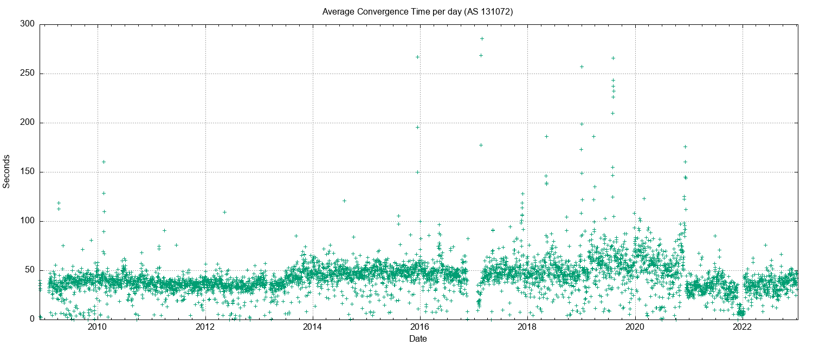
IPv4 BGP Convergence Performance

Slide 27
IPv4 BGP Convergence Performance
Convergence performance has been steady for 15 years, despite the massive growth in the network
The network topology continues to increase in density, keeping critical AS Paths short as the network itself increases in size

Slide 28
Updates in IPv4 BGP
The IPv4 inter-domain routing system is still highly stable …
The number of updates per instability event and the time to converge to a stable forwarding state has been relatively constant for many years - it rose in 2019 - 2020 and has declined again in 2021, and stabilized in 2022
20% of prefixes generate 80% of all updates. Less than 5% of all origin networks are linked to 80% of all updates. Instability is concentrated in a small number of highly unstable cases.

Slide 29
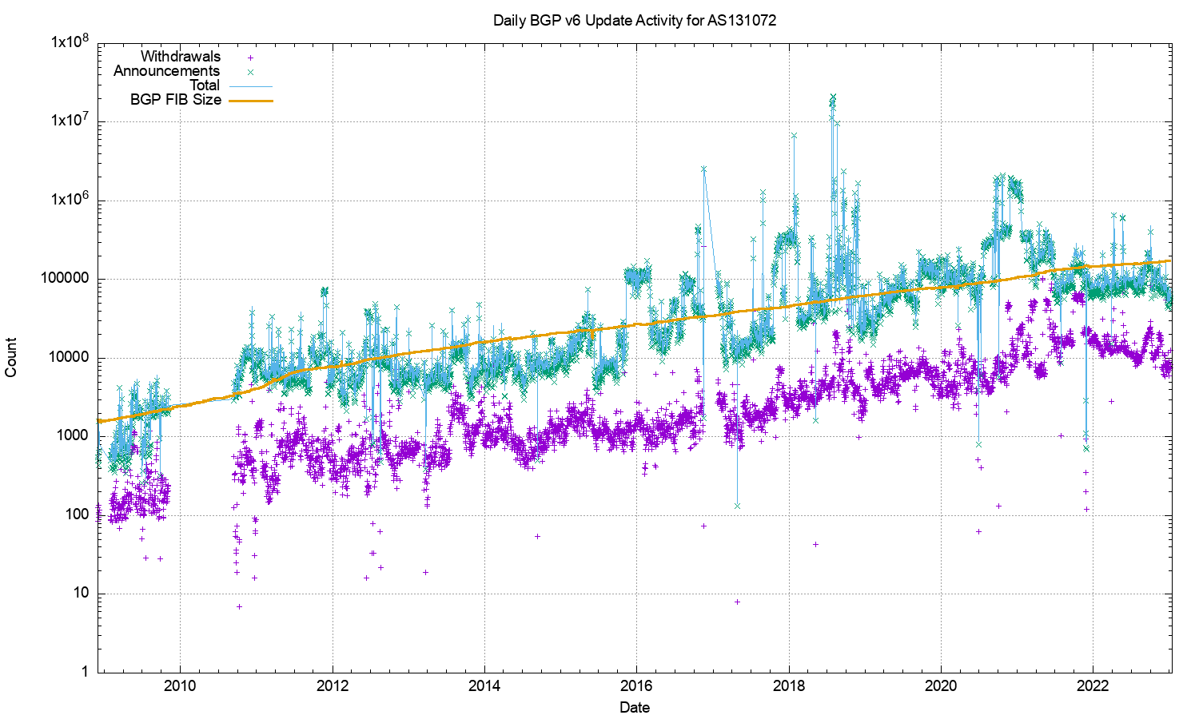
V6 BGP Updates

Slide 30
V6 BGP Updates
The number of daily announcements and withdrawals continues to
rise in IPv6

Slide 31
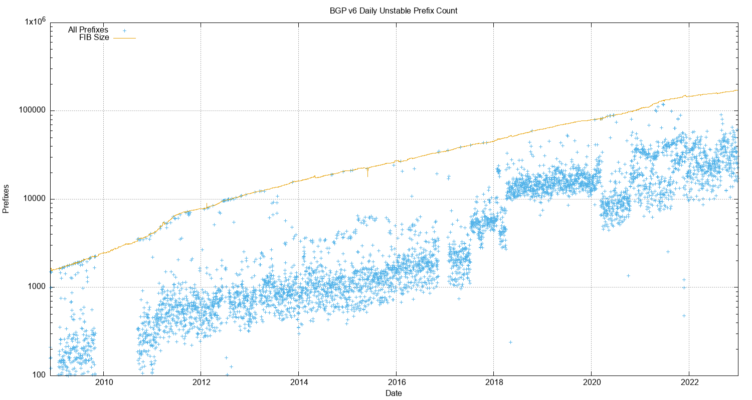
V6 Unstable Prefixes

Slide 32
V6 Unstable Prefixes
The number of unstable address prefixes continues to
rise in IPv6 – there is no sign of this stabilising so far

Slide 33
V6 Convergence Performance

Slide 34
V6 Convergence Performance
Time to converge has been very unstable for years.
Given that the IPv6 network is a lot smaller than the IPv4 network, this convergence data points to some structural instabilities in the IPv6 network

Slide 35
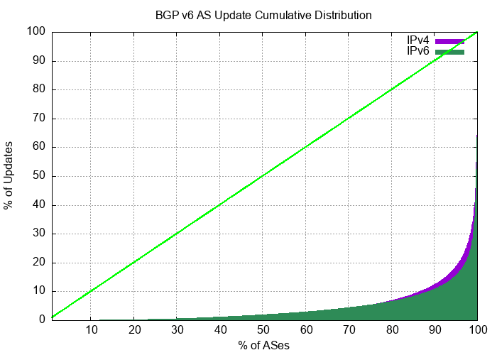
Updates in IPv6 BGP
It’s improving …
Compared to IPv4, the IPv6 network has exhibited a high level of routing instability, which is unexpected as the old overlay approaches are disappearing and the topology of IPv6 is now converging to the same topology as IPv4.
Just 2 AS’s generated 70% of the BGP update load in the last 2 weeks of 2022. IPv6 routing instability is still concentrated in a small number of pathological cases.

Slide 36
The Highlights
IPv4 FIB Summary
IPv6 FIB Summary
FIB Projections
Churn
Conclusions

Slide 37
Routing Futures
There is still little in the way of scaling pressure from BGP as a routing protocol – the relatively compressed inter-AS topology and stability of the infrastructure links tend to ensure that BGP remains effective in routing the internet.
Instability levels are rising, generally driven by a small set of highly unstable “super generators”

Slide 38
Routing Futures
The issues of FIB size, line speeds and equipment cost of line cards represent a more significant issue for hardware suppliers – we can expect cheaper line cards to to use far smaller LRU cache local FIBs in the high-speed switches and push lesser-used routes to a slower / cheaper lookup path. This approach may also become common in very high-capacity line cards

Slide 39
Some Practical Suggestions
Know your network’s limits
Understand your routing hardware’s line card FIB capacity in the default-free parts of your network

Slide 40
Some Practical Suggestions
Know your network’s limits
Review your routers’ settings
Review your IPv4 / IPv6 portioning in the FIB tables - a dual-stack eBGP router will need 1M 32-bit IPv4 slots and 320K 128-bit IPv6 slots for a full eBGP routing table in line cards in 2 years time if they are using a full eBGP FIB load (plus internal routes of course). That’s roughly the same memory footprint for IPv4 and IPv6!

Slide 41
Some Practical Suggestions
Know your network’s limits
Review your routers’ settings
Default routes can be helpful
Judicious use of default routes in your internal network may allow you drop this high speed line card memory requirement significantly

Slide 42
Some Practical Suggestions
Know your network’s limits
Review your routers’ settings
Default routes can be helpful
Time for hot caching in line card FIBs?
Using a hot cache for line card FIB cache would reduce the high-speed TCAM memory requirement significantly without visible performance cost

Slide 43
Some Practical Suggestions
Know your network’s limits
Review your routers’ settings
Default routes can be helpful
Time for hot caching in line card FIBs?

Slide 44
That’s it!
Questions?

