Slide 1
Future Network Needs
Geoff Huston AM
Chief Scientist, APNIC

Slide 2
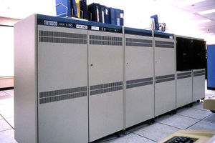
The Internet used to be simple…
1980’s:
The network was the transmission fabric for computers
It was just a packet transmission facility
Every other function was performed by attached mainframe computers
“dumb” network, “smart” devices

Slide 3
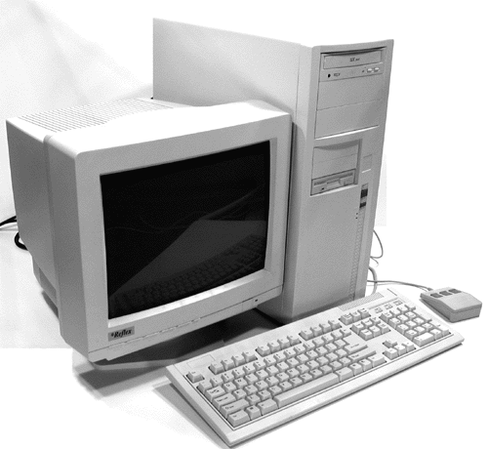
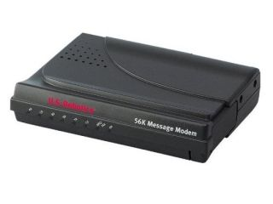
Then we went client/server
1990’s:
The rise of the Personal Computer as the “customer’s computer”
We started to make a distinction between “customers” and “network”
The naming system was pulled into the network
The routing system was pulled into the network
Messaging, content and services were pulled into the network
We created the asymmetric client/server network architecture for the Internet

Slide 4
Internet Infrastructure of 2000
Rapid expansion of network infrastructure in many directions:
Exchanges, Peering Points and Gateways
Transit and Traffic Engineering
Data Centres and Service “Farms”
Quality of Service Engineering
MPLS, VPNs and related network segmentation approaches
Mobility Support – Mobile Networks
Customer Access Networks
Content Distribution Networks

Slide 5
Aren’t these all “different” networks?
Well, yes they are
The true genius of the Internet was to separate the service environment from the link technology
Each time we invented a new comms technology we could just “map” the Internet onto it
This preserved the value of the investment in “the Internet” across successive generations of comms technologies

Slide 6
What about the coming decades?
The seeds of the dominant factors of the future environment are probably with us today
The problem is that a lot of other seeds are here as well, and sifting out the significant from the merely distracting is the challenge
So with that in mind lets work out the big drivers in today’s environment…

Slide 7
Abundant Capacity
Fibre cables continue to deliver massive capacity increases within relatively constant unit cost of deployment
https://www.ncbi.nlm.nih.gov/
(That 2022 number is probably low – at the end of 2022 we can pull 2.2T per lambda with a 190Gbd signal rate, giving a fibre capacity of 105T)

Slide 8
Abundant Compute Power
By Max Roser, Hannah Ritchie - https://ourworldindata.org/uploads/2020/11/Transistor-Count-over-time.png, CC BY 4.0, https://commons.wikimedia.org/w/index.php?curid=98219918

Slide 9
Abundant Storage
http://aiimpacts.org/wp-content/uploads/2015/07/storage_memory_prices_large-_hblok.net_.png

Slide 10
What’s driving change today?
From scarcity to abundance!
For many years the demand for communications services outstripped available capacity
We used price as distribution function to moderate demand to match available capacity
But this is no longer the case – available capacity in today’s communications domain far outpaces demand

Slide 11
How can we use this abundance?
By changing the communications provisioning model from on demand to just in case
Instead of using the network to respond to users by delivering services on demand we’ve changed the service model to provision services close to the edge just in case the user requests the service
With this change we’ve been able to eliminate the factors of distance from the network and most network transactions occur over shorter network spans
What does a shorter network enable?

Slide 12
Bigger
Increasing transmission capacity by using photonic amplifiers, wavelength multiplexing and phase/amplitude/polarisation modulation for fibre cables
Serving content and service transactions by distributing the load across many individual platforms through server and content aggregation
The rise of high capacity mobile edge networks and mobile platforms add massive volumes to content delivery
To manage this massive load shift we’ve stopped pushing content and transactions across the network and instead we serve from the edge

Slide 13
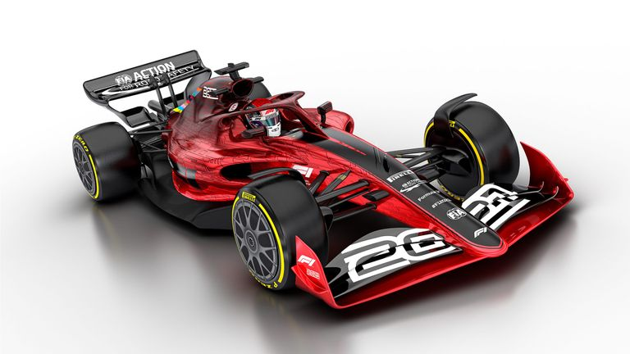
Faster
Reduce latency - stop pushing content and transactions across the network and instead serve from the edge
The rise of CDNs serve (almost) all Internet content and services from massively scaled distributed delivery systems.
The “Packet Miles” to deliver content to users has shrunk - that’s faster!
The development of high frequency cellular data systems (4G/5G) has resulted in a highly capable last mile access network with Gigabit capacity
Applications are being re-engineered to meet faster response criteria
Compressed interactions across shorter distances using higher capacity circuitry results in a much faster Internet

Slide 14
Cheaper
We are living in a world of abundant comms and computing capacity
And working in an industry when there are significant economies of scale
And being largely funded by capitalising a collective asset that is infeasible to capitalise individually – the advertisement market
The result is that a former luxury service accessible to just a few has been transformed into an affordable mass-market commodity service available to all

Slide 15
So it’s all good!
Right?

Slide 16
Longer Term Trends?
Pushing EVERYTHING out of the network and over to applications
Transmission infrastructure is an abundant commodity
Network sharing technology (multiplexing) is decreasingly relevant
We have so much network and computing that we no longer have to bring consumers to service delivery points - instead, we are bringing services towards consumers and using the content frameworks to replicate servers and services
With so much computing and storage the application is becoming the service, rather than just a window to a remotely operated service

Slide 17
Do Networks matter any more?
We have increasingly stripped out network-centric functionality in our search for lower cost, higher speed, and better agility
As we push functions out to the edge and ultimately off “the network” altogether and all that’s left is just dumb pipes
What defines “the Internet”?
A common shared transmission fabric, a common suite of protocols and a common protocol address pool?
or
A disparate collection of services that share common referential mechanisms?

Slide 18
Some issues to think about
What matters today?
End Point Addressing – IPv4 / IPv6 / IPv? Absolute? Relative?
Is universal unique end-point addressing a 1980’s concept who’s time has come and gone?
If network transactions are localised then what is the residual role of unique global end point addressing for clients or services?
And if we cannot find a role then why should we bother?
Who decides when to drop it?
Is this a market function, so that a network that uses local addressing can operate from an even lower cost base gains a competitive market edge?
Or are carriage services so cheap already that the relative benefit in discarding the last vestiges of unique global addresses are so small that its just not worth bothering about?

Slide 19
Some issues to think about
What matters today?
Naming and Name Spaces – DNS evolution?
Are ”names” a common attribute of the network, or an attribute of a service environment or application realm?
Should names be persistent over time?
Is the resolution of a name absolute or relative to the content of the resolution query?
In a world of densely replicated service delivery points how does a client rendezvous with the “best” service point? Does the client work it out? Or the network? Or the service?
If names are an attribute of applications then why do we need a single name domain? Surely each application realm can define its own name space? How can we associate a referential name space with a given name?
If both names and addresses are ephemeral and unstable then what defines the Internet?

Slide 20
Some issues to think about
What matters today?
Referential Frameworks?
Without a common referential space then how do we usefully communicate?
What do we mean by “common” when we think about referential frameworks?
How can we join the ‘fuzzy’ human language spaces with the tightly constrained deterministic computer-based symbol spaces?

Slide 21
Thanks!

