Slide 1
IPv6
Geoff Huston
APNIC

Slide 2
Why?

Slide 3
Because we ran out of IP addresses

Slide 4
Again.

Slide 5
We’ve been here before ...
The original ARPAnet design from 1969 used the NCP protocol, which used 8 bit addresses in the NCP packet header
Maximum network span of 256 nodes
Enough?
Well yes, because at the time computers were the size of entire rooms, cost many millions of dollars and there were only a few thousand in the entire world.
At the time the entire concept of shrinking the computer to something you could hold in one hand and trying to connect billions of them together was just too far into the future to worry about

Slide 6
Transition V1.0
Turns out that 8 bits of addresses was not enough for the next generation of mini-computers
ARPAnet undertook a transition from NCP to a new protocol: TCP/IP
Expansion from 8-bit to 32-bit addresses
Flag Day: 1 January 1983
Shutdown and reboot every node into the new protocol!

Slide 7
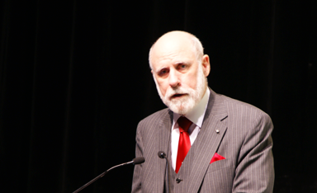
“This time, for sure!” *
* Actually Vint Cerf didn’t say this!

Slide 8
IP Version 4
32-bit address field
That’s 4,294,967,296 addresses
In 1983 that looked like a HUGE number of computers

Slide 9
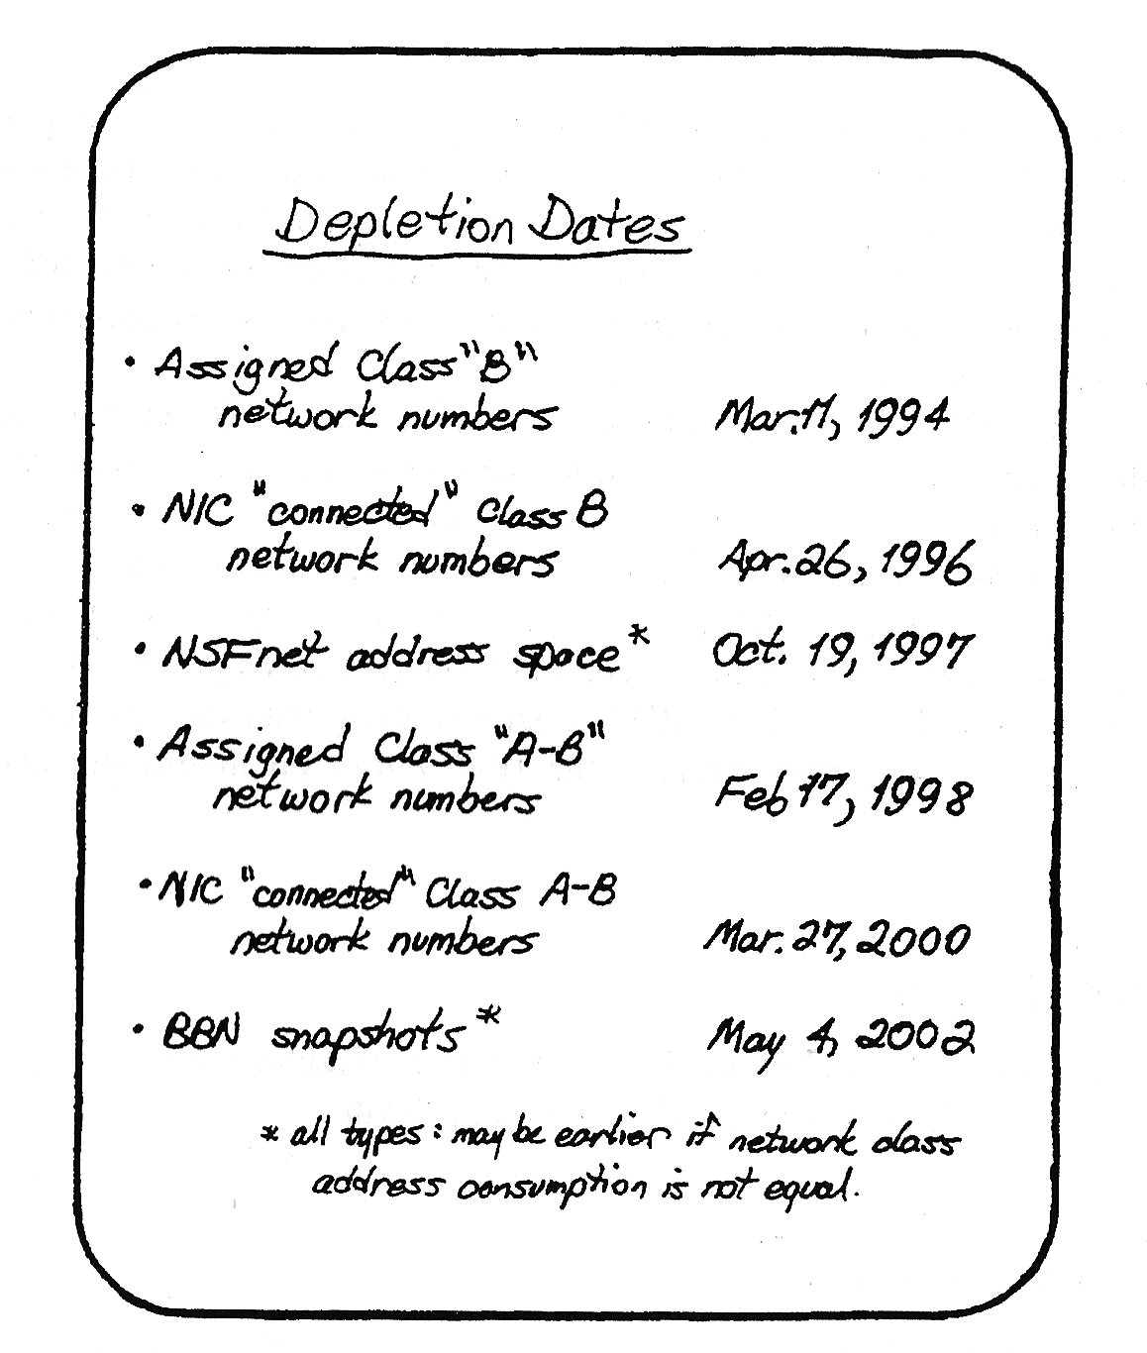
Digital Pressures
Through the 1980’s computers changed from large expensive pieces of ironware to desktop consumer products
And the size of the computer market changed from thousands to tens of millions
And the prospect was smaller, cheaper and more
So by 1990 that 4 billion address space was looking pretty small
And it was not going to last much longer!
Frank Solensky – IETF 1990
Presentation on IPv4 Address Depletion Predictions

Slide 10
IPocalypse?

Slide 11
So we hit the wall – right?

Slide 12
Panic!
This was a brutal wakeup call
We had hardly started with the Internet and its demise was just 4 years away!
So we rapidly worked on short term responses to push this exhaustion date out
To give us more time to work on the longer term solutions
So:
We dropped the classful address plan
We introduced NATs to allow address sharing
We worked on a new protocol

Slide 13
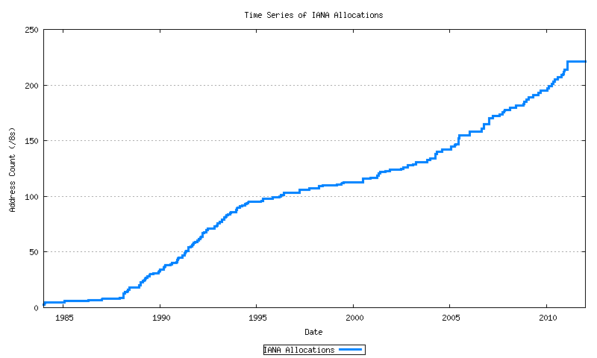
The short-term band aid worked!
14 years of extra time
Exhaustion!
Mobiles
GFC
Broadband
Boom & Bust
CIDR
A&R networks
The short term response to imminent depletion
NSFNET

Slide 14
That longer term plan
Was to develop a new IP protocol
And then transition the Internet over to use this new protocol

Slide 15
What are we transitioning to?

Slide 16
IPv6!

Slide 17
IPv6 is…
IPv4 with larger address fields
Not much else changed
It’s still an address-based stateless datagram forwarding protocol
It still has decoupled forwarding, routing, naming, transport
The interfaces to the underlying media protocols are largely unchanged
The APIs to interface to the upper layers are largely unchanged
So transition to IPv6 should be easy

Slide 18
Aside: “Not much else changed”

Slide 19
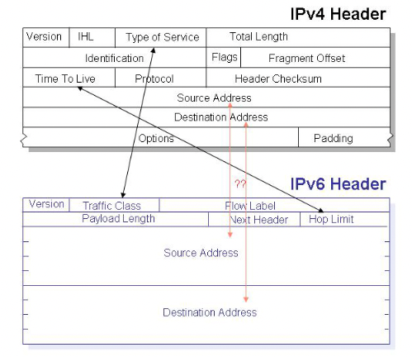
Aside: “Not much else changed”
What actually changed with IPv6:

Slide 20
Aside: “Not much else changed”
What changed with IPv6:
128 bit address fields
Fixed host/network boundary
Replace Broadcast and ARP with Multicast and SLAAC
Removed on-the-fly fragmentation with source fragmentation
No NATS!
Flow Label
Make Fragmentation Controls an optional Extension Header
Change “Options” to “Extension Headers”
Multi-Addressing
Scoped Addresses

Slide 21
128 bit addresses
Network ID
Interface ID
64 bits
64 bits
We experimented with a constant interface ID for a while, and realised that this was an unacceptable privacy leak if the value was held constant
So clients use a temporary random interface identifier for the low order 64 bits
Which means that the constant length of an IPv6 address is back to 64 bits

Slide 22
The Flow ID
Huh?
It probably sounded like a reasonable thing at the time
But no one remembers what its good for!
So that’s 20 waste bits in the header!

Slide 23
Extension Headers
Don’t work on today’s silicon!
High speed switching gear that wants to preserve TCP and UDP packet flows need to see the TCP and UDP headers at a fixed offset in the packet header
Extension headers are a chained header structure where each header points to the next header, with the transport header at the end of the chain
Unravelling that chain in very high speed silicon is a challenging task
Easier to drop all IPv6 packets with extension headers!

Slide 24
Fragmentation Control
Packet Fragmentation was a big feature of the IPv4 design
It allowed new media types to the integrated into the Internet environment seamlessly
But it had a performance cost
The IPv6 design disallowed fragmentation on the fly
If a packet is too big for the next hop you need to send a signal to the source and discard the too-big packets
This is slow and unreliable
The signalling is also uinreliable
So the best response is to avoid packet fragmentation completely
Which means that packets in IPv6 tend be 1,280 octets
Which has a performance cost

Slide 25
No NATs!
Really?
We’ve grown addicted to NATs and IPv6 NATs are already a common feature of IPv6

Slide 26
Aside: “Not much else changed”
What’s giving us grief with IPv6:
128 bit address fields
Fixed host/network boundary
Replace Broadcast and ARP with Multicast and SLAAC
Removed on-the-fly fragmentation with source fragmentation
No NATS!
Flow Label
Make Fragmentation Controls an optional Extension Header
Change “Options” to “Extension Headers”
Multi-Addressing
Scoped Addresses

Slide 27
So Transition should be easy?
Right?

Slide 28
So Transition should be easy?
Well, no, not really!

Slide 29
Why is this taking so long?
IPv6 was a minimal change to IPv4
So early adopters found little in the way of an early adoption benefit
IPv6 was not backward compatible with IPv4
This is a key “feature” of protocols that use fixed length addresses in their packet headers – you can’t jam all 128 bits into a 32 bit field.
This meant that IPv6 hosts could not directly communicate with IPv4 hosts
IPv6 adopters still had to support IPv4
This meant that EVERYONE has to transition to dual stack BEFORE we can drop IPv4

Slide 30
Transition, the second time around
That last point is important – let me repeat it for you:
A “Flag Day” switchover is impossible
Piecemeal replacement won’t work either, as IPv6 is not backward compatible with IPv4
So, we need to run both protocols in tandem “for a while”
But bear in mind that one protocol has already run out of addresses
And network growth continues at record levels

Slide 31
Transition, the second time around
We need to :
deploy IPv6 in parallel with IPv4
deploy ever more stringent IPv4 address conservation measures within the network
allow the network to expand at an ever-increasing rate
All at the same time!

Slide 32
What we thought was the IPv6 Transition Plan
Size of the Internet
IPv6 Deployment
IPv6 Transition – Dual Stack
IPv4 Pool Size
Time

Slide 33
The Plan
We would build in a piecemeal fashion “islands” of dual stack networks while we still had adequate amounts of IPv4
The IPv6 islands were meant to grow faster than the Internet itself
Over time the dual stack “islands” would link up
Once the entire Internet was dual stack we could drop IPv4

Slide 34
But…
3G mobile networks were not designed with this transition in mind
A 3G network operator’s costs will double if they opt to use two protocol stacks in their network
So they have to tunnel IPv6 in IPv4, or tunnel IPv4 in IPv6 if they want to support IPv6
Which is messay
IPv4 was running out
So the larger networks were using net 10 internally for their IPv4 support
But net 10 wasn’t big enough
So they needed to either internally segment their IPv4 network and reuse net 10 or run an IPv6 only internal network and tunnel IPv4 on demand wityh CGNs at the edge

Slide 35
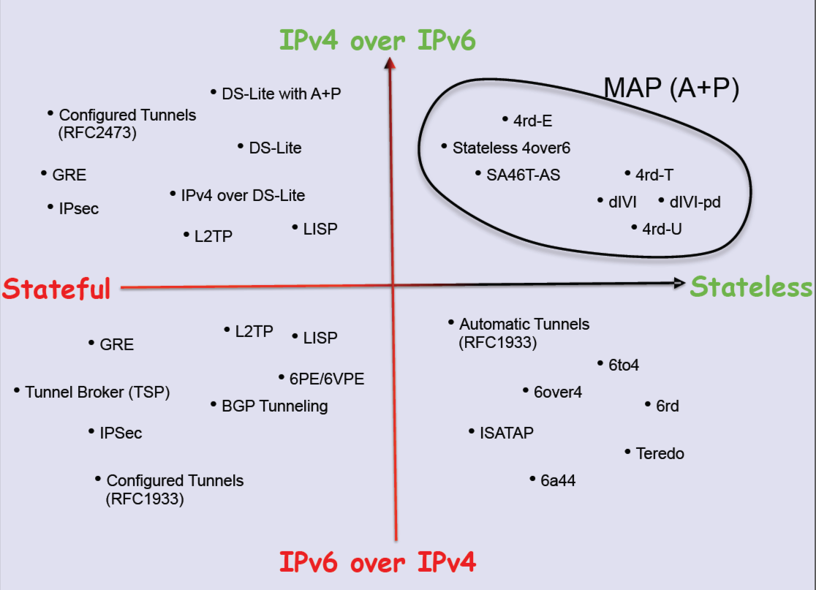
But…
Transition became more and more complex with multiple “solutions”

Slide 36
Complexity layered on complexity

Slide 37
The IPv6 Transition Plan as it happened!
IPv4 Pool Size
Size of the Internet
IPv6 Deployment
IPv6 Transition – Dual Stack
Time

Slide 38
“The Internet” does not exist
The Internet is not a singly managed entity
Noone is in control
Noone is there to tell anyone else what they can (or cannot) do
The Internet is a collection of markets (Goods and services, Transmission and switching, Technologies, …)
We find it impossible to orchestrate collective synchronised actions across all these distinct activities
So the status quo accumulates a huge amount of inertial momentum
Which makes it terribly hard to change direction in an orderly manner!

Slide 39
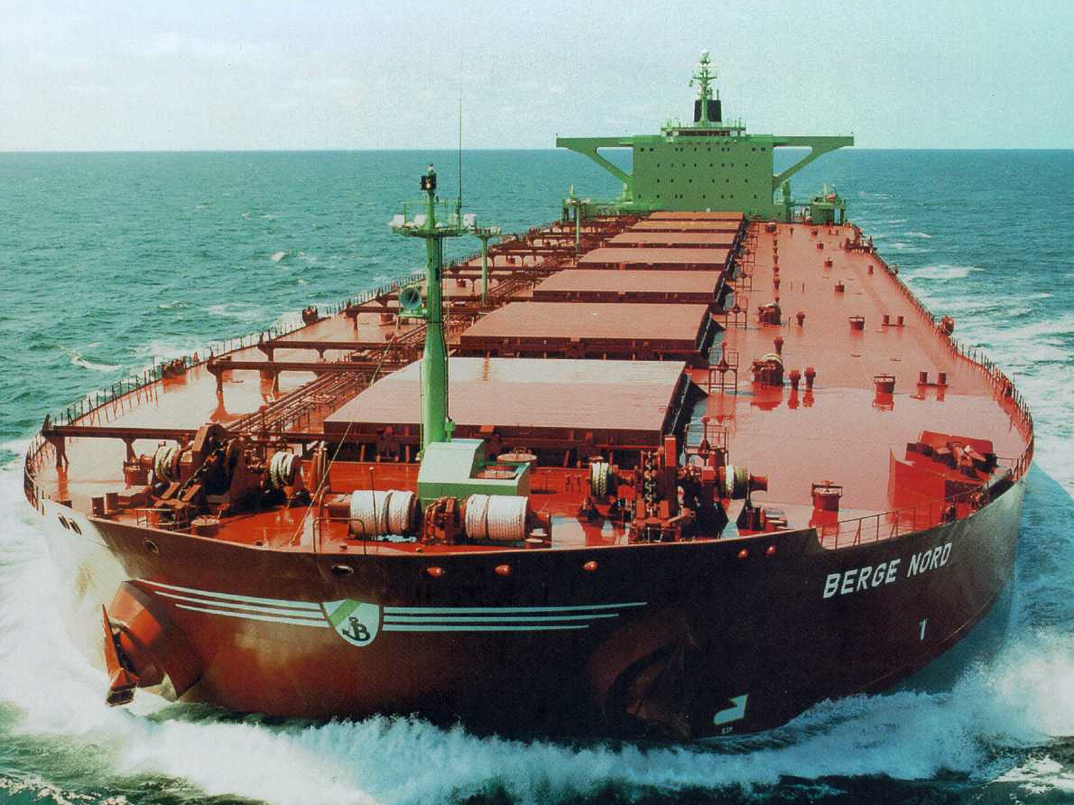
The transition is more like this!

Slide 40
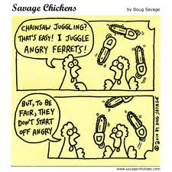
Or this!

Slide 41
Its now 2022 and we are still in this transition
We underestimated the awesome ability of NATs to squeeze out address efficiencies – the past decade of massive growth on the Internet has been largely based on various forms of NAT usage
NATs expanded the usable IPv4 address capacity by a further ~20 bits
Each bit of increased address size doubles the total capacity of the space
It’s taken us much longer than we thought to fill up these additional address bits
There is no common sense of urgency here

Slide 42
So how is this transition going?
Slowly!

Slide 43
Let’s look at progress so far
2012 – no significant deployment of IPv6

Slide 44
Let’s look at progress so far
2012
2014 – still very little movement in the larger environment

Slide 45
Let’s look at progress so far
2012
2014
2017 – India IPv6 deployment

Slide 46
Let’s look at progress so far
2012
2014
2017
2019 – stirring in China

Slide 47
Where are we in 2022?
11 years after the depletion of the central IPv4 address pools we are still sitting on some 30% of the Internet user base with Dual Stack (IPv4 + IPv6) support
The other 3 billion uses are on IPv4 only
How much longer will it take before we can call this transition “completed”?

Slide 48
Why is this taking so long?
If we designed the IPv6 protocol 30 years ago
And we’ve been running the IPv4 Internet on empty for many years
Then why isn’t the Internet an all-IPv6 Internet today?

Slide 49
Why is this taking so long?
IPv6 is not different enough
IPv6 is just IPv4 with larger addresses
It does not make packet switching any cheaper, so it does not give early adopters any advantage
And IPv6 not backward compatible with IPv4, so early adopters still have to run IPv4 as well

Slide 50
Why is this taking so long?
NATs are just too good!
NATs drive every part of today’s internet, and we’ve adapted the entire IP infrastructure and application space to work in a NAT environment
We’ve pushed the role of service identification to the name space
And changed the architecture of the Internet into a client/server model
And clients don’t need permanently assigned public addresses
So NATs have allowed us to build a network with some 40 billion connected devices – and we are confident that we can grow further

Slide 51
Why is this taking so long
The transition timetable is not being set by the early adopters
There is not enough competitive advantage for early adopters to drive the transition
The transition timetable is not being set by the late adopters
At some point the last to adopt cannot impose a hold over everyone else
So transition is a form of “majority” decision making
It’s a case of “critical mass” that will determine at what point dual stack service providers will contemplate dropping IPv4 and completing their part of the transition

Slide 52
IPv6 Adoption today
0
Not everywhere – not all at once
~1 B IPv6 users out of 4B

Slide 53
Will we complete this transition?
Or will it just run out of momentum and we will turn our collective attention elsewhere
But where?

Slide 54
If not IPv6 then what?

Slide 55
Some issues to think about
What matters in such a network?
Addressing – IPv4 / IPv6 / IPv? Absolute? Relative?
Is universal unique end-point addressing a 1980’s concept who’s time has come and gone?
Naming and Name Spaces – DNS evolution?
Are ”names” a common attribute of the network, or an attribute of a service environment?
Referential Frameworks?
In a world of densely replicated service delivery points how does a client rendezvous with the “best” service point? Does the client work it out? Or the network? Or the service?

Slide 56
Some issues to think about
What matters in such a network?
If we don’t try to share our transactions across a common network then what are we asking from common infrastructure?
If anything?
Why is a 1980’s networking architecture roughly modelled on telephony still relevant today?
How should we represent service identity and location?
What is the relationship between applications, hosts and networks?
Mutual trust or mutual suspicion?

Slide 57
Longer Term Trends?
Pushing EVERYTHING out of the network and over to the edge!
Transmission infrastructure is becoming an abundant commodity
Sharing technology (multiplexing) is decreasingly relevant
We have so much network and computing that we no longer have to bring consumers to service delivery points - instead, we are shifting services towards consumers and using the network to replicate servers
With so much computing and storage the application is becoming the service, rather than just a window to a remotely operated service

Slide 58
Do networks matter any more?
We have increasingly stripped out network-centric functionality in out search for lower cost, higher speed, and better agility
We are pushing functions out to the edge and ultimately off “the network” altogether and what is left is just dumb pipes
What defines “the Internet”?
A common network, a common protocol and a common protocol address pool?
or
A disparate collection of services that share common referential mechanisms?

Slide 59
What’s important in a “flat” access network?
Unique endpoint addressing?
Hardly
Routing?
Nope!
Names and references?
That’s all that matters!

Slide 60
Where are we?
What we call the “IPv4 Internet” has changed the semantics of “an address”
Its not an endpoint identity
It’s an ephemeral session token to allow the network to distinguish the traffic between various active sessions
Much of what we build upon these days is the name infrastructure (DNS)
It may not have been deliberate, but we’ve been building name-based networks for the past decade or so
And so far it has been working!

Slide 61
Thanks!

