Slide 1
Measuring the Effectiveness of Route Origin Validation Filtering via Drop Invalids from the perspective of the End User using a Technique of Broad Scale Reachability Measurement
Geoff Huston
APNIC Labs

Slide 2
Measuring RPKI
Geoff Huston
APNIC

Slide 3
Measuring RPKI
Route Origin Validation Filtering!
Geoff Huston
APNIC

Slide 4

Routing Security
What’s “the objective” of routing security?

Slide 5
Routing Security
What’s “the objective” of routing security?
  Protect the routing system from all forms of operator mishaps?
  Protect the routing system from some forms of operator mishaps?
  Protect the routing system from all hostile attacks?
  Protect the routing system from some hostile attacks?
  Prevent the routing of bogus address prefixes?
  Prevent the use of bogus AS’s in the routing system?
  Prevent all forms of synthetic routes from being injected into the routing system?
  Prevent unauthorised route withdrawal?
  Protect users from being directed along bogus routing paths?

Slide 6
Let’s not be too ambitious!
Enforcing rules to ensure that the routes carried in BGP are both protocol-wise accurate and policy-wise accurate is well beyond the capabilities of BGP and viable BGP control mechanisms *
Route Origin Validation is designed to prevent BGP speakers from learning and preferring routes that are not authorised by the prefix holder
The intent of not preferring unauthorised routes is to prevent users’ traffic from being steered along these bogus routes
* BGP is not a deterministic protocol, but more of a negotiation protocol that attempts to find meta-stable ‘solutions to importer / export policy preferences simultaneously. Where the policies are incompatible the BGP “solution” is not necessarily reached deterministically and different outcomes will be seen at different times – see “BGP Wedgies” for an illustration of this form of indeterminism

Slide 7
Routing Security
What’s “the objective” of routing security?
  Protect the routing system from all forms of operator mishaps?
  Protect the routing system from some forms of operator mishaps?
  Protect the routing system from all hostile attacks?
  Protect the routing system from some hostile attacks?
  Prevent the routing of bogus address prefixes?
  Prevent the use of bogus AS’s in the routing system?
  Prevent all forms of synthetic routes from being injected into the routing system?
  Prevent unauthorised route withdrawal?
  Protect users from being directed along bogus routing paths?

Slide 8

Our Objective
To measure the “impact” of invalid route filtering on users
The question we want to answer here is user-centric:
  What proportion of users can’t reach a destination when the destination route is invalid according to ROV?
We’d like to continue this as a long term whole-of-Internet measurement to track the increasing deployment of RoV filtering* over the coming months and years
* “RoV filtering” is shorthand for “using RPKI validation of published Route Origination Attestations to detect and drop route objects that are invalid according to the conventional RoA interpretation”, which in practice means either the prefix is too specific (shorted than MaxLength) or has an origin AS which is not contained in a valid ROA

Slide 9
Production vs Consumption
There are two aspects to this framework:
Generating ROAs to describe the intended origination of prefixes
Looking for those networks that will admit and propagate invalid routes
  i.e.: those networks that are not performing some for of “drop invalid” filtering on BGP advertisements

Slide 10

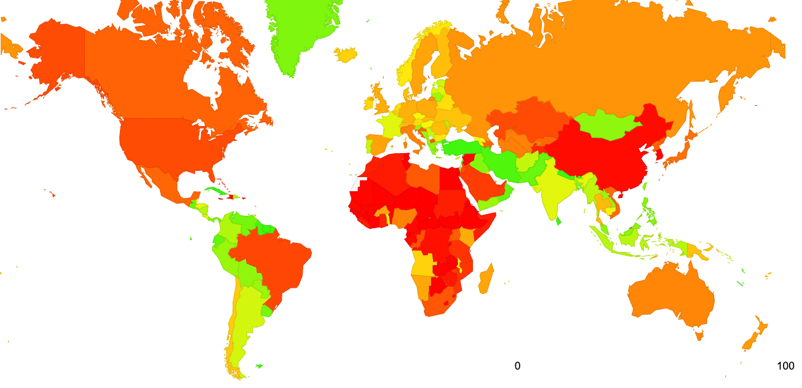
Production
Which national operator communities have been generating ROAs for their announced prefixes?
https://stats.labs.apnic.net/roas

Slide 11
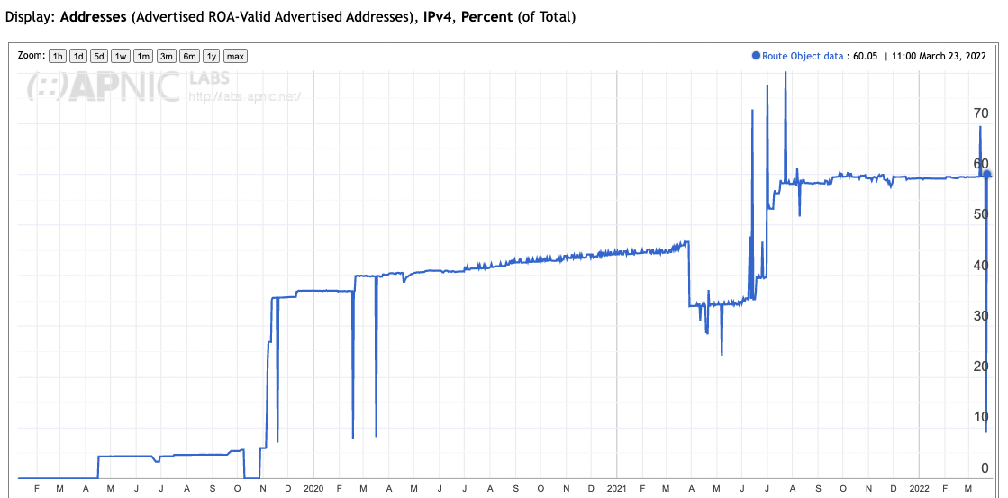
ROAs for Australian Networks

Slide 12
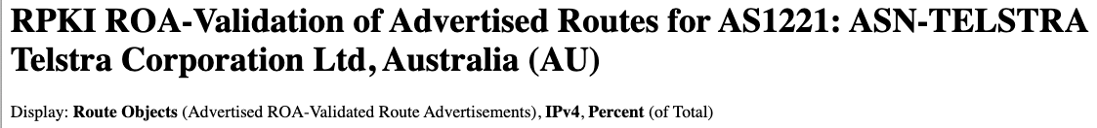
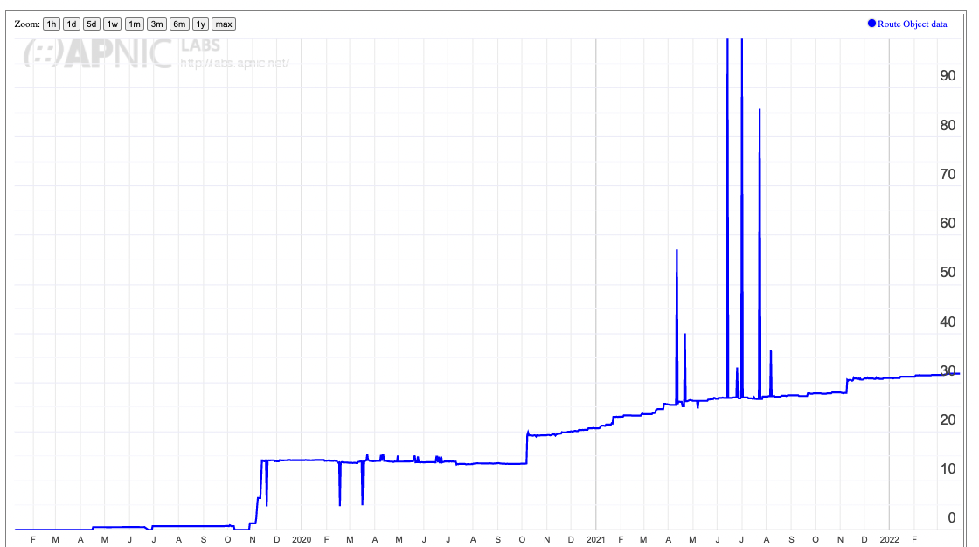
ROAs for individual networks
30%

Slide 13
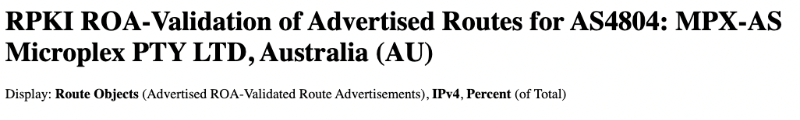
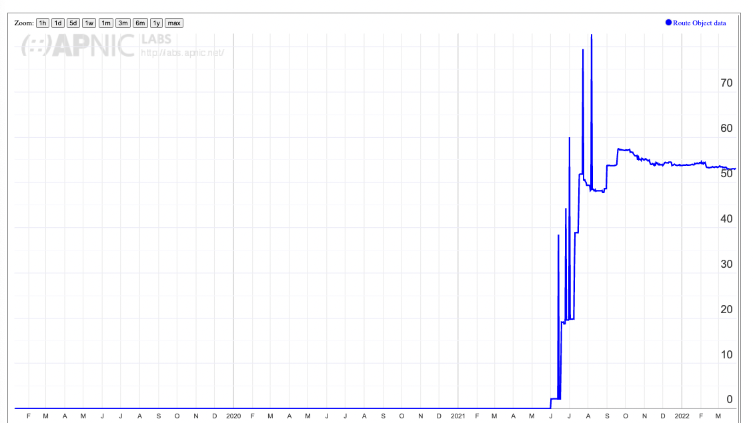
ROAs for individual networks
50%

Slide 14
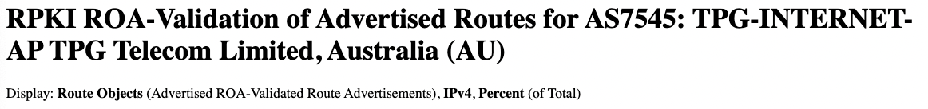
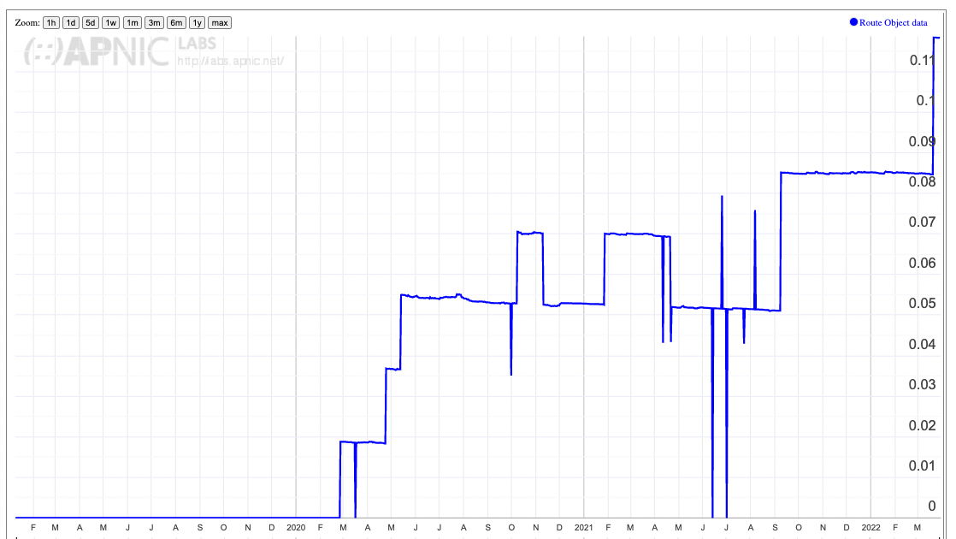
ROAs for individual networks
0.1%

Slide 15
Production vs Consumption
So we are looking at the uptake of the generation of ROAs
The next question is: Who is using these ROAs to determine whether to accept routes (or not!)

Slide 16

Measurement Approach
If we are looking at the effectiveness of the secure routing system in blocking the ability to direct users along bogus routing paths, then this suggests a measurement approach:
Set up a bogus (RPKI RoV-invalid) routing path as the only route to a prefix
Direct a very large set of users from across the Internet to try to reach a web server located at this prefix
Use a ‘control’ of a valid routing path to the same destination
Measure and compare

Slide 17

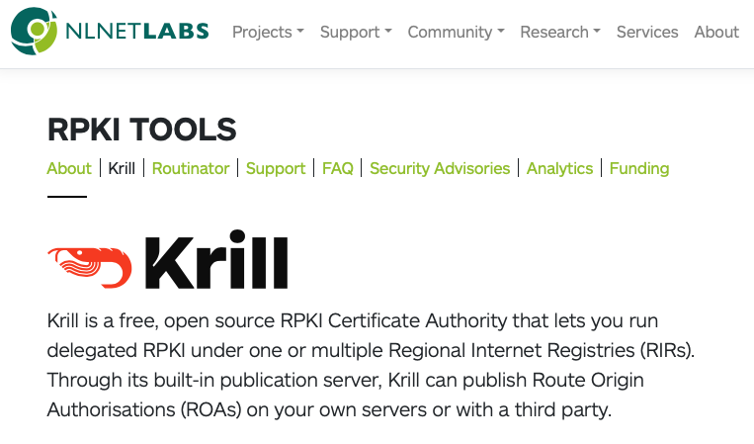
Methodology
Set up a prefix and AS in a delegated RPKI repository
  We used the Krill package to achieve this
  It Just Worked! ^{tm}
https://www.nlnetlabs.nl/projects/rpki/krill/

Slide 18
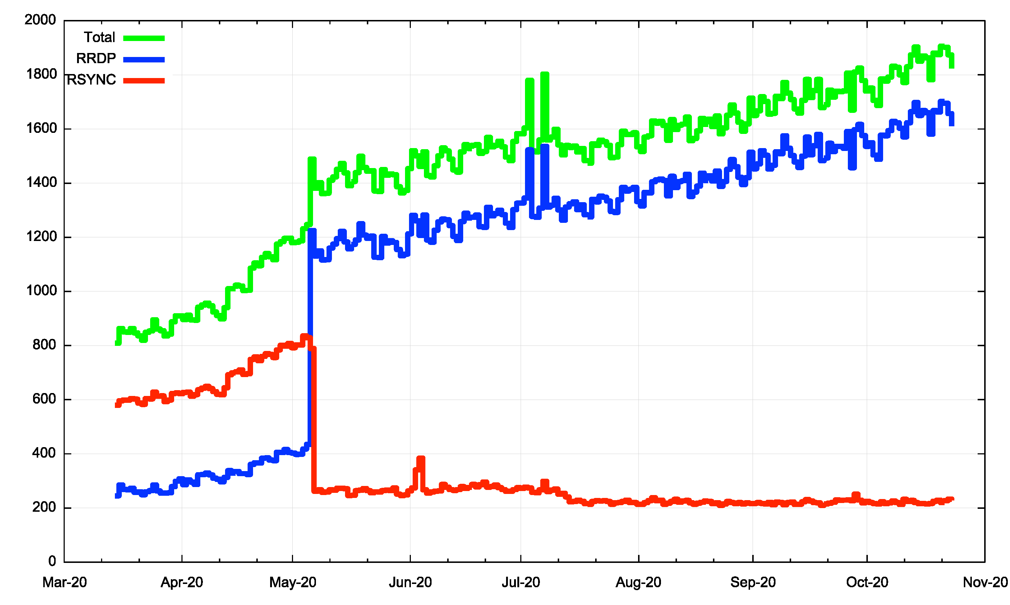
Counting RPKI Clients
Number of Unique IP addresses per day performing a fetch from our RPKI repository

Slide 19
Methodology
Set a prefix and AS in a delegated RPKI repository
Regularly revoke and re-issue ROAs that flip the validity state between valid and invalid states
# Flip to "good" at 00:00 on Fri/Mon/Thu
0 0 * * 1,4,5 /home/krill/.cargo/bin/krillc roas update --delta ./delta-in.txt > /tmp/krillc-in.log 2>&1
# Flip to "bad" at 12:00 on sat/Tue/Thu
0 12 * * 2,4,6 /home/krill/.cargo/bin/krillc roas update --delta ./delta-out.txt > /tmp/krillc-out.log 2>&1
These two scripts flip the ROA valid state between ‘good’ and’bad’ origin ASNs for the prifix

Slide 20
Methodology
Set a prefix and AS in a delegated RPKI repository
Regularly revoke and re-issue ROAs that flip the validity state between valid and invalid states
Anycast the prefix and AS pair in a number of locations across the Internet
  We are using 3 locations: US (LA), DE (FRA), SG
  We are using 3 transit providers
  The server at this location delivers 1x1 blots
  This is IPv4-only at this point

Slide 21
Methodology
Set a prefix and AS in a delegated RPKI repository
Regularly revoke and re-issue ROAs that flip the validity state between valid and invalid states
Anycast the prefix and AS pair in a number of locations across the Internet
  We started by using 3 locations: US (LA), DE (FRA), SG
  We then enlisted the assistance of a very large cloud provider and expanded this to more than 200 locations!

Slide 22
Methodology
Set a prefix and AS in a delegated RPKI repository
Regularly revoke and re-issue ROAs that flip the validity state between valid and invalid states
Anycast the prefix and AS pair in a number of locations across the Internet
Load a unique URL that maps to the destination into a measurement script
  The DNS component uses HTTPS and a unique DNS label component to try and ensure that the HTTP FETCH is not intercepted by middleware proxies

Slide 23
Methodology
Set a prefix and AS in a delegated RPKI repository
Regularly revoke and re-issue ROAs that flip the validity state between valid and invalid states
Anycast the prefix and AS pair in a number of locations across the Internet
Load a unique URL that maps to the destination into a measurement script
Feed the script into the advertising systems
  This is part of the larger APNIC Labs ad-based measurement system – this test is one URL in a larger collection of URLs

Slide 24
Methodology
Set a prefix and AS in a delegated RPKI repository
Regularly revoke and re-issue ROAs that flip the validity state between valid and invalid states
Anycast the prefix and AS pair in a number of locations across the Internet
Load a unique URL that maps to the destination into a measurement script
Feed the script into the advertising systems
Collect and analyse data
  We use the user record of successful fetch to avoid zombies and stalkers

Slide 25
Flipping ROA states
What’s a good frequency to flip states?
  How long does it take for the routing system as a whole to learn that a previously valid route is now invalid? And how long for the inverse invalid to valid transition
Validity / Invalidity is determined by what is published at the RPKI publication point
  Each transition is marked by revocation of the previous ROA’s EE certificate and the issuing of a new ROA and EE certificate
What’s the re-query interval for clients of a RPKI publication point?
  There is no standard-defined re-query interval so implementors have exercised their creativity!

Slide 26
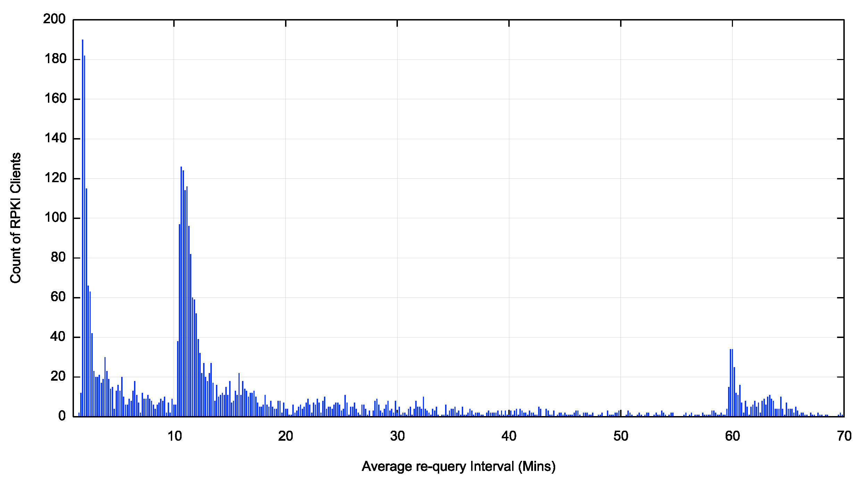
RPKI Publication Point Re-Query Intervals (first hour)
120 seconds is popular
600 seconds is also well used
as is one hour
What’s this?

Slide 27
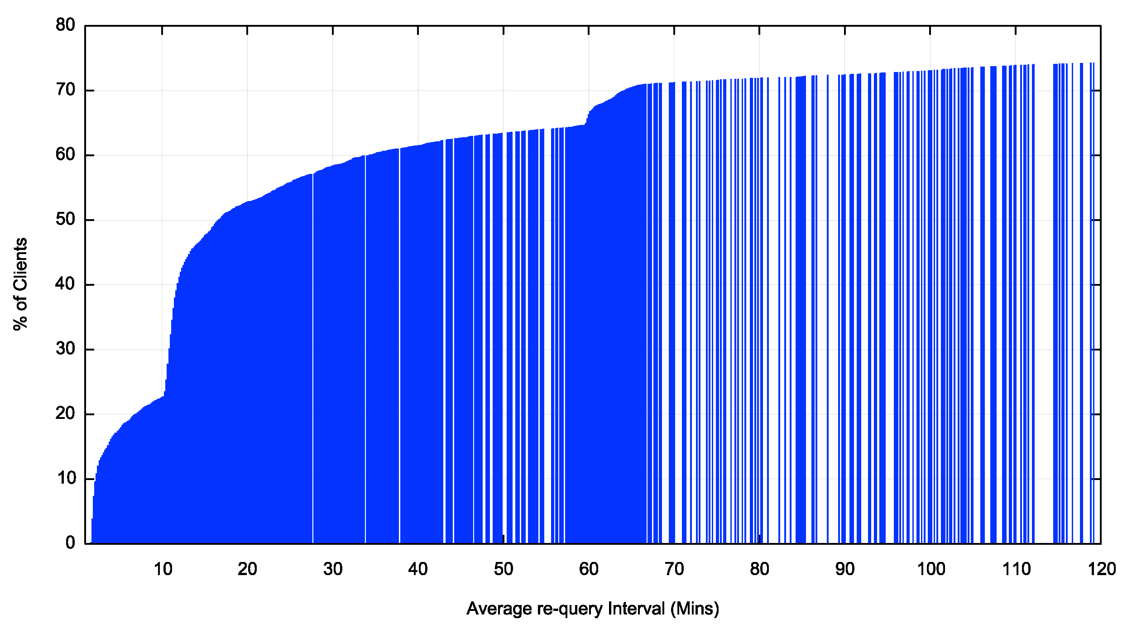
Re-Query – Cumulative Distribution
Within 2 hours we see 75% of clients perform a requery

Slide 28
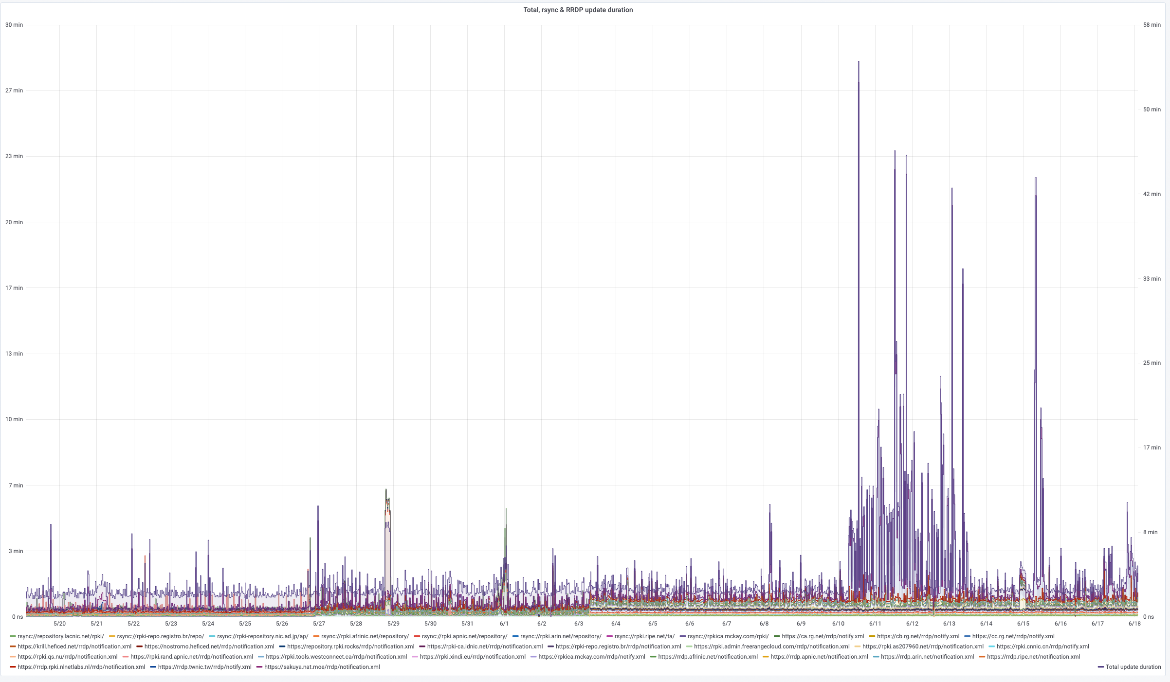
Why the tail lag?
Clients can take a significant amount of time to complete a pass through the entire RPKI distributed repository set, which makes the entire system sluggish to respond to changes
https://grafana.wikimedia.org/d/UwUa77GZk/rpki?panelId=59&fullscreen&orgId=1&from=now-30d&to=now

Slide 29
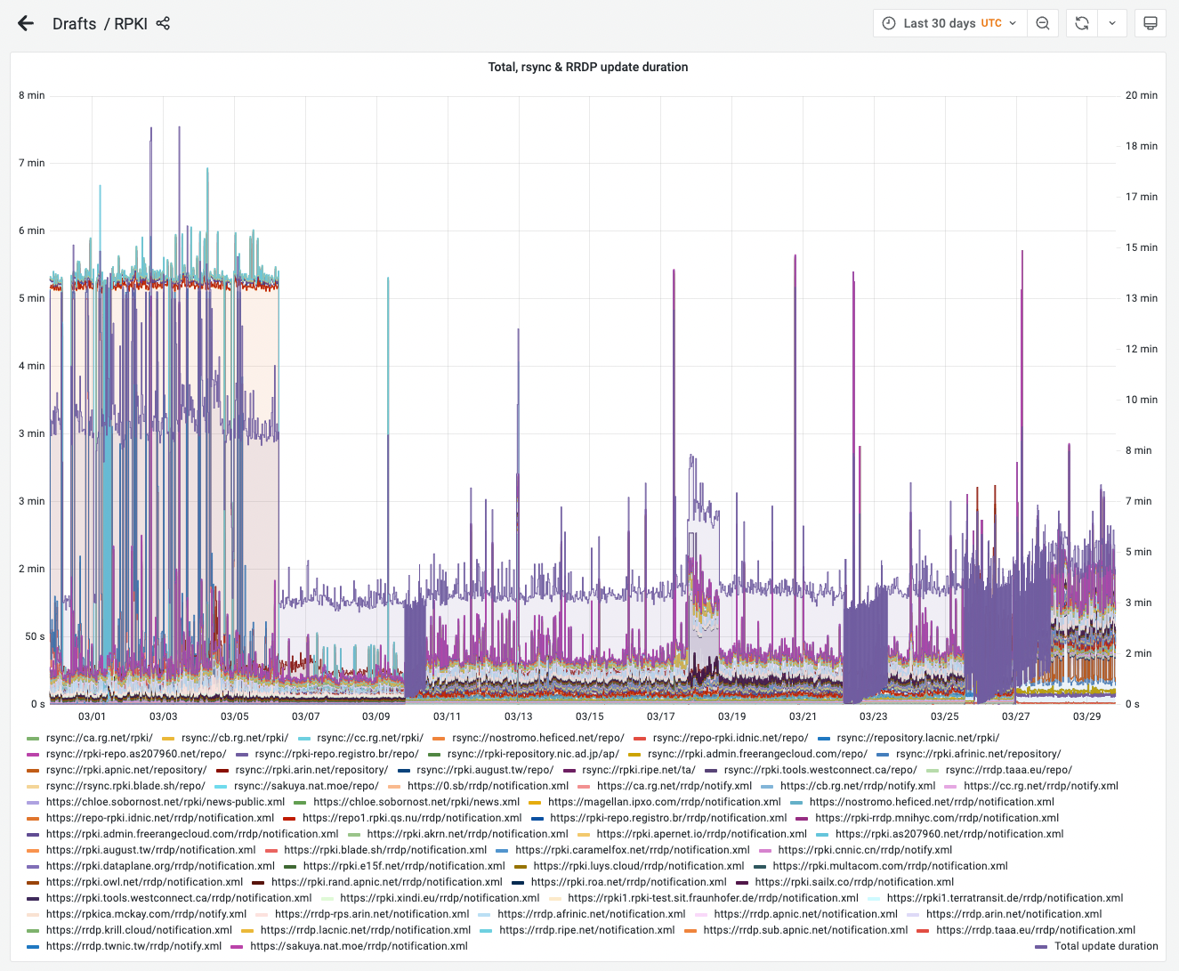
This is NOT scaling well
As more publication points and clients are added to the RPKI, the RPKI scanning function is getting slower (and more variable)
https://grafana.wikimedia.org/d/UwUa77GZk/rpki?from=now-30d&orgId=1&to=now&viewPanel=59

Slide 30
We use 12 and 36 hour held states for ROA validity
The route object validity state cycles over a 7 day period in a set of 12 and 36 hour intervals

Slide 31
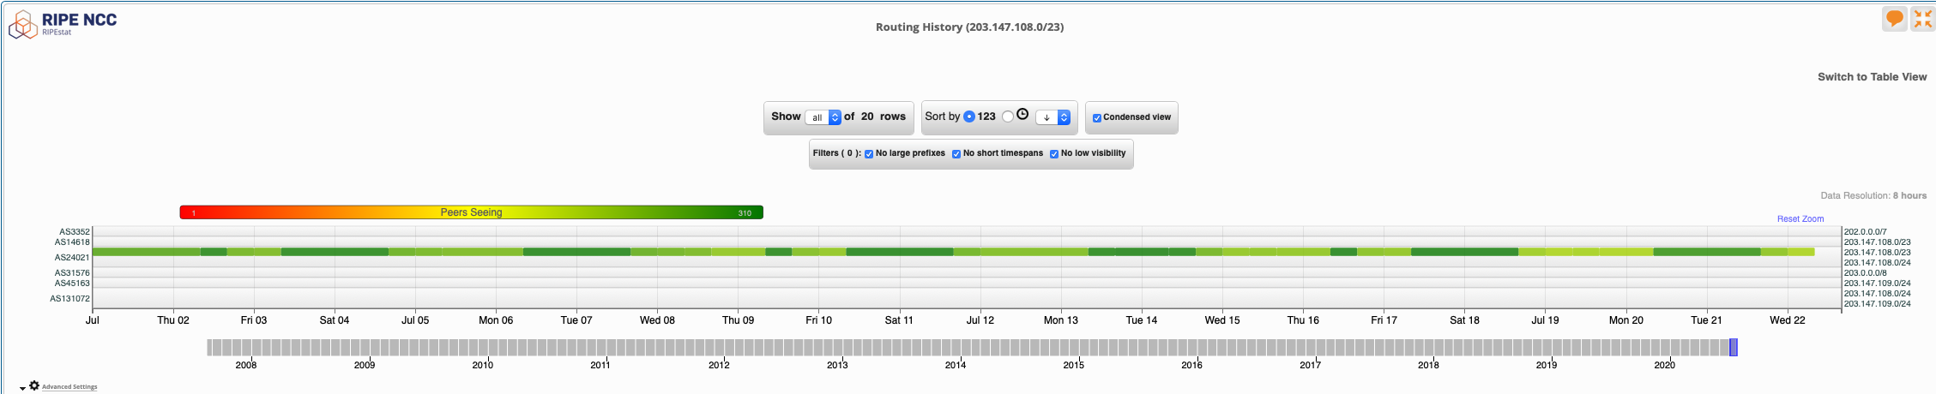
We use 12 and 36 hour held states
view from stat.ripe.net

Slide 32
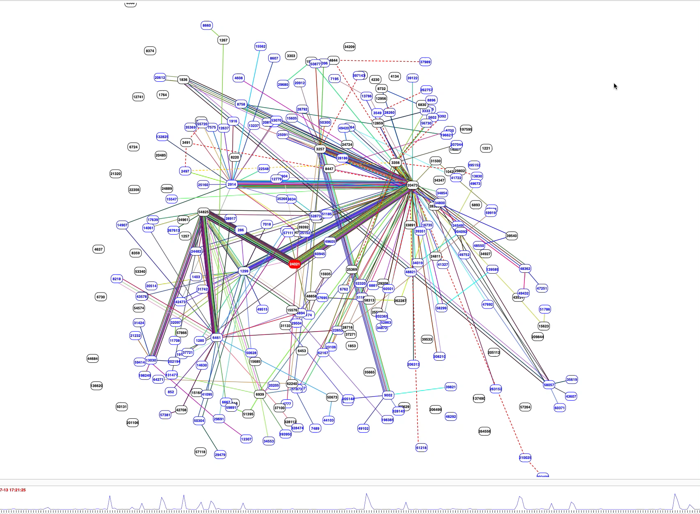
We use 12 and 36 hour held states
BGP Play view of the
routing changes

Slide 33
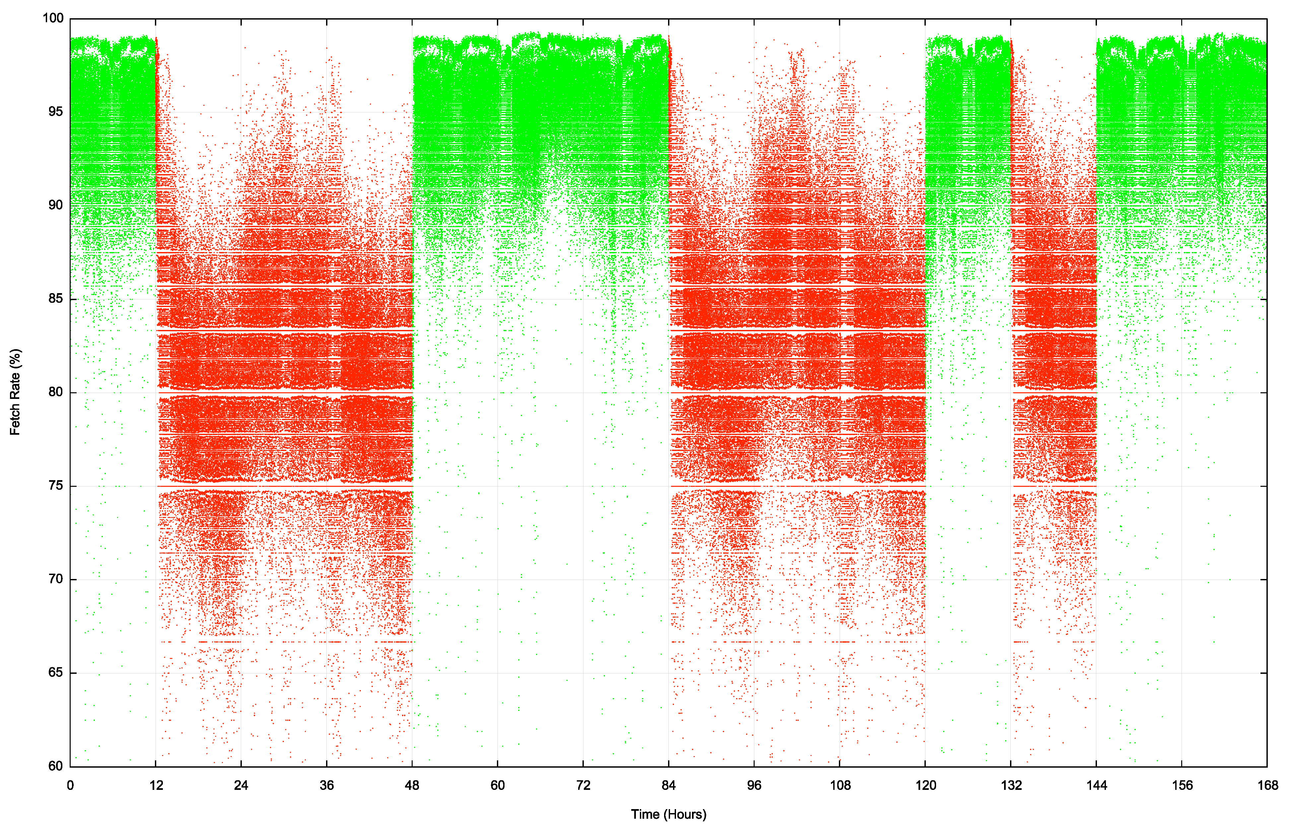
We used 12 and 36 hour states
”valid” route state
This shows the per-second fetch rate when the route is valid (green) and invalid (red) over a 7 day window
The route validity switches are clearly visible
Weekly Measurement
”invalid” route state

Slide 34
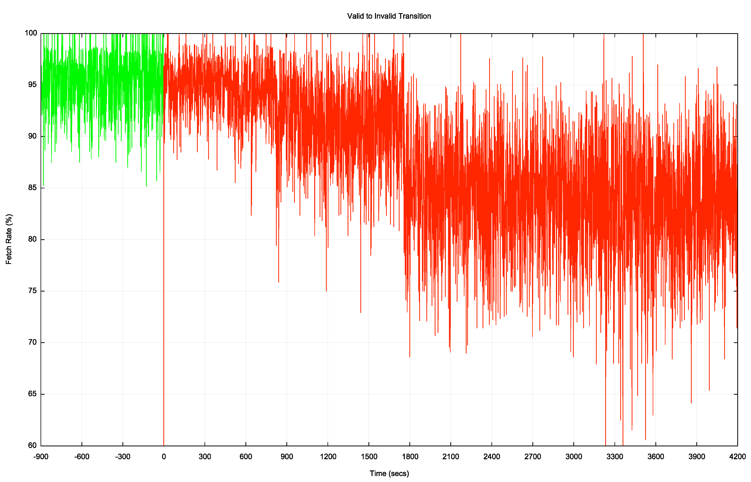
Transition – Valid to Invalid
It takes some 30 minutes for the valid to invalid transition to take effect in this measurement
It appears that this is a combination of slow re-query rates at the RPKI publication point and some delays in making changes to the filters being fed into the routers
This system is dependant on the last transit ISP to withdraw
Time of ROA change at the RPKI repository

Slide 35
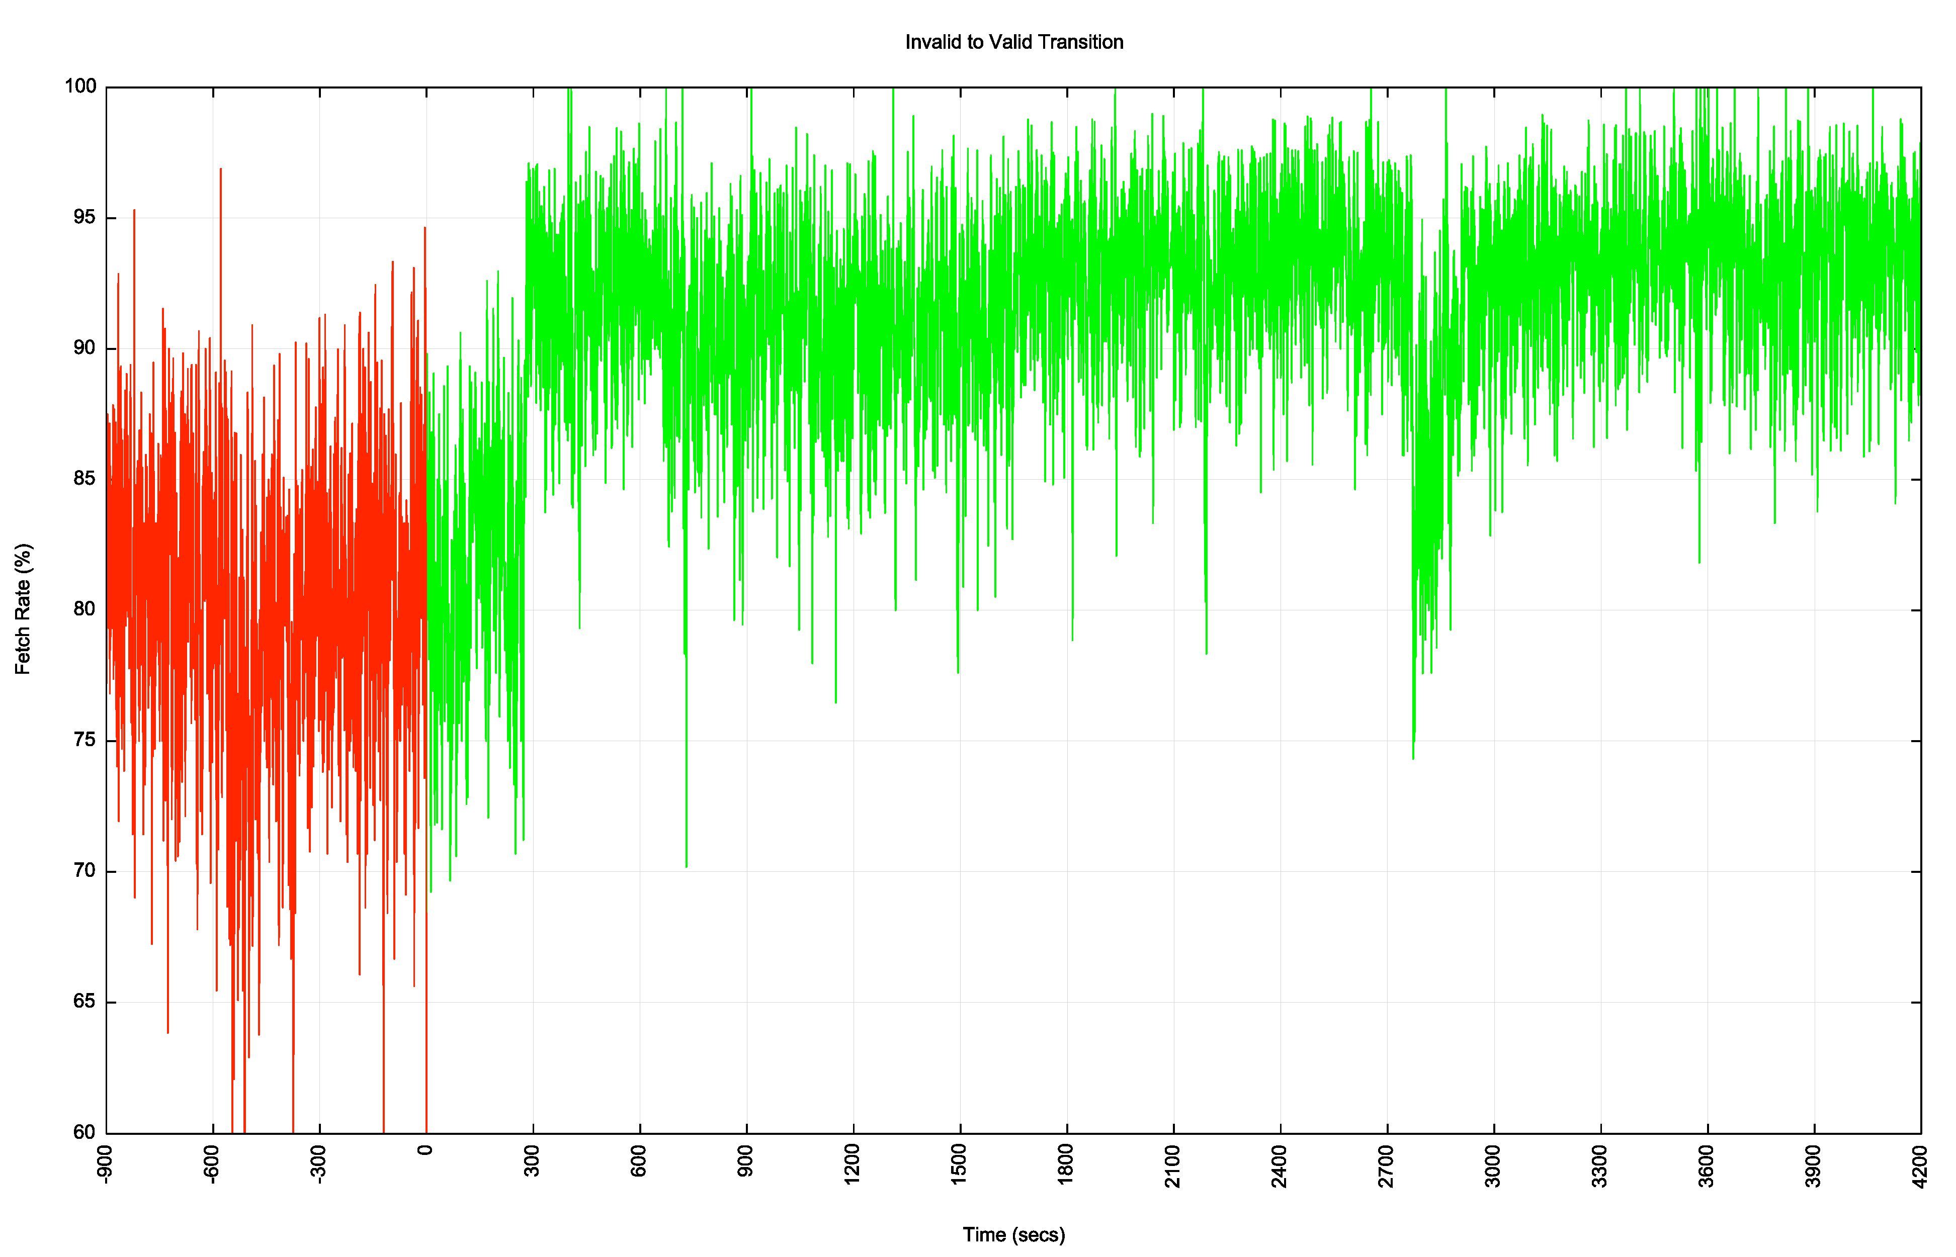
Transition – Invalid to Valid
It takes some 5 minutes for the invalid to valid transition to take effect in this measurement
This system is dependant on the first transit ISP to announce, so it tracks the fastest system to react
Time of ROA change at the RPKI repository

Slide 36
RPKI “sweep” software
There is a mix of 2, 10 and 60 minute timers being used
2 minutes seems like a lot of thrashing with little in the way of outcome – the responsiveness of the system is held back by those clients using longer re-query timers
60 minutes seems too slow
(I’d go with a 10 minute query timer as a compromise here)

Slide 37
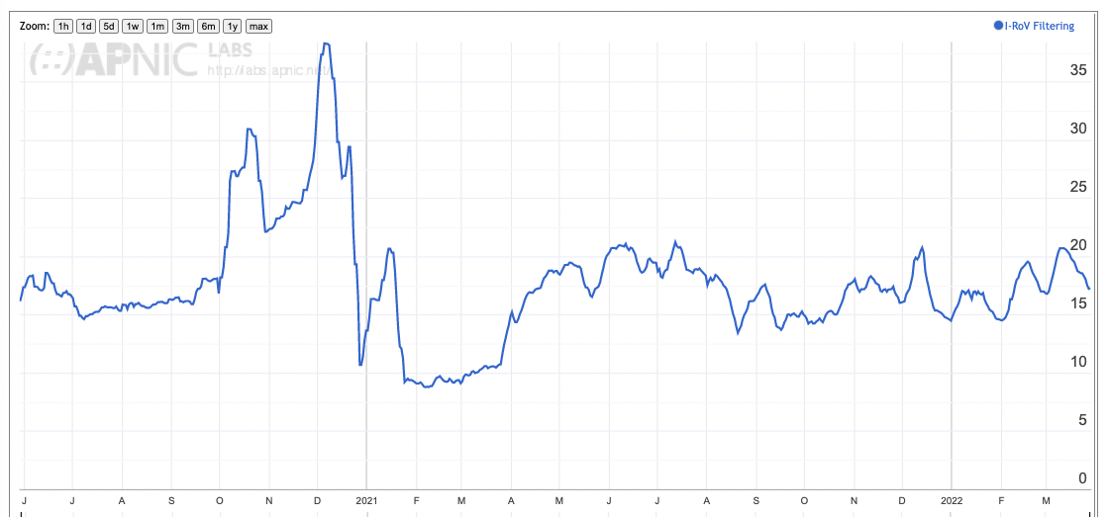
User impact of RPKI filtering
At 20% of users that’s a surprisingly large impact for a very recent technology
However, nothing much has changed in the past 16 months!

Slide 38
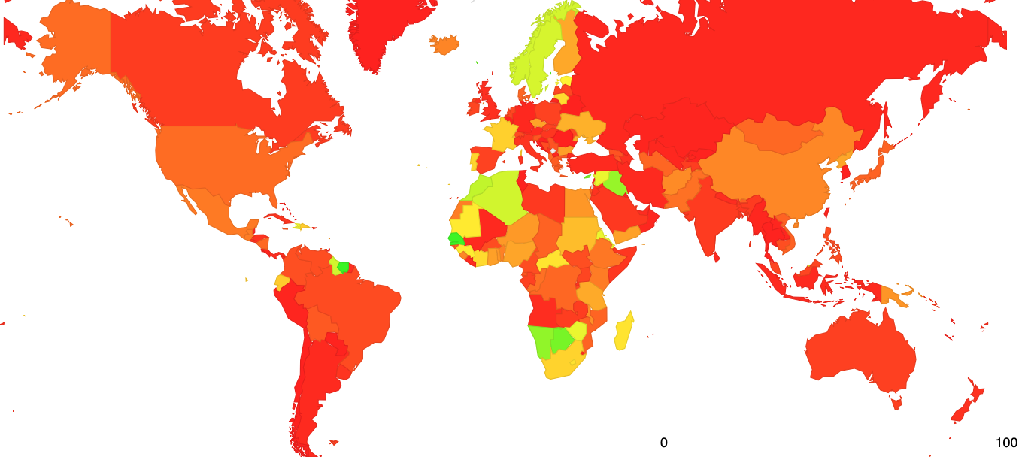
Results: User Impact of RPKI filtering – Jul 2020
https://stats.labs.apnic.net/rpki

Slide 39
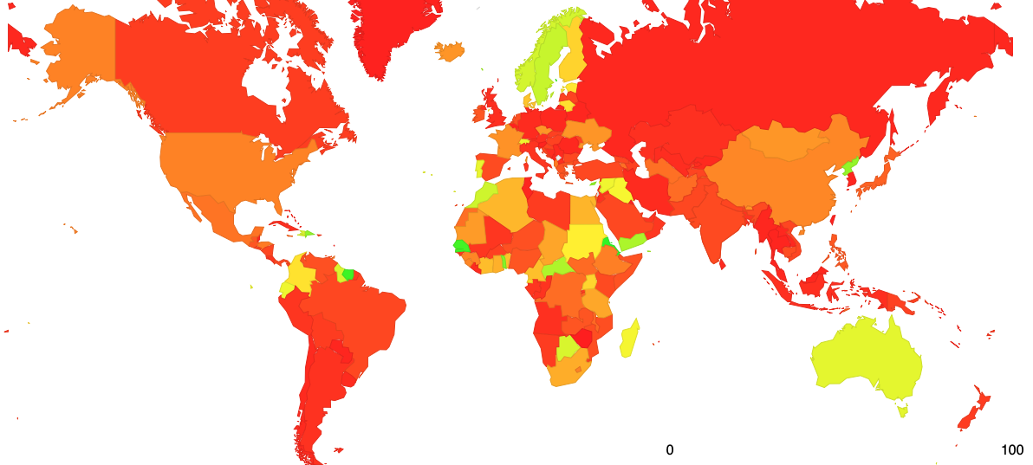
Results: User Impact of RPKI filtering – Oct 2020
74
https://stats.labs.apnic.net/rpki

Slide 40
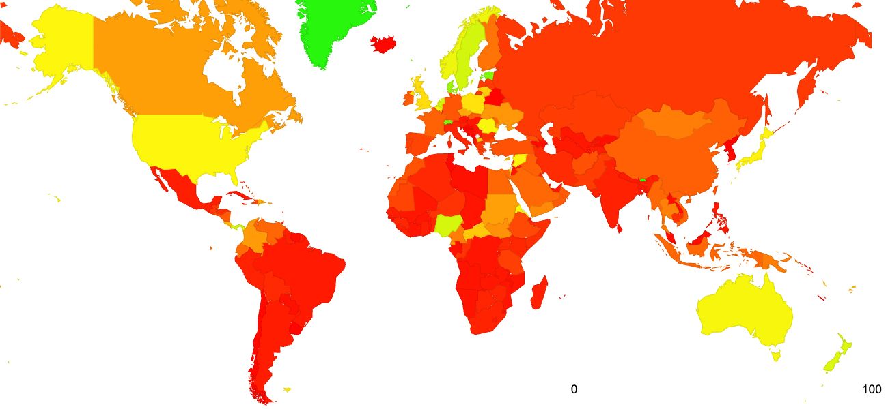
Results: User Impact of RPKI filtering – Mar 2022
https://stats.labs.apnic.net/rpki

Slide 41
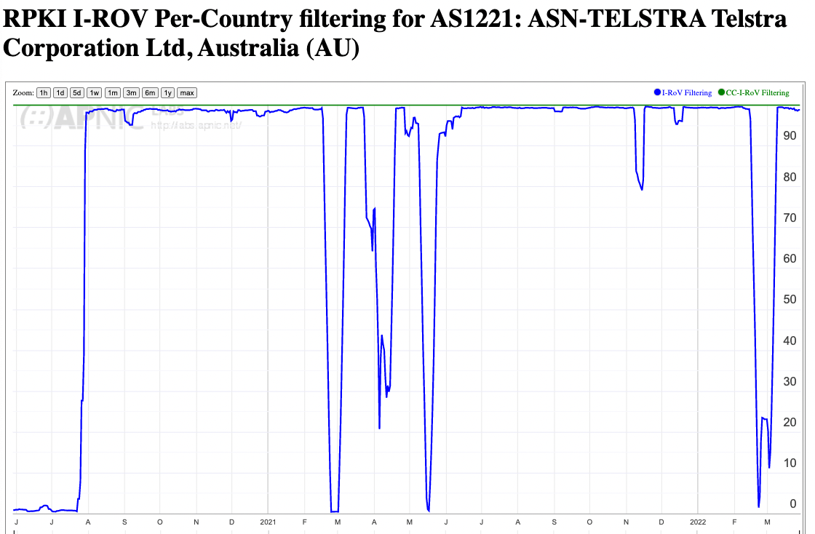
Turning on Drop Invalid Filtering

Slide 42
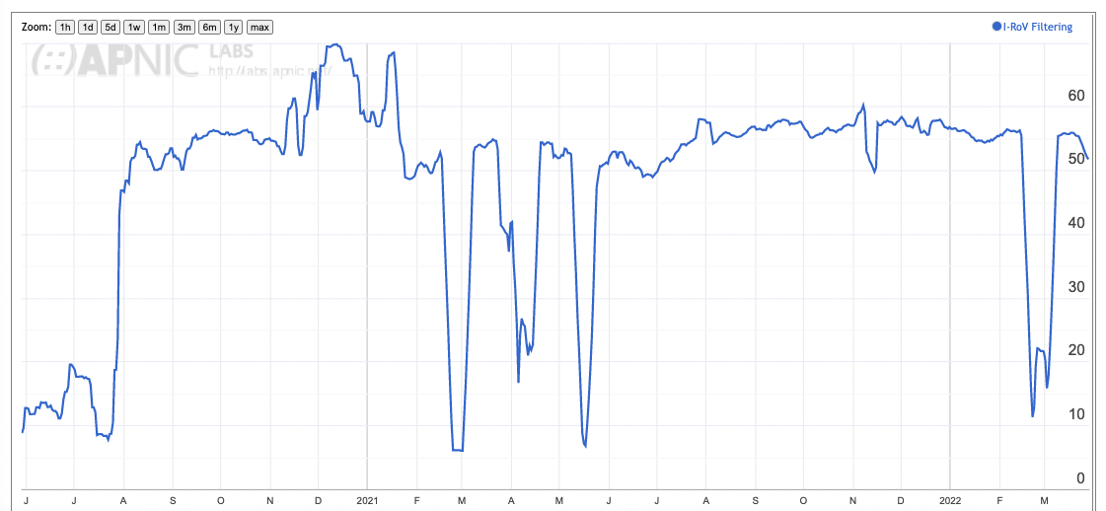
Australia
% of AU users

Slide 43
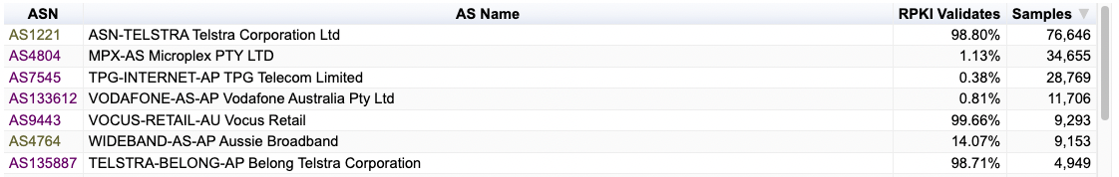
Local ISPs

Slide 44
Does everyone have to play?
There are two factors at play:
  Networks that perform invalid route filtering
  and
  Network that do not filter themselves, but are customers of transit providers who filter
In either case the basic RPKI RoV objective is achieved, in that the users within these ISP networks are not exposed to invalid route objects

Slide 45
Next Steps for Measurement
This is a work in progress and would benefit from more refinement, including:
Could we attempt selective traceroute from the anycast servers to identify the networks that are performing the RoV invalid filter drop?
  The measurement setup detects the user impact but not the individual networks who are performing drop invalid. Selective traceroute may allow a better way to identify the point of invalid drop
Should we perform further analysis of BGP route updates in route collectors to determine route withdrawal and announcement patterns when RPKI validity changes?
  What is the difference between the primary point of route withdrawal / announcement and the consequent propagation in eBGP to the surrounding networks?

Slide 46
Questions we might want to think about
Stub vs Transit
Is it necessary for every AS to operate RPKI ROV infrastructure and filter invalid routes?
If not, what’s the minimal set of filtering networks that could provide similar levels of filtering for the Internet as a whole
What’s the marginal benefit of stub AS performing RPKI ROV filtering?

Slide 47
Questions we might want to think about (2)
Ingress vs Egress
Should a stub AS RPKI only RoV filter its own announcements?
Should every AS filter their own announcements?
What’s more important: Protecting others who DON’T RoV filter from your operational mishaps or protecting yourself from the mishaps of others?
Does Partial Adoption change your answer?

Slide 48
Questions we might want to think about (3)
Prefix vs AS attestations
Should an AS be able to enumerate ALL of its originations in a AS-signed attestation?

Slide 49
Questions we might want to think about (4)
When and how will we protect the AS Path?
What is going in with the ASPA drafts in the IETF?
Is anyone experimenting with ASPA yet?
What is the benefit of Origination protection without AS Path protection?

Slide 50
What are we trying to achieve here?
If this is a routing protection measure then what are you trying to protect? From whom? From what threat?
If this is guard against operational errors then don’t forget that operational mishaps are endlessly varied, and we can’t foresee all possible causes of routing accidents!
If this is a user protection measure then the issue of route filtering is an issue for transit providers, not stub networks
  A stub network should generate ROAs for its routes, but there is far less of an incentive to perform RoV invalid filtering if the stub’s upstreams / IXs are already performing this filtering
  Is it more important for IXs and Transits to perform drop-invalids than for stubs?

Slide 51
Thanks!

