Slide 1
Passive vs Active Measurements in the DNS
Geoff Huston, Joao Damas
APNIC

Slide 2
This is work-in-progress
So its not clear what the conclusions might be
But we have noticed a set of not-well-explained behaviours in the DNS, and we are wondering if the observational behaviour has an influence on the observed DNS behaviour

Slide 3
Some anomalies
In previous studies associated with the KSK roll we noticed that the profile of resolvers and their query volumes seen at root servers had a very different profile to the resolvers who ask authoritative servers for “terminal” DNS names
We see repeat queries at servers that are inconsistent with our perceptions of how caching by recursive resolver systems should mitigate queries

Slide 4
Some questions we’d like to ask
If we actively “plant” a sequence of DNS resolution queries into the edge, and record the queries we see at the authoritative name server for the DNS name being queried, then what can this tell us about the general behaviour of the DNS?
What proportion of queries are the result of stub resolution questions and what proportion are the result of the DNS talking to itself (such as self-triggered cache refresh)
Why are there query “storms”?

Slide 5
An active observation platform
We might understand the effect better if we controlled the cause
  i.e. generate queries in a known context and look at their effect within in the DNS resolution environment

Slide 6

From the Inside looking Out
Instrument a DNS client
  Use the client to generate various DNS queries
  Measure the absolute outcomes and the variance
This needs the ability to either coopt or manufacture a collection of willing clients

Slide 7
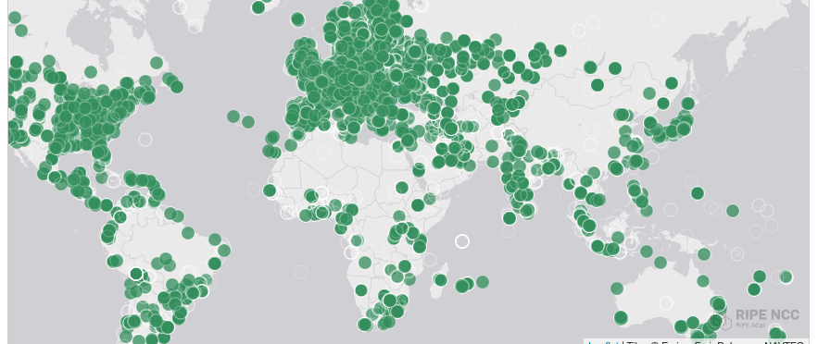
From the Inside looking Out
  RIPE Atlas
    Many thousands of end points installed in end user networks
    Programmable DNS queries
    Report back

Slide 8

From the Outside looking In
Set up authoritative server(s)
  Enroll end users to send queries to it
  Measure the outcomes from the perspective of the server, not the end client

Slide 9
In the Middle looking both ways
Instrument recursive resolvers and observe both stub behaviours and authoritative server behaviours for queries
There are obvious privacy issues that lurk very close to the surface here

Slide 10
How to measure using millions of end devices?
APNIC Lab’s approach
we originally wanted to measure IPv6 deployment as seen by end users
We wanted to say something about ALL users
So we were looking at a way to sample end users in a random but statistically significant fashion across the entire network
We stumbled across the advertising networks...

Slide 11
What can be scripted in an Ad
Not much:
  http.FetchImg()
    i.e. attempt to retrieve a URL
But that’s enough!
  It’s EXACTLY what users do!
  A URL consists of a DNS question and an HTML question
  What if we point both the DNS and the HTML to servers we run?
  As long as each Ad execution uses unique names we can push the user query back to our servers

Slide 12
DNS Label Encoding
Think of a URL name as a microcoded instruction set directed to programmable DNS and HTTP servers …
http://06s-u69c5b052-c13-a4c5-s1579128735-icb0a3c4c-0.ap.dotnxdomain.net/1x1.png
Immediate response
IPv6 access only
Valid DNSSEC signature available
uuid to map multiple queries to a single experiment
User is located in Country 13 (Australia)
User is located in AS1221 (Telstra)
Label Creation Time is 16 January 2020 9:52am
User’s IPv4 address is 203.10.60.76

Slide 13
DNS Label Encoding
Think of a URL name as a microcoded instruction set directed to programmable DNS and HTTP servers …
http://06s-u69c5b052-c13-a4c5-s1579128735-icb0a3c4c-0.ap.dotnxdomain.net/1x1.png
Immediate response
IPv6 access only
Valid DNSSEC signature available
uuid to map multiple queries to a single experiment
User is located in Country 13 (Australia)
User is located in AS1221 (Telstra)
Label Creation Time is 16 January 2020 9:52am
User’s IPv4 address is 203.10.60.76

Slide 14
Experiment Profile
Daily Ad Impression Count
Daily DNS Query Count

Slide 15
DNS Amplification
This compares the daily DNS query count against the daily new label “injection” count

Slide 16
DNS Zombies per day
These are single use DNS labels
So let’s look at the queries where the time is more than 30 seconds older than the label creation time
Some days have a high avg peak rate – some don’t – why?
The zombie rate on non-peaking days is (slowly) falling – why?

Slide 17
One ‘Intense’ Zombie Day

Slide 18
One ‘Other’ Zombie Day

Slide 19
Some Questions
Some of the Zombie activity might be based on high speed query log replay
  How prevalent is this behaviour across the entire DNS query landscape?
  How would this impact on passive query observations
What contributes to the background query profile?
  Why does the background have such a long tail?

Slide 20
Further Studies?
Correlate select query data from recursor(s) with query data from authoritatives
Look for query teleportation (geo shift from original to zombie)
How much DNS stalking is going on?
Would changing the response code for zombie queries change the zombie query behaviour?
How much of the query data is based on end user queries and how much on synthetic queries and DNS thrashing?

