Slide 1
Reporting on Route Objects and ROA Validation
Geoff Huston
APNIC Labs

Slide 2
Within each economy, and within each network, what’s the extent of publication of ROAs to allow validation of route objects?
How many of these advertised routes are valid, invalid and unknown?
What about if we looked at advertised address spans rather then just route objects?
How about IPv4 and IPv6 routes?

Slide 3
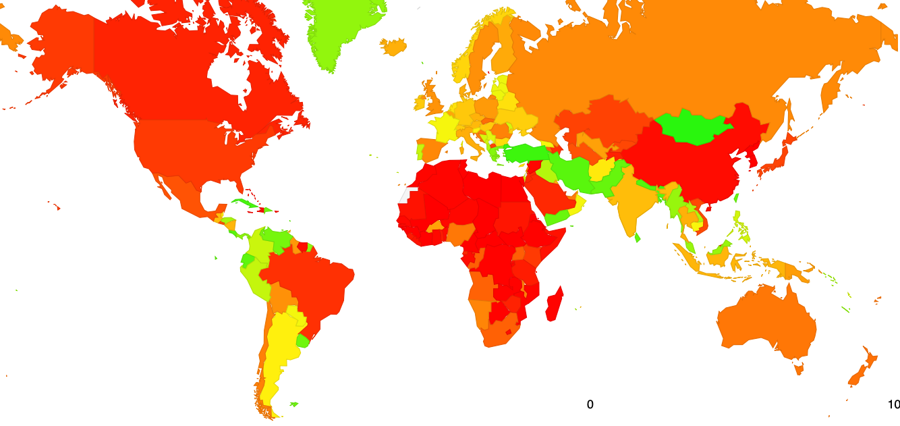
https://stats.labs.apnic.net/roas
Within each economy what’s the percentage of ROA-valid route objects of the total count of advertised route objects?

Slide 4
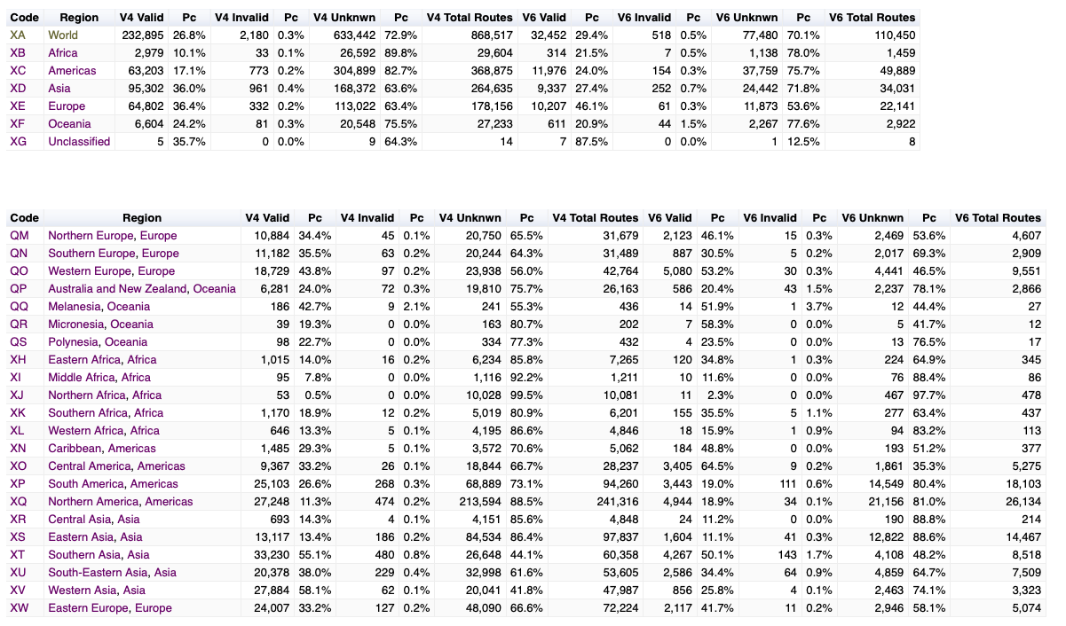
https://stats.labs.apnic.net/roas
And display the dataset used to generate the map

Slide 5
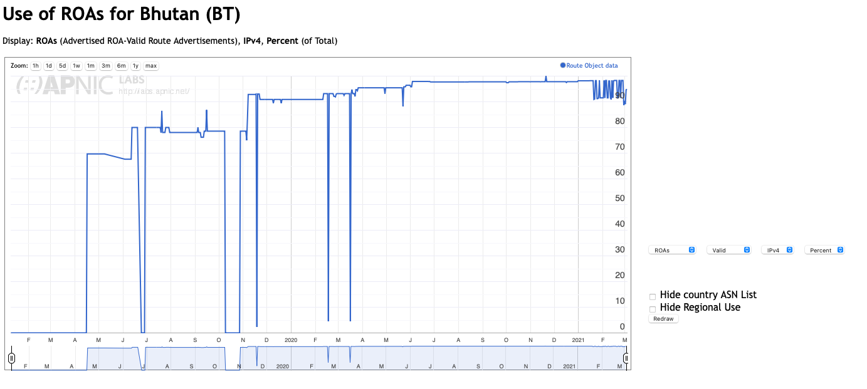
Country View

Slide 6
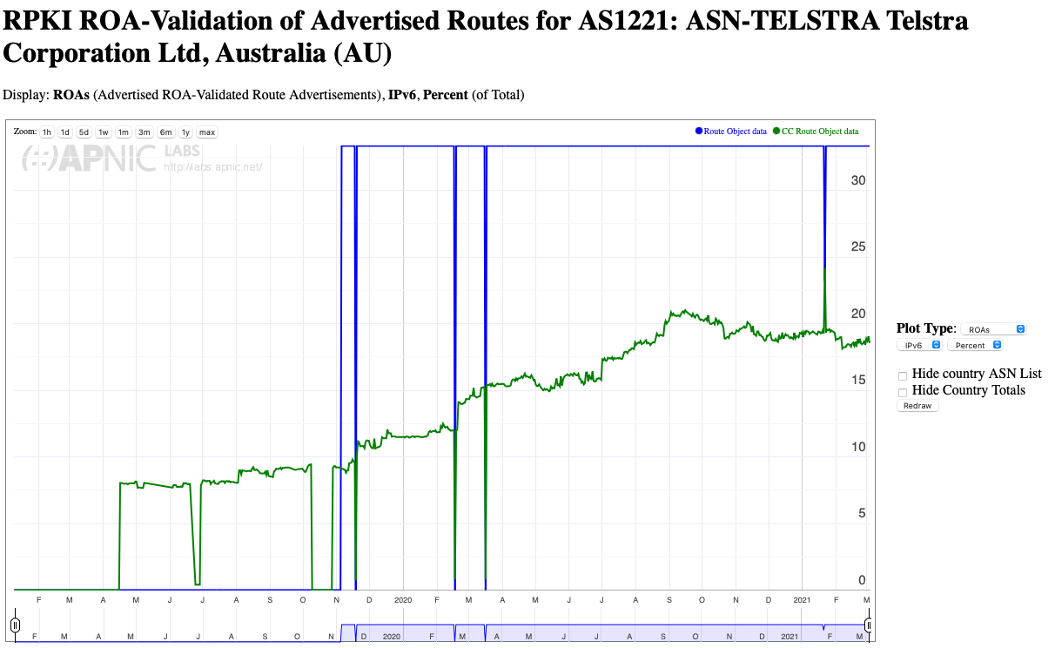
Network (ASN) View

Slide 7
https://stats.labs.apnic.net/roas
It’s still being developed (and debugged!)
Please let me know if you have suggestions, comments, bug reports, etc
EMail: research (a) apnic.net

Slide 8
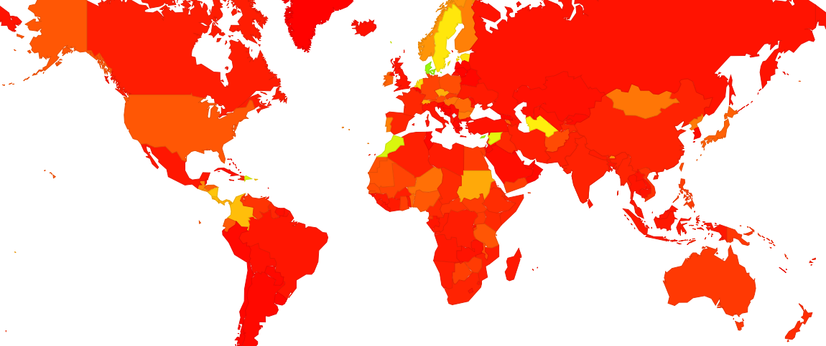
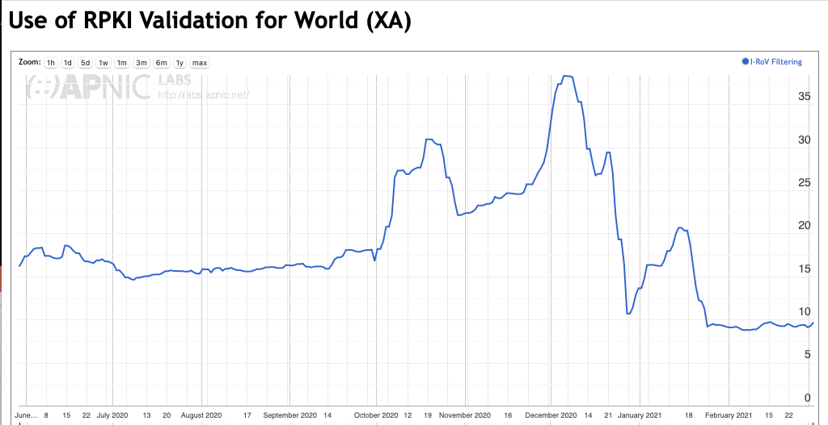
By the way…
How well are economies and networks doing with drop-invalid ROV filtering?
https://stats.labs.apnic.net/rpki tracks our progress in deployment of ROV filter tools to drop ROV-invalid routes

Slide 9
Questions?

