Slide 1
Measuring Query Name Minimization
Geoff Huston
Joao Damas
APNIC Labs
October 2020

Slide 2
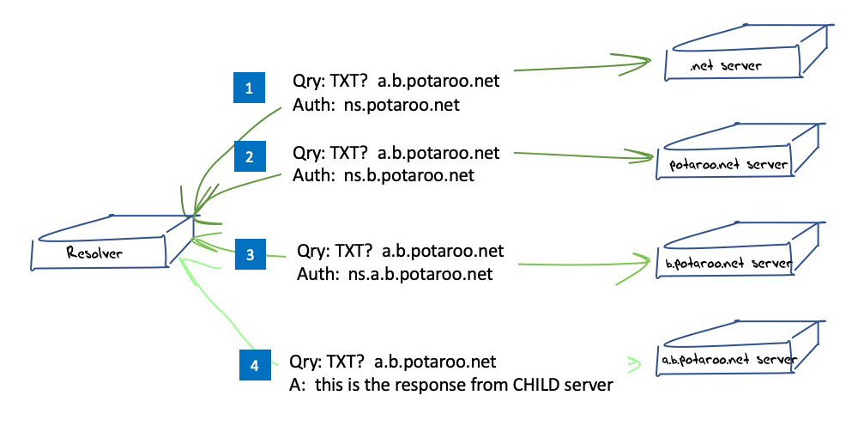
Quick Summary
NON-query name minimisation resolution sequence

Slide 3
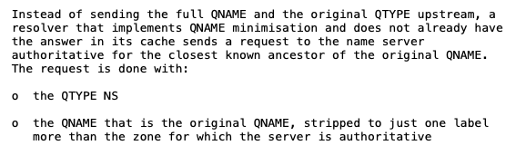
Quick Summary
Query name minimisation technique described in RFC 7816

Slide 4
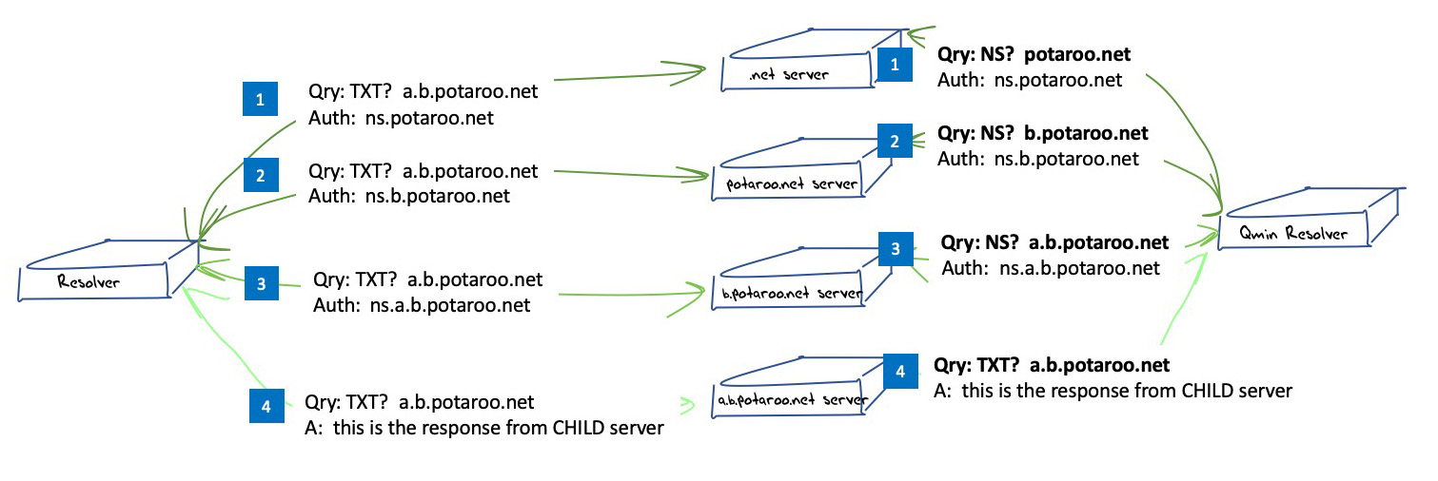
Quick Summary
Query name minimisation technique described in RFC 7816

Slide 5
Common Resolver Implementation Status
BIND 9
  Implemented in 9.14, active in “relaxed” mode by default
Unbound
  Implemented in 1.7.2, active in “non-strict” mode
Knot
  Implemented in 1.2.2, active by default
Power DNS Recursor
  Implemented in 4.3.0-alpha1, enabled by default since 4.3.0-beta 1

Slide 6
Common Resolver Implementation Status
BIND 9
  Implemented in 9.14, active in “relaxed” mode by default
Unbound
  Implemented in 1.7.2, active in “non-strict” mode
Knot
  Implemented in 1.2.2, active by default
Power DNS Recursor
  Implemented in 4.3.0-alpha1, enabled by default since 4.3.0-beta 1
It looks like all recursive resolvers that use up-to-date versions of these code bases should be doing query name minimisation by default these days.
What do we see?

Slide 7
Measurement
Let’s look at the adoption of query name minimisation from the perspectives of the end user and their queries, and from the perspective of recursive resolvers

Slide 8
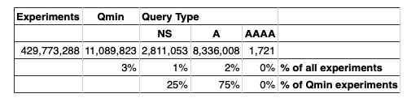
Users whose Queries are handled with Qname Minimization
2019 Results

Slide 9
Users whose Queries are handled with Qname Minimization
2019 Results
2020 Results

Slide 10
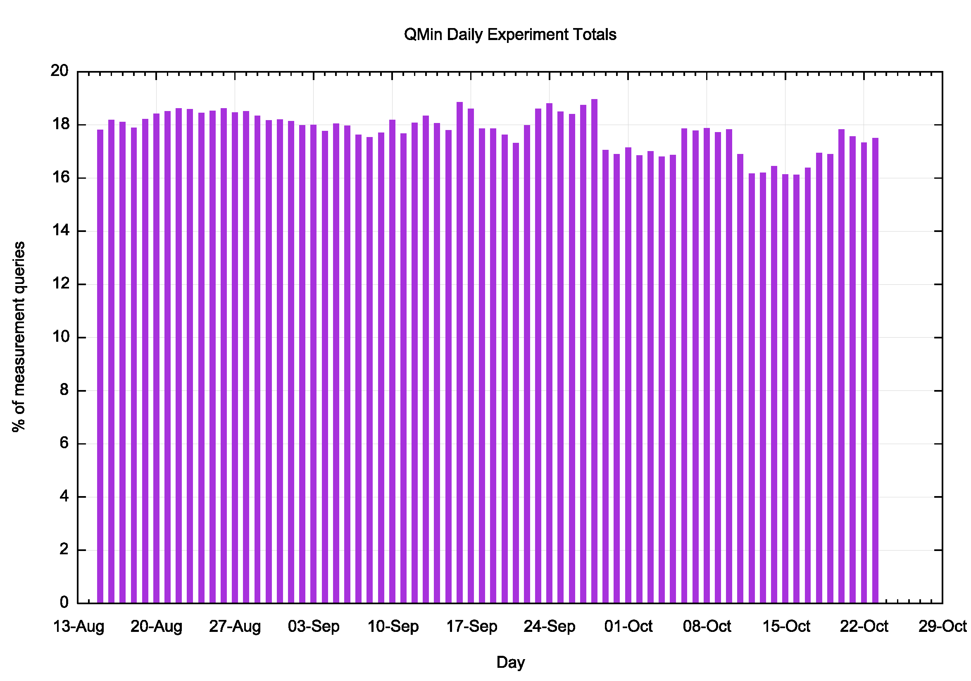
Daily Results - 2020
Yes, this is a relatively brief 8-week measurement but the rate is not growing, and may even be declining a little!

Slide 11
Where are these Users?

Slide 12
Resolver Measures
What’s a “resolver”?
  Always hard to tell these days.
  Over a 16 day period we saw 183,438 distinct IP addresses of resolvers
    148,230 IPv4 addresses
    77,548 distinct /24 subnets
    35,209 IPv6 addresses
    9,069 distinct /48 subnets
resolver engine
query distributor
resolver engine
resolver engine
resolver engine

Slide 13
Open Resolvers
What’s behind these 50%-70% ratios? Is Qmin only partially deployed in the DNS service anycast constellation?
This is more expected!

Slide 14
ISP Resolvers

Slide 15
Observations
Query name minimisation is gathering momentum in the past 12 months (3% or users in mid 2019 to 18% of users in mid-2020)
While all common vendor code has enabled Query name minimisation, enabling this behaviour in ISP and open resolvers is fragmentary
Why is it not deployed at levels greater than 18%?
What’s the concern?

Slide 16
Our Measurement
We are using the 4th and 5th level names to perform the experiment
  <unique-label> . ent-<unique label> . <region> . <common_name> . net
  Some resolvers (Google?) only perform Qname minimisation to the 3rd level
Why?
  Is privacy no longer important at the bottom of the name hierarchy?
  Or is it only TLD servers that breach privacy in query names?
  Or are recursive operators just making it up on the fly?

Slide 17
More Questions
Where and why is Query Name minimisation important?
Does it differ by scale?
  Small scale recursive resolvers at the edge of the network?
  ISP-operated recursive resolvers?
  Open recursive resolvers?
Is the query name alone a privacy threat or is the combination of the recursive resolver with the query name the problem?
Does attribution in the form of Client Subnet in queries change the picture?

Slide 18
Last Question
What’s the most critical privacy risk in today’s DNS?
Please rank the following:
  Client Subnet in queries
  Unencrypted stub-to-recursive DNS transactions
  Full query name without attribution from recursive to authoritative
  Recursive resolvers seeing both the full query name and attribution
  Unencrypted recursive-to-authoritative DNS transactions

Slide 19
Thanks!

