Slide 1
Measuring Query Name Minimization
Joao Damas
Geoff Huston
APNIC Labs
September 2020

Slide 2
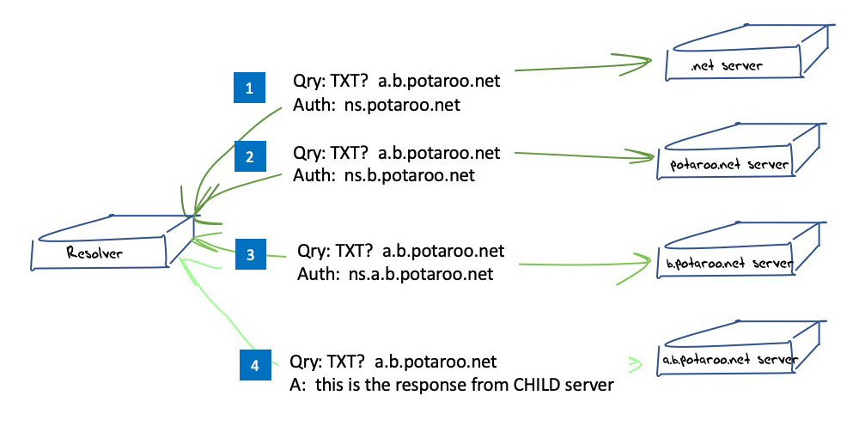
Quick Summary
NON-query name minimisation resolution sequence

Slide 3
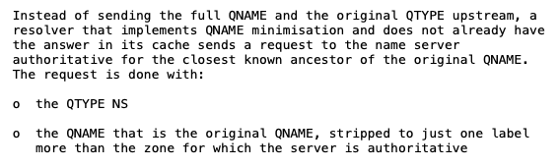
Quick Summary
Query name minimisation technique described in RFC 7816

Slide 4
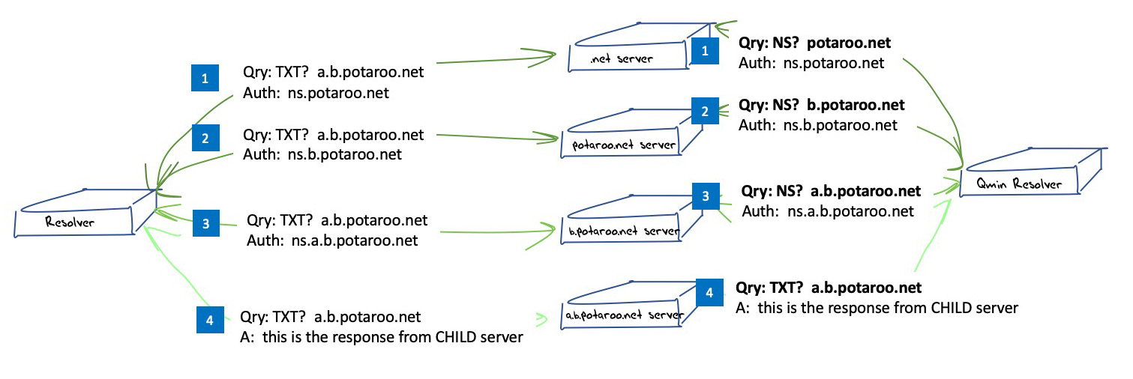
Quick Summary
Query name minimisation technique described in RFC 7816

Slide 5
Common Resolver Implementation Status
BIND 9
  Implemented in 9.14, active in “relaxed” mode by default
Unbound
  Implemented in 1.7.2, active in “non-strict” mode
Knot
  Implemented in 1.2.2, active by default
Power DNS Recursor
  Implemented in 4.3.0-alpha1, enabled by default since 4.3.0-beta 1

Slide 6
Common Resolver Implementation Status
BIND 9
  Implemented in 9.14, active in “relaxed” mode by default
Unbound
  Implemented in 1.7.2, active in “non-strict” mode
Knot
  Implemented in 1.2.2, active by default
Power DNS Recursor
  Implemented in 4.3.0-alpha1, enabled by default since 4.3.0-beta 1
It looks like all recursive resolvers should be doing query name minimisation these days.
Right?

Slide 7
Measurements
Let’s look at the adoption of query name minimisation from the perspectives of the end user and their queries, and from the perspective of recursive resolvers

Slide 8
Users whose Queries are handled with Qname Minimization

Slide 9
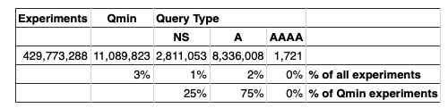
User Measurements
2019 Results

Slide 10
User Measurements
2019 Results
2020 Results

Slide 11
User Measures
The proportion of users who use recursive resolvers that perform Query Name minimization has risen from 3% of users to 18% of users in the past 12 months.
The common resolver behaviour is to perform the discovery queries using query type A, not NS or AAAA

Slide 12
Where are these Users?

Slide 13
Resolver Measures
What’s a “resolver”?
  Always hard to tell these days.
  Over a 16 day period we saw 183,438 distinct IP addresses of resolvers
    148,230 IPv4 addresses
    77,548 distinct /24 subnets
    35,209 IPv6 addresses
    9,069 distinct /48 subnets

Slide 14
Open Resolvers
What’s behind these 50%-70% ratios? Is Qmin only partially deployed in the DNS service anycast constellation?
;
This is more expected!

Slide 15
ISP Resolvers

Slide 16
Observations
Query name minimisation is gathering momentum in the past 12 months (3% or users in mid 2019 to 18% of users in mid-2020)
While all common vendor code has enabled Query name minimisation, enabling this behaviour in ISP and open resolvers is fragmentary
  Why is it not deployed? What’s the concern?

Slide 17
Questions
Where and why is Query Name minimisation important? Does it differ by scale?
  Small scale recursive resolvers at the edge of the network?
  ISP-operated recursive resolvers?
  Open recursive resolvers?
Is the query name alone a privacy threat or is the combination of the recursive resolver with the query name the problem?
Are there residual issues with handling of empty non-terminals?

Slide 18
Thanks!

