Slide 1
Abuse of the DNS

Slide 2
What we do:
Run an online advertisement with an embedded measurement script
  The script caused the browser to fetch a number of 1x1 ‘blots’
  To ensure that we had a clear view of the actions of the user and the DNS resolvers they use, we used unique URL labels.

Slide 3
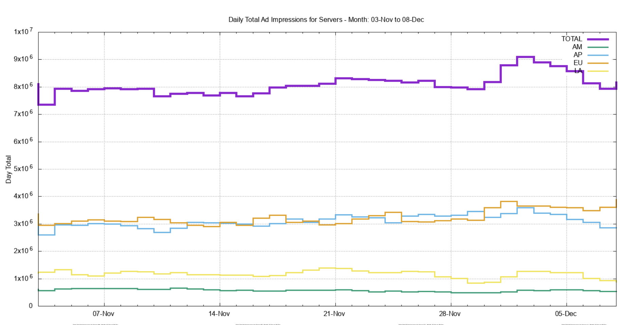
Ad Impressions per Day
We are currently serving some 8 M
Ad impressios per day

Slide 4
URL Load
We are generating some 24 million DNS queries for “unique” DNS names per day
And similarly performing some 24 million HTTP blot fetches for “unique” URLs per day

Slide 5
“Unique”?
What is meant by “unique”?
  The DNS name is queried by a single endpoint once and only once(*) – never again!
      (And the name includes a subfield of the time it was created)
  Which means that we should see one query for the name at the authoritative name server
* Well not quite, 25% of the time its queried twice, and sometimes more, but its all triggered by a single resolution action initiated by the endpoint – all these queries are clustered together in time

Slide 6
What do we see?
1575763200.052782 client 2001:558:fe00:c:69:252:228:155#28173: query: 0di-ua3a8f5b9-c233-s1575763198-i00000000-0.am.dotnxdomain.net. IN A -ED () 0 327
1575763200.107703 client 2001:1890:1ff:9c5:12:121:117:117#59964: query: 0du-results-uffc468d4-c233-s1575763190-i6cf3ec1f-0.am.dotnxdomain.net. IN A -EDC () 0 114
1575763200.116616 client 2600:387:2:807::f#2425: query: 0du-results-ufa9c53fd-c233-s1575763189-i6b4de8b7-0.am.dotnxdomain.net. IN A -EDC () 0 114
1575763200.170904 client 76.96.24.3#38686: query: 0ds-u7dc476e7-c233-s1575763199-i00000000-0.am.dotnxdomain.net. IN A -ED () 0 327
1575763200.237990 client 76.96.24.7#37373: query: 0di-u7dc476e7-c233-s1575763199-i00000000-0.am.dotnxdomain.net. IN AAAA -ED () 0 339
1575763200.256426 client 144.160.112.7#31949: query: 06u-udd090ee9-c233-s1552588424-i6b4dd023-0.am.dotnxdomain.net. IN A -ED () 0 146
1575763200.286878 client 144.160.112.7#39678: query: 06u-udd090ee9-c233-s1552588424-i6b4dd023-0.am.dotnxdomain.net. IN AAAA -ED () 0 118
1575763200.324318 client 107.77.253.241#36892: query: 0du-uacb2983c-c233-s1575763200-i6b4dfd37-0.am.dotnxdomain.net. IN A -ED () 0 106
1575763200.324671 client 107.77.253.240#37953: query: 0du-uacb2983c-c233-s1575763200-i6b4dfd37-0.am.dotnxdomain.net. IN AAAA -ED () 0 118
1575763200.329448 client 2600:387:6:983::16#5656: query: 04u-uacb2983c-c233-s1575763200-i6b4dfd37-0.am.dotnxdomain.net. IN A -ED () 0 106
1575763200.329884 client 107.77.253.241#1154: query: 04u-uacb2983c-c233-s1575763200-i6b4dfd37-0.am.dotnxdomain.net. IN AAAA -ED () 0 146
Name ‘creation’ time
Query time

Slide 7
What do we see?
1575763200.052782 client 2001:558:fe00:c:69:252:228:155#28173: query: 0di-ua3a8f5b9-c233-s1575763198-i00000000-0.am.dotnxdomain.net. IN A -ED () 0 327
1575763200.107703 client 2001:1890:1ff:9c5:12:121:117:117#59964: query: 0du-results-uffc468d4-c233-s1575763190-i6cf3ec1f-0.am.dotnxdomain.net. IN A -EDC () 0 114
1575763200.116616 client 2600:387:2:807::f#2425: query: 0du-results-ufa9c53fd-c233-s1575763189-i6b4de8b7-0.am.dotnxdomain.net. IN A -EDC () 0 114
1575763200.170904 client 76.96.24.3#38686: query: 0ds-u7dc476e7-c233-s1575763199-i00000000-0.am.dotnxdomain.net. IN A -ED () 0 327
1575763200.237990 client 76.96.24.7#37373: query: 0di-u7dc476e7-c233-s1575763199-i00000000-0.am.dotnxdomain.net. IN AAAA -ED () 0 339
1575763200.256426 client 144.160.112.7#31949: query: 06u-udd090ee9-c233-s1552588424-i6b4dd023-0.am.dotnxdomain.net. IN A -ED () 0 146
1575763200.286878 client 144.160.112.7#39678: query: 06u-udd090ee9-c233-s1552588424-i6b4dd023-0.am.dotnxdomain.net. IN AAAA -ED () 0 118
1575763200.324318 client 107.77.253.241#36892: query: 0du-uacb2983c-c233-s1575763200-i6b4dfd37-0.am.dotnxdomain.net. IN A -ED () 0 106
1575763200.324671 client 107.77.253.240#37953: query: 0du-uacb2983c-c233-s1575763200-i6b4dfd37-0.am.dotnxdomain.net. IN AAAA -ED () 0 118
1575763200.329448 client 2600:387:6:983::16#5656: query: 04u-uacb2983c-c233-s1575763200-i6b4dfd37-0.am.dotnxdomain.net. IN A -ED () 0 106
1575763200.329884 client 107.77.253.241#1154: query: 04u-uacb2983c-c233-s1575763200-i6b4dfd37-0.am.dotnxdomain.net. IN AAAA -ED () 0 146
Old queries
Name ‘creation’ time
Query time

Slide 8
One Day, One DNS Server

Slide 9
One Day, One DNS Server

Slide 10
60 Days, All DNS Servers
50% of all zombie queries are more than 6 months old!

Slide 11
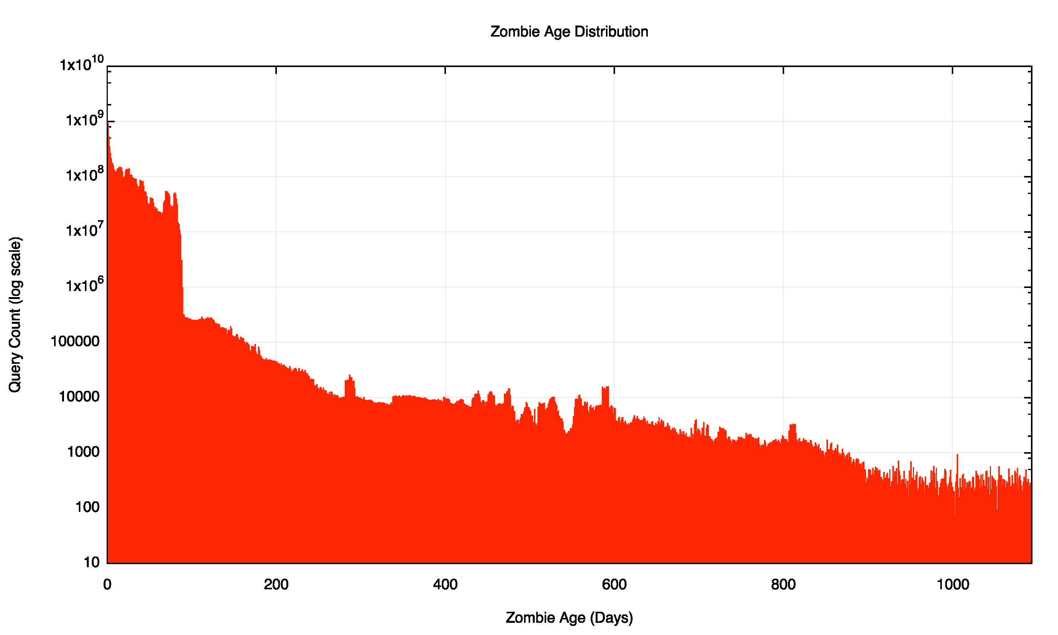
180 Days, All DNS Servers
44,733,946,408 DNS queries, of which 11,274,142,797 are zombies – a 25% zombie rating!

Slide 12
Zombie Queries per day
2/3 of all queries occur once per day

Slide 13
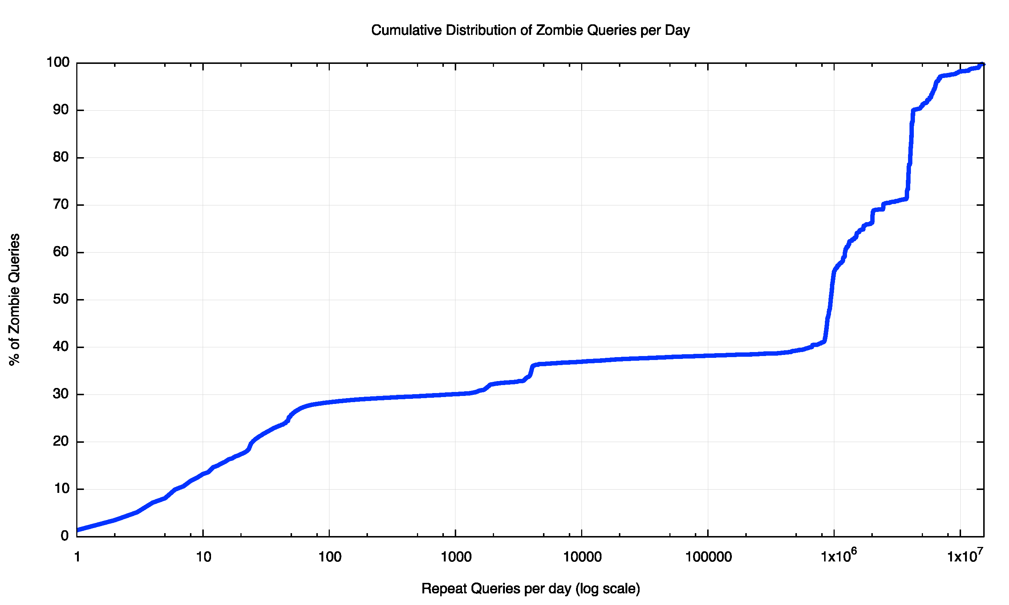
Zombie Repeats per day

Slide 14
What is causing this?
Is this the result of a collection of deranged DNS recursive resolvers with an obsession about never forgetting a thing?
Or web proxies that just have too much time (and space) on their hands and want to fill all that space with a vast collection of identical 1x1 pixel gifs?
Let’s look at web zombies …

Slide 15
Zombie URL Age Distribution

Slide 16
Zombie URL Age Distribution
50% of all zombie URLs are less than 4 days old

Slide 17
Zombie URL Repeats

Slide 18
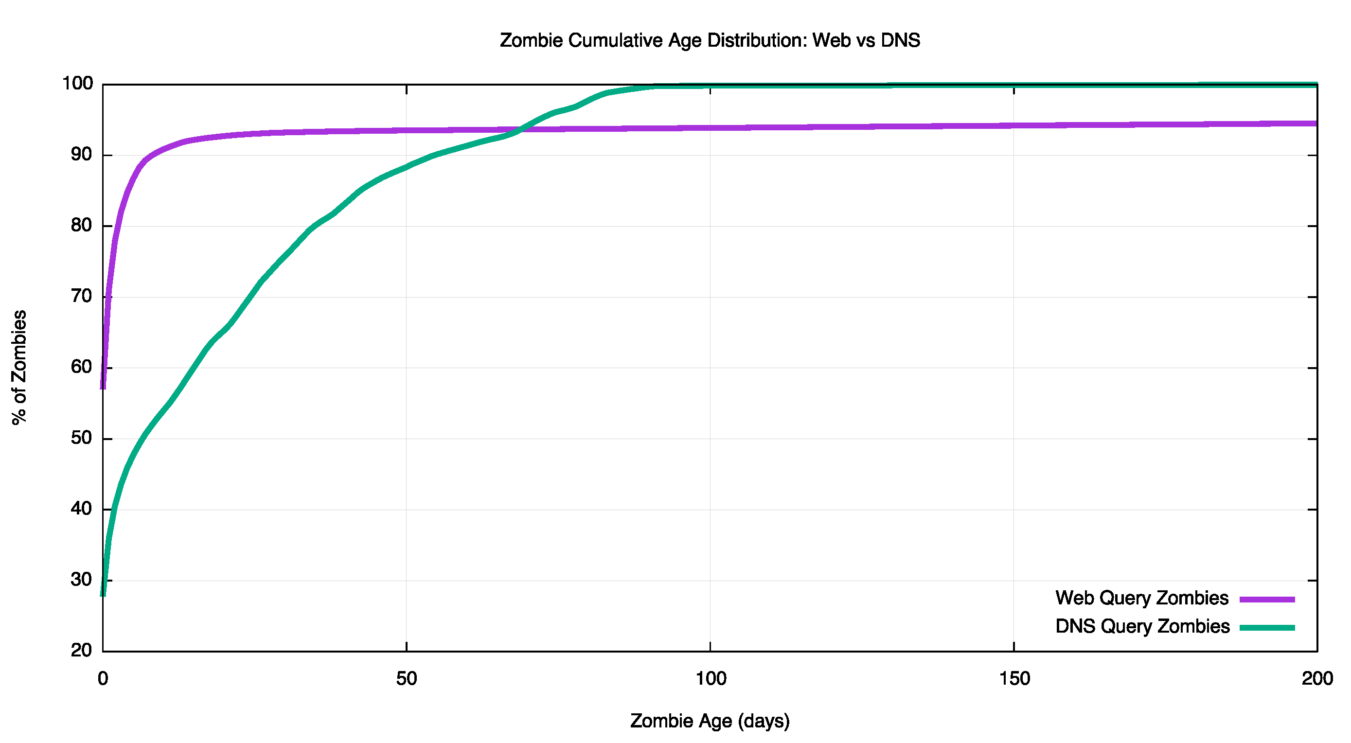
DNS vs URLs
Web
DNS zombies are living their own zombie half life! They are not the hell spawn of zombie URLS!
DNS

Slide 19
What is causing this?
Is this the result of a collection of deranged DNS recursive resolvers with an obsession about never forgetting a thing?
Or web proxies that just have too much time (and space) on their hands and want to fill all that space with a vast collection of identical 1x1 pixel gifs?
Let’s look at web zombies …

Slide 20
Who Are These Deranged Resolvers?
Resolver Current Zombie Ratio ASN CC AS Name
186.151.28.130 3,978,931 4,610,444,812 1,158 14754 GT Telgua, Guatemala
87.236.233.178 14,124,423 1,006,797,893 71 35656 JO JUNET Jordanian Universities, Jordan
74.205.176.249 9,868,204 870,945,137 88 53618 CA ADITY-OSH - Aditya Birla Minacs, Canada
204.184.141.253 35,034,545 594,314,499 16 2572 US Missouri Research and Edu., United States
38.229.33.65 7 573,038,416 81,862,630 23028 US Team Cymru Inc. United States
80.246.0.3 1,486,712 379,724,419 255 21391 DZ TDA-AS,DZ Algeria
80.246.0.2 2,041,670 373,155,047 182 21391 DZ TDA-AS,DZ Algeria
87.236.232.5 5,697,987 255,364,280 44 35656 JO JUNET Jordanian Universities, Jordan
74.205.162.254 1,975,978 200,821,246 101 14214 CA MINACS - Minacs Inc, Canada
38.229.33.67 11 128,929,881 11,720,898 23028 US Team Cymru Inc, United States
38.229.33.68 2 109,905,028 54,952,514 23028 US Team Cymru Inc, United States
38.229.33.100 3 90,637,788 30,212,596 23028 US Team Cymru Inc, United States
38.229.33.99 3 67,436,258 22,478,752 23028 US Team Cymru Inc, United States
200.195.185.205 93,986 39,623,754 421 14868 BR COPEL Telecom S.A. Brazil
167.102.229.10 1,632,910 17,868,074 10 27026 US Network Maryland, US United States
54.183.221.9 13 17,637,567 1,356,735 16509 US AMAZON-02 - Amazon.com, United States
54.183.144.165 59 17,331,749 293,758 16509 US AMAZON-02 - Amazon.com, United States
192.235.48.69 3,259,591 12,759,627 4 14813 BB Columbus Telecommunications, Barbados

Slide 21
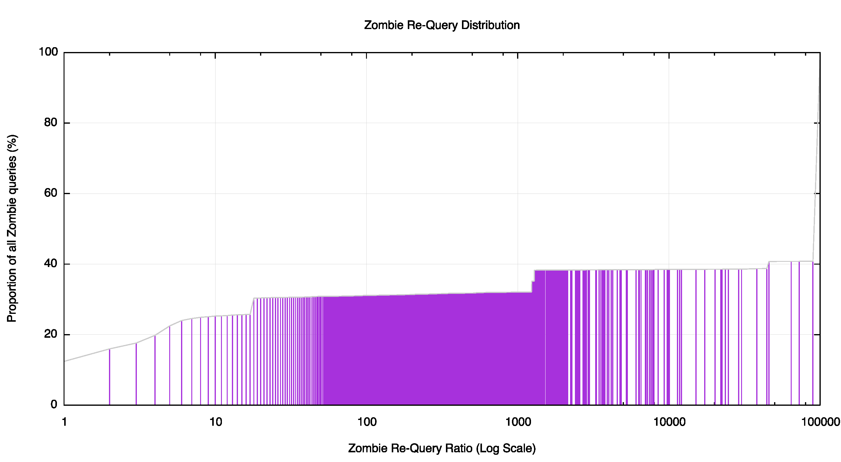
Three Zombie Factories
The totally
Deranged!
The stalkers
The storers

Slide 22
The Stalkers
Resolver Current Zombie Ratio ASN CC AS Name
38.229.33.65 7 573,038,416 81,862,630 23028 US Team Cymru Inc, United States
38.229.33.68 2 109,905,028 54,952,514 23028 US Team Cymru Inc, United States
38.229.33.100 3 90,637,788 30,212,596 23028 US Team Cymru Inc, United States
38.229.33.99 3 67,436,258 22,478,752 23028 US Team Cymru Inc, United States
38.229.33.67 11 128,929,881 11,720,898 23028 US Team Cymru Inc, United States
199.91.135.162 0 5,519,461 5,519,461 27471 US Blue Coat Systems, Inc, United States
212.142.63.183 0 2,472,109 2,472,109 6830 NL LGI-UPC Liberty Global Operations, Netherlands
212.142.48.75 0 2,401,930 2,401,930 6830 NL LGI-UPC Liberty Global Operations, Netherlands
54.193.90.244 1 1,480,634 1,480,634 16509 US AMAZON-02 - Amazon.com, Inc, United States
54.193.58.86 0 1,479,066 1,479,066 16509 US AMAZON-02 - Amazon.com, Inc, United States
54.193.65.165 0 1,423,147 1,423,147 16509 US AMAZON-02 - Amazon.com, Inc, United States
54.183.221.9 13 17,637,567 1,356,735 16509 US AMAZON-02 - Amazon.com, Inc, United States
54.193.7.134 0 842,849 842,849 16509 US AMAZON-02 - Amazon.com, Inc, United States
218.241.99.50 0 713,779 713,779 24151 CN China Internet Network Information Center, China
54.215.202.77 0 372,889 372,889 16509 US AMAZON-02 - Amazon.com, Inc, United States
54.215.190.109 0 365,598 365,598 16509 US AMAZON-02 - Amazon.com, Inc, United States
54.215.215.191 0 361,804 361,804 16509 US AMAZON-02 - Amazon.com, Inc, United States
54.193.83.224 0 361,474 361,474 16509 US AMAZON-02 - Amazon.com, Inc, United States
54.219.130.114 0 345,080 345,080 16509 US AMAZON-02 - Amazon.com, Inc, United States
54.183.145.224 0 338,949 338,949 16509 US AMAZON-02 - Amazon.com, Inc, United States
54.193.11.144 0 334,725 334,725 16509 US AMAZON-02 - Amazon.com, Inc, United States
220.128.227.81 0 326,208 326,208 3462 TW HINET Data Communication Business Group, Taiwan
59.120.57.250 0 323,403 323,403 3462 TW HINET Data Communication Business Group, Taiwan
86.82.68.237 0 321,396 321,396 1136 NL KPN, Netherlands
64.89.232.86 0 317,115 317,115 17204 US Nominum, Inc, United States

Slide 23
The Storers (and the totally deranged!)
Resolver Current Zombie Zombie ASN CC AS Name
Uniques Repeats Uniques Repeats Repeat Ratio
74.205.176.249 3,238 10,501,108 724 876,780,601 1,211,023 53618 CA Aditya Birla Minacs Worldwide, Canada
204.184.141.253 2,495 35,034,545 572 600,739,995 1,050,244 2572 US MOREnet, United States
186.151.28.130 926 3,978,931 6,462 4,704,634,886 728,046 14754 GT Telgua, Guatemala
74.205.162.254 345 2,167,441 411 202,079,128 491,676 14214 CA MINACS – Minacs, Canada
87.236.233.178 8,201 14,435,262 3,094 1,019,572,525 329,532 35656 JO JUNET Jordanian Universities, Jordan
209.173.47.77 136 495,700 11 3,338,108 303,464 18474 US Aeneas Internet Services, United States
115.249.45.34 37 265,058 12 3,154,574 262,881 18101 IN Reliance Communications, India
200.195.185.205 74 93,986 218 40,534,251 185,936 14868 BR COPEL Telecom, Brazil
195.53.128.4 215 70,442 1 138,326 138,326 31418 ES SOGECABLE, Spain
50.203.18.22 223 1,946,242 6 668,671 111,445 7922 US Comcast, United States
197.215.152.195 13,830 37,012,512 1,408 142,438,304 101,163 37558 LY LITC, Libya
201.94.158.33 98 347,644 17 1,522,810 89,577 28625 BR Terremark do Brasil, Brazil
38.95.167.66 75 242,166 6 436,269 72,711 174 US Cogent Communications, United States
46.174.164.4 93 785,915 6 435,973 72,662 39742 UA ITM IT-MARK, Ukraine
167.102.229.7 612 99,122 58 3,729,929 64,309 27026 US NETWORKMARYLAND, United States
87.236.232.5 54,998 5,819,430 5,634 258,275,972 45,842 35656 JO JUNET Jordanian Universities, Jordan
217.108.239.47 12 55,886 39 1,731,390 44,394 3215 FR AS3215 Orange, France
217.108.239.58 68 57,215 39 1,727,063 44,283 3215 FR AS3215 Orange, France
167.102.229.10 6,823 1,634,688 505 19,286,366 38,190 27026 US NETWORKMARYLAND, United States
67.51.123.126 57 239,777 5 150,976 30,195 7385 US Integra Telecom, United States
89.207.162.2 670 16,443 1 28,921 28,921 41383 GB WOLASN Wolseley, United Kingdom
187.7.128.5 0 0 18 444,244 24,680 8167 BR Brasil Telecom, Brazil
41.63.166.180 14 4,696 4 94,524 23,631 36907 AO TVCaboAngola, Angola
216.195.101.101 189 358,403 9 201,797 22,421 33481 US BELWAVE COMMUNICATIONS, United States
212.118.102.114 94 223,292 3 66,067 22,022 34397 SA Cyberia Riyadh, Saudi Arabia
200.111.157.10 41 53,333 183 3,690,776 20,168 6471 CL ENTEL, Chile
12.13.190.116 14 1,890 8 137,972 17,246 7018 US ATT-INTERNET4, United States
98.142.39.194 19 484,707 2 30,221 15,110 25899 US LS Networks, United States of America
200.3.214.69 5 3,536 16 193,635 12,102 17126 CL E-money, Chile
84.17.5.235 42 195,941 13 152,705 11,746 8359 RU MTS MTS PJSC, Russian Federation

