Slide 1
Why is Securing the Internet’s Routing System so Damn Difficult?
Geoff Huston
APNIC
February 2019

Slide 2
Usual BGP Disaster-Porn Clips

Slide 3
Yawn

Slide 4
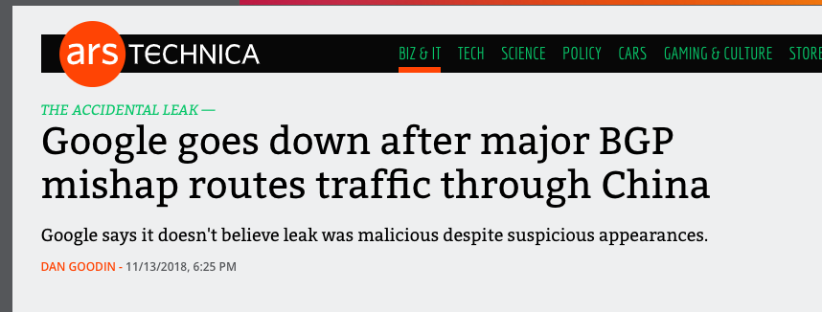
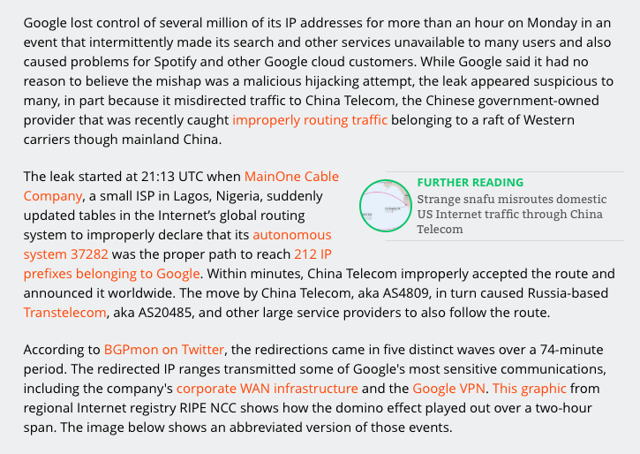
FFS! No better 10 years later

Slide 5
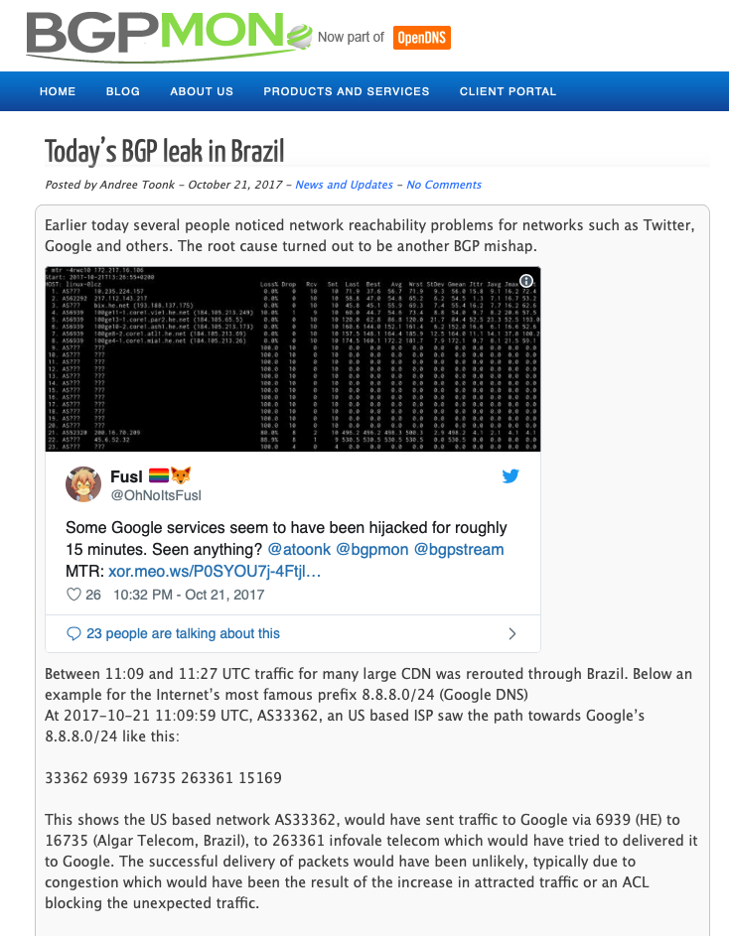
more

Slide 6
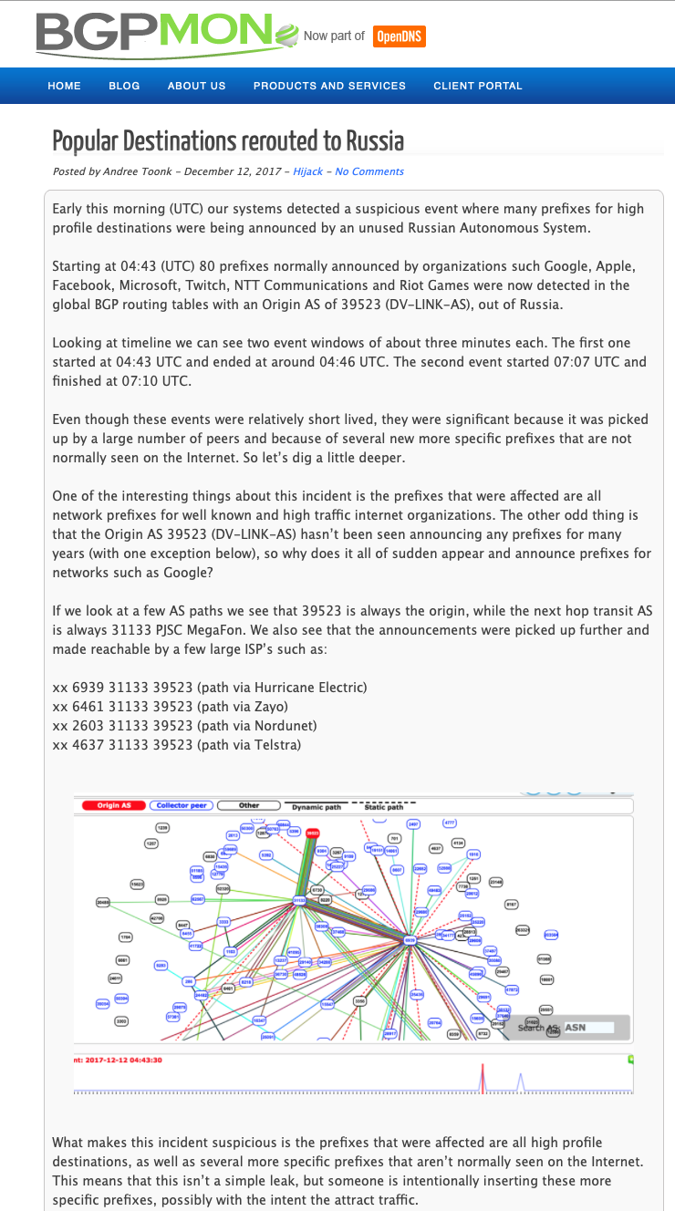
and more

Slide 7
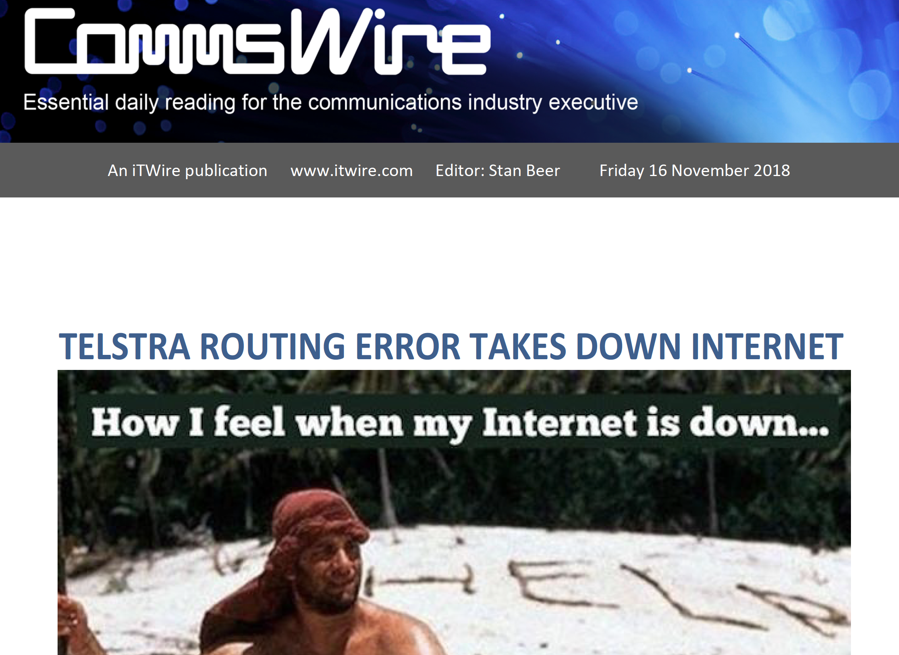
Why do we keep seeing these headlines?

Slide 8
Degrees of Difficulty
Why are some issues so challenging to solve, while others seem to be effortless?
Why was the IPv4 Internet an unintended runaway success in the 90’s, yet IPv6 has been a protracted exercise in industry-wide indecision?

Slide 9
Internet Successes
IPv4 (and datagram packet switching)
Network Address Translators (perversely!)
TCP evolution and adaptation
DNS
Content Distribution Systems
Streaming

Slide 10
Success Factors
Piecemeal deployment without the requirement for central orchestration
Competitive advantages to early adopters
Economies of scale as adopter numbers increase
Alignment of common benefit with individual benefit

Slide 11
Internet Non-Successes
Failures!
SPAM
DDOS defence
BCP 38 deployment
Secure end systems
Secure networks
Internet of Things
IPv6 adoption (so far!)

Slide 12
Failure Factors
Need for orchestrated actions (flag days)
Technologies that require universal or near universal adoption
Where there are common benefits but not necessarily individual benefits
Where there is no clear early adopter advantage

Slide 13
What makes a problem “hard”?
It might be technically challenging: While we understand what we might want that does not mean we know how to construct a solution
It might be economically hard: The costs of a solution are not directly borne by the potential beneficiaries of deploying the solution
It might be motivated by risk mitigation: We are notorious for undervaluing future risk!

Slide 14
Why is Securing Routing so Hard?
Because no single entity is in charge
Because we can’t audit BGP, as we have no standard reference route set to compare with
Because we can’t arbitrate between conflicting BGP information (because there is no standard reference point)
Because there are no credentials that allow a BGP update to be compared against the original route injection (because BGP is a hop-by-hop protocol)
Because BGP is based on opaque local decisions

Slide 15
Why should we worry?

Slide 16
Because it’s just too easy to be bad in routing!

Slide 17
What’s the risk?
User traffic gets diverted enabling a Man-in-the-Middle attack on a service
Re-directed network path
False route to server address
Service Point
User
“normal” network path

Slide 18
What’s the risk?
DOS Attack
Divert the traffic to a sinkhole
Deny users access to the site
Crude, but effective!

Slide 19
What’s the risk?
DNS Attacks
Divert DNS traffic to fake DNS servers and provide fake answers
Very few domains are DNSSEC-signed and not enough resolvers perform DNSSEC validation
So the faked answer can pass unchallenged

Slide 20
What’s the risk?
Server Attacks
Divert TCP traffic to fake servers and provide fake answers
Collect user credentials while shadowing the actual site

Slide 21
An attack vector on HTTPS…
Let’s say you can find an online trusted CA
that uses the DNS as proof-of-possession of a DNS name in order to mint a domain name certificate
And the DNS name is not DNSSEC protected
You can mint a fake domain name certificate by:
Mount a routing attack on the DNS infrastructure with a fake DNS responder
Answer everything correctly except for *.victim ACME DNS challenge from the CA
And for the *.victim challenge queries respond with your own answer
Which means you can answer the CA’s DNS challenge
Now you have a trusted fake domain name certificate
You are now able to pull off a MITM attack on a TLS ‘protected’ service

Slide 22
I want a Pony Routing Security wish list
Identify whether an address is “bogus” or not
Assure that the address holder has given their permission for an address to be announced into the routing system
Identify which AS(s) have been given this permission
Identify if the AS Path is consistent with the ‘correct’ operation of BGP
Identify if the AS Path is consistent with the routing policies of the each of the Ases
Identify when routing information is being ‘incorrectly’ withheld

Slide 23
The saga so far…

Slide 24
Internet Route Registries
First used in the early 1990’s as the Route Arbiter Database (RADB) as part of the NSFNET program
Describes route origination and inter-AS routing policies
An explicit declaration of intent in routing
Route Registries can be used to filter BGP announcements, filtering out route advertisements that are not described in the route registry
Primary value in preventing neighbor route leaks
Can be used to prevent hijacks

Slide 25
Route Registry Issues
Poor Authority Model (or the complete lack of one in many cases!)
How can a user know that a RR entry is genuine and current?
How can a user know that a RR entry is maintained by an entity who is the authoritative “owner” of an IP address or ASN?
How can a user tell the difference between a current RR entry and a lapsed historical RR entry?
Too many Route Registries
If two different RRs contain conflicting information, what are users meant to do?
Incomplete Data
If a route is not described in a Route Registry is it just the registry that is missing data or is the route itself invalid?
Scaling issues
No realistic way to apply IRR filters to upstreams
RPSL got too geeky!
The Route Policy Language used by Route Registries got overly expressive and complex

Slide 26
What’s missing with RRs?
If we want to improve the usefulness of route registries we probably need a robust authority model
How about Digital Signatures?
The signatures can provide currency and authenticity
The authority model can allow RR entries to be seen as explicit authorities or permissions from address holders to network operators and from network operators to other networks

Slide 27
X.509 Public Key Certificates for IP addresses and AS Numbers
An X.509 Public key certificate that includes a set of IP addresses and AS numbers
If a certificate can be validated against a trust anchor then it indicates that:
The IP addresses and/or AS numbers have been validly allocated
The holder of the subject key pair is the current holder of the IP addresses and/or AS numbers
Attestations validly signed using this key can be considered as genuine authorities that cannot be repudiated
This is the foundation of the current work in routing security

Slide 28
Route Origination Authority
An address holder can convey a ‘permission’ for an AS to originate a BGP route for the address by signing a permission authority (ROA) using a signing key associated with a valid public key address certificate
This authority:
can be validated by any interested party
is dated, so currency is known
cannot be repudiated

Slide 29
If we all used ROAs then:
Identify whether an address is “bogus” or not
Assure that the address holder has given their permission for an address to be announced into the routing system
Identify which AS(s) have been given this permission
Identify if the AS Path is consistent with the ‘correct’ operation of BGP
Identify if the AS Path is consistent with the routing policies of the each of the Ases
Identify when routing information is being ‘incorrectly’ withheld

Slide 30
Is 3 out of 6 good enough to get a pony?
NO!
The hijack can reproduce the origin and if the ROA is sloppy then it can use a more specific
Even if the ROA is tight the conflicting routes can still support a desired attack profile

Slide 31
From ROAs to a fully secure BGP
ROAs are good, but probably not enough to stop a determined routing attacker
The attacker simply needs to replicate the BGP origination in the AS path to be accepted as “good”
So we really need to secure the BGP AS Path as well
We can do this with RPKI certs!
Every eBGP speaker has a key that is certified by the AS
When an update is passed to a neighbor AS, the router signs across the existing AS Path signature and the neighbor AS
A BGPSEC speaker validates a received update by checking that
there is a current ROA to describe the address and origin AS
The received AS Path can be validated as a sequence of sign-over-sign operations by the AS keys
AS 1
AS 3
AS1 -> AS2
Signed AS1
AS1 -> AS2
Signed AS1
AS 2
AS2 -> AS3
Signed AS2
AS1 -> AS2
Signed AS1
AS 4
AS2 -> AS4
Signed AS2

Slide 32
But ASPath protection is hard…
BGPSEC cannot cope with partial adoption
It cannot jump across non-participating networks
It has a high crypto overhead for session restarts
It does not define how to promulgate the collection of certificates required to validate the digital signatures
It does not necessarily identify and prevent route leaks
Which means that BGPSEC is not looking like its going to be deployed everywhere
Which means that there is little value in deploying it anywhere

Slide 33
What’s going wrong?
The economics of this situation work against it
There are inadequate commercial drivers to undertake extensive informed route monitoring that would enable hijack suppression at source
Probably because integrity of common infrastructure is everyone’s problem which in turn quickly becomes nobody’s problem
And we have no ‘forcing’ authority to compel network operators

Slide 34
Where to from here?
We are pretty convinced about the value of RPKI certificates and digital signatures
Because we really have nothing better to offer in their place
But the AS Path protection elements of BGPSEC are a critical problem!
In the IETF we are working on approaches that address the issues with BGPSEC and AS Path protection
But that effort could take years
And there is no guarantee of success!

Slide 35
Where are we heading?
The problem is not going to go away
So we probably need to look at other ways to secure the propagation of routing information:
What if we decoupled origination, topology and policy validation?
Will open market disciplines lead us to a secure Internet environment or are we necessarily looking at regulatory imposts to force universal adoption?
What could we gain by using deliberate efforts at asymmetric partial adoption?
What’s more important in routing security: client routes or server routes?
i.e. should we concentrate on IXPs and CDN routes as points of active route policing?

Slide 36
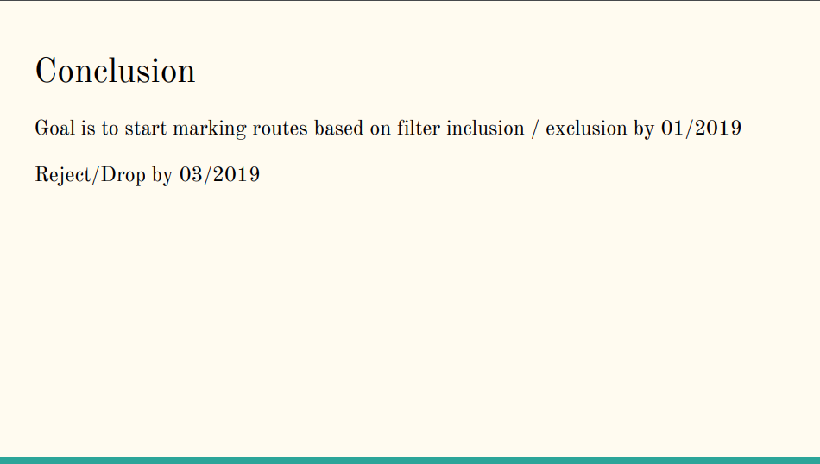
In the meantime…
Over at the Google ranch:
October 2018
https://pc.nanog.org/static/published/meetings/NANOG74/1760/20181003_Tzvetanov_Security_Track_Bgp_v1.pdf

Slide 37
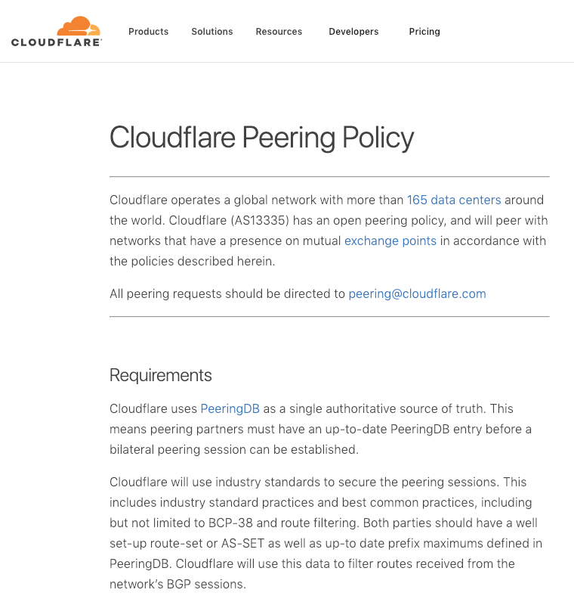
In the meantime…
Over at the Cloudflare ranch:
https://www.cloudflare.com/peering-policy/

Slide 38
What can you do today?
“Don’t let the perfect be the enemy of the good!”
You could just wait for a complete routing security framework to be invented
Or you could do something practical right now that might be helpful

Slide 39
What can you do today?
You might want to take some steps to make routing attacks easier to detect and easier to deflect
BCP38 filters can help
UDP DOS attacks are very common
Generating ROAs can help
Maybe they won’t help a lot today, but as more networks filter on ROAs then they will be more effective to protect against simple address hijacking
Route Registry objects can help
www.irr.net
Again this is not a complete answer, but its better than nothing
You should really should filter your customers
Filter customer routing updates according to BCP38, ROAs and IRR profiles
Consider signing up to MANRS
https://www.manrs.org/ (Even spending a few minutes thinking about routing security is better than not thinking about it at all)
DNSSEC-sign your domain name
Validate DNS responses

Slide 41
Thanks!
Questions?

Slide 42
Additional Material
soBGP
General Comments
Opinions

Slide 43
1. soBGP: an alternative to BGPSEC
Instead of the high overhead of AS Path validation we can look at secure origin BGP (soBGP) from 2003
soBGP looked at the AS Path as a topology vector composed of a number of paired AS adjacencies
An AS publishes a signed adjacency attestation for all of its neighbors
If a signing AS appeared in an AS Path then its neighbors in the AS Path must also by described in the adjacency attestion
This replaces strict AS Path Validation with AS Path Plausibility

Slide 44
1, soBGP and AS Adjacencies
AS 1
AS 3
AS3 -> AS2
Signed AS3
AS1 -> AS2
Signed AS1
AS 2
AS2 -> AS3
Signed AS2
AS Path Processing using AS Adjacency ‘hints’
AS1 -> AS2 -> AS3 plausible
AS1-> AS3 -> AS2 implausible
AS1-> AS2 -> AS3 -> AS4 implausible
AS2 -> AS1
Signed AS2
AS2 -> AS4
Signed AS2
AS 4
AS4 -> AS2
Signed AS4

Slide 45
1. soBGP compared to BGPSEC
Lower crypto overhead
Can be used in scenarios of partial adoption
Does not prevent a network from learning false information, but prevents a network being used in a falsified AS path
Unless you also include the AS’s peers
And so on
Incremental deployment generates incremental benefit
Can include directionality in the AS adjacency attestation
As a simple “policy” filter

Slide 46
2. Generic Concerns over PKIs
Is a trust hierarchy the best approach to use?
The concern here is concentration of vulnerability
If validation of routing information is dependent on the availability and validity of a single root trust anchor then what happens when this single digital artifact is attacked?
But is there a viable alternative approach?
Can you successfully incorporate robust diversity of authentication of security credentials into a supposedly highly resilient secure trust framework?
This is a very challenging question about the nature of trust in a diverse networked environment!
Web trust – 1,500 CAs vs DNSSEC trust – 1 key
which is ‘better’?

Slide 47
2. Generic Concerns over universality
A major issue here is that of partial use and deployment
This security mechanism has to cope with partial deployment in the routing system
The basic conventional approach of “what is not certified and proved as good must be bad” will not work in a partial deployment scenario
In BGP we need to think about both origination and the AS Path of a route object in a partial deployed environment
AS path validation is challenging indeed in an environment of piecemeal use of secure credentials, as the mechanism cannot tunnel from one BGPsec “island” to the next “island”
A partially secured environment may incur a combination of high incremental cost with only marginal net benefit to those deploying BGPsec

Slide 48
2. Generic Concerns: Prevention vs Detection
Is certification the only way to achieve useful outcomes in securing routing?
Is this form of augmentation to BGP to enforce “protocol payload correctness” over-engineered, and does it rely on impractical models of universal adoption?
Can various forms of routing anomaly detectors adequately detect the most prevalent forms of typos and deliberate lies in routing with a far lower overhead, and allow for unilateral detection of routing anomalies?
Or are such anomaly detectors yet another instance of “cheap security pantomime” that offer a thinly veiled placebo of apparent security that is easily circumvented or fooled by determined malicious attack?

Slide 49
3. My Opinions!
My personal view of a design compromise for secure BGP:
Improve the robustness of RPKI certs by altering the cert validation algorithm
Flatten the certificate hierarchy by using a single CA and distributed RAs
Place origination signatures, ROAs and certs into the BGP protocol updates as opaque attributes
Use AS Adjacency attestations
Place AS Adjacency attestations into BGP protocol updates as opaque attributes
Exploit the use of TCP in BGP to never resend already-sent certs
Flatten parts of the CA hierarchy by using RAs rather than CA delegations
Reduce OOB credential distribution to just TA material
For which you can use the DNS and DNSSEC if you really want to put all your eggs in one basket!
Like all the other approaches, this represents a particular set of compromises about speed, complexity, cost, deployment characteristics and robustness – it has it’s weaknesses in terms of comprehensive robustness, but it attempts to reduce the number of distinct moving parts

