Slide 1
What If Everyone Did It?
Geoff Huston
APNIC Labs

Slide 2
DNSSEC and DNS Security
$ dig xxx.00001.z.dotnxdomain.net
;; flags: qr rd ra ad; QUERY: 1, ANSWER: 1, AUTHORITY: 1, ADDITIONAL: 1
;; ANSWER SECTION:
xxx.00001.z.dotnxdomain.net. 1 IN A 199.102.79.186
$ dig xxx.00001.z.dashnxdomain.net
;; flags: qr rd ra; QUERY: 1, ANSWER: 1, AUTHORITY: 1, ADDITIONAL: 2
;; ANSWER SECTION:
xxx.00001.z.dashnxdomain.net. 3600 IN A 199.102.79.188
What does this mean?

Slide 3
DNSSEC and DNS Security
$ dig xxx.00002.z.dotnxdomain.net
;; Got answer:
;; ->>HEADER<<- opcode: QUERY, status: SERVFAIL, id: 9216
;; flags: qr rd ra; QUERY: 1, ANSWER: 0, AUTHORITY: 0, ADDITIONAL: 1
;; OPT PSEUDOSECTION:
; EDNS: version: 0, flags:; udp: 4096
;; QUESTION SECTION:
;xxx.00002.z.dotnxdomain.net. IN A
;; Query time: 619 msec
;; SERVER: 127.0.0.1#53(127.0.0.1)
;; WHEN: Wed Sep 10 01:20:02 UTC 2014
;; MSG SIZE rcvd: 56
What does this DNS response mean?

Slide 4
DNSSEC and DNS Security
Setting the AD bit in a recursive resolver response seems like a rather unimpressive way of conveying a positive security outcome, and in the same manner, setting SERVFAIL seems like a rather poor way of conveying a failed security outcome
Various approaches to securing the channel between the client and the recursive resolver have been suggested, but in a simple lightweight UDP transaction model this can be challenging
Perhaps it would be simpler for the edge device to perform DNSSEC validation directly
Which is fine, but will this approach scale?

Slide 5
  What can we say about a DNS environment where every edge device that poses DNS queries performs their own DNSSEC validation?

Slide 6
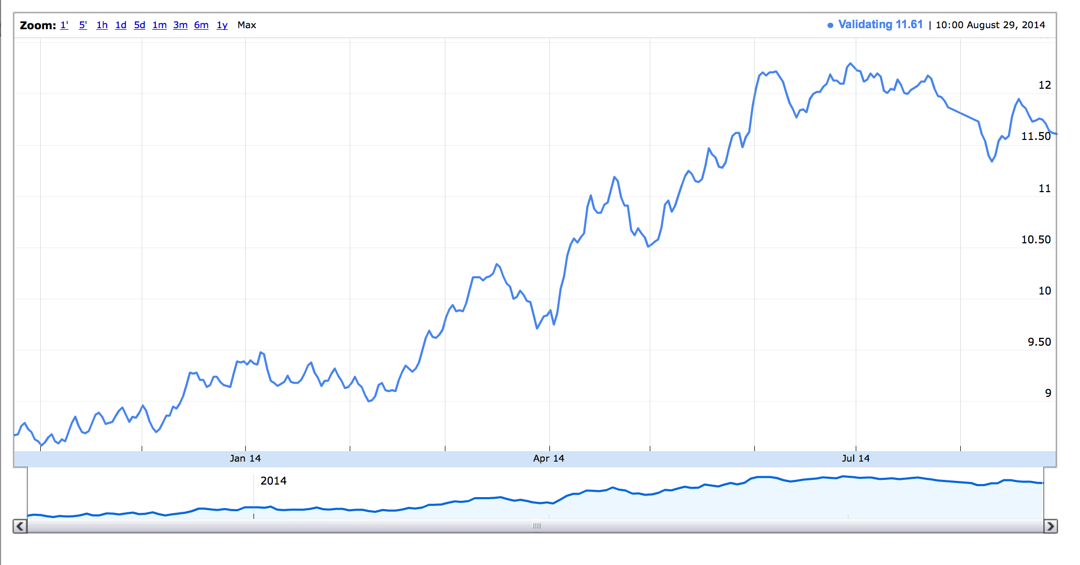
DNSSEC today
A small, but growing, fraction of all domain names are signed using DNSSEC
A larger, but still small, fraction of users use DNS resolvers that perform DNSSEC validation
At the end of August 2014, some ~11.5% of users send their DNS queries to DNSSEC-validating resolvers

Slide 7
What if everyone did it?
What if:
  every resolver performed DNSSEC validation?
or even if:
  every end device performed DNSSEC validation?
What difference in traffic loads and query rates would we see at an authoritative name server between serving an unsigned domain name and serving the signed equivalent of the domain name?

Slide 8
The Experiment
We serve an online Ad with 3 embedded URLs that the user’s browser is tasked to fetch. The URLs use unique domain names that are:
  Unsigned
  Signed (good)
  Signed (bad)
We are looking for behaviours where we see the browser perform:
  Queries for the DS and DNSKEY RRs for both of the the signed domains, and
  Fetch the signed (good) but not the signed (bad) URLs

Slide 9
What we saw
Users who exclusively used DNSSEC-validating resolvers
Users who used a mix of validating and non-validating resolvers
      (typically, we saw the SERVFAIL response on a badly signed domain name cause the user to repeat the query to a resolver that did not perform DNSSEC validation)
Users who exclusively used non-validating resolvers

Slide 10
What we saw
Did not attempt to fetch DNSSEC RRs
DNSSEC-validating
Mixed DNSSEC-validating

Slide 11
If your resolver validates DNS responses…
Then the resolver will need to fetch the DNSKEY and DS RRs for the zone, and recurse upward to the root
If these RRs are not cached, then at a minimum there are at least two additional DNS queries that are performed as part of the validation process

Slide 12
If your resolver validates DNS responses…
More queries, longer resolution time
Dual Stack client - query for unsigned domain name
20:36:40.288 query: unsigned.example.com IN AAAA -ED (199.102.79.186)
20:36:41.028 query: unsigned.example.com IN A -ED (199.102.79.186)
Dual Stack client - query for signed domain name
20:36:41.749 query: signed.example.com IN A -ED (199.102.79.186)
20:36:41.758 query: signed.example.com IN AAAA -ED (199.102.79.186)
20:36:41.876 query: signed.example.com IN DS -ED (199.102.79.186)
20:36:41.993 query: signed.example.com IN DNSKEY -ED (199.102.79.186)

Slide 13
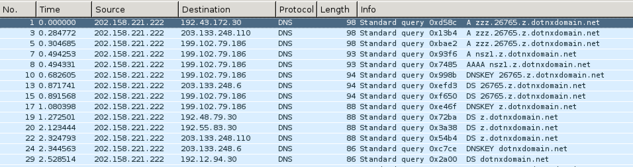
Validation – DNS Queries
DNS queries
Validation Queries

Slide 14
Measured Time Cost
Distribution of elapsed time difference, measured at the server, from the first DNS query until the WEB object fetch. There are three types of clients: those who validate, those who do not validate, and those who use a mix of validating and non-validating resolvers

Slide 15
Measured Time Cost
Distribution of elapsed time difference, measured at the server, from the first DNS query of a signed name until the WEB object fetch. There are three types of clients: those who validate, those who do not validate, and those who use a mix of validating and non-validating resolvers

Slide 16
Time Cost
Cumulative distribution of elapsed time difference, measured at the server, from the first DNS query until the WEB object fetch

Slide 17
DNS Resolution Time
This measures just the DNS resolution part, collecting the elapsed time between the first and last queries for a domain name

Slide 18
Unsigned/Non-Validating vs Signed/Validating
Let’s try a slightly different comparison, and compare the total DNS query time between
  Non-validating users querying an unsigned name
  and
  Validating users querying for a signed name

Slide 19
Like-vs-like: unsigned vs signed

Slide 20
Like-vs-like: unsigned vs signed
25% of DNSSEC-validating users cannot resolve a signed name within ½ second
25% of users cannot resolve a simple uncached unsigned domain name within a single query

Slide 21
Validation Time
When resolving a previously unseen domain name most clients will experience up to 500ms additional time spent in validation
  This is due to the additional queries related to the fetch of the DNSKEY / DS RR sequence to validate the RRSIG of the original response
This validation phase could be processed in less time…
Most resolvers appear to perform the validation path check using serial fetches. Parallel fetches of the DNSSEC validation path RRs would improve this situation so that the validation fetches would take a single query cycle time

Slide 22
Do any clients drop out?
Does the addition of the DNSSEC RR’s in the response cause any clients to stop attempts at DNS resolution?
So we looked…

Slide 23
Do any clients drop out?
If there was any clear evidence of DNSSEC causing resolution failure then the blue line would be clearly higher than the other three control lines
But its not.
There is no experimental evidence to suggest systematic resolution failure here for DNSSEC-signed names
However, the DNS responses in this experiment were all below 1500 octets. We have yet to test the case of forced UDP fragmentation in DNS responses

Slide 24
Client Behaviour
Retrieving DNSSEC credentials takes additional time and volume when validating the resolution outcomes of a signed name
But much of this overhead is mitigated by use of local caches in the DNS resolution path
And if resolvers performed validation using parallel fetches, the additional overhead could be brought down to a single retrieval cycle time

Slide 25
Authoritative Server Measurements
The following analysis attempts to answer the question:
  What increase in queries and traffic should I expect to see if the unsigned zone I currently serve is DNSSEC signed, and everyone is using DNSSEC validating resolvers?

Slide 26
If you serve a signed Domain Name:
You will generate larger responses:
Dual Stack client - query for unsigned domain name, no EDNS0
Query: 117 Bytes
Response: 168 bytes
Dual Stack client - query for signed domain name, EDNS0
Query: (A) 127 Bytes
Response: (A) 1168 bytes
Query: (DS) 80 Bytes
Response: (DS) 341 bytes
Query: (DNSKEY) 80 Bytes
Response: (DNSKEY) 742 bytes
Total: Query: 287 bytes
Response: 2,251 bytes

Slide 27
If you serve a signed Domain Name:
You will generate larger responses:
Dual Stack client - query for unsigned domain name, no EDNS0
Query: 117 Bytes
Response: 168 bytes
Dual Stack client - query for signed domain name, EDNS0
Query: (A) 127 Bytes
Response: (A) 1168 bytes
Query: (DS) 80 Bytes
Response: (DS) 341 bytes
Query: (DNSKEY) 80 Bytes
Response: (DNSKEY) 742 bytes
Total: Query: 287 bytes
Response: 2,251 bytes
The DS query is directed to the parent zone, so you may or may not see this query at the authoritative server. In our case we are serving the parent zone as well

Slide 28
If you serve a signed Domain Name:
You will generate larger responses:
Dual Stack client - query for unsigned domain name, no EDNS0
Query: 117 Bytes
Response: 168 bytes
Dual Stack client - query for signed domain name, EDNS0
Query: (A) 127 Bytes
Response: (A) 1168 bytes
Query: (DS) 80 Bytes
Response: (DS) 341 bytes
Query: (DNSKEY) 80 Bytes
Response: (DNSKEY) 742 bytes
Total: Query: 287 bytes
Response: 2,251 bytes
That’s an increase of 13x in terms of outbound traffic volume
The DS query is directed to the parent zone, so you may or may not see this query at the authoritative server. In our case we are serving the parent zone as well

Slide 29
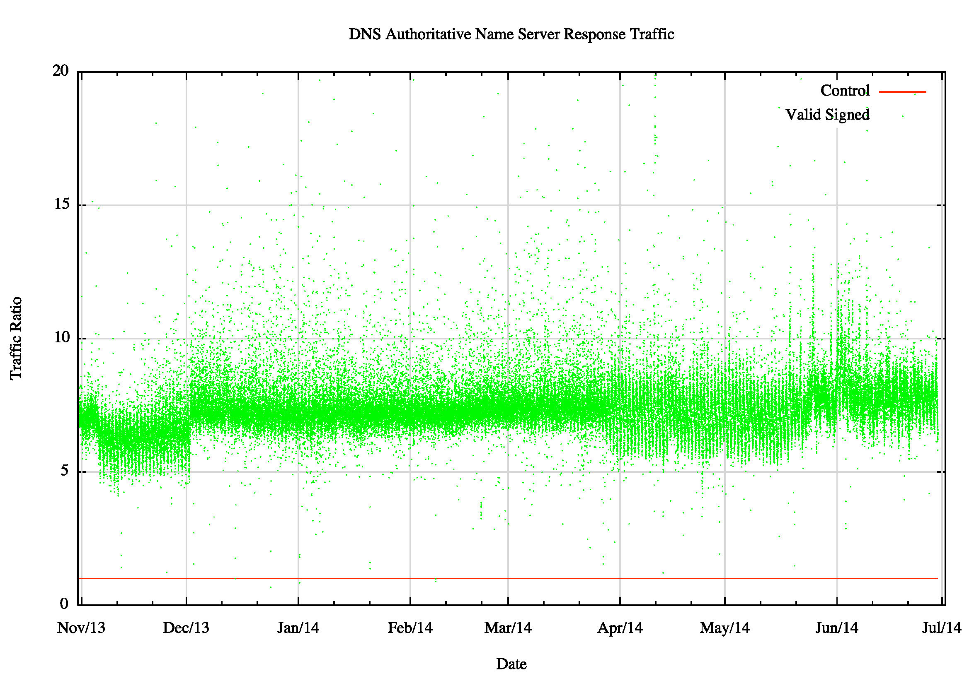
Server Traffic Load
This represents the 5 minute relative traffic load between serving an unsigned control domain and serving a validly signed domain. The originating query rates are the same

Slide 30
Server Traffic Load
Serving a DNSSEC-signed name appears to generate 7.5x the traffic load, as compared to serving an unsigned name
  But 20% of clients are performing validation, and hence 20% of the clients generate 13x more traffic
  The theory would expect to see a 3.4x increase in traffic.
  Why is this observed result double the prediction?

Slide 31
Server Traffic Load
Use of the EDNS DNSSEC-OK flag is far higher than the level of DNSSEC validation
  84% of queries have the EDNS0 DNSSEC-OK flag set
  And this query generates a response of 1168 bytes (i.e. 7x the size of a null EDNS response)
  So 64% of clients set EDNS0 DNSSEC-OK, and 20% of clients also ask for DS and DNSKEY RRs
  The theory predicts that this would result in 7.25x the traffic over an unsigned domain
  Which is (roughly) what we see

Slide 32
Server Traffic Load
What is the traffic load difference between serving an unsigned zone and serving a signed zone if every client performed DNSSEC validation?
  The difference from the current levels of DNSSEC traffic lies predominately in the additional DNSKEY and DS responses
  You should expect approximately 15x the traffic load for response traffic

Slide 33
If you serve a signed Domain Name:
You’ll receive 2-3 times as many queries:
Dual Stack client - query for unsigned domain name, no EDNS0
Query: 117 Bytes
Response: 168 bytes
Dual Stack client - query for signed domain name, EDNS0
Query: (A) 127 Bytes
Response: (A) 1168 bytes
Query: (DS) 80 Bytes
Response: (DS) 341 bytes
Query: (DNSKEY) 80 Bytes
Response: (DNSKEY) 742 bytes
The DS query is directed to the
parent zone, so you may or may not see this query at the authoritative server. In our case we are serving the parent zone as well

Slide 34
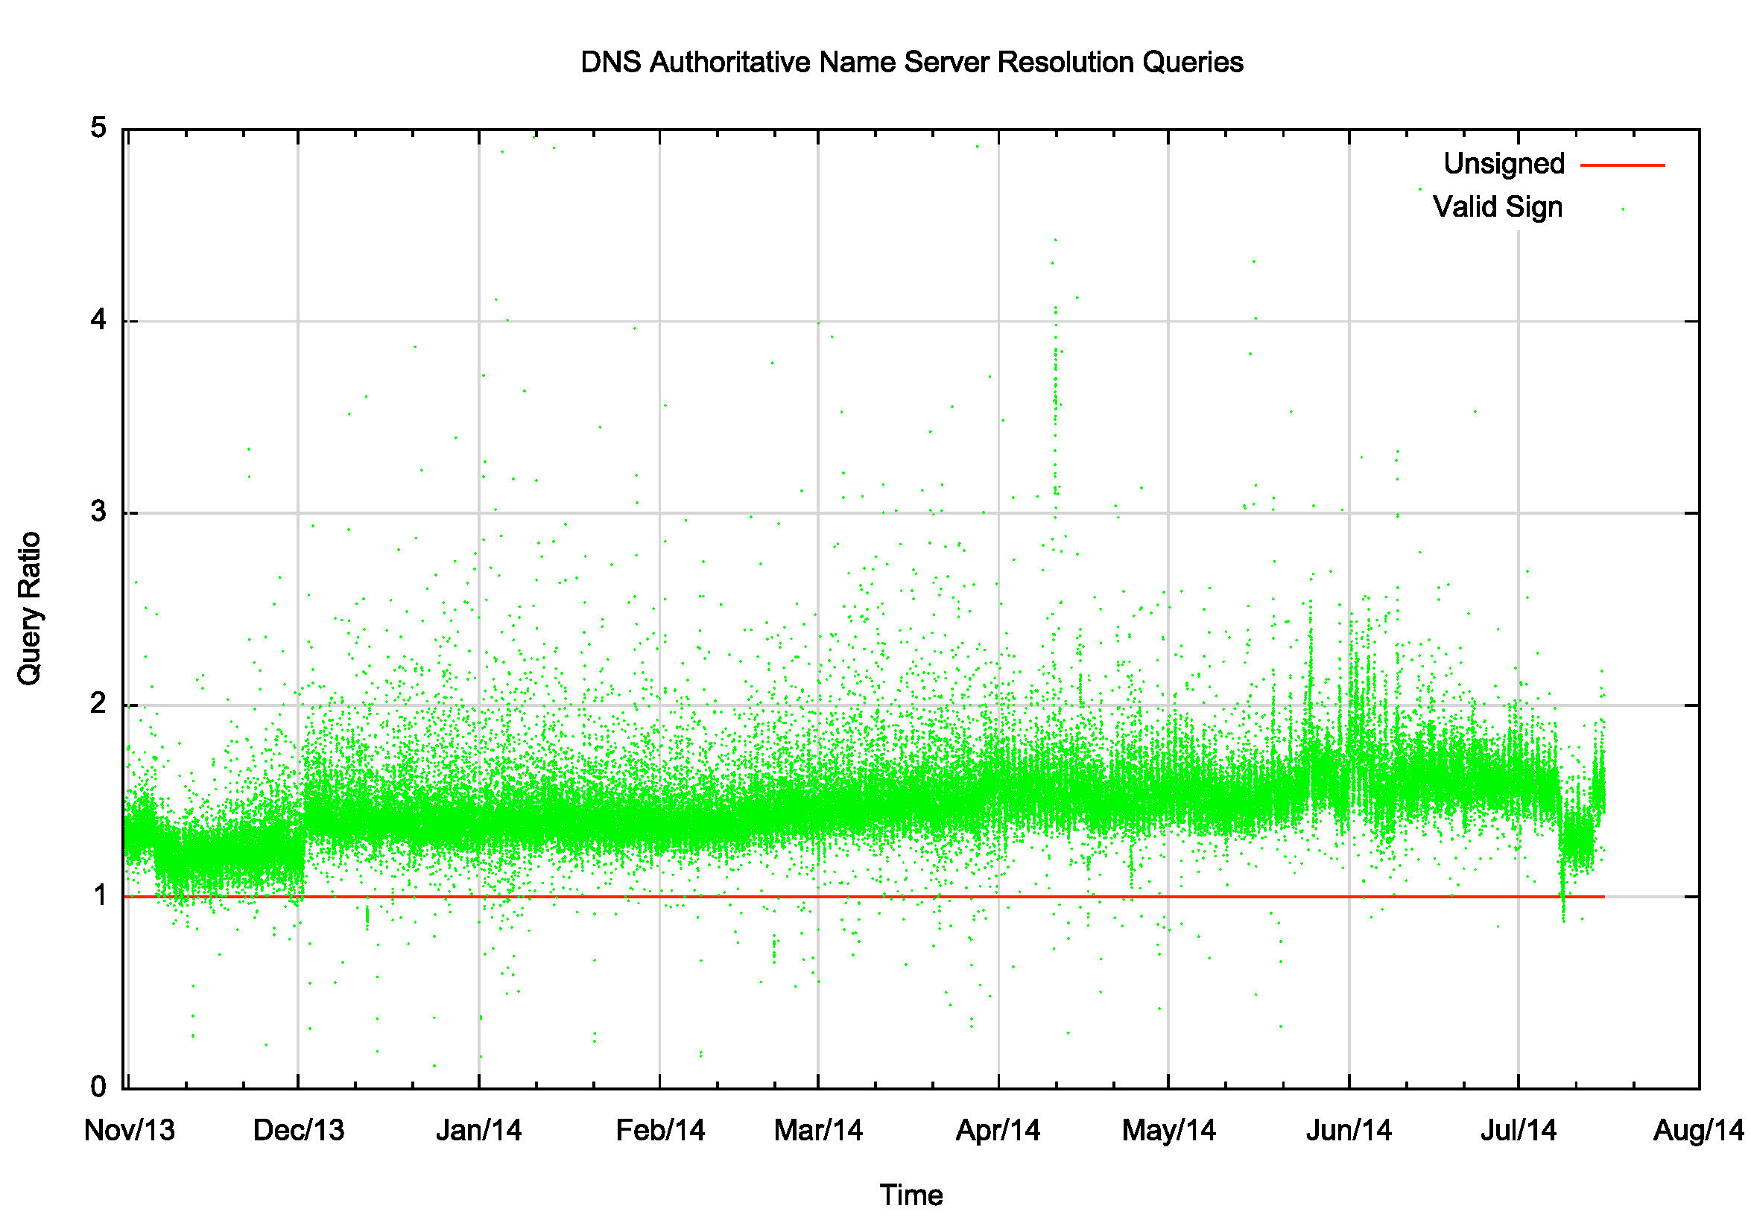
Server Query Load

Slide 35
Server Query Load
20% of clients use validating resolvers, so the signed domain query load should be 1.4x that of the unsigned domain
But we are observing an increase in the query load of 1.6x the unsigned domain.
Why?

Slide 36
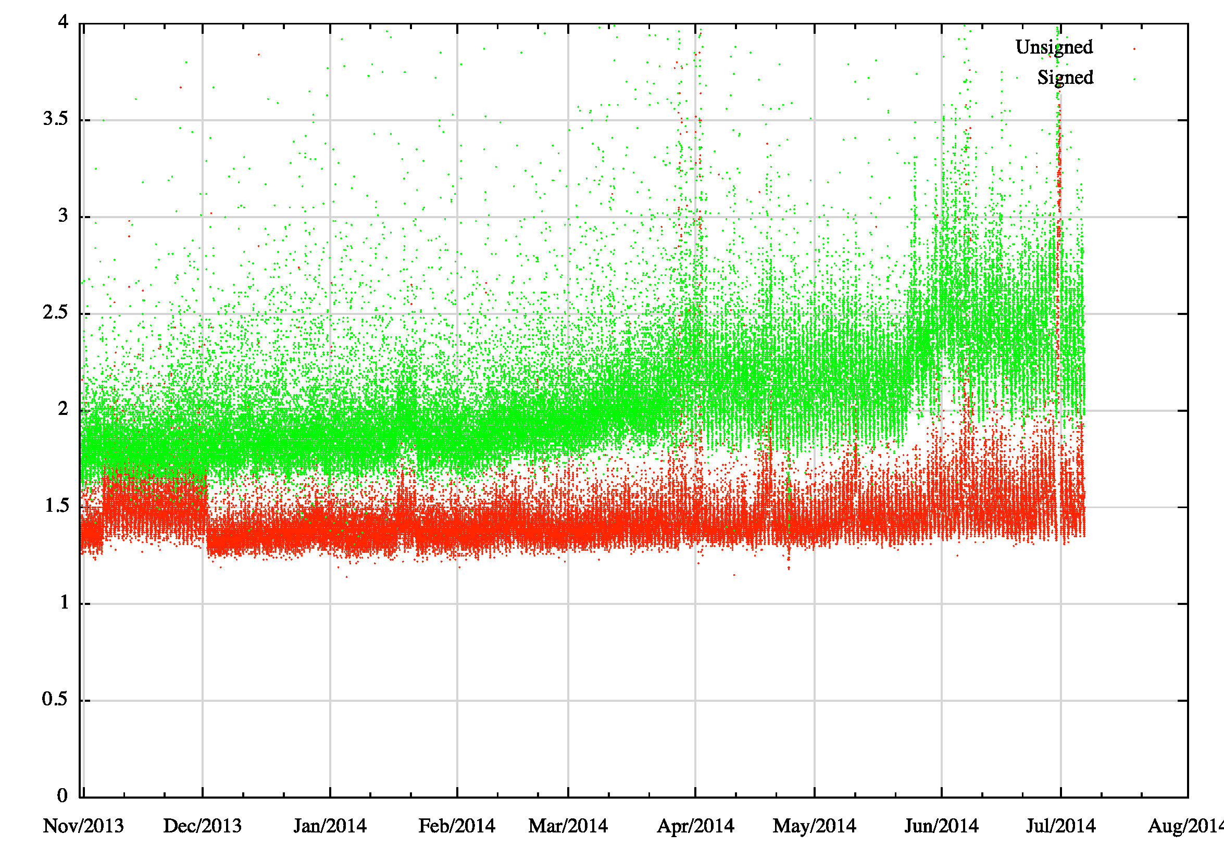
Repeat queries are rising
Queries per domain name

Slide 37
Query duplication
We are seeing a noticeable level of query duplication from anycast DNS server farms
The same query is being received from multiple slave resolvers within a short period of time
This is rising over time
Domain Time Query source Query
0a62f.z.example.com 02:05:31.998 74.125.41.81 port: 52065 q: DNSKEY?
0a62f.z.example.com 02:05:32.000 74.125.41.19 port: 53887 q: DNSKEY?
0a62f.z.example.com 02:05:32.005 74.125.41.146 port: 52189 q: DNSKEY?
0a62f.z.example.com 02:05:32.008 74.125.16.213 port: 42079 q: DNSKEY?

Slide 38
Setting Expectations
For a validly signed zone an authoritative server may anticipate about 4x the query load and 15x the traffic load as compared to serving an equivalent unsigned zone, if everyone performed DNSSEC validation *
    (* if you served the parent zone as well)

Slide 39
The Worst Case
But things get worse when the DNSSEC signatures are invalid:
  The response from a DNSSEC-validating recursive resolver upon DNSSEC validation failure is SERVFAIL, which prompts clients of this resolver to re-query using an alternative resolver
  The recursive resolver may re-query the name using alternative servers, on the assumption that the validation failure is due to a secondary server falling out of sync with the current zone data
How much worse does it get?

Slide 40
DNS Resolution Time Difference
In this case we look at clients who use a mixed set of resolvers, and fail over from a validating resolver to a non-validating resolver, and measure the time from first DNS query to Web fetch

Slide 41
DNS Resolution Time Difference
In this case we look at clients who use a mixed set of resolvers, and fail over from a validating resolver to a non-validating resolver, and measure the time from first DNS query to Web fetch

Slide 42
DNS Resolution Times
25% of DNSSEC-validating clients continue DNS resolution attempts for more than 6 seconds with a badly signed DNS name

Slide 43
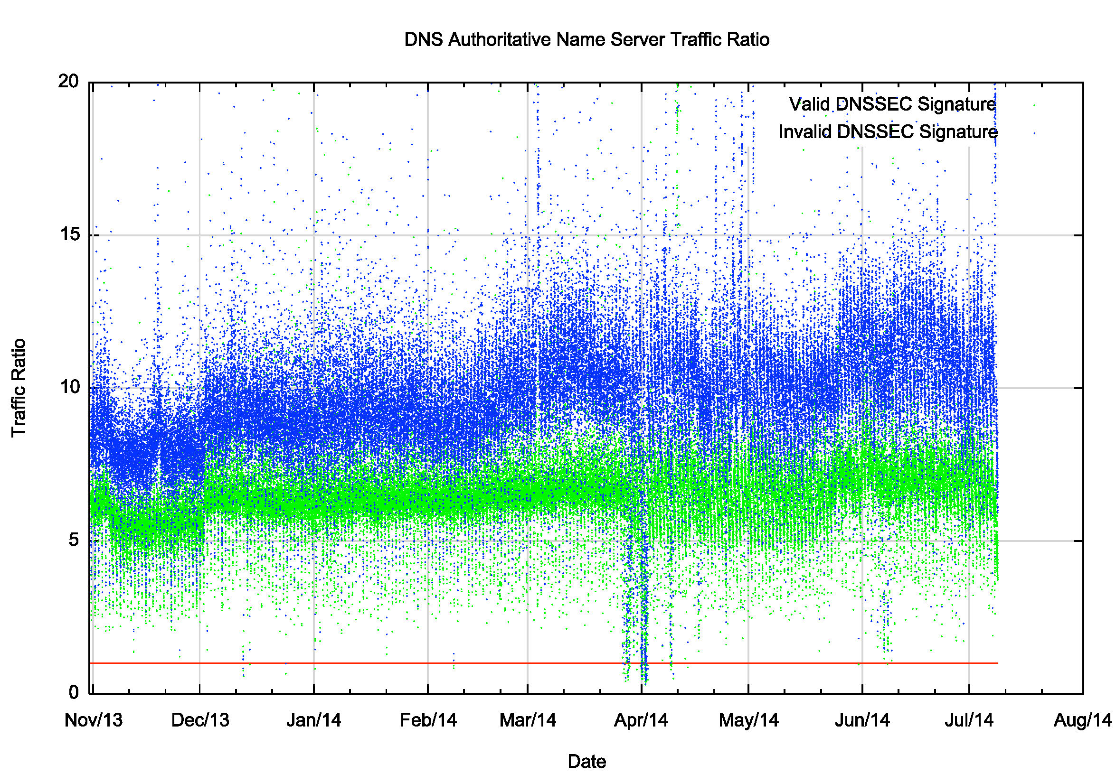
Relative Traffic Profile

Slide 44
Traffic Profile
The traffic load for a badly signed domain name is around 10x the load for an unsigned domain
If everyone were to use validating resolvers then the load profile would rise to around 26x the load of an unsigned domain

Slide 45
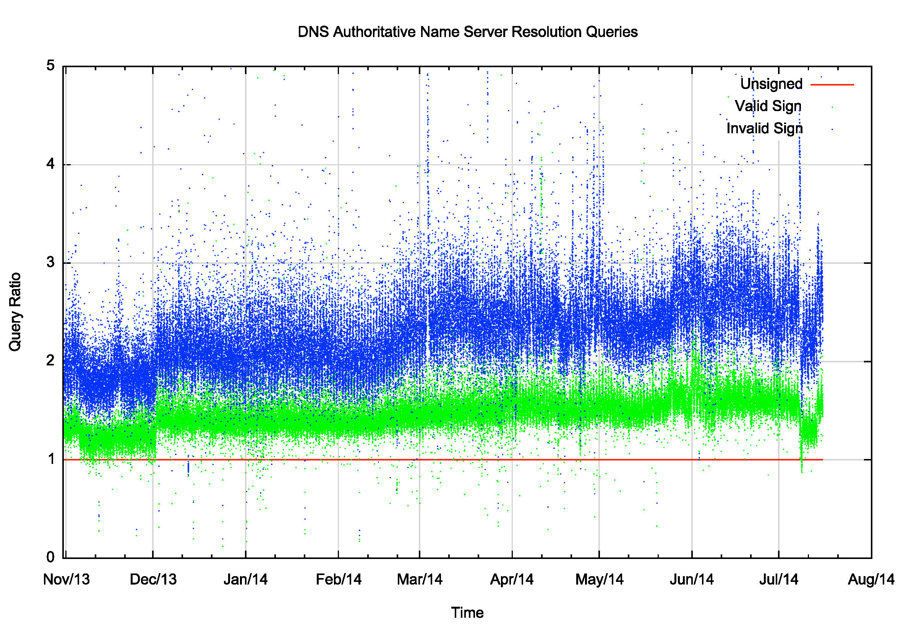
Query Profile

Slide 46
Query Profile
The query load for a badly signed domain name is around 2.5x the load for an unsigned domain
If everyone were to use validating resolvers then the load profile would rise to around 4x the load of an unsigned domain

Slide 47
Badly Signed Names
The problem with a badly signed name is the lack of caching – when a name does not validate, a validating resolver should not cache the resolution outcomes
So now all resolution attempts from validating resolvers generate queries at the authoritative name servers
And the use of a rather cryptic “ServFail” response prompts some recursive resolvers to query all nameservers
So the resultant query load on the authoritative name servers is far higher than these measurements would suggest

Slide 48
Badly Signed Names
Edge Device
Resolvers
Authoritative Name Servers

Slide 49
Setting Expectations for DNSSEC
For a validly signed zone an authoritative server may anticipate about 4x the query load and 15x the traffic load as compared to serving an equivalent unsigned zone, if everyone performed DNSSEC validation *
But if you serve a badly signed zone, expect >>8x the query load and around >>26x the traffic load *
    (* if you served the parent zone as well)

Slide 50

Thank You
Questions?

