Slide 1
Measuring the End User
Geoff Huston
APNIC Labs, February 2014

Slide 2
What’s the question?
How many users do <x>?
    How many users can retrieve a URL using IPv6?
    How many users perform DNSSEC validation when they resolve a domain name?
    How many users follow DNAME chains in the DNS
    etc

Slide 3
“Measurable” Questions
How much traffic uses IPv6?
How many connections use IPv6?
How many routes are IPv6 routes?
How many service providers offer IPv6?
How many domain names have AAAA RRs?
How many domains are DNSSEC signed?
How many DNS queries are made over IPv6?
…

Slide 4
Users vs Infrastructure
None of these specific measurement questions really embrace the larger questions about the end user behaviour
They are all aimed at measuring an aspect of of behaviour within particular parameters of the network infrastructure, but they don’t encompass how the end user assembles a coherent view of the network

Slide 5
For example… IPv6
To make an IPv6 connection everything else (routing, forwarding, DNS, transport) has to work with IPv6
So can we measure how many connected devices on today’s Internet are capable of making IPv6 connections?

Slide 6
How to measure a million end users for their IPv6 capability

Slide 7

How to measure a million end users for their IPv6 capability
Be Google (or any other massively popular web service provider)

Slide 8
How to measure a million end users for their IPv6 capability
Be Google (or any other massively popular web service provider)
  And insert measurement code on the web page that is executed as part of the page load
</div>
<script src="http://labs.apnic.net/measure-ipv6.php" type="text/javascript"></script>
<script src="http://www.google-analytics.com/urchin.js" type="text/javascript"> </script>
<script type="text/javascript">_uacct = "UA-597837-1"; urchinTracker(); </script>
</body>
</html>

Slide 9
How to measure a million end users for their IPv6 capability
Be Google (or any other massively popular web service provider)
or

Slide 10
How to measure a million end users for their IPv6 capability
Be Google (or any other massively popular web service provider)
or
Get your code to run on a million users’ machines through another delivery channel

Slide 11

Ads are ubiquitous

Slide 12
Ads are ubiquitous

Slide 13
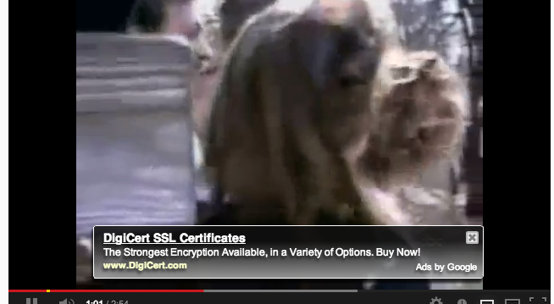
Ads are ubiquitous

Slide 14


Ads are implemented in Adobe Flash
Advertising channels use Flash to make ads interactive
  This is not just an ‘animated gif’

Slide 15
Flash makes ads interactive
[Apply Now] hover-over is interactive, and responds when selected.

Slide 16

Flash and the network
Flash includes primitives in ‘actionscript’ to fetch ‘network assets’
  Typically used to load alternate images, sequences
  Not a generalized network stack, subject to constraints:
    Port 80
    crossdomain.xml on hosting site must match source name (wildcard syntax)
Flash has asynchronous ‘threads’ model for event driven, sprite animation

Slide 17

APNIC’s measurement technique
Craft flash/actionscript which fetches network assets to measure.
Assets are reduced to a notional ‘1x1’ image which is not added to the DOM and is not displayed
Assets can be named (DNS resolution via local gethostbyname() styled API within the browser’s Flash engine) or use literals (bypass DNS resolution)
Encode data transfer in the name of fetched assets
  Use the DNS as the information conduit:
    Result is returned by DNS name with wildcard
  Use HTTP as the information conduit
    Result is returned via parameters attached to an HTTP GET command

Slide 18

Advertising placement logic
Fresh Eyeballs == Unique IPs
  We have good evidence the advertising channel is able to sustain a constant supply of unique IP addresses
Pay by click, or pay by impression
  If you select a preference for impressions, then the channel tries hard to present your ad to as many unique IPs as possible
Time/Location/Context tuned
  Can select for time of day, physical location or keyword contexts (for search-related ads)
  But if you don’t select, then placement is generalized
Aim to fill budget
  If you request $100 of placement a day, then inside 24h algorithm tries hard to even placement but in the end, will ‘soak’ place your ad to achieve enough views, to bill you $100

Slide 19
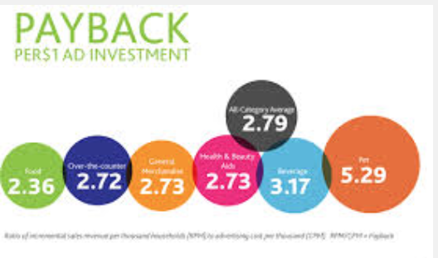
Advertising placement logic
Budget: $100 per day, at $1.00 ‘CPM’ max
  Clicks per millepressions: aim to pay no more than $1 per click but pay up to $1 for a thousand impressions
Even distribution of ads throughout the day
No constraint on location, time
Outcome: 350,000 placements per day, on a mostly even placement model with end of day ‘soak’ to achieve budget goal

Slide 20
Ad Placement Training – Day 1

Slide 21
Ad Placement Training – Day 2

Slide 22
Ad Placement Training – Day 3

Slide 23
Ad Placement Training – Day 4

Slide 24
Ad Placement Training – Days 5, 6 & 7

Slide 25
Measurement Control Channel
Use Flash code that is executed on ad impression that retrieves the actual measurement script
  Ad carries code to send the client to retrieve an ad-controller URL
      http://drongo.rand.apnic.net/measureipv6id.cgi?advertID=9999
  Client retrieves set of “tests” from the ad-controller as a sequence of URLs to fetch and a “result” URL to use to pass the results to the ad-server
This allows us to vary the measurement experiment without necessarily altering the ad campaign itself – the ad, and its approval to run, remain unchanged so that measurements can be activated and deactivated in real time.

Slide 26
Experiment Server config
There are currently three servers, identically configured (US, Europe, Australia)
Server runs Bind, Apache and tcpdump
Experiment directs the client to the “closest” server (to reduce rtt-related timeouts) based on simple /8 map of client address to region

Slide 27
Measuring IPv6 via Ads
  Client is given 5 URLs to load:
    Dual Stack object
    V4-only object
    V6-only object
    V6 literal address (no DNS needed)
    Result reporting URL (10 second timer)
    All DNS is dual stack

Slide 28
Measuring DNSSEC via Ads
  Client is given 4 URLs to load:
    DNSSEC-validly signed DNS name
    DNSSEC-invalidly signed DNS name
    Unsigned DNS name (control)
    Result reporting URL (10 second timer)
    All DNS is IPv4

Slide 29
Discovering Routing Filters via Ads
  Client is given 3 URLs to load:
    DNS name that resolves into the test prefix
    DNS name the resolves to a control prefix
    Result reporting URL (10 second timer)

Slide 30
Caching
Caching (generally) defeats the intent of the measurement
  Although some measurements are intended to measure the effects of caching
We use unique DNS labels and unique URL GET parameters
  Ensures that all DNS resolution requests and HTTP fetch requests end up at the experiment’s servers
We use a common “tag” across all URLs in a single experiment
  Allows us to join the individual fetches to create the per-user view of capability

Slide 31
Collected Data
Per Server, Per Day:
  http-access log
    (successfully completed fetches)
  dns.log
    (incoming DNS queries)
  Packet capture
    All packets

Slide 32
Collected Data
Web Logs:
h.labs.apnic.net 2002:524d:xxxx::524d:xxxx [29/Apr/2013:05:55:05 +0000] "GET /1x1.png?
t10000.u7910203317.s1367214905.i888.v1794.v6lit
h.labs.apnic.net 2002:524d:xxxx::524d:xxxx [29/Apr/2013:05:55:05 +0000] "GET /1x1.png?
t10000.u7910203317.s1367214905.i888.v1794.r6.td
h.labs.apnic.net 82.77.xxx.xxx [29/Apr/2013:05:55:05 +0000] "GET /1x1.png?
t10000.u7910203317.s1367214905.i888.v1794.rd.td
h.labs.apnic.net 82.77.xxx.xxx [29/Apr/2013:05:55:05 +0000] "GET /1x1.png?
t10000.u7910203317.s1367214905.i888.v1794.r4.td
h.labs.apnic.net 82.77.xxx.xxx [29/Apr/2013:05:55:05 +0000] "GET /1x1.png?
t10000.u7910203317.s1367214905.i888.v1794&r=zrdtd-348.zr4td-376.zr6td-316.zv6lit-228
(In this case the client is using 6to4 to access IPv6, and prefers to use IPv4 in a dual stack context)

Slide 33
Collected Data
DNS Logs:
27-Feb-2014 00:00:07.849 queries: client 12.121.116.213#54311 query: f.t10000.u3934702783.s1393459207.i1022.v6022.47c34.z.dotnxdomain.net IN A -EDC (199.102.79.186)
27-Feb-2014 00:00:07.850 queries: client 12.121.116.213#30544 query: e.t10000.u3934702783.s1393459207.i1022.v6022.47c33.z.dashnxdomain.net IN A -EDC (199.102.79.186)
27-Feb-2014 00:00:07.851 queries: client 12.121.116.213#55619 query: d.t10000.u3934702783.s1393459207.i1022.v6022.47c33.z.dotnxdomain.net IN A -EDC (199.102.79.186)

Slide 34
What does this allow?
In providing an end user with a set of URLs to retrieve we can examine:
  Protocol behaviour
    e.g.: V4 vs V6, protocol performance, connection failure rate
  DNS behaviours
    e.g.: DNSSEC use, DNS resolution performance…

Slide 35
The generic approach
Seed a user with a set of tasks that cause identifiable traffic at an instrumented server
The user does not contribute measurements
The server performs the data collection

Slide 36
Collision detection?
There was a thought that this approach could be used to perform collision detection:
  Test:
  http://<unique_id>-a.TestName.CandidateTLD/1x1.png?<uniqueid>-a
  http://<unique_id>-a.TestName.ExistingTLD/1x1.png?<uniqueid>-b
  http://results.TestName.ExistingTLD/1x1.png?<uniqueid>?za=<a_result>&zb=<b_result>
  Result Analysis:
  If the server sees a query for B and NOT A, then we can infer that there is possibly a collision for the use of CandidateTLD between local and globally scoped contexts

Slide 37
Really?
But is this collision or the opposite?
This shows the extent of local zone instances occluding a global zone
But I thought we were looking for the possibility of global zone delegation altering the behaviour of client applications using / assuming a local zone resolution
Which looks like the opposite

Slide 38
Furthermore …
Is it the use of a local name or the content of local name search lists that is critical here?
And what name forms trigger the local name resolution function to invoke the local search list to apply to the given name?
Are we measuring the extent of name collision itself or the extent of deployment of various forms of name resolution with search lists?

Slide 39
What about…
  Test:
  http://<unique_id>-single-label-name/1x1.png?<uniqueid>-a
  http://second-label.<unique_id>-single-label-name/1x1.png?<uniqueid>-b
  http://<unique_id>-single-label-name.Existing.domain.name/1x1.png?<uniqueid>-c
  http://results.TestName.Existing.domain.name/1x1.png?<uniqueid>?za=<a_result>&zb=<b_result>&zc=<c_result>
  Question:
  If we launched a high volume of ads, then what would we see at a root server?

Slide 40
A few observations
Measuring what happens at the user level by measuring some artifact or behaviour in the infrastructure and inferring some form of user behaviour is going to be a guess of some form
If you really want to measure user behaviour then its useful to trigger the user to behave in the way you want to study or measure
The technique of embedding code behind ads is one way of achieving this objective, for certain kinds of behaviours relating to the DNS and to URL fetching

Slide 41
Questions?
APNIC Labs:
Geoff Huston
research@apnic.net

