Slide 1
IPv6 Transition and CGNs: A Progress Report
Geoff Huston Chief Scientist
APNIC

Slide 2
The story so far…
The status of the transition to IPv6 is not going according to the original plan:
Over the past two years APNIC (Asia Pacific) and the RIPE NCC (Europe and the Middle East) have exhausted their supplies of general use of IPv4 Addresses
ARIN have some 14 months to go, but this assumes a very constrained availability over this period
We we meant to have IPv6 deployed by now. This is not happening.

Slide 3
The story so far…
What we are seeing is the increasing use of Carrier Grade NATs as a means of extending the useable life of the IPv4 Internet while we are still waiting for IPv6 to be viable in its own right
This has some significant implications for LEA functions, principally in traceback and Internet meta-data record keeping
So lets look at this…

Slide 4
Traceback – Version 1
A: 192.0.2.1
Internet
Ftp Server
Lets start by looking waaaay back to the Internet of the 1980’s

Slide 5
Traceback – Version 1
A: 192.0.2.1
Internet
ftp Server
Ftp Server Log
ftpserver.net 192.0.2.1 [31/Aug/2013:00:00:08 +0000]
No web – just ftp
And server logs were pretty basic

Slide 6
Traceback – Version 1
A: 192.0.2.1
Internet
Ftp Server
Ftp Server Log
ftpserver.net 192.0.2.1 [31/Aug/2013:00:00:08 +0000
$ whois 192.0.2.1
NetRange: 192.0.2.0 - 192.0.2.255
NetName: TEST-NET-1
Contact: User Contact Details
There was a rudimentary whois service and it listed all end users!

Slide 7
Traceback – Version 1
A: 192.0.2.1
Internet
ftp Server
Ftp Server Log
ftpserver.net 192.0.2.1 [31/Aug/2013:00:00:08 +0000]
$ whois 192.0.2.1
NetRange: 192.0.2.0 - 192.0.2.255
NetName: TEST-NET-1
Contact: User Contact Details

Slide 8
Assumptions:
Each end site used a stable IP address range
Each address range was recorded in a registry, together with the end user data
Each end device was manually configured with a stable IP address
Traceback was keyed from the IP address

Slide 9
Assumptions:
Each end site used a stable IP address range
Each address range was recorded in a registry, together with the end user data
Each end device was manually configured with a stable IP address
Traceback is keyed from the IP address
This model largely fell into disuse in the 1990’s
It was replaced by a combination of provider-address blocks, dynamic addressing to end users (AAA tools) and CPE NATs

Slide 10
+ NATs
A: 10.0.0.1
192.0.2.1
ISP
B: 10.0.0.2
CPE NAT/
DHCP Server
C: 10.0.0.3

Slide 11
Traceback – Version 2
A: 10.0.0.1
ISP
192.0.2.1
Web Server
CPE NAT/
DHCP Server
Web Server Log
webserver.net 192.0.2.1 [31/Aug/2013:00:00:08 +0000] "GET /1x1.png HTTP/1.1" 200
$ whois 192.0.2.1
NetRange: 192.0.2.0 - 192.0.2.255
CIDR: 192.0.2.0/24
OriginAS:
NetName: TEST-NET-1
NetHandle: NET-192-0-2-0-1
Parent: NET-192-0-0-0-0
NetType: IANA Special Use

Slide 12
Traceback – Version 2
ISP RADIUS Log
15/Aug/2013:18:01:02: user XXX IP: 192.0.2.1
A: 10.0.0.1
ISP
192.0.2.1
Web Server
CPE NAT/
DHCP Server
Web Server Log
webserver.net 192.0.2.1 [31/Aug/2013:00:00:08 +0000] "GET /1x1.png HTTP/1.1" 200
$ whois 192.0.2.1
NetRange: 192.0.2.0 - 192.0.2.255
CIDR: 192.0.2.0/24
OriginAS:
NetName: TEST-NET-1
NetHandle: NET-192-0-2-0-1
Parent: NET-192-0-0-0-0
NetType: IANA Special Use

Slide 13
Traceback – Version 2
ISP RADIUS Log
15/Aug/2013:18:01:02: user XXX IP: 192.0.2.1
A: 10.0.0.1
ISP
192.0.2.1
Web Server
CPE NAT/
DHCP Server
Web Server Log
CPE NAT Log
webserver.net 192.0.2.1 [31/Aug/2013:00:00:08 +0000] "GET /1x1.png HTTP/1.1" 200
31/Aug/2013:00:00:02: 10.0.0.1:34233 128.66.0.0:80 -> 192.0.2.1:45800 128.66.0.0:80
$ whois 192.0.2.1
NetRange: 192.0.2.0 - 192.0.2.255
CIDR: 192.0.2.0/24
OriginAS:
NetName: TEST-NET-1
NetHandle: NET-192-0-2-0-1
Parent: NET-192-0-0-0-0
NetType: IANA Special Use

Slide 14
Traceback – Version 2
ISP RADIUS Log
15/Aug/2013:18:01:02: user XXX IP: 192.0.2.1
CPE DHCP Server Log:
A: 10.0.0.1
B: 10.0.0.2
C: 10.0.0.3
A: 10.0.0.1
ISP
192.0.2.1
Web Server
CPE NAT/
DHCP Server
Web Server Log
CPE NAT Log
webserver.net 192.0.2.1 [31/Aug/2013:00:00:08 +0000] "GET /1x1.png HTTP/1.1" 200
31/Aug/2013:00:00:02: 10.0.0.1:34233 128.66.0.0:80 -> 192.0.2.1:45800 128.66.0.0:80
$ whois 192.0.2.1
NetRange: 192.0.2.0 - 192.0.2.255
CIDR: 192.0.2.0/24
OriginAS:
NetName: TEST-NET-1
NetHandle: NET-192-0-2-0-1
Parent: NET-192-0-0-0-0
NetType: IANA Special Use

Slide 15
Traceback – Version 2
ISP RADIUS Log
15/Aug/2013:18:01:02: user XXX IP: 192.0.2.1
CPE DHCP Server Log:
A: 10.0.0.1
B: 10.0.0.2
C: 10.0.0.3
A: 10.0.0.1
ISP
192.0.2.1
Web Server
CPE NAT/
DHCP Server
Web Server Log
CPE NAT Log
webserver.net 192.0.2.1 [31/Aug/2013:00:00:08 +0000] "GET /1x1.png HTTP/1.1" 200
31/Aug/2013:00:00:02: 10.0.0.1:34233 128.66.0.0:80 -> 192.0.2.1:45800 128.66.0.0:80
$ whois 192.0.2.1
NetRange: 192.0.2.0 - 192.0.2.255
CIDR: 192.0.2.0/24
OriginAS:
NetName: TEST-NET-1
NetHandle: NET-192-0-2-0-1
Parent: NET-192-0-0-0-0
NetType: IANA Special Use

Slide 16
Assumptions
The ISP operates an address pool
Each end site is dynamically assigned a single IP address upon login (AAA)
The site is dynamically addressed using a private address range and a DHCP server
The single public address is shared by the private devices through a CPE NAT

Slide 17
Assumptions
Traceback to an end site is keyed by an IP address and a date/time
Requires access to WHOIS records to identify the ISP and the ISP’s AAA logs to identify the end site
Further traceback within the end site relies on access to the site’s DHCP and NAT logs (assuming that there are such logs!)

Slide 18
Assumptions
Traceback to an end site is keyed by an IP address and a date/time
Requires access to WHOIS records to identify the ISP and the ISP’s AAA logs to identify the end site
Further traceback within the end site relies on access to the site’s DHCP and NAT logs (assuming that there are such logs!)
This model is commonly used today

Slide 19
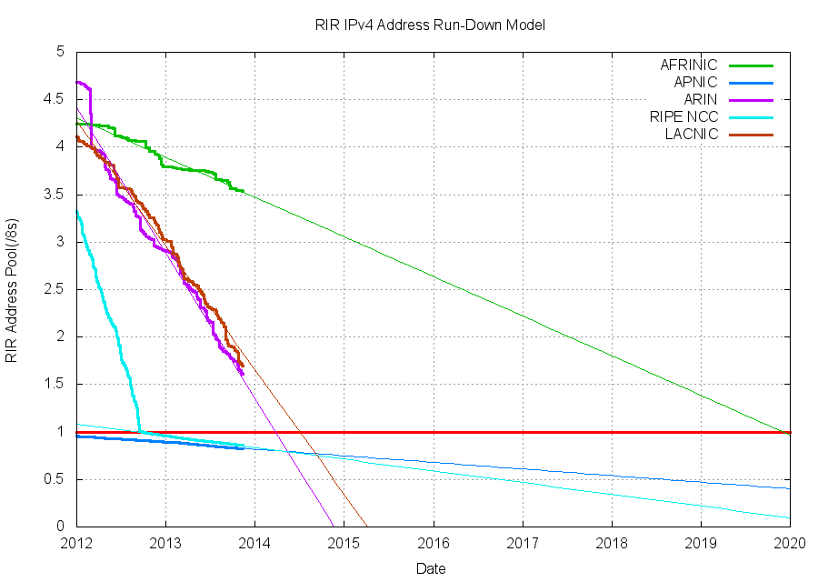
IPv4 Address Exhaustion

Slide 20
IPv4 Address Exhaustion
APNIC – April 2011
RIPE NCC– September 2012
ARIN – January 2015
LACNIC – March 2015
20

Slide 21
IPv4 Address Exhaustion
We are seeing ISPs in Asia Pac and Europe run out of IPv4 addresses
And while the plan was to have IPv6 fully deployed by now, that has not happened

Slide 22
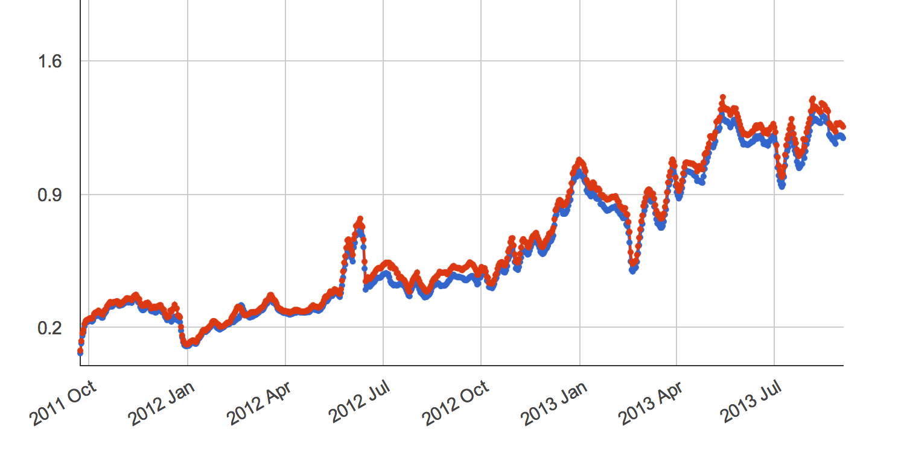
IPv6 Penetration in the Internet
% of end-user clients who are CAPABLE of using IPv6
% of the Internet’s User Population
% of end-user clients who PREFER to use IPv6 in Dual Stack Scenarios

Slide 23
IPv6 Penetration in the Internet
Yes, that’s just 1.5
%
% of the Internet’s User Population

Slide 24
IPv4 Address Exhaustion
What are ISP’s doing in response?
It’s not viable to switch over to IPv6 yet
But the supply of further IPv4 addresses to fuel service platform growth has dried up / will soon dry up
How will ISPs continue to offer IPv4 services to customers in the interim?

Slide 25
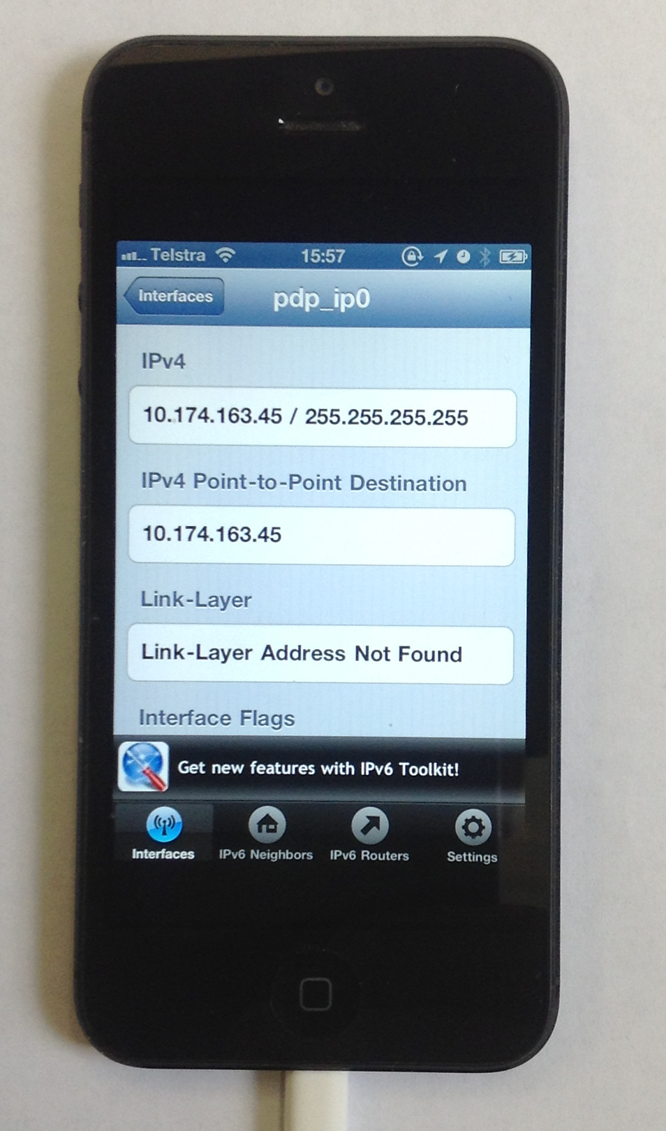
Carrier Grade NATs
By sharing public IPv4 addresses across multiple customers!
Yes, that’s my phone using net 10!

Slide 26
Carrier Grade NATs
By sharing public IPv4 addresses across multiple customers!
http://tech.slashdot.org/story/13/05/07/1232234/bt-begins-customer-tests-of-carrier-grade-nat

Slide 27
NATs + CGNs
ISP CGN
A: 10.0.0.1
B: 10.0.0.2
CPE NAT/
DHCP Server
C: 10.0.0.3
End User Private Address Pool
ISP Private Address Pool
Public Address Pool

Slide 28
NATs + CGNs + Connections
ISP CGN
A: 10.0.0.1
192.0.2.0/24
172.16.5.6
Internet
B: 10.0.0.2
CPE NAT/
DHCP Server
Web Server
C: 10.0.0.3

Slide 29
Traceback – Version 3
ISP CGN
A: 10.0.0.1
192.0.2.0/24
172.16.5.6
Internet
B: 10.0.0.2
CPE NAT/
DHCP Server
Web Server
C: 10.0.0.3
Web Server Log
webserver.net [192.0.2.1]:45800 [31/Aug/2013:00:00:08 +0000] "GET /1x1.png HTTP/1.1" 200
$ whois 192.0.2.1
NetRange: 192.0.2.0 - 192.0.2.255
CIDR: 192.0.2.0/24
OriginAS:
NetName: TEST-NET-1
NetHandle: NET-192-0-2-0-1
Parent: NET-192-0-0-0-0
NetType: IANA Special Use

Slide 30
Traceback – Version 3
ISP CGN
A: 10.0.0.1
192.0.2.0/24
172.16.5.6
Internet
B: 10.0.0.2
CPE NAT/
DHCP Server
Web Server
C: 10.0.0.3
ISP CGN Log
Web Server Log
31/Aug/2013:00:00:02
172.16.5.6:34233 128.66.0.0:80 -> 192.0.2.1:45800 128.66.0.0:80
webserver.net [192.0.2.1]:45800 [31/Aug/2013:00:00:08 +0000] "GET /1x1.png HTTP/1.1" 200
$ whois 192.0.2.1
NetRange: 192.0.2.0 - 192.0.2.255
CIDR: 192.0.2.0/24
OriginAS:
NetName: TEST-NET-1
NetHandle: NET-192-0-2-0-1
Parent: NET-192-0-0-0-0
NetType: IANA Special Use

Slide 31
Traceback – Version 3
ISP RADIUS Log
15/Aug/2013:18:01:02: user XXX IP: 172.16.5.6:34000-40000
ISP CGN
A: 10.0.0.1
192.0.2.0/24
172.16.5.6
Internet
B: 10.0.0.2
CPE NAT/
DHCP Server
Web Server
C: 10.0.0.3
ISP CGN Log
Web Server Log
31/Aug/2013:00:00:02
172.16.5.6:34233 128.66.0.0:80 -> 192.0.2.1:45800 128.66.0.0:80
webserver.net [192.0.2.1]:45800 [31/Aug/2013:00:00:08 +0000] "GET /1x1.png HTTP/1.1" 200
$ whois 192.0.2.1
NetRange: 192.0.2.0 - 192.0.2.255
CIDR: 192.0.2.0/24
OriginAS:
NetName: TEST-NET-1
NetHandle: NET-192-0-2-0-1
Parent: NET-192-0-0-0-0
NetType: IANA Special Use

Slide 32
Traceback – Version 3
ISP RADIUS Log
15/Aug/2013:18:01:02: user XXX IP: 172.16.5.6:34000-40000
ISP CGN
CPE DHCP Server Log:
A: 10.0.0.1
B: 10.0.0.2
C: 10.0.0.3
A: 10.0.0.1
192.0.2.0/24
172.16.5.6
Internet
B: 10.0.0.2
CPE NAT/
DHCP Server
Web Server
C: 10.0.0.3
ISP CGN Log
Web Server Log
31/Aug/2013:00:00:02
172.16.5.6:34233 128.66.0.0:80 -> 192.0.2.1:45800 128.66.0.0:80
webserver.net [192.0.2.1]::45800 [31/Aug/2013:00:00:08 +0000] "GET /1x1.png HTTP/1.1" 200
$ whois 192.0.2.1
NetRange: 192.0.2.0 - 192.0.2.255
CIDR: 192.0.2.0/24
OriginAS:
NetName: TEST-NET-1
NetHandle: NET-192-0-2-0-1
Parent: NET-192-0-0-0-0
NetType: IANA Special Use
CPE NAT Log
31/Aug/2013:00:00:02: 10.0.0.1:10233 128.66.0.0:80 -> 72.16.5.6:34233 128.66.0.0:80

Slide 33
Traceback – Version 3
ISP RADIUS Log
15/Aug/2013:18:01:02: user XXX IP: 172.16.5.6:34000-40000
ISP CGN
CPE DHCP Server Log:
A: 10.0.0.1
B: 10.0.0.2
C: 10.0.0.3
A: 10.0.0.1
192.0.2.0/24
172.16.5.6
Internet
B: 10.0.0.2
CPE NAT/
DHCP Server
Web Server
C: 10.0.0.3
ISP CGN Log
Web Server Log
31/Aug/2013:00:00:02
172.16.5.6:34233 128.66.0.0:80 -> 192.0.2.1:45800 128.66.0.0:80
webserver.net [192.0.2.1]::45800 [31/Aug/2013:00:00:08
+0000] "GET /1x1.png HTTP/1.1" 200
$ whois 192.0.2.1
NetRange: 192.0.2.0 - 192.0.2.255
CIDR: 192.0.2.0/24
OriginAS:
NetName: TEST-NET-1
NetHandle: NET-192-0-2-0-1
Parent: NET-192-0-0-0-0
NetType: IANA Special Use
CPE NAT Log
31/Aug/2013:00:00:02: 10.0.0.1:10233 128.66.0.0:80 -> 72.16.5.6:34233 128.66.0.0:80

Slide 34
Assumptions
The ISP operates a public address pool and a private address pool
The access into the public address pool is via an ISP-operated NAT (CGN)
Each end site is dynamically assigned a single private IP address upon login (AAA)
The site is dynamically addressed using a private address range and a DHCP server
The single public address is shared by the private devices through a CPE NAT

Slide 35
Assumptions
Traceback to an end site is keyed by an IP address AND a port address, and a date/time (uSec!)
Requires access to WHOIS records to identify the ISP, the ISP’s CGN logs to identify the ISP’s private address and the ISP’s AAA logs to identify the end site
Further traceback within the end site relies on access to the site’s DHCP and NAT logs (assuming that there are such logs!)

Slide 36
ISP CGN Logging
CGN bindings are formed for EVERY unique TCP and UDP session
That can be a LOT of data to retain…
http://www.nanog.org/meetings/nanog54/presentations/Tuesday/GrundemannLT.pdf

Slide 37
It could be better than this…
Use Port Blocks per customer
or
Use a mix of Port Blocks and Shared Port Pool overflow
and
Compress the log data (which will reduce storage but may increase search overhead)

Slide 38
Or it could be worse…

Slide 39
Challenges:
This is a deregulated and highly
competitive environment
There is no plan, just the interplay of
various market pressures
2. Varying IPv4 Address Exhaustion Timelines
Differing time lines create differing
pressures in the market
3. Regional Diversity
One network architecture is not an
assured outcome!

Slide 40
What does this mean for the Internet?

Slide 41
What does this mean for the Internet?
We are going to see a LOT of transition middleware being deployed!

Slide 42
What does this mean for LEAs?
We are going to see a LOT of transition middleware being deployed!
And we are going to see a significant diversity in what that middleware does

Slide 43
What does this mean for LEAs?
LEAs have traditionally focused on the NETWORK as the point of interception and tracing
They are used to a consistent model to trace activity:
get an IP address and a time range
trace back based on these two values to uncover a set of network transactions

Slide 44
What does this mean for LEAs?
In a world of densely deployed CGNs and ALGS then the IP address loses coherent meaning in terms of end party identification.

Slide 45
What does this mean for LEAs?
In a world of densely deployed CGNs and ALGS then the IP address loses coherent meaning in terms of end party identification.
Today’s traceback approaches won’t work any more!

Slide 46
What does this mean for LEAs?
And instead of shifting to a single “new” model of IP address use, we are going to see widespread diversity in the use of transition mechanisms and NATs in carrier networks
Which implies that there will no longer be a useful single model of how to perform traceback on the network
Or even a single coherent model of “what is an IP address” in the network

Slide 47
Variants of NAT444 CGN Technologies
Address Compression
Ratio
10:1
100:1
1,000:1
>>10,000:1
Variant:
CGN with per-user port blocks
CGN with per-user port blocks + pooled overflow
CGN with pooled ports
CGN with 5-tuple binding maps
The same public address and port is used
simultaneously by multiple different internal
users
Customer A
Source: 192.0.2.1:1234
Dest: 128.66.0.0:80
ISP
Internet
Customer B
CGN
Source: 192.0.2.1:1234
Dest: 128.66.2.2:80

Slide 48
Adding IPv6 to the CGN Mix
The space is not exclusively an IPv4 space.
While CGNs using all-IPv4 technologies are common today, we are also looking at how to use CGN variants a mix of IPv6 and IPv4
For example: Dual-Stack Light connects IPv4 end users to the IPv4 Internet across an IPv6 ISP infrastructure.
We can expect to see many more variants of ISP’s address transform middleware when you are allowed to add IPv6 into the mix

Slide 49
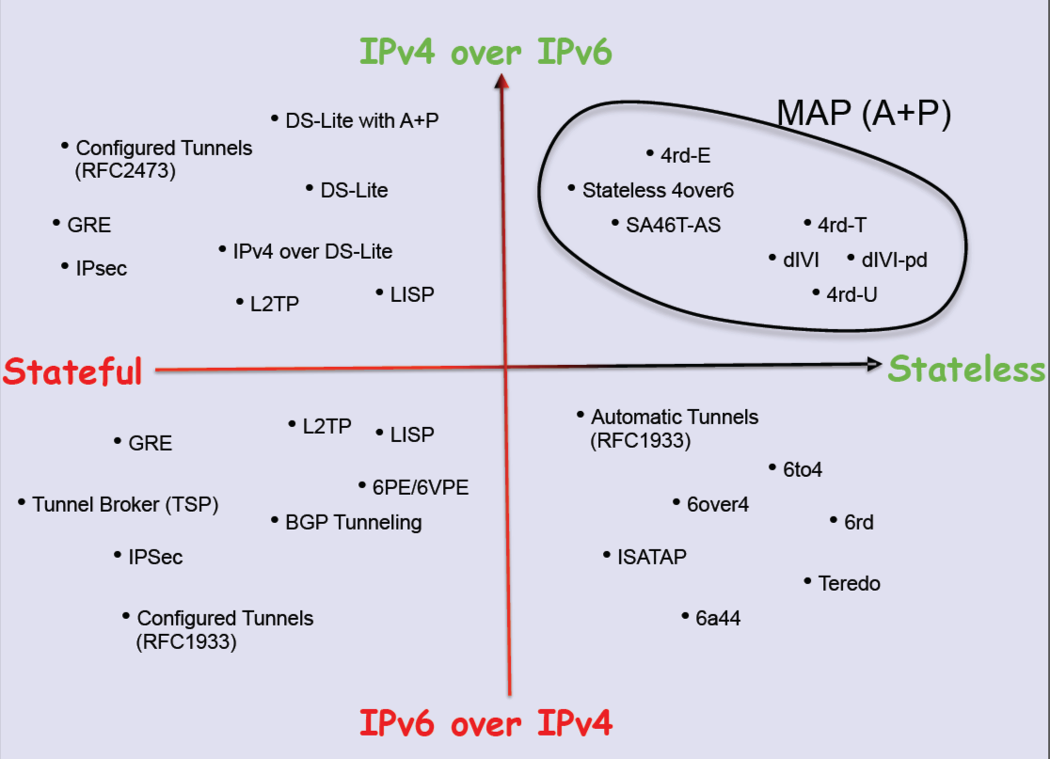
++IPv6: Transition Technologies
Randy Bush, APPRICOT 2012: http://meetings.apnic.net/__data/assets/pdf_file/0016/45241/120229.apops-v4-life-extension.pdf

Slide 50
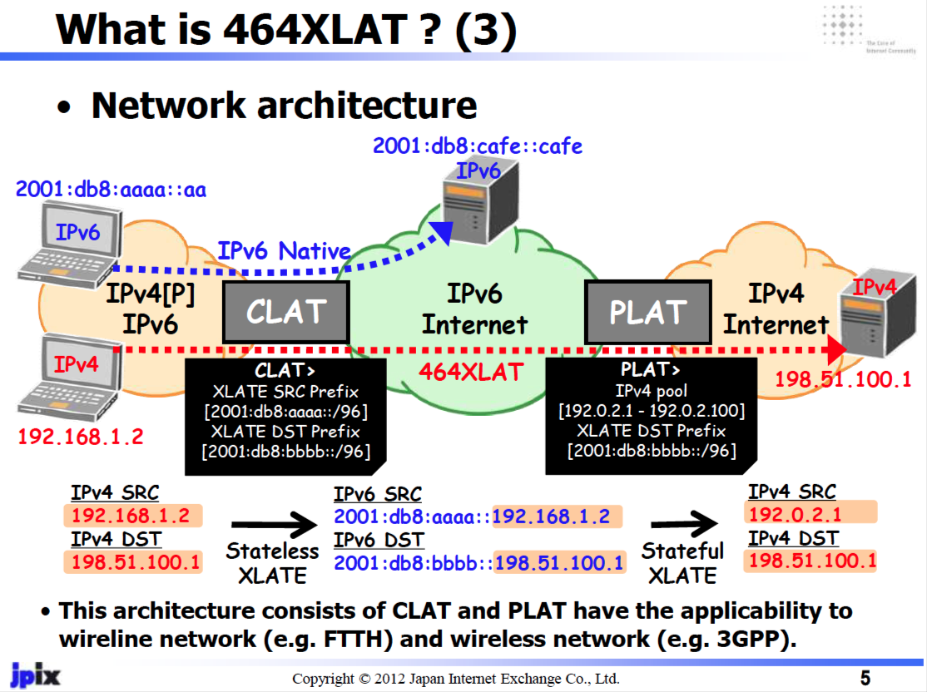
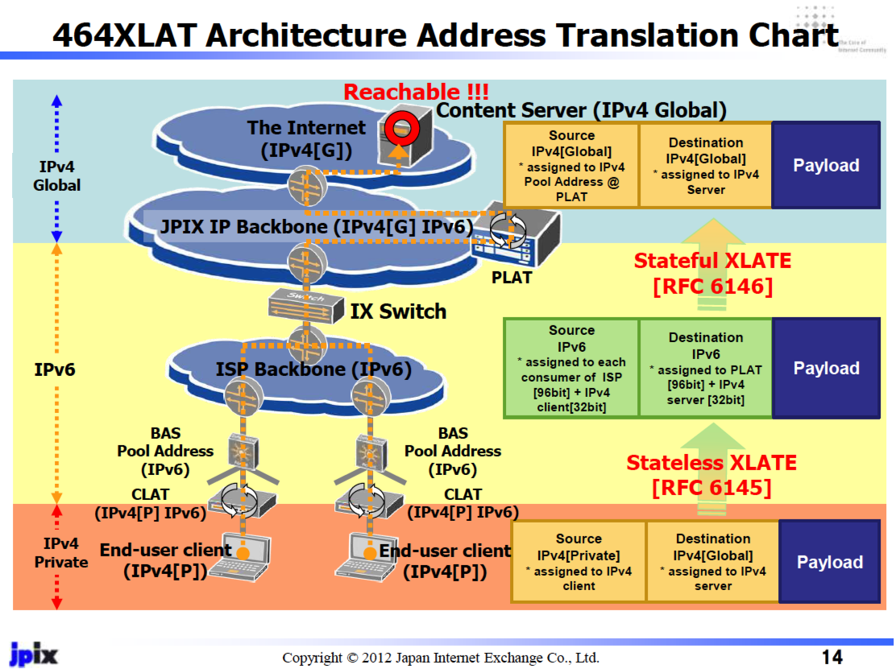
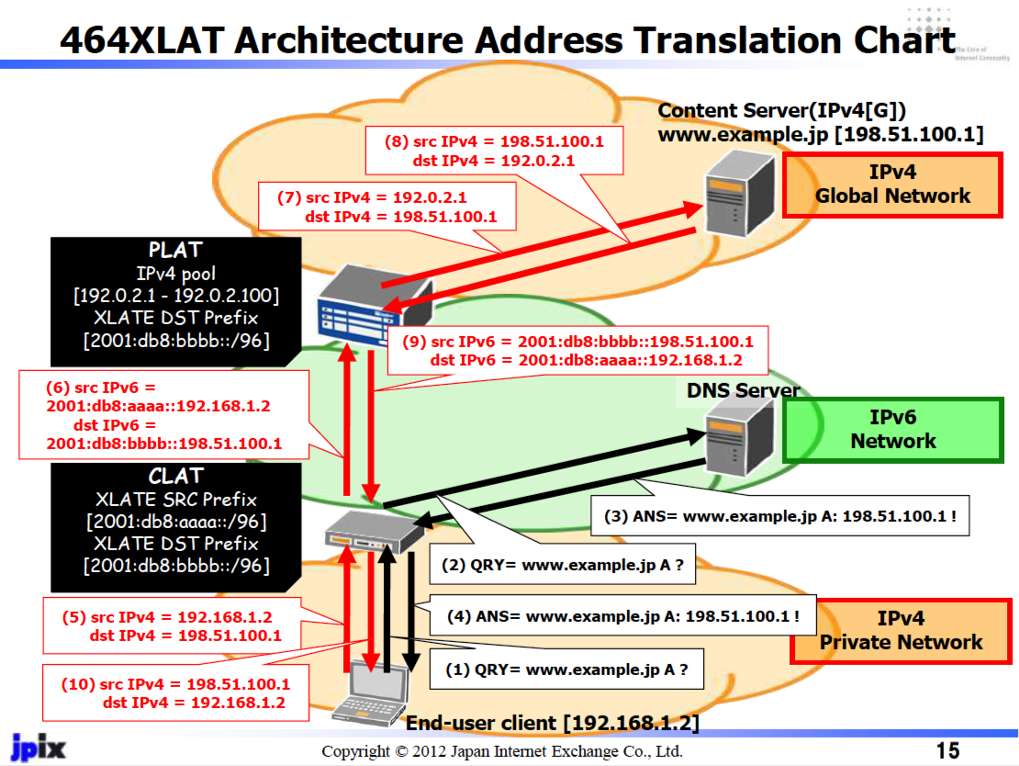
Transition Technologies Example: 464XLAT
Masataka Mawatari, Apricot 2012, http://meetings.apnic.net/__data/assets/pdf_file/0020/45542/jpix_464xlat_apricot2012_for_web.pdf

Slide 51
What does this mean for LEAs?
The risk we are running at the moment is that in the near future there will no longer be a single consistent model of how an IP network manages IPv4 and IPv6 addresses

Slide 52
What does this mean for LEAs?
What’s the likely response from LEAs and regulators?
One likely response is to augment the record keeping rules for ISPs:
“record absolutely everything, and keep the records for years”

Slide 53
What does this mean for ISPs and LEAs?
But what are the new record keeping rules?
In order to map a “external” IP address and time to a subscriber as part of a traceback exercise then:
for every active middleware element you now need to hold the precise time and the precise transforms that were applied to a packet flow
and you need to be able to cross-match these records accurately

Slide 54
What does this mean for ISPs and LEAs?
But what are the new record keeping rules?
In order to map a “external” IP address and time to a subscriber as part of a traceback exercise then:
for every active middleware element you now need to hold the precise time and the precise transforms that were applied to a packet flow
and you need to be able to cross-match these records accurately
Degree of difficulty: approaching 10/10 !

Slide 55
What does this mean for ISPs and LEAs?
How many different sets of record keeping rules are required for each CGN / dual stack transition model being used?
And are these record keeping practices affordable?
(granularity of the records is shifting from “session” records to “transition” and even individual packet records in this diverse model)
Are they even practical within today’s technology capability?
Is this scaleable?
Is it even useful any more?

Slide 56
Traceback in tommorrow’s Internet?
The traceback toolkit:
precise time, source and dest IP addrs, protocol and port information
Access to all ISP middleware logs
CDN SP logs
Network and Middleware deployment maps
V6 Transition technology map used by the ISP
A thorough understanding of vendor’s equipment behaviour for various applications
A thorough understanding of application behaviours

Slide 57
Making it hard...
The V6 transition was challenging enough
The combination of V4 exhaustion and V6 transition is far harder
The combination of varying exhaustion times, widespread confusion, diverse agendas, diverse pressures, V4 exhaustion and V6 transition is now amazingly challenging

Slide 58
Making it very hard...
The problem we are facing is that we are heading away from a single service architecture in our IP networks
Different providers are seeing different pressures and opportunities, and are using different technology solutions in their networks
And the longer we sit in this “exhaustion + transitioning” world, the greater the diversity and internal complexity of service networks that will be deployed

Slide 59
Even harder?
All this will make the entire record and trace problem for ISPs and LEAs far harder than it is at present!
At some point along this path of escalating network complexity and diversity its likely that our networks will be simply be unable to track individual use in any coherent manner
If this is where the Internet is heading, then from an LEA perspective the tracking and tracing story is looking pretty bad

Slide 60
Does it ever get easier?
Is there light at the end of this tunnel?

Slide 61
The Transition to IPv6
Once we get to complete this transition we no longer need to use IPv4
Which means that we can throw aware these CGNs and their associated records
And the entire exercise of record keeping and traceback gets a whole lot easier

Slide 62
Traceback – IP Version 6
ISP
CPE
Web Server
Web Server Log
webserver.net 2001:db8:1:0:426c:8fff:fe35:45a8 [31/Aug/2013:00:00:08 +0000] "GET /1x1.png HTTP/1.1" 200
$ whois 2001:db8:1:0:426c:8fff:fe35:45a8
inet6num: 2001:0DB8::/32
netname: IPV6-DOC-AP
descr: IPv6 prefix for documentation purpose
country: AP

Slide 63
Traceback – IP Version 6
ISP AAA Log
15/Aug/2013:18:01:02: user XXX IP: 2001:db8:1::/56
2001:DB8:1::/56
ISP
CPE
Web Server
Web Server Log
webserver.net 2001:db8:1:0:426c:8fff:fe35:45a8 [31/Aug/2013:00:00:08 +0000] "GET /1x1.png HTTP/1.1" 200
$ whois 2001:db8:1:0:426c:8fff:fe35:45a8
inet6num: 2001:0DB8::/32
netname: IPV6-DOC-AP
descr: IPv6 prefix for documentation purpose
country: AP

Slide 64
Traceback – IP Version 6
ISP AAA Log
15/Aug/2013:18:01:02: user XXX IP: 2001:db8:1::/56
2001:DB8:1::/56
ISP
CPE
Web Server
A: inet6: fe80::426c:8fff:fe35:45a8%en0
inet6: 2001:db8:1:0:426c:8fff:fe35:45a8
Web Server Log
webserver.net 2001:db8:1:0:426c:8fff:fe35:45a8 [31/Aug/2013:00:00:08 +0000] "GET /1x1.png HTTP/1.1" 200
$ whois 2001:db8:1:0:426c:8fff:fe35:45a8
inet6num: 2001:0DB8::/32
netname: IPV6-DOC-AP
descr: IPv6 prefix for documentation purpose
country: AP

Slide 65
IPv6 makes it easy again. Right?
Yes.
The semantics an IPv6 address in an IPv6 network are much the same as the original model of IPv4 addresses in a non-NATTed IPv4 Internet
Which is good.
But it’s not completely the same as the original IPv4 model…

Slide 66
IPv6 makes it easy again. Right?
mostly
Firstly, there are private addresses creeping into IPv6
The use of ULAs is taking hold in IPv6 networks
Apple use ULA addresses in “back to my Mac”, and many enterprise networks use ULAs internally because network renumbering in IPv6 is hard.
So we can expect more ULAs + V6NATs, not less.
Which, if they leak out to the public Internet, would not be so good

Slide 67
IPv6 makes it easy again. Right?
mostly
Secondly, IPv6 Privacy Addresses introduce ephemeral public IPv6 addresses into the mix
IPv6 Privacy addresses are used in Windows, Max OSx, some variants of Linux
The privacy address cannot trace back to the original device. At best it can track back to the original site network, but no further
And there are no logs of the privacy address, as it’s self assigned
So IPv6 may not be able to track back to the device every time. Sometimes the best you can get is the home site and no closer!

Slide 68
The Bottom Line
Compared to the byzantine complexities of the emerging CGN world of the IPv4 Internet, it certainly appears that an IPv6 Internet makes the conventional activities of record keeping and logging far easier once more
Typically, these IPv6 addresses will map all the way back to the MAC address of the device that is attached to the network
With IPv6 Privacy Addresses these address records do not necessarily resolve back to individual devices all the time, but they should give consistent visibility to the granularity of the home/end site network based on IPv6 address without massive record generation
And that’s a big win over where IPv4 + CGNs is heading!

Slide 69
Thank You!

