Slide 1
A Question of Protocol
Geoff Huston
APNIC

Slide 2
Originally there was RFC791:

Slide 3

Originally there was RFC791:

Slide 4
Originally there was RFC791:
“All hosts must be prepared to accept datagrams of up to 576 octets (whether they arrive whole or in fragments). It is recommended that hosts only send datagrams larger than 576 octets if they have assurance that the destination is prepared to accept the larger datagrams.”

Slide 5
Then came RFC1123:
... it is also clear that some new DNS record types defined in the future will contain information exceeding the 512 byte limit that applies to UDP, and hence will require TCP. Thus, resolvers and name servers should implement TCP services as a backup to UDP today, with the knowledge that they will require the TCP service in the future.

Slide 6
Then came RFC1123:
... it is also clear that some new DNS record types defined in the future will contain information exceeding the 512 byte limit that applies to UDP, and hence will require TCP. Thus, resolvers and name servers should implement TCP services as a backup to UDP today, with the knowledge that they will require the TCP service in the future.
Is that a “SHOULD”, or a mere “should”?

Slide 7
Hang on…
RFC 791 said 576 octets, yet RFC 1123 reduces this even further to 512 bytes
What’s going on?
An IPv4 UDP packet contains:
  20 bytes of IP header
  <= 40 bytes of IP options
  8 bytes of UDP header
  payload
  The IP header is between 28 and 68 bytes
All IPv4 hosts must accept a 576 byte IP packet, which implies that the maximum UDP payload that all hosts will accept is 512 bytes

Slide 8
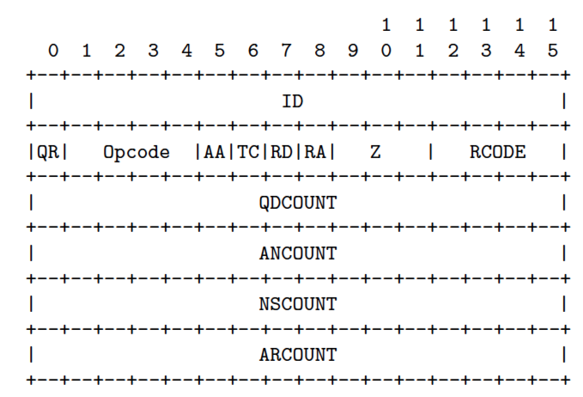
The original DNS model
If the reply is <= 512 bytes, send a response over UDP
If the reply is > 512 bytes, send a response over UDP, but set the TRUNCATED bit in the DNS payload
  Which should trigger the client to re-query the server using TCP

Slide 9
Then came EDNS0
RFC2671:
4.5. The sender's UDP payload size (which OPT stores in the RR CLASS
field) is the number of octets of the largest UDP payload that can
be reassembled and delivered in the sender's network stack. Note
that path MTU, with or without fragmentation, may be smaller than
this.
The sender can say to the resolver: “It’s ok to send me DNS responses using UDP up to size <xxx>. I can handle packet reassembly.”

Slide 10
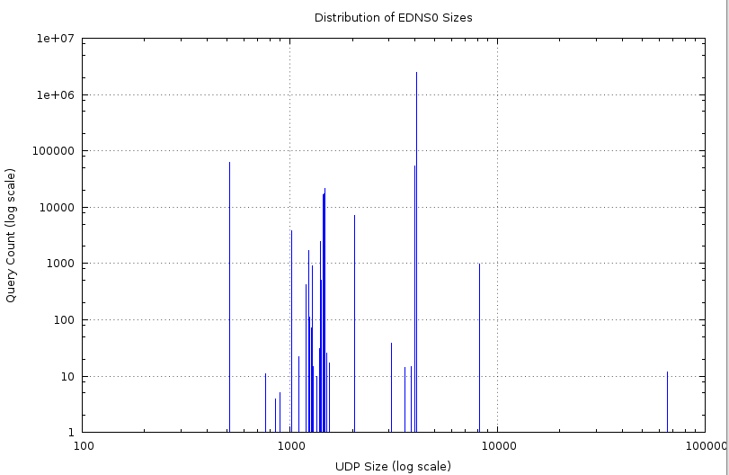
Aside: Offered EDNS0 Size Distribution
4096
512
4000
1480
1024
2048
1232
8K
65K
0

Slide 11
Aside: Offered EDNS0 Size Distribution
512 62977
768 11
850 4
900 5
1024 3857
1100 22
1200 416
1232 1706
1252 112
1272 71
1280 906
1300 15
1352 10
1392 31
1400 2431
1410 1291
1412 209
1420 513
1440 10443
1450 16332
1452 3605
1460 17387
1472 1933
1480 21225
1500 26
1550 17
2048 6984
3072 38
3584 14
3839 15
4000 54492
4096 2500352
8192 981
65535 12
IPv6?? 1500 - 48
?? 1500 -20
?? IPv6
RFC6891

Slide 12
What if…
One were to send a small query in UDP to a DNS resolver with:
  EDNS0 packet size set to a large value
  The IP address of the intended victim as the source address of the UDP query
  A query that generates a large response in UDP
  ISC.ORG IN ANY, for example
You get a 10x – 100x gain!
Mix and repeat with a combination of a bot army and the published set of open recursive resolvers (of which there are currently some 28 million!)

Slide 13
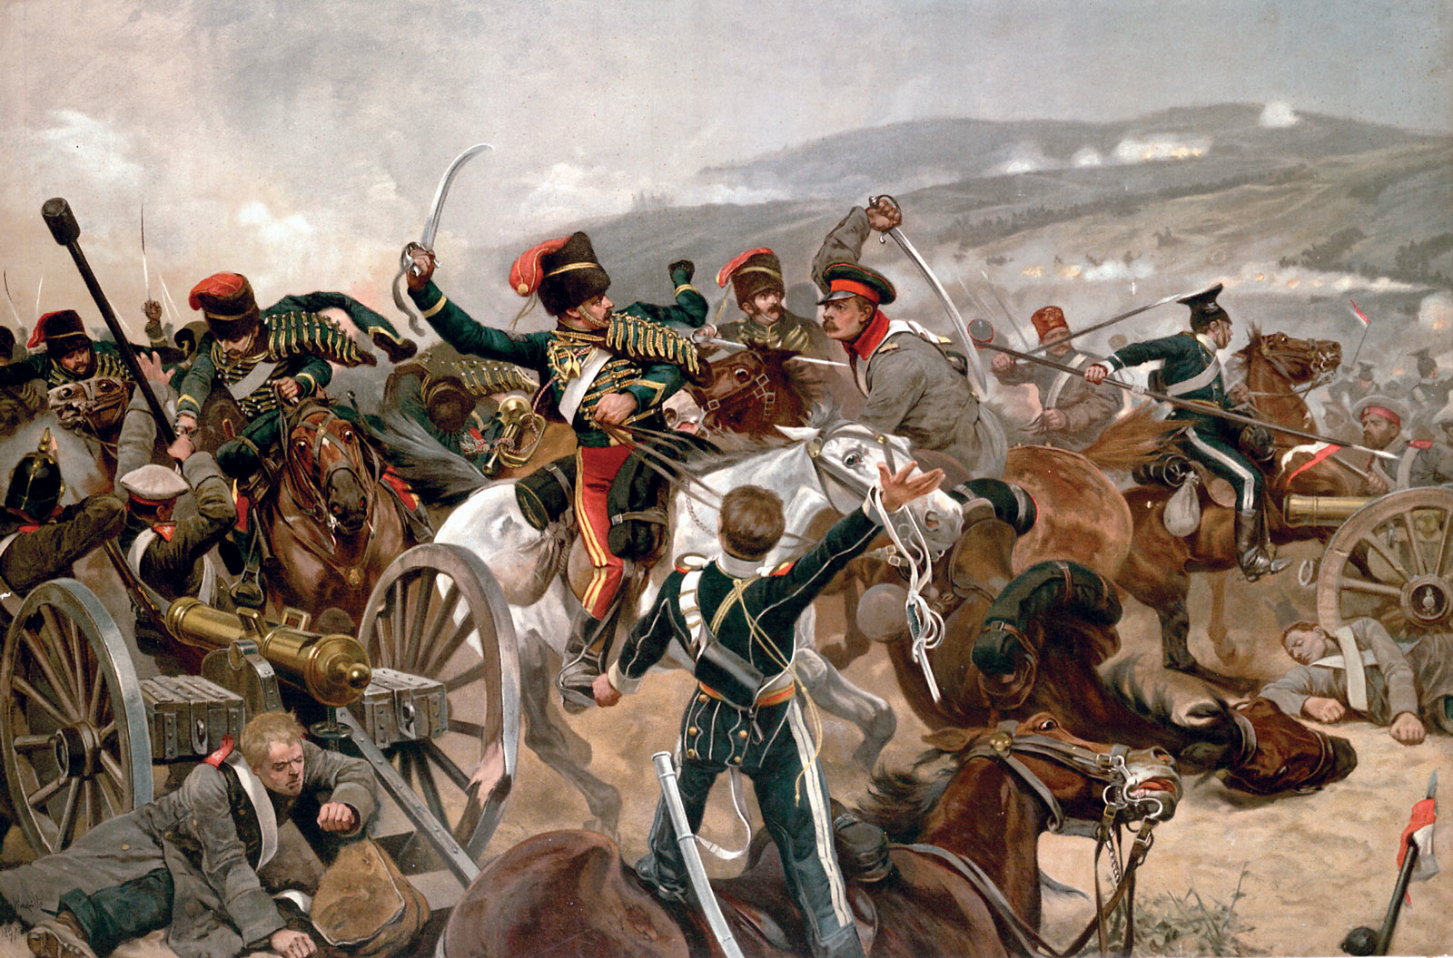
Which leads to…

Slide 14
Possible Mitigations…?
Get everyone to use BCP38

Slide 15
Possible Mitigations…?
1) Get everyone to use BCP38
2) Use a smaller EDNS0 max size

Slide 16
Possible Mitigations…?
1) Get everyone to use BCP38
2) Use a smaller EDNS0 max size
3) Selectively push back with TC=1

Slide 17
Possible Mitigations…?
1) Get everyone to use BCP38
2) Use a smaller EDNS0 max size
3) Selectively push back with TC=1
So lets look at 2) & 3):
  This would then force the query into TCP
  And the TCP handshake does not admit source address spoofing

Slide 18
Could this work?
How many customers use DNS resolvers that support TCP queries?
  Lets find out with an experiment:
    Turn down the EDNS0 size limit on an authoritative server to 512 bytes
    Enlist a large number of clients to fetch a collection of URLs:
      Short DNS name, unsigned (fits in a 512 byte UDP response)
      Short DNS name, DNSSEC-signed
      Long DNS name, unsigned
      Long DNS name, DNSSEC-signed

Slide 19
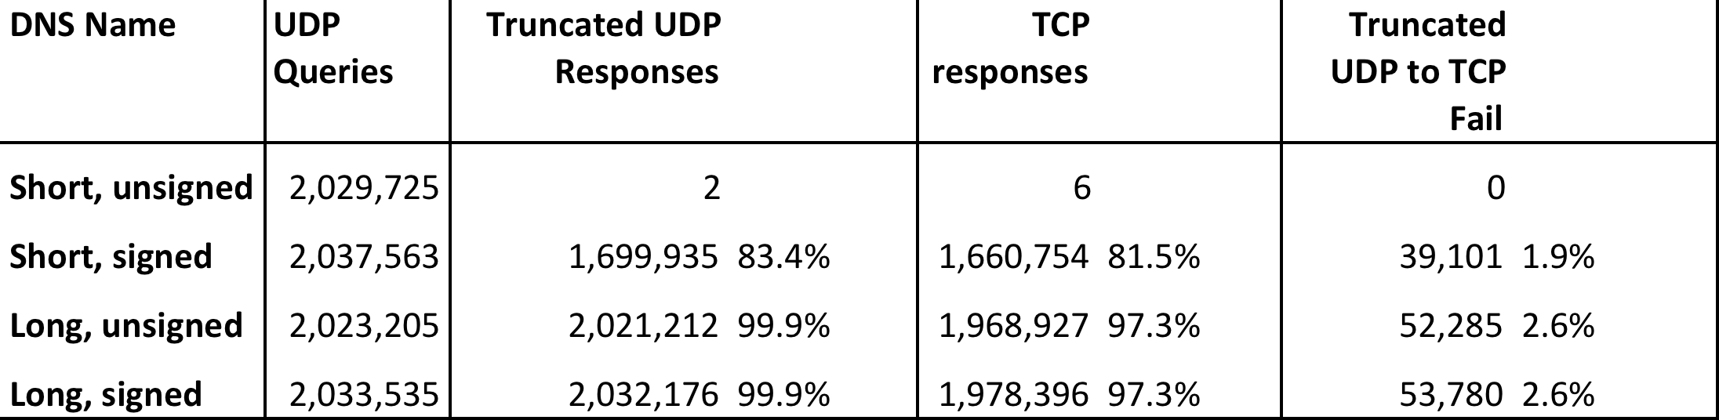
Results

Slide 20
Results

Slide 21
Results
To get to the long name with a >512 byte response we used cnames:
4a9c317f.4f1e706a.6567c55c.0be33b7b.2b51341.a35a853f.59c4df1d.3b069e4e.87ea53bc.2b4cfb4f.987d5318.
fc0f8f61.3cbe5065.8d9a9ec4.1ddfa1c2.4fee4676.1ffb7fcc.ace02a11.a3277bf4.2252b9ed.9b15950d.db03a738.
dde1f863.3b0bf729.04f95.z.dotnxdomain.net.
CNAME
33d23a33.3b7acf35.9bd5b553.3ad4aa35.09207c36.a095a7ae.1dc33700.103ad556.3a564678.16395067.
a12ec545.6183d935.c68cebfb.41a4008e.4f291b87.479c6f9e.5ea48f86.7d1187f1.7572d59a.9d7d4ac3.
06b70413.1706f018.0754fa29.9d24b07c.04f95.z.dotnxdomain.net
33d23a33.3b7acf35.9bd5b553.3ad4aa35.09207c36.a095a7ae.1dc33700.103ad556.3a564678.16395067.
a12ec545.6183d935.c68cebfb.41a4008e.4f291b87.479c6f9e.5ea48f86.7d1187f1.7572d59a.9d7d4ac3.
06b70413.1706f018.0754fa29.9d24b07c.04f95.z.dotnxdomain.net. A 199.102.79.187,

Slide 22
Results
To get to the long name with a >512 byte response we used cnames
  Are these cnames causing a higher dropout rate?
  We re-ran the experiment with a mangled DNS authoritative name server that had a lowered max UDP response size of 275 bytes, which allowed us to dispense with the cname construct

Slide 23
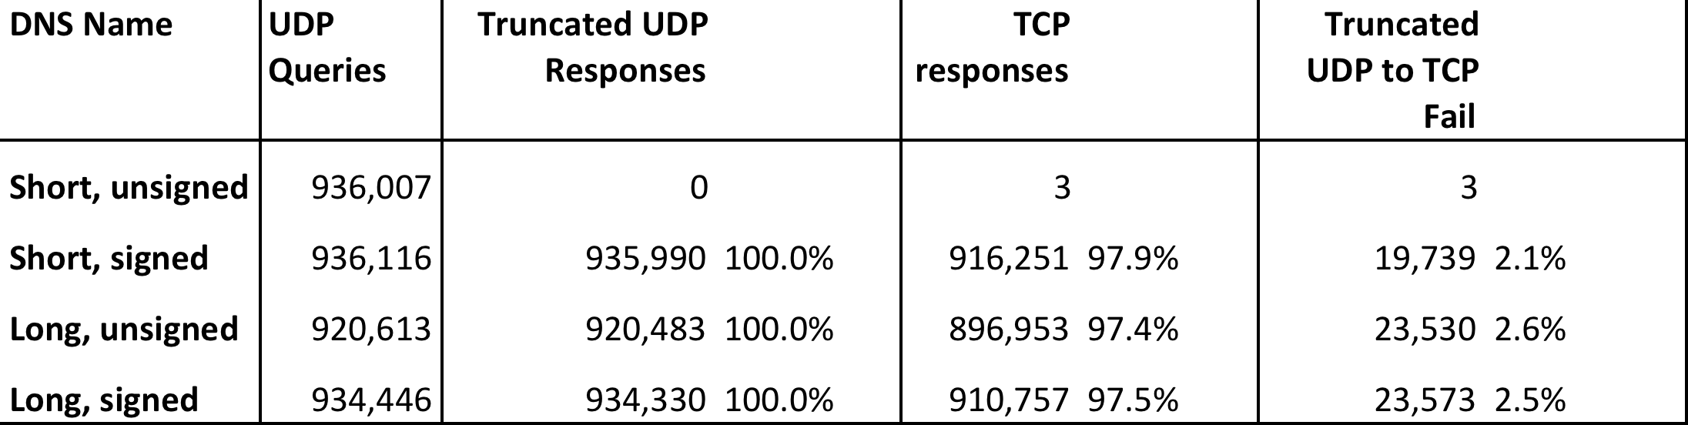
Results (2)
It looks like the cname construct is not influencing the results!

Slide 24
Results
2.6% of clients use a set of DNS resolvers that are incapable of reverting to TCP upon receipt of a truncated UDP response from an authoritative name server
  (The failure here in terms of reverting to TCP refers to resolvers at the “end” of the client’s DNS forwarder chain who are forming the query to the authoritative name server)

Slide 25
Aside: Understanding DNS Resolvers is “tricky”
What we would like to think happens in DNS resolution!
x.y.z?
x.y.z?
Authoritative
Nameserver
Client
DNS Resolver
x.y.z? 10.0.0.1
x.y.z? 10.0.0.1

Slide 26
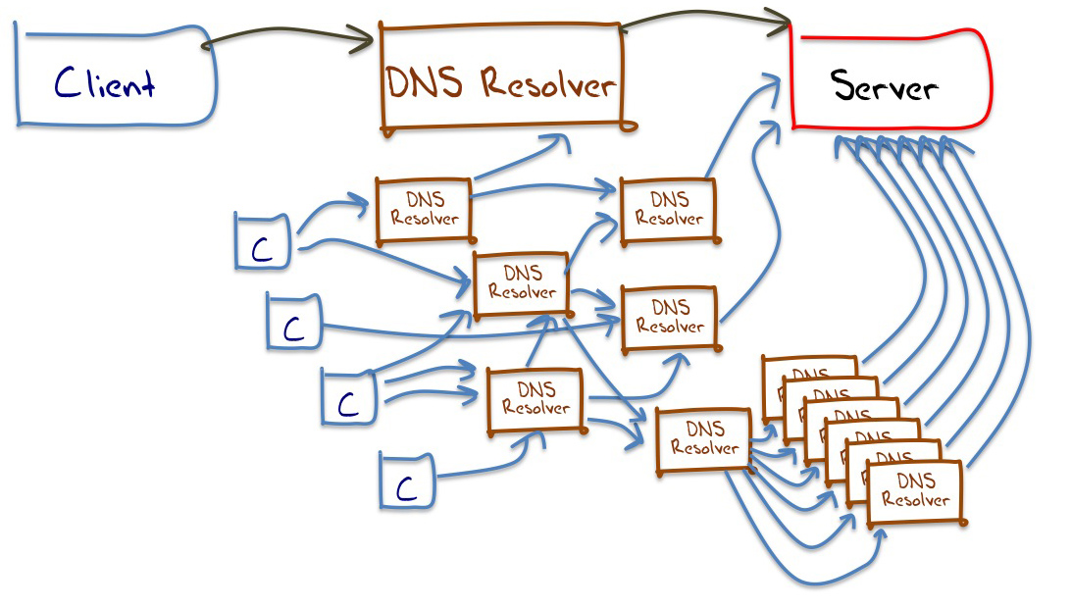
Aside: Understanding DNS Resolvers is “tricky”
A small sample of what appears to happen in DNS resolution

Slide 27
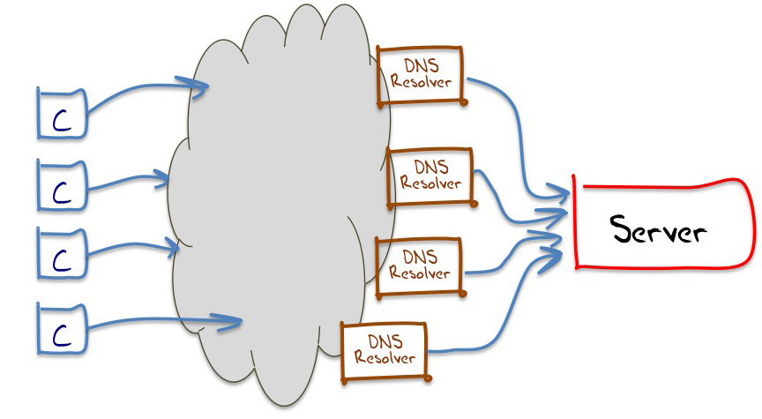
Aside: Understanding DNS Resolvers is “tricky”
We can measure the DNS resolution of these clients
We can measure the behaviour of these resolvers
All this DNS resolver
infrastructure is opaque
The best model we can use for DNS resolution in these experiments

Slide 28
Can we say anything about these “visible” resolvers?
Visible Resolvers
Total Seen: 80,505
UDP only: 13,483
17% of resolvers cannot ask a query in TCP following receipt of a truncated UDP response
6.4% of clients uses these resolvers
3.8% of them failover to use a resolver that can ask a TCP query
2.6% do not

Slide 29
Can we say anything about these “visible” resolvers?
Visible Resolvers
Total Seen: 80,505
UDP only: 13,483
17% of resolvers cannot ask a query in TCP following receipt of a truncated UDP response
6.4% of clients uses these resolvers
3.8% of them failover to use a resolver that can ask a TCP query
2.6% do not

Slide 30
What about DNS resolution performance?
The theory says:
Client
Visible Resolver
Authoritative Name Server
UDP Query
DNS Resolver
Infrastructure
UDP Response

Slide 31
What about DNS resolution performance?
The theory says:
Client
Visible Resolver
Authoritative Name Server
UDP Query
DNS Resolver
Infrastructure
UDP Response (TC=1)
TCP SYN
2 x RTT
TCP SYN + ACK
TCP ACK
2 x RTT
TCP Query
TCP Response

Slide 32
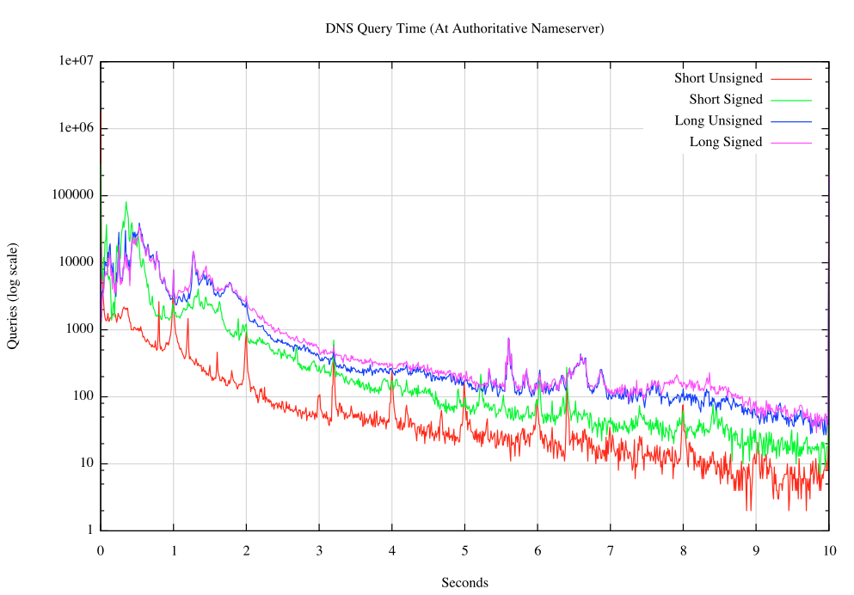
Time to resolve a name

Slide 33
Time to resolve a name

Slide 34
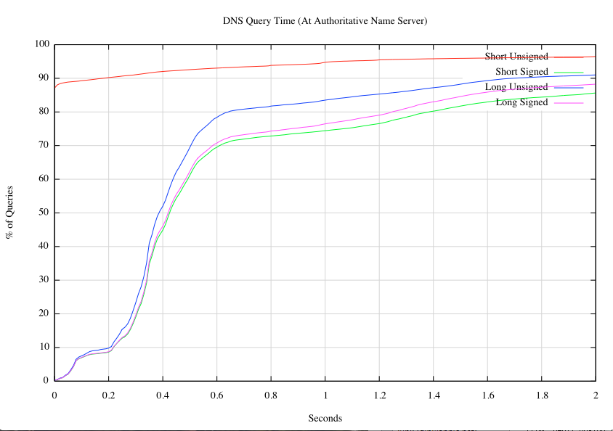
Time to resolve a name
Cumulative Distribution of DNS Resolution Time
for the first 2 seconds

Slide 35
Time to resolve a name
Median point = +400ms

Slide 36
Time to resolve a name
What’s going on here?
Median point = +400ms

Slide 37
Time to resolve a name
How does this median value of 400ms relate to the RTT measurements to reach the authoritative name server?
The authoritative name server is located in Dallas, and the initial TCP SYN/ACK exchange can provide an RTT measurement sample
We can geo-locate the resolver IP addresses to get the following RTT distribution map

Slide 38
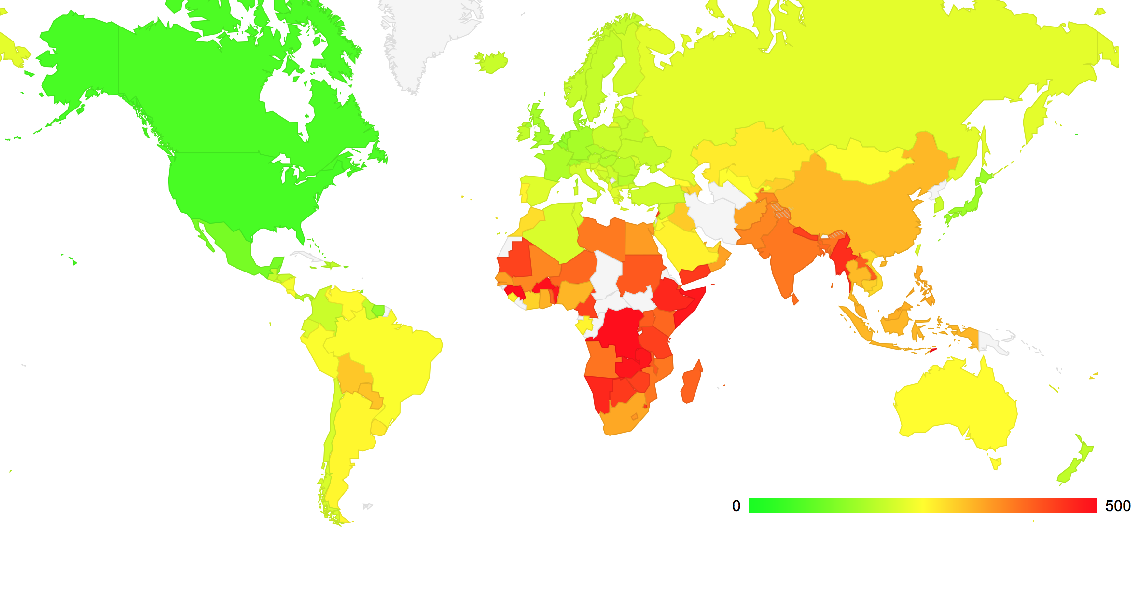
Measured RTT Distributions by Country
Median RTT is 150 – 200 ms

Slide 39
DNS over TCP
Around 70% of clients will experience an additional DNS resolution time penalty of 2 x RTT time intervals
However the other 30% experience a longer delay.
  10% of clients experience a multi-query delay with a simple UDP query response
  20% of clients experience this additional delay when the truncated UDP response forces their resolver to switch to TCP

Slide 40

If we really want to use DNS over TCP
Then maybe its port 53 that’s the problem for these 17% of resolvers and 20% of the clients
Why not go all the way?
  How about DNS over XML over HTTP over port 80 over TCP?

Slide 41
Thanks!

