Slide 1
What a Ride! The Last Decade of the Internet

Slide 2
What a Ride! The Last Decade of the Internet and a peep into the next
Geoff Huston
APNIC

Slide 3
Remember 2002?
The EURO Currency is Launched
Switzerland joins the UN
Argentina defaults on a World Bank loan
US President George W Bush gets Congressional authorization to use US Armed Forces against Iraq
SARS epidemic outbreak
Brazil defeats Germany to win the FIFA World Cup

Slide 4
Remember 2002?
Still Struggling?
How about these?
The Internet Bubble bursts
The Dow Jones Stock index falls below 7,500
Worldcom files for bankruptcy with assets valued at $103B (the largest to date in the US) Sep 2008: Washington Mutual $327B , Lehmann Bros$ 691B
Napster shut down
Ebay buys Paypal
HP buys Compaq
Apple releases the iPod
9 root servers disabled in a coordinated DDOS attack
LACNIC was formed!

Slide 5
2002
The Internet in 2002
569 million online users
900 million GSM users
Web 2.0 Web Services were hot
Web Portals were not
WAP was cool
XML was not
Laptops were cool
Large PCs were a tiny bit yesterday
Friendster had 3 million users
Look Smart was dead
Windows XP was the OS of the day
Mac OS was not

Slide 6
What’s happened since then?

Slide 7
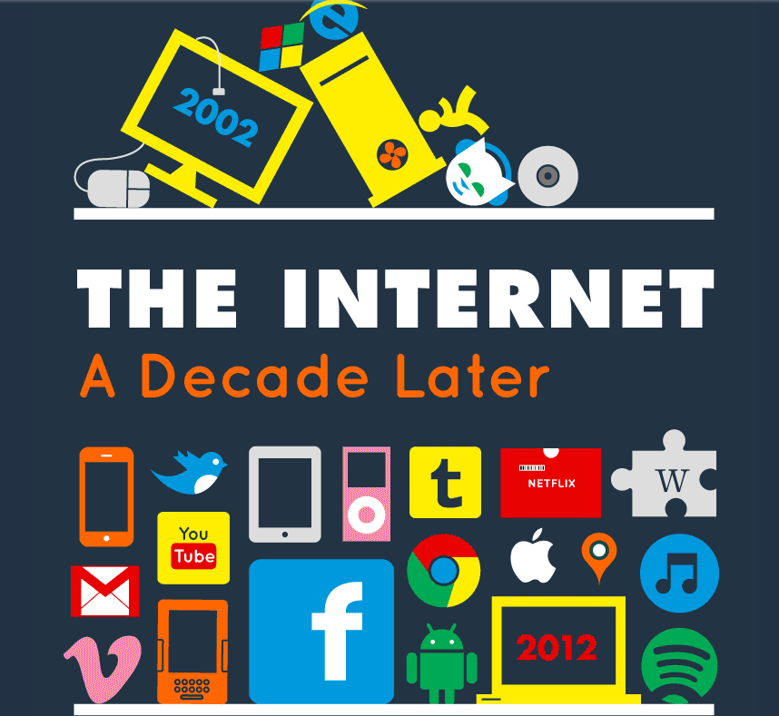

Slide 8
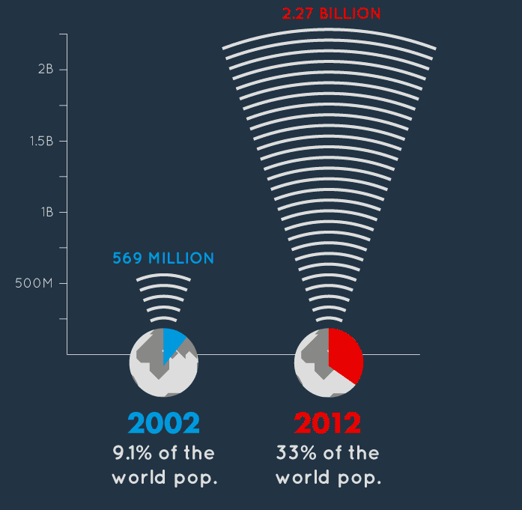
Who would’ve thought this possible?
More users

Slide 9
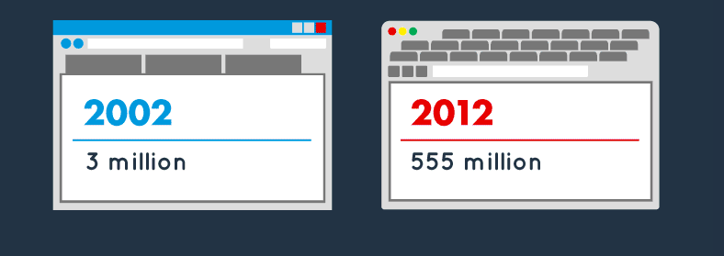
More to see

Slide 10
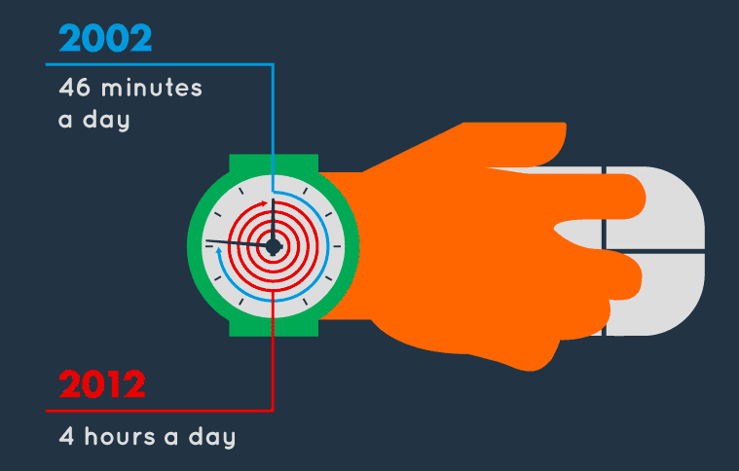
More time looking

Slide 11
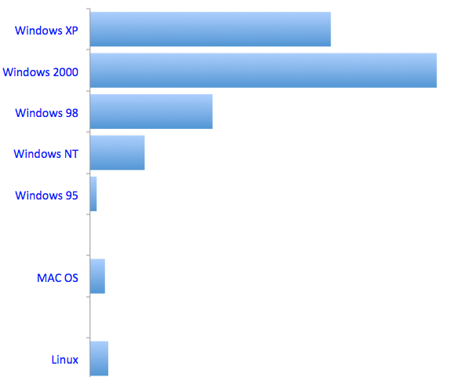
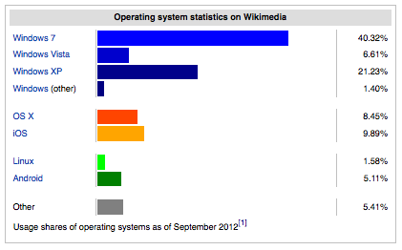
Operating system statistics for 2002
Operating Systems
29.10%
41.90%
14.80%
6.60%
0.80%
1.80%
2.20%
Windows: 96%
Operating system statistics for 2012
Windows: 70%

Slide 12
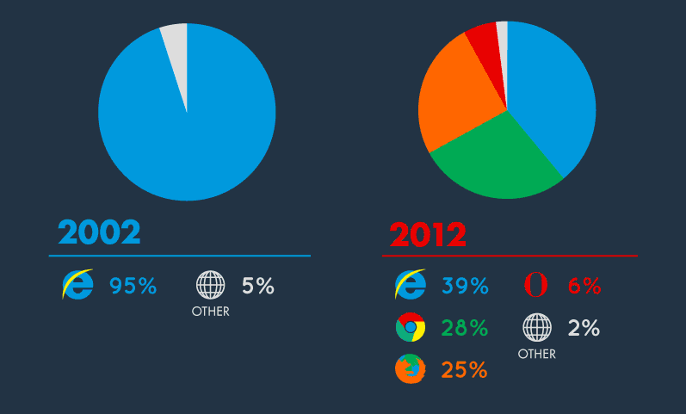
More browsers

Slide 13
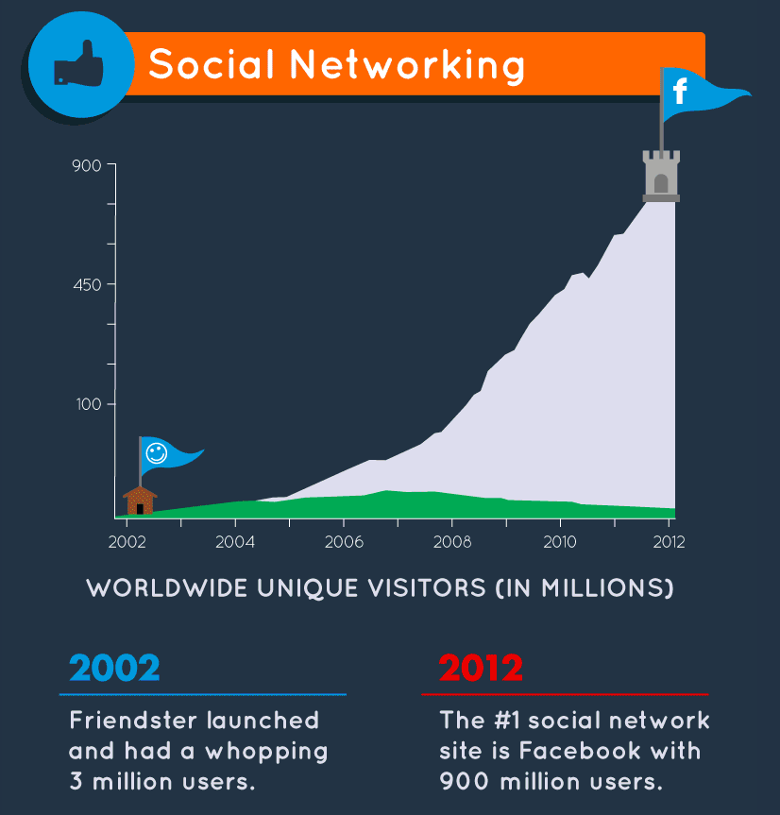
The twitter-verse now runs at more than 340 million tweets per day.

Slide 14
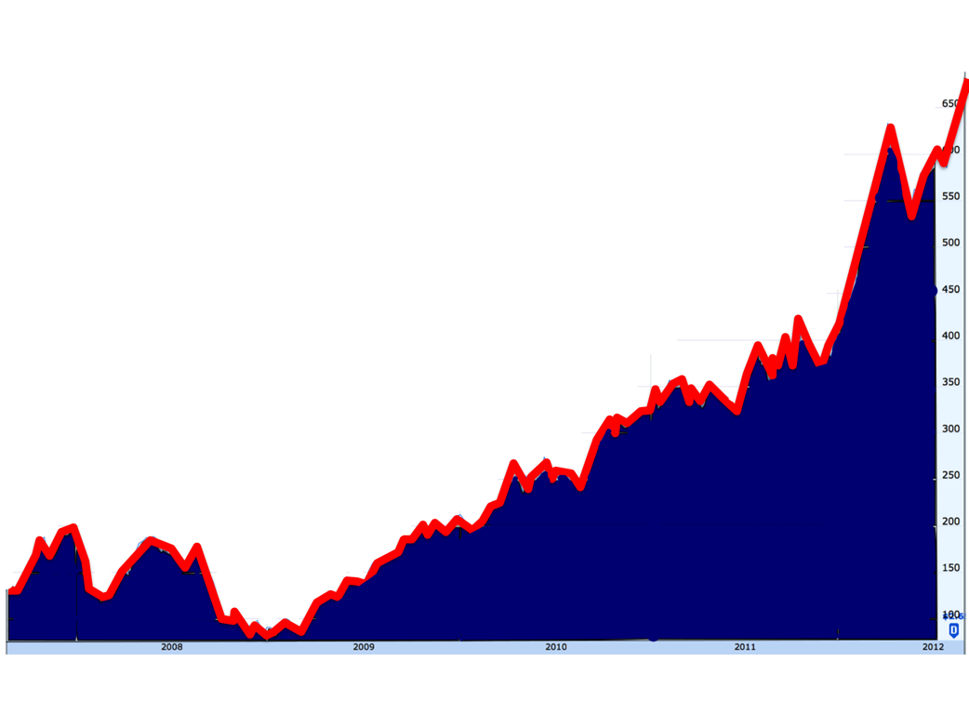
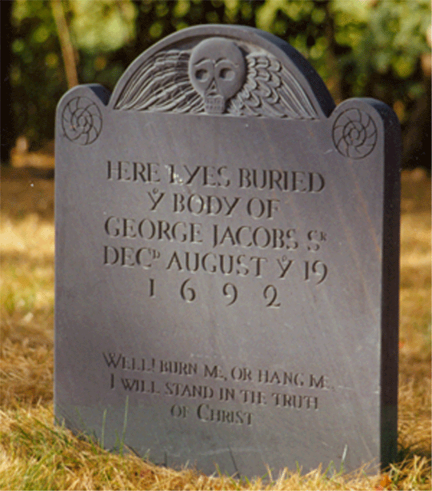
Winners and Losers

Slide 15
Winners and Losers
Blockbuster – Video Rental
2002: Revenue $5.5B
2010: Bankrupt
Netflix – Online Video
2002: Revenue $150M
2012: Revenue $3.2B

Slide 16
Winners and Losers
Borders – Retail Books
2003: 1,249 stores worldwide,
$3.2B sales
2011: Bankrupt
Amazon– Online Books and more
2002: $2.8B sales
2012: $18B sales

Slide 17
Winners vs Losers
Tower Records – Retail Music
2002: 200 Stores, $800M sales
2006: Bankrupt
iTunes– Online music
2003: Started
2012: 20 billion songs sold
$6B sales

Slide 18
All these changes point to a massive shift in online channels to retail sales for entertainment services.

Slide 19
And its not just online books and music...
Free-to-air advertisement revenues are falling, and many TV broadcasters are in trouble
Print media advertisements are falling, and print newspapers are in trouble

Slide 20
And all this happened in just 10 years...

Slide 21
But the real driver for change in the last decade was not the shift in advertising and retail business models.

Slide 22
The real shift was away from wires...

Slide 23
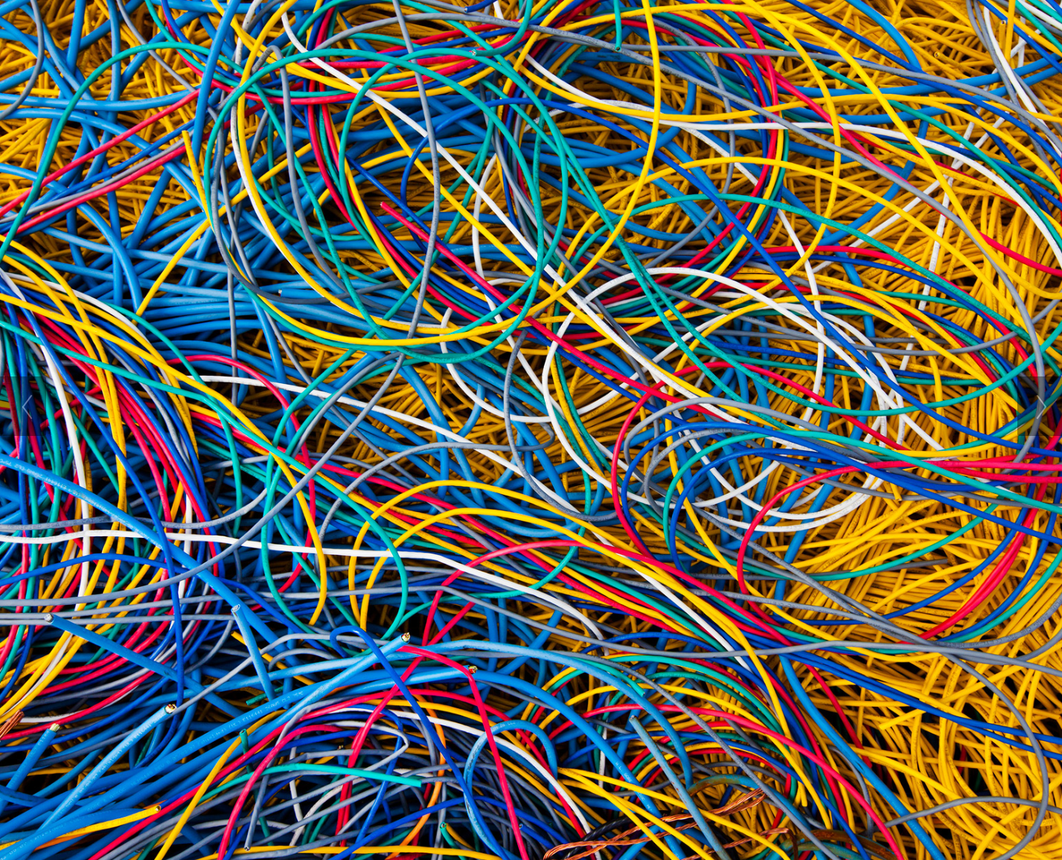

Slide 24
The real shift was achieved in a wireless device that just worked brilliantly...

Slide 25
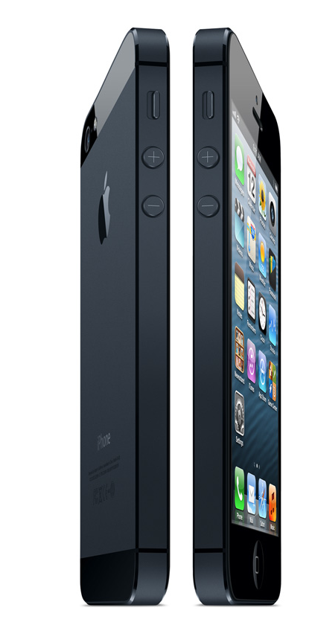

Slide 26
And it has changed everything...

Slide 27
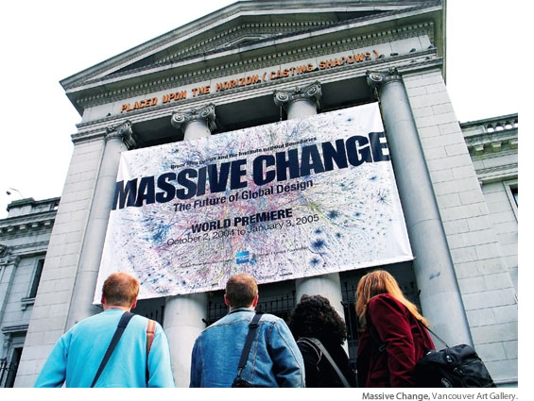

Slide 28
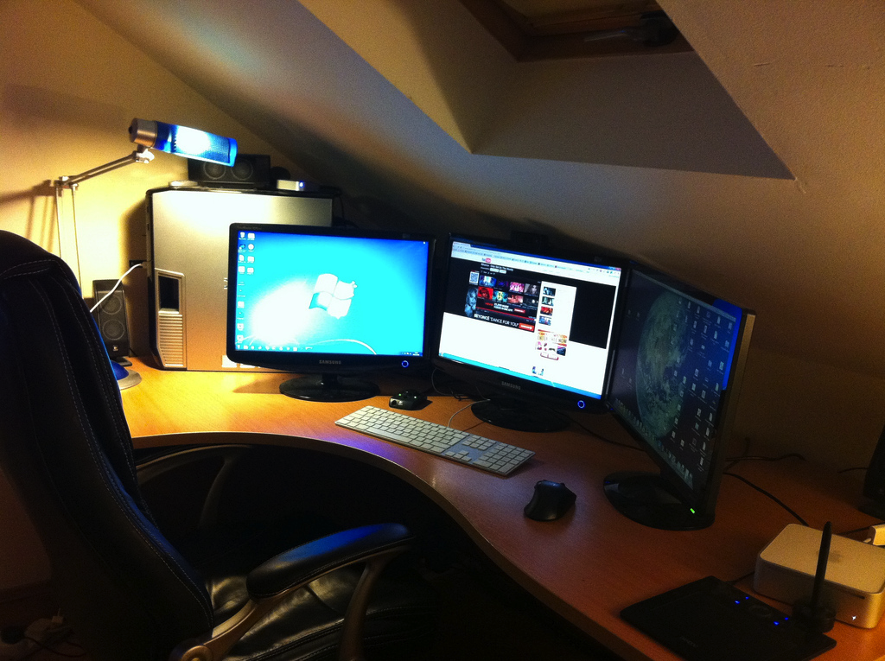
With desktop devices the Internet was a dedicated activity
lighting
privacy
reliable power
large view screens
dedicated worktop
wired bandwidth
dedicated chair

Slide 29
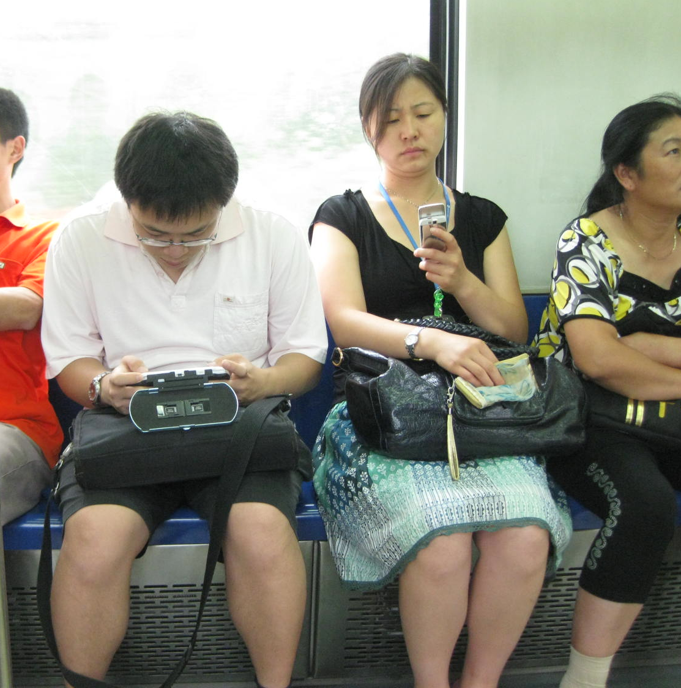
The Internet is now anywhere and everywhere
radio connectivity
Thumb
operated
hand sized
battery power
Its trivial, commonplace and blends into all our activities

Slide 30
“We are now living in a post-PC world”
Apple’s Tim Cook, March 2012

Slide 31
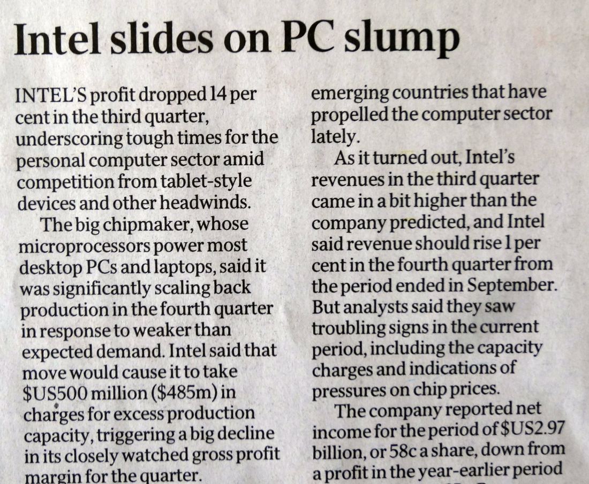
“We are now living in a post-PC world”
The Australian
18 October 2012
Apple’s Tim Cook, March 2012

Slide 32
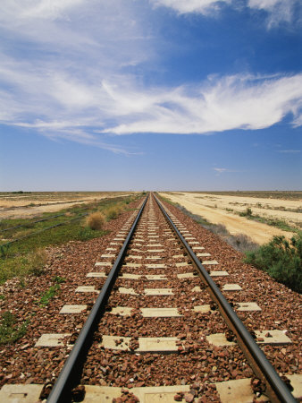
Where to from here?

Slide 33
5 Years Out
2017

Slide 34
It’s a mobile world!
2011: 270 million mobile units shipped
Factors:
Production volumes are bringing down component unit cost
Android is bringing down software unit cost
No need for new content - leverage off the the existing web universe of content
Shift away from the desktop and the laptop by the production industry seeking new markets for their production capability

Slide 35
In the next five years...
we have a choice...

Slide 36
In the next five years...
Everything gets squashed into HTTP, IPv4 and CGNs
IPv6

Slide 37
And its not yet clear which path the Internet will take!

Slide 38
And its not yet clear which path the Internet will take!
market forces

Slide 39
Can we look further out?

Slide 40
10 Years Out?
2022

Slide 41
My personal view...by 2022
The Internet will be all IPv6 by 2022!
The market in IPv4 trading is a short term phase
CGNs also have near term limits under intense scaling pressure
There is no extended afterlife in store for CGNs + IPv4 if we make this transition to IPv6
(look at what happened to DECnet, SNA, Appletalk, X.25,...)

Slide 42
My personal view...by 2022
Radio spectrum will become even more of a scarce and highly valuable asset
well it is already, but the competition for spectrum in highly populous areas will continue
Fewer wide area services - more cellular / femtocell services backed by fibre backhaul to improve spectrum efficiency

Slide 43
My personal view...by 2022
Cloud / Data Centre services may well have peaked by 2022 and be on the decline again
Innovative competitive pressure at this time may well come from highly distributed systems that do not rely on intense concentrations of computation and information storage

Slide 44
20 Years Out?
2032

Slide 45
My personal view...by 2032
This is extremely tough!
very little from the world of 1992 is still with us today
very little of today’s environment will be persistent for the next two decades
Why?

Slide 46
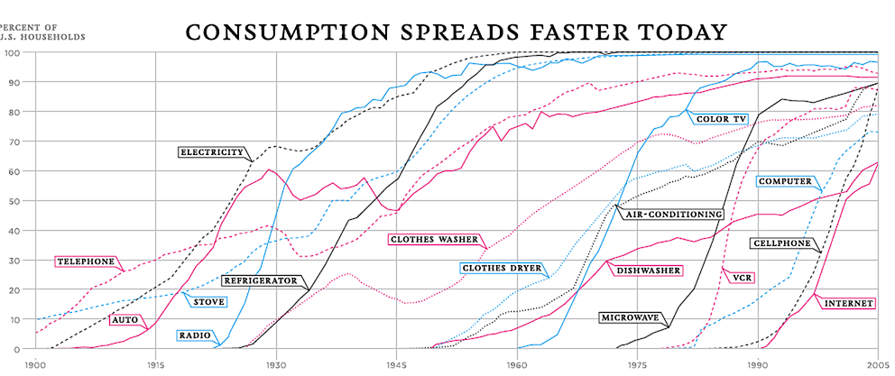
As the pace of technology adoption gets faster we cycle through successive generations of technologies at ever faster rates
http://visualecon.wpengine.netdna-cdn.com/wp-content/uploads/2008/02/history-of-products.gif

Slide 47
What’s shaping our future?
You and I

Slide 48
What’s shaping our future?
You and I
We need to think about a post-PC world where computation, storage and communications are abundant commodities. It’s innovative mass-produced consumer devices and services that will shape much of the Internet’s future. And the innovative force here is one of constant technology refinement and evolution!

Slide 49
The most profound technologies are those that disappear. They weave themselves into the fabric of everyday life until they are indistinguishable from it...
- Mark Weiser 1991

Slide 50
Thank You!

