Slide 1
Geoff Huston
Chief Scientist,
Asia Pacific Network Information Centre
IPv6 Workshop
European Digital Agenda Assembly
June 2011

Slide 2
How Much IPv6 is Out There?
We have been measuring the number of Internet clients who can complete an entire end-to-end IPv6 connection
We’ve used embedded IPv6 “tests” in banner ads to perform IPv6 capability tests on a diverse set of some 100K clients per day for an extended period
The results…

Slide 3
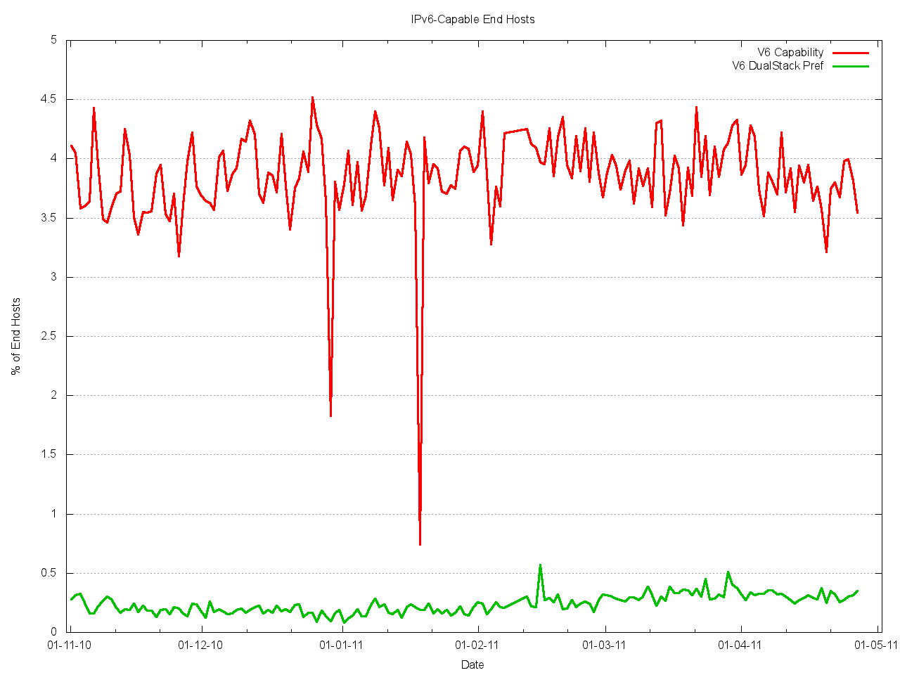
IPv6: “could” vs “will”
5%
IPv6 Capable
4%
3%
2%
1%
IPv6 Preferred
Nov
Dec
Jan
Feb
Mar
Apr
May

Slide 4
4% is Not Enough
AsiaPac is now running on empty with IPv4!
Europe/Mid East will probably exhaust its remaining pools of IPv4 addresses by late 2011
It would have been encouraging to see client capability over 25% by now, rising to over 40% by year end
The blocking factor at present appears to be a combination of widespread use of NATs and a lack of native IPv6 in the Access Networks

Slide 5
Why are we so slow to move?
Market dynamics are not sending clear signals to all actors
  Some differences between motivations of content and carriage services are becoming evident
  Some parts of the carriage sector see relative self advantage in deploying Carrier Grade NATs and further delaying investment in IPv6 services
  Content providers are sending out mixed signals, with more use of IPv4 CDNs that extend inside carrier networks, as well as calling for IPv6 adoption

Slide 6
IPv6 uptake is not fast enough…
The problem is not technical
The problem is not a lack of promotion
  - although active promotion helps
The problem is not a lack of IPv6 requirements in public procurement programs
  - although such programs also help
The problem lies in the dynamics of the complex interaction between a diverse set of Internet actors

Slide 7
Cost and Benefit are not aligned
Much of the immediate cost of IPv6 transition lies within the access carriage sector, where commodity utility margins are hindering any new large scale investment in network infrastructure
Much of the long term benefit of IPv6 transition lies with the content sector and end users, neither of which are willing to pay an immediate premium for IPv6, as it provides no incremental utility to existing services

Slide 8
Is this Transition an instance of a technical “Market Failure”?
In which case we may need to look to use some additional Public Good distribution mechanisms to provide the needed impetus to the market to assist in completing this transition

Slide 9

Risk of Inaction
Continued delay by incumbents to embrace IPv6 allows further industry consolidation, and increased ability by carriage and content incumbents to define (and limit) the parameters of future competition.
What is at risk here is the future of a truly open public network infrastructure for public communications

