Slide 1
IPv6 Operational Issues (with DNS)
Geoff Huston

Slide 2
IETF Best Current Practice – BCP 91
RFC3901 – September 2004 “DNS IPv6 Transport Operational Guidelines”:
Every recursive name server SHOULD be either IPv4-only or dual stack
Every DNS zone SHOULD be served by at least one IPv4-reachable name server

Slide 3
IETF Best Current Practice – BCP 91
RFC3901 – September 2004 “DNS IPv6 Transport Operational Guidelines”:
Every recursive name server SHOULD be either IPv4-only or dual stack
Every DNS zone SHOULD be served by at least one IPv4-reachable name server
Which is saying as an IPv6 Operational guideline “you better keep IPv4 going”
The RFC actually says very little about IPv6!

Slide 4
Proposed: 3901bis
Current IETF draft proposed to update RFC3901 by saying:
It is RECOMMENDED that are least two NS for a zone are dual stack name servers
Every authoritative DNS zone SHOULD be served by at least one IPv6-reachable authoritative name server
Which is saying as an IPv6 Operational guideline “time to take IPv6 seriously” and NOT saying that servers need to keep IPv4 around– which is largely the opposite of the advice in RFC 3901!

Slide 5
The assumption behind 3901bis
That IPv6 is now a mature and well understood technology, and using IPv6 as the transport for the DNS is as efficient and as fast as using IPv4

Slide 6
The assumption behind 3901bis
That IPv6 is now a mature and well understood technology, and using IPv6 as the transport for the DNS is as efficient and as fast as using IPv4
Is this really true?

Slide 7
IPv6 and the DNS
How well is IPv6 supported in the DNS?
How does the DNS handle dual-stacked authoritative servers?
Is there a “happy eyeballs” version of DNS server selection?
Or is there a reverse bias to use IPv4?
If you placed authoritative servers on an IPv6-only service how many users would be able to reach you?
And what about DNSSEC?
How well does IPv6 support large UDP packets?

Slide 8
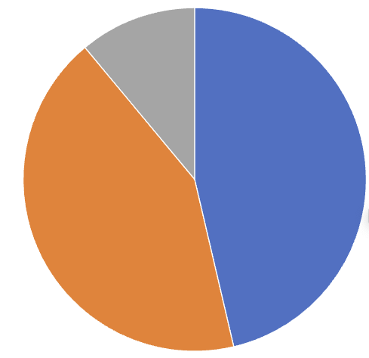
Dual Stack and the DNS
A “happy eyeballs*” DNS approach would be to prefer to use the IPv6 address of the authoritative server in preference to the IPv4 address
A “reverse bias” DNS approach would be to prefer to use the IPv4 address
Data collected Dec 23 – Jan 24 using 445M individual measurements
IPv6 Only
11%
IPv4 + IPv6
46%
IPv4 Only 43%
% of user measurements

Slide 9
Dual Stack and the DNS
A “happy eyeballs*” DNS approach would be to prefer to use the IPv6 address of the authoritative server in preference to the IPv4 address
A “reverse bias” DNS approach would be to prefer to use the IPv4 address
Data collected Dec 23 – Jan 24 using 445M individual measurements
IPv6 Only
11%
Less than one half of all name resolution query sequences show both
protocols being used to query a name at the authoritative server
IPv4 + IPv6
46%
IPv4 Only 43%
% of user measurements

Slide 10
Dual Stack DNS
V4 Only
A “happy eyeballs” DNS approach would be to prefer to use the IPv6 address of the authoritative server in preference to the IPv4 address and follow this initial query with a IPv4 query soon after
We just don’t observe a visible bias to this “IPv6 First” approach
Happy Eyeballs?
V6-V4
V4-V6
V6 Only

Slide 11
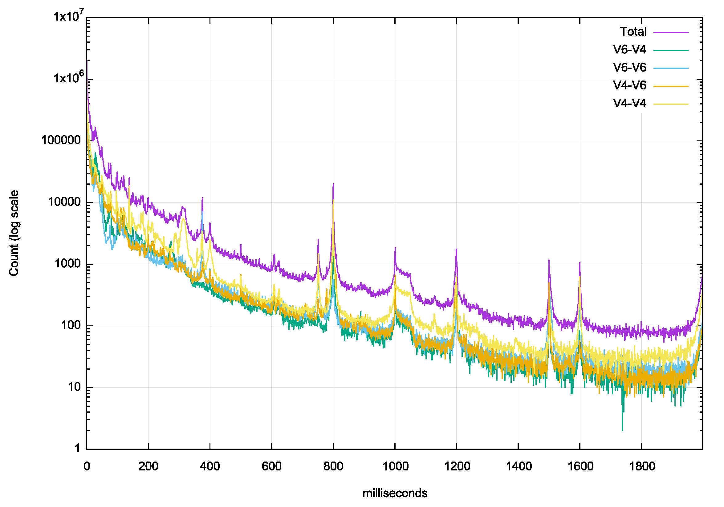
Dual Stack DNS
Delay between first 2 Queries
A “happy eyeballs” DNS approach would be minimise the delay between the initial 2 queries
Which is observed in the data, but we also see evidence of conventional DNS timeout values of 370ms, 400ms, 800ms and 1 sec
Is the high repeat query count in the first 50 ms due to DNSMASQ behaviour?

Slide 12
Dual Stack DNS
How well is IPv6 supported in the DNS?
How does the DNS handle dual-stacked authoritative servers?
Is there a “happy eyeballs” version of DNS server selection?
Or is there a reverse bias to use IPv4?
If you placed authoritative servers on an IPv6-only service how many users would be able to reach you?
And what about DNSSEC?
How well does IPv6 support large UDP packets?
No!
Probably!

Slide 13
Dual Stack DNS
How well is IPv6 supported in the DNS?
How does the DNS handle dual-stacked authoritative servers?
Is there a “happy eyeballs” version of DNS server selection?
Or is there a reverse bias to use IPv4?
If you placed authoritative servers on an IPv6-only service how many users would be able to reach you?
And what about DNSSEC?
How well does IPv6 support large UDP packets?
No!
Probably!

Slide 14
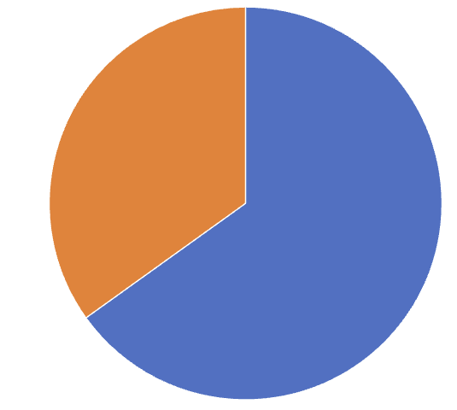
Dual Stack vs IPv6 only DNS
IPv6 Only Test
In this case the authoritative name server only has an IPv6 address
Of all the clients that are presented with an experiment (51M over 5 days) 65% of names are seen asking for the experiment name if the DNS server is reachable over IPv6 only
IPv6 – 65%
No query – 35%

Slide 15
Dual Stack vs IPv6 only DNS
Dual Stack
IPv6 Only Test
IPv6 Only
11%
IPv6 – 65%
IPv4 + IPv6
46%
IPv4 Only 43%
No query – 35%

Slide 16
Dual Stack DNS
How well is IPv6 supported in the DNS?
How does the DNS handle dual-stacked authoritative servers?
Is there a “happy eyeballs” version of DNS server selection?
Or is there a reverse bias to use IPv4?
If you placed authoritative servers on an IPv6-only service how many users would be able to reach you?
And what about DNSSEC?
How well does IPv6 support large UDP packets?
No!
Probably!
Only 65%

Slide 17
Dual Stack DNS
How well is IPv6 supported in the DNS?
How does the DNS handle dual-stacked authoritative servers?
Is there a “happy eyeballs” version of DNS server selection?
Or is there a reverse bias to use IPv4?
If you placed authoritative servers on an IPv6-only service how many users would be able to reach you?
And what about DNSSEC?
How well does IPv6 support large UDP packets?
No!
Probably!
Only 55%

Slide 18
Who uses large DNS packets anyway?
.sl 3319
.pl 2193
.gdn 1954
.ve 1951
.uy 1951
.bg 1951
.xn--mgbx4cd0ab 1931
.africa 1897
.ad 1769
.ss 1715
.firmdale 1693
.xn--mgbah1a3hjkrd 1691
.xn--mgbt3dhd 1681
.ar 1675
.nowruz 1669
.beats 1667
.apple 1667
.shia 1665
.pars 1665
.tci 1663
.zm 1661
.td 1661
.si 1661
.na 1661
.ly 1661
.kw 1661
.ke 1661
.gy 1661
.lifestyle 1638
.living 1629
These folk do!
Size of dnssec-signed DNSKEY response for some gtlds in Nov-23

Slide 19
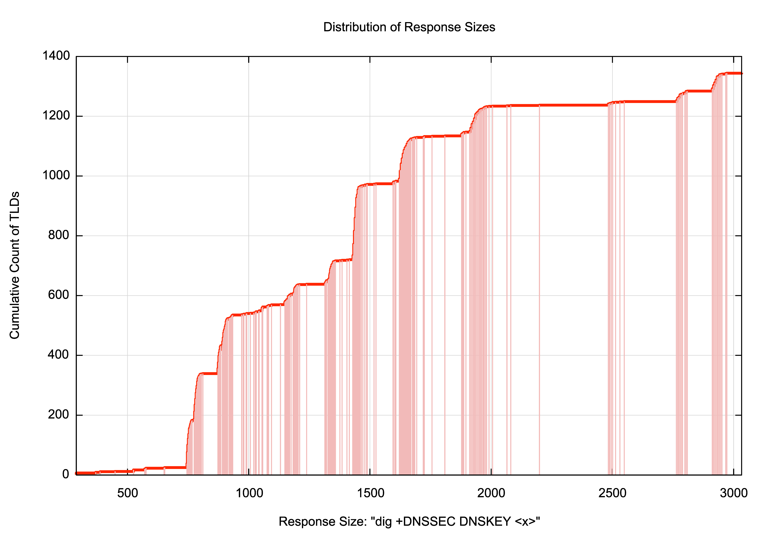
Who uses large DNS packets anyway?
Some 300 gtlds rely on fragmented UDP responses!

Slide 20
Is this a problem for today’s IPv6 Internet?
Can we measure the extent to which users might be affected with this scenario of large DNS responses, DNS resolvers and IPv6?
Yes!
By sending large (>1500 octet) responses in the DNS and obeying the query’s EDNS buffer size and fragmenting or truncating as determined by the query

Slide 21
V6, the DNS and Fragmented UDP
Total number of tests (DNS over UDP over IPv6): 32,951,595
Failure Rate in receiving a large response: 18,557,838
IPv6 Fragmentation Failure Rate: 56%
Data gathered 20 Dec 2023 – 9 Jan 2024

Slide 22
V6, the DNS and Fragmented UDP
Total number of tests (DNS over UDP over IPv6): 32,951,595
Failure Rate in receiving a large response: 18,557,838
IPv6 Fragmentation Failure Rate: 56%
That’s awesomely bad!
Data gathered 20 Dec 2023 – 9 Jan 2024

Slide 23
Dual Stack DNS
How well is IPv6 supported in the DNS?
How does the DNS handle dual-stacked authoritative servers?
Is there a “happy eyeballs” version of DNS server selection?
Or is there a reverse bias to use IPv4?
If you placed authoritative servers on an IPv6-only service how many users would be able to reach you?
And what about DNSSEC?
How well does IPv6 support large UDP packets?
No!
Probably!
Only 55%
Very Badly!

Slide 24
What should we do about this?

Slide 25
What can we do about it?
Fix it!
Get all the deployed routers, switches and firewalls and related network middleware to accept packets with IPv6 Fragmentation Headers

Slide 26
What can we do about it?
Change it!
Change application behaviour to avoid the use of packet fragmentation completely

Slide 27
What do the RFC’s say?

Slide 28
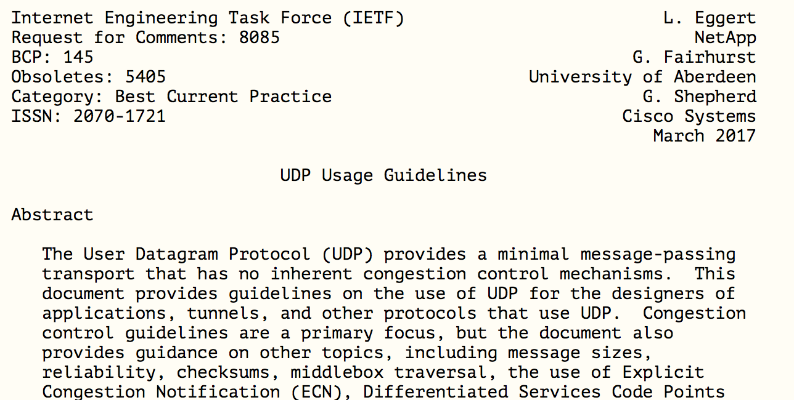
What do the RFC’s say?

Slide 29
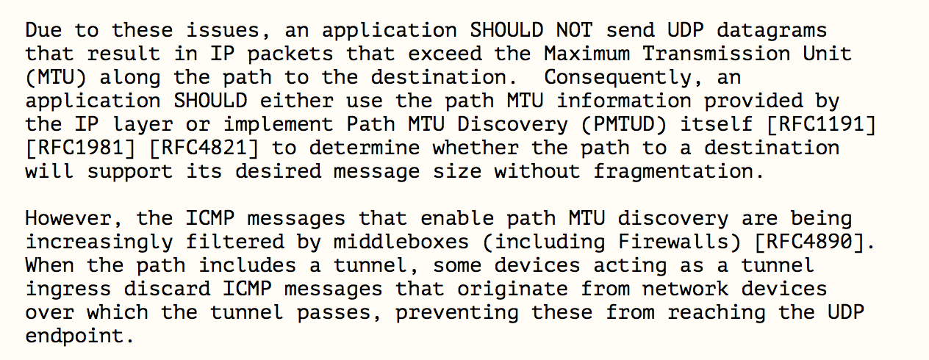
What do the RFC’s say?

Slide 30
What do the RFC’s say?
DON’T FRAGMENT!
This BCP is saying that using EDNS(0) in the DNS to signal the capability of accepting large fragmented DNS responses was unwise, and if a host/application does not know the path MTU, it should truncate at UDP at 1280 octets

Slide 31
Truncate and failover to TCP
Use an EDNS Buffer Size in queries to ensure that IPv6 responses are never fragmented
Large responses will be truncated
The truncation should trigger the querier to perform an immediate followup of the same query, using TCP
Which means that we are probably looking at working around the problem by changing the configuration of DNS queries and use an EDNS buffer size of 1232 octets
See https://dnsflagday.net/2020/

Slide 32
Is the DNS ready for IPv6-only?
Not yet!

Slide 33
Thanks!

