Slide 1
IPv6
Geoff Huston
APNIC

Slide 2
Why?

Slide 3
Because we ran out of IP addresses

Slide 4
Again.

Slide 5
We’ve been here before ...
The original ARPAnet design from 1969 used the NCP protocol, which used 8 bit addresses in the NCP packet header
Maximum network span of 256 nodes
Enough?
Well yes, because at the time computers were the size of entire rooms, cost many millions of dollars and there were only a few thousand in the entire world.
At the time the entire concept of shrinking the computer to something you could hold in one hand and trying to connect billions of them together was just too far into the future to worry about

Slide 6
Transition V1.0
Turns out that 8 bits of addresses was not enough for the next generation of mini-computers
ARPAnet undertook a transition from NCP to a new protocol: TCP/IP
Expansion from 8-bit to 32-bit addresses
Flag Day: 1 January 1983
Shutdown and reboot every node into the new protocol!

Slide 7
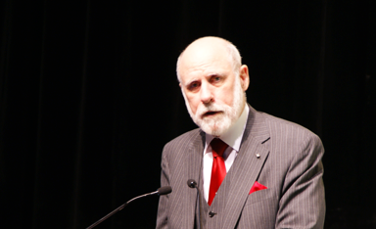
“This time, for sure!” *
* Actually Vint didn’t say this!

Slide 8
IP Version 4
32-bit address field
That’s 4,294,967,296 addresses
In 1983 that looked like a HUGE number of computers

Slide 9
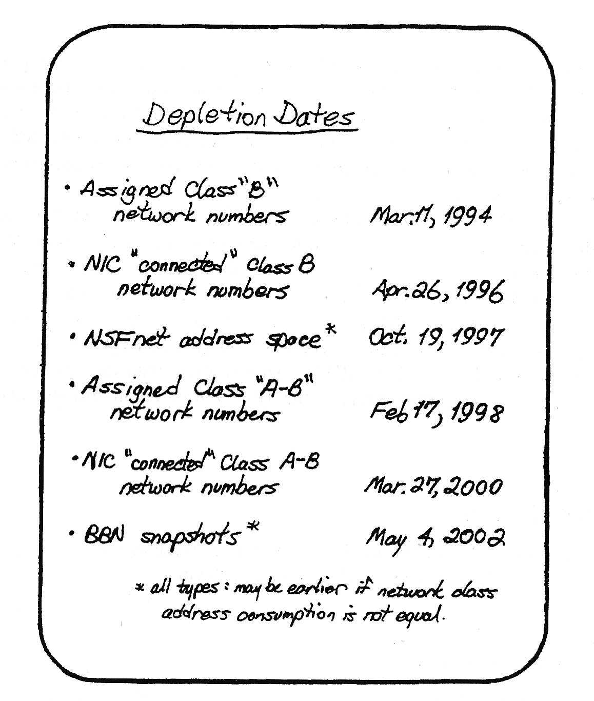
Digital Pressures
Through the 1980’s computers changed from large expensive pieces of ironware to desktop consumer products
And the market changed from thousands to tens of millions
And the prospect was smaller, cheaper and more
So by 1990 that 4 billion address space was looking pretty small
And it was not going to last much longer!
Frank Solensky – IETF 1990
Presentation on IPv4 Address Depletion Predictions

Slide 10
IPocalypse?

Slide 11
So we hit the wall – right?

Slide 12
Panic!
This was a brutal wakeup call
We had hardly started with the internet and its demise was just 4 years away!
So we rapidly worked on short term responses to push this exhaustion date out
To give us more time to work on the longer term solutions
So:
We dropped the classful address plan
We introduced NATs to allow address sharing
We worked on a new protocol

Slide 13
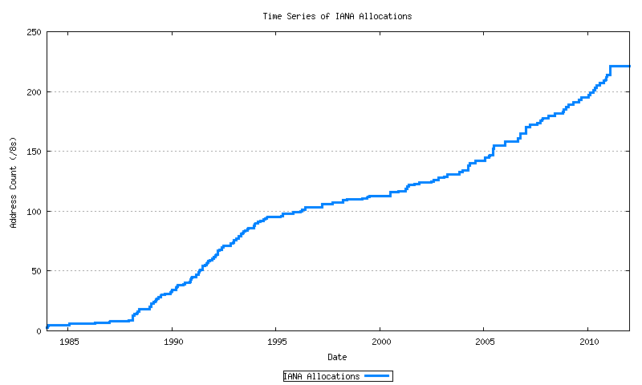
It worked!
Exhaustion!
Mobiles
GFC
Broadband
Boom & Bust
CIDR
A&R networks
The short term response to imminent depletion
NSFNET

Slide 14
That longer term plan
Was to develop a new IP protocol
And then transition the Internet over to use this new protocol

Slide 15
What are we transitioning to?

Slide 16
IPv6!

Slide 17
IPv6 is…
IPv4 with larger address fields
Not much else changed
It’s still an address-based stateless datagram forwarding protocol
It still has decoupled forwarding, routing, naming, transport
The interfaces to the underlying media protocols are largely unchanged
So transition to IPv6 should be easy

Slide 18
So transition should be easy?
Right?

Slide 19
So transition should be easy?
Well, no, not really!

Slide 20
Why is this taking so long?
IPv6 was a minimal change to IPv4
So early adopters found little in the way of an early adoption benefit
IPv6 was not backward compatible with IPv4
IPv6 adopters still had to support IPv4
EVERYONE has to transition to dual stack BEFORE we can drop IPv4

Slide 21
Transition, the second time around
A “Flag Day” switchover is impossible
Piecemeal replacement won’t work either, as IPv6 is not backward compatible with IPv4
So, we need to run both protocols in tandem “for a while”
But bear in mind that one protocol has already run out of addresses
And network growth continues at record levels

Slide 22
Transition, the second time around
We need to :
deploy IPv6 in parallel with IPv4
deploy ever more stringent IPv4 address conservation measures within the network
allow the network to expand at an ever-increasing rate
All at the same time!

Slide 23
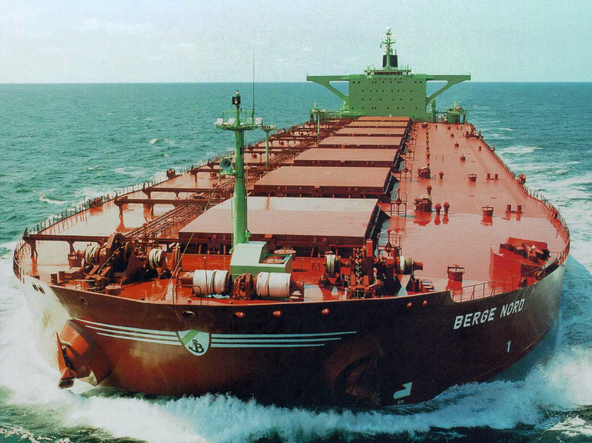
Transition is more like this!

Slide 24
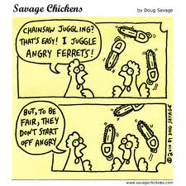
Or this!

Slide 25
“The Internet” does not exist
The Internet is not a singly managed entity
Noone is in control
Noone is there to tell anyone else what they can (or cannot) do
The Internet is a collection of markets (Goods and services, Transmission and switching, Technologies, …)
We find it impossible to orchestrate collective synchronised actions across all these distinct activities
So the status quo accumulates a huge amount of inertial momentum
Which makes it terribly hard to change direction in an orderly manner!

Slide 26
Its now 2022 and we are still in this transition
We underestimated the awesome ability of NATs to squeeze out address efficiencies – the past decade of massive growth on the Internet has been largely based on various forms of NAT usage
NATs expanded the usable IPv4 address capacity by a further ~20 bits
Each bit of increased address size doubles the total capacity of the space
So it’s taken us much longer than we though to fill up these additional address bits

Slide 27
So how is this transition going?
Slowly!

Slide 28
Let’s look at progress so far
2012 – no significant deployment of IPv6

Slide 29
Let’s look at progress so far
2012
2014 – still very little movement in the larger environment

Slide 30
Let’s look at progress so far
2012
2014
2017 – India IPv6 deployment

Slide 31
Let’s look at progress so far
2012
2014
2017
2019 – stirring in China

Slide 32
Where are we in 2022?
11 years after the depletion of the central IPv4 address pools we are still sitting on some 30% of the Internet user base with Dual Stack (IPv4 + IPv6) support
The other 3 billion uses are on IPv4 only
How much longer will it take before we can call this transition “completed”?

Slide 33
Why is this taking so long?
If we designed the IPv6 protocol 30 years ago
And we’ve been running the IPv4 Internet on empty for many years
Then why isn’t the Internet an all-IPv6 Internet today?

Slide 34
Why is this taking so long?
NATs are just too good!
NATs drive every part of today’s internet, and we’ve adapted the entire IP infrastructure and application space to work in a NAT environment
We’ve pushed the role of service identification to the name space
And changed the architecture of the Internet into a client/server model
And clients don’t need permanently assigned public addresses
So NATs have allowed us to build a network with some 40 billion connected devices – and we are confident that we can grow further

Slide 35
Why is this taking so long?
IPv6 is not different enough
IPv6 is just IPv4 with larger addresses
It does not make packet switching any cheaper, so it does not give early adopters any advantage
And IPv6 not backward compatible with IPv4, so early adopters still have to run IPv4 as well

Slide 36
Why is this taking so long
The transition timetable is not being set by the early adopters
There is not enough competitive advantage for early adopters to drive the transition
The transition timetable is not being set by the late adopters
At some point the last to adopt cannot impose a hold over everyone else
So transition is a form of “majority” decision making
It’s a case of “critical mass” that will determine at what point dual stack service providers will contemplate dropping IPv4 and completing their part of the transition

Slide 37
IPv6 Adoption today
0
Not everywhere – not all at once
~1 B IPv6 users out of 4B

Slide 38
Asia
900M IPv6 users out of 2.3 B

Slide 39
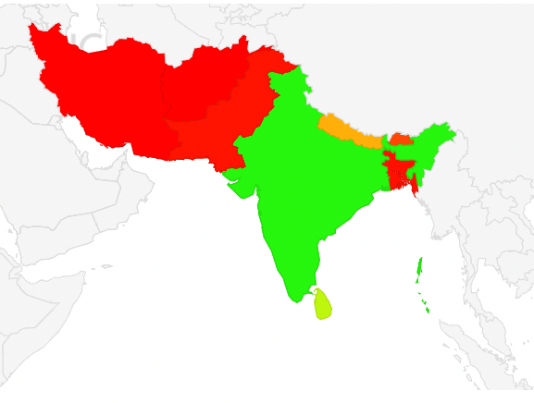
India

Slide 40
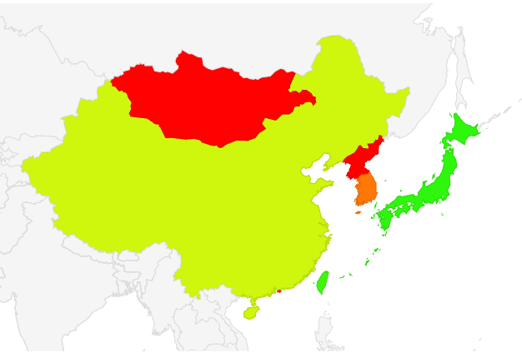
China

Slide 41
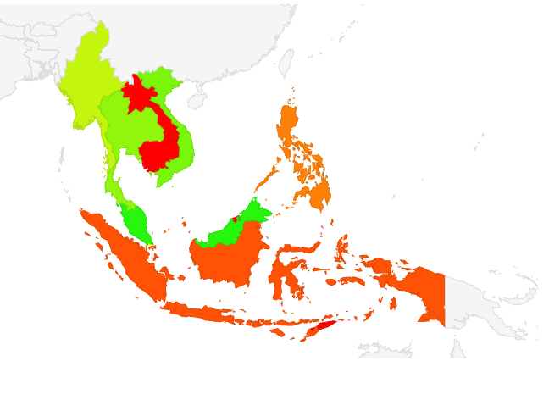
Malaysia

Slide 42
Singapore
What’s this?
It’s likely to be the combination of Cloudflare and Apple’s recent Private Relay service
https://www.theregister.com/2022/05/11/internet_has_shrunk/

Slide 43
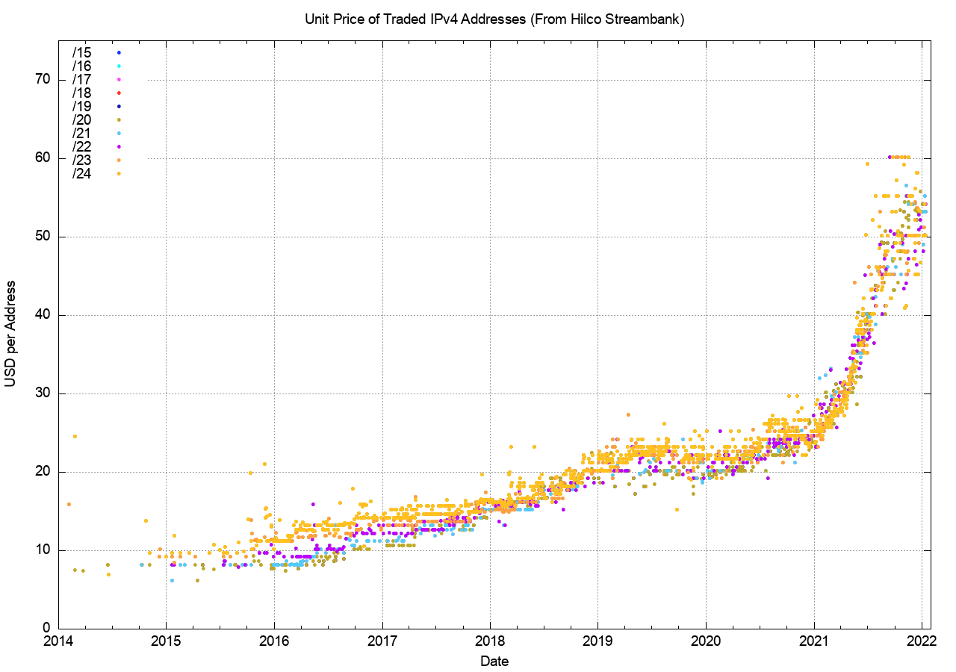
Market Signals
The Price of IPv4 Addresses

Slide 44
Conclusions
Is this transition was coming to an end the price of IPv4 addresses on the market would be collapsing
Instead it doubled over 2021!
So it seems that this transition will continue for some time yet
There is no Plan B
There is no alternative to IPv6 out there, and continued growth of the silicon base continues to drain IPv4 resources
The escalating IPv4 price makes staying in IPv4-only less and less tenable
So its not a case of “if” IPv6, but a case of “when” IPv6

Slide 45
Thanks!

