Slide 1
Routing Security is more than RPKI
Geoff Huston AM
Chief Scientist, APNIC

Slide 2
Don’t stop signing ROAs!
This is not saying RPKI is wrong and you shouldn’t use it
We have only a few tools to help us with keeping routing together, so we shouldn’t let the perfect become the enemy of the good
Unless of course the entire Route Refresh story scares you, in which case turning on RoV might not be your best idea you’ve had today!
But
If we can’t be honest in appraising the effectiveness of these various approaches then we’ve walked away from evidence-based engineering and headed right into the fantasy marketing department!

Slide 3
Don’t stop signing ROAs!
This is not saying RPKI is wrong and you shouldn’t use it
We have only a few tools to help us with keeping routing together, so we shouldn’t let the perfect become the enemy of the good
Unless of course the entire Route Refresh story scares you, in which case turning on RoV might not be your best idea you’ve had today!
But
If we can’t be honest in appraising the effectiveness of these various approaches then we’ve walked away from evidence-based engineering and headed right into the fantasy marketing department!

Slide 4
Routing incidents comes in all shapes and sizes
Some are malicious attacks intended to generate victims
But most are incidents we inflict upon ourselves in various inept and accidental ways

Slide 5
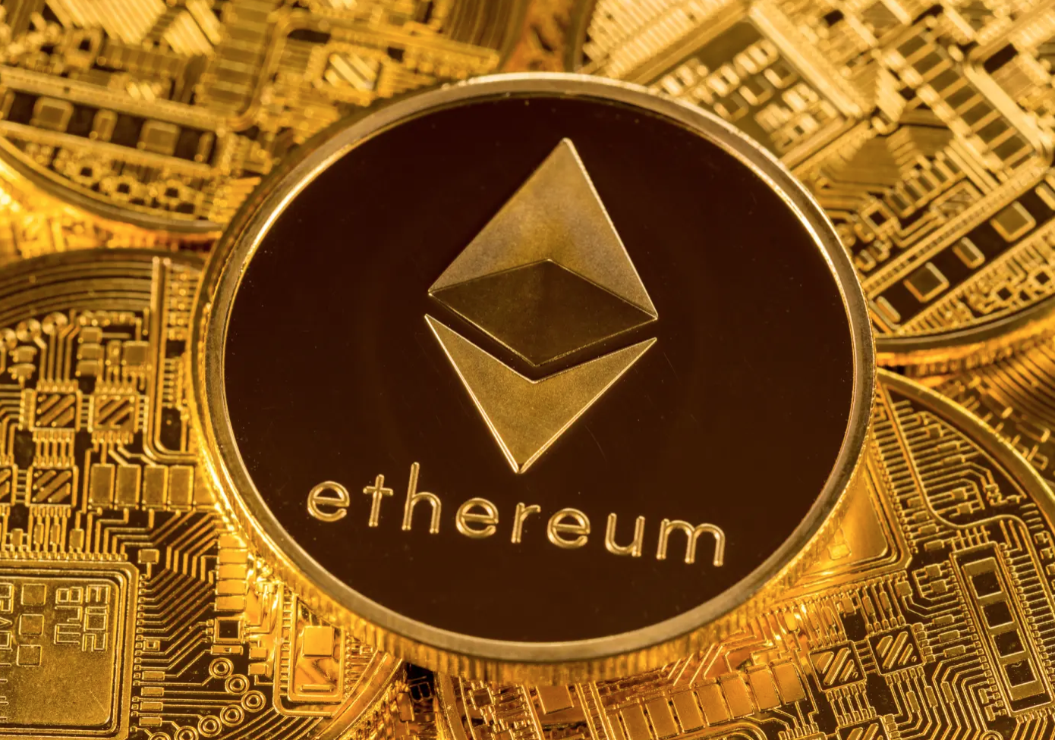
What do real routing attacks look like?
Ethereum – 2018
Deliberate attempt to subvert DNS, to take over Ethereum wallets
Subverted routing for Route 53 Authoritative DNS servers via more specific announcements for their own DNS server
This attack used a different origin AS (AS10297), but as it was a more specific prefix, they could’ve faked AS16509 if we were doing origination checks at the time
Replied SERVFAIL for domains it wasn’t attacking
Misdirected DNS for myetherwallet.com to intercepting website
If users clicked through a false SSL warning, then their Ethereum wallet was stolen
This attack could’ve been defeated by:
Users NOT clicking through a bad cert warning
Using DNSSEC signing for the myetherwallet.com domain
Using RPKI ROA with a maxlength parameter

Slide 6
What do real routing attacks look like?
Lessons:
Attacks tend to be multi-part these days
Subvert the infrastructure enough to fool a DNS registrar
Take over the name registration and delegate the name
Re-sign the name with DNSSEC
Grab a cert from an CA
You’re in!
Fool the CA’s tests to get a fake certificate
By a targeted attack on the DNS resolution infrastructure
Then attack routing and use the fake cert to redirect users
You’re in!
Attacks are executed very quickly
From the original subversion to trigger the attack to completion is often less than a couple of hours
Anything after that is a bonus
Attackers don’t bother to clean up afterwards
Attackers don’t care about certificate transparency, system logs or any other related forensic information
They rely on existing network capabilities to hide their identities

Slide 7
And then there are all the rest…
While these attacks get headlines, there are more mundane self-harm incidents in routing that happen all the time

Slide 8
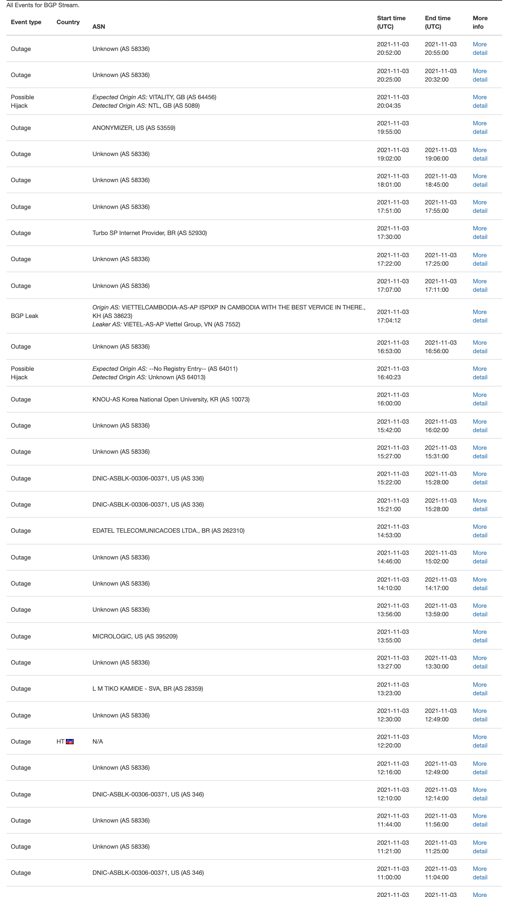
We get routing wrong a lot of the time
BGPMon report

Slide 9
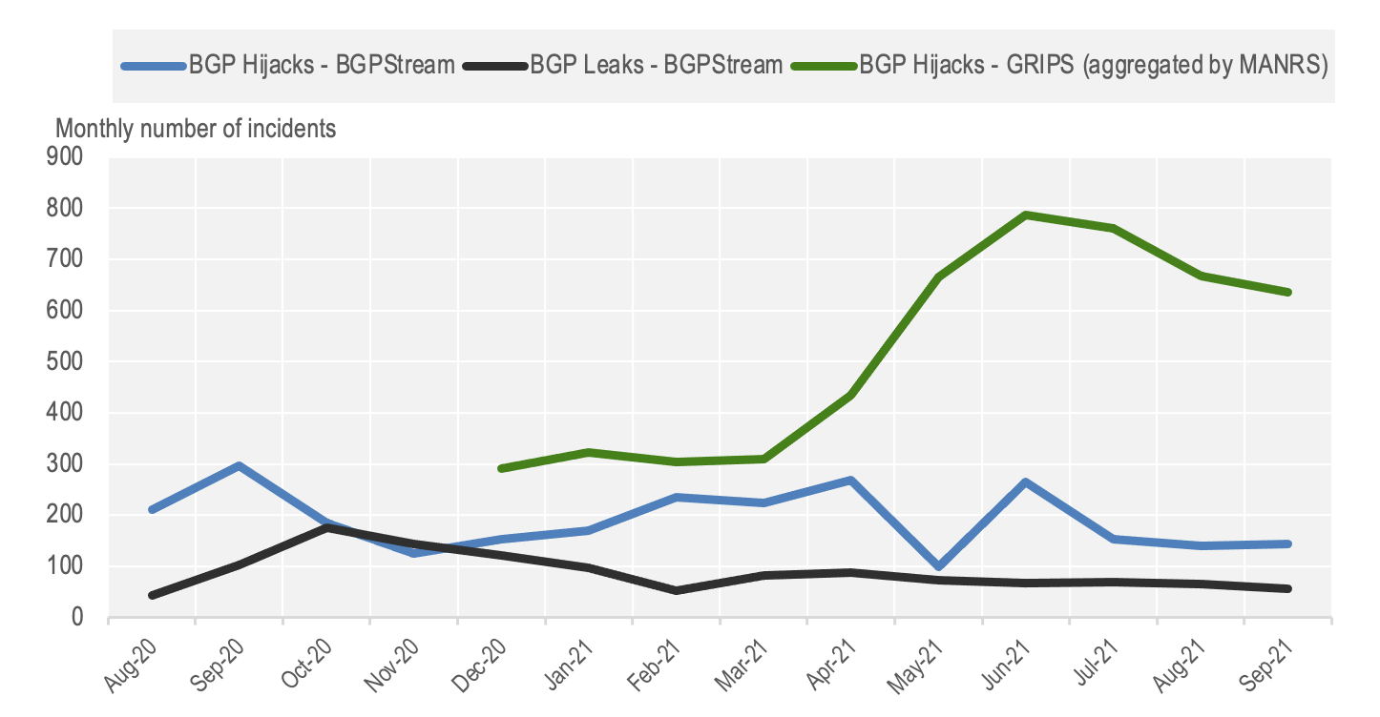
We get routing wrong a lot of the time
Annual summary of BGPStream reports

Slide 10
And we would all like to handle this better
So we take one or two proto-typical attacks
It’s simpler and focusses the effort to mitigate the issue
We hope that they are good examples of what we are trying to prevent
We design tools to prevent those attacks

Slide 11
The Archetypical BGP Incident
February 2008

Slide 12
How?
My
AS36561 (YouTube) was announcing 208.65.152.0/22
AS17557 (Pakistan Telecom) announced 208.65.153.0/24
In BGP more specific prefixes “win” every time – so if a network heard the /24 then it believed it as a refinement to the encompassing /22
This was a failure in filtering.
But while (some) ISPs filtered their customers, the practise of applying filters to internal wholesale connections was less common. So the false route propagated and everyone else believed it.

Slide 13
But that was 13 years ago
Are we getting better at filtering?
Not really
February 2021 AS 136168 (Campana MYTHIC) in Myanmar implements a government directive and propagates a more specific of Twitter’s service address (104.244.42.0/24)
Twitter had lodged an RADB entry and filtering on this RADB entry would’ve stopped the false route propagating
Yet the route still propagated outward to AS132132, AS61292, AS4844, AS8106 and AS23673 and onward to ~40 other ASes who don’t filter based on RADB entries

Slide 14
Maybe we need more than Route Registries…
We’ve been using Route Registries as the foundation of route filtering since the NSF-funded Routing Arbiter project of the early 90’s
The problem with route registries is that they require intense feeding and watering, as they develop bitrot very quickly
Surely we could use the Awesome Power of Digital Cryptography and automate the heck out of this and not just rely on hand-curated lists and fallible human operators?

Slide 15
Meanwhile, over the fence in RIR Land
We were looking at how to provide testable authenticity in supporting whois queries in the address registries
The RIRs were aware that many ISPs used these registries as a source of authenticity to process requests to route BYO prefixes from customers, and ISPs were keen to push the authenticity problem off to literally anyone else!
Maybe we could inject this testable authenticity directly into the routing system to literally make it impossible to lie!

Slide 16
All Hail RPKI!
Use the RIR registry as the source of authority
Registry operator “certifies” a resource holder through a public key certificate
Resource holders can digitally sign attestations with their resources
The signature also means that they are acknowledged resource holder and the resource is validly allocated or assigned
Validation of a signature means that the attestation is genuine, complete and current
We can feed this information into the routing system to audit announcements for veracity

Slide 17
RPKI, meet BGP!
Separate out origination and propagation and treat them separately

Slide 18
RPKI, meet BGP!
Separate out origination and propagation and treat them separately
Origination is protected by using a signed authority issued by the prefix holder to authorise an AS to originate a route or set of routes (ROA)

Slide 19
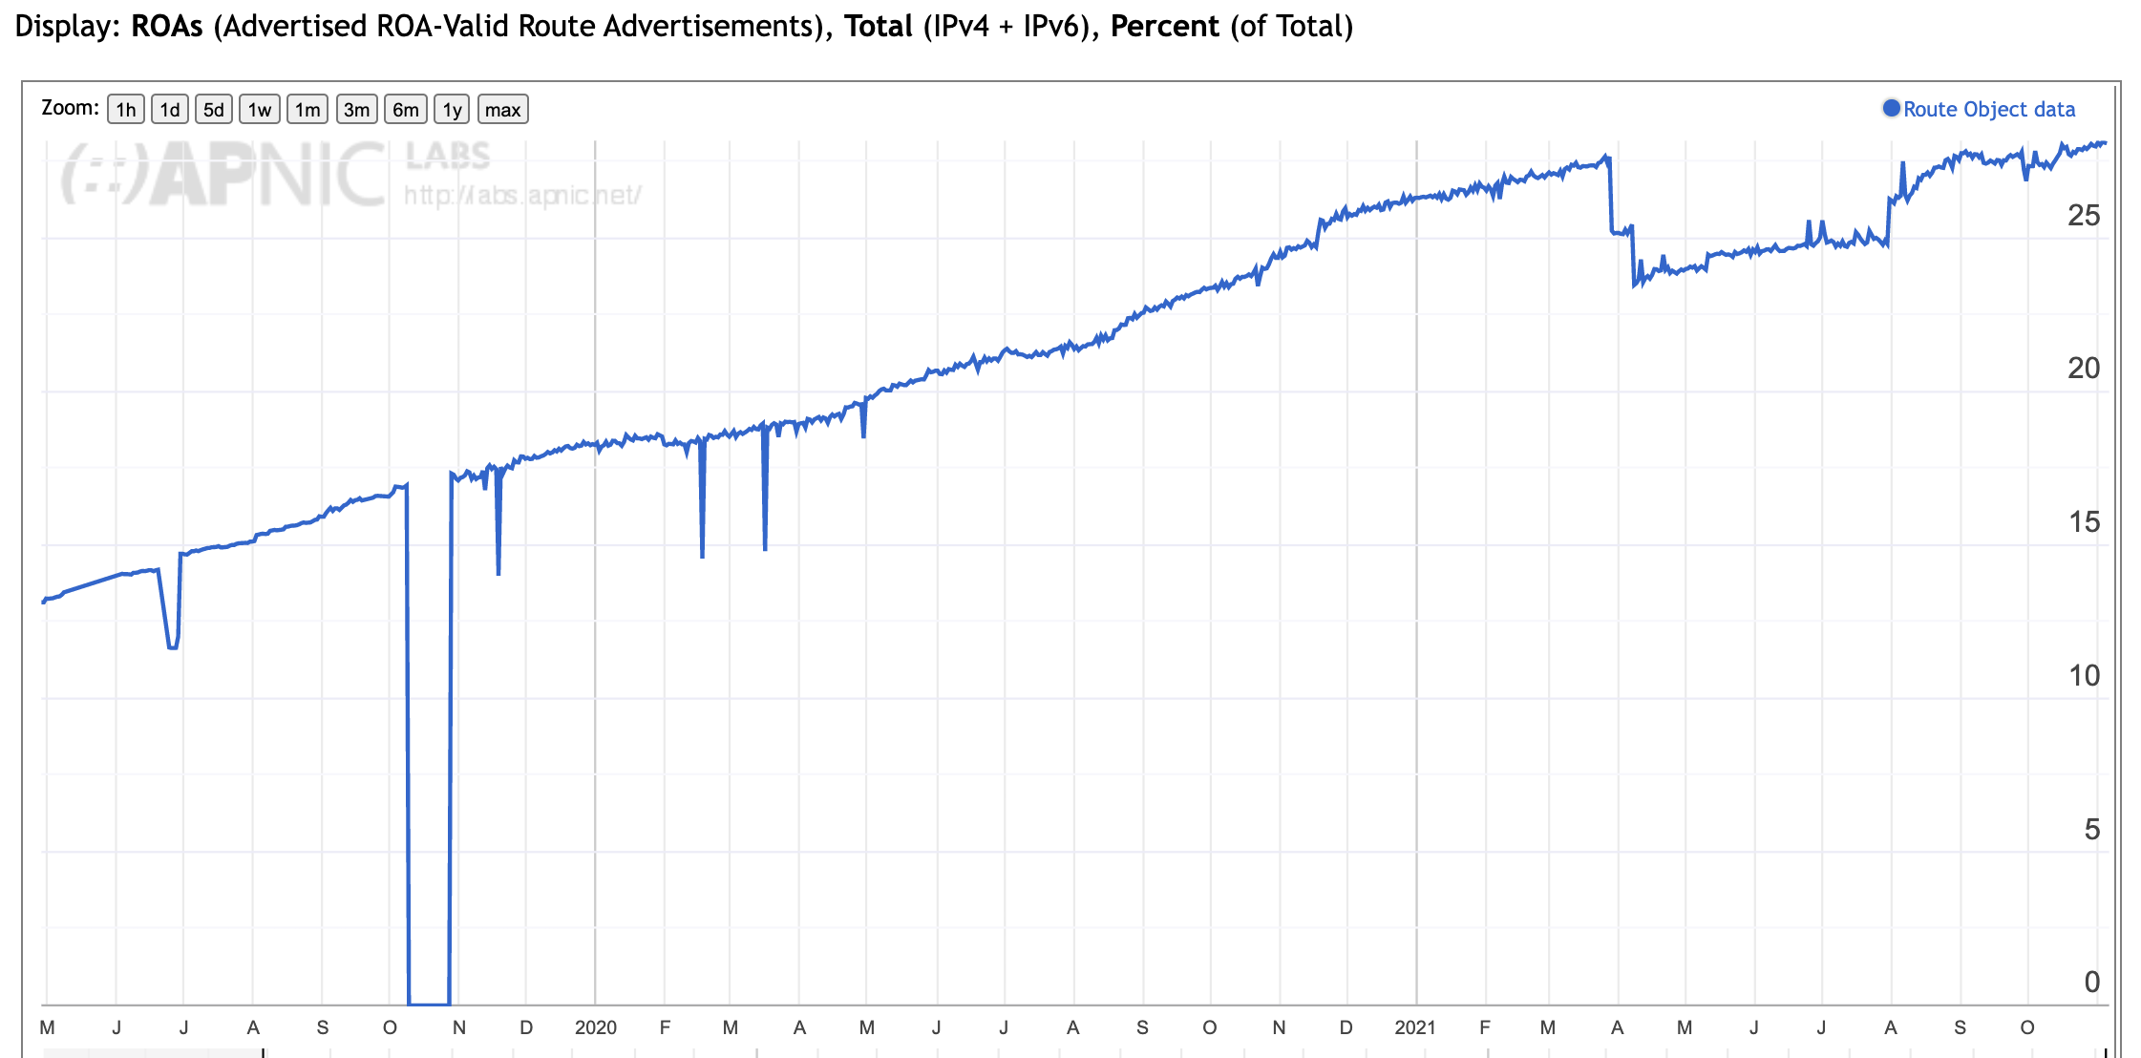
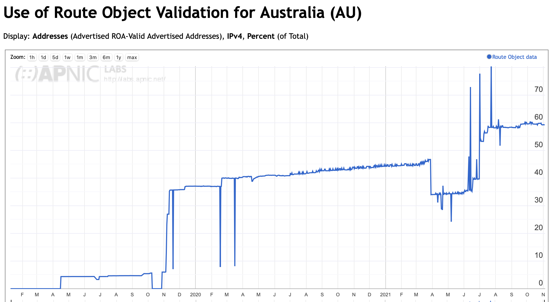
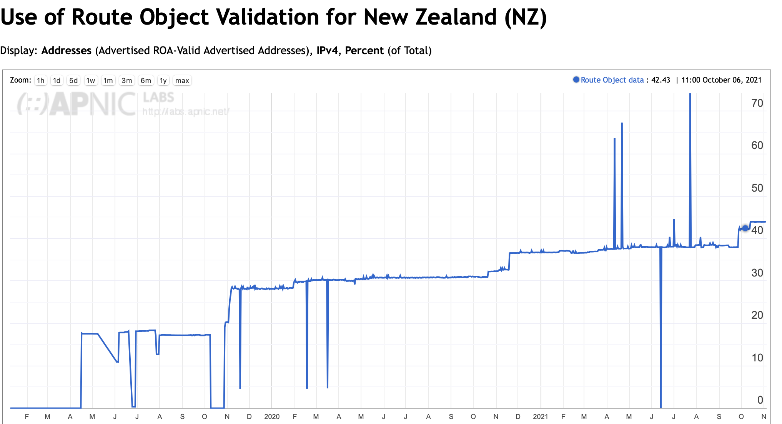
ROA Production
Internet-wide average
27% of routes
40%
60%
https://stats.labs.apnic.net/ROAS

Slide 20
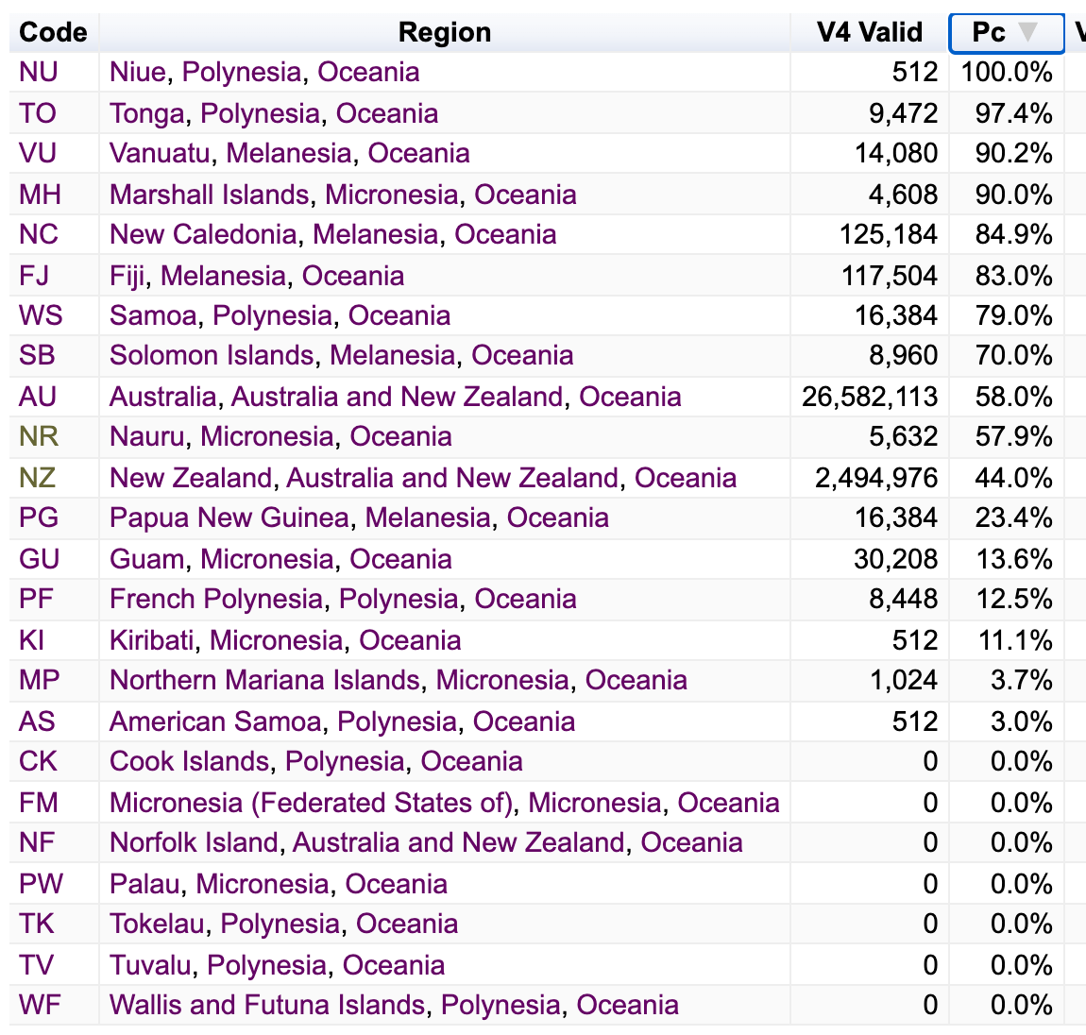
ROA Production
Internet-wide average
27% of routes
40%
60%
https://stats.labs.apnic.net/ROAS

Slide 21
RPKI, meet BGP!
Separate out origination and propagation and treat them separately
Origination is protected by using a signed authority issued by the prefix holder to authorise an AS to originate a route or set of routes (ROA)
Then you assemble these digital authorities and generate a filter list in the router and drop all routing announcements that are invalid

Slide 22
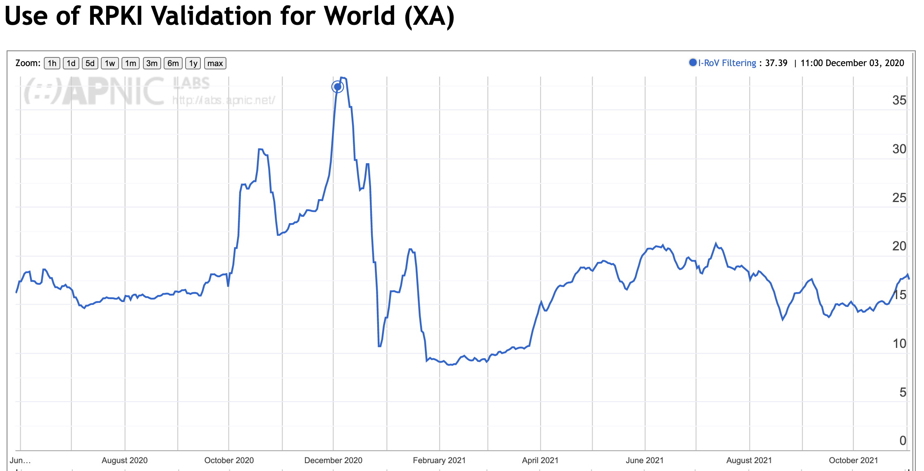
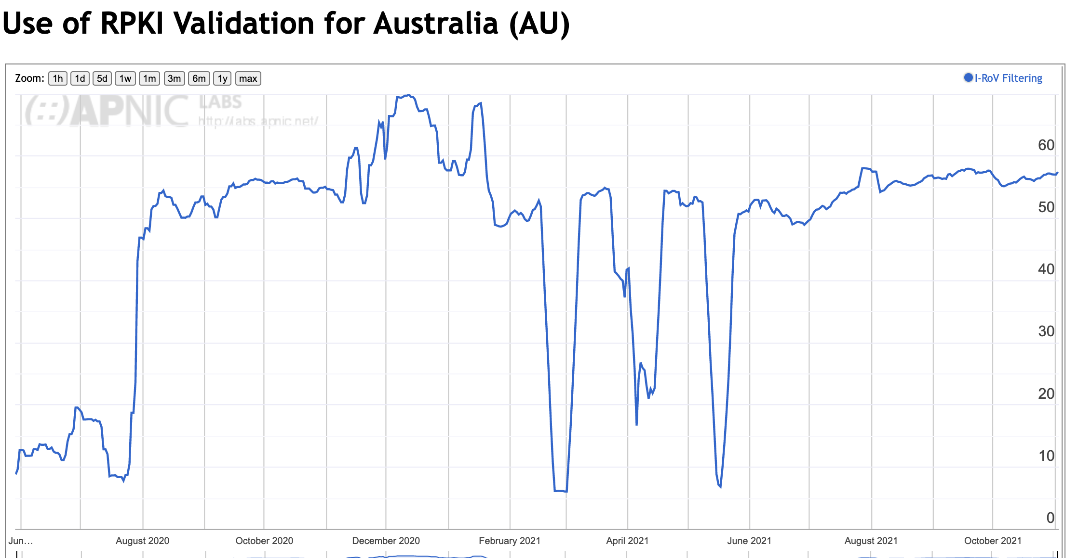
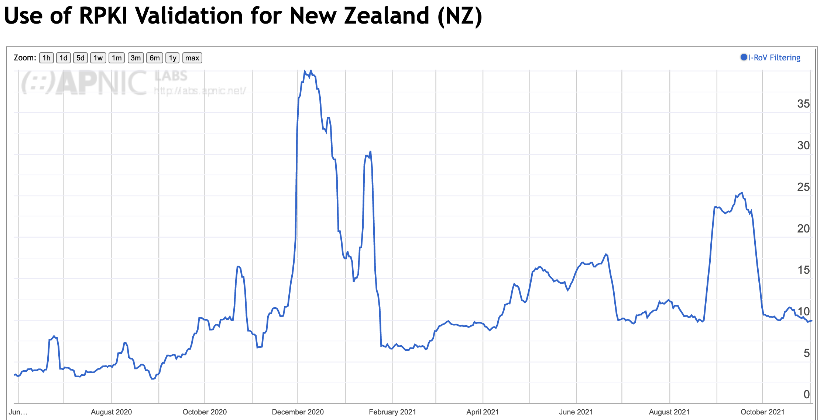
Drop RoV-Invalid routes
Internet-wide average
15% of users
10% of users
55% of users

Slide 23
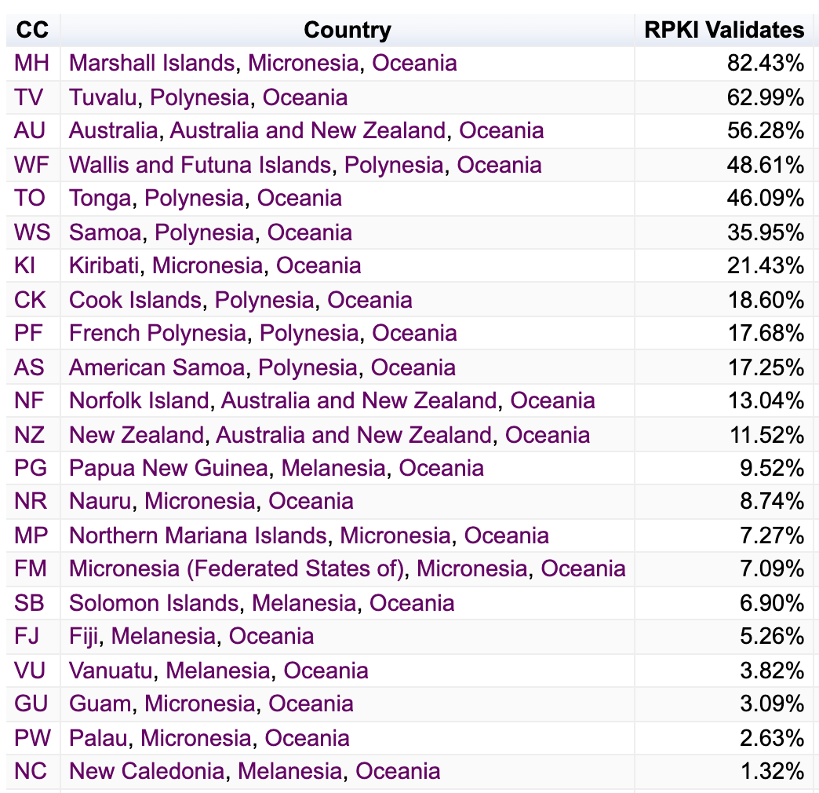
Drop RoV-Invalid routes
Internet-wide average
15% of users
10% of users
55% of users

Slide 24
RPKI, meet BGP!
Separate out origination and propagation and treat them separately
Origination is protected by using a signed authority issued by the prefix holder to authorise an AS to originate a route or set of routes (ROA)
Then you assemble these authorities and generate a filter list in the router and drop announcements that are invalid
Propagation

Slide 25
RPKI, meet BGP!
Separate out origination and propagation and treat them separately
Origination is protected by using a signed authority issued by the prefix holder to authorise an AS to originate a route or set of routes (ROA)
Then you assemble these authorities and generate a filter list in the router and drop announcements that are invalid
Propagation is a problem
Wholistic approaches that attempt to link the AS path to the propagation of an update (BGPSEC) resist piecemeal deployment and are crypto-intensive – BGPSEC is largely DOA
Piecemeal approaches offer more limited protections that limit the plausibility of some forms of lies

Slide 26
RPKI, meet BGP!
It’s not an entirely comfortable match
The implicit withdrawal of ROA-invalid routes can cause spurious route refresh operations against your BGP peers
The hop-by hop aspects of BGP (withdrawals, communities) an not possible to validate against an origination “root cause”
Routing is “backwards”
BGP does NOT select the forwarding path
It creates a partial topology by passing reachability in the reverse direction
And that’s all
An AS Path describes the route propagation path, not the packet’s forwarding path
What matters is “forwards”
Our concern is with the forwarding path
And that’s what we can’t check from the routing system

Slide 27
So securing routing is hard
But its still only part of the picture
What do we see in terms of “incidents” in todays network?
Would RPKI in BGP defend the network from such incidents in any case?
Let’s look at some more examples of incidents and outages that induced routing anomalies

Slide 30
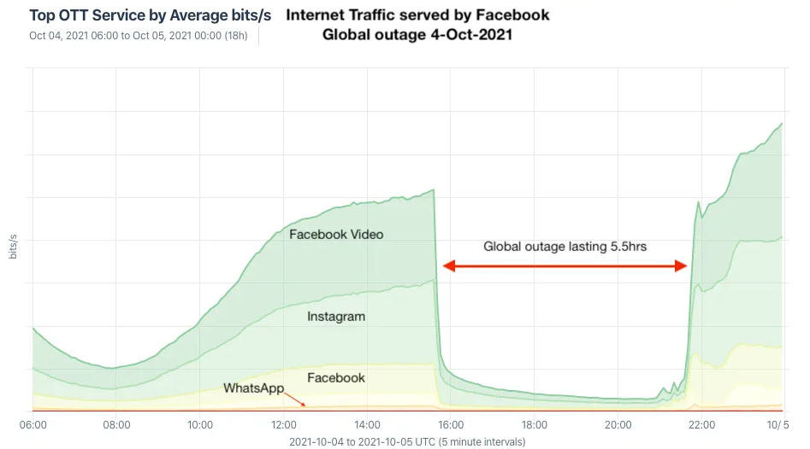
Facebook Meta, October 2021
Lost route to nameservers
Used a single route to all nameservers
Used short cache lifetime DNS records
Lost sight of all 4 anycast nameservers for @facebook.com
Lost access to secure entry tokens in @facebook.com
Even if they’d had DNS, NLRI routes to offline server surface would have looked pretty bad
Web service sending what?
6-8 hour outage
(5nines is 5min/year unplanned outage, so that’s 72 years of ’credit’ for 5nines!)
Huge amounts of Africa functionally offline for business
WhatsApp for money exchange
3 billion Facebook users totally disconnected from the platform

Slide 31
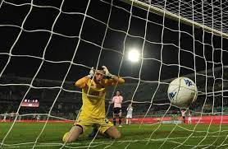
Own Goal Syndrome
Yes, there was a BGP incident
It was a withdrawal that isolated the authoritative nameservers for facebook.com
But it was not an attack
It was an internal operational error
And RPKI/BGPSEC cannot “protect” inadvertent route withdrawals in any case
And the outage was multiplied by the withdrawal of the DNS records because of cache expiry
And made worse because the outage also locked them out of their facilities (!)

Slide 32
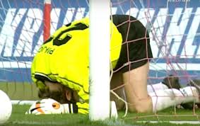
More recent Own Goals
June 2021
A certain customer configuration change that was flagged as valid triggered a complete platform crash in their Varnish platform
Varnish is NOT a Fastly-developed platform – it is open source developed by a Norwegian newspaper site
July 2021
A config change had a format error that disabled the front end load balancer, that disabled their DNS steering and took out the platform
Obviously, not a routing problem

Slide 33
Own Goals are insanely common!
But what about collateral damage?

Slide 34
Collateral Damage
November 2018, MainOne in Nigeria had a configuration error that leaked ~200 Google Cloud routes to various transits, including China Telecom, who propagated the routes onward
Two hours later Main One Leaked Cloudflare routes along the same transit paths
Would RPKI have helped here?
Assuming this was a path leak, then no, not really

Slide 35
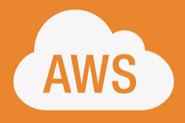
Collateral Damage
June 2019 AS33154 (DQE Communications, US) had a Noction BGP Optimizer that announced a set of more specifics to its customer AS396531 (Allegheny Technologies) who readvertised these routes to AS7012 (Verizon) a Large Tier 1 transit network who was not performing route filtering
A large set of routes were redirected along this mule track detour, including AWS and Cloudflare, causing major disruption
RPKI? Maybe – depends on the use of ROAs with maxlength to reject more specifics

Slide 36
Other Recent Collateral Damage incidents
IBM cloud outage, June 2020
“external provider leak”
Unnamed external provider, 2+ hours, multiple regions.
RPKI? Possibly, possibly not!
Notes:
Or June of 2020 when IBM, who did not name the external party, but had an external provider which caused a 2 hours outage in multiple worldwide regions for their cloud solutions: Remember IBM is the service provider of choice for a lot of finance and government, so this had pretty wide impact, and although IBM don't share what happened Thousand Eyes are pretty confident in their write up that it was routing.

Slide 37
More
TWC, Rogers, Charter, July 2020
Small ISP deploying “BGP optimisers” leaked routes
Propagated by Telia
Notes:
How about same year, bit later on, Another small ISP, deploys a BGP optimiser, leaks routes, this time it was Telia which propagated things, and this broke Time-Warner Cable, Rogers in Canada, Charter communications.

Slide 38
Yes, More
Vodafone India prefix leak, April 2021
30,000 prefixes mistakenly leaked
Google, Akamai, Edgecast, Deutsche Telekom, TIM, Claro, Orange, Telefonica), Vodafone itself (worldwide) amongst others
Notes:
How about this one from Vodafone in India, April of this year. This was bigger. They leaked 30,000 prefixes and thats a substantial chunk of the global routing: its 3, maybe 4 % of the prefixes, and they took out these nine big players, including the other international Vodafone affiliates. Not everywhere, but for a lot of related parties, peers.

Slide 39
Commonalities
Its an indirect sideswipe
But there is still a service loss, loss of business, customer/SLA effects
Yes, some of these could have been avoided by a ROA with careful use of maxlength
But
ROAs are universal, not context specific
They don’t come with an “apply here, but not there, sticker”
If ROAs allow you to accept more specifics, then they won’t stop you propagating them onward
But many incidents are policy routing issues relating to leakage, not synthetic routes
Notes:
So the point to be made here, is that probably right now, no, "security" isnt't the primary problem.
These were all straightforward mis-configurations.
The point to be made here, is that I put up a sheaf of logos, for corporates and ISPs affected and they weren't the ones who deployed the footgun.
They are the ones who were affected, and they are the ones who had to deal with the consequences. So this is the kind of problem which is maybe hard to characterize as a "foot gun" because its not like they shot themselves in the foot, except kinda, they did:
Because if they'd deployed a ROA, if they had some kind of RPKI protection over things, then at least some of the damage might have been limited. If you go look at the prefix lists for a lot of the affected parties, many of them do now have ROA.
They didn't back in 2018 and 2019. Google signed over its prefixes in around September 2020 from what I can see, which should have limited the visibility of the Vodafone India problem

Slide 40
Does Network Automation help here?
Yes and No
A config change can flip the state of all components of the network all at once – amplifying the potential for a problem to be network wide though just one command transaction
Less margin for error and greater potential for damage.
And automated scripts within these system can generate completely unanticipated outcomes!
Some network managers see the purchase of an automated network management system as a compatible substitute for a skilled workforce
a stunning triumph of unwarranted optimism over reality!

Slide 41
Does RPKI help here?
Well, yes sometimes, but its not the full picture:
And adding more moving parts to a complex system does not make it more robust – it often achieves the exact opposite
RPKI uses a single rule set that is applied everywhere – it does not provide context-specific conditional application
Many route leaks are a policy violation, not a protocol violation
And policies are often contextual, not universal
So RPKI won’t catch them
Some of the routing issues are the result of loss of a synchronised forwarding state, and BGP (and RPKI) don’t and can’t enforce synchronicity in state across BGP speakers
We’ve seen “ghost routes” in BGP that have been persistent for years!

Slide 42
So… what’s the answer?
We continue to push larger route sets and larger policy agendas onto the routing system
And because clue is finite, we are automating more and more of network management to make up for a serious skill gap
Which creates brittleness in the routing that is prone to fail in unsafe states that can’t be readily recovered
How can we make routing more robust?
Notes:
I should stress, I’m not here to tell you what to do: I’m not an operator, and I am not a BGP speaker, and I don’t have to configure BGP for a living.
I do wonder how the model coming in from code, where people do continuous integration testing and deployment, how this could be applied to the control plane in routing. How could people automate changes to their BGP intent safely, with some kind of testbed, to do sanity checks?
Because the drive to automate, is very strong. But, it brings with it some concepts which I don't think translate well to routing. In classic CI, you have a testbed. you have integration tests, and runtime tests, and selenium tests. How do you do that, for what your peers and upstreams are going to do, faced with your changes? How do you CI test the Internet?
And, I beg you to keep doing your side of RPKI: sign things, make declarations of intent in ROAS, and be careful your ROA doesn’t open the door to attacks on path with more specifics. Think about MaxLength.
Finally, try not to “come to the party” of people who will follow a Lie. It doesn’t really matter if its misfortune or mischief, its still bad BGP.

Slide 43
Routing is Difficult
“The most complicated computation ever attempted by mankind is the global distributed routing algorithm that runs the Internet.
In fact, if anybody thought about it very hard, before we started, they would've been too scared to try.
Ah, because it runs in near real-time, it's an online algorithm, it runs on a multimillion node multicomputer, of an arbitrary topology, built by lots of people who have never met each other. Right?
And, it's a very very complex computation because it's piecewise constructive, there is a lot of local consistency constraints, there is a bunch of global correctness criteria that are occasionally satisfied, and yet the thing mostly works.
Which is astounding, when you actually look at what's going on.”
Mike O’Dell, 2000 (http://www.dtc.umn.edu/~odlyzko/isources/odell-transcript.txt)

Slide 44
Routing Security is not a solved problem
I’m not sure we really know what we really mean when we talk of routing security
And I’m not sure that operationally focussed piecemeal incrementalism is really helping here with the bigger picture of tackling “routing robustness” and stopping these various routing mishaps
This is remains a problem space that would benefit from further research and experimentation
And research funding of course! ☺

Slide 45
But there really are some things you should do in routing
SECURE YOUR ROUTERS!
Avoid multi-hop EBGP wherever possible
And if you must multi-hop, use TCP-AO or MD5 to secure the channel
Use an IRR
Yeah, it may seem like a bit of a waste of time, but honestly the rigor of enumerating your routes and keeping these records up to date is worth it even if you are the only user of the IRR entry!
Apply Source filters to prevent source address spoofing
Look at your network from afar – all of the time!
Look at your routes from afar – all of the time!

Slide 46
More BGP Safety First
Rehearse every routing config change
Always have a backout plan prepared
Talk with your BGP peers, upstreams and customers
So at the very least you know how to reach them when you are desperate!
Don’t try and cover up any routing mistakes – be honest and open so that we can all help to clean it up as quickly as possible
And yes, we’ve all been responsible for our share of routing lapses
Certify your resources
Sign ROAs
Filter inbound and outbound routes when you (and your router) feel ready!
Follow the technology yourself
Reliance on vendors to do all the heavy lifting for you is generally a mistake

Slide 47
More safety first
Its not directly related to routing, but it really helps your overall security stance
Use a DNSSEC-validating recursive resolver to server your customers
YES, all of the time!
No exceptions
DNSSEC-sign your domain names
Because the worst attacks corrupt the DNS as well as routing

Slide 48
It won’t catch everything
But hopefully you will feel more confident that you can manage your network to provide a stable service
And you will be more confident that you can recover quickly when things don’t quite go as planned!

Slide 49
Thanks!

