Slide 1
BGP Security Threats and Challenges
Geoff Huston AM
Chief Scientist, APNIC

Slide 2
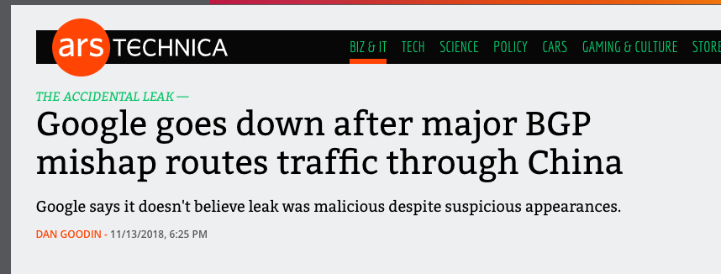
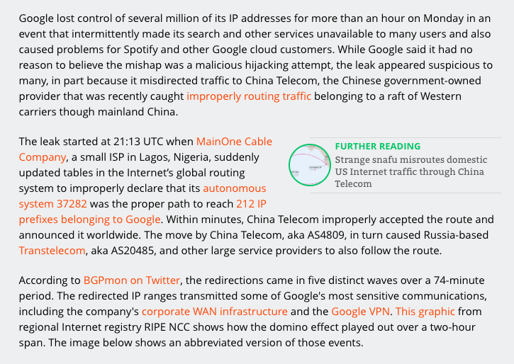
Why do we keep seeing these headlines?

Slide 3
The Problem
We designed and built a dynamic self-learning (and self-healing) routing system that operates without any centrality of authorisation or control
This is extraordinarily flexible, robust, and scalable, as we have seen

Slide 4
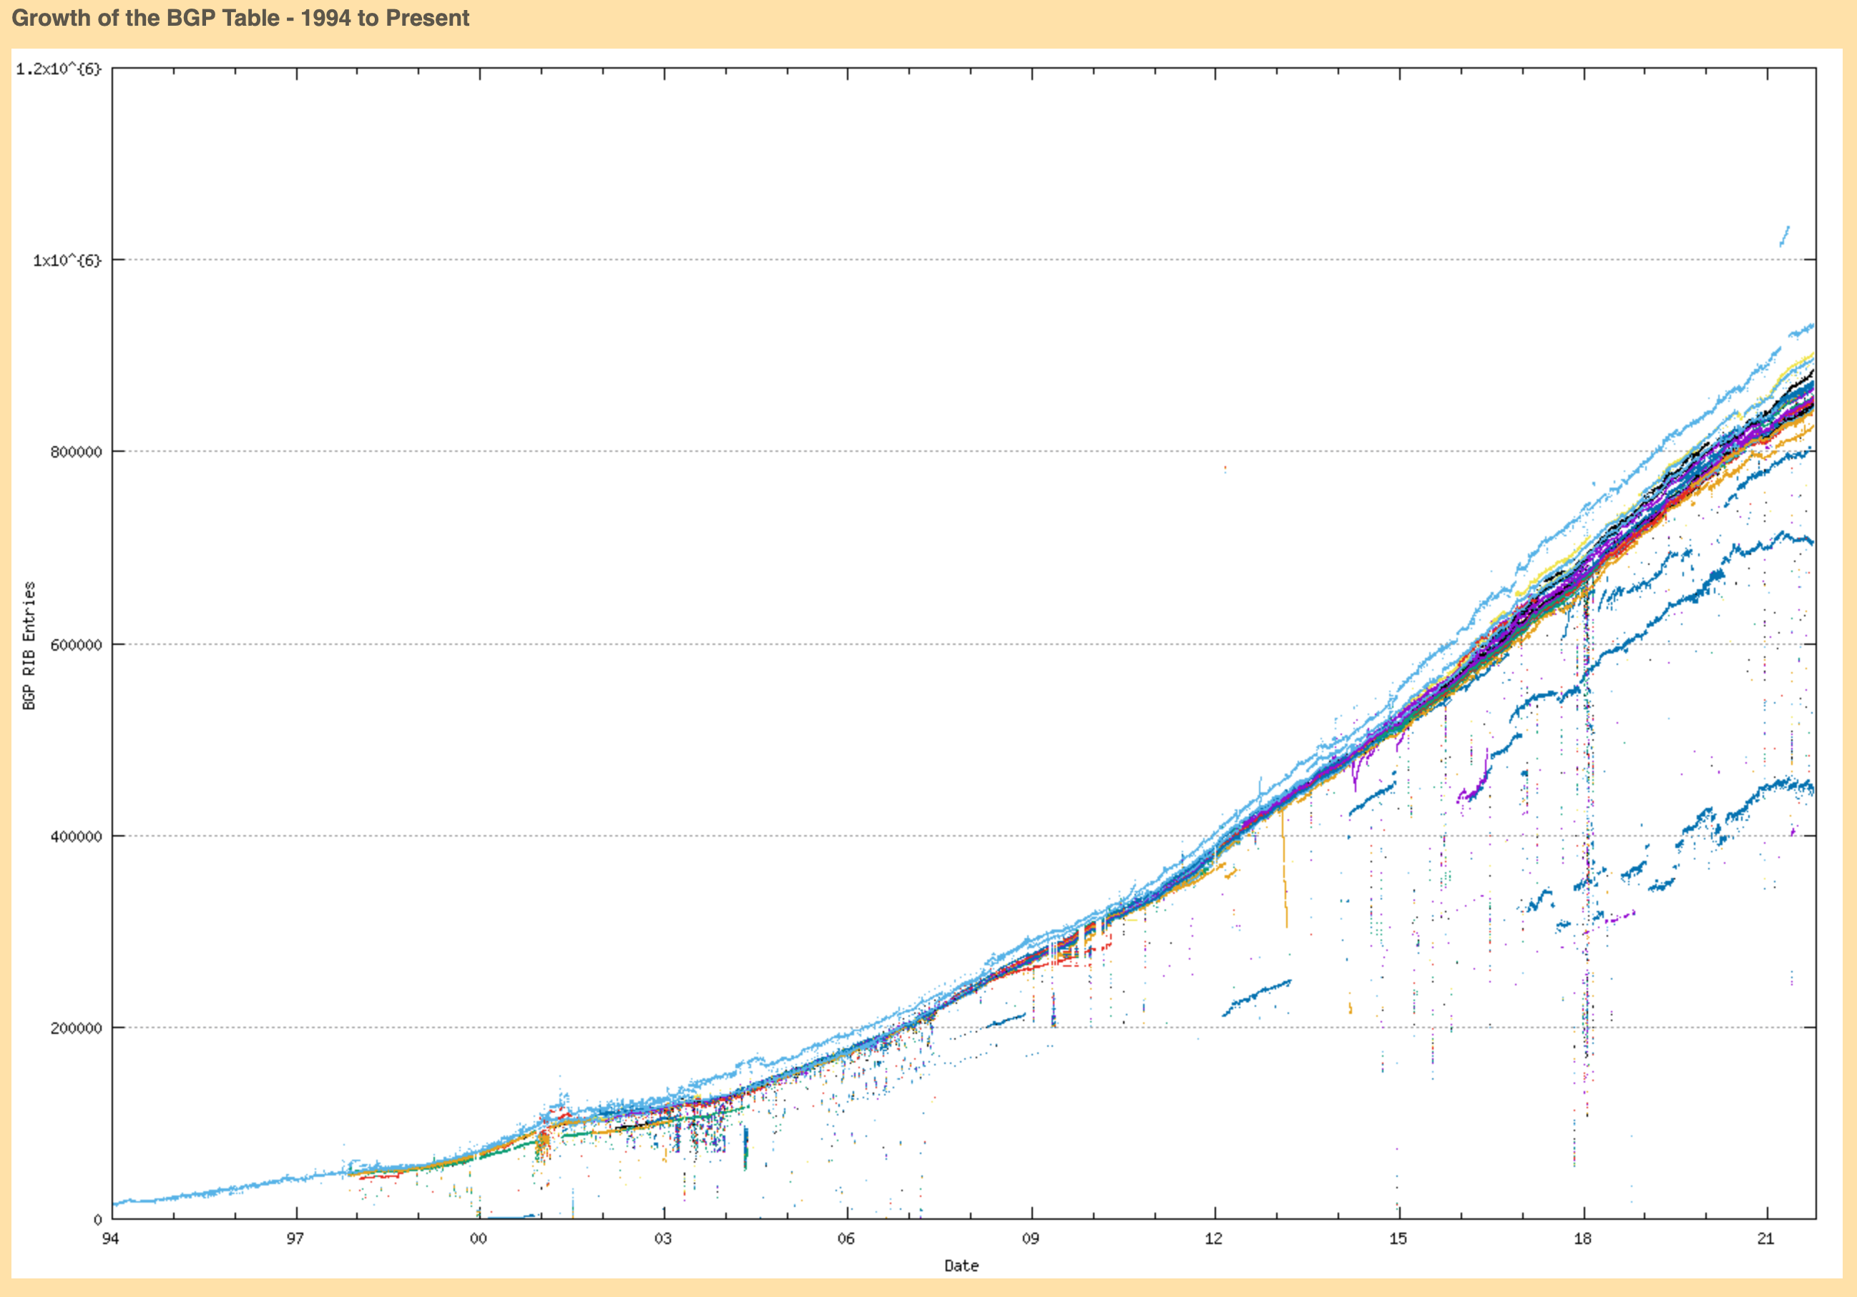
BGP just scales (so far!)
1M BGP Routes

Slide 5
The Problem
We designed and built a dynamic self-learning (and self-healing) routing system that operates without any centrality of authorisation or control
This is extraordinarily flexible, robust, and scalable, as we have seen
The problem is that nobody can tell when the routing information being passed inside this routing system is untrue

Slide 6
The Threat
Falsifying routing information can cause:
  Traffic diversion
  Service impersonation
  Denial of service
Which can lead to outcomes of service disruption and potential theft.
Attacks to routing can be highly targeted or very broadly based

Slide 7
The Threat
Route hijacking is not necessarily an end in itself, but can be a part of a larger attack
  The April ‘18 MyEtherWallet raid was an attack involving a domain name registrar, the DNS, a susceptible certificate authority and a BGP route injection to work
Sometimes its not a hostile attack but a result of accidental self-harm
  Facebook managed to remove the IP prefixes of its own name servers from BGP on October 5th, causing a global 6-hour outage of the entire Facebook platform

Slide 8
Counter Measures
Improving the resilience of host systems cannot mitigate this threat – routing attacks rely on the host performing “normally”
Improved application design can mitigate some of the impacts of a routing attack
  Use of TLS provides an end-to-end encrypted session so that traffic diversion cannot reveal session contents
  TLS also can provide server authentication so that service impersonation is more challenging when TLS is being used
But the problem of disruption remains
  And we can’t “fix” this at the ends
  We need to address this vulnerability within the routing system itself

Slide 9
The Routing Security Goal
Can we devise changes to operational practices, or operational tools or routing technologies that manage the inter-domain routing system that could prevent the propagation of false or artificial routing information across the Internet?

Slide 10
This is a Very Challenging Goal
It’s a problem as old as the concept of a distributed inter-domain routing system
Each actor applies local policy constraints on local topology knowledge to guide its local route object propagation decisions
No single actor has sufficient “whole of system” data to determine the difference between what it should’ve learned and what it has learned – the routing system has no higher knowledge that it can use to filter incoming routing information to discard “lies”

Slide 11

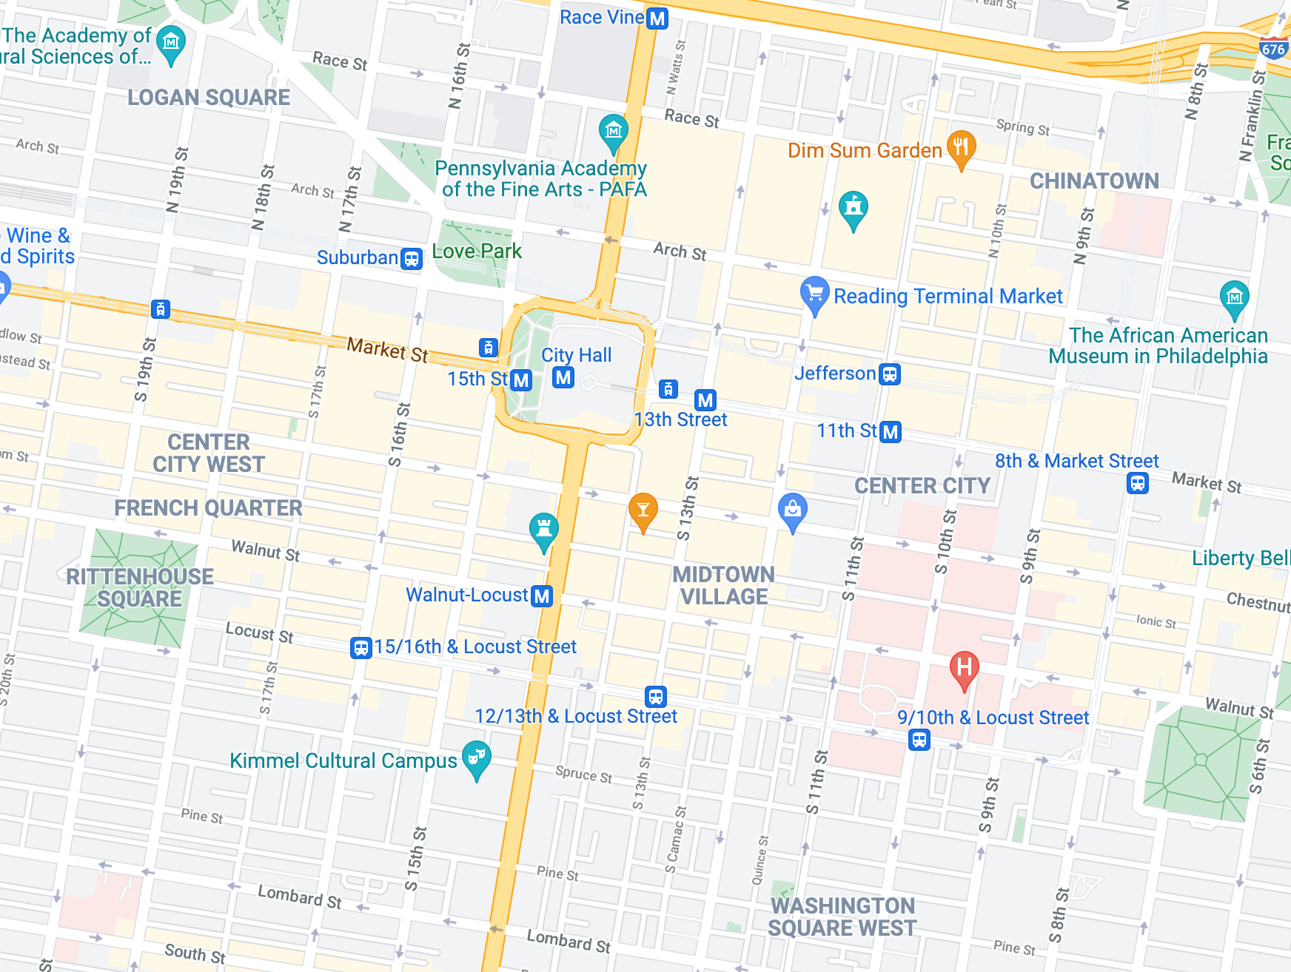
BGP has “Tunnel Vision”
What BGP “sees”
What BGP “wants”

Slide 12
The Ideal
We want the interdomain routing system to advertise the correct reachability information for “legitimately connected” prefixes at all times
That means that we want to avoid:
  propagating reachability for bogus address prefixes
  propagating incorrect paths for reachable prefixes
  blocking paths for legitimately connected prefixes

Slide 13
The Problem Space
While we’d like to think we understand the provenance for each and every IP address, that is not exactly the case
And even if we did, we have no precise knowledge as to which network has the authority to originate a route object for that address
And even then, we have no exact knowledge of the inter-domain topology of the network
And even then, we have no clear knowledge of the local policy constraints that are applied to the propagation of reachability and topology information

Slide 14
The Problem
All of which means that we have no clear model of “truth” to compare to the information flow in the routing system
  Which ASes have a legitimate authority to announce a prefix into the inter-domain routing system?
  Which ASes are interconnected?
  What route policies are applied to each pair-wise AS interconnection?
  What is the “best” route to the prefix destination?

Slide 15
A Weaker Routing Security Goal
Can we devise changes to operational practices, or operational tools or routing technologies that manage the inter-domain routing system that could resist attempts to inject false or contrived routing information across the Internet?

Slide 16
What Data would we Like?
An (impossible) ideal data set is the “reference set” that describes a ‘correct’ route object set that should be visible at any vantage point in the network
  And access to a set of credentials that support any such attestation of “correctness”
As a compromise we could settle for a reference set that describes a ‘stable’ route object set that should be visible at any vantage point in the network

Slide 17
What we want and don’t want
BGP anomaly detectors and observatories are all well and good, but they have not proved to be all that useful to the operations community
  They are a bit like smoke alarms – they can’t prevent the root cause, but simply alarm after it happens
What we would like is some form of route acceptance model that can be used as an acceptance filter for incoming route updates

Slide 18
So, we’ve been working on this…
We observed that we needed to improve “verifiable truth” in addressing and routing:
We wanted to use the technology of digital signatures to allow receivers to validate aspects of the routing information being passed to them
We designed a Public Key Infrastructure to bind public/private key pairs to ownership or IP address prefixes and/or Autonomous System Numbers
We published tools to allow network operators to use this RPKI to generate digital authorizations
Prefix holders could provide verifiable “authorities” for an AS to advertise the prefix into the inter-domain routing space (ROAs)
Network operators could then filter routing information and discard those routes that do not match these ROAs (ROV Filtering)
And we hoped that network operators would see the common benefit in adoption this technology

Slide 19
A Word of Caution
“And we hoped that network operators would see the common benefit in adoption this technology”
“Common Benefit” is extremely hard to identify in something as large and diverse as the Internet
The economics of this situation work against it
  The integrity of common infrastructure is everyone’s problem which in turn quickly becomes nobody’s problem
Which implies that just identifying a benefit for all does not imply that each individual network perceives that self interest align to common interest
Which means that adoption is likely to be slow and not necessarily going to complete anytime soon

Slide 20
How are we doing with RPKI tool adoption?

Slide 21
Lets look at some RPKI tool Adoption Measurements
Lets look at the metrics of adoption of RPKI
  Number of published ROAS
  Number of Route Objects that are validated by RAOS
  Number of clients that perform a regular fetch of RPKI material
  Adoption of Route Filtering

Slide 22
Populating the RPKI - ROAs
280,000 ROAs are published today

Slide 23
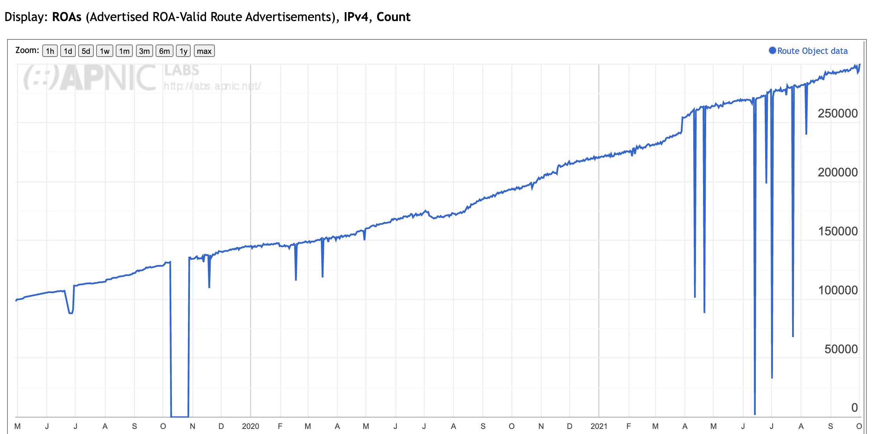
Applying ROAs to Routes
IPv4 Routes that are ”covered” by a ROA

Slide 24
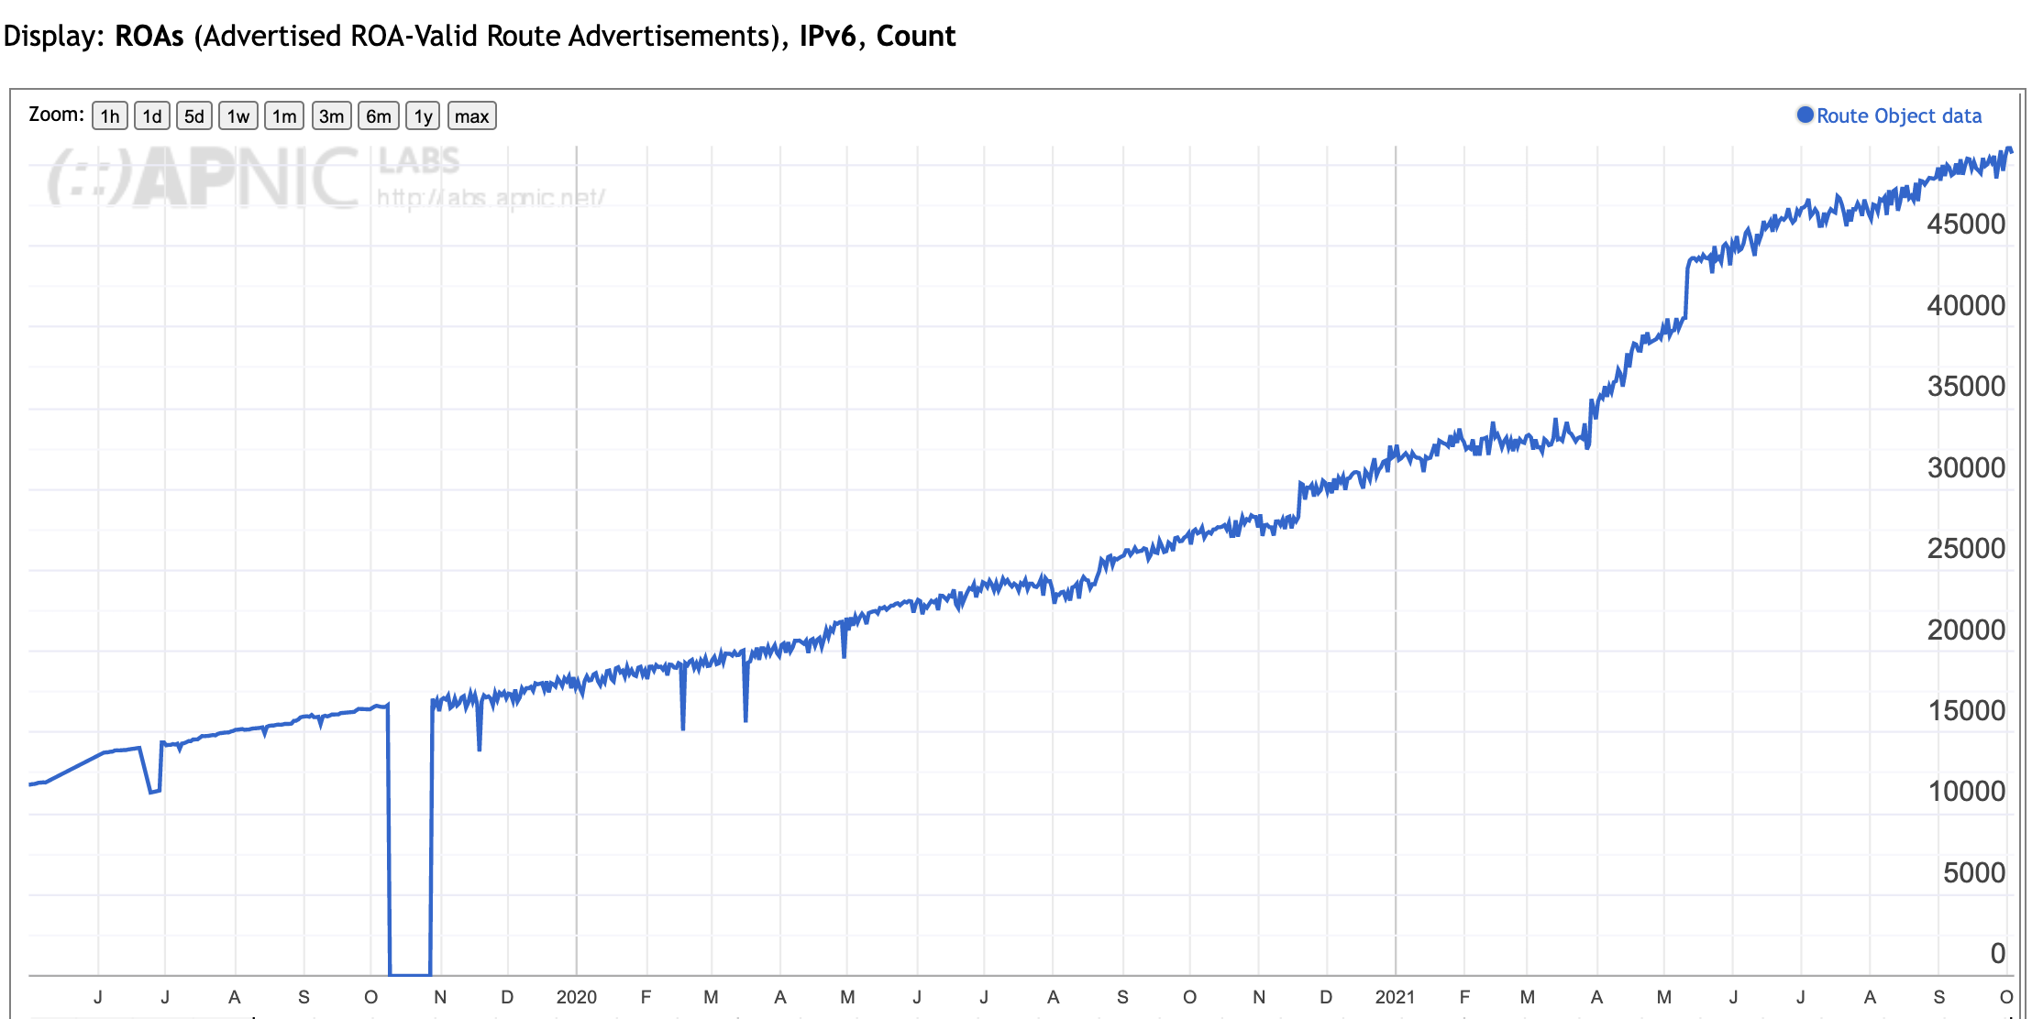
Applying ROAs to Routes
IPv6 Routes that are ”covered” by a ROA

Slide 25
RPKI Clients
How many clients regularly maintain a local cache of the entire RPKI product set ?

Slide 26
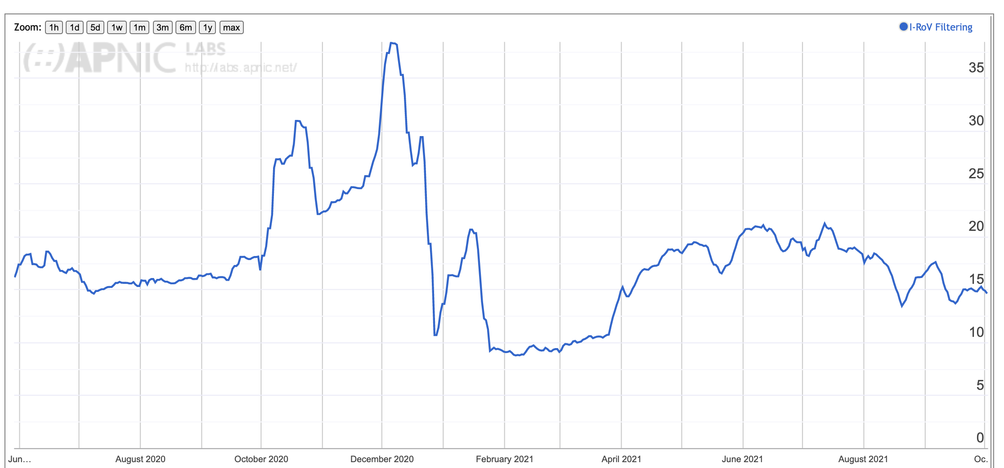
Filtering RoV routes
What proportion of users are behind networks that filter ROV-invalid routes?

Slide 27
RoV Filtering
This is an unexpected result
Only some 15% of users cannot reach a prefix when it is advertised using a ROV-invalid prefix
And this has been constant measurement for the past ~12 months
It seems that few edge networks have been performing ROV dropping
And similarly few transit networks have taken up ROV-dropping
And there is sufficient diversity in the inter-AS topology that even if some paths are filtered out, alternate transit paths sill provide access

Slide 28
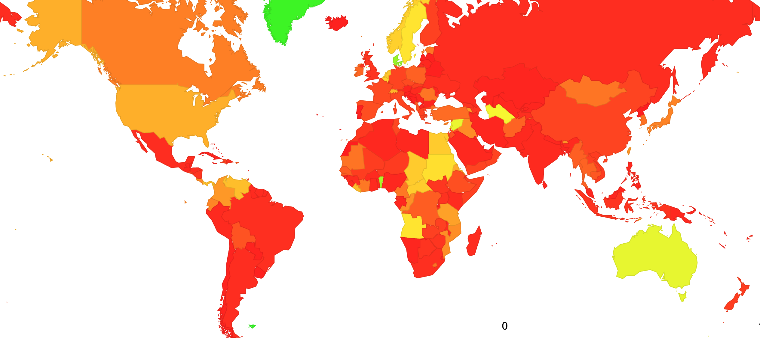
Where is RoV Filtering?

Slide 29
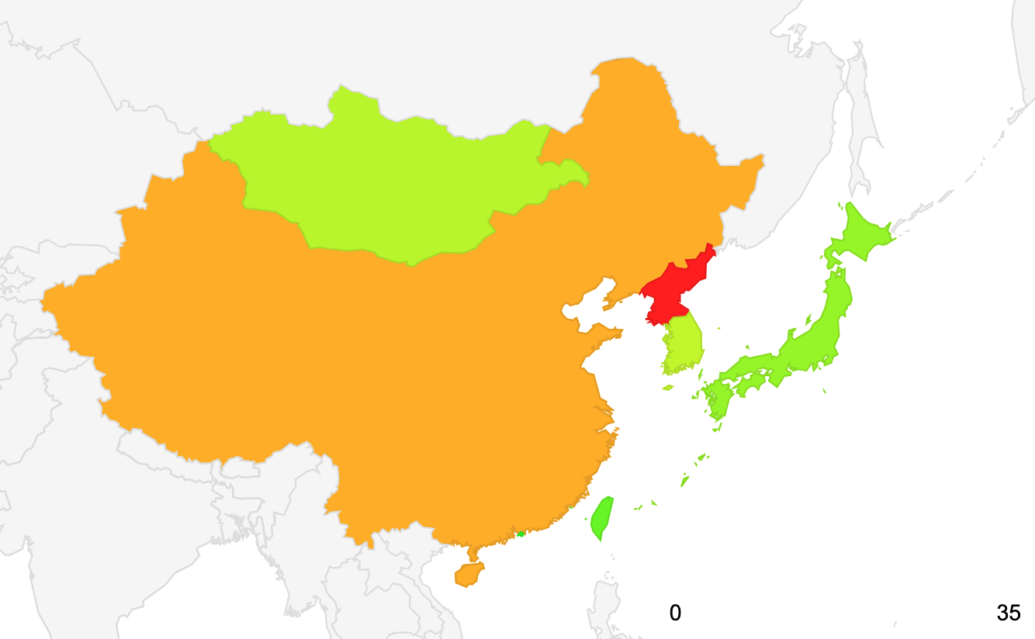
Where is RoV Filtering?

Slide 30
But – all this is not enough!
This is only one part of the overall effort to secure the routing system
It is still possible to mount a routing attack by reproducing the originating AS with a faked AS Path
To complement Routing Origination Validation we need to provide a means to validate the information in the AS Path

Slide 31
How about ASPA?
AS Provider Attestations allows a network to list those networks that act as a transit provider to this network
Its being developed in the IETF at the moment, but it looks quite promising:
  It supports partial deployment models
  It’s a “light weight” approach compared to BGPSEC
  It shifts the burden from the defender to the attacker
It’s likely to be entering trials and tests in the coming months

Slide 32
Other Activity
The BGP Code of Practice – ISOC’s MANRS
  Its hard to be convinced that folk will listen when nobody has been listening for the BCP38 source address filtering for more twenty years!
BGPSEC
  A heavyweight BGP implementation of AS Path signing developed in the IETF
  Its hard to see this going anywhere at all! I think its DOA.
Blockchain
  Its currently fashionable
  But it doesn’t really address the core routing security issue
    Its not the ledger / registry model that’s the issue here – the challenge is how to integrate this information into the BGP protocol, not the derivation of trust and authority in the overall address architecture

Slide 33
What can you do right now?

Slide 34
What can you do right now?
Sign your IP address holdings

Slide 35
What can you do right now?
Sign your IP address holdings
Generate ROAs to describe your announcements

Slide 36
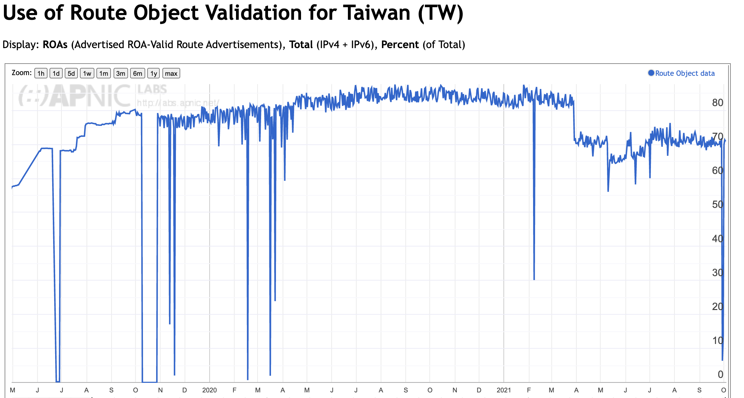
Use of ROAS in Taiwan

Slide 37
What can you do right now?
Sign your IP address holdings
Generate ROAs to describe your announcements
The Taiwan numbers look good!

Slide 38
What can you do right now?
Sign your IP address holdings
Generate ROAs to describe your announcements
Filter invalid routes from BGP updates

Slide 39
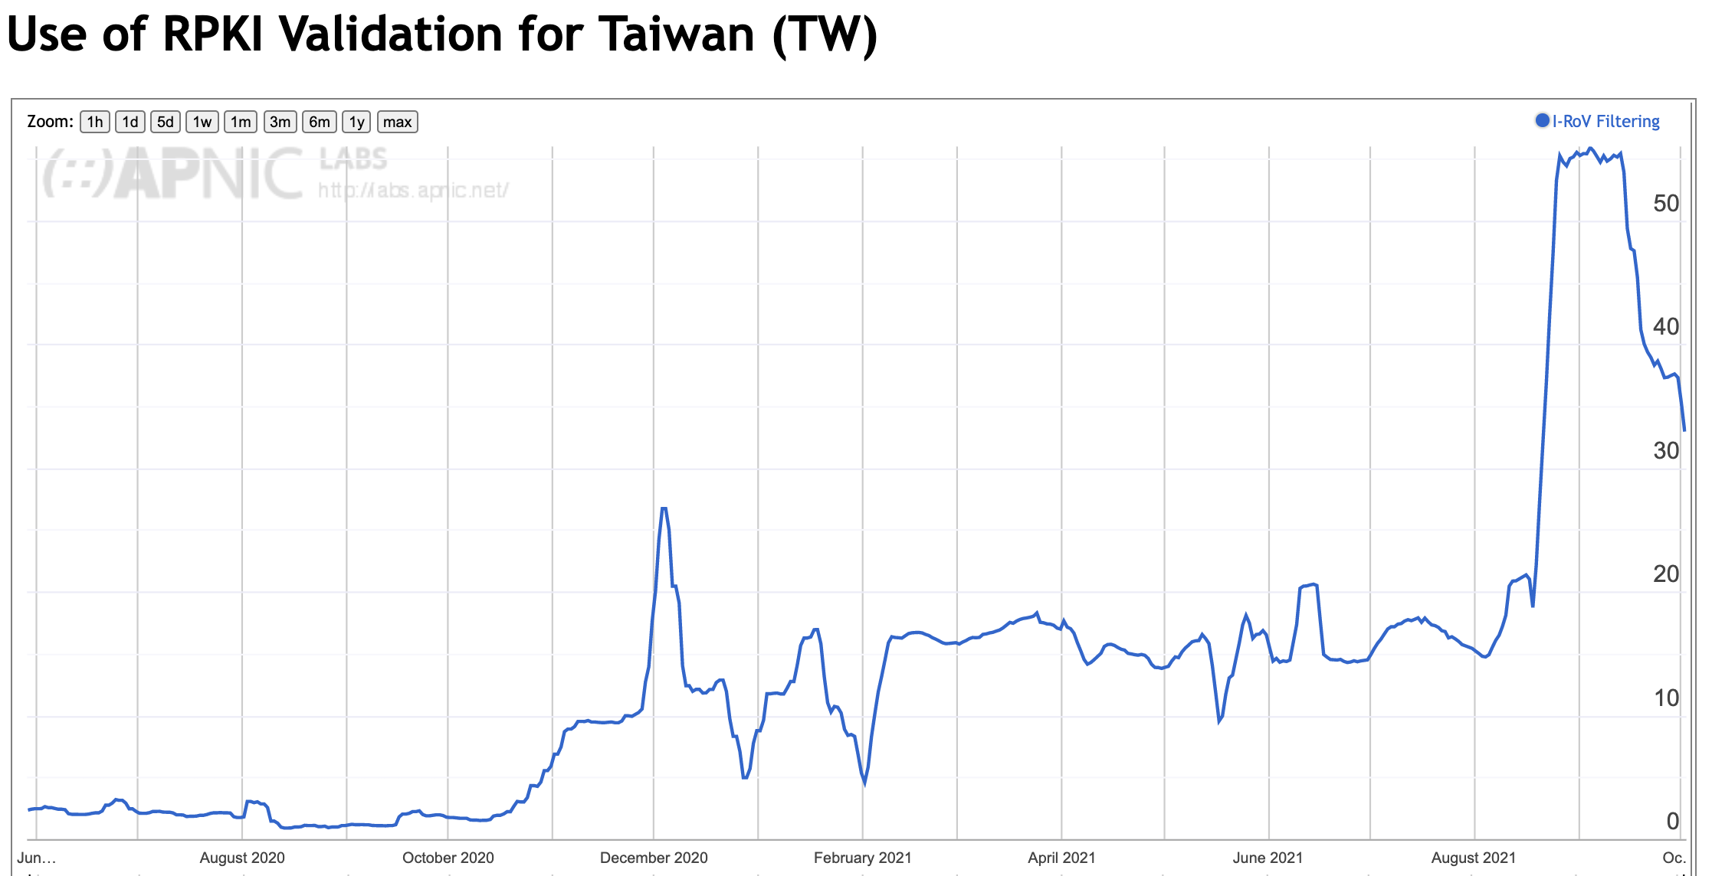
Filtering RoV routes - Taiwan
What proportion of users are behind networks that filter ROV-invalid routes?

Slide 40
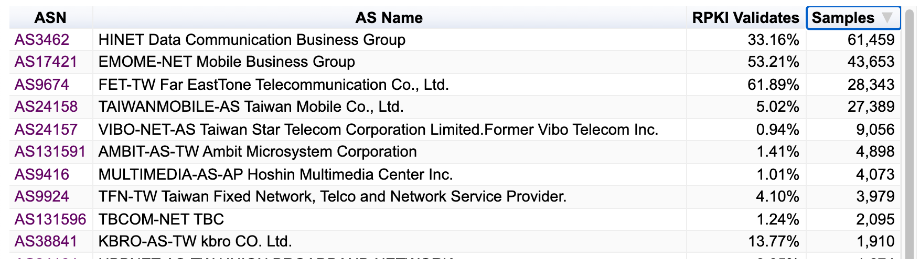
Filtering RoV routes - Taiwan
What proportion of users are behind networks that filter ROV-invalid routes?

Slide 41
What can you do?
Sign your IP address holdings
Generate ROAs to describe your announcements
Filter invalid routes from BGP updates
Could do better!

Slide 42
Thank You!

