Slide 1

IPv6 Deployment
Geoff Huston AM
Chief Scientist
APNIC Labs

Slide 2
Some Questions
Where is IPv6 Deployment activity?
Where is IPv6 widely deployed today?
Where are the most active areas of IPv6 growth?
Have the disruptions of COVID-19 impacted the momentum of IPv6 deployment?

Slide 3
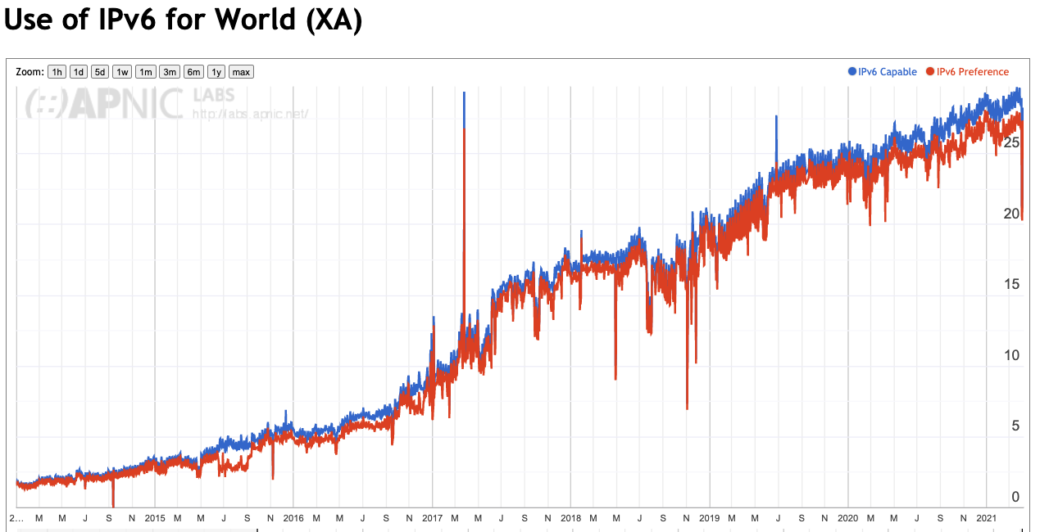
The Big Picture(s)
2020
2019

Slide 4
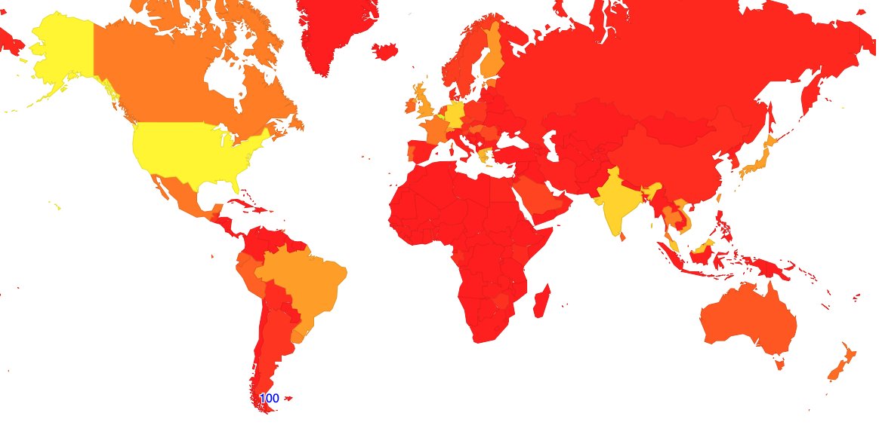
IPv6 - January 2019
Nothing!
All Done!!

Slide 5
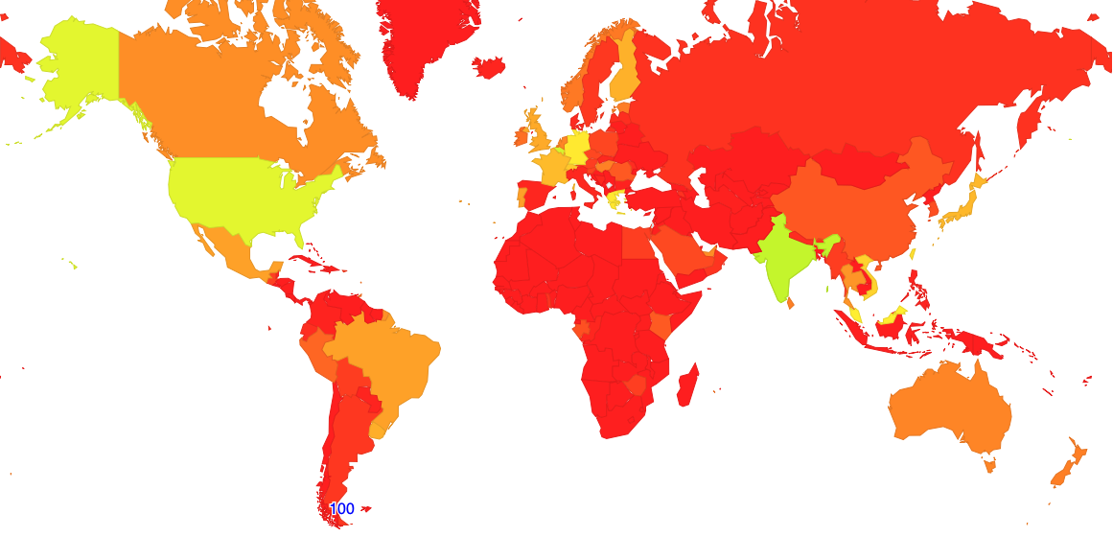
IPv6 - January 2020
Nothing!
All Done!!

Slide 6
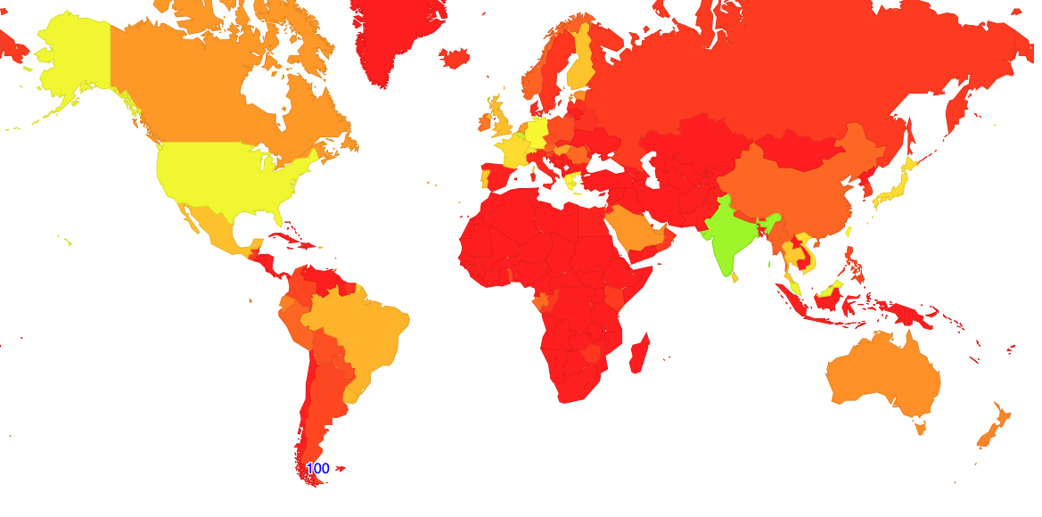
IPv6– January 2021
Nothing!
All Done!!

Slide 7
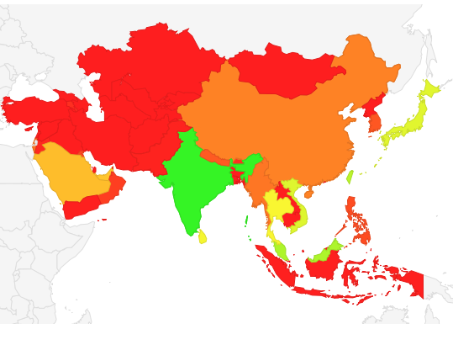
Let’s Focus on Asia…

Slide 8
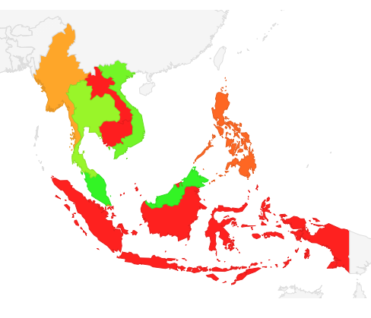
South East Asia

Slide 9
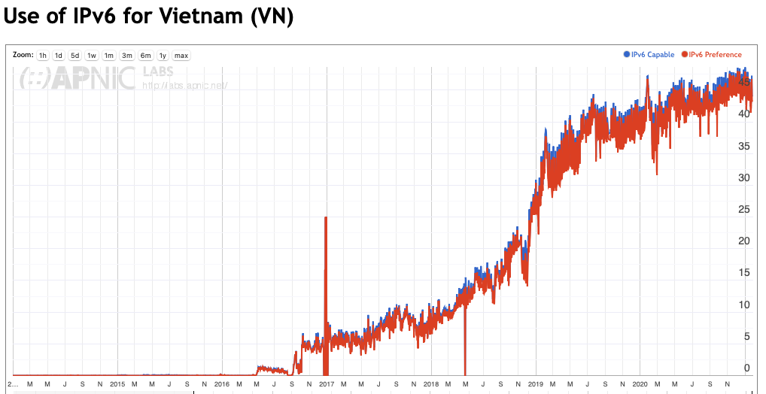
Vietnam
2020
2019

Slide 10
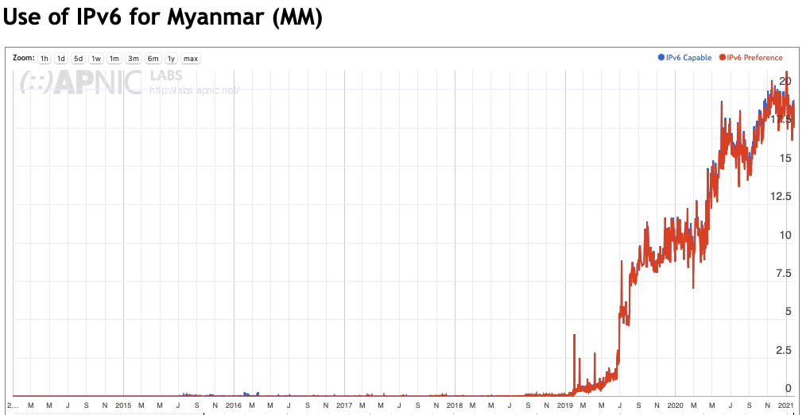
Myanmar
2020
2019

Slide 11
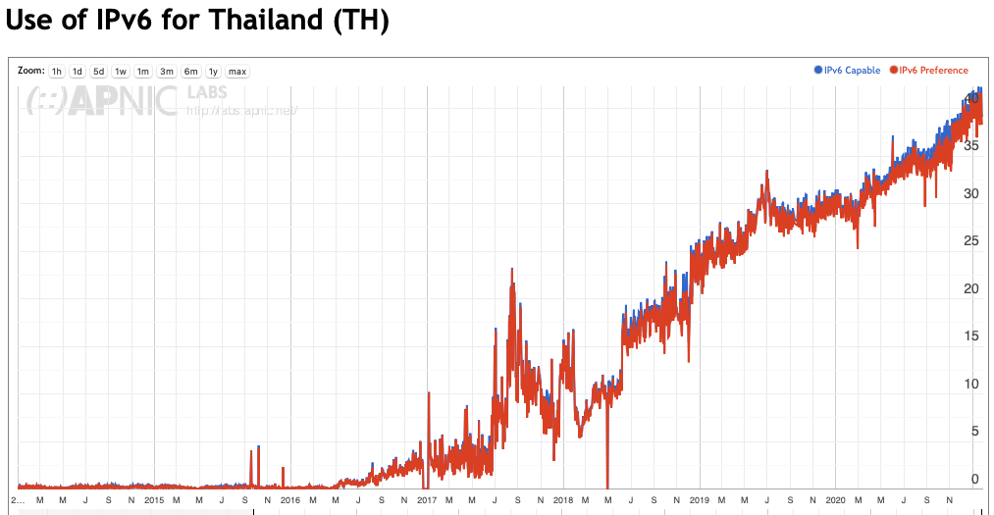
Thailand
2020
2019

Slide 12
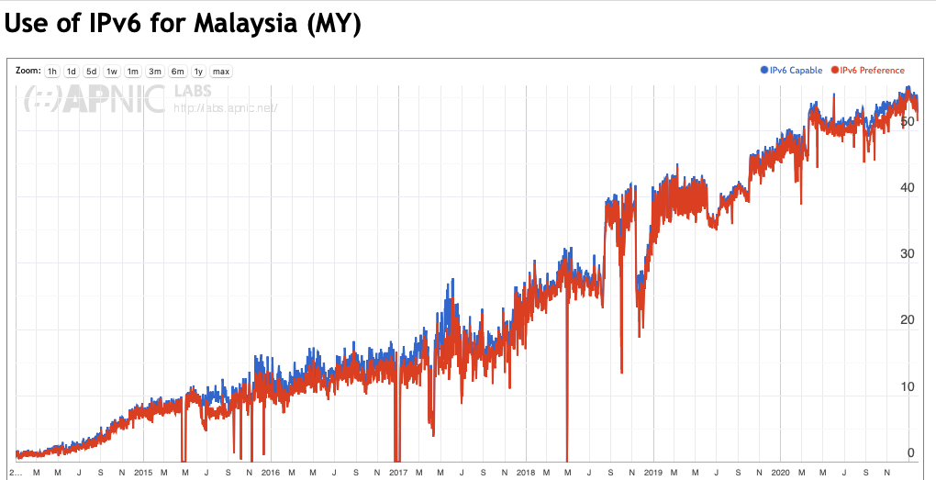
Malaysia
2020
2019

Slide 13
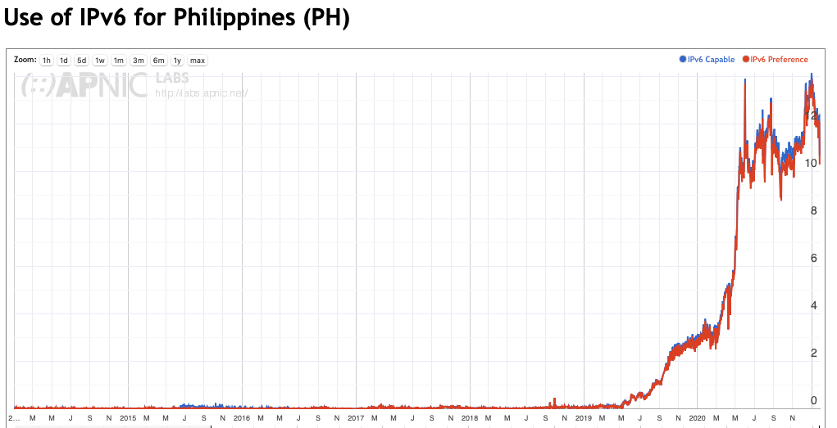
Philippines
2020
2019

Slide 14
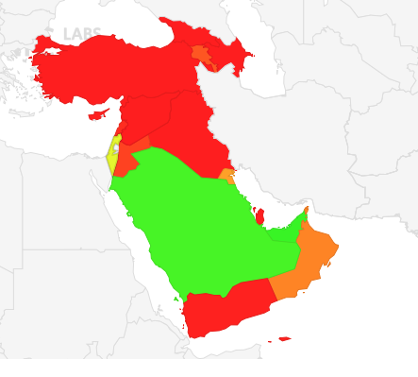
Western Asia / Middle East

Slide 15
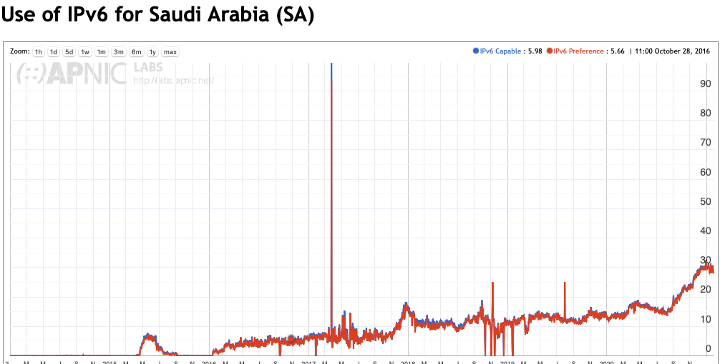
Saudi Arabia
2020
2019

Slide 16
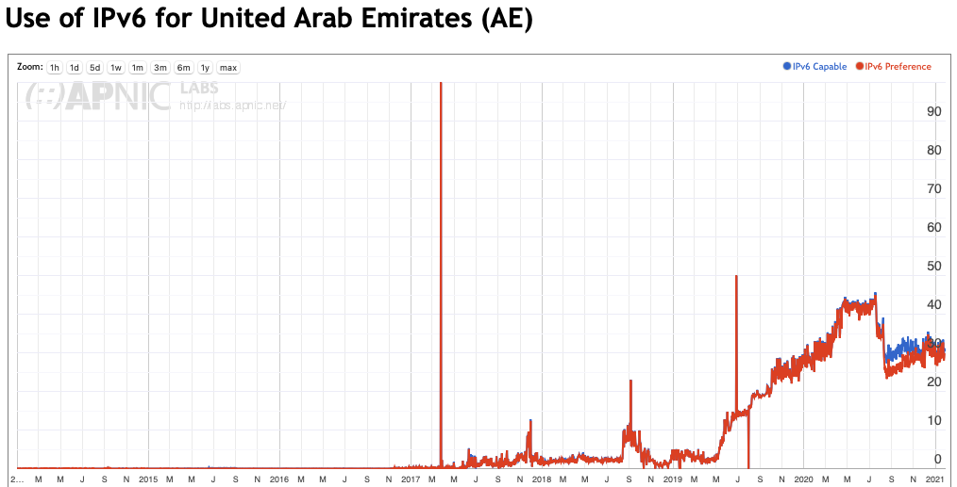
United Arab Emirates
2020
2019

Slide 17
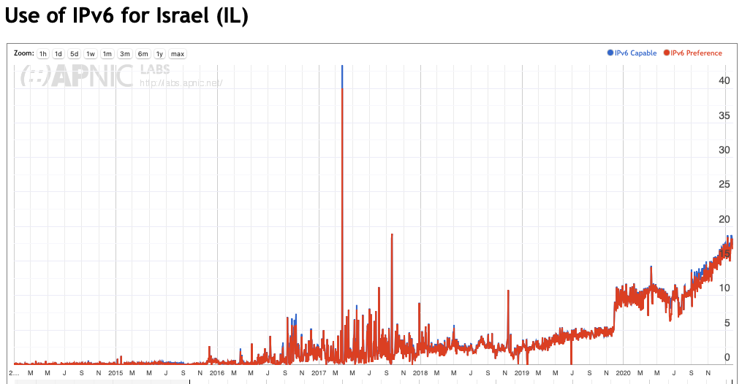
Israel
2020
2019

Slide 18
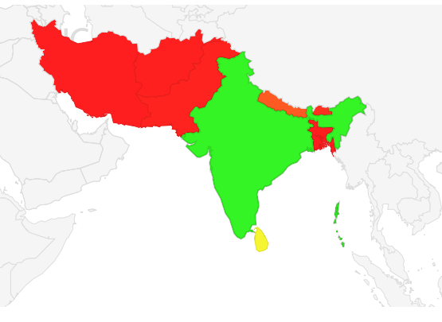
South Asia

Slide 19
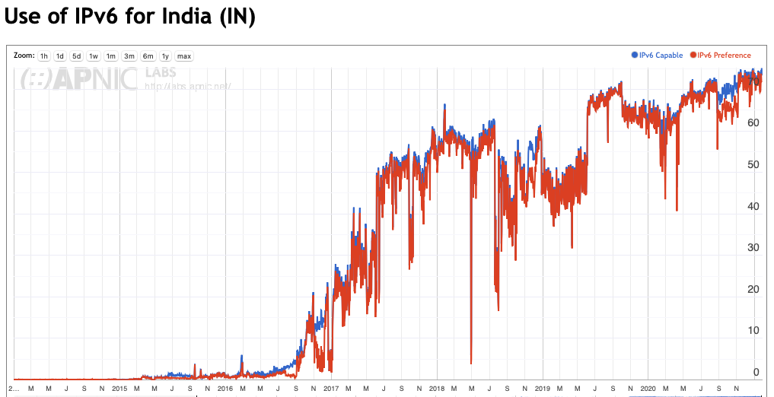
India
2020
2019

Slide 20
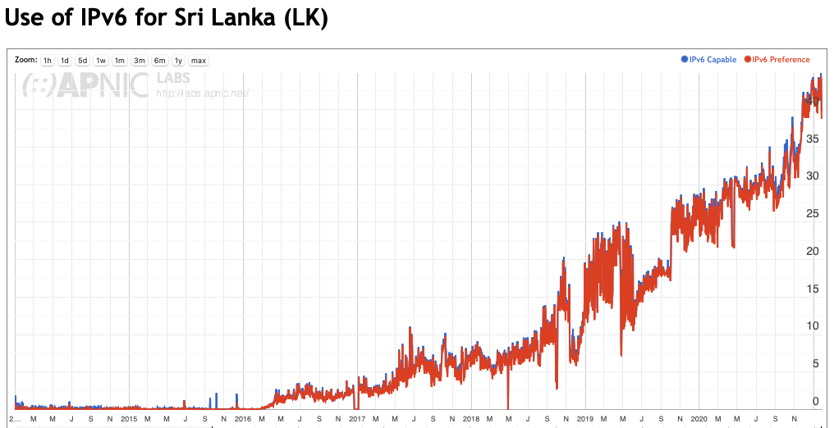
Sri Lanka
2020
2019

Slide 21
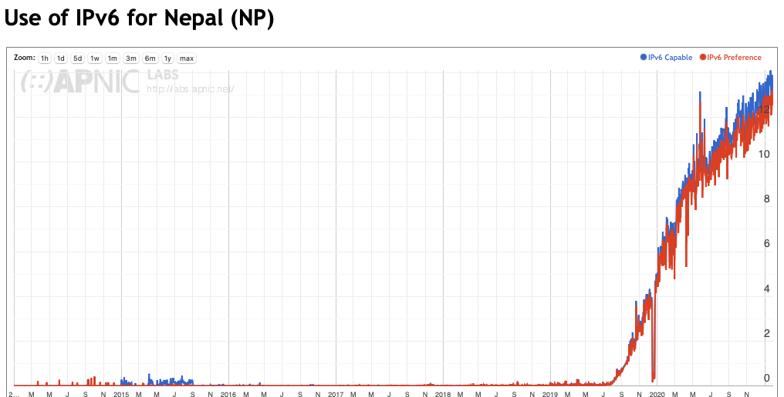
Nepal
2020
2019

Slide 22
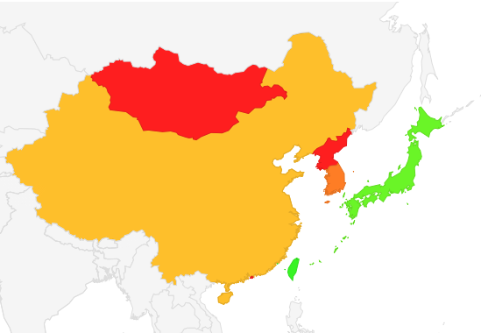
East Asia

Slide 23
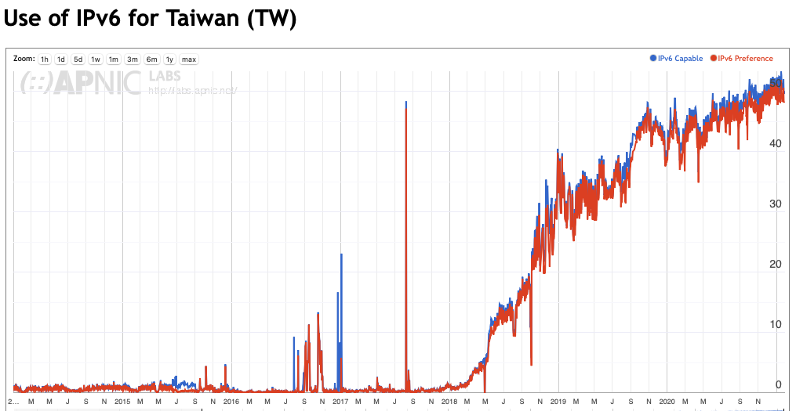
Taiwan
2020
2019

Slide 24
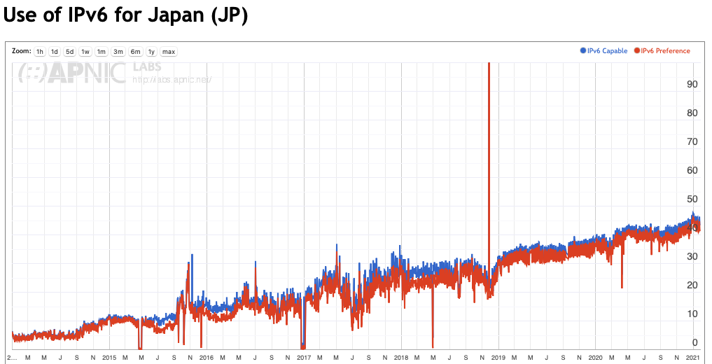
Japan
2020
2019

Slide 25
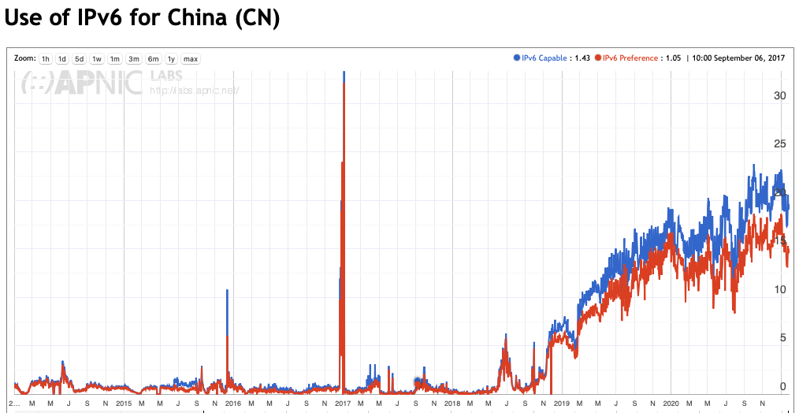
China
2020
2019

Slide 26
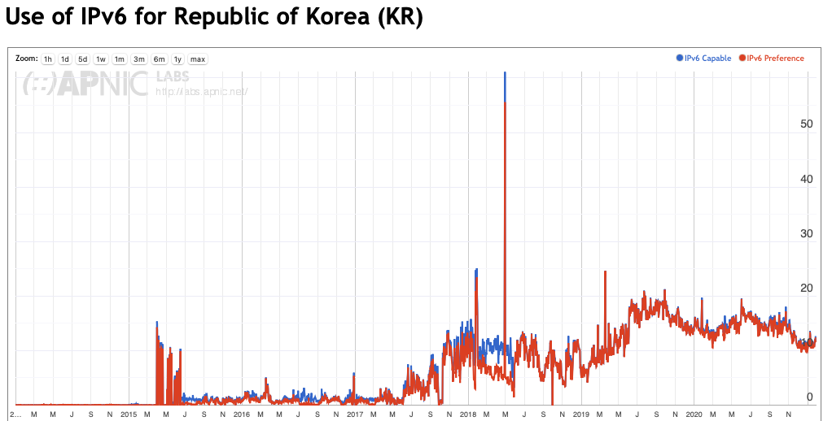
South Korea
2020
2019

Slide 27
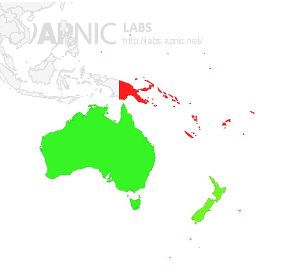
Oceania

Slide 28
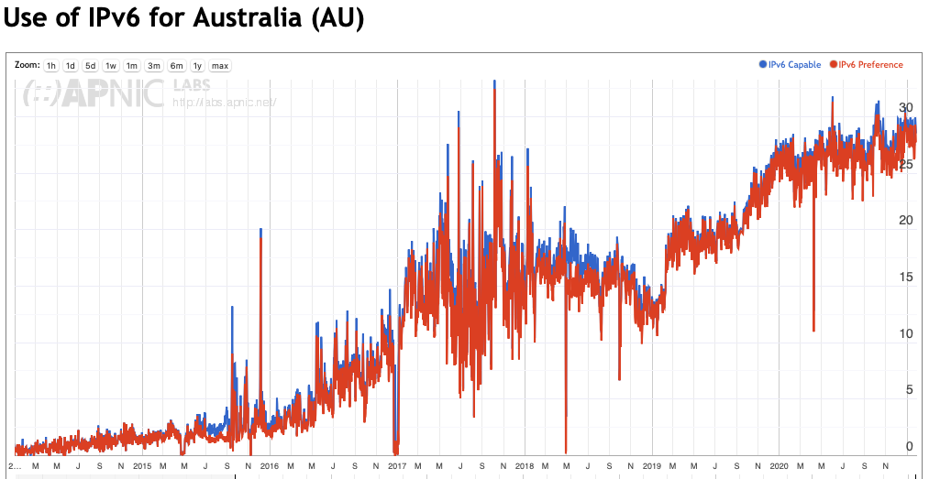
Australia
2020
2019

Slide 29
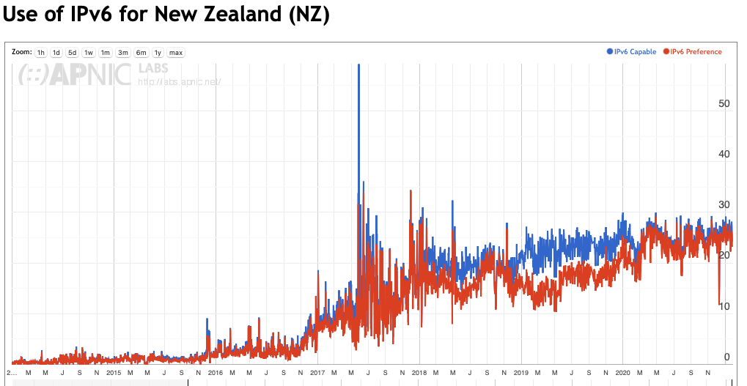
New Zealand
2020
2019

Slide 30
Observations
Global growth of IPv6 is much slower overall in 2020 as compared to 2019
  2019: 6% growth in users (18% to 24%)
  2020: 3% growth in users (24% to 27%)
But, IPv6 growth has not slowed down in 2020 for many Asian economies
Lets now look at some tables…

Slide 31
Greatest 24-Month Deployment Growth
This is the change in the relative IPv6 capability for each economy from the start of 2019 to the start of 2021
It’s the change in % of users within each economy who have IPv6 comparing the start of 2019 to the start of 2021

Slide 32
% IPv6 Growth over the past 24 months
V6 deployment
January 2019
V6 deployment
January 2020
V6 deployment
January 2021

Slide 33
24-month User Growth
Percentages only tell part of the story
We can convert percentages to estimates of IPv6 users per economy
Over the past 24 months some 470M users were connected with IPv6
The bulk of this IPv6 user growth is in India and China, with a further 380M IPv6 users

Slide 34
User Growth – 2019 compared to 2020
Annual IPv6 User Growth 2019
Annual IPv6 User Growth 2020

Slide 35
COVID-19 Impact?
The number of IPv6-enabled users added in 2020 is half that of 2019
  332M added in 2019 and 132M added in 2020
Most regions and economies saw a similar decline in IPv6 growth in user numbers
What does a monthly view of 2020 show?

Slide 36
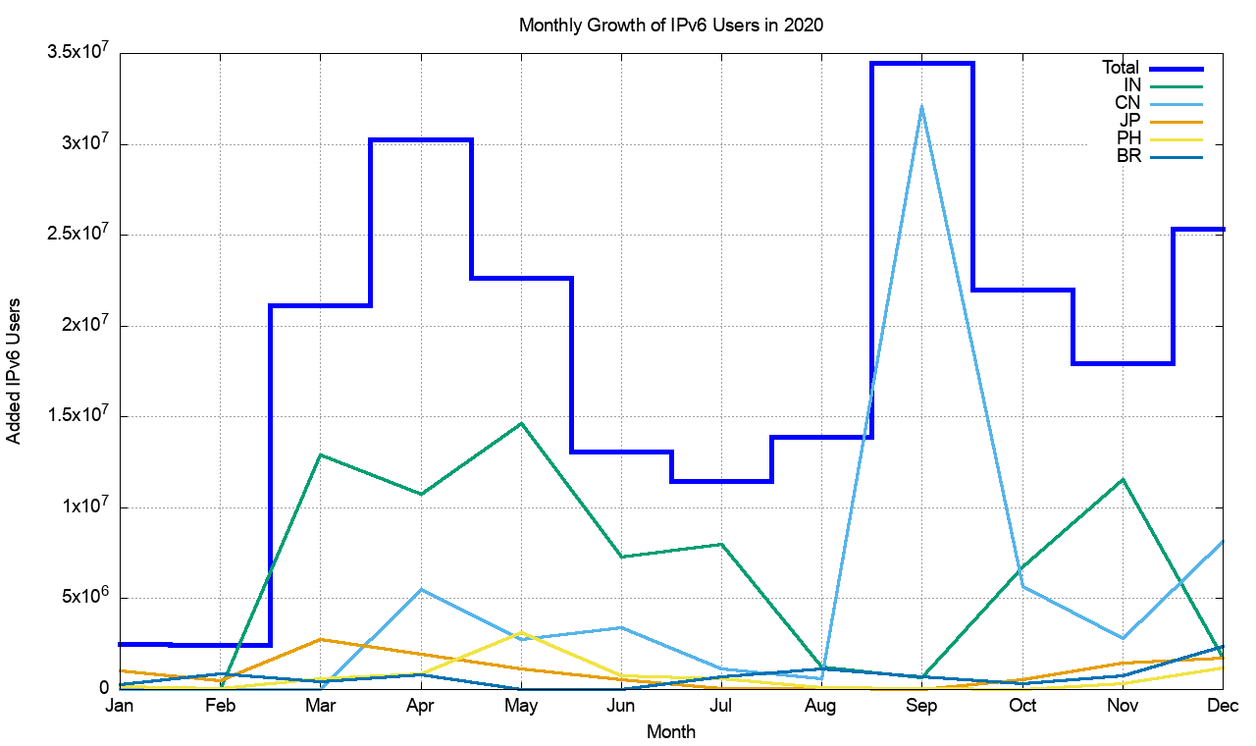
2020 Monthly view of Growth of IPv6 Users
This figure shows the month-by-month growth in IPv6 users – mid-year saw a pause in IPv6 growth for the global Internet which is likely to be related to national COVID-19 lockdowns
For the 5 largest per-economy IPv6 user counts for 2020:
India had a major deployment in March through May and November
China resumed IPv6 deployment in August and September
Brazil appears to have moved in November

Slide 37
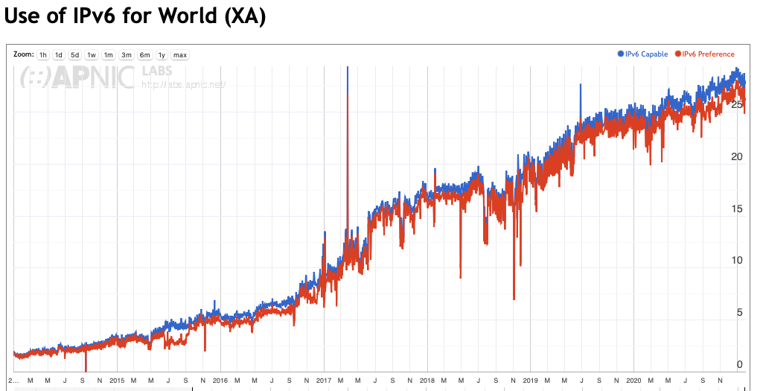
Back to that Bigger Picture…
2020
2019

Slide 38
The Overall Objective
Is not a common Dual Stack Internet
IPv4 Use
IPv6 Use
Dual Stack

Slide 39
The Overall Objective
Is not a common Dual Stack Internet
It’s a common IPv6-only Internet
IPv6 Use
Dual Stack
IPv4 Use

Slide 40
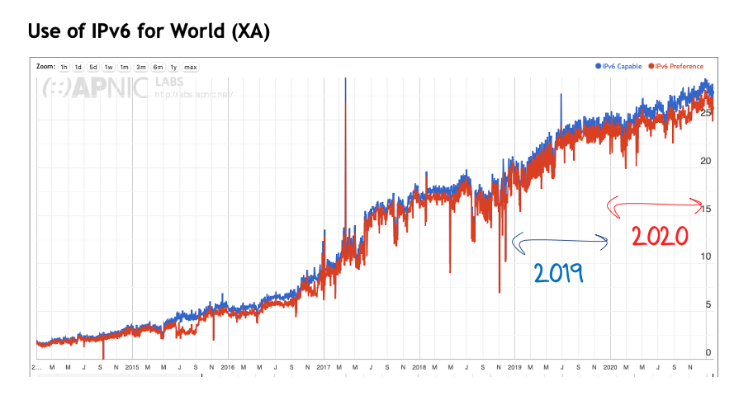
The Overall Objective
Is not a common Dual Stack Internet
It’s a common IPv6-only Internet
IPv6 Use
You are here
Dual Stack
IPv4 Use

Slide 41
Technology Adoption in Inflexion Points
Laggards / Skeptics
Mainstream
Inflexion Point
Market Adoption
Early Adopters /
Risk Takers
Failure
Enthusiasts
Time

Slide 42
The Big Question
If there is an inflexion point in IPv6 adoption, then has it already occurred in 2018 (or earlier)?
Mainstream
Failure

Slide 43
The Big Question
If there is an inflexion point in IPv6 adoption, then has it already occurred in 2018 (or earlier)?
Or are we (still) yet to reach this inflexion point?
Mainstream
Failure

Slide 44
The Big Question
If there is an inflexion point in IPv6 adoption, then has it already occurred in 2018 (or earlier)?
Or are we (still) yet to reach this inflexion point?
Its unlikely that this is a tension between IPv4 and IPv6 any longer – that’s pretty much a done deal
  I suspect that the emerging tension in alternative networking futures lies between destination-based packet forwarding network architectures and name-based architectures that use ephemeral associations with network-level addressing

Slide 45
Thanks!

