Slide 1
It was thirty++ years ago …
On Sunday 23rd June 1989 we commissioned a permanent IP link between the the University of Melbourne and the University of Hawaii, using a 56Kbps satellite link
The Internet had arrived in Australia
Notes:
Thanks indeed having me here today.
It may be known to some here, but let me say that I am not a descendant of the first peoples of this land. I am not a member of a minority group. I’m not a woman and I’m not a new voice – far from it! I’m not sure that it makes any sense that I need to apologise for that, as its simply what I am. But maybe you’re tired of hearing the same old stuff from me and folk like me. So if you want to hop away from the keyboard to get a flattie or a tea then now’s a good time to do so. I promise I won’t be offended in the slightest. I can’t even tell who else shares this grey void with me. I’ll be done in about 15 minutes or so.
I should also say that I’m here as an individual and nothing more. I’m not pretending to speak on behalf of my employer in any way. This is my voice.
I was briefed that "I think the most useful thing would be to hear your thoughts on what are the big issues at the moment. Where you see things heading. It would mean that you'd be speaking on your areas of interest from your perspective, not necessarily trying to channel some sort of universal internet zeitgeist."
Ok. You asked for this. Because where I see things heading is to the bad place. The very bad place.

Slide 2
Over these thirty years…
We seen the inexorable and rise of the Internet weaving its way into the very fabric of our lives:
From bits to megabits to gigabits to terabits
From mainframes, to workstations to desktops to mobile devices
From FTP to WAIS to the Web to apps to Facebook to Fake News
From data to search to streaming to analytics to stalking
And we’ve seen optimism and hope turn to disillusion and distrust
All in just thirty years
Notes:
I spent some time thinking about the burning issues with the Internet both in Australia and more generally, how we got here and what we might want to think about to try and improve the situation.
What we thought was progress has been perverted and twisted and it seems at time that we are emulating Joseph Bazalgette’s great works of the 19 century, except this time we are standing on the wrong side of the pies and we are right under the ever more putrid ever larger sewage outfall. And this time its not just London. It’s pour entire world.
Little wonder that if there is an internet zeitgeist these days its disillusion and distrust.

Slide 3
Why?
The marriage of computing and communications is one of the most prodigious marriages in human history
Its ramifications are so profound and so widespread that it sits alongside industrialisation, printing, metallurgy, and agriculture as a defining stage in human history
Is it because we distrust change?
Or because these changes are so overwhelming and exploitative in nature that we as individuals, as communities and as nations are rendered so impotent?
Notes:
Compared to our somewhat naive expectations about the role of computers and networking in the 1980’s we’ve come a long way down a dark path.
We’ve ended up in rigged elections, fake news, the wholesale destruction of livelihoods and the creation of a new economy based solely on surveillance capitalism.
What went wrong?
Well I’m sure exploring that subject would make a great talk, but there are two problems with that. Firstly I’ve only got a few minutes of your time today and secondly I don’t know why it went so wrong anyway!

Slide 4
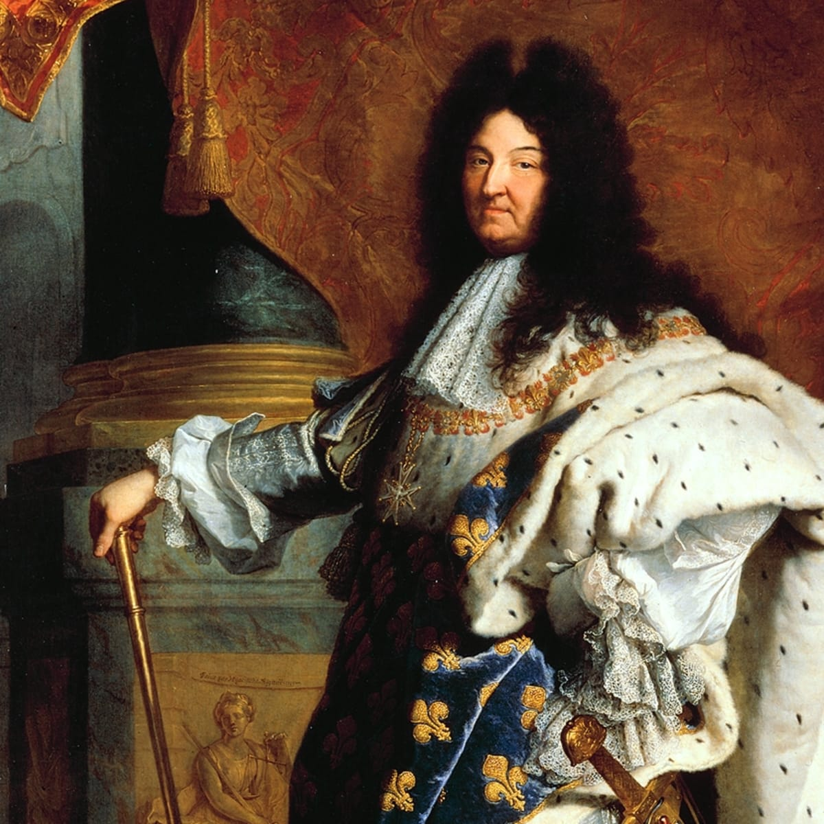
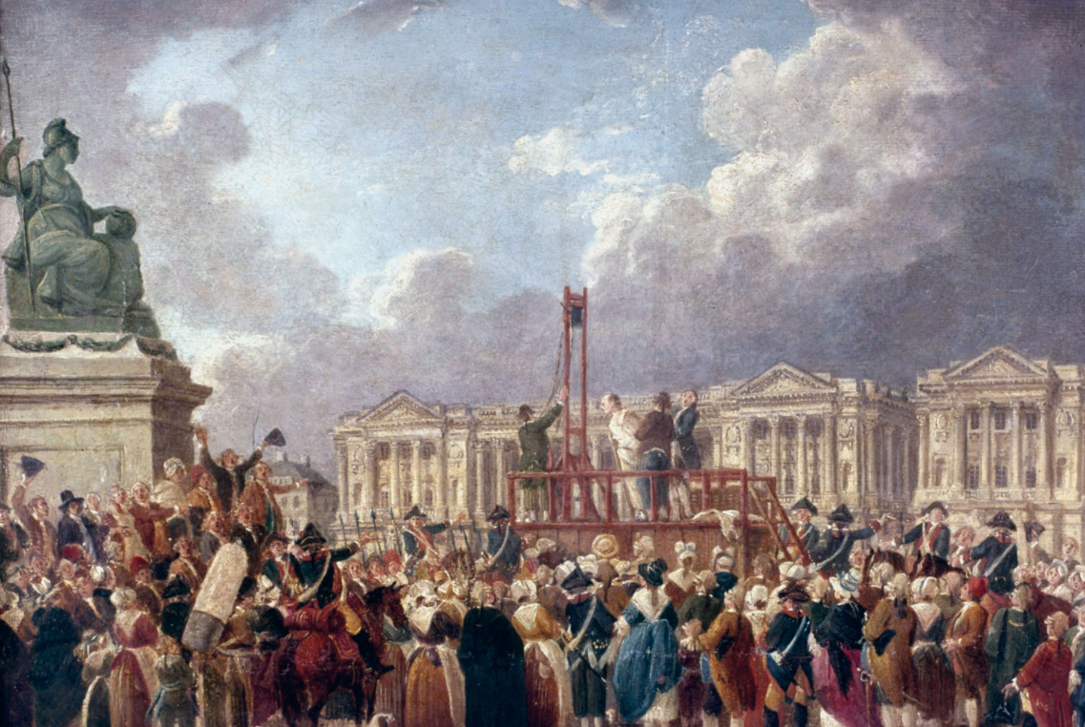
It’s a Full Blown Revolution
Like all the ones we’ve had before
Tyranny
Disquiet
Tyranny
Reign of Terror
Over the barricades!
Notes:
So without truly knowing how it happened we find ourselves trapped in another massive revolution.
So what should I say? Don’t trust that Robespierre guy – He’s going to kill us all. That Napoleon is a despot who will kill everyone whom Robespierre spared? Would this be helpful to you today? I don’t think so!

Slide 5
Revolutions are times of Great Threat
Changing social structures mean incumbents are displaced and social capital and social structures are often upended
Change brings unease, fear and resistance
Social capital and social power changes hands
It’s easy to view revolutions with suspicion and distrust
particularly when many revolutions have been accompanied by a major body count as well!
More so this time when the very foundations of our digital systems are so unbelievably crappy!
Notes:
You see dire warnings about threats are water off a ducks back – no one listens. So we rush headlong into the problem and then wonder why the air smells sulphurous and why the temperature is rising.

Slide 6
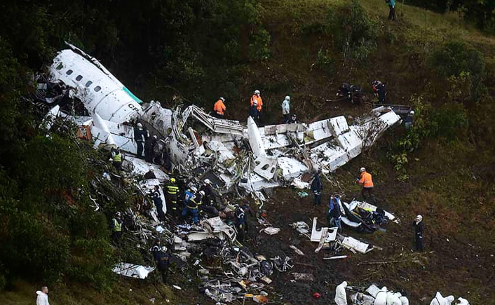
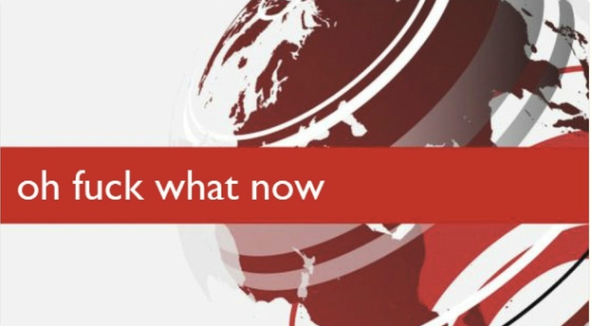
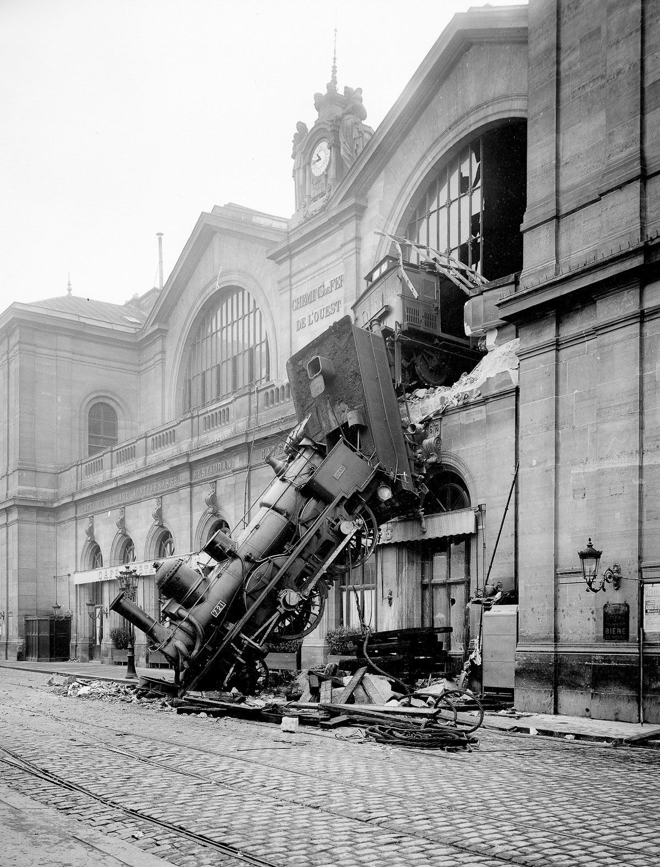
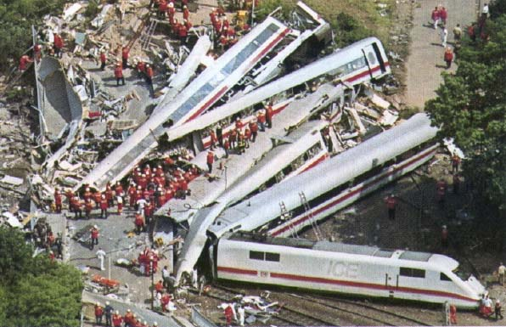
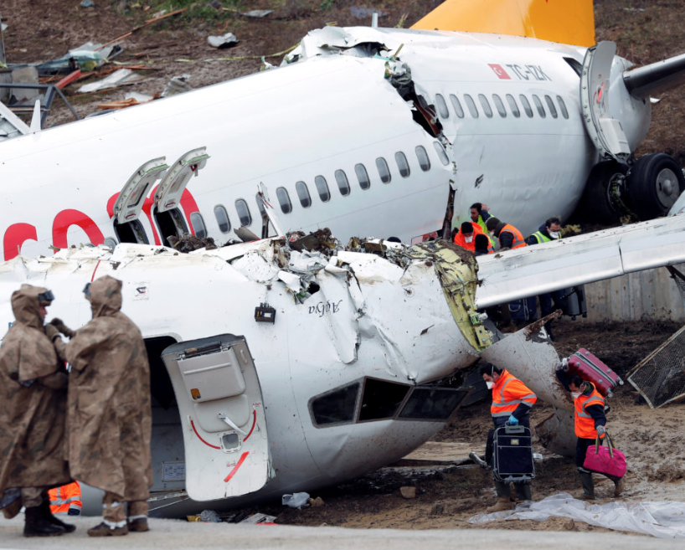
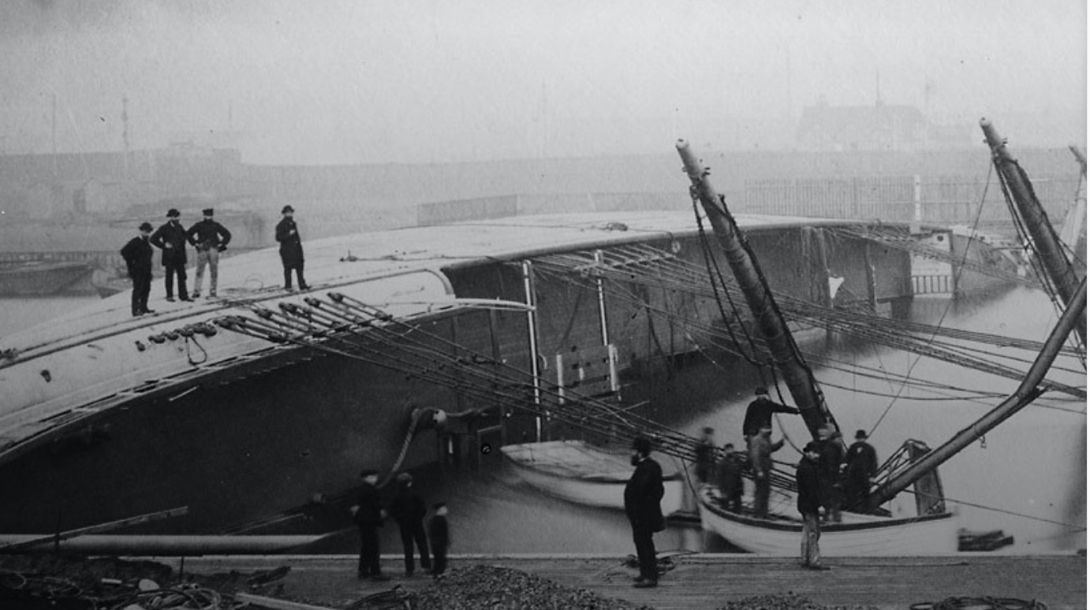
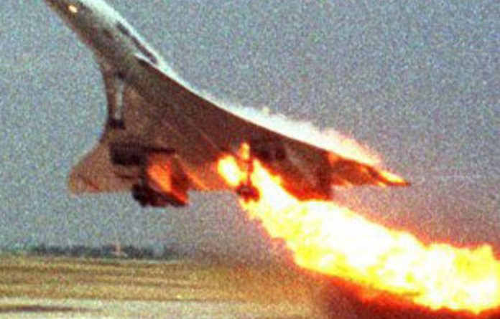
It’s all so broken..
Notes:
What should I say?
I want to say sincerely, “Sorry.”
Seriously, I want to apologise for my small part in this mess we find ourselves in.
Because it's all turned out so horrendously badly, and I think we should’ve been more aware of the risks, even if at the time they may have sounded totally far-fetched.
We said “this is so good everyone should be able to play”. “The Internet is for everyone” and similar. But we never really thought about what we were saying when we proclaimed, “Everyone should be able to do this?” . And now we are asking ourselves “what the hell have we done?”

Slide 7
The Darker Side of Digital Chaos
Social Networking is a rancid festering societal cancer
We build services to dimension to attack, not service
Hacking is now attacking, and hackers are now nation state employees
The Internet’s basic security framework is ineffective against resourced nation state attackers practising unsophisticated digital disruption attacks against totally vulnerable and indefensible digital ecostructure
The Internet is a toxic wasteland that glows in the dark
Notes:
I’m a shocking programmer. And I know I’m not the only one. I’m probably average. We are all shocking programmers. We’re building these massive edifices of mind boggling complexity and then replicate this crappy software in billions of devices
Your car has at least 300 processors. God alone know what’s in the 737 Max 8. Boeing don’t. Or in your fancy digital front door bell.
The KPIs in our industry are best described by the currently oh so fashionable Agile process: Let’s write even crappier code even faster and let’s make more of it!
Noone knows how these systems work any more.
Noone truly understands the dependences any more (if they ever did) and the continual stream of upgrades should give you ample evidence that we are only just bailing as fast as we can to stop the entire ship from sinking!
We spend hundreds of millions of dollars on staffing shiny cyber defence bodies to try and show what a great job we are doing to defend ourselves when in fact the problem is not the folk who are driving the hostile trucks through the open doors. They are just the truck drivers. You can’t blame them for being a truck driver.

Slide 8
It will only get worse
Notes:
The real problem is that it's the people just like me who produced the insanely shitty code in the first place that left all these gaping holes behind them.
Because we are all just not up to the task.
And I don’t know about everybody else, but I am still on the keyboard. Still writing code. Collectively we’ve done an amazing job. The internet is now thoroughly busted!
And its not clear that we can fix that. We can’t make it better.
I’m sorry.

Slide 9
Notes:
We have no desire to build truly secure systems. In the rush to digitise our world of services we are taking extraordinary risks. The term “web security” is the punchline to some demented sick joke because the online world is held together by a level of naive trust that makes all other forms of human credulity look restrained and cautious! Even when we thought about what better security might look like, the response was that we have neither the time nor the money to do a better job. We believe that the consumer is so impatient that milliseconds matter far more than security. We continue to cut corners and build fast shitty code. Maybe we should’ve said ‘no’ and walked away from the keyboard. But we didn’t. Sorry
We thought we were helping people to communicate - as after all communications is what drives the human experience. We knew that if you change how we communicate you change the nature of human societies. We knew that. But we didn’t take that message to heart. None of us envisioned the perversion of that nobly motivated ambition into the sewerage of twitter and the incessant deluge of waste products from the facebook factory. We only appreciate the role of content mediators when we eliminated them from the planet. Its not pretty. We choose to only listen to what we agree with. The Internet has become a vanity reinforcing gigantic distorted tictoc selfie. I’m sorry I help it to happen.

Slide 10
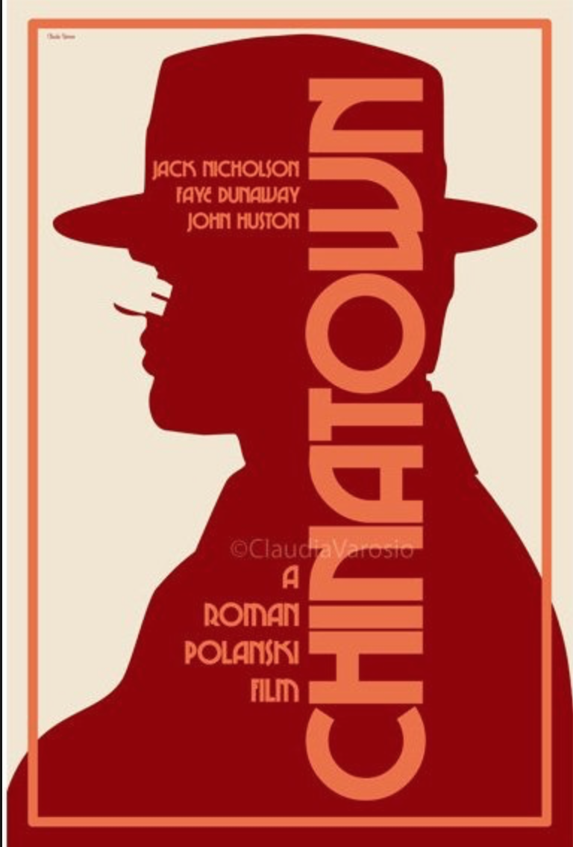
The Internet’s Future
Gittes: How much are you worth? Cross: I've no idea. How much do you want? Gittes: I just want to know what you're worth. Over ten million? Cross: Oh my, yes! Gittes: Why are you doing it? How much better can
you eat? What can you buy that you
can't already afford? Cross: The future, Mr. Gittes - the future!
Chinatown (1974)
Notes:
We built this new world so quickly that we outpaced everything else. There are no controls, no regulation, no competition. In the rush to be the first to unleash the ruthless forms of surveillance capitalism on an unsuspecting populace we’ve bypassed all the conventional forms of care and restraint. Just seven digital digital giants dominate our world. Their unstinting efforts to lobby politicians has turn the political process into a fatally corrupted empty shell. We moved too quickly and no-one else kept up. We wrote our own rules and rule number 1 was “Just do it.”. From Uber to Google the word was disruption. Destruction of the old world business environment wasn’t the worst thing we’ve done. Far worse is that we privatised the public communications space. We turned our culture and our public discourse into private property. We’ve privatised our intellectual achievements. Who owns antibiotics? Who owns my genome? Who owns my personal profile? We turned everything into a transaction. We destroyed our libraries and replaced them with search. We replaced journalism with twitter. Our world is no longer a collection of public spaces, but a collection of private enclosures.
And now its not just the present that has been usurped, but the future is now also being captured.
I helped to build that. I’m sorry.

Slide 11
If you want to sleep tonight …
Then I suggest that you try to forget about all of the following:
Digital Privacy and Anonymity
Web Security
Encryption
Quantum Computing
AI
Advertising Models
Digital Markets and subsidies
Cyber Warfare
IOT
(Any kind of) Security
Ubiquitous Crap Software
Monopolies
A corrupted political sector driven completely by lobby interests
An eviscerated Public Sector
Climate Change
COVID-19
Notes:
I suppose an opening talk, assuming that anyone remembers it (which is dubious) is meant to provide some helpful suggestions, offer some motivation, or provide the comfort that our voices matter and we can change our world for the better. But I feel that I’ve already betrayed you thirty years ago. The glittering prizes that this new technology was going to offer us were always tawdry, corrupted and debased. And I did not appreciate that. I thought that technology would be a compelling force for good. I was wrong. I’m truly sorry.
So I think I’ve given up the right to offer suggestions - they're probably wrong anyway. I have nothing to sell and not much to motivate you or me. But If you’ll indulge me I do have one closing observation

Slide 12
Wherever we’re heading…
It’s not the Internet any more
That has already died and gone to silicon heaven!
Notes:
The task before us right now is not to make it better – that's way too ambitious - but simply to come to terms with what we’ve already done!
Sorry
And for those you who stepped out for a hot beverage of your choice for the last 15 minutes, welcome back!

