Slide 1
APNIC’s Engagement on Security
Geoff Huston
Chief Scientist, APNIC

Slide 2
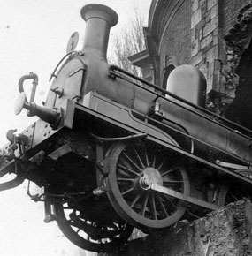
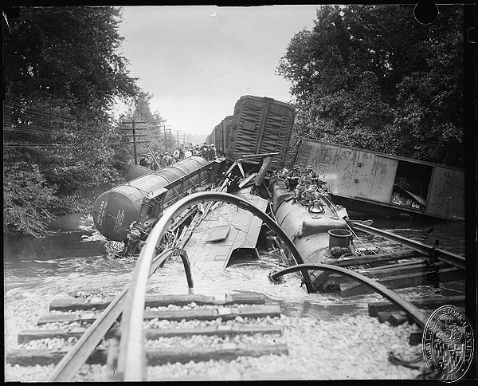
Even simple machinery can fail in epic ways!

Slide 3
With more complex machinery…
We can confidently anticipate even more epic forms of failure

Slide 4
Our Shared Vulnerability
Many aspects of our society now rests upon digital foundations:
Government
Infrastructure
Finance
Health
Food
Water
If we undermine the integrity and security of these digital foundations then we expose ourselves to very serious risks

Slide 5
A Toxic Internet
What kind of world have we built when millions of webcam baby monitors can be orchestrated to perform a terabit attack on the domain name infrastructure on the US eastern seaboard, and disrupt the lives of millions of people for an afternoon?

Slide 6
What are we doing about it?

Slide 7
APNIC’s Security Stance
APNIC’s vision is for a global, open, stable, and secure Internet that serves the entire Asia Pacific community.

Slide 8
Our Surveys
We regularly survey our members and stakeholders regarding their views of current challenges
Security is now the highest rated challenge (it used to be IPv6)

Slide 9
APNIC Survey 2018
Q9. Thinking about your Internet-related services, products or activities, what are the MAIN operational challenges facing your organisation?
Consistent with focus group feedback, network security is the number one challenge facing the community in 2018
 | East Asia | Oceania | SE Asia | South Asia | LDEs | Developing | Developed
Network security | 28% | 34% | 22% | 26% | 28% | 25% | 31%
Scarcity of IPv4 addresses | 13% | 9% | 14% | 14% | 11% | 13% | 12%
Cost of network operations | 10% | 14% | 17% | 11% | 13% | 13% | 11%
Hiring and / or keeping skilled employees | 12% | 12% | 13% | 10% | 8% | 11% | 16%
Deployment of IPv6 | 9% | 8% | 8% | 17% | 16% | 10% | 7%
Management of bandwidth and network capacity | 9% | 9% | 9% | 8% | 7% | 9% | 8%
Keeping up with the pace of technology changes | 10% | 5% | 7% | 6% | 5% | 9% | 4%
Regulatory requirements involving the Internet | 4% | 6% | 4% | 3% | 4% | 4% | 5%
Benchmarking and understanding best practice in network operations | 4% | 2% | 3% | 3% | 3% | 4% | 3%
Access to reliable and credible Internet industry data | 3% | 1% | 4% | 3% | 4% | 2% | 2%
Other | 0% | 1% | 0% | 0% | 0% | 0% | 1%

Slide 10
APNIC Survey 2018
Q10. Thinking about network security, what are the MAIN challenges facing your organisation?
Q11. How might APNIC best assist you or others with network security challenges?
10

Slide 11
What we do in this area
Sharing global security best practice information with APNIC Members and building regional security capacity through training and technical assistance
Working with the NIRs to ensure accuracy of registry
Ongoing consistency checks to historical NIR block assignments
RDAP and Whois alignment
Point of Contact validation
Supporting the creation of CERT/CSIRTs in the Asia Pacific to strengthen the community’s ability to mitigate security incidents
Coordinating with the Asia Pacific security community, including the law enforcement community, to enhance mutual understanding and share views from the numbers community.

Slide 12
Infrastructure Security
This is perhaps the most critical common vulnerability in the Internet
If an attacker can successfully undermine the integrity of the routed address space and the integrity of the name space then the attacker does not have to target individual hosts or systems, as the entire network is exposed

Slide 13
Infrastructure Security
How can we improve the name and address infrastructure of the Internet to mitigate the continual stream of routing anomalies and name hijacks?
Some collection of cryptographic mechanisms appears to offer the most promise, by allowing all BGP speakers and DNS resolvers the ability to distinguish a genuine artefact from an artifice intended to mislead and misdirect

Slide 14
Securing the Address Space and Routing
Some 15 years ago APNIC designed a secure framework that allows testable attestations about addresses and their uses – this is today’s RPKI
We’ve been working with other RIRs, the IETF, the Internet Society and other stakeholders to encourage the use of this RPKI as a the central tool to support address and routing integrity
We continue to work in the IETF for viable approaches to integrate this RPKI into the inter-domain routing system

Slide 15
Securing the DNS
We are supporting the effort to deploy DNSSEC validation across the resolution space
We are using measurement platforms to inform the community what is happening with DNSSEC deployment, and encouraging service operators to switch on DNSSEC validation
We have encouraged DNS resolver vendors to integrate DNS features that make the DNS more resilient against attack and reduce the fragility of the current WebPKI CA system

Slide 16
We are doing what we can here
But its probably not enough when thinking about the scope of the security issues confronting us
There is no magic solution in our visible future, so we don’t expect this topic to go away anytime soon
While there is no ‘silver bullet’ to make all this just go away, we are doing what we can, and working with others, to make incremental improvements in the area, to make abuse and attack more challenging for bad actors

