Slide 1
Are we there yet?
Measuring iPv6 in 2016
Geoff Huston
APNIC

Slide 2
A question to each of you…

Slide 3

A question to each of you…
How many IPv6 presentations have you sat through?

Slide 4
A question to each of you…
How many IPv6 presentations have you sat through?
20?
100?
1,000?
I really don’t know!

Slide 5
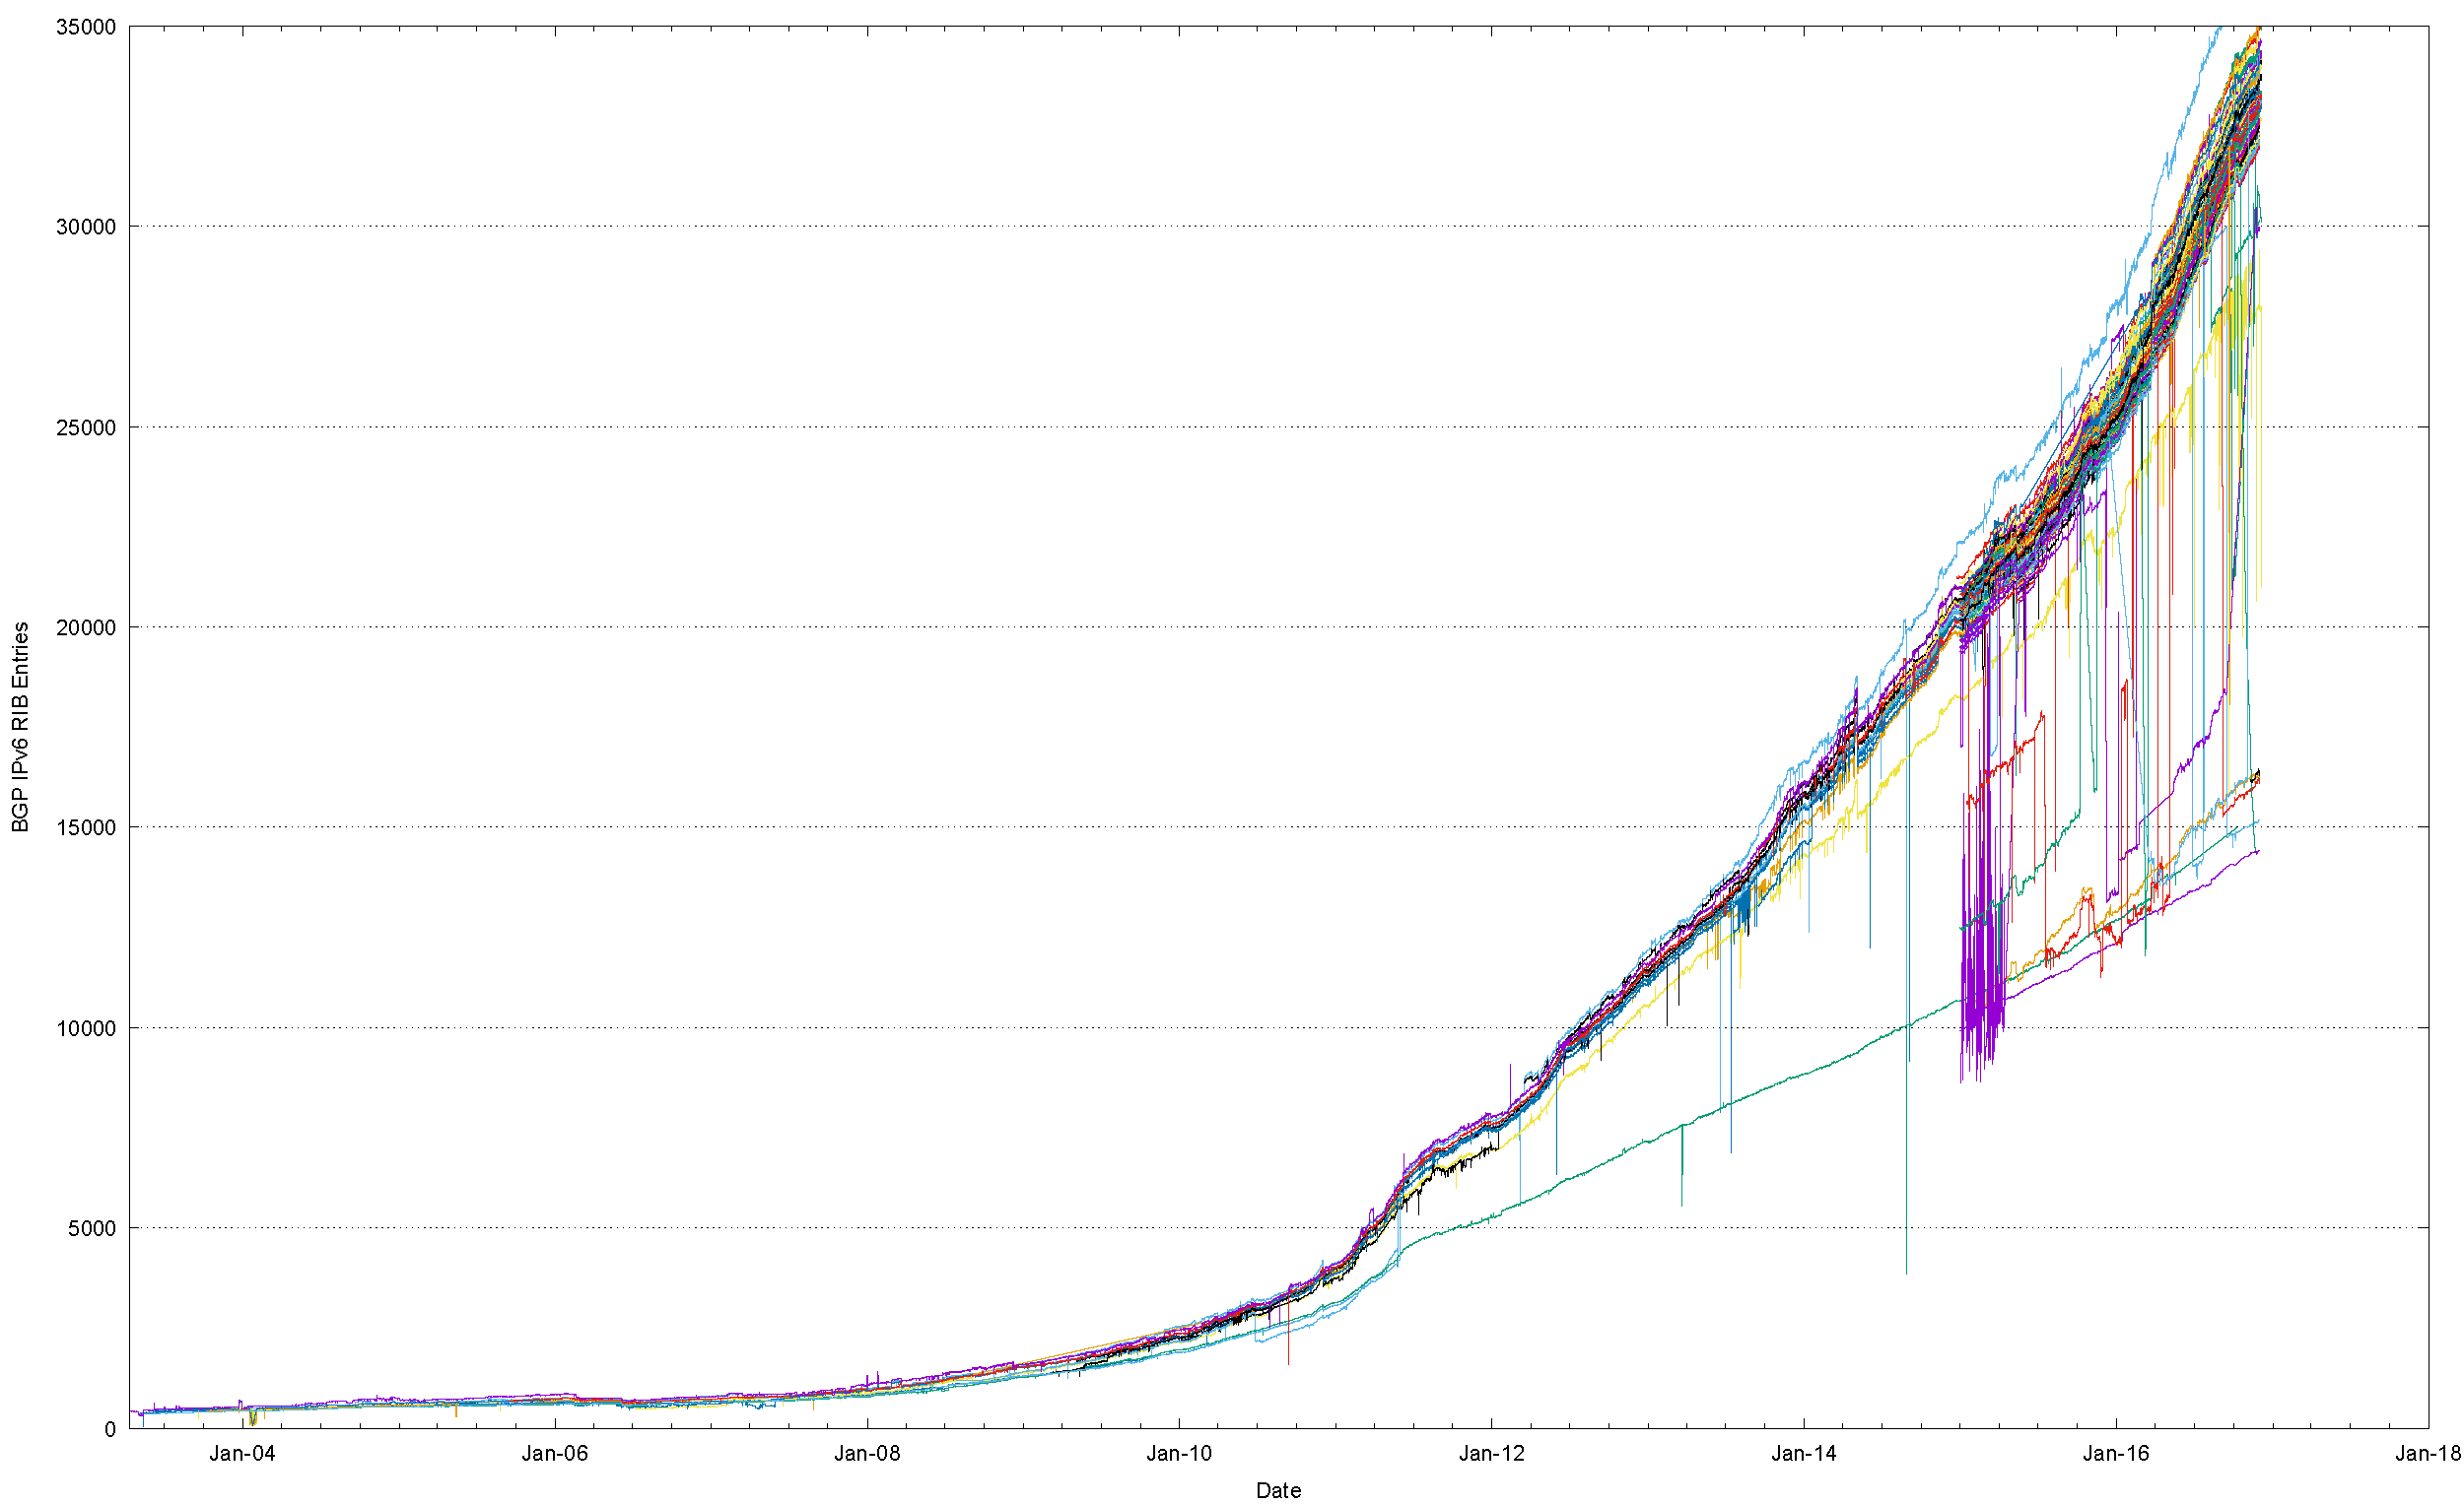
Measuring IPv6
How can we “measure” the uptake of IPv6?
  BGP: Network Deployment numbers
ARIN IPv4 Exhaustion
LACNICIPv4 Exhaustion
RIPE NCC IPv4 Exhaustion
APNIC IPv4 Exhaustion
IANA IPv4 Exhaustion

Slide 6
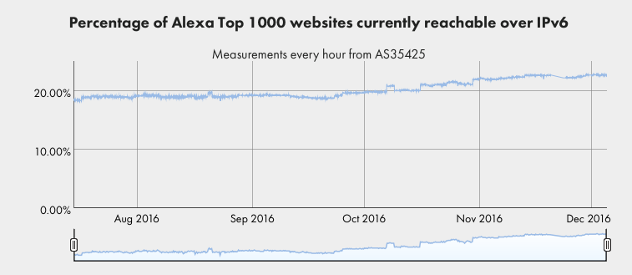
Measuring IPv6
How can we “measure” the uptake of IPv6?
  Alexa Lists: Dual Stack services
ISOC 360 Deploy Pages

Slide 7
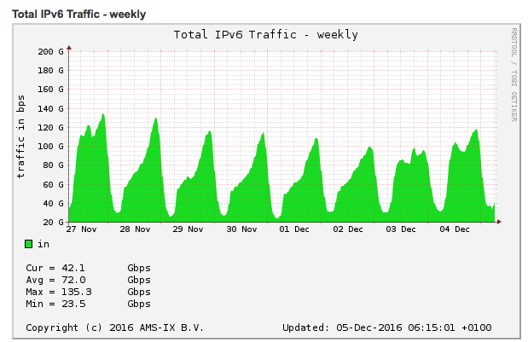
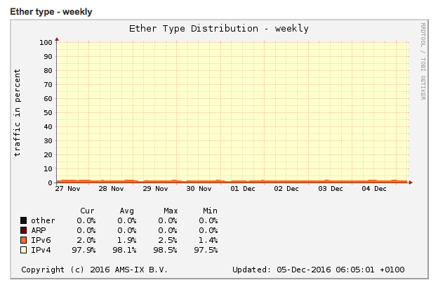
Measuring IPv6
How can we “measure” the uptake of IPv6?
  IX stats: IPv6 traffic stats
AMSIX Traffic Statistics

Slide 8
Measuring IPv6
How can we “measure” the uptake of IPv6?
  End User Capability: APNIC measurements

Slide 9
APNIC’s Measurement Technique
Embed a test script in an online ad
Have the script generate a set of URLs to fetch
  Each script uses unique names to avoid caching distortion
Direct all the DNS and the HTTP traffic to a set of measurement servers
Examine the traffic profile seen at the server

Slide 10

How We Measure
We use an online ad to present a sequence of small fetches to the user’s browser

Slide 11
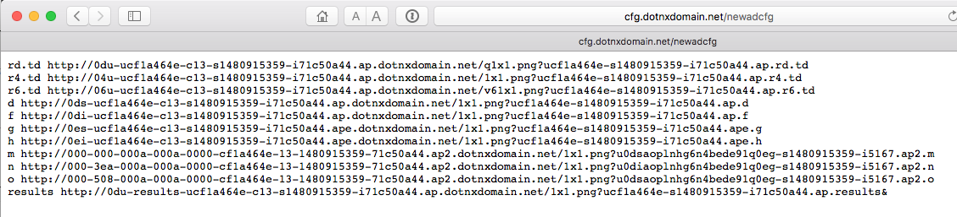
How We Measure
The sequence of tests is used to test a number of types of actions including fetches of IPv4,
IPv6 and Dual stack

Slide 12
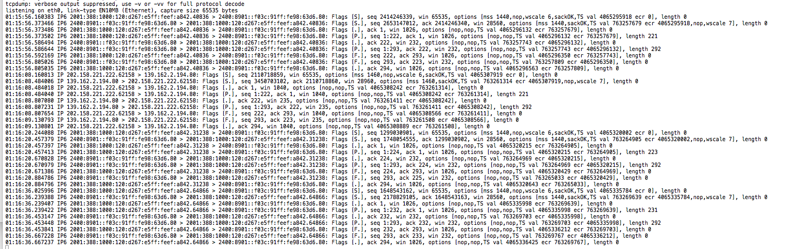
How We Measure
We use full packet capture to record all packet activity at the experiment’s servers

Slide 13
How Much do We Measure?
5M sample points per day

Slide 14
Where are we today?
Originally we thought that the Internet would avoid complete IPv4 exhaustion and adopt IPv6 while there was still some IPv4 left in the unallocated address pools

Slide 15
Where are we today?
Originally we thought that the Internet would avoid complete IPv4 exhaustion and adopt IPv6 while there was still some IPv4 left in the unallocated address pools
This has not happened!

Slide 16
Where are we today?
Originally we thought that the Internet would avoid complete IPv4 exhaustion and adopt IPv6 while there was still some IPv4 left in the unallocated address pools
Then we thought that the reality of IPv4 exhaustion would prompt all service providers to accelerate their IPv6 deployment plans
This has not happened!

Slide 17
Where are we today?
Originally we thought that the Internet would avoid complete IPv4 exhaustion and adopt IPv6 while there was still some IPv4 left in the unallocated address pools
Then we thought that the reality of IPv4 exhaustion would prompt all service providers to accelerate their IPv6 deployment plans
This has not happened!
  This appears to be happening in some areas with some providers

Slide 18
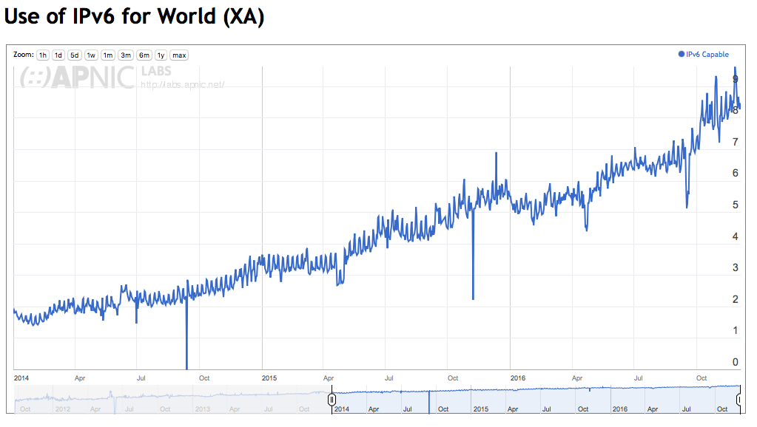
Global Use of IPv6
Internet-wide use of IPv6 is around 8% today

Slide 19
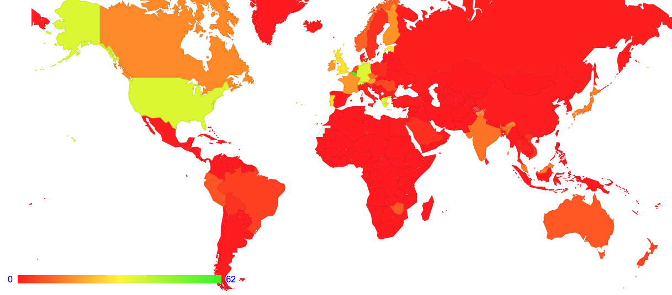
Where are IPv6 Users?

Slide 20
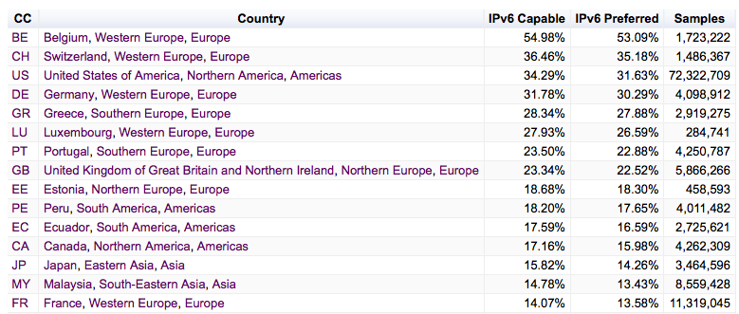
Where are IPv6 Users?

Slide 21
Where are IPv6 Users?

Slide 22
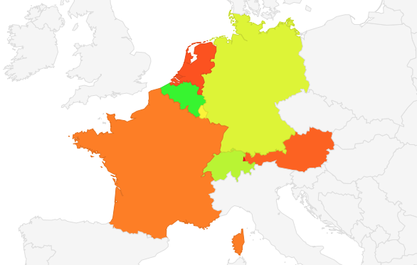
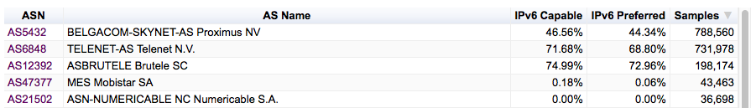
Belgium

Slide 23
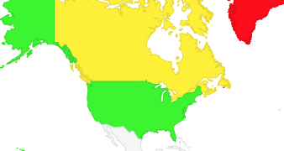
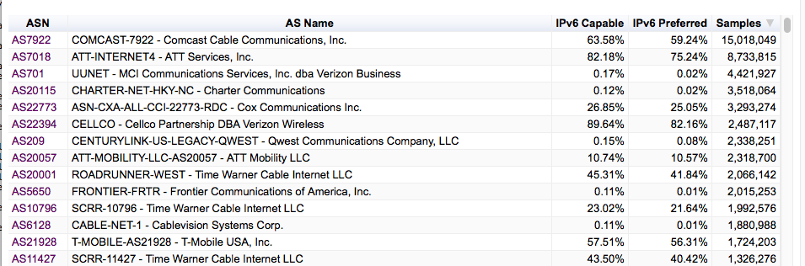
United States

Slide 24
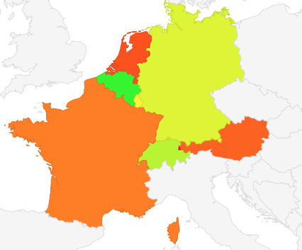
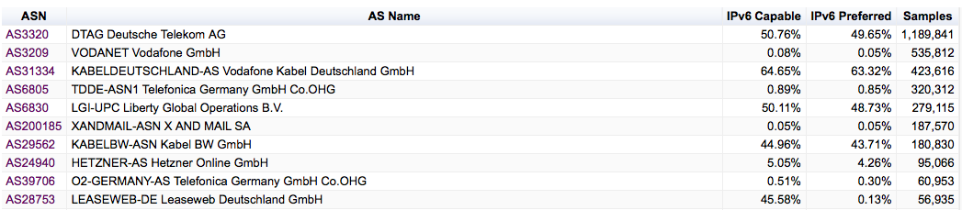
Germany

Slide 25
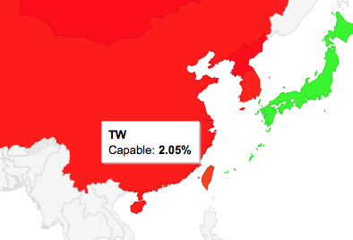
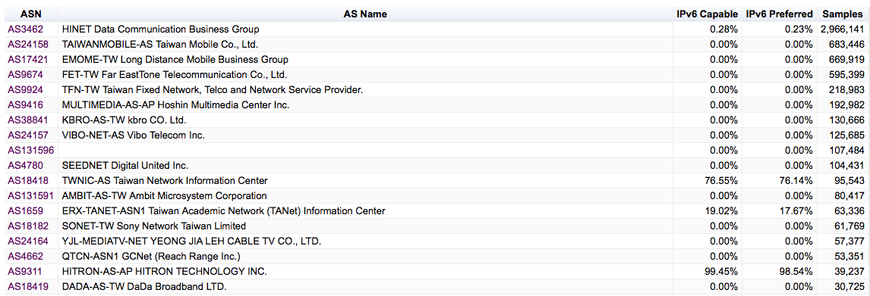
Taiwan

Slide 26
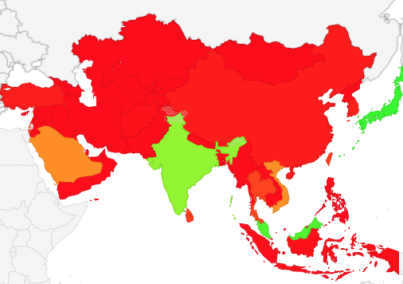
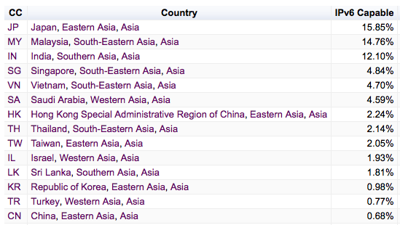
Asia

Slide 27
What are we seeing?
IPv6 deployment is not happening everywhere.
IPv6 is not happening all at once.
But it IS happening.

Slide 28
But..
We still hear that many ISPs think that IPv6 is slow and reliable, and they are waiting for the situation to improve
So lets look at IPv6 performance

Slide 29
What are we looking at when we say “IPv6 Performance”?
How “reliable” are IPv6 connections?
How “fast” are IPv6 connections?

Slide 30
What are we looking at when we say “IPv6 Performance”?
How “reliable” are IPv6 connections?
How “fast” are IPv6 connections?
Do all TCP connection attempts succeed?
Is V6 slower than V4?

Slide 31
What are we looking at:
How “reliable” are IPv6 connections?
How “fast” are IPv6 connections?
Do all TCP connection attempts succeed?
Is V6 slower than V4?

Slide 32
What we see: Connection Failure
Outbound SYN
client
server
Busted SYN ACK
Return path
What the server sees is an incoming SYN, but no matching incoming ACK

Slide 33
IPv4 Connection Failure
Missing PCAP data

Slide 34
IPv4 Failures
IPv4 failures are around 1 in 500 connection attempts
How does IPv6 compare?

Slide 35
Daily IPv6 Failures

Slide 36
Daily IPv6 Failures
6to4 is highly unreliable!

Slide 37
Daily IPv6 Failures
Unicast IPv6 shows moderate reliability

Slide 38
IPv6 Failures
1 in 70 connection failure for unicast V6 is still unacceptable!
  IPv4 has a comparable 1 in 500 failure rate
Why is this happening in IPv6?
  Auto-tunnelling?
  Lousy CPE firmware?
  Strange firewall filters?
  Asymmetric routing

Slide 39
Is IPv6 failure uniformly distributed?

Slide 40
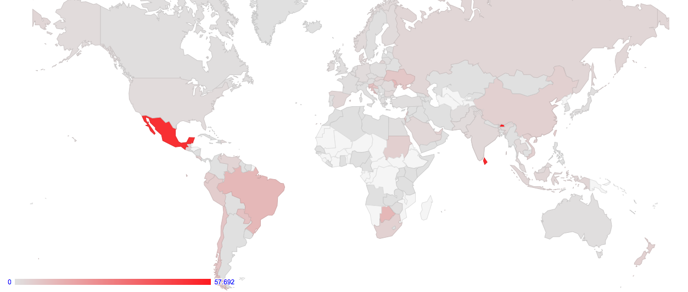
Is IPv6 failure uniformly distributed?

Slide 41
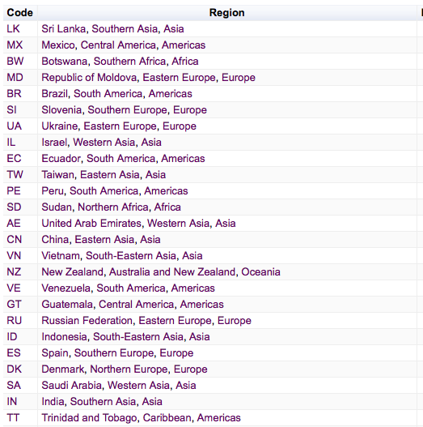
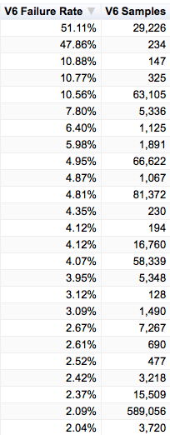
Failure by Country

Slide 42
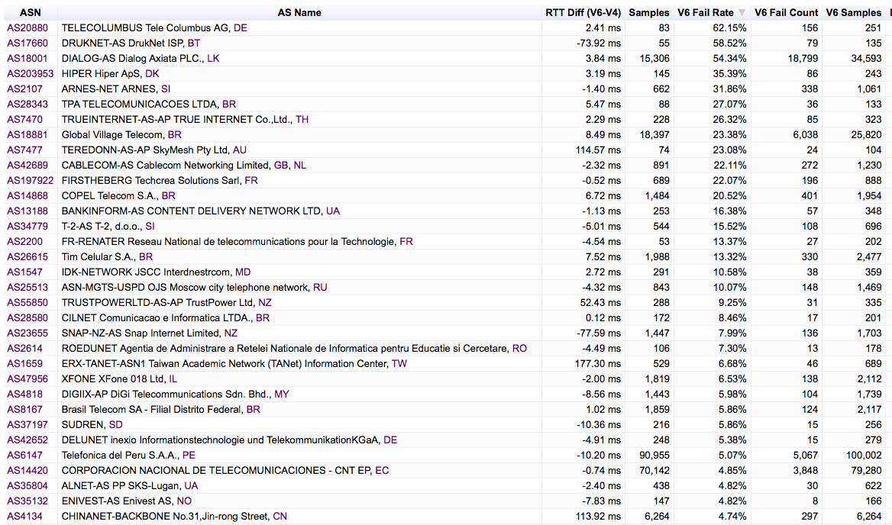
Failure by Network

Slide 43
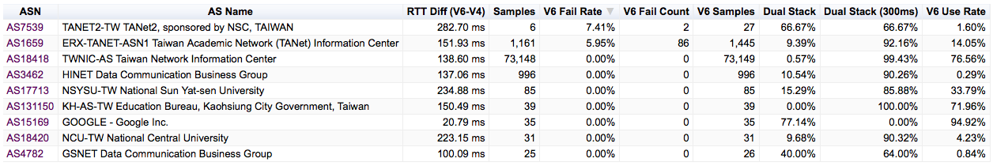
The view of Taiwan

Slide 44
A cautionary note
These are “single shot” measurements rather than sustained repeated test, so there is some noise component here
Its also likely that connection failure is related to consumer equipment rather than network-level failure, as a network level failure would conventionally give a failure rate closer to 100% than ~10%

Slide 45
What are we looking at:
How “reliable” are IPv6 connections?
How “fast” are IPv6 connections?
Do all TCP connection attempts succeed?
Is V6 slower than V4?

Slide 46
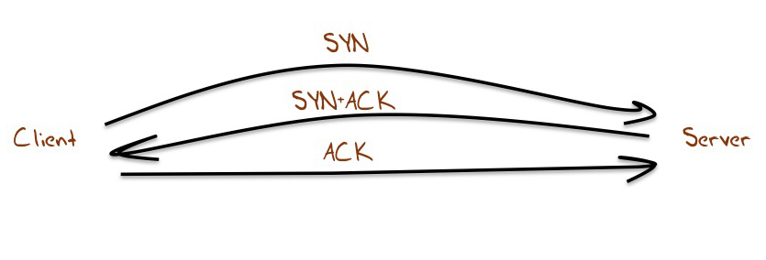
Let’s look at TCP SYNs
1 RTT interval

Slide 47
Why SYNs?
Every TCP session starts with a SYN handshake
Its typically a kernel level operation, which means that there is little in the way of application level interaction with the SYN exchange
On the downside there is only a single sample point per measurement

Slide 48
Generating a comparative RTT profile
For each successful connection couplet (IPv4 and IPv4) from the same endpoint, gather the pair of RTT measurements from the SYN-ACK exchanges
  Use the server’s web logs to associate a couplet of IPv4 and IPv6 addresses
  Use the packet dumps to collect RTT information from the SYN-ACK Exchange
  Use IPv6 RTT – IPv4 RTT as the metric

Slide 49
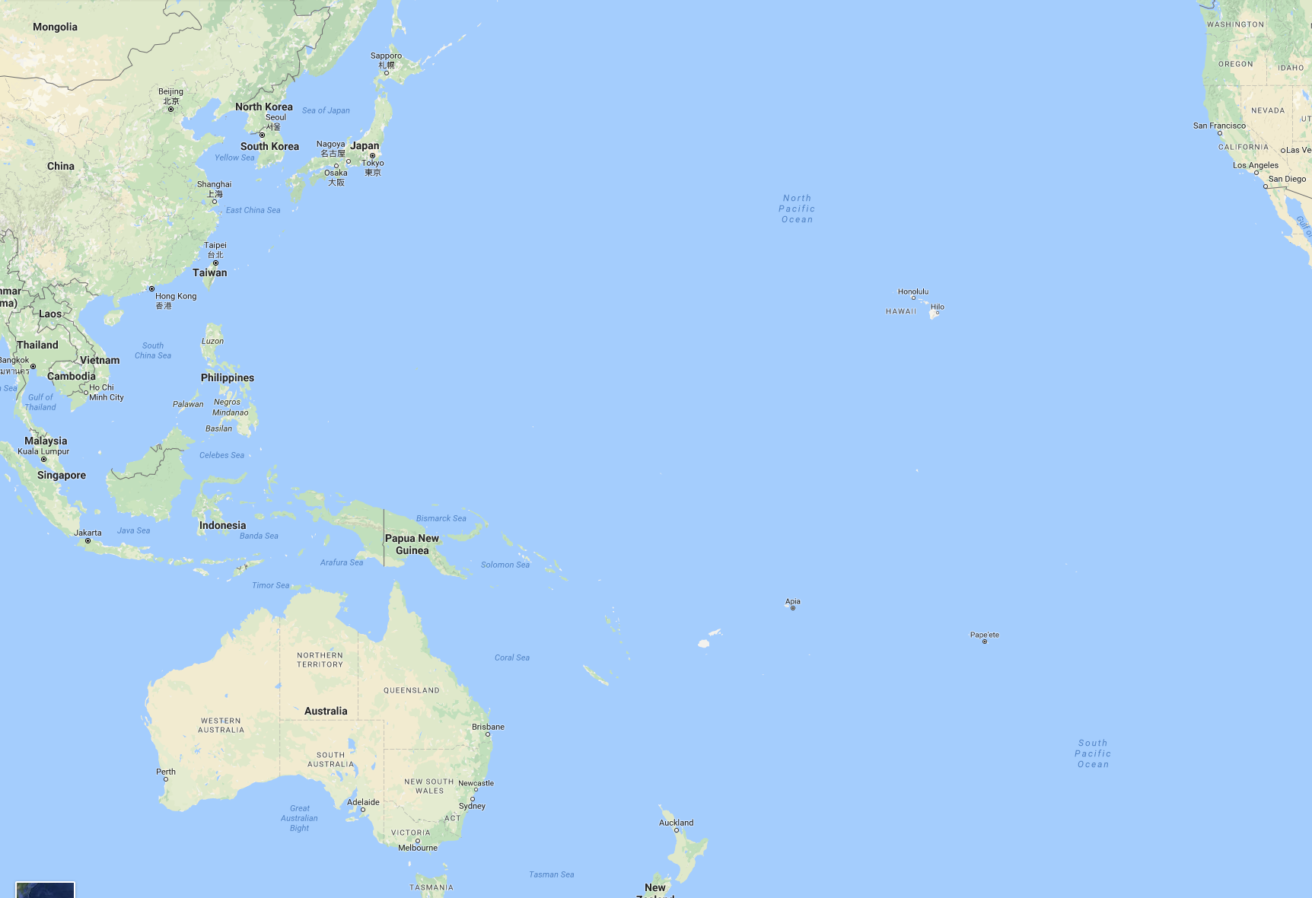
An Example of Path Divergence
$ traceroute from Singapore to Canberra, IPv4
traceroute to 202.158.xxxx.yyy, 30 hops max, 60 byte packets
1 103.3.60.3 0.672ms 0.796ms 0.899ms
2 139.162.0.9 0.754ms 0.708ms 0.732ms
3 te0-1-0-21.br03.sin02.pccwbtn.net 1.697ms 0.760ms 0.726ms
4 ntt.fe3-18.br01.sin02.pccwbtn.net 69.526ms 69.644ms 69.754ms
5 ae-10.r20.sngpsi05.sg.bb.gin.ntt.net 60.702ms 68.474ms 68.469ms
6 ae-8.r22.snjsca04.us.bb.gin.ntt.net 168.447ms 168.532ms 168.138ms
7 ae-19.r01.snjsca04.us.bb.gin.ntt.net 167.489ms 170.665ms 178.832ms
8 xe-0-8-0-21.r01.snjsca04.us.ce.gin.ntt.net 330.084ms 323.556ms 329.772ms
9 xe-1-0-1.pe1.msct.nsw.aarnet.net.au 330.020ms 323.738ms 334.474ms
10 et-3-3-0.pe1.rsby.nsw.aarnet.net.au 327.788ms 334.157ms 328.199ms
11 138.44.161.6 323.644ms 319.455ms 323.563ms
12 202.158.xxx.yyy 319.885ms 333.933ms 325.014ms
$ traceroute from Canberra to Singapore, IPv4
traceroute to 139.162.xxx.yyy, 64 hops max, 52 byte packets
1 202.158.x.y 0.682ms 0.388ms 0.313ms
2 xe-5-0-4-205.pe1.actn.act.aarnet.net.a 0.721ms 0.828ms 0.674ms
3 et-0-3-0.pe1.rsby.nsw.aarnet.net.au 4.548ms 4.733ms 4.533ms
4 et-7-1-0.pe1.brwy.nsw.aarnet.net.au 4.734ms 5.418ms 4.745ms
5 et-0-3-0.pe1.bkvl.nsw.aarnet.net.au 5.117ms 5.512ms 5.524ms
6 xe-0-0-0.bb1.b.sea.aarnet.net.au 148.017ms 148.019ms 148.131ms
7 ge3-0.cr02.sea01.pccwbtn.net (206.81.80.13) 148.469ms 148.059ms 148.429ms
8 tenge0-2-0-14.br03.sin02.pccwbtn.net 319.435ms 325.053ms 319.117ms
9 tenge0-2-0-15.br03.sin02.pccwbtn.net 319.257ms 332.560ms 323.415ms
10 linode.te0-1-0-21.br03.sin02.pccwbtn.net 323.723ms 323.627ms 323.587ms
11 139.162.aaa.bbb 334.609ms 347.243ms 347.220ms
12 139.162.xxx.yyy 325.186ms 338.209ms 325.603ms
IPv4

Slide 50
An Example of Path Divergence
$ traceroute from Singapore to Canberra, IPv6
traceroute6 to 2001:388:1000:110:e4d:e9ff:x:y, 30 hops max, 80 byte packets
1 2400:8901::5287:89ff:fe40:9fc1 0.897ms 0.912ms 1.051ms
2 2400:8901:1111::1 0.851ms 0.827ms 0.792ms
3 2001:cb0:2102:2:f::1 0.364ms 0.333ms 0.516ms
4 2001:cb0:2102:2:f::1 0.502ms 0.461ms 0.431ms
5 2001:cb0:21f0:1:17::2 2.512ms 2.176ms 3.445ms
6 2001:cb0:21f0:1:17::2 2.354ms 2.382ms 1.238ms
7 10gigabitethernet3-5.core1.sin1.he.net 1.080ms 1.034ms 1.020ms
8 10ge1-5.core1.tyo1.he.net 88.053ms
10ge1-16.core1.hkg1.he.net 39.369ms
10ge1-5.core1.tyo1.he.net 88.084ms
9 10ge1-5.core1.tyo1.he.net 88.157ms
100ge8-1.core1.sea1.he.net 192.408ms 192.642ms
10 100ge8-1.core1.sea1.he.net 192.631ms 192.608ms 196.154ms
11 xe-1-0-1.pe2.brwy.nsw.aarnet.net.au 214.176ms 186.238ms 213.061ms
12 et-3-1-0.pe1.brwy.nsw.aarnet.net.au 211.298ms 211.300ms 214.200ms
13 et-1-1-0.pe1.rsby.nsw.aarnet.net.au 211.492ms 211.359ms 211.427ms
14 et-0-3-0.pe1.actn.act.aarnet.net.au 213.332ms 211.458ms 211.476ms
15 2001:388:1000:110:e4d:e9ff:x.y 213.274ms 213.199ms 213.169ms
$ traceroute from Canberra to Singapore, IPv6
traceroute6 to 2400:8901::f03c:91ff:a:b) 64 hops max, 12 byte packets
1 2001:388:1000:110::x:y 0.808ms 0.899ms 1.586ms
2 xe-5-0-4-205.pe1.actn.act.aarnet.net.au 1.633ms 0.646ms 0.578ms
3 et-0-1-0.pe1.dksn.act.aarnet.net.au 0.682ms 0.649ms 0.694ms
4 et-5-3-0.pe1.crlt.vic.aarnet.net.au 8.072ms 8.086ms 8.049ms
5 et-5-1-0.pe1.wmlb.vic.aarnet.net.au 8.116ms 8.055ms 8.073ms
6 et-0-3-0.pe1.adel.sa.aarnet.net.au 17.790ms 16.984ms 17.036ms
7 et-1-1-0.pe1.prka.sa.aarnet.net.au 17.080ms 17.152ms
et-0-3-0.pe1.eper.wa.aarnet.net.au 43.319ms
8 et-0-3-0.pe1.knsg.wa.aarnet.net.au 43.357ms 43.443ms 43.353ms
9 gigabitethernet-5-1-0.bb1.b.per.aarnet.net.au 43.849ms 43.919ms 43.850ms
10 so-0-0-0.bb1.a.sin.aarnet.net.au 92.219ms 92.275ms 92.189ms
11 as6939.singapore.megaport.com 212.347ms 212.426ms 212.471ms
12 * * *
13 2400:8901:1110::2 213.924ms 213.904ms 213.717ms
14 2400:8901::f03c:91ff:a:b 213.954ms 213.393ms 213.726ms
IPv4 – IPv6

Slide 51
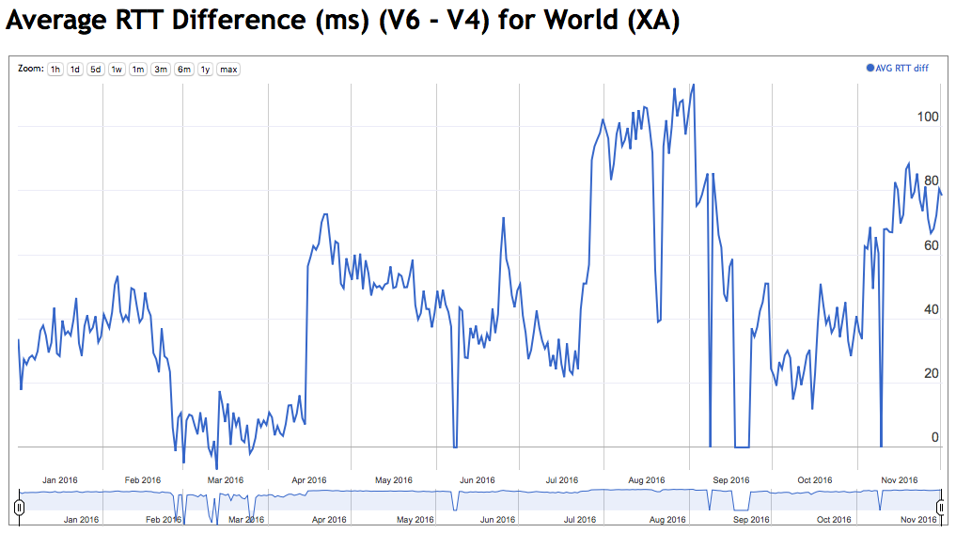
Global Results
On average IPv6 is showing 10 – 20ms slower that IPv4

Slide 52
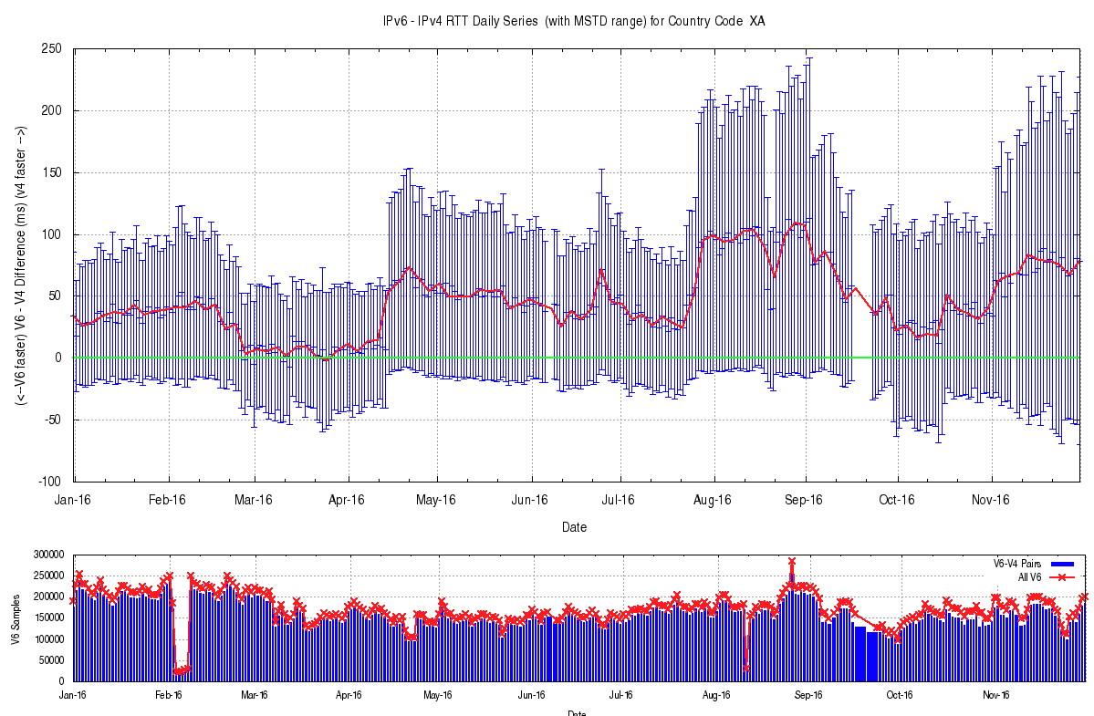
Global Results
Mean Standard Deviation per day of these measurements
Number of sample points per day

Slide 53
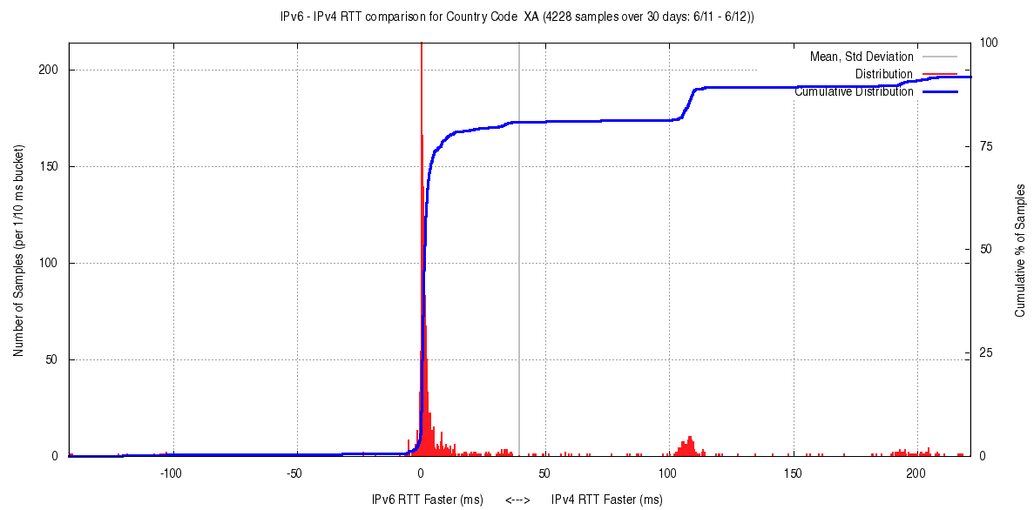
Relative RTT Distribution
60 day average
IPv6 Faster (ms)
IPv4 Faster (ms)

Slide 54
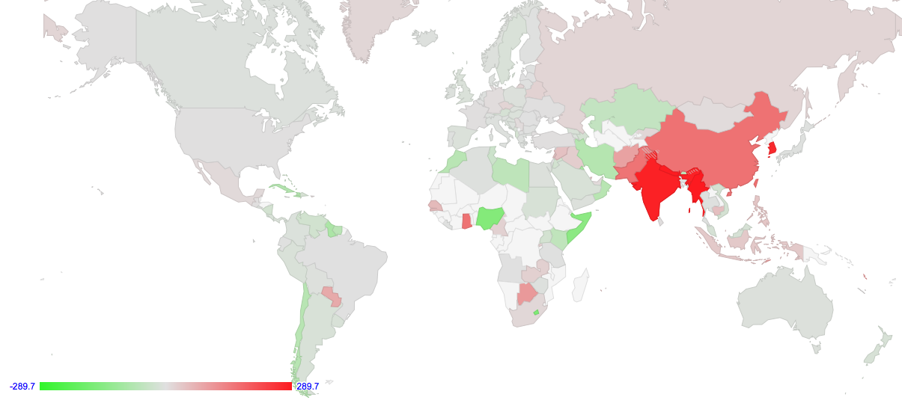
Performance by Country

Slide 55
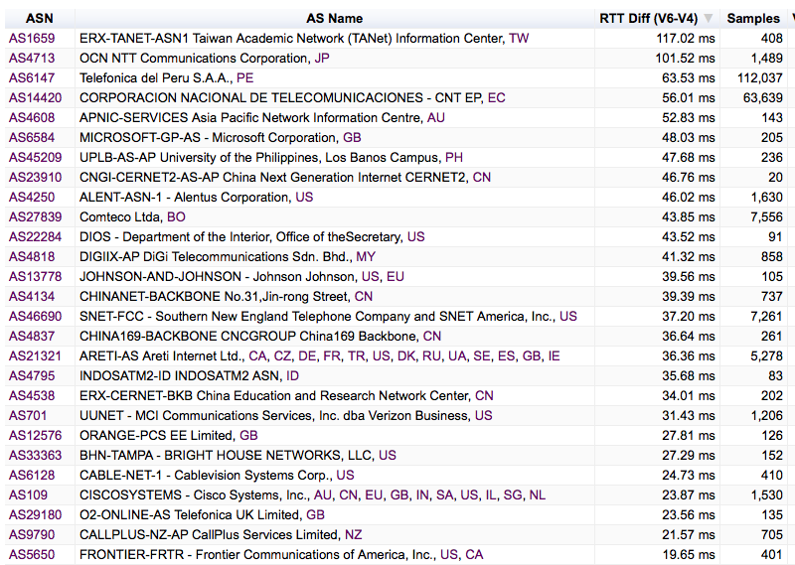
Performance by Network

Slide 56
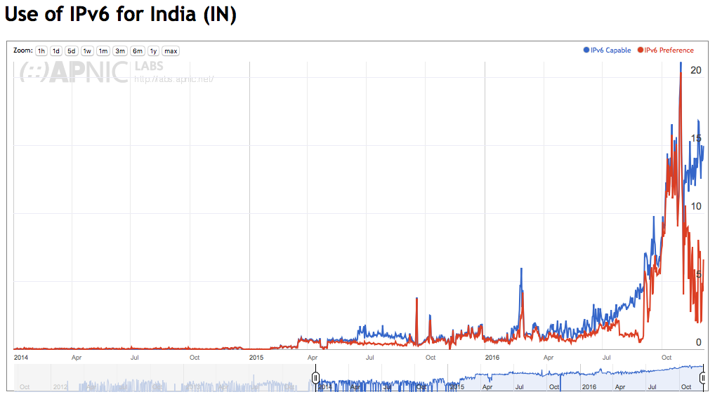
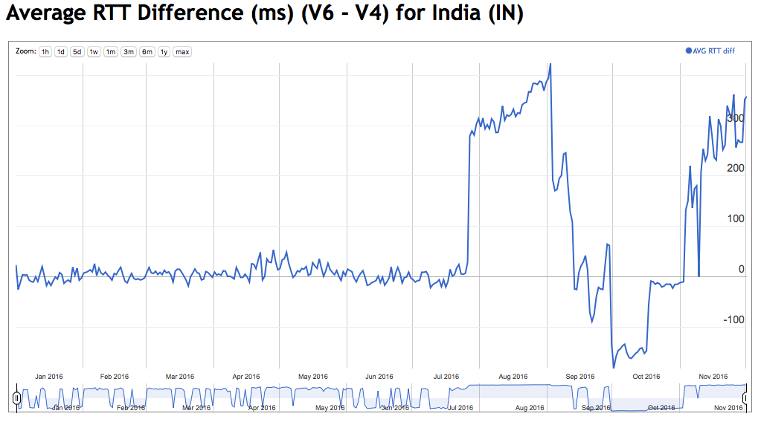
India

Slide 57
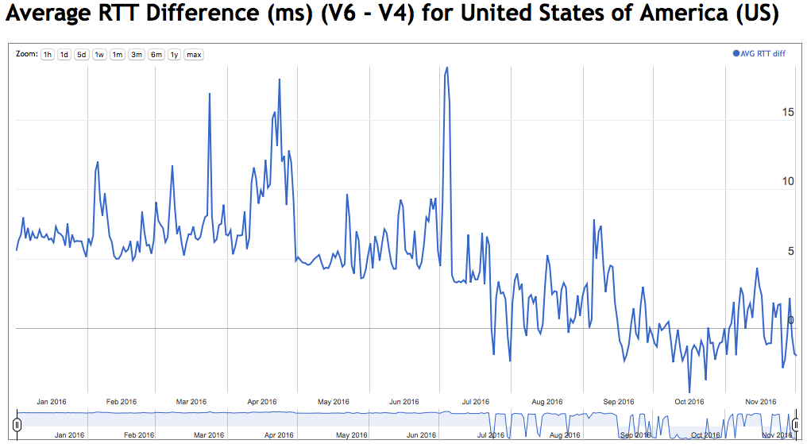
The United States

Slide 58
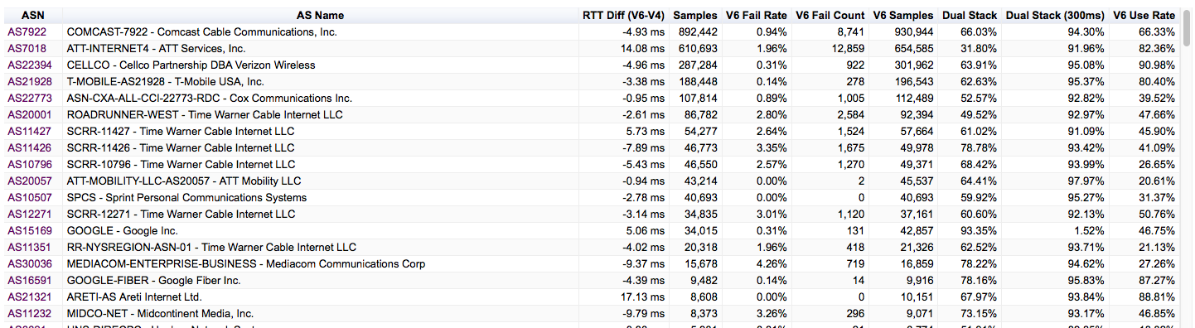
The United States

Slide 59
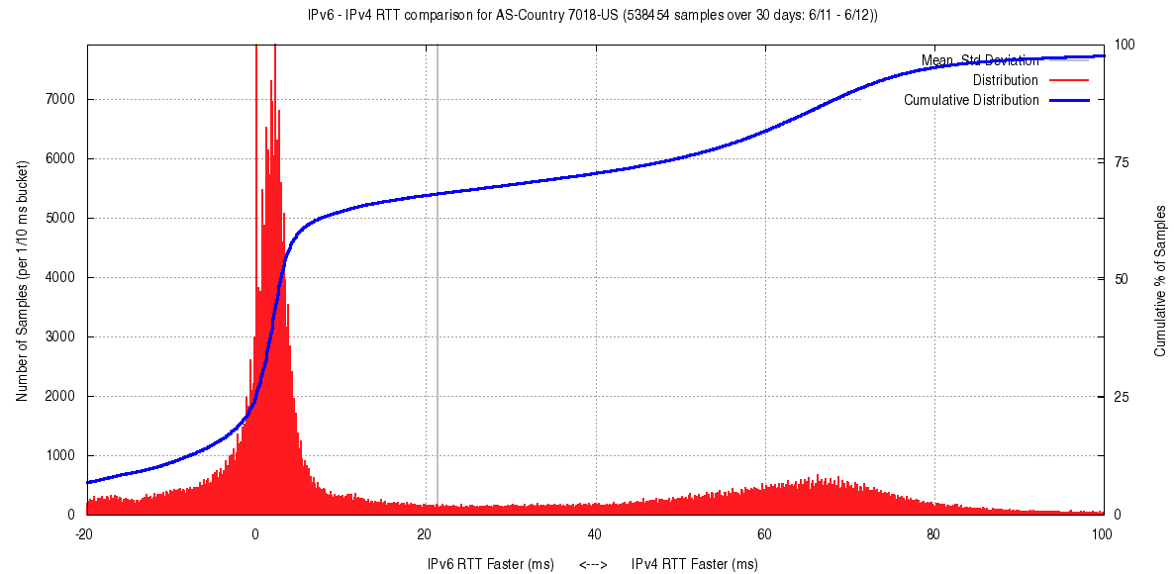
AT&T - AS7018

Slide 60
Is IPv6 as “good” as IPv4?

Slide 61
Is IPv6 as “good” as IPv4?
Is IPv6 as fast as IPv4?
  Basically, yes
  IPv6 is faster about half of the time
  For 75% of unicast cases, IPv6 is within 10ms RTT of IPv4
  So they perform at much the same rate
  (But that’s just for unicast IPv6 - the use of 6to4 makes this a whole lot worse!)

Slide 62
Is IPv6 as “good” as IPv4?
Is IPv6 as robust as IPv4?
  IPv4 connection reliability currently sits at 0.2%
  The base failure rate of Unicast V6 connection attempts at 1.5% of the total V6 unicast connections is not brilliant.
  It could be a whole lot better!

Slide 63
Is IPv6 as “good” as IPv4?
If you can establish a connection, then IPv4 and IPv6 appear to have comparable RTT measurements across most of the Internet
And that’s good!
But the odds of establishing that connection are still weighted in favour of IPv4!
And that’s not good!

Slide 64
That’s it!
http://stats.labs.apnic.net/v6perf

Slide 65
A question to each of you…
How many IPv6 presentations have you sat through?
21?
101?
1,001?
I don’t know – I was asleep by the end!

