Slide 1
Routing 2015
Geoff Huston
APNIC

Slide 2
Through the Routing Lens
There are very few ways to assemble a single view of the entire Internet
The lens of routing is one of the ways in which information relating to the entire reachable Internet is bought together
Even so, its not a perfect lens…

Slide 3

Through the Routing Lens

Slide 4
There is no Routing God!
There is no single objective “out of the system” view of the Internet’s Routing environment.
BGP distributes a routing view that is modified as it is distributed, so every eBGP speaker will see a slightly different set of prefixes, and each view is relative to a given location
So the picture I will be painting here is one that is drawn from the perspective of AS131072. This is a stub AS at edge of the Internet, and this is an eBGP view.
You may have a similar view from your network.

Slide 5
20 Years of Routing the Internet
2011: Address Exhaustion
This is a view pulled together from each of the routing peers of Route Views
2009: The GFC hits the Internet
2005: Broadband to the Masses
2001: The Great Internet Boom and Bust
1994: Introduction of CIDR

Slide 6
20 Years of Routing the Internet
2011: Address Exhaustion
This is a view pulled together from each of the routing peers of Route Views
2009: The GFC hits the Internet
2005: Broadband to the Masses
2001: The Great Internet Boom and Bust
1994: Introduction of CIDR

Slide 7
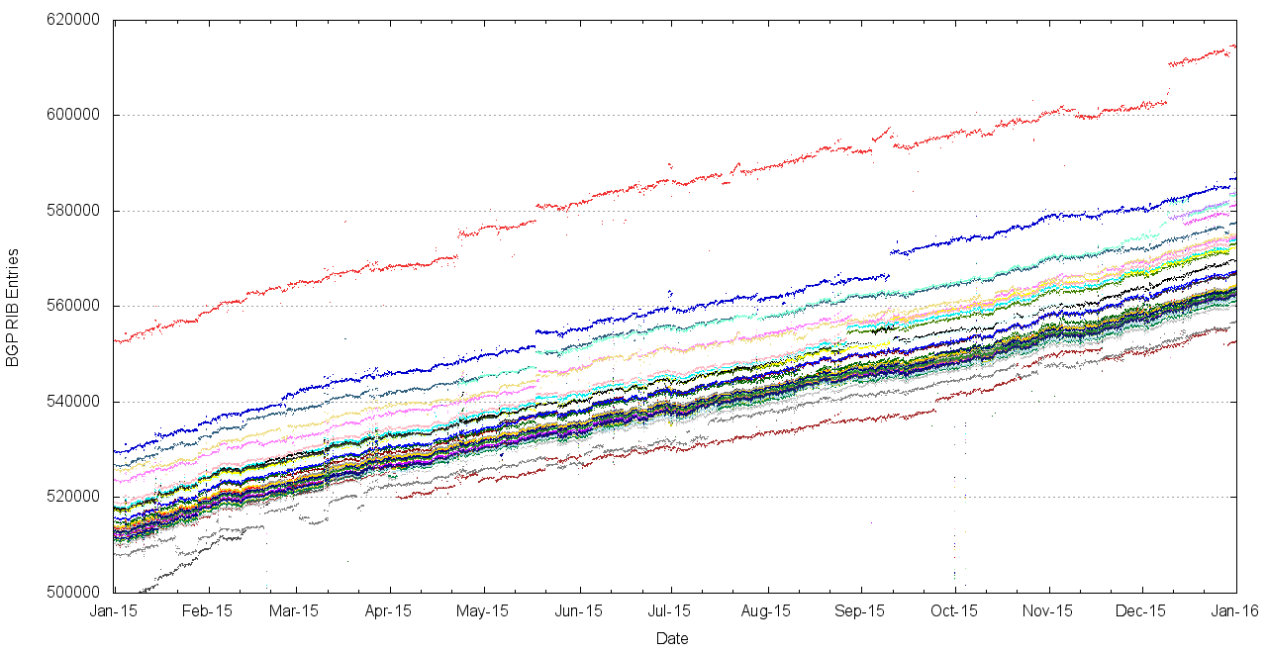
2015, as seen at Route Views

Slide 8
2015, as seen at Route Views
Initial growth rate

Slide 9
2015, as seen at Route Views
Initial growth rate
annual growth rate

Slide 10
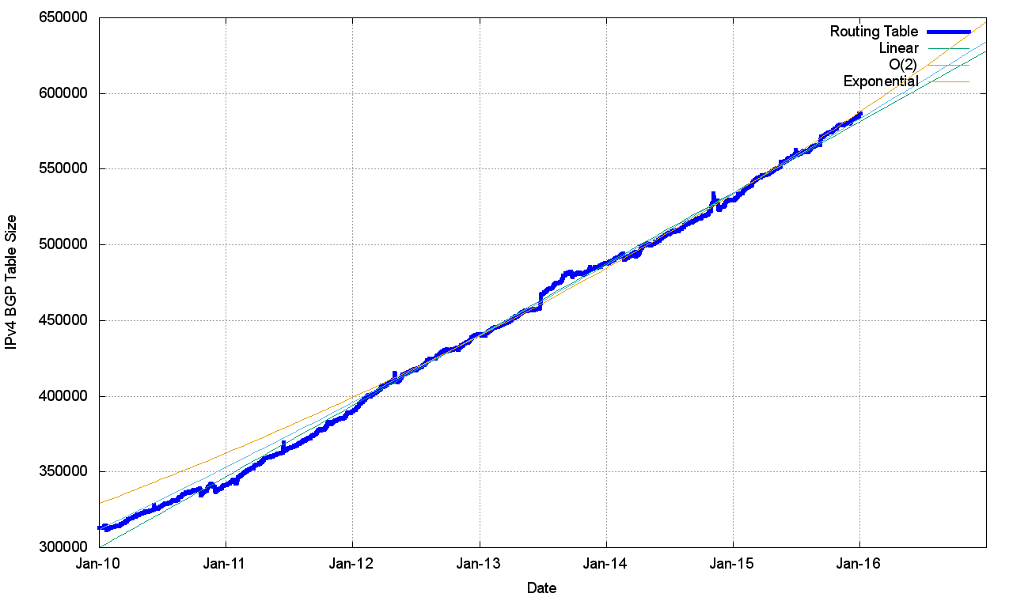
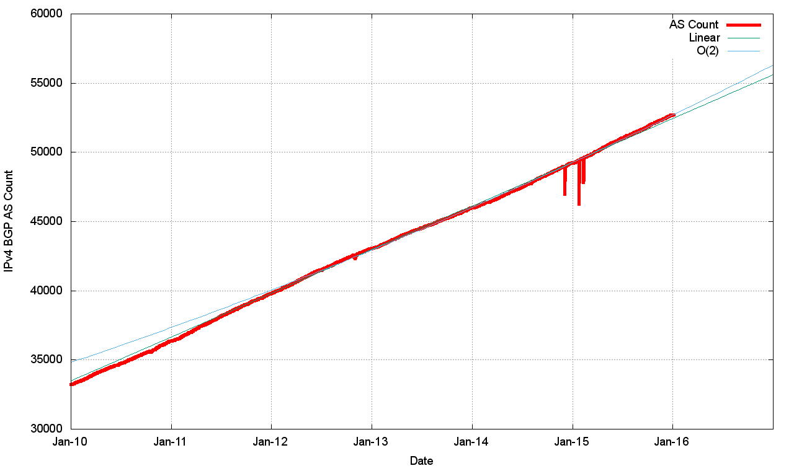
Routing Indicators for IPv4
Routing prefixes – growing by some 47,000 prefixes per year
AS Numbers– growing by some 3,100 prefixes per year

Slide 11
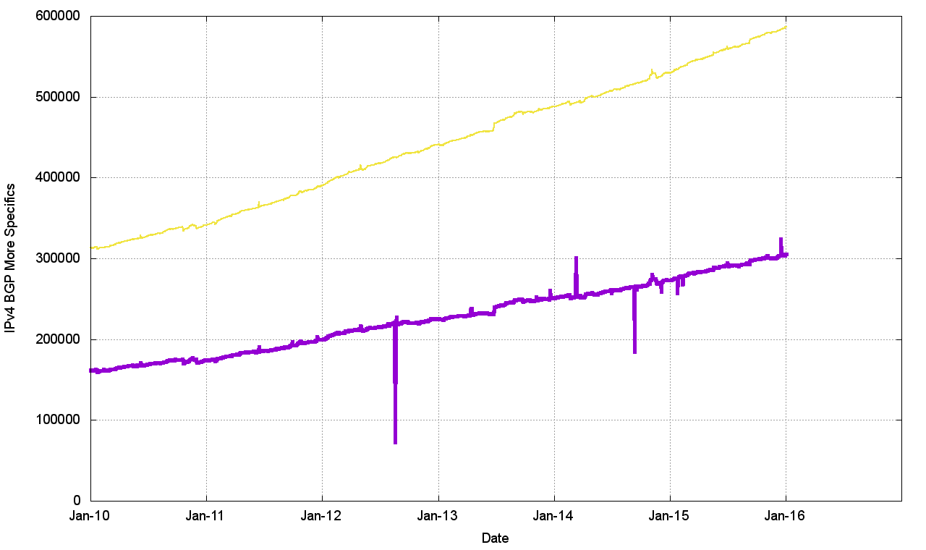
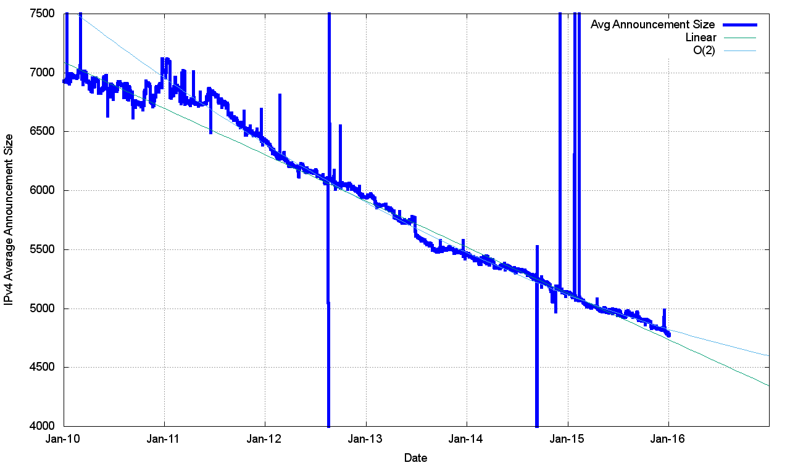
Routing Indicators for IPv4
More Specifics are still taking up one half of the routing table
But the average size of a routing advertisement is getting smaller

Slide 12
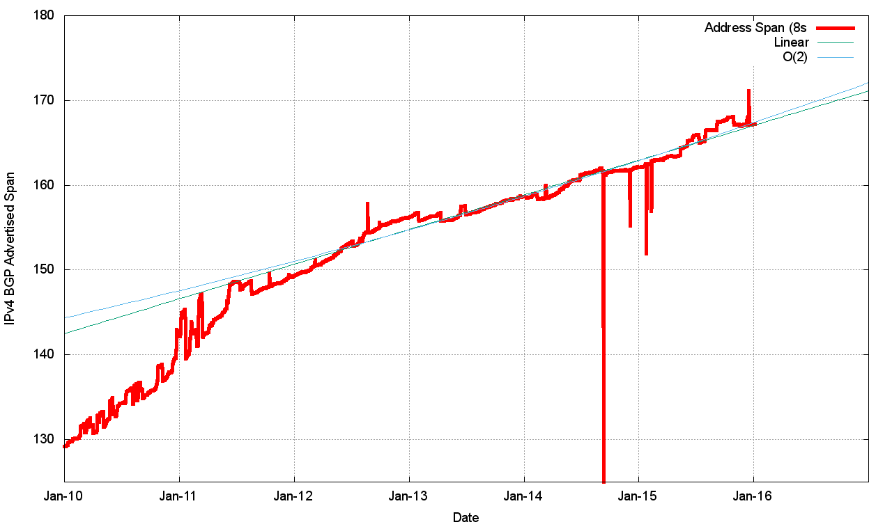
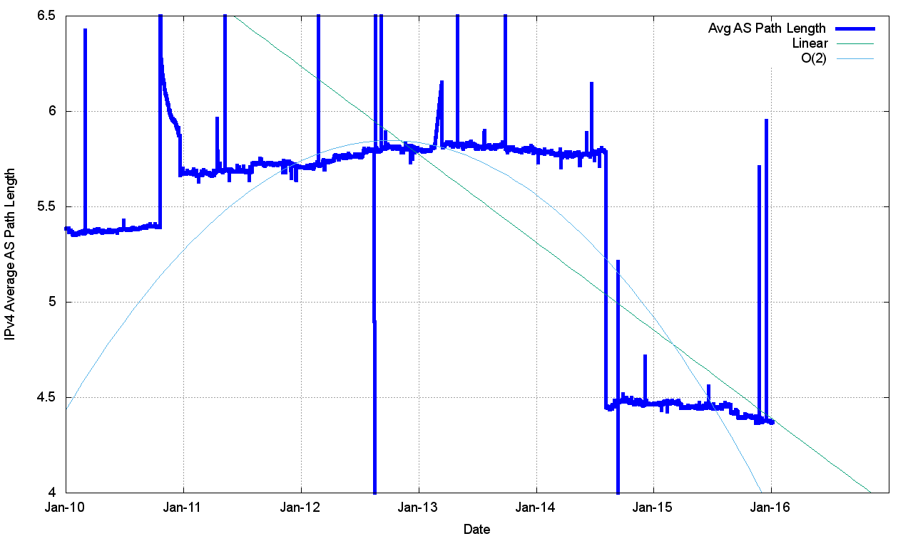
Routing Indicators for IPv4
Address Exhaustion is now visible in the extent of advertised address space
The “shape” of inter-AS interconnection appears to be relatively steady, as the Average AS Path length has been steady through the year

Slide 13
What happened in 2015 in V4?
From the look of the growth plots, its business as usual, despite the increasing pressure on IPv4 address availability
The number of entries in the default-free zone is now heading to 600,000
The pace of growth of the routing table is still relatively constant at ~50,000 new entries per year
  IPv4 address exhaustion is not changing this!

Slide 14
How can the IPv4 network continue to grow when we are running out of IPv4 addresses?
We are now recycling old addresses back into the routing system
Some of these addresses are transferred in ways that are recorded in the registry system, while others are being “leased” without any clear registration entry that describes the lessee

Slide 15
Address “Age”
Address “age” in 2010
2% of all new addresses announced in 2010 were >= 20 years ‘old’ (legacy)
80% of all new addresses announced in 2010 were allocated or assigned within the past 12 months

Slide 16
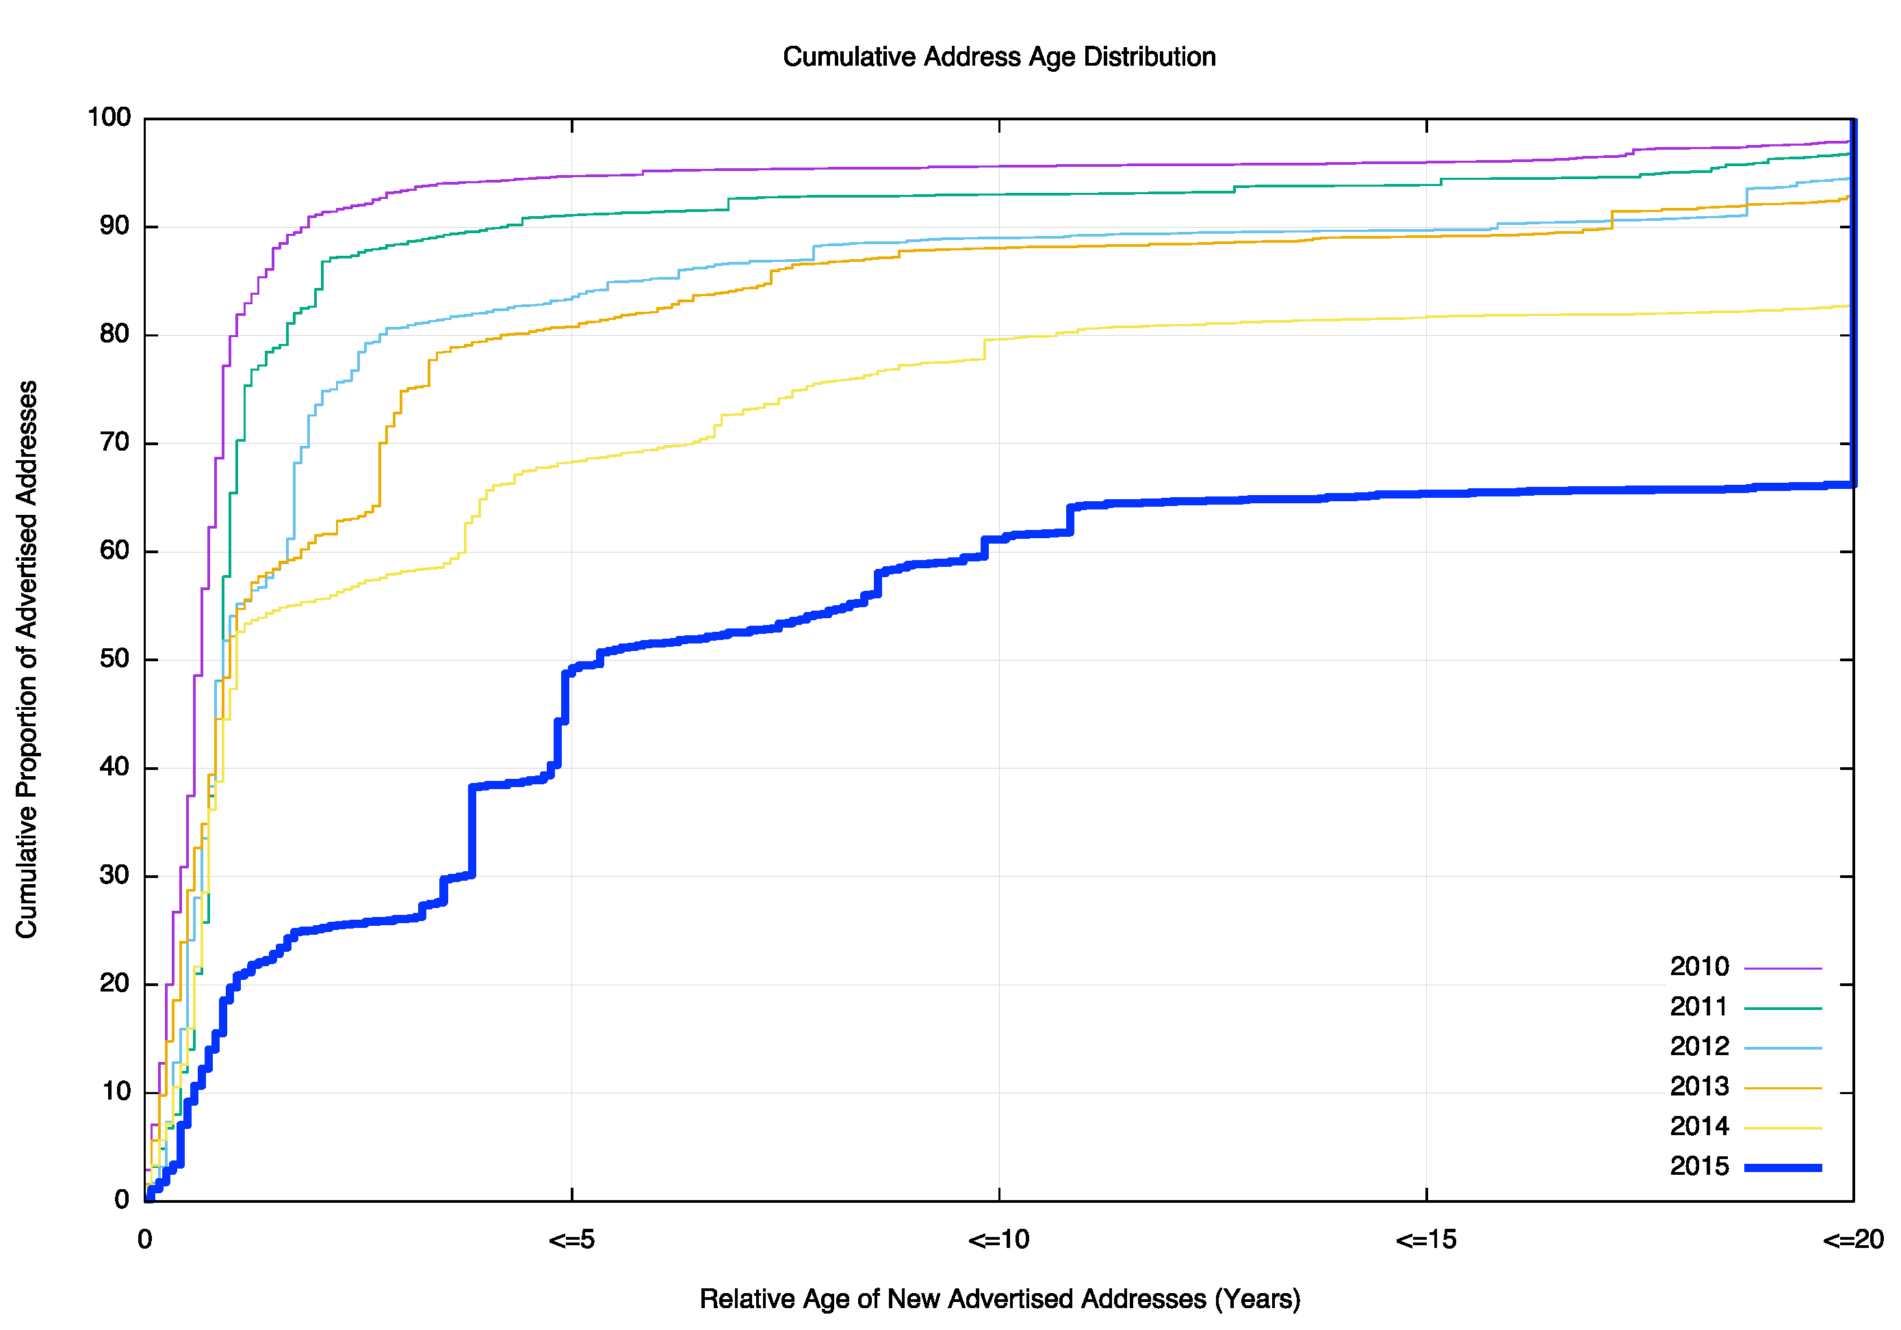
IPv4 Address Reuse
Address “age” in 2015
33 % of all new addresses announced in 2015 were >= 20 years ‘old’ (legacy)
20 % of all new addresses announced in 2015 were allocated or assigned within the past 12 months

Slide 17
IPv4 in 2015 – Growth is Steady
Overall IPv4 Internet growth in terms of BGP is at a rate of some ~47,000 entries p.a.
But we’ve run out of the unallocated address pools everywhere except Afrinic
So what’s driving this post-exhaustion growth?
  Transfers?
  Last /8 policies in RIPE and APNIC?
  Leasing and address recovery?

Slide 18
IPv4: Advertised vs Unadvertised Addresses

Slide 19
IPv4: Unadvertised Addresses

Slide 20
IPv4: Unadvertised Addresses
This is not!
This is expected!

Slide 21
IPv4: Unadvertised Addresses

Slide 22
IPv4:Assigned vs Recovered

Slide 23
IPv4 in 2015
Approximately 4 /8s were assigned and advertised in 2015
  2.3 /8s were assigned by ARIN
  1 /8 assigned by AfriNIC
Up to 3 /8s were ‘recovered’ from the unallocated address pool and advertised during 2015
  But 2/8s of addresses were withdrawn in the last two months of the year

Slide 24
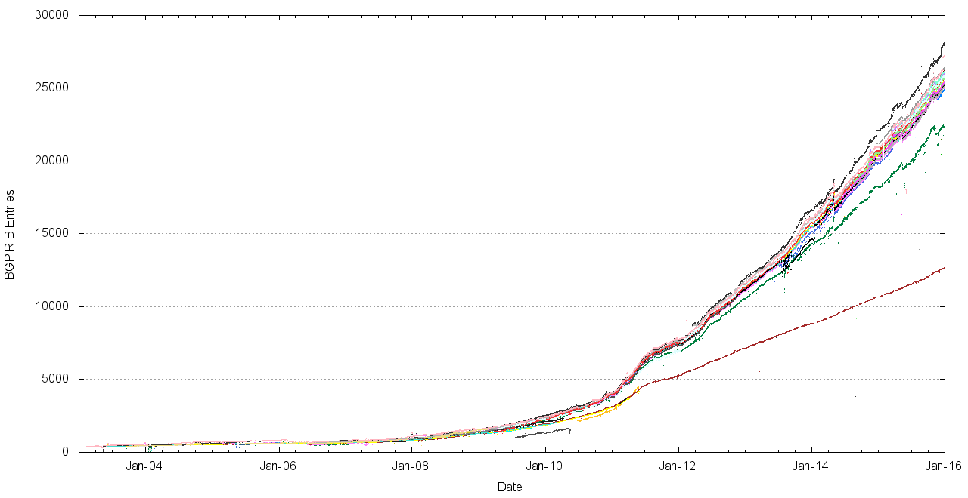
The Route Views view of IPv6
World IPv6 Day
IANA IPv4 Exhaustion

Slide 25
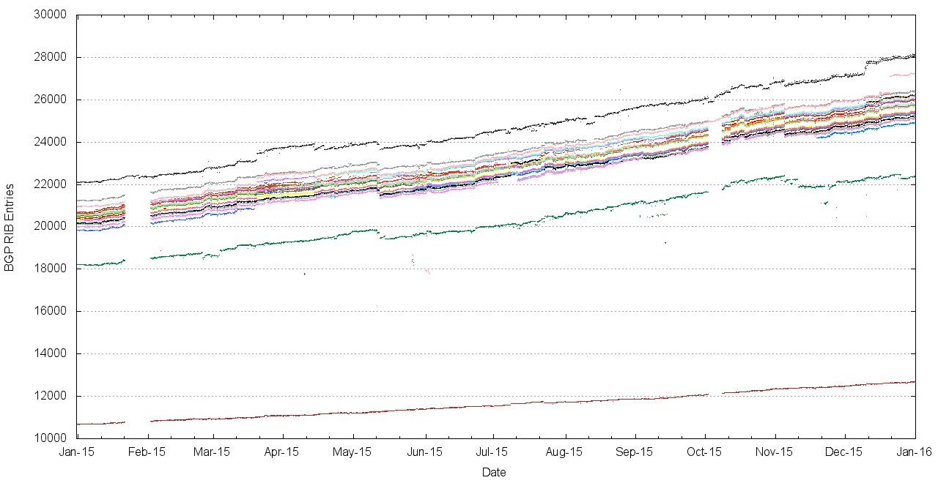
2015 for IPv6, as seen at Route Views

Slide 26
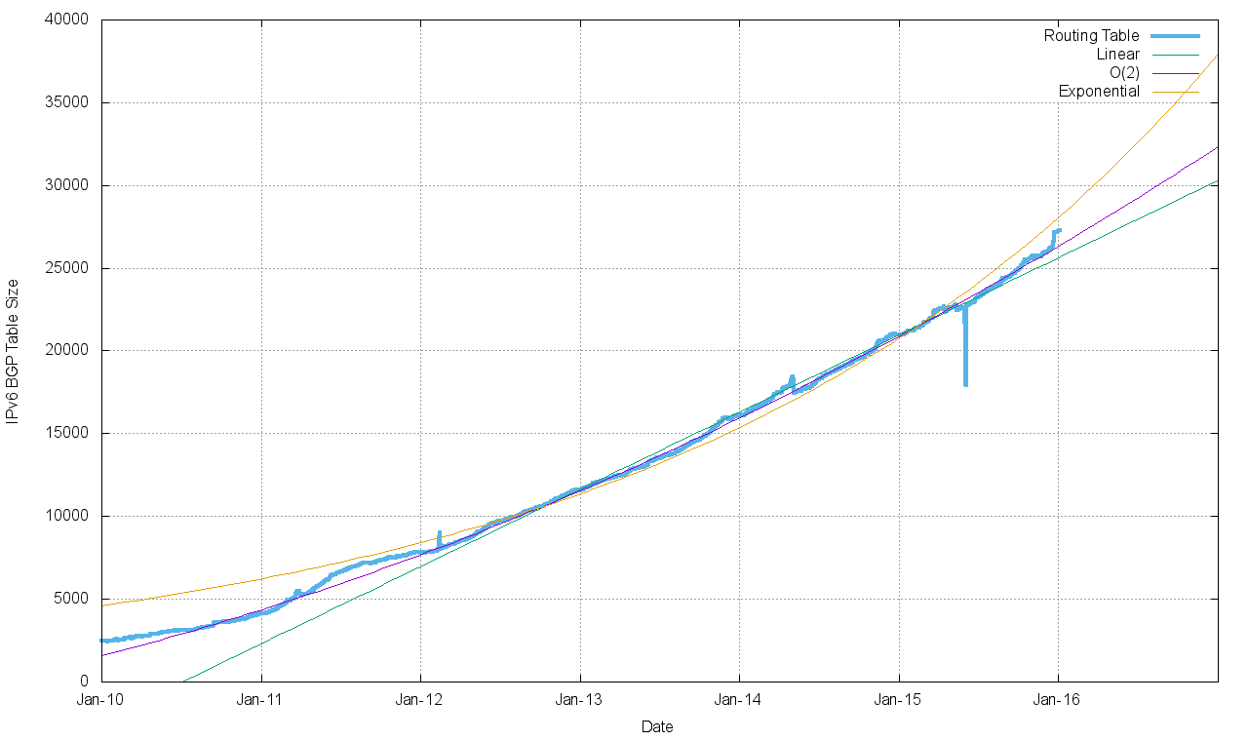
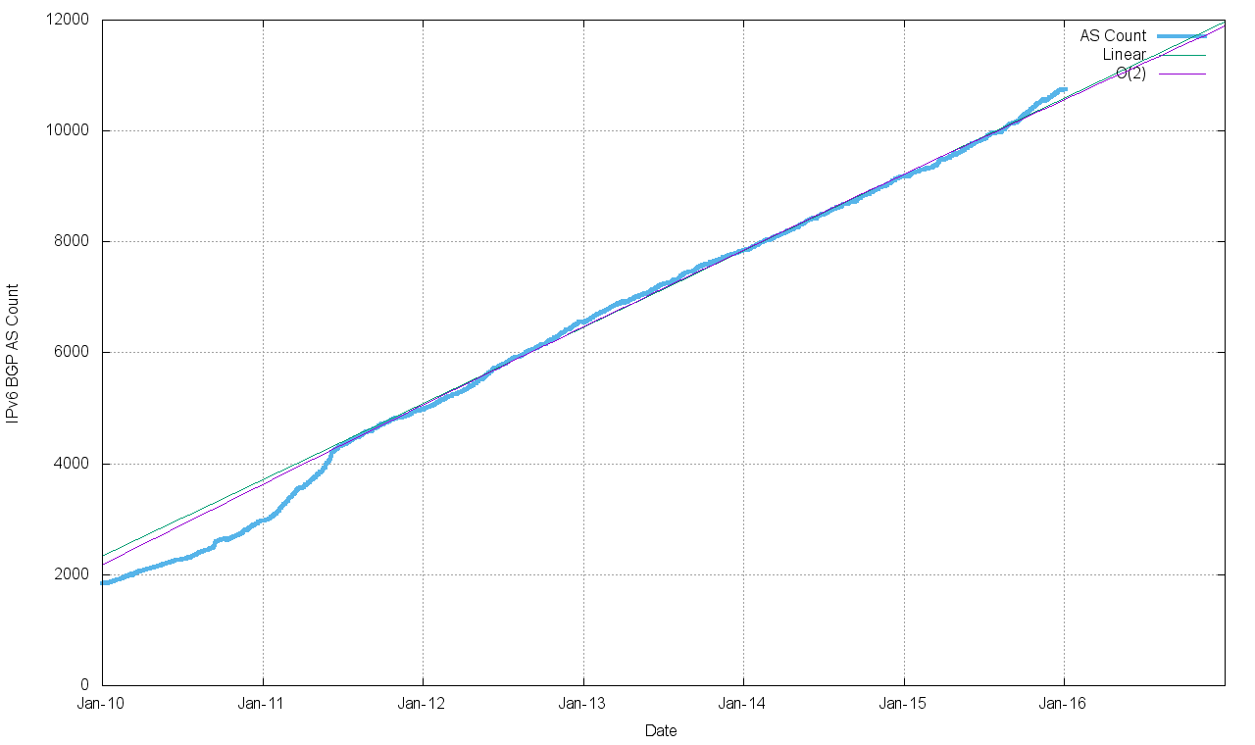
Routing Indicators for IPv6
Routing prefixes – growing by some 6,000 prefixes per year
AS Numbers– growing by some 1,600 prefixes per year (which is half the V4 growth)

Slide 27
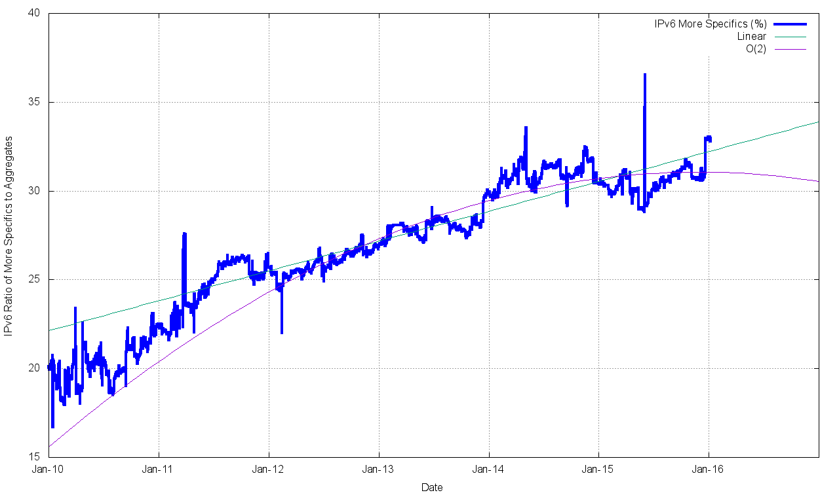
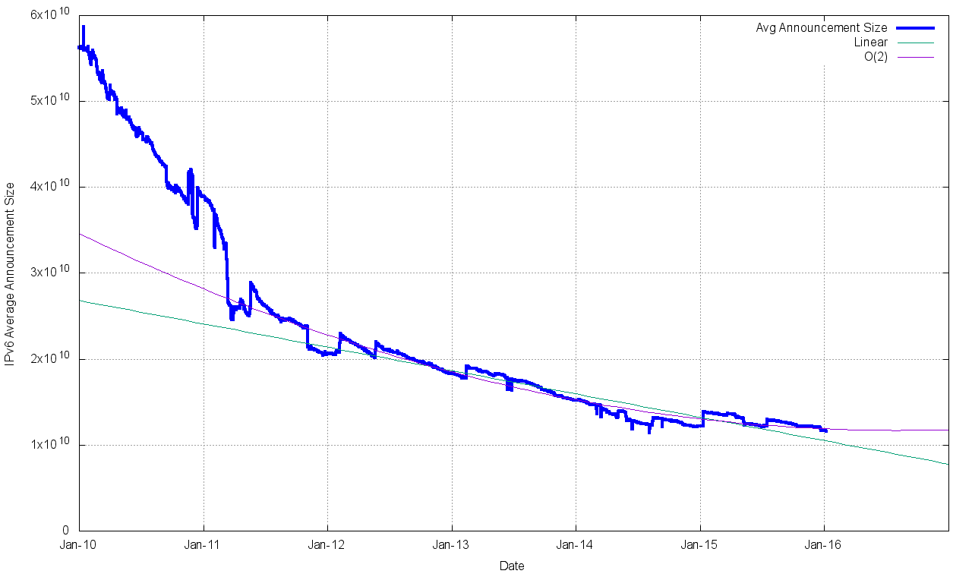
Routing Indicators for IPv6
More Specifics now take up one third of the routing table
The average size of a routing advertisement is getting smaller

Slide 28
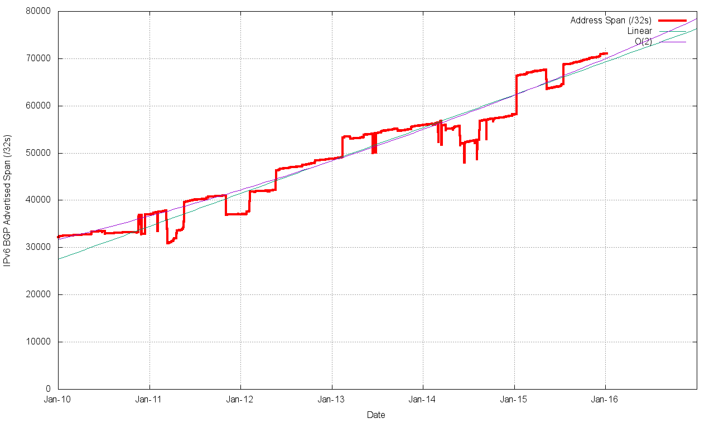
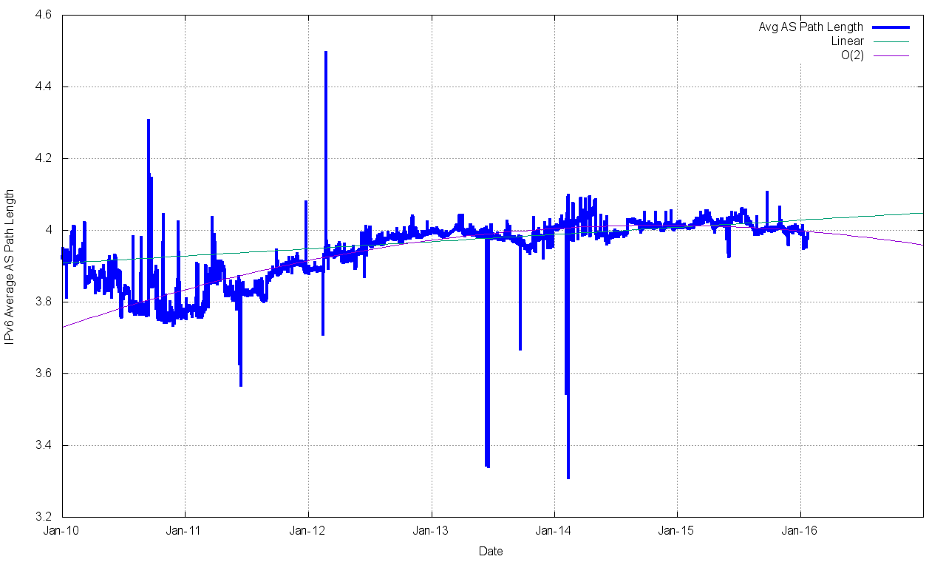
Routing Indicators for IPv6
Advertised Address span is growing at a linear rate
The “shape” of inter-AS interconnection appears to be steady, as the Average AS Path length has been held steady through the year

Slide 29
IPv6 in 2015
Overall IPv6 Internet growth in terms of BGP is steady at some 6,000 route entries p.a.
  This is growth of BGP route objects is 1/7 of the growth rate of the IPv4 network – as compared to the AS growth rate which is 1/2 of the IPv4 AS number growth rate

Slide 30
What to expect

Slide 31
BGP Size Projections
For the Internet this is a time of extreme uncertainty
    Registry IPv4 address run out
    Uncertainty over the impacts of any after-market in IPv4 on the routing table
    Uncertainty over IPv6 takeup leads to a mixed response to IPv6 so far, and no clear indicator of trigger points for change

Slide 32
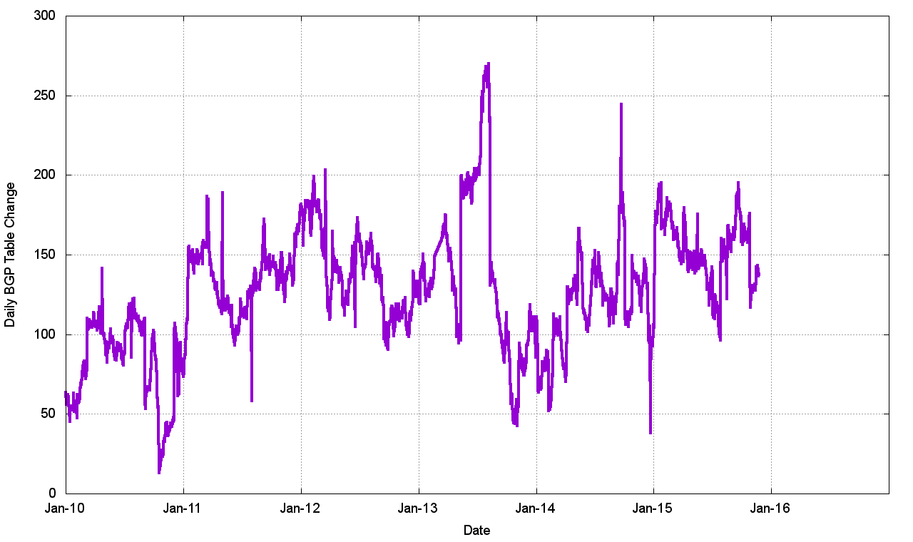
V4 - Daily Growth Rates

Slide 33
V4 - Daily Growth Rates

Slide 34
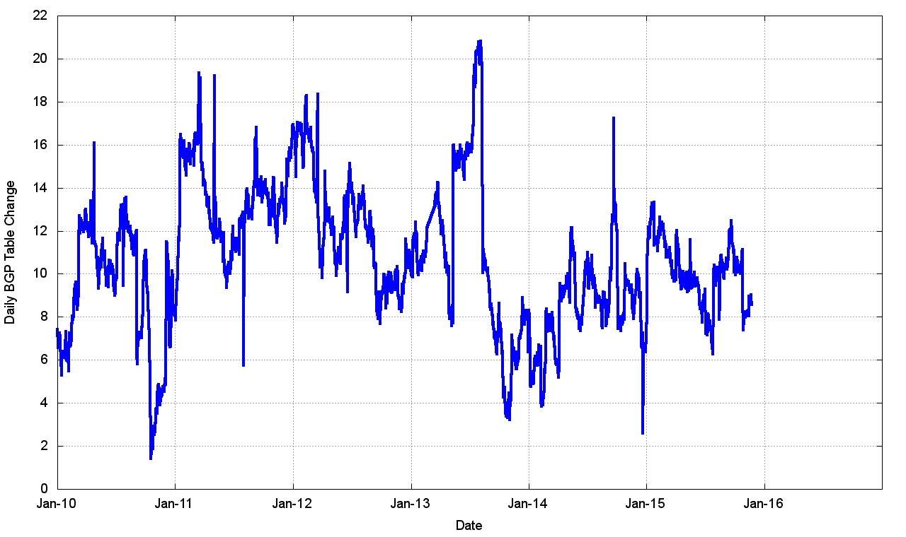
V4 - Relative Daily Growth Rates

Slide 35
V4 - Relative Daily Growth Rates
Growth in the V4 network appears to be constant at a long term average of 120 additional routes per day, or some 45,000 additional routes per year
Given that the V4 address supply has run out this implies further reductions in address size in routes, which in turn implies ever greater reliance on NATs
Its hard to see how and why this situation will persist at its current levels over the coming 5 year horizon

Slide 36
IPv4 BGP Table Size predictions
2014 PREDICTION
2013 PREDICTION
Jan 2013 441,000
2014 488,000
2015 530,000 540,000
2016 586,000 580,000 590,000
2017 628,000 620,000 640,000
2018 675,000 670,000 690,000
2019 722,000 710,000 740,000
2020 768,000 760,000
2021 815,000
These numbers are dubious due to uncertainties introduced by IPv4 address exhaustion pressures.

Slide 37
IPv6 Table Size

Slide 38
V6 - Daily Growth Rates

Slide 39
V6 - Relative Growth Rates

Slide 40
V6 - Relative Growth Rates
Growth in the V6 network appears to be increasing, but in relative terms this is slowing down.
Early adopters, who have tended to be the V4 transit providers, have already received IPv6 allocation and are routing them. The trailing edge of IPv6 adoption are generally composed of stub edge networks in IPv4. These networks appear not to have made any visible moves in IPv6 as yet.
If we see a change in this picture the growth trend will likely be exponential. But its not clear when such a tipping point will occur

Slide 41
IPv6 BGP Table Size predictions
Exponential Model
Linear Model
Jan 2014 16,100 entries
2015 21,200
2016 27,000
2017 38,000 30,000
2018 51,000 35,000
2019 70,000 40,000
2020 94,000 44,000
2021 127,000 49,000
Range of potential outcomes

Slide 42
BGP Table Growth
Nothing in these figures suggests that there is cause for urgent alarm -- at present
The overall eBGP growth rates for IPv4 are holding at a modest level, and the IPv6 table, although it is growing at a faster relative rate, is still small in size in absolute terms
As long as we are prepared to live within the technical constraints of the current routing paradigm, the Internet’s use of BGP will continue to be viable for some time yet
Nothing is melting in terms of the size of the routing table as yet

Slide 43
BGP Updates
What about the level of updates in BGP?
Let’s look at the update load from a single eBGP feed in a DFZ context

Slide 44
Announcements and Withdrawals

Slide 45
Announcements and Withdrawals

Slide 46
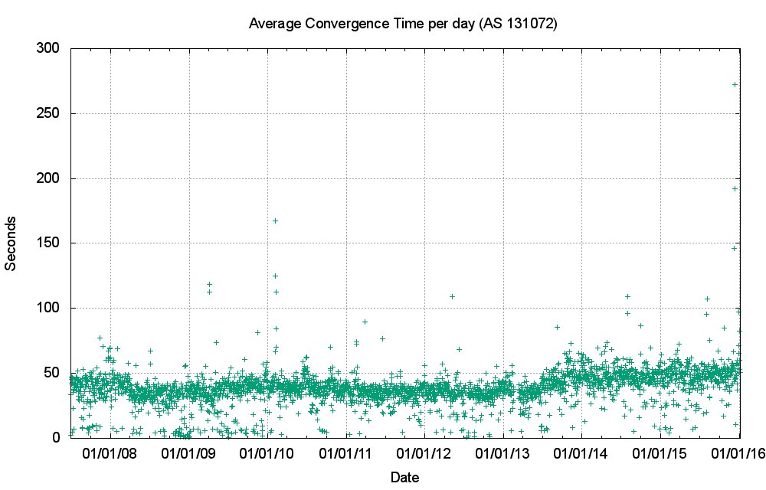
Convergence Performance

Slide 47
Updates in IPv4 BGP
Nothing in these figures is cause for any great level of concern …
  The number of updates per instability event has been relatively constant, which for a distance vector routing protocol is weird, and completely unanticipated. Distance Vector routing protocols should get noisier as the population of protocol speakers increases, and the increase should be multiplicative.
  But this is not happening in the Internet
  Which is good, but why is this not happening?
  Likely contributors to this outcome are the damping effect of widespread use of the MRAI interval by eBGP speakers, and the topology factor, as seen in the relatively constant V4 AS Path Length

Slide 48
V6 Announcements and Withdrawals

Slide 49
V6 Convergence Performance

Slide 50
V6 Updated prefixes per day

Slide 51
V6 Updates per event

Slide 52
Updates in IPv6 BGP
IPv6 routing behaviour is diverging from IPv4 behaviour
  The instability is greater
  Its not the number of unstable prefixes, but the number of updates and elapsed time for the network to re-converge for each instability event
  It this were to happen in the V4 network at the same relative scale it would be a major stability problem!
  So what is going on and why has this happened?

Slide 53
Updates in IPv6
BGP Route Updates are very unequally distributed across the prefix set – they appear to affect a very small number of prefixes which stand out well above the average

Slide 54
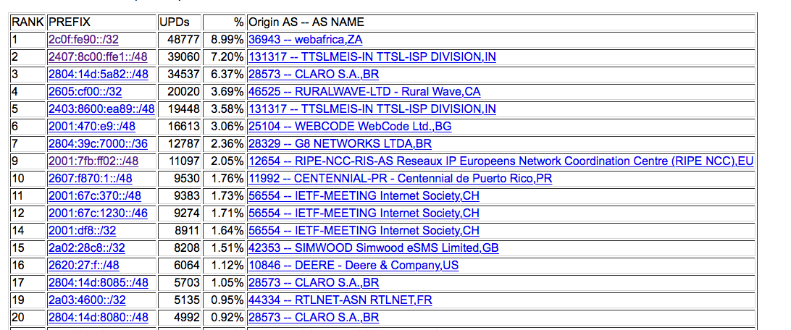
Updates in IPv6
The busiest 48 prefixes accounted for 2/3 of all prefix updates

Slide 55
That’s it!
Questions?

