Slide 1
Addressing and Routing in 2014
Geoff Huston
APNIC

Slide 2

The Addressing View

Slide 3
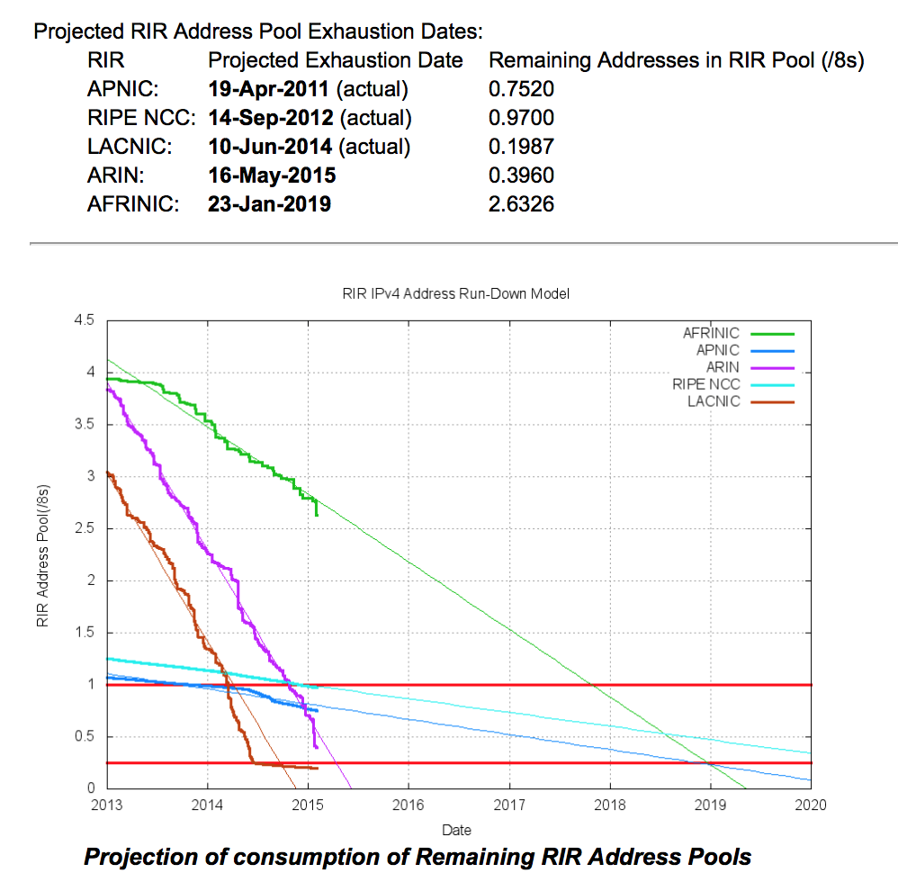
Addressing V4 Exhaustion
We have been predicting that the exhaustion of the free pool of IPv4 addresses would eventually happen for the past 25 years
And, we’ve now hit bottom!
  APNIC, RIPE NCC and LACNIC are now empty of general use IPv4 addresses
  We now have just ARIN and AFRINIC to go – ARIN is expected to run out in the coming weeks

Slide 4
Allocations in the Last Years of IPv4

Slide 5
Allocations in the Last Years of IPv4
Pre Exhaustion
Global Financial
Crisis
Exhaustion
Profile

Slide 6
Where did the Addresses Go?
Volume of Allocated IPv4 Addresses (using units of millions of /32s) per year
APNIC runs out
RIPE NCC runs out
LACNIC runs out

Slide 7
The IPv4 After-Market: Address Transfers
There is a considerable residual demand for IPv4 addresses following exhaustion
  IPv6 is not a direct substitute for the lack of IPv4
Some of this demand is pushed into using middleware that imposes address sharing (Carrier Grade NATS, Virtual Hosting, etc)
Where there is no substitute then we turn to the aftermarket
Some address transfers are “sale” transactions, and they are entered into the address registries
Some transfers take the form of “leases” where the lease holder’s details are not necessarily entered into the address registry

Slide 8
Address Transfers
Number of registered
Address transfers per year
Volume of addresses transferred
per year (millions of /32s p.a.)

Slide 9
How old are transferred addresses?
6% of addresses are >20 years old
10% of addresses are >15 years old
2014 transferred addresses are predominately between 2 and 9 years old

Slide 10
IPv6 Allocations
Number of individual IPv6
address allocations per year

Slide 11
IPv6 Allocated Addresses
Volume of Allocated IPv6 Addresses (using units of /32s) per year

Slide 12
Where did the IPv6 addresses go?
Volume of Allocated IPv6 Addresses (using units of /32s) per country, per year

Slide 13

The Routing View

Slide 14
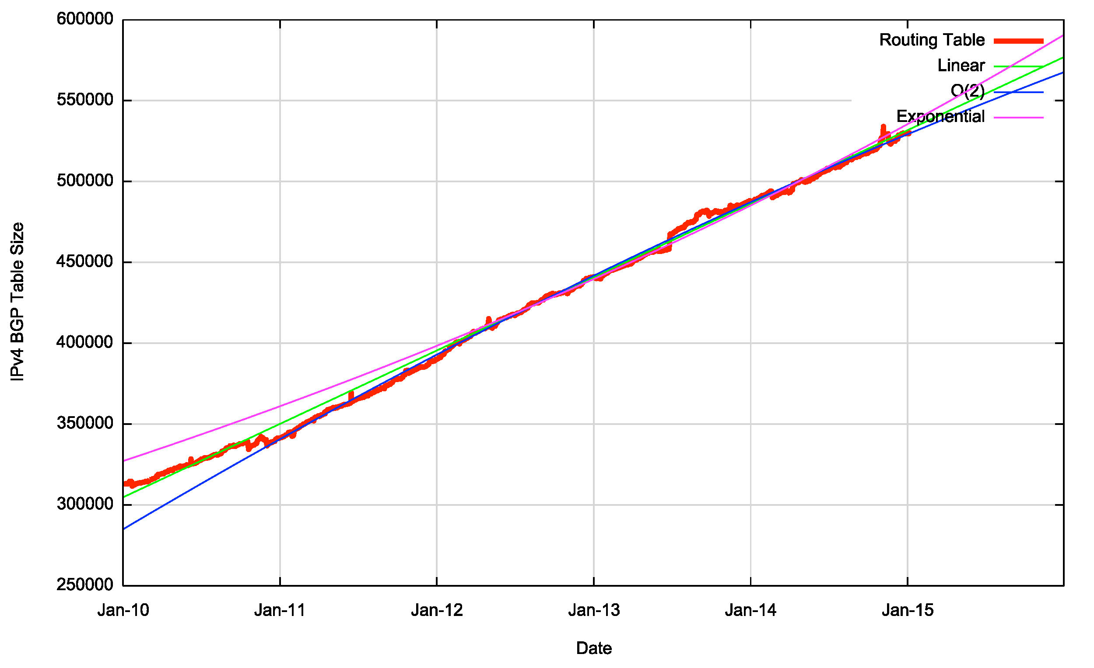
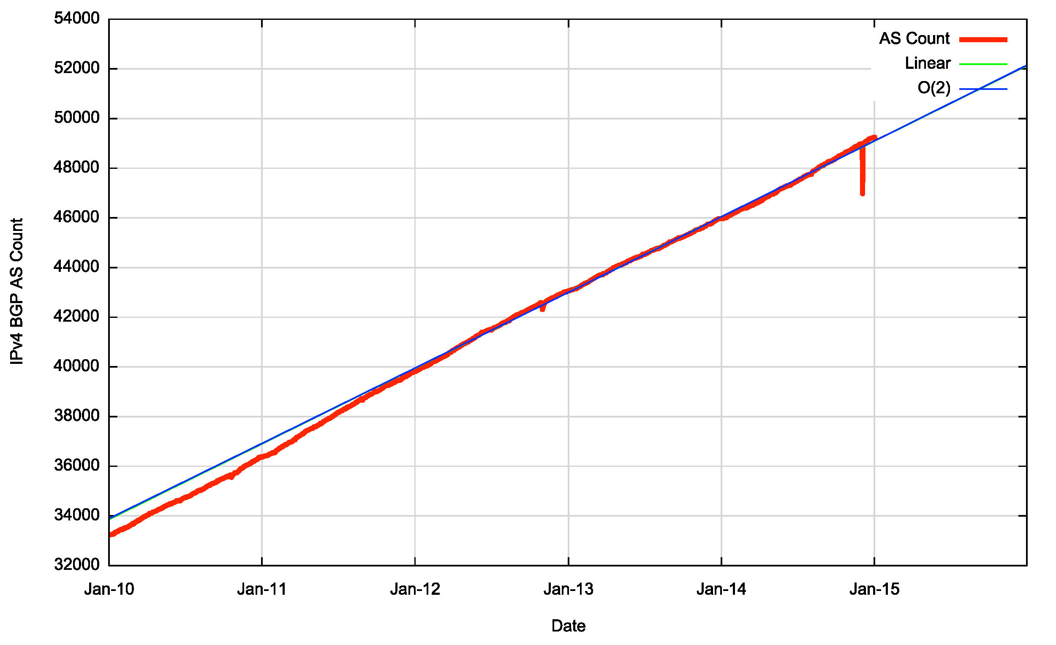
Routing Indicators for IPv4
Routing prefixes – growing by some 45,000 prefixes per year
AS Numbers– growing by some 3,000 ASNs per year

Slide 15
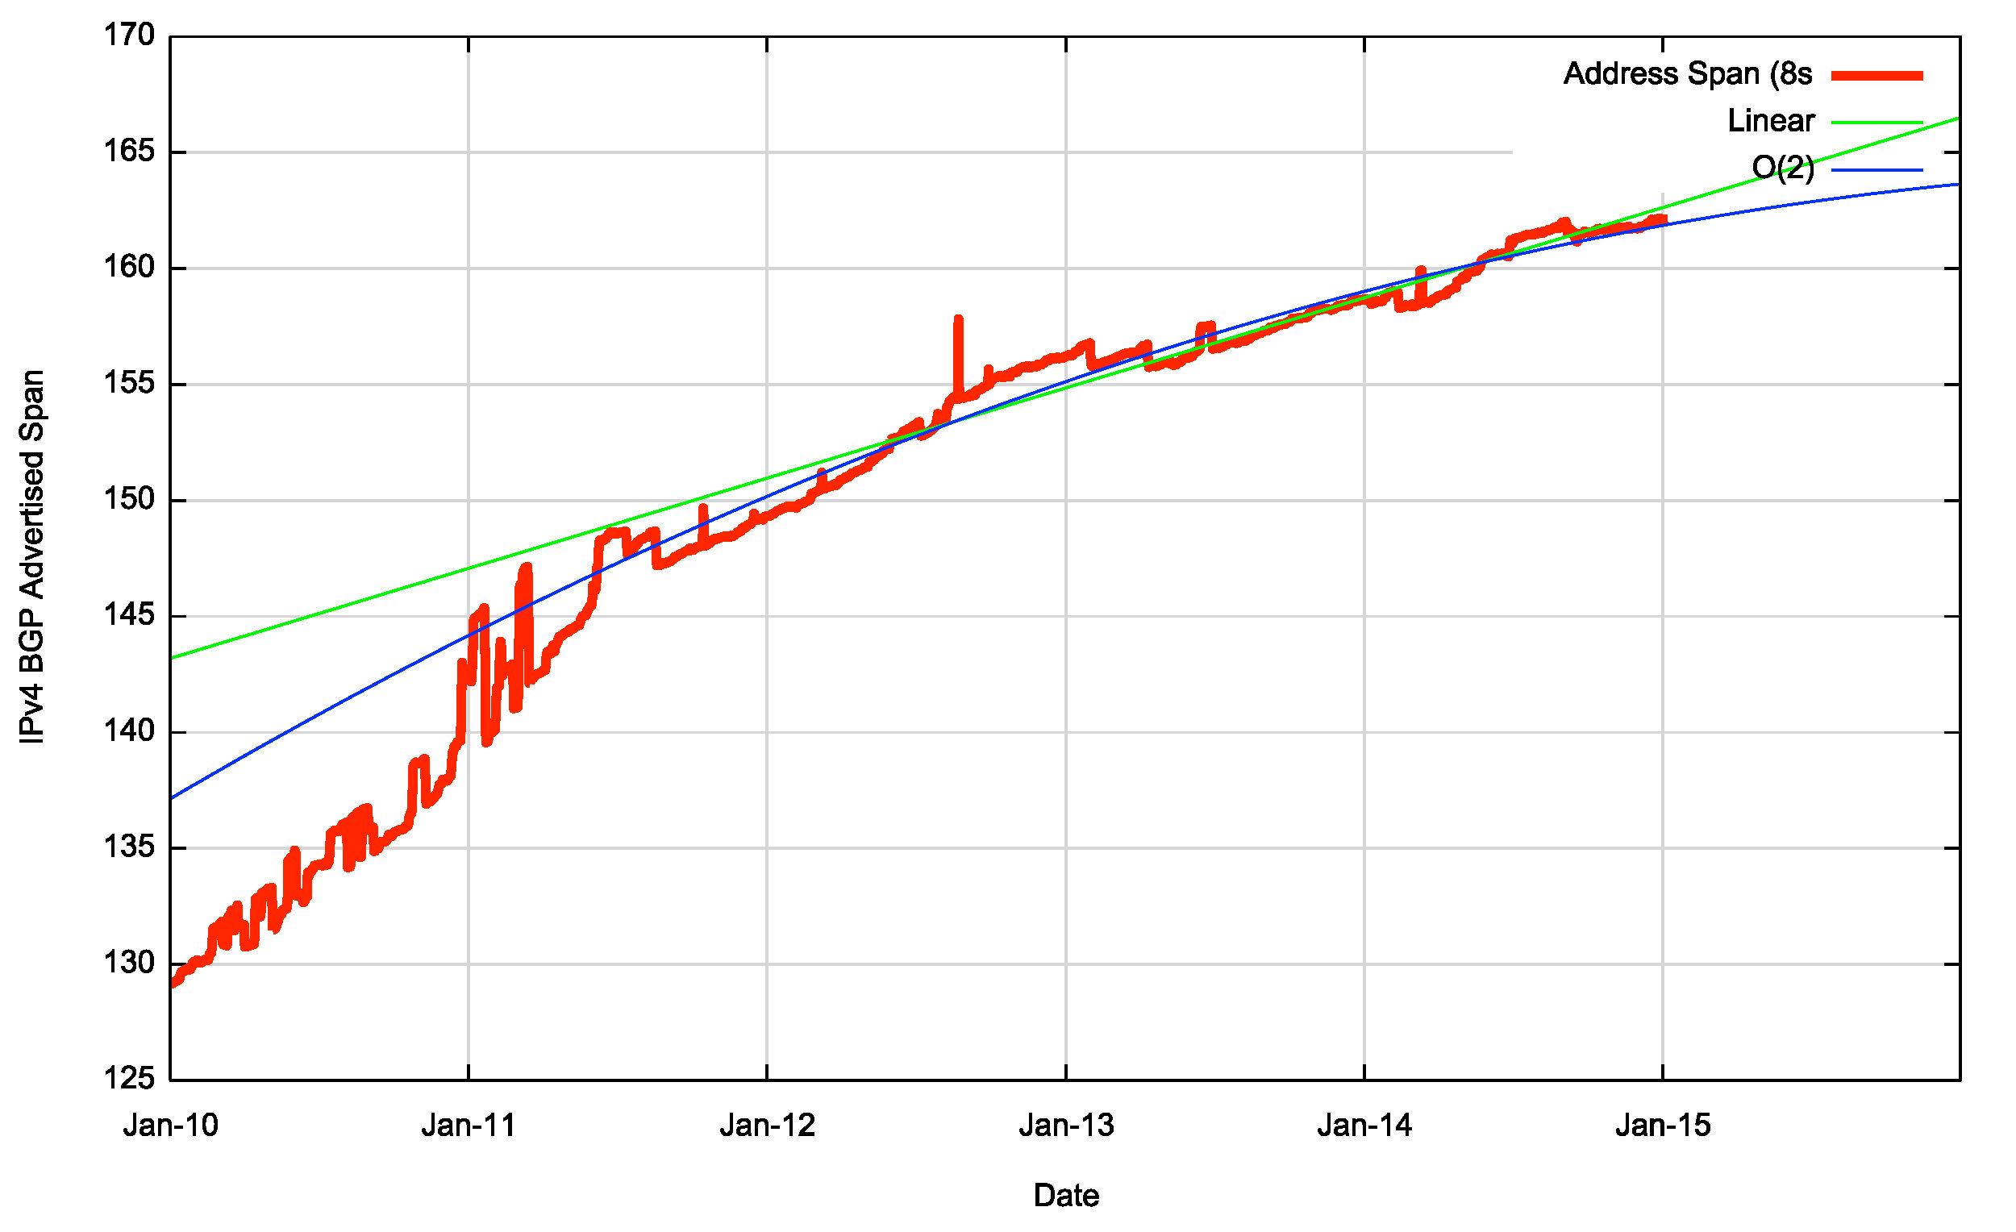
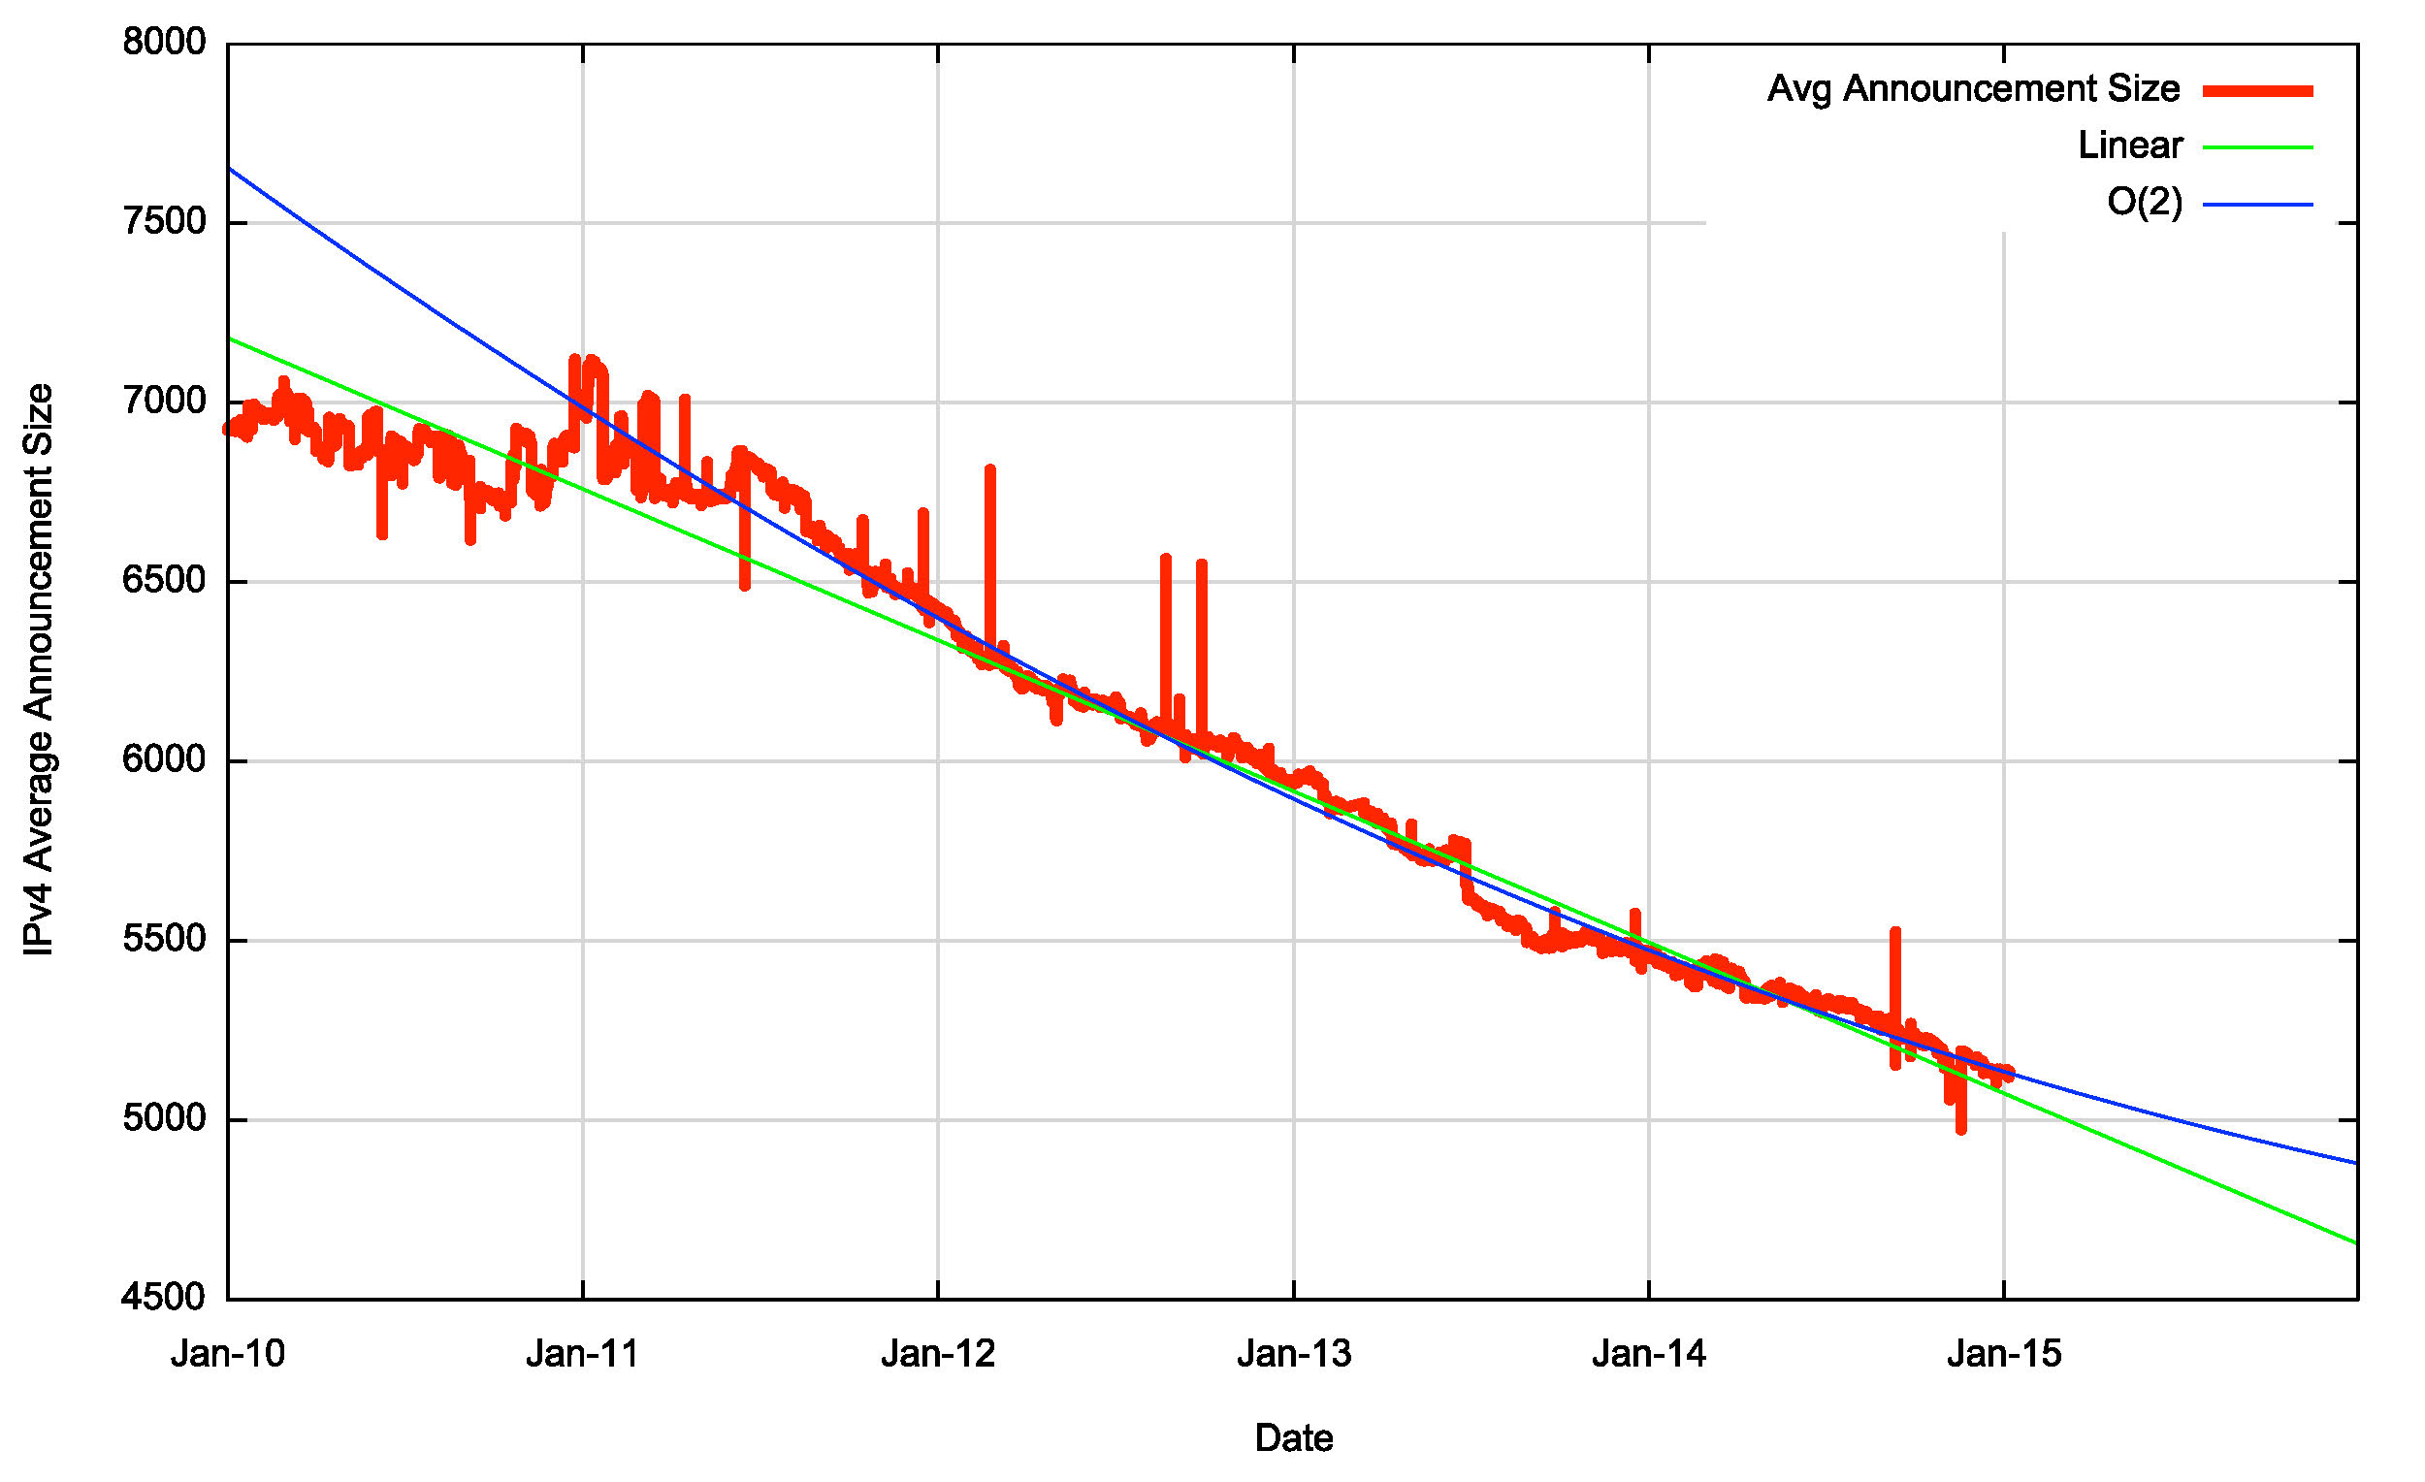
Routing Indicators for IPv4
Address Exhaustion is now visible in the extent of advertised address space
The average size of a routing advertisement is getting smaller

Slide 16
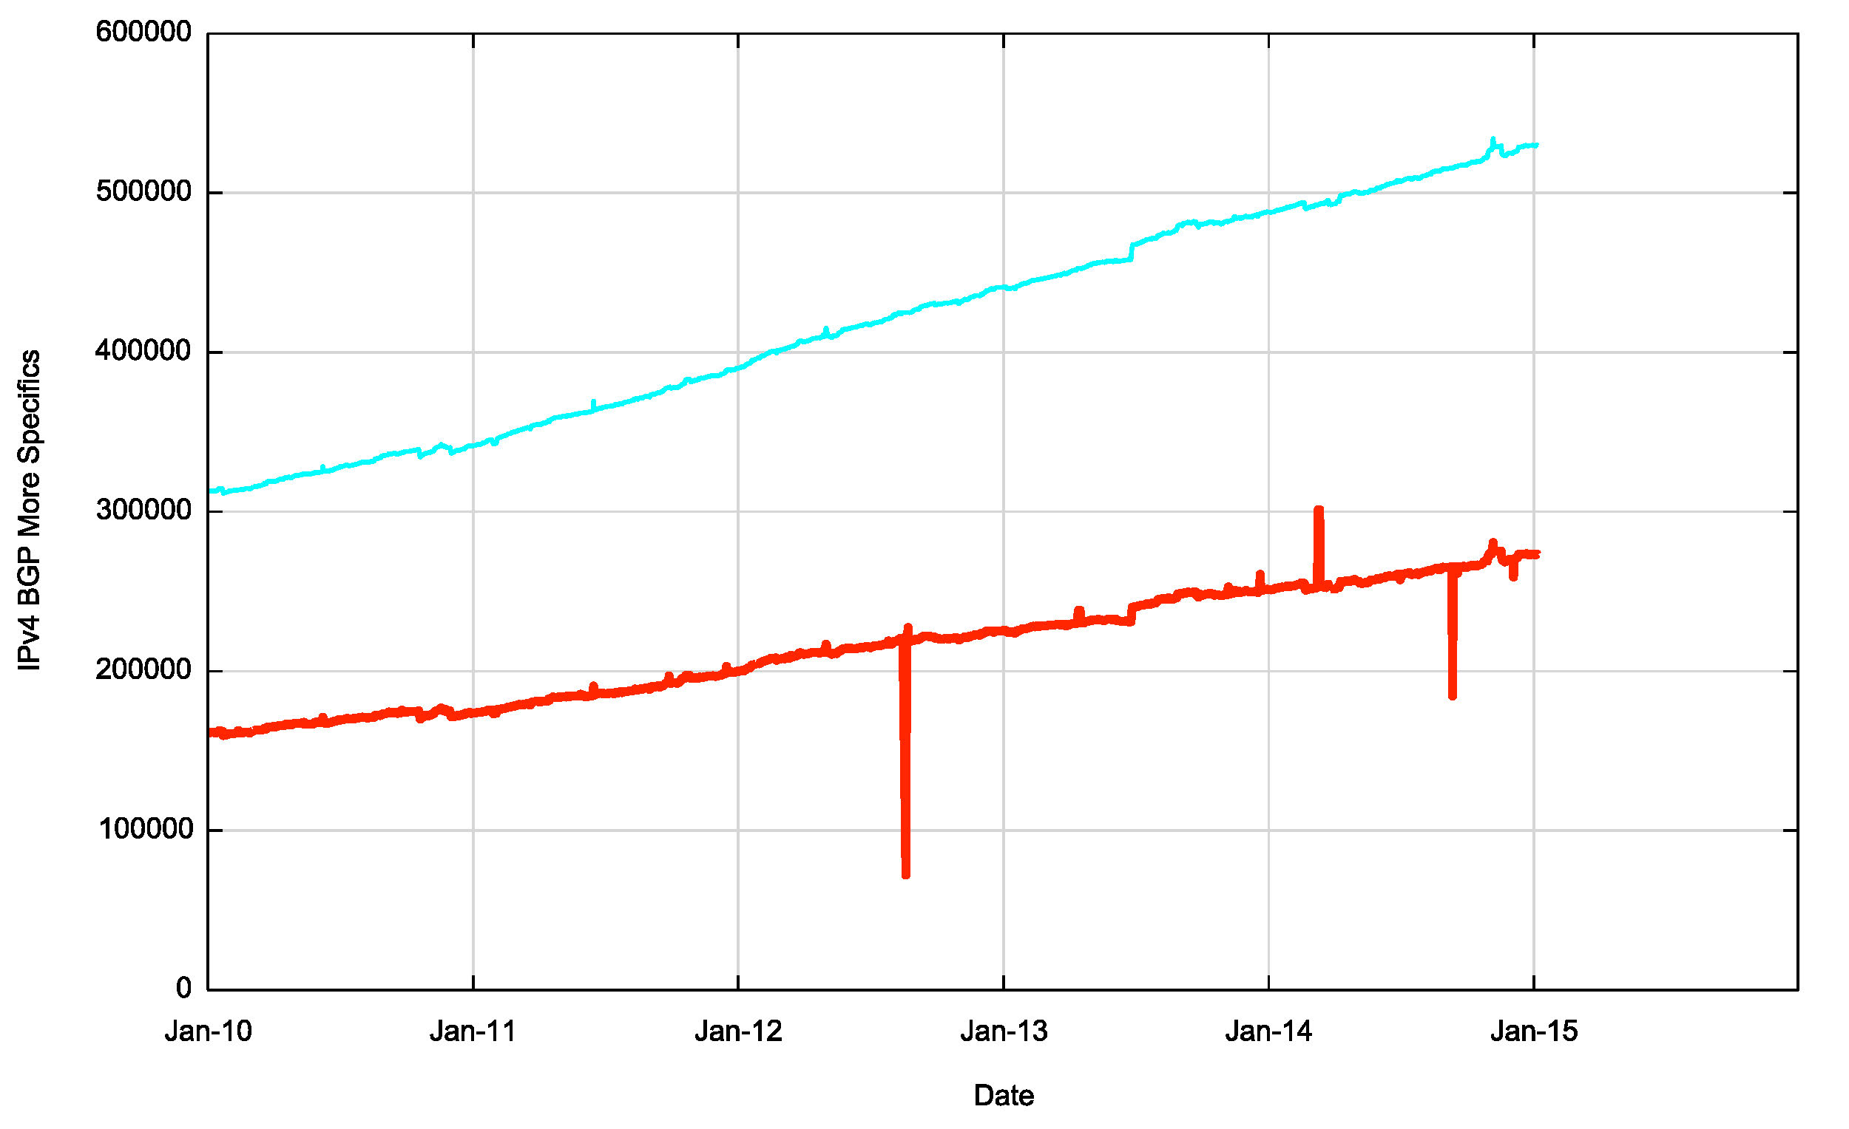
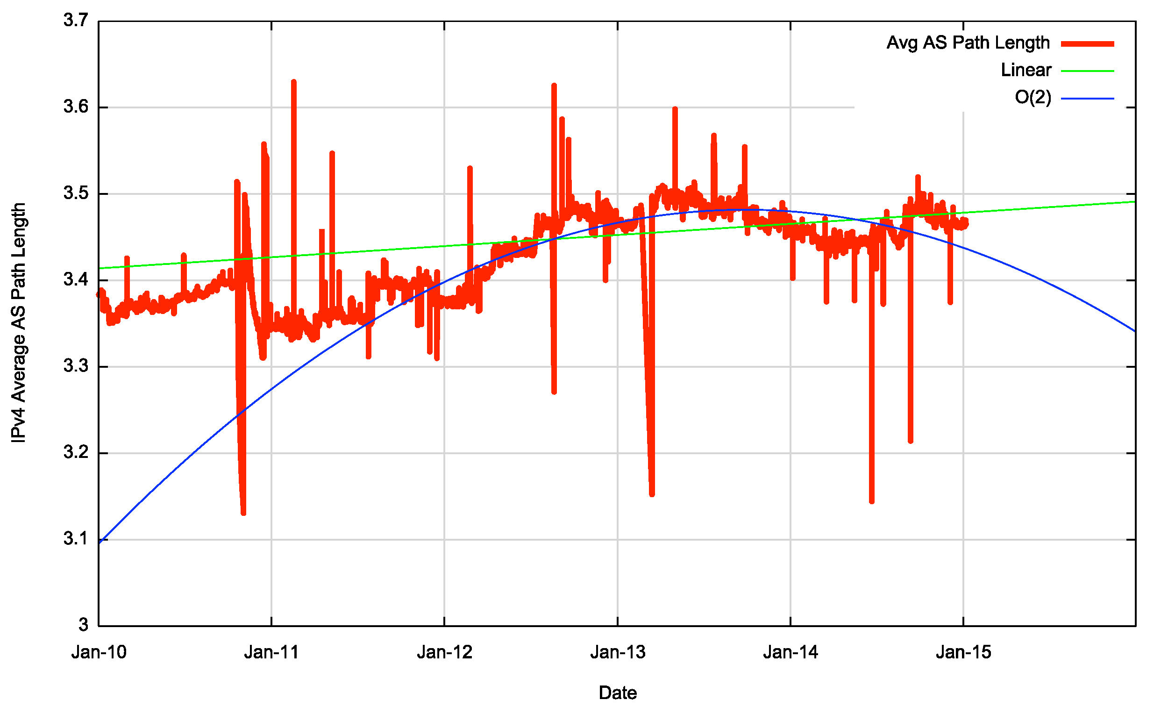
Routing Indicators for IPv4
More Specifics are still taking up one half of the routing table
The “shape” of inter-AS interconnection appears to be steady, as the Average AS Path length has been held steady through the year

Slide 17
How can the IPv4 network continue to grow when we are running out of IPv4 addresses?
We are now recycling old addresses back into the routing system

Slide 18
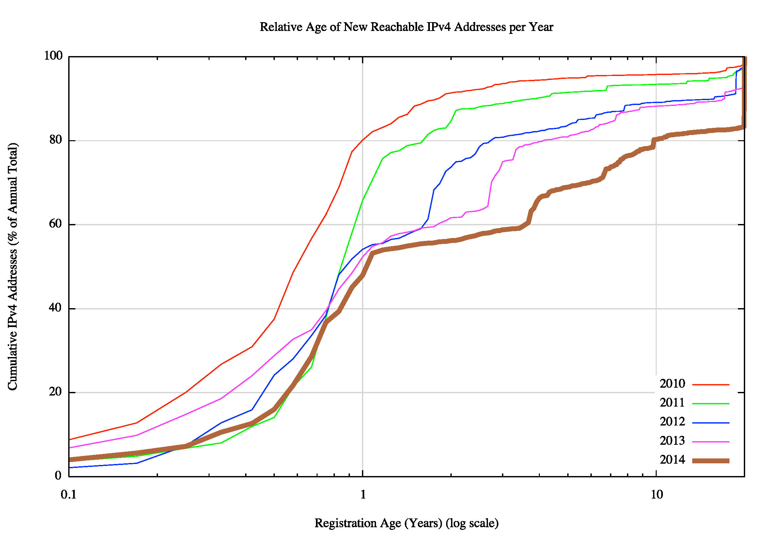
IPv4 Address Reuse
The age distribution of new addresses announced into the
‘routing system each year
20% of new addresses in 2010 were more than 1 year old
50% of new addresses in 2014 were more than 1 year old
18% of new addresses in 2014 were more than 20 years old
It appears that this collection of “old” addresses includes space that has been leased rather than transferred
i.e. the current address user is not listed in the address registry

Slide 19
IPv4 in 2014 – Growth is Slowing
Overall IPv4 Internet growth in terms of BGP is at a rate of some ~9%-10% p.a.
Address span growing far more slowly than the table size
The rate of growth of the IPv4 Internet is slowing down
  Address shortages
  Masking by NAT deployments and transfers
  Saturation of critical market sectors
  Transition uncertainty

Slide 20
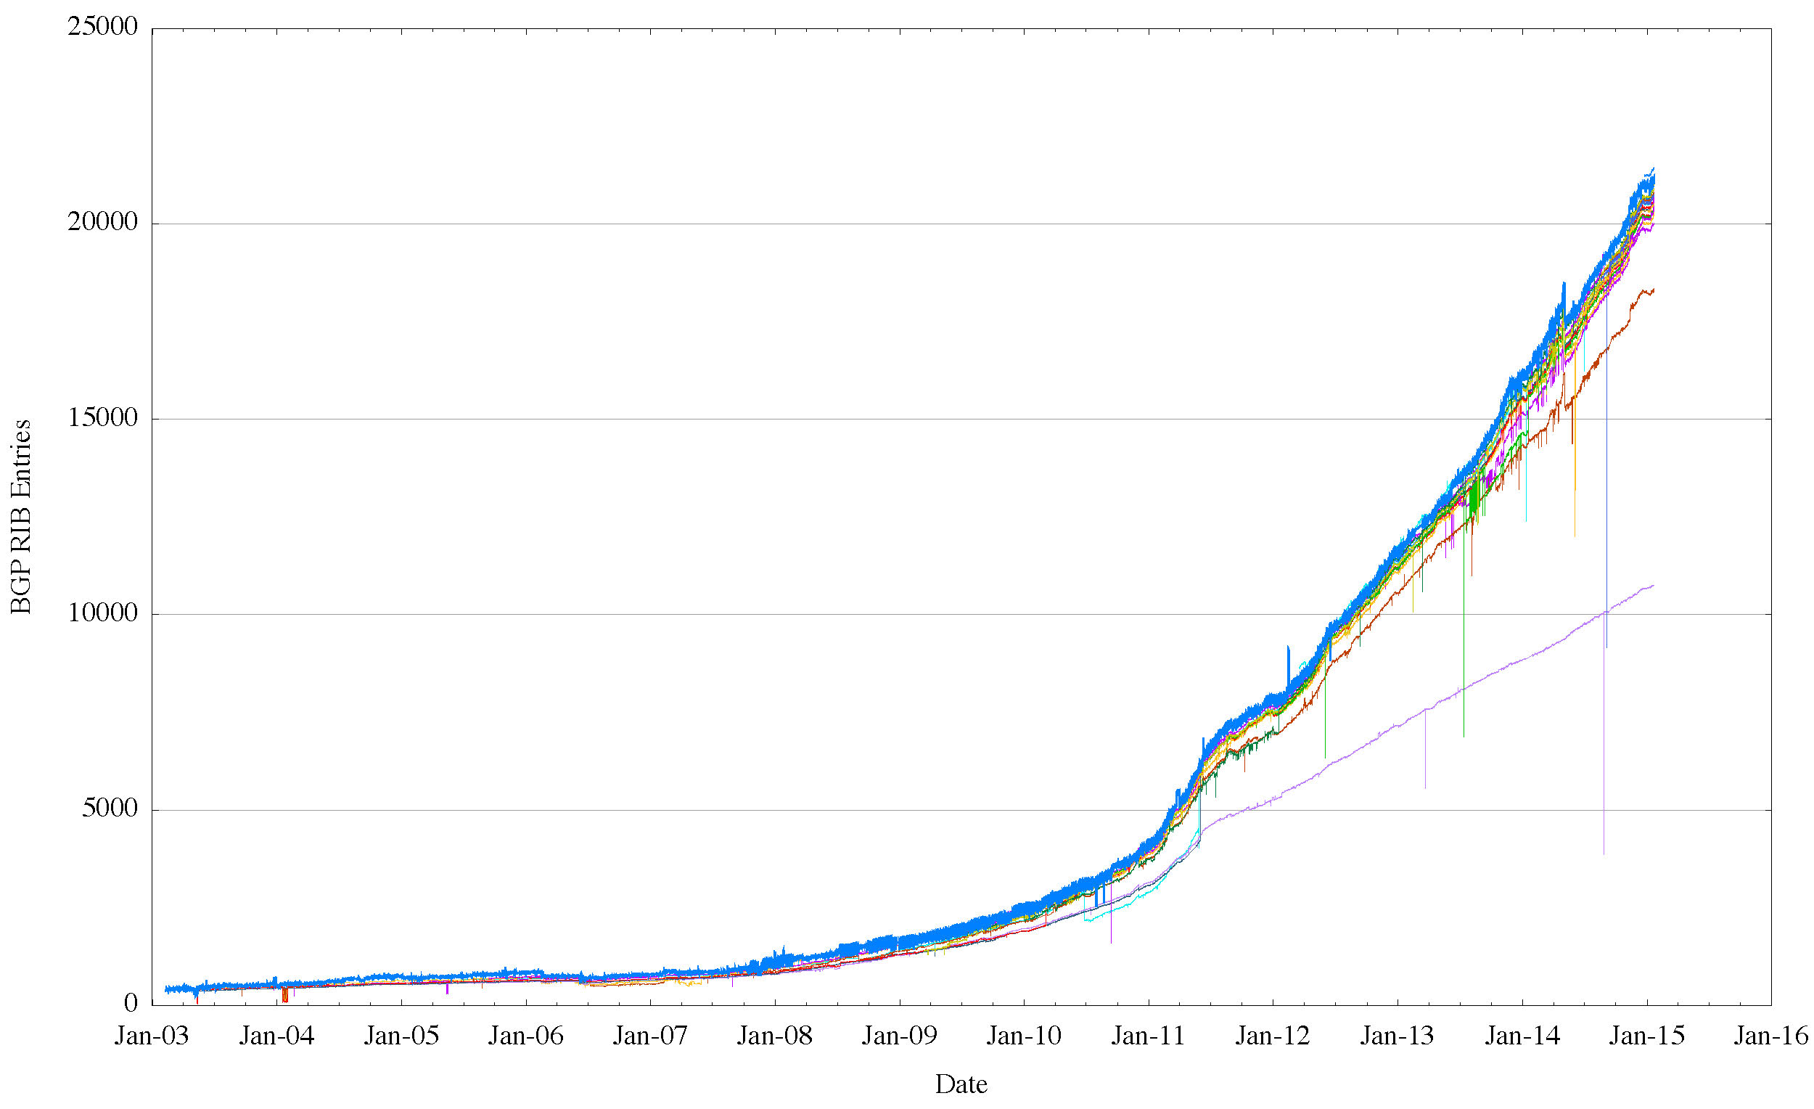
The Route Views view of IPv6
World IPv6 Day
IANA IPv4 Exhaustion

Slide 21
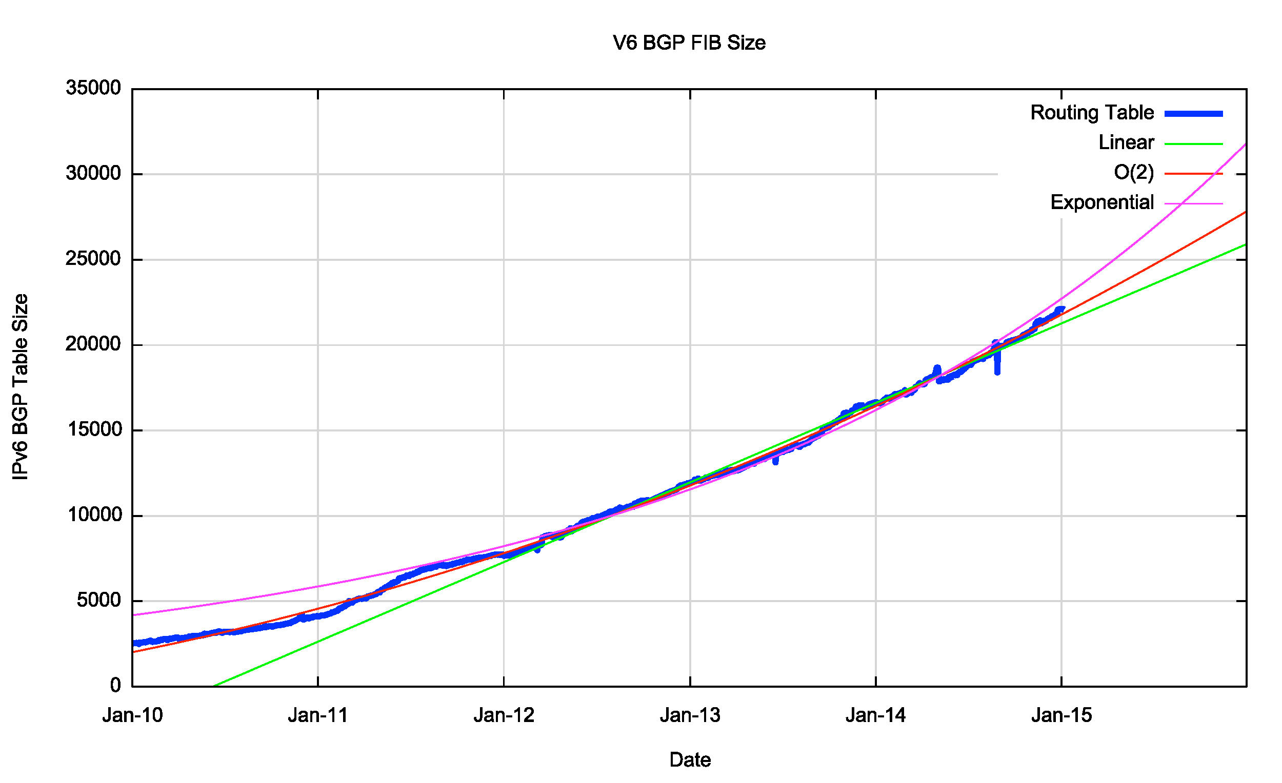
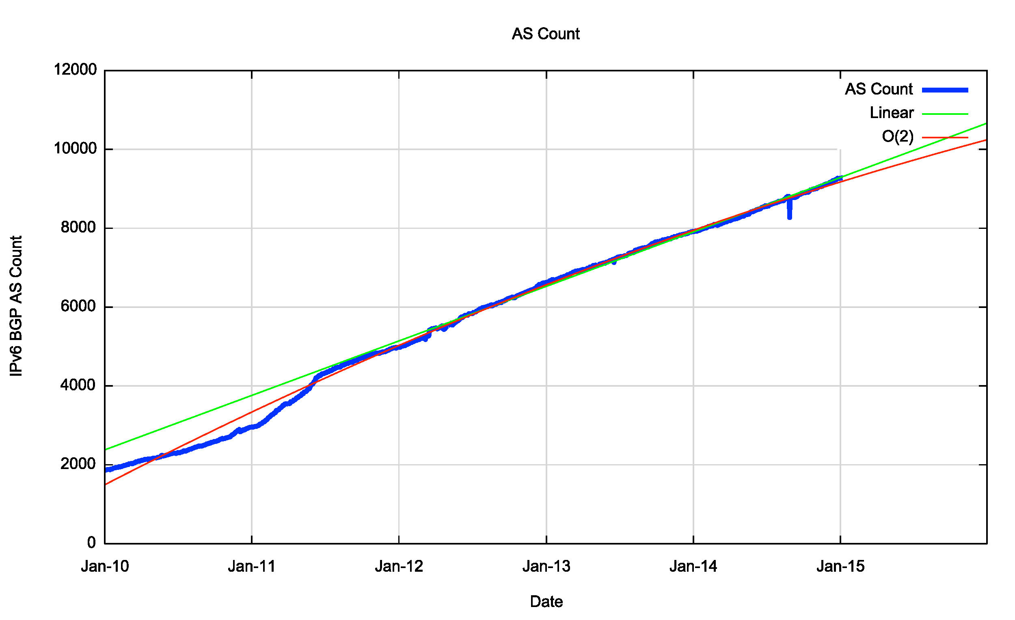
Routing Indicators for IPv6
Routing prefixes – growing by some 6,000 prefixes per year
AS Numbers– growing by some 1,600 prefixes per year (which is half the V4 growth)

Slide 22
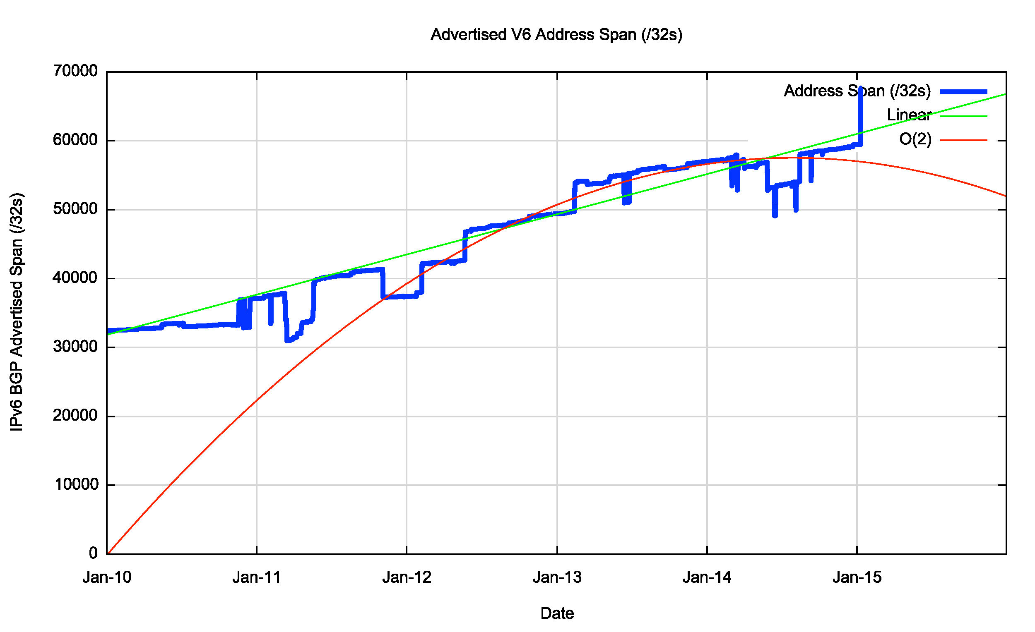
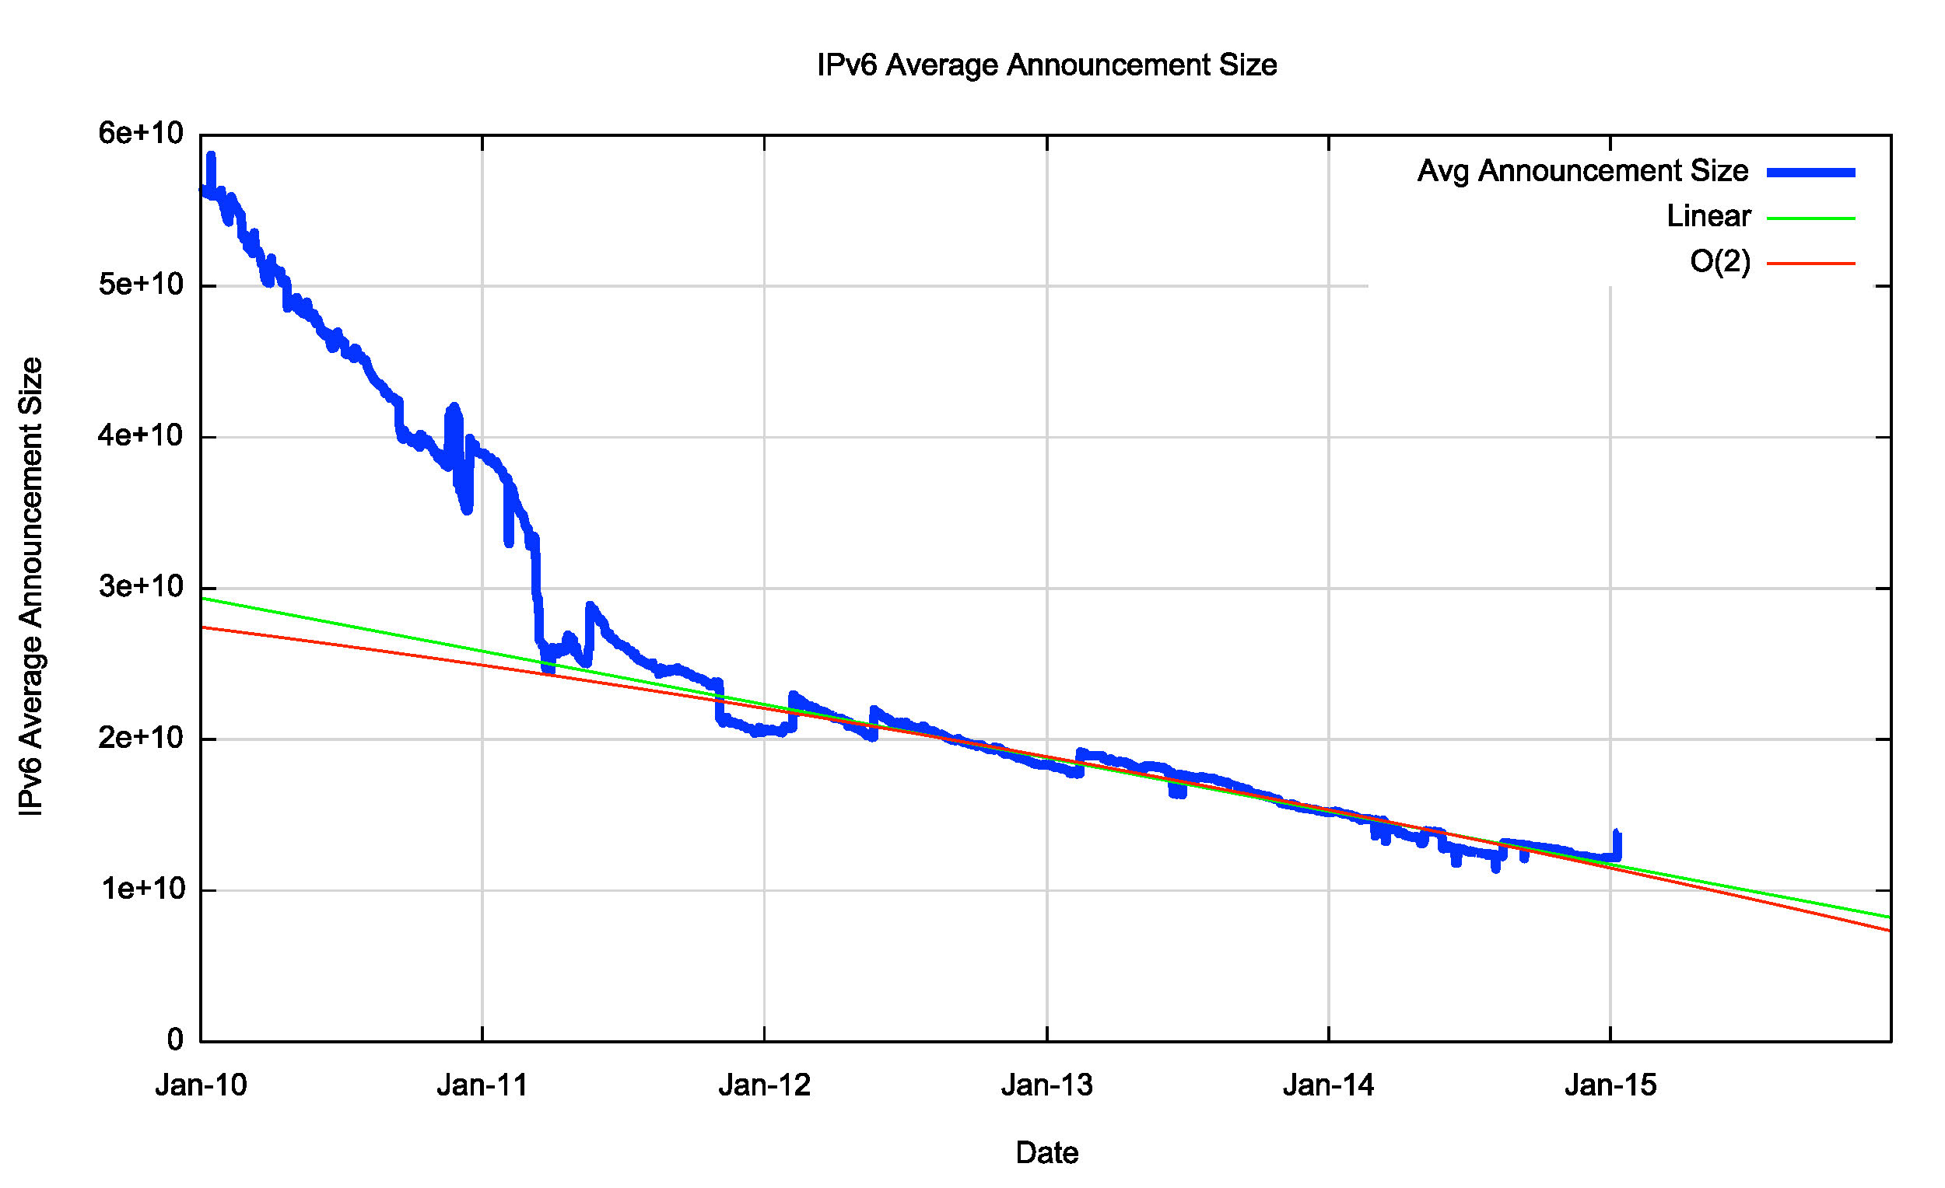
Routing Indicators for IPv6
Address consumption is happening at a constant rate, and not growing year by year
The average size of a routing advertisement is getting smaller

Slide 23
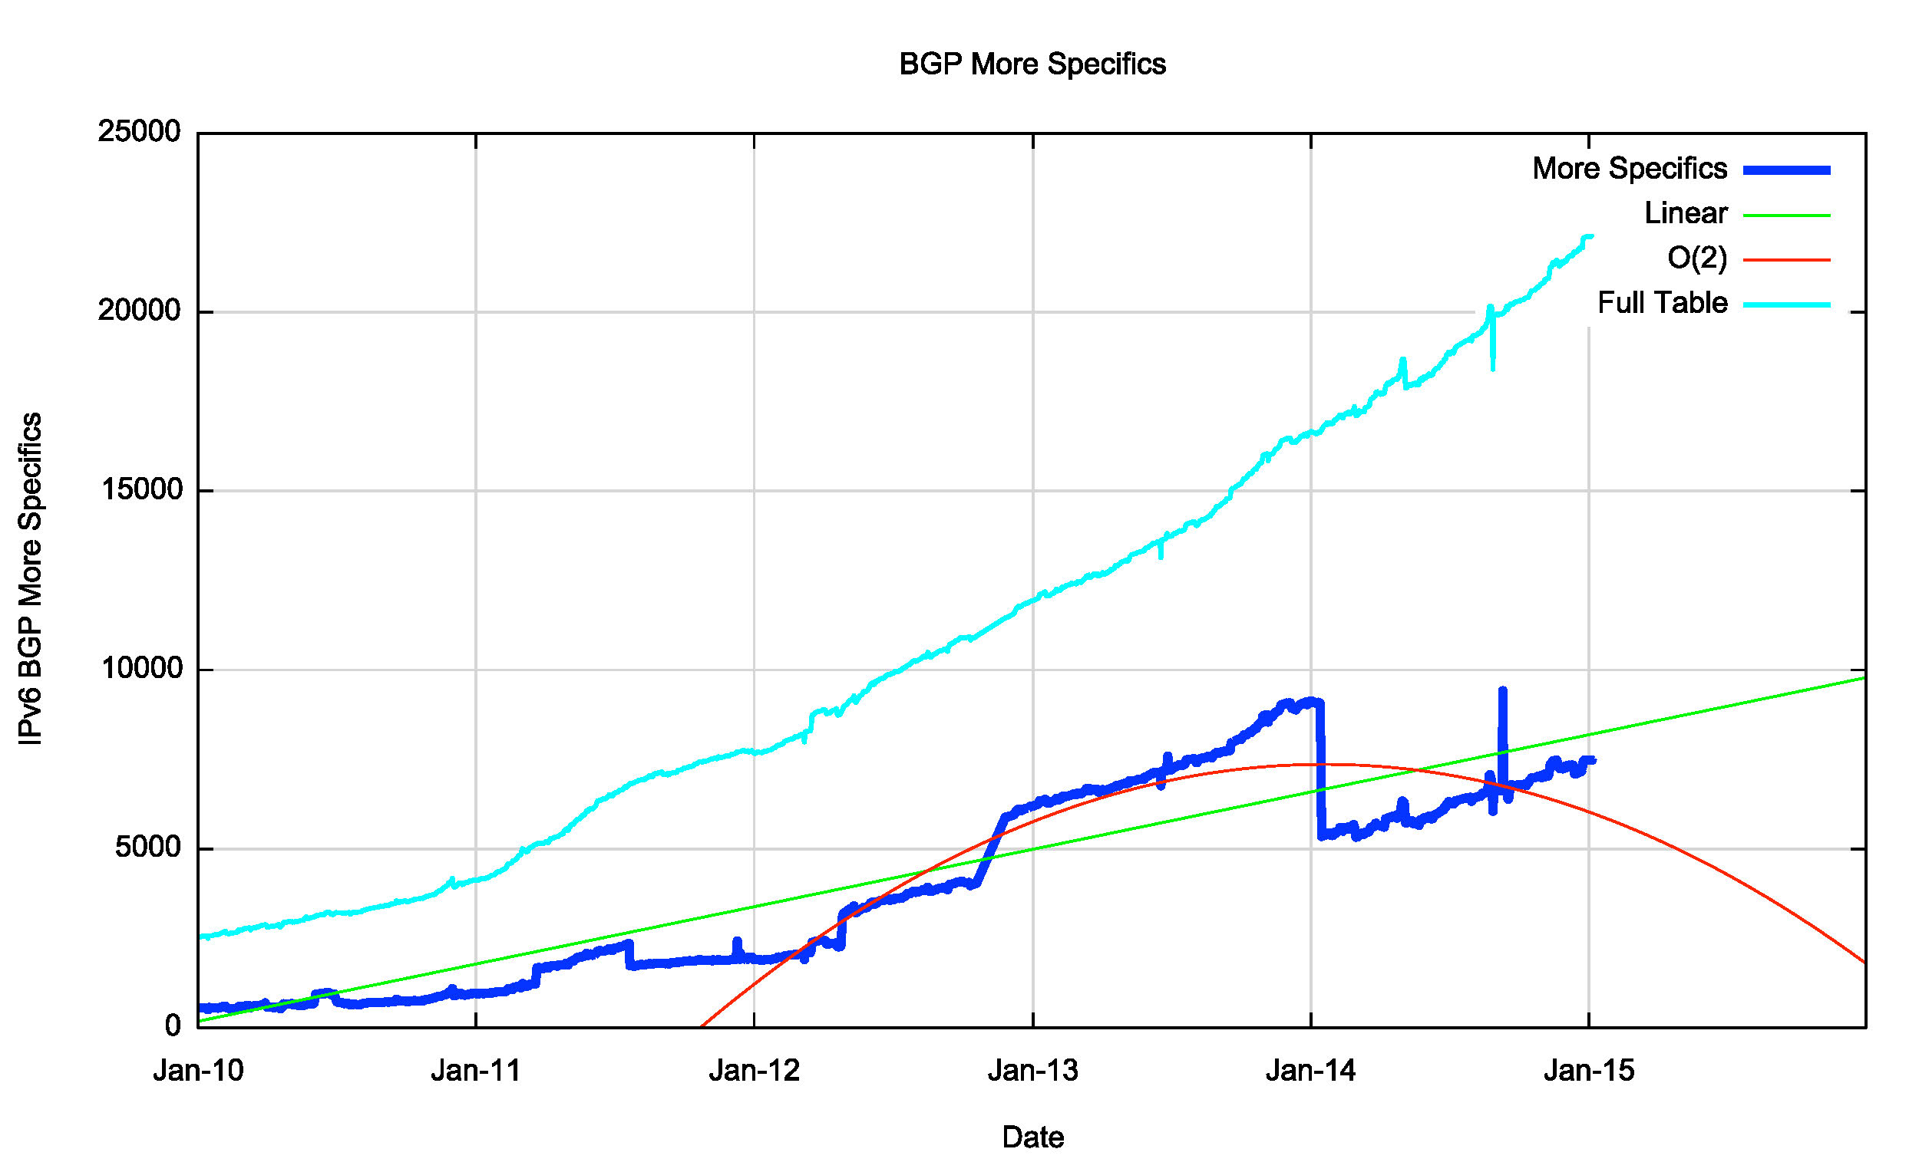
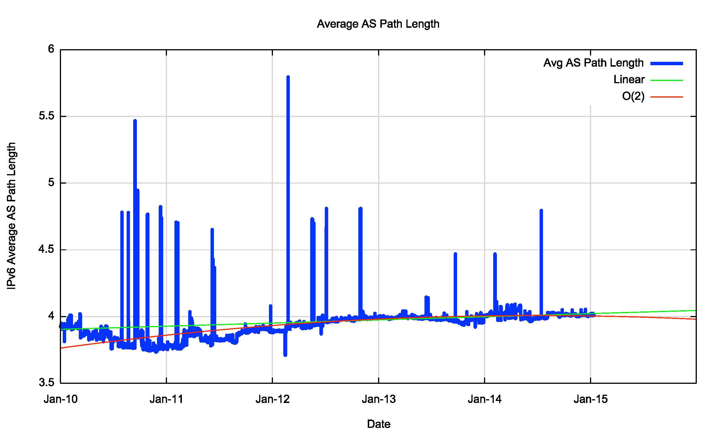
Routing Indicators for IPv6
More Specifics now take up one third of the routing table
The “shape” of inter-AS interconnection appears to be steady, as the Average AS Path length has been held steady through the year

Slide 24
IPv6 in 2013
Overall IPv6 Internet growth in terms of BGP is 20% - 40 % p.a.
  2012 growth rate was ~ 90%.
If these relative growth rates persist then the IPv6 network would span the same network domain as IPv4 in ~16 years time

Slide 25
Are we all now using V6?

Slide 26
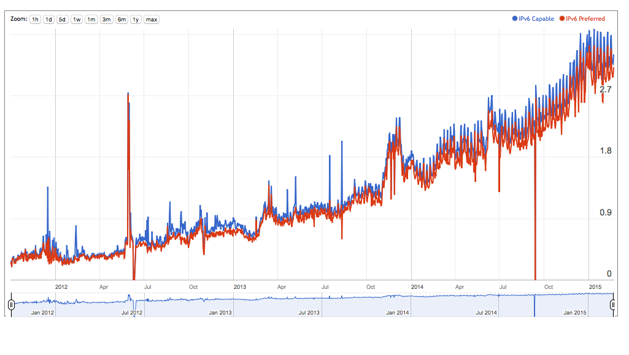
IPv6: How Many Can?

Slide 27
IPv6: How Many Can?
Weekend numbers are 0.4% higher then weekday numbers
0.2% of users prefer to use V4 in dual stack scenarios
IPv6 use has doubled across 2014

Slide 28
Forward Guesstimates
Best Case: IPv6 uptake doubles every year:
2019
Worst Case: IPv6 update constant 2% every year:
2067

Slide 29
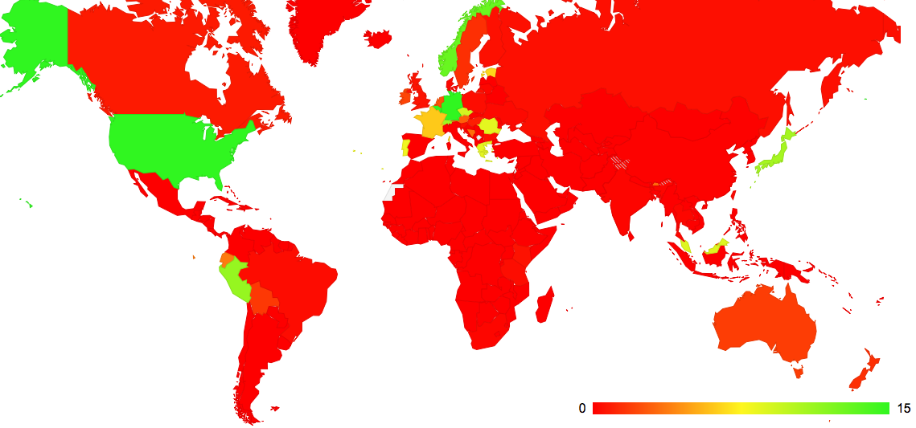
IPv6: Who Can?
IPv6 use by Country – February 2015

Slide 30
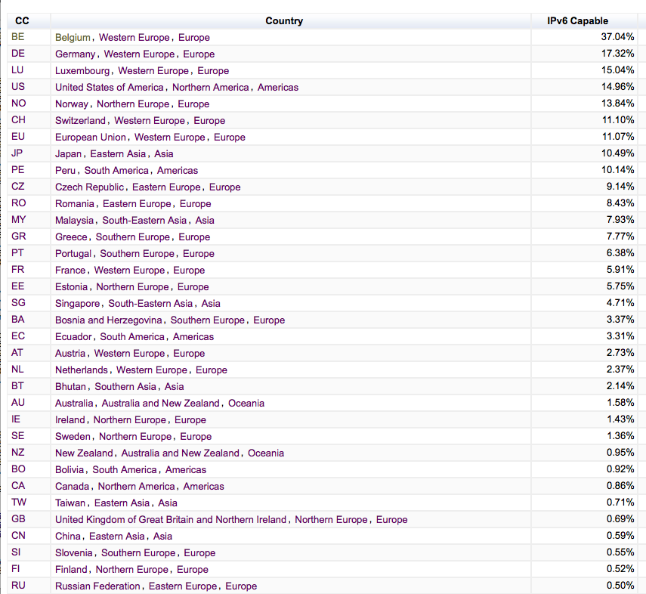
IPv6: Who Can?
IPv6 use by Country – February 2015
World Average

Slide 31
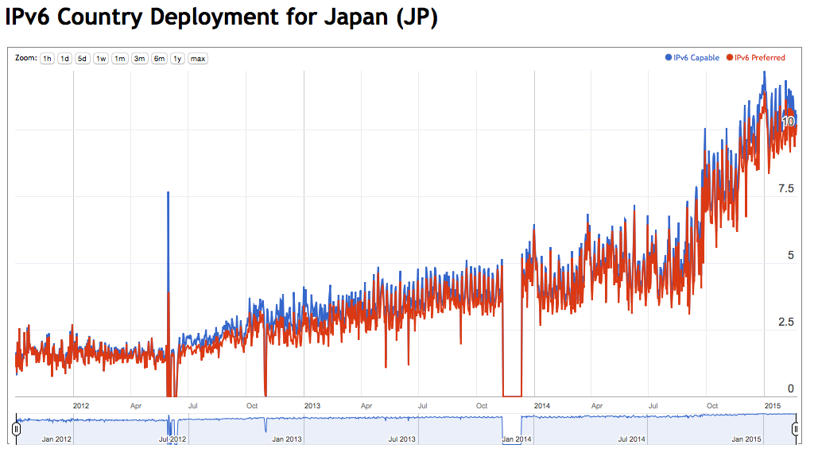
The Local View: Japan

Slide 32
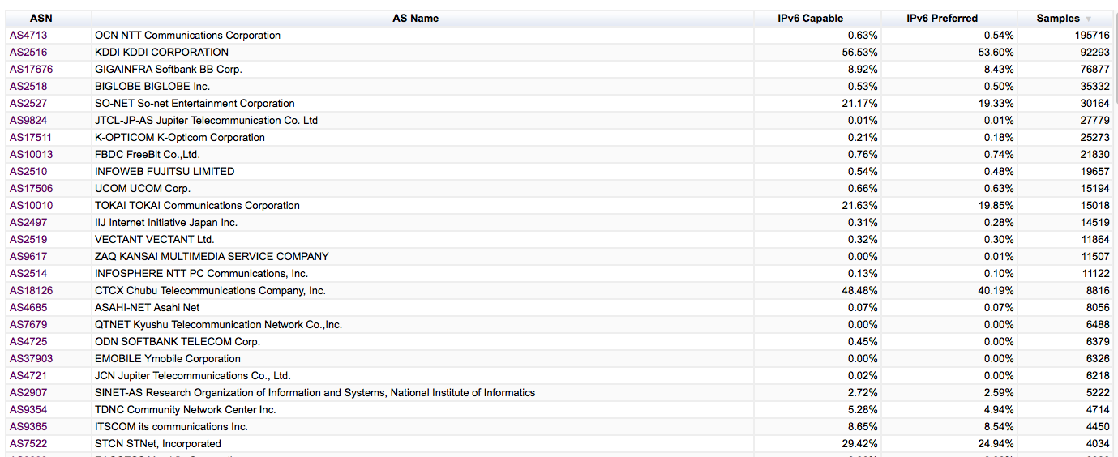
The Local View: Japan

Slide 33
The Internet’s IPv6 Top 30
Est. V6 Users
V6 Takeup

Slide 34
The Internet’s IPv6 Top 30
Est. V6 Users
V6 Takeup
Cumulative Sum

Slide 35
The Internet’s IPv6 Top 30
Est. V6 Users
V6 Takeup
Cumulative Sum
It’s a very uneven takeup of IPv6 – 86% of the world’s IPv6 users sit behind just 30 ISPs

Slide 36
Some Observations
If you allow the customer to own and maintain their own CPE then the CPE upgrade path is a critical issue – old CPE drags the IPv6 numbers down
Mobile providers should see higher penetration numbers … but legacy handsets seem to pull the numbers down
There are some high penetration numbers on “greenfield” deployments, but its rare to see:
49,AS16591,"GOOGLE-FIBER - Google Fiber Inc.",US,155096,87.3%

Slide 37
The Internet’s 30 Largest ISPs

Slide 38
Some Further Observations
IPv6 support is still very patchy:
  While most of the V6 activity in terms of user counts is confined to 30 ISPs, just 6 of the top 30 largest ISPs have any significant IPv6 deployments
The Internet is heavily skewed
  The 30 largest ISPs service 40% of the entire Internet user population
  If these 30 providers were to achieve an average 50% IPv6 uptake in their customer base, then the total IPv6 capability level would be 20% rather than 3.6%

Slide 39
Thank You

