Slide 1
The Resolvers We Use
Geoff Huston
APNIC

Slide 2
Measuring the Internet via Users
At APNIC we’ve been using online ads to measure the user’s view of the Internet for some years
We ask users to fetch a unique URL
This involves a DNS resolution and a HTTP GET to our servers
So we collect sets of DNS queries and WEB queries
And we can put them together
To see which DNS resolvers are used by which users

Slide 3
Some Numbers
January to October 2014
55,543,450 individual sample points
510,371 unique resolver IP addresses

Slide 4
Top 25 Resolvers
Rank Resolver Use %
1 74.125.189.20 962,729 0.42%
2 74.125.189.16 961,207 0.42%
3 74.125.189.23 960,124 0.42%
4 74.125.189.17 959,964 0.42%
5 74.125.189.21 959,915 0.42%
6 74.125.189.19 959,060 0.42%
7 74.125.189.18 958,675 0.42%
8 74.125.189.22 958,597 0.42%
9 74.125.41.81 879,019 0.39%
10 74.125.41.82 877,909 0.39%
11 74.125.41.84 876,049 0.39%
12 74.125.41.83 875,978 0.39%
13 74.125.41.80 875,355 0.39%
14 74.125.41.16 862,749 0.38%
15 74.125.41.17 862,407 0.38%
16 74.125.41.18 861,868 0.38%
17 74.125.41.20 861,713 0.38%
18 74.125.41.19 861,538 0.38%
19 74.125.16.82 731,702 0.32%
20 74.125.16.81 730,670 0.32%
21 74.125.16.84 730,328 0.32%
22 74.125.16.80 730,098 0.32%
23 74.125.16.83 729,540 0.32%
24 74.125.41.145 669,941 0.30%
25 74.125.41.147 669,081 0.29%

Slide 5
Top 25 Resolvers
Rank Resolver Use %
1 74.125.189.20 962,729 0.42%
2 74.125.189.16 961,207 0.42%
3 74.125.189.23 960,124 0.42%
4 74.125.189.17 959,964 0.42%
5 74.125.189.21 959,915 0.42%
6 74.125.189.19 959,060 0.42%
7 74.125.189.18 958,675 0.42%
8 74.125.189.22 958,597 0.42%
9 74.125.41.81 879,019 0.39%
10 74.125.41.82 877,909 0.39%
11 74.125.41.84 876,049 0.39%
12 74.125.41.83 875,978 0.39%
13 74.125.41.80 875,355 0.39%
14 74.125.41.16 862,749 0.38%
15 74.125.41.17 862,407 0.38%
16 74.125.41.18 861,868 0.38%
17 74.125.41.20 861,713 0.38%
18 74.125.41.19 861,538 0.38%
19 74.125.16.82 731,702 0.32%
20 74.125.16.81 730,670 0.32%
21 74.125.16.84 730,328 0.32%
22 74.125.16.80 730,098 0.32%
23 74.125.16.83 729,540 0.32%
24 74.125.41.145 669,941 0.30%
25 74.125.41.147 669,081 0.29%
This list looks pretty strange!

Slide 6
Top Resolvers
Rank Resolver Use % Origin AS
1 74.125.189.20 962,729 0.42% 15169 - Google
2 74.125.189.16 961,207 0.42% 15169 - Google
3 74.125.189.23 960,124 0.42% 15169 - Google
4 74.125.189.17 959,964 0.42% 15169 - Google
5 74.125.189.21 959,915 0.42% 15169 - Google
6 74.125.189.19 959,060 0.42% 15169 - Google
7 74.125.189.18 958,675 0.42% 15169 - Google
8 74.125.189.22 958,597 0.42% 15169 - Google
9 74.125.41.81 879,019 0.39% 15169 - Google
10 74.125.41.82 877,909 0.39% 15169 - Google
11 74.125.41.84 876,049 0.39% 15169 - Google
12 74.125.41.83 875,978 0.39% 15169 - Google
13 74.125.41.80 875,355 0.39% 15169 - Google
14 74.125.41.16 862,749 0.38% 15169 - Google
15 74.125.41.17 862,407 0.38% 15169 - Google
16 74.125.41.18 861,868 0.38% 15169 - Google
17 74.125.41.20 861,713 0.38% 15169 - Google
18 74.125.41.19 861,538 0.38% 15169 - Google
19 74.125.16.82 731,702 0.32% 15169 - Google
20 74.125.16.81 730,670 0.32% 15169 - Google
21 74.125.16.84 730,328 0.32% 15169 - Google
22 74.125.16.80 730,098 0.32% 15169 - Google
23 74.125.16.83 729,540 0.32% 15169 - Google
24 74.125.41.145 669,941 0.30% 15169 - Google
25 74.125.41.147 669,081 0.29% 15169 - Google
When we add origin AS it gets a little clearer
These resolvers are part of Google’s Public DNS resolver
farms that support 8.8.8.8 and 8.8.4.4 – they are the fetch slaves
So we need a different counting approach -- what if we group all resolvers by their AS?

Slide 7
Top Resolvers by AS
Rank AS Count Share Cumulative AS Name
1 15169 77,752,963 34.24% 34.24% GOOGLE - Google Inc.,US
2 4134 7,515,050 3.31% 37.55% CHINANET-BACKBONE No.31,Jin-rong Street,CN
3 3462 5,651,005 2.49% 40.04% HINET Data Communication Business Group,TW
4 3356 5,544,822 2.44% 42.48% LEVEL3 - Level 3 Communications, Inc.,US
5 6147 5,123,169 2.26% 44.74% Telefonica del Peru S.A.A.,PE
6 16880 4,120,210 1.81% 46.55% AS2-TRENDMICRO-COM - TREND MICRO INCORPORATED,US
7 8151 4,090,436 1.80% 48.35% Uninet S.A. de C.V.,MX
8 7470 3,388,845 1.49% 49.85% TRUEINTERNET-AS-AP TRUE INTERNET Co.,Ltd.,TH
9 4837 3,150,429 1.39% 51.23% CHINA169-BACKBONE CNCGROUP China169 Backbone,CN
10 9121 2,958,671 1.30% 52.54% TTNET Turk Telekomunikasyon Anonim Sirketi,TR
11 7922 2,808,303 1.24% 53.77% COMCAST-7922 - Comcast Cable Communications, Inc.,US
12 9299 2,719,648 1.20% 54.97% IPG-AS-AP Philippine Long Distance Telephone Company,PH
13 4766 2,595,704 1.14% 56.11% KIXS-AS-KR Korea Telecom,KR
14 45758 2,408,824 1.06% 57.17% TRIPLETNET-AS-AP TripleT Bangkok,TH
15 36692 2,075,246 0.91% 58.09% OPENDNS - OpenDNS, LLC,US
16 9318 1,839,866 0.81% 58.90% HANARO-AS Hanaro Telecom Inc.,KR
17 8048 1,740,434 0.77% 59.67% CANTV Servicios, Venezuela,VE
18 3786 1,675,723 0.74% 60.40% LGDACOM LG DACOM Corporation,KR
19 9737 1,662,131 0.73% 61.14% TOTNET-TH-AS-AP TOT Public Company Limited,TH
20 13489 1,634,966 0.72% 61.86% EPM Telecomunicaciones S.A. E.S.P.,CO
21 17974 1,554,658 0.68% 62.54% TELKOMNET-AS2-AP PT Telekomunikasi Indonesia,ID
22 7643 1,487,808 0.66% 63.20% VNPT-AS-VN Vietnam Posts and Telecommunications,VN
23 7303 1,414,687 0.62% 63.82% Telecom Argentina S.A.,AR
24 19994 1,357,249 0.60% 64.42% RACKSPACE - Rackspace Hosting,US
25 8708 1,272,774 0.56% 64.98% RCS-RDS RCS & RDS SA,RO

Slide 8
Top Resolvers by AS
Rank AS Count Share Cumulative AS Name
1 15169 77,752,963 34.24% 34.24% GOOGLE - Google Inc.,US
2 4134 7,515,050 3.31% 37.55% CHINANET-BACKBONE No.31,Jin-rong Street,CN
3 3462 5,651,005 2.49% 40.04% HINET Data Communication Business Group,TW
4 3356 5,544,822 2.44% 42.48% LEVEL3 - Level 3 Communications, Inc.,US
5 6147 5,123,169 2.26% 44.74% Telefonica del Peru S.A.A.,PE
6 16880 4,120,210 1.81% 46.55% AS2-TRENDMICRO-COM - TREND MICRO INCORPORATED,US
7 8151 4,090,436 1.80% 48.35% Uninet S.A. de C.V.,MX
8 7470 3,388,845 1.49% 49.85% TRUEINTERNET-AS-AP TRUE INTERNET Co.,Ltd.,TH
9 4837 3,150,429 1.39% 51.23% CHINA169-BACKBONE CNCGROUP China169 Backbone,CN
10 9121 2,958,671 1.30% 52.54% TTNET Turk Telekomunikasyon Anonim Sirketi,TR
11 7922 2,808,303 1.24% 53.77% COMCAST-7922 - Comcast Cable Communications, Inc.,US
12 9299 2,719,648 1.20% 54.97% IPG-AS-AP Philippine Long Distance Telephone Company,PH
13 4766 2,595,704 1.14% 56.11% KIXS-AS-KR Korea Telecom,KR
14 45758 2,408,824 1.06% 57.17% TRIPLETNET-AS-AP TripleT Bangkok,TH
15 36692 2,075,246 0.91% 58.09% OPENDNS - OpenDNS, LLC,US
16 9318 1,839,866 0.81% 58.90% HANARO-AS Hanaro Telecom Inc.,KR
17 8048 1,740,434 0.77% 59.67% CANTV Servicios, Venezuela,VE
18 3786 1,675,723 0.74% 60.40% LGDACOM LG DACOM Corporation,KR
19 9737 1,662,131 0.73% 61.14% TOTNET-TH-AS-AP TOT Public Company Limited,TH
20 13489 1,634,966 0.72% 61.86% EPM Telecomunicaciones S.A. E.S.P.,CO
21 17974 1,554,658 0.68% 62.54% TELKOMNET-AS2-AP PT Telekomunikasi Indonesia,ID
22 7643 1,487,808 0.66% 63.20% VNPT-AS-VN Vietnam Posts and Telecommunications,VN
23 7303 1,414,687 0.62% 63.82% Telecom Argentina S.A.,AR
24 19994 1,357,249 0.60% 64.42% RACKSPACE - Rackspace Hosting,US
25 8708 1,272,774 0.56% 64.98% RCS-RDS RCS & RDS SA,RO
This list still looks pretty strange!
The problem is that resolver farms amplify their
presence in this list because they splay multiple
Instances of the same query across slave resolvers
Can we compensate for this?

Slide 9
Top Resolvers by AS – Filtered
Rank AS Use AS Name
1 15169 11.88% GOOGLE - Google Inc.,US
2 4134 4.04% CHINANET-BACKBONE No.31,Jin-rong Street,CN
3 8151 2.68% Uninet S.A. de C.V.,MX
4 4837 2.19% CHINA169-BACKBONE CNCGROUP China169 Backbone,CN
5 3356 2.12% LEVEL3 - Level 3 Communications, Inc.,US
6 6147 2.11% Telefonica del Peru S.A.A.,PE
7 36692 2.00% OPENDNS - OpenDNS, LLC,US
8 9121 1.75% TTNET Turk Telekomunikasyon Anonim Sirketi,TR
9 3462 1.24% HINET Data Communication Business Group,TW
10 4766 1.18% KIXS-AS-KR Korea Telecom,KR
11 45758 1.14% TRIPLETNET-AS-AP TripleT Internet Internet service provider Bangkok,TH
12 7470 1.05% TRUEINTERNET-AS-AP TRUE INTERNET Co.,Ltd.,TH
13 8452 0.97% TE-AS TE-AS,EG
14 6713 0.96% IAM-AS,MA
15 9737 0.92% TOTNET-TH-AS-AP TOT Public Company Limited,TH
16 7303 0.90% Telecom Argentina S.A.,AR
17 17974 0.88% TELKOMNET-AS2-AP PT Telekomunikasi Indonesia,ID
18 7643 0.86% VNPT-AS-VN Vietnam Posts and Telecommunications (VNPT),VN
19 45595 0.82% PKTELECOM-AS-PK Pakistan Telecom Company Limited,PK
20 9299 0.80% IPG-AS-AP Philippine Long Distance Telephone Company,PH
21 8048 0.79% CANTV Servicios, Venezuela,VE
22 8708 0.79% RCS-RDS RCS & RDS SA,RO
23 13489 0.77% EPM Telecomunicaciones S.A. E.S.P.,CO
24 22927 0.75% Telefonica de Argentina,AR
8400 0.73% TELEKOM-AS TELEKOM SRBIJA a.d.,RS
Total: 78,138,640 end user query sets

Slide 10
Who’s “Local” and Who’s Not?
Let’s filter this data by removing all entries where the user and the visible resolver are in the same network (same AS)
Which non-local resolvers are being used?

Slide 11
Non-Local (AS) Resolution: Top Resolvers by AS
Rank AS Use AS Name
1 15169 29.53% GOOGLE - Google Inc.,US
2 3356 5.26% LEVEL3 - Level 3 Communications, Inc.,US
3 36692 4.99% OPENDNS - OpenDNS, LLC,US
4 7470 2.55% TRUEINTERNET-AS-AP TRUE INTERNET Co.,Ltd.,TH
5 7643 2.13% VNPT-AS-VN Vietnam Posts and Telecommunications (VNPT),VN
6 19994 1.75% RACKSPACE - Rackspace Hosting,US
7 14080 1.62% Telmex Colombia S.A.,CO
8 16880 1.53% AS2-TRENDMICRO-COM - TREND MICRO INCORPORATED,US
9 4134 1.33% CHINANET-BACKBONE No.31,Jin-rong Street,CN
10 174 1.29% COGENT-174 - Cogent Communications,US
11 4813 1.21% BACKBONE-GUANGDONG-AP China Telecom(Group),CN
12 9737 0.96% TOTNET-TH-AS-AP TOT Public Company Limited,TH
13 20746 0.93% ASN-IDC Telecomitalia s.p.a.,IT
14 3786 0.93% LGDACOM LG DACOM Corporation,KR
15 3462 0.80% HINET Data Communication Business Group,TW
16 2914 0.77% NTT-COMMUNICATIONS-2914 - NTT America, Inc.,US
17 4837 0.73% CHINA169-BACKBONE CNCGROUP China169 Backbone,CN
18 17894 0.71% APMI-AS-AP AyalaPort Makati, Inc. / Data Center Operator,PH
19 9121 0.67% TTNET Turk Telekomunikasyon Anonim Sirketi,TR
20 4766 0.54% KIXS-AS-KR Korea Telecom,KR
21 23724 0.51% CHINANET-IDC-BJ-AP IDC, China Telecommunications Corporation,CN
22 29791 0.48% VOXEL-DOT-NET - Voxel Dot Net, Inc.,US
23 18101 0.47% RELIANCE-COMMUNICATIONS-IN Reliance Communications Ltd.DAKC MUMBAI,IN
24 4808 0.46% CHINA169-BJ CNCGROUP IP network China169 Beijing Province Network,CN
8151 0.44% Uninet S.A. de C.V.,MX
Total: 31,366,769 (41% of total) end user query sets

Slide 12
Who’s “Foreign”?
Let’s apply a further filter and look only at those instances where the IP address of the end users and that of the resolvers that they are using are geo-located into different countries

Slide 13
Foreign (CC) Resolution: Top Resolvers by AS
Rank AS Use AS Name
1 15169 42.69% GOOGLE - Google Inc.,US
2 3356 7.47% LEVEL3 - Level 3 Communications, Inc.,US
3 36692 7.05% OPENDNS - OpenDNS, LLC,US
4 19994 2.56% RACKSPACE - Rackspace Hosting,US
5 174 1.87% COGENT-174 - Cogent Communications,US
6 16880 1.70% AS2-TRENDMICRO-COM - TREND MICRO INCORPORATED,US
7 2914 1.09% NTT-COMMUNICATIONS-2914 - NTT America, Inc.,US
8 4134 0.91% CHINANET-BACKBONE No.31,Jin-rong Street,CN
9 29791 0.70% VOXEL-DOT-NET - Voxel Dot Net, Inc.,US
10 3462 0.67% HINET Data Communication Business Group,TW
11 9121 0.64% TTNET Turk Telekomunikasyon Anonim Sirketi,TR
12 3303 0.64% SWISSCOM Swisscom (Switzerland) Ltd,CH
13 6939 0.63% HURRICANE - Hurricane Electric, Inc.,US
14 6147 0.50% Telefonica del Peru S.A.A.,PE
15 6713 0.48% IAM-AS,MA
16 8048 0.47% CANTV Servicios, Venezuela,VE
17 3257 0.47% TINET-BACKBONE Tinet SpA,DE
18 13238 0.43% YANDEX Yandex LLC,RU
19 45595 0.41% PKTELECOM-AS-PK Pakistan Telecom Company Limited,PK
20 9299 0.40% IPG-AS-AP Philippine Long Distance Telephone Company,PH
21 7643 0.39% VNPT-AS-VN Vietnam Posts and Telecommunications (VNPT),VN
22 45758 0.39% TRIPLETNET-AS-AP TripleT Internet Internet service provider Bangkok,TH
23 8151 0.38% Uninet S.A. de C.V.,MX
24 7470 0.35% TRUEINTERNET-AS-AP TRUE INTERNET Co.,Ltd.,TH
4837 0.35% CHINA169-BACKBONE CNCGROUP China169 Backbone,CN
Total: 21,770,772 (28% of total) end user query sets

Slide 14
Countries with users that have the lowest foreign resolution counts
CC % Foreign Domestic Country
KR 6.40% 126,289 1,847,614 Republic of Korea
MT 9.19% 6,616 65,386 Malta
PF 9.46% 866 8,289 French Polynesia
EE 10.28% 7,506 65,534 Estonia
LT 10.54% 30,701 260,520 Lithuania
GR 10.76% 75,816 628,865 Greece
NZ 11.46% 16,913 130,625 New Zealand
US 12.27% 345,141 2,468,489 United States of America
CN 12.55% 1,040,371 7,252,198 China
UY 12.71% 18,610 127,825 Uruguay
CL 13.17% 95,664 630,654 Chile
FR 13.45% 135,454 871,551 France
SA 13.62% 65,878 417,676 Saudi Arabia
HR 13.66% 41,844 264,445 Croatia
FI 13.88% 11,941 74,069 Finland
PT 14.05% 36,183 221,333 Portugal
NO 14.16% 5,414 32,817 Norway
LV 14.32% 17,282 103,380 Latvia
MD 14.51% 13,058 76,947 Republic of Moldova
PE 14.95% 312,380 1,776,943 Peru
OM 15.20% 7,959 44,402 Oman
ES 15.83% 100,854 536,200 Spain
UZ 15.89% 1,927 10,199 Uzbekistan
SI 16.36% 30,856 157,700 Slovenia
BE 16.47% 22,420 113,685 Belgium
RO 16.49% 246,980 1,250,893 Romania
SE 17.01% 14,803 72,197 Sweden
IL 17.07% 42,632 207,185 Israel
MX 17.14% 620,083 2,996,650 Mexico
DE 17.57% 84,623 397,127 Germany

Slide 15
Countries with highest foreign resolution counts
CC % Foreign Domestic Country
DZ 99.20% 1,421,962 11,481 Algeria
VC 99.07% 5,727 54 Saint Vincent and the Grenadines
TC 99.05% 1,667 16 Turks and Caicos Islands
AW 98.55% 4,978 73 Aruba
AF 94.94% 17,816 949 Afghanistan
BF 93.58% 3,572 245 Burkina Faso
SO 93.50% 6,125 426 Somalia
DJ 93.06% 8,075 602 Djibouti
GN 87.93% 1,901 261 Guinea
GQ 87.55% 1,048 149 Equatorial Guinea
LR 85.84% 1,358 224 Liberia
CD 84.67% 2,336 423 Democratic Republic of the Congo
NI 82.95% 51,406 10,567 Nicaragua
CG 81.10% 1,952 455 Congo
SV 78.61% 88,730 24,147 El Salvador
IR 76.26% 1,031 321 Iran (Islamic Republic of)
RE 74.56% 3,057 1,043 Reunion
SL 72.16% 1,296 500 Sierra Leone
ZW 71.46% 3,305 1,320 Zimbabwe
VN 68.42% 2,265,186 1,045,587 Vietnam
BN 67.66% 22,813 10,904 Brunei Darussalam
BI 67.40% 827 400 Burundi
ZM 64.17% 2,644 1,476 Zambia
NG 63.29% 21,066 12,217 Nigeria
HN 60.19% 34,908 23,084 Honduras
GH 59.30% 31,273 21,464 Ghana
AZ 57.01% 134,218 101,222 Azerbaijan

Slide 16
Mapping the resolver spread
For each country can we show the distribution of the resolvers used by users located within that country?

Slide 17
Mapping Foreign Resolution- US
11.95% use JP resolvers
6.46% use PK resolvers
% of foreign name resolution per country
US: 2,813,576 samples, 345,087 foreign resolution instances
7.23% use CN resolvers

Slide 18
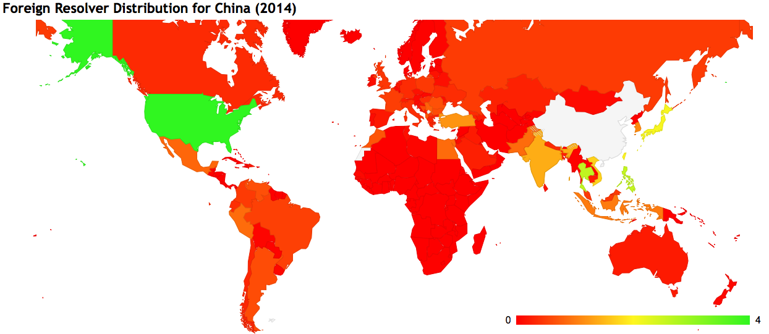
Mapping Foreign Resolution - CN
59.9% use US resolvers
% of foreign name resolution per country
2.55% use PH resolvers
China: 8,292,566 samples, 1,040,368 foreign resolution instances
2.59% use TH resolvers

Slide 19
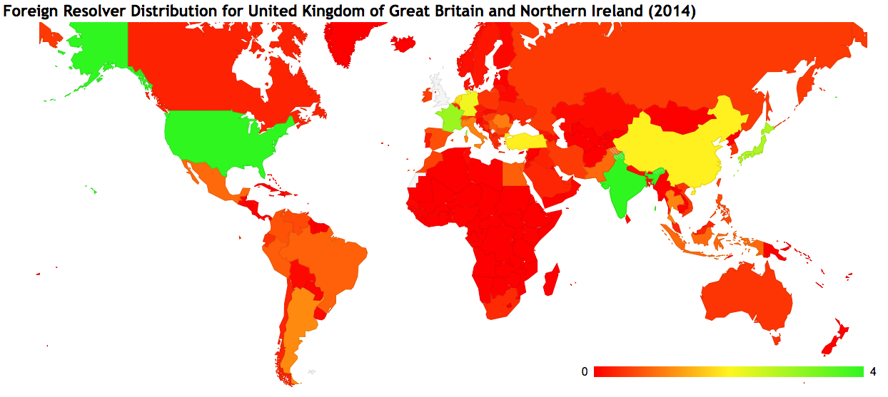
Mapping Foreign Resolution - GB
48.76% use US resolvers
2,93% use FR resolvers
% of foreign name resolution per country
4,20% use IN resolvers
UK: 519,190 samples, 106,638 foreign resolution instances

Slide 20
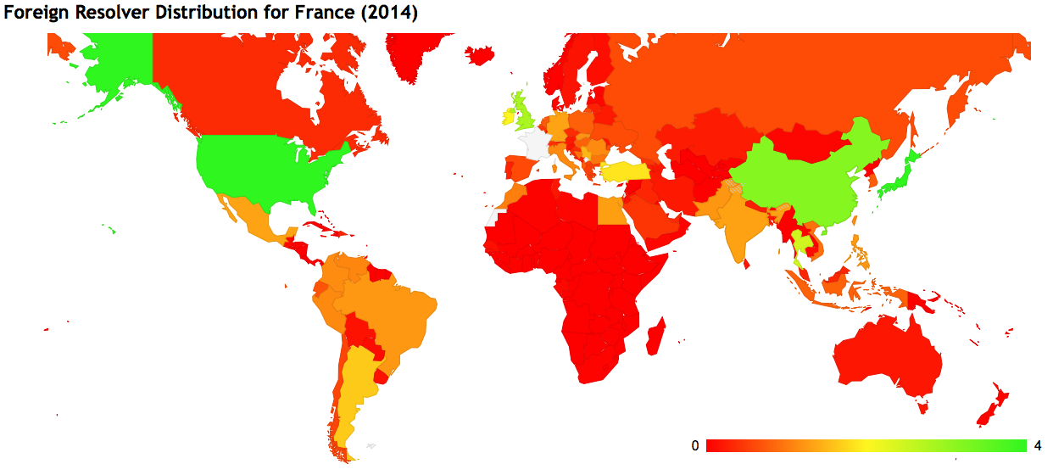
Mapping Foreign Resolution - FR
35.53% use US resolvers
2.83% use GB resolvers
% of foreign name resolution per country
3.14% use CN resolvers
France: 1,007,004 samples, 135,453 foreign resolution instances

Slide 21
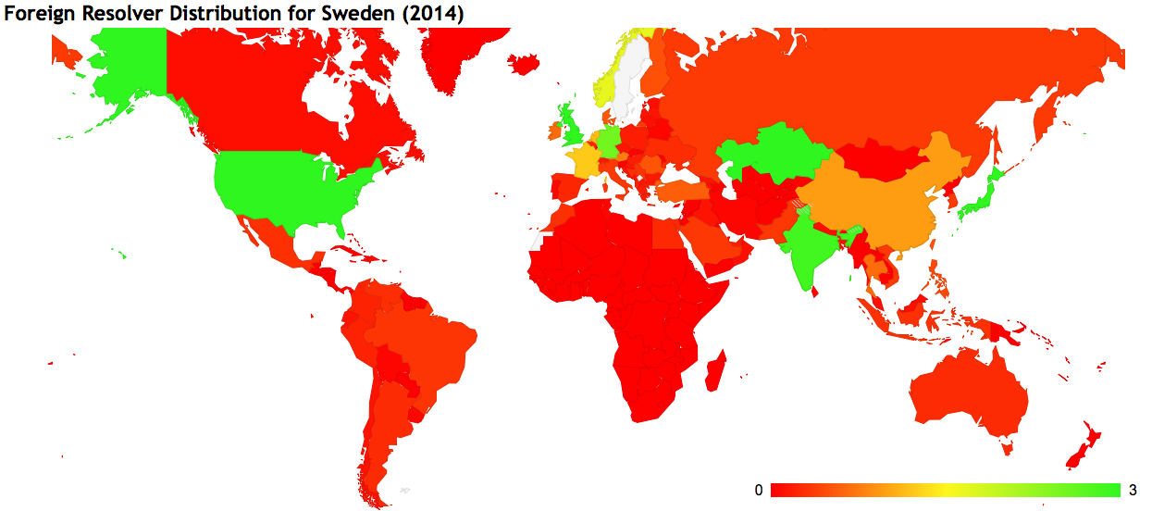
Mapping Foreign Resolution - SE
51.21% use US resolvers
13.15% use GB resolvers
% of foreign name resolution per country
Sweden: 87,000 samples, 14,803 foreign resolution instances

Slide 22
Mapping Foreign Resolution - SE
51.21% use US resolvers
13.15% use GB resolvers
% of foreign name resolution per country
3.26% use KZ resolvers
WTF?
Sweden: 87,000 samples, 14,803 foreign resolution instances

Slide 23
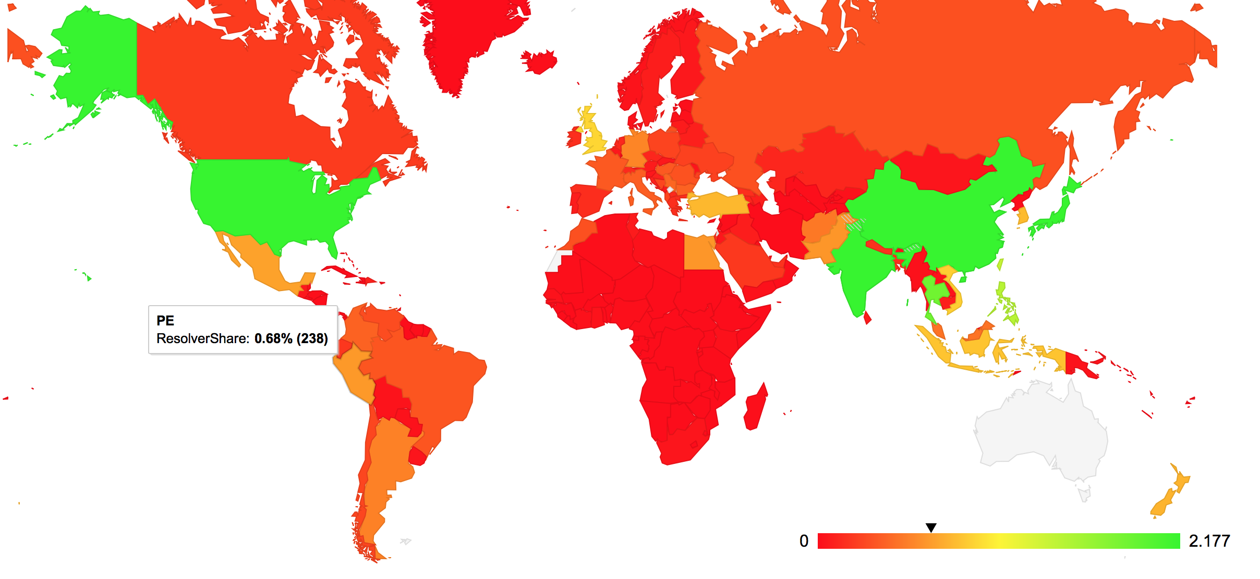
Mapping Foreign Resolution - AU

Slide 24
Mapping Foreign Resolution - AU
There are a couple of hundred users in Australia using a DNS
resolver that is located in Peru. You’d think they’d notice
that something was sort of slow with their Internet if all their DNS queries are being sent out via Peru!

Slide 25
Why is this happening?
It’s Google: Google’s Public DNS (all instances are mapped to the US in this per-AS analysis)
Users’ efforts to circumvent DNS-based geo-loc content access controls (think Netflix!)
3rd party DNS query monitoring/stalking (yes, there is some of this going on, but that’s a lightning talk for another time!)
Virus contamination of the host (yes, captured systems often show a redirected DNS config)
<insert your favourite theory here>

Slide 26
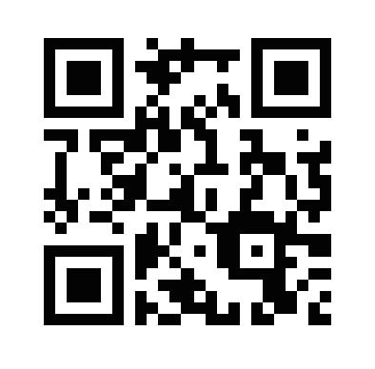
If you want to play with these maps, here’s a (temporary) URL:
http://bit.ly/13oU09X
% of foreign name resolution per country

Slide 27
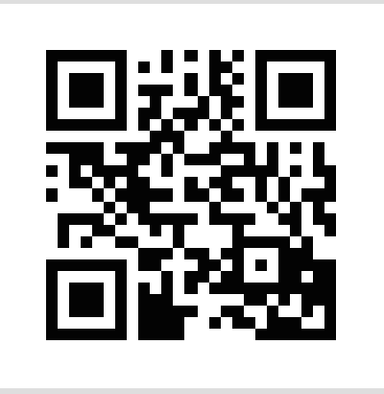
Thanks!

