Slide 1

Analysing Dual Stack Behaviour and IPv6 Quality
Geoff Huston & George Michaelson
APNIC

Slide 2

What does a browser do in a dual stack environment?
Is this behaviour better – or worse – than comparable behaviour in a IPv4-ony world?

Slide 3
Dual Stack Behaviour: V1.0
IPv6 First:
Unconditional preference for IPv6 over IPv4

Slide 4
Dual Stack Behaviour: V1.0
IPv6 First:
Unconditional preference for IPv6 over IPv4
If the local client has an active IPv6 interface then:
  Perform two DNS queries: A and AAAA record queries
  Wait for both to complete
  If the AAAA query succeeds then initiate the browser connection using IPv6
  If there is no AAAA record then initiate the browser connection using IPv4

Slide 5
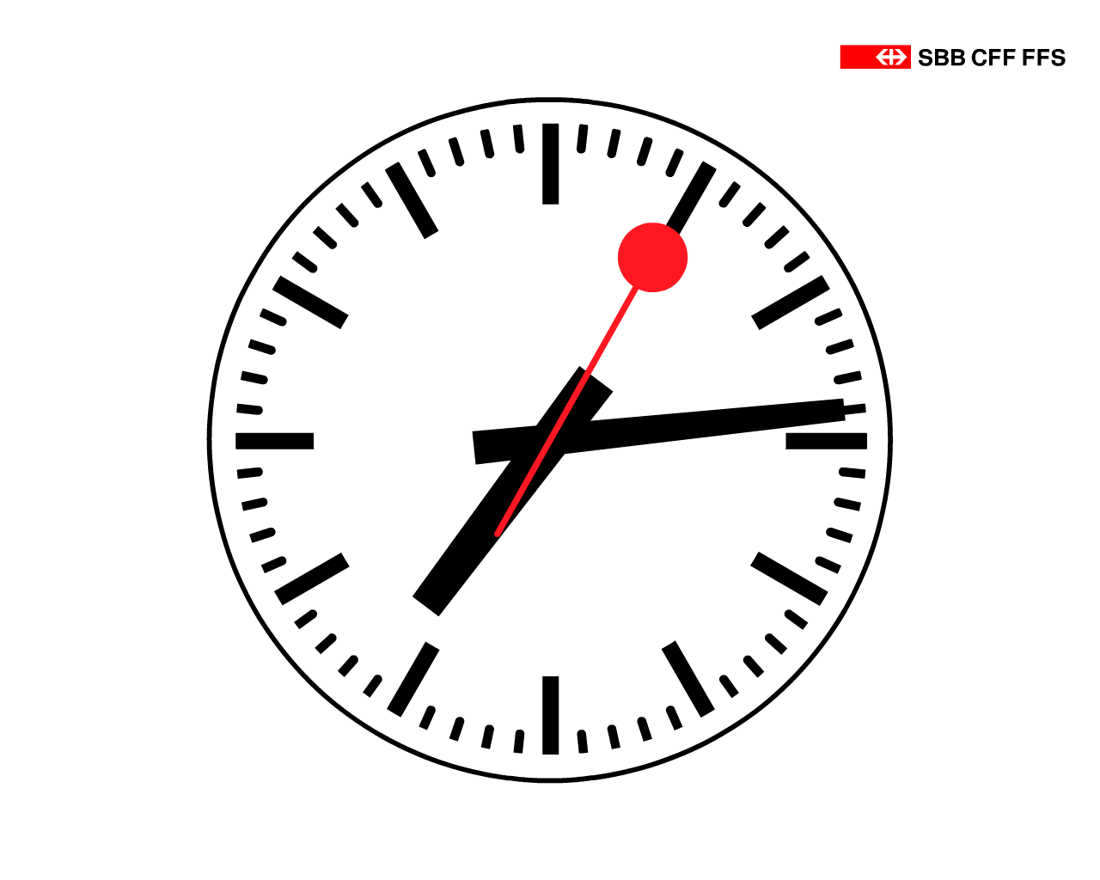
Dual Stack Failure: V1.0
What if the IPv6 connection attempt does not elicit a response?
Then you fall back to use IPv4
How long will you wait before decide that this has failed and you need fall back?
As long as it takes for the Operating System’s TCP system to fail
- Windows: 3 SYN packets, 19 seconds
- Mac OS X 6.8 and earlier: 11 SYN packets, 75 seconds
- Linux: >= 11 SYN packets, between 75 to 180 seconds
Obviously, this sucks!

Slide 6
Dual Stack Behaviour: V2.0
Native IPv6 First:
Unconditional preference for native IPv6 over IPv4
Add Local Preference Rules:
  unicast IPv6
  unicast IPv4
  6to4 tunneled IPv6
  Teredo IPv6
The effect of this preference table is that if the local IPv6 interface is an auto-tunneled interface than it will only be used when there is no local unicast IPv6 interface and the remote site is IPv6-only

Slide 7
Dual Stack Failure: V2.0
What if the IPv6 SYN does not elicit a response?
Then you fall back to IPv4
How long will you wait before you fall back?
As long as it takes for the Operating System’s TCP system to fail
Windows: 3 SYN packets, 19 seconds
Mac OS X 6.8 and earlier: 11 SYN packets, 75 seconds
Linux: >= 11 SYN packets, between 75 to 180 seconds
i.e. no change – this still sucks.
If you are behind a broken V6 connection, your life is still abject misery!

Slide 8
Dual Stack Behaviour: V2.5
Windows Vista and 7
While Vista and 7 has IPv6 “on” by default, if the system is behind a NAT the IPv6 interface is a auto-configured as a Teredo auto-tunnel interface
The modified behaviour is that these systems will not even query the DNS for a AAAA record if the only local IPv6 interface is a Teredo interface
  i.e. the Teredo interface is only used when there is no precursor DNS lookup (e.g. use of IPv6 address literal form of URL)

Slide 9
Dual Stack Behaviour: V2.5
Native IPv6 First:
Unconditional preference for native IPv6 over IPv4
(and avoid Teredo)
Add Local Preference Rules:
  unicast IPv6
  unicast IPv4
  6to4 tunneled IPv6
  Teredo IPv6
The effect of this is that if the Windows box is behind a NAT and does not have a unicast V6 connection then it shows IPv4-only behaviours

Slide 10
All this is broken!
When the network sucks, this form of browser behaviour makes it suck even more!
These serialized approaches to dual stack connectivity really don’t work well when there is a connection failure.
The technique used to identify a failure falls back to a timeout – and this can be frustrating to the user if a default OS-provided timeout is used

Slide 11
We need better failures!

Slide 12
We need better failures!
Altering the local preference rules may alter the chances of encountering a failure, but does not alter the poor method of determining when you have failed
The fine print: The real problem here is that the assumption behind the TCP connection code in most operating systems was that there was no fallback – you either connected to a given address or you report failure. To provide a behaviour that was robust under adverse network conditions the OS connection code is incredibly persistent (up to 3 minutes In the case of Linux default). But to use this same code in the circumstance where you have alternate connection possibilities is just testing the user’s patience. So we need to rethink this and use a connection strategy that tests all possibilities in a far shorter elapsed time.

Slide 13
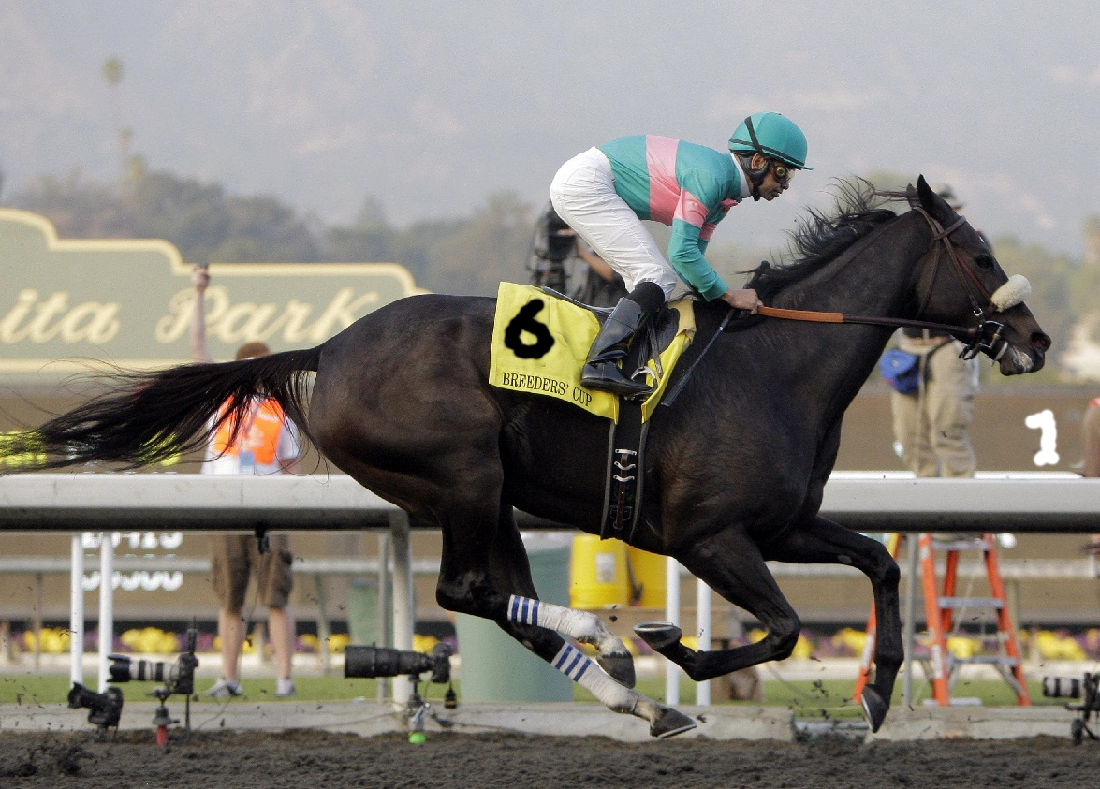
How to conduct a two horse race...
Start with one horse

Slide 14
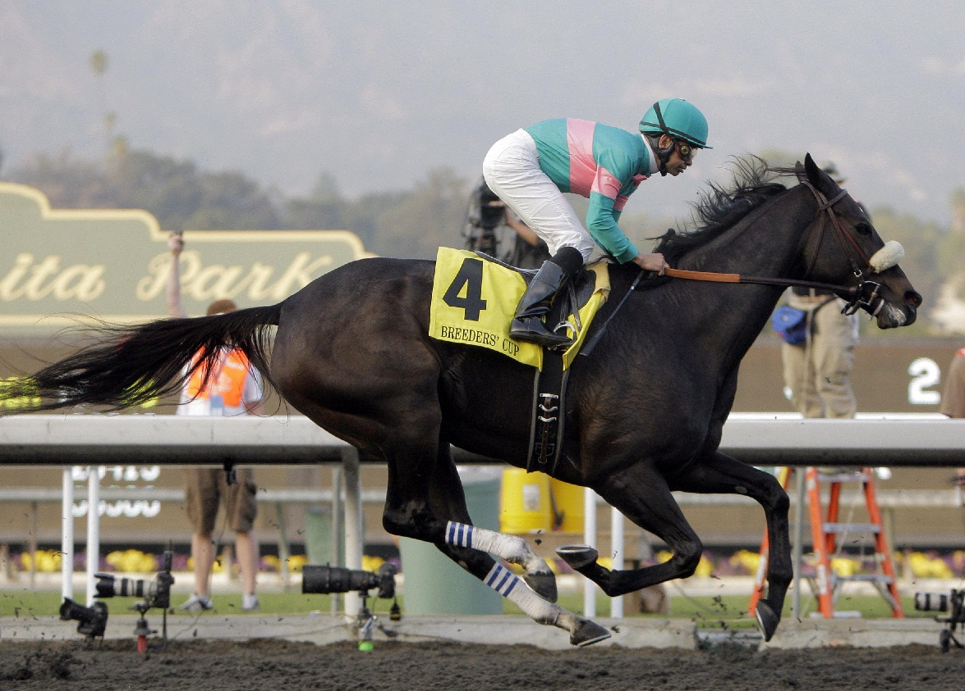
How to conduct a two horse race...
Start with one horse
If it dies on the way then send off the other
horse!

Slide 15

How to conduct a two horse race...
Or...
You can send off both horses at once
and go with whichever is fastest...

Slide 16
Dual Stack Behaviour: V3.0
Safari and Mac OSX 10.7 and later
Moderately Happy Eyeballs:
Determine the preference between IPv4 and IPv6 by maintaining a running performance metric of per-protocol average RTT to each cached destination address
When DNS queries return both A and AAAA records initiate a connection using the protocol with the lowest current average RTT

Slide 17
Dual Stack Failure: V3.0
Safari and Mac OSX 10.7 and later
If the connection is not established within the RTT estimate time interval then fire off a connection attempt in the other protocol
  i.e. use a very aggressive timeout to trigger protocol fallback

Slide 18
Dual Stack Failure: V3.0
Safari and Mac OSX 10.7 and later
If the connection is not established within the RTT estimate time interval then fire off a connection attempt in the other protocol
  i.e. use a very aggressive timeout to trigger protocol fallback

Slide 19
Dual Stack Failure: V3.0
Safari and Mac OSX 10.7 and later
If the connection is not established within the RTT estimate time interval then fire off a connection attempt in the other protocol
    Only when you have tried ALL the addresses in the first protocol family, then flip over to the other protocol

Slide 20
Dual Stack Failure: V3.0
Safari and Mac OSX 10.7 and later
If the connection is not established within the RTT estimate time interval then fire off a connection attempt in the other protocol
Only when you have tried ALL the addresses in the first protocol family, then flip over to the other protocol
Multi-addressing a critical service point in dual stack situations can make it look worse to clients, not better!

Slide 21
Dual Stack Behaviour: V3.1
Chrome Browser
Happyish Eyeballs:
Fire off the A and AAAA DNS queries in parallel
It’s a DNS race: Initiate a TCP connection with the first DNS response
If the TCP connection fails to complete in 300ms then start up a second connection on the other protocol
Yes, 300ms is arbitrary. But assuming that a fast DNS response
equates to a fast data path RTT is equally arbitrary!

Slide 22
Dual Stack Behaviour: V3.2
Firefox and Fast Failover
Happier Eyeballs:
Fire off the A and AAAA DNS Queries
Initiate a TCP connection as soon as the DNS response is received
It’s a SYN race: Use the first connection to complete the SYN-ACK handshake for data retrieval
Close off the other connection
This makes a little more sense – now the data path RTT
has some influence over protocol selection, and the user
connection will proceed with the protocol that completes
the connection in the least time

Slide 23
The bigger picture...
Protocol Preference Setting
Failover Timer Values
http://www.potaroo.net/ispcol/2011-12/esotropia.html

Slide 24
The bigger picture...
http://www.potaroo.net/ispcol/2011-12/esotropia.html

Slide 25
Why?
Why add all this parallel complexity to browser behaviour?
What was wrong with the initial concept of “prefer IPv6 if you can, use IPv4 otherwise”?
Is there really any difference in performance between IPv6 connections?
Lets see...

Slide 26
Measuring Dual Stack Quality
Enlist a large set of dual stack clients to connect to an instrumented server using both IPv4 and IPv6
  Equip a number of web sites with a javascript module that poses a number of image-blot retrieval tests
  Extended this using Flash to embed the same tests in a Google Image Ad*
Thank you to Google, ISOC
RIPE NCC & ISC for
assistance in conducting
this experiment!

Slide 27
Test Volume – Number of unique tests performed per day
We are currently performing 600K – 900K unique IPv6 tests per day
Embedding tests in Ads
Web Scripts

Slide 28
Measuring Dual Stack Quality
Enlist a large set of dual stack clients to connect to an instrumented server using both IPv4 and IPv6
  For each successful connection couplet gather the pair of RTT measurements on the SYN-ACK exchanges
  Gather connection failure statistics (where a “failure” is defined as a received SYN, but no followup ACK)

Slide 29
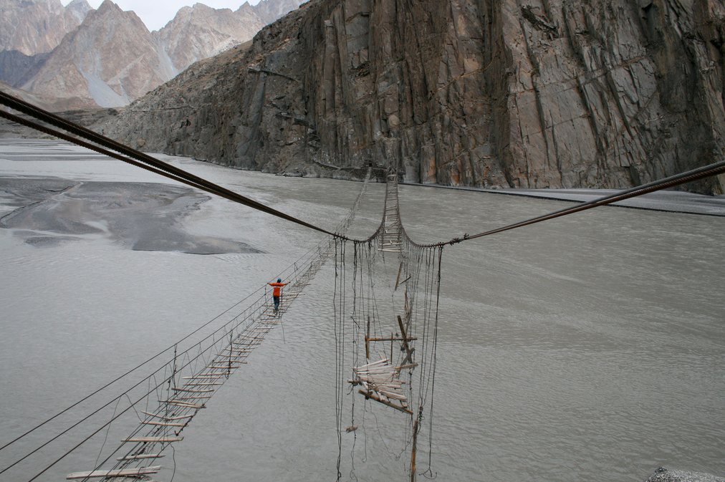
Connection Failure
Outbound SYN
Busted SYN ACK
Return path

Slide 30
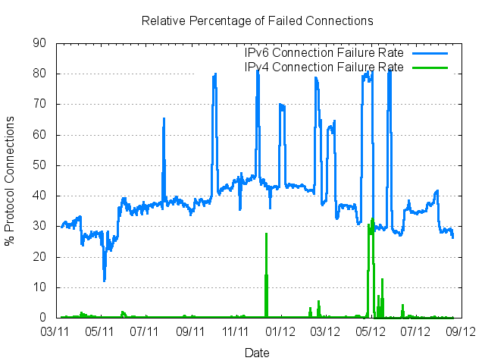
Measuring Failure

Slide 31
Measuring Failure
Why is this failure rate for V6
so incredibly high?

Slide 32
Measuring Failure
What are these v4 failure spikes?

Slide 33
What is going on with IPv4?

Slide 34
What is going on with IPv4?
The failure rate for V4 decreases as the volume of experiments increases – which implies that the number of “naked SYNs” being sent to the servers is not related to the number of tests being performed.
Aside from residual IPv4 failures in the image fetch due to device resets, connection dropouts, etc, the bulk of the recorded failures here is probably attributable to bots doing address scanning on port 80

Slide 35
What is going on with IPv4?
Syn Flood Attacks
bot scanning on port 80?

Slide 36
What about IPv6?
Local Miredo Relay Failures
Why is the base failure rate
of all IPv6 connections sitting
at 30% - 40%?
This is amazingly bad!

Slide 37
V6 Failure Rate by Address Type
Teredo
All V6 Average
6 to 4
Unicast

Slide 38
Teredo Failures
Teredo connections use a 2-step connection process:
  An ICMP exchange to establish the form of local NAT behaviour (full cone, port restricted cone, ...) and to set up the symmetric path
  A TCP 3-way handshake
There are 2 failure modes:
  ICMP seen, no SYN
  ICMP seen, SYN seen, no ACK

Slide 39
Teredo Failure Rate
ICMP Exchange fails to complete
ICMP completed, but SYN Exchange fails to complete

Slide 40
It’s NAT Traversal Failure
Teredo failure is around 35% of all connection attempts
  Obviously, this is unacceptably high!
  This is unlikely to be local filtering effects given that Teredo presents to the local NAT as conventional IPv4 UDP packets
  More likely is the failure of the Teredo protocol to correctly identify the behaviour mode of the local NAT device

Slide 41
Working with Failure
A 35% connection failure is unworkable is almost all circumstances
But one particular application can thrive in this environment, and makes use of Teredo addresses - torrents
  Not many DPI interceptors are sensitive to V6 in V4 UDP encap
  The massive redundancy of the data set across multiple sources reduces the sensitivity of individual session failures

Slide 42
6to4 Auto-tunnelling
6to4 Auto-tunnelling technique
  Cannot operate through IPv4 NATs
  Relies on third party relays in BOTH directions
  Asymmetric traffic paths
  Some of the performance problems can be mitigated by placing the reverse 6to4 relay into the V6 service point

Slide 43
6to4 Failure Rate
US
ASIA
EU

Slide 44
6to4 Failure is Local Failure
6to4 failure appears to be related to two factors:
  The client’s site has a protocol 41 firewall filter rule for incoming traffic (this is possibly more prevalent in AsiaPac than in Europe)
  Load / delay / reliability issues in the server’s chosen outbound 6to4 relay (noted in the data gathered at the US server)
Even so, the 10% to 20% connection failure rate for 6to4 is unacceptably high!

Slide 45
V6 Unicast Failures
January – August2012:
  962,737 successful V6 connecting endpoints
  22,923 failures
  That’s a connection failure rate of 2.3%!
  13 clients used fe80:: link local addresses
  139 clients used fc00:/7 ULA source addresses
  22 clients used fec0::/16 deprecated site local addresses
  16 clients used 1f02:d9fc::/16
  1 client used 1f01:7e87:12:10ca::/64
  1 client used a 3ffe::/16 address
  7 clients used :: IPv4 –mapped addresses (10/8, 192.168/16)
  7 clients used ::ffff:<IPv4>-mapped addresses
  What about the other 22,717 clients?

Slide 46
Unicast IPv6 Failures
38 were using unallocated unicast V6 addresses
150 were using unadvertised unicast V6 addresses
22,529 were using V6 addresses drawn from conventional advertised V6 prefixes!
Local inbound filters appear to be a common problem in IPv6

Slide 47
Where does V6 Fail?
Average - 2.3% of unicast V6 connections fail to complete
However, we saw wide variance across countries:
Highest:
Pakistan - 35%
Hong Kong - 18%
Canada - 12%
Vietnam – 12%
Romania – 10%
Indonesia – 10%
Taiwan – 10%
Malaysia – 7%
New Zealand – 7%
Lowest:
France – 0.3%
UK – 0.3%
Germany – 0.9%
Norway – 0.9%
Australia – 0.9%
Japan - 1%
Greece – 1%
Italy – 1%
Finland – 1%

Slide 48
The “Good” IPv6 AS’s
AS V6 connection AS Description
Failure Rate
AS38083 0.0% AU CURTIN-UNI-AS-AP Curtin University
AS24226 0.1% NZ CATALYST-IT-AS-AP Catalyst IT
AS1312 0.1% US VA-TECH-AS - Virginia Polytechnic Institute and State Univ.
AS12552 0.1% SE IPO-EU IP-Only Telecommunication Networks AB
AS31334 0.1% DE KABELDEUTSCHLAND-AS Kabel Deutschland Vertrieb und Service GmbH
AS237 0.1% US MERIT-AS-14 - Merit Network Inc.
AS55 0.2% US UPENN-CIS - University of Pennsylvania
AS17727 0.2% ID NAPINFO-AS-AP PT. NAP Info Lintas Nusa
AS21453 0.2% RU FLEX-AS Flex Ltd
AS2516 0.2% JP KDDI KDDI CORPORATION
AS6661 0.2% LU EPT-LU Entreprise des P. et T. Luxembourg
AS2107 0.2% SI ARNES-NET ARNES
AS12322 0.2% FR PROXAD Free SAS
AS3676 0.2% US UIOWA-AS - University of Iowa
AS4802 0.3% AU ASN-IINET iiNet Limited
AS39326 0.3% GB GOSCOMB-AS Goscomb Technologies Limited
AS53347 0.3% US PREMIER-COMMUNICATIONS - Premier Communications
AS3333 0.3% NL RIPE-NCC-AS Reseaux IP Europeens Network Coordination Centre (RIPE NCC)
AS22394 0.3% US CELLCO - Cellco Partnership DBA Verizon Wireless
AS19782 0.3% US INDIANAGIGAPOP - Indiana University
AS5661 0.3% US USF - UNIVERSITY OF SOUTH FLORIDA
AS4608 0.3% AU APNIC-AP Asia Pacific Network Information Centre
AS3582 0.3% US UONET - University of Oregon
AS22548 0.3% BR Comite Gestor da Internet no Brasil
AS8426 0.3% ES CLARANET-AS ClaraNET LTD
AS2852 0.4% CZ CESNET2 CESNET, z.s.p.o.
AS57 0.4% US UMN-REI-UC - University of Minnesota
AS7018 0.4% US ATT-INTERNET4 - AT&T Services, Inc.
AS1103 0.4% NL SURFNET-NL SURFnet, The Netherlands
AS55391 0.5% JP MF-NATIVE6-E INTERNET MULTIFEED CO.

Slide 49
The “Not So Good” IPv6 AS’s
AS V6 connection AS Description
Failure Rate
AS29113 12.5% CZ SLOANE-AS UPC Ceska Republica, s.r.o.
AS1659 12.6% TW ERX-TANET-ASN1 Tiawan Academic Network (TANet) Information Center
AS45230 12.6% NZ UBERGROUP-AS-NZ UberGroup Limited
AS18119 12.8% NZ ACSDATA-NZ ACSData
AS17451 13.6% ID BIZNET-AS-AP BIZNET ISP
AS24173 13.8% VN NETNAM-AS-AP Netnam Company
AS12271 15.1% US SCRR-12271 - Road Runner HoldCo LLC
AS17709 16.8% TW EBT Eastern Broadband Telecom Co.,Ltd
AS11427 18.4% US SCRR-11427 - Road Runner HoldCo LLC
AS2907 18.4% JP SINET-AS Research Organization of Information and Systems, National Institute of Informatics
AS8591 19.2% SI AMIS AMiS
AS812 19.6% CA ROGERS-CABLE - Rogers Cable Communications Inc.
AS12046 19.8% MT ASN-CSC-UOM University of Malta
AS3356 20.2% US LEVEL3 Level 3 Communications
AS4725 20.9% JP ODN SOFTBANK TELECOM Corp.
AS8970 21.6% PL WASK WROCMAN-EDU educational part of WASK network, Wroclaw, Poland
AS17579 21.6% KR KREONET2-AS-KR Korea Institute of Science and Technology Information
AS7539 22.3% TW TANET2-TW TANet2, sponsored by NSC, TAIWAN
AS3262 22.9% ES SARENET SAREnet, Spain
AS11537 25.3% US ABILENE - Internet2
AS16880 32.5% US TRENDMICRO Global IDC and Backbone of Trend Micro Inc.
AS9431 33.2% NZ AKUNI-NZ The University of Auckland
AS4528 33.6% HK HKU-AS-HK The University of Hong Kong
AS45809 34.7% NZ NZRS-AS-AP ASN for .nz registry content
AS2576 42.0% US DOT-AS - U. S. Department of Transportation
AS17996 42.3% ID UIINET-ID-AP PT Global Prima Utama
AS3562 45.5% PK SNLL-NET-AS - Sandia National Laboratories
AS24514 58.6% MY MYREN-MY Malaysian Research & Education Network

Slide 50
Measuring Dual Stack Quality
For each successful connection couplet gather the pair of RTT measurements on the SYN-ACK exchanges
  Use the server’s web logs to associate a couplet of IPv4 and IPv6 addresses
  Use the packet dumps to collect RTT information from the SYN-ACK Exchange

Slide 51
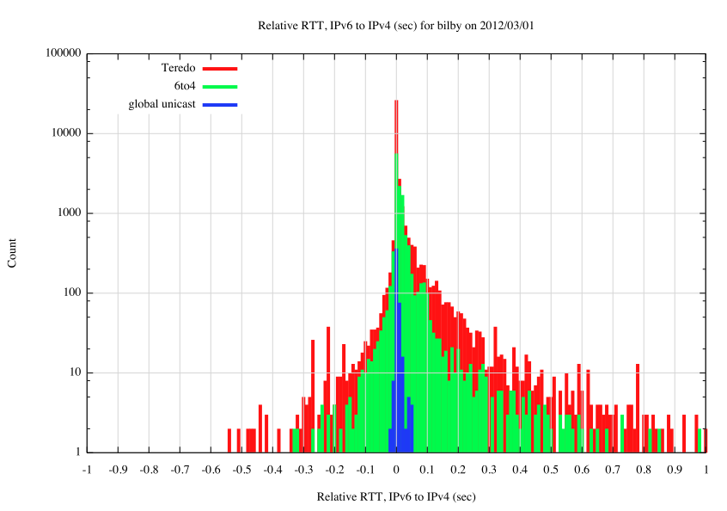

Slide 52
IPv6 is faster
IPv6 is slower
Number of samples (log scale)
6 to 4
Teredo
Unicast
RTT Difference (in fractions of a second)

Slide 53
Europe-located Server
This is unexpected!

Slide 54
Why is Teredo slower?
The technique used here is to measure the interval between the first received SYN and the first received ACK
  But something is happening with Teredo
    we use inbuilt Teredo Relays, so the Teredo RTT should precisely match the IPv4 RTT
      But we are measuring the initial SYN exchange
      It appears that there are some major setup delays in Teredo that are occurring in the initial SYN ACK exchange
      The performance of CPE based NATs has a massive tail of delay, woe and abject misery!

Slide 55
Europe-located Server
This is unexpected!

Slide 56
Why is V6 faster in some cases?
We see some sessions that have faster V6 RTTs than their paired IPv4 counterpart
  Because IPv6 is faster?
    This is possible – there are some strange IPv4 paths out there
    But why would a Teredo SYN exchange be faster than a native IPv4 SYN exchange?
  Becuase IPv4 is slower?
    Is this related to the behaviour characteristics of some CPE based NATs and their handling of NAT bindings during a a SYN exchange?

Slide 57
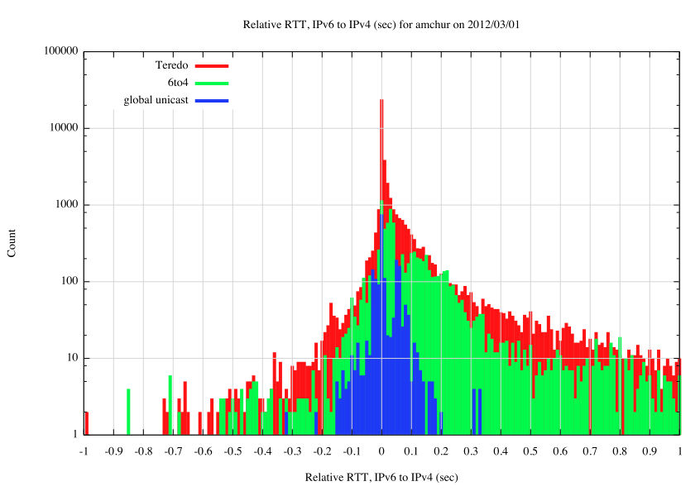
Australia-located Server
Huh?
Huh?
Huh?

Slide 58
The server’s V6 routing transit is not always optimal
And nor is V4 transit optimal in some cases
There are 6to4 delay peaks at 40ms and 150ms
And the long tail of Teredo slowness
Australia-located Server
Huh?
Huh?
Huh?

Slide 59
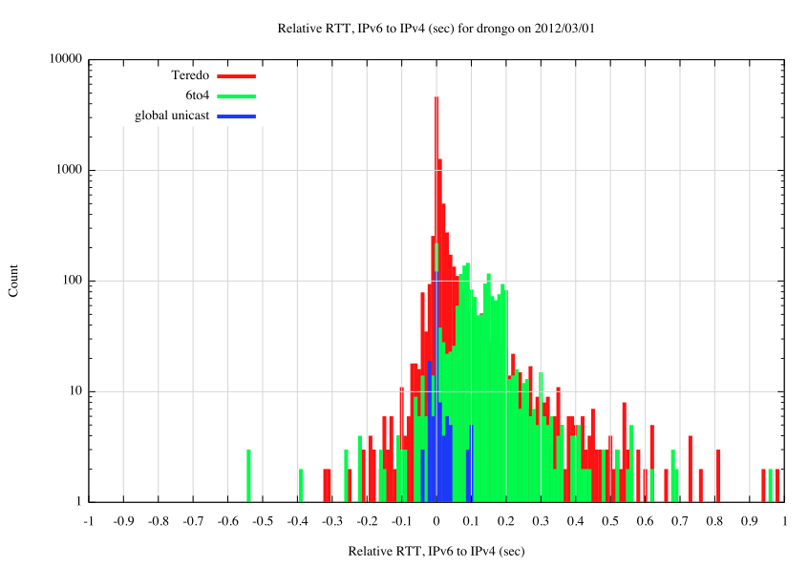
US-located Server
Remote outbound
6to4 relay

Slide 60
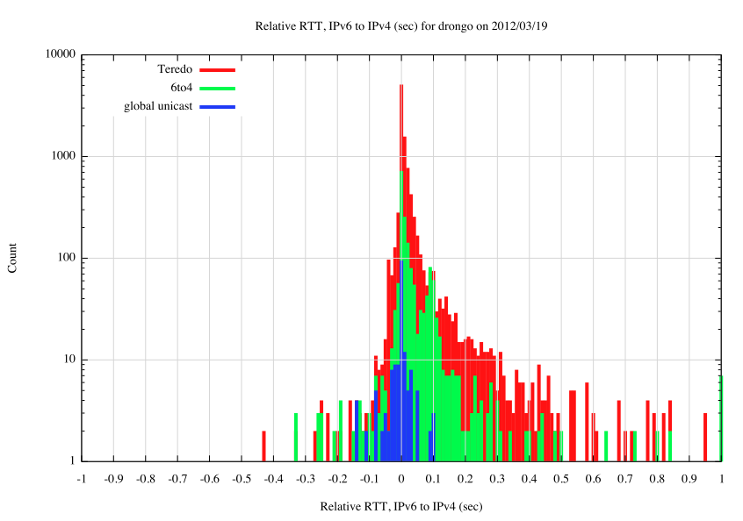
US-located Server
Use of local outbound
6to4 relay has
reduced this skew

Slide 61
Observations
Is IPv6 as fast as IPv4?
  If you are native in IPv6, then, yes!
  The use of tunnels and overlays can make this worse in some cases, but, in general, V6 is as fast as V4

Slide 62
Observations
Is IPv6 as robust as IPv4?
  Sadly, on average, No
  The base failure rate of V6 connection attempts at ~2% of the total V6 unicast traffic volume is simply unacceptable as a service platform
  But its not in the core network. It appears that this is mainly self-inflicted with local edge firewall filter settings that trap V6 packets
  But relative robustness is highly variable – some ASes have IPv6 at the same level of robustness as IPv4, while others do no.

Slide 63
How Should Browsers Behave?
One view is to place both protocols on equal footing in a parallel connection environment, using a “SYN-ACK race” with parallel DNS and TCP session establishment
  E.g. Firefox with fast retransmit
Or reduce the server load by using a “DNS race” and take whichever answers first, but prepare for failover using a very aggressive timeout
  E.g. Chrome with 300ms failover timer
Or use local heuristics to estimate which is faster and failover within 1 RTT interval
  E.g. Safari + Mac OS X >= 10.7

Slide 64
How Should Browsers Behave?
One view is to place both protocols on equal footing in a parallel connection environment, using a “SYN-ACK race” with parallel DNS and TCP session establishment
  E.g. Firefox with fast retransmit
Or reduce the server load by using a “DNS race” and take whichever answers first, but prepare for failover using a very aggressive timeout
  E.g. Chrome with 300ms failover timer
Or use local heuristics to estimate which is faster and failover within 1 RTT interval
  E.g. Safari + Mac OS X >= 10.7
None of these are that bad – they are all very fast. The trade off is slightly higher number of connections with the server against speed and robustness of the session

Slide 65
But it’s still not enough!
Many access providers see their immediate future as having to
deploy IPv6 across their infrastructure, and at the same time field CGNs
But how $big$ does the CGN need to be?
  Generically, the CGN needs to be as big as the residual preference for using IPv4 in dual stack scenarios
So how can we help this story along?

Slide 66
How Should Browsers Behave?
  Fire off the DNS queries in parallel
  If the DNS returns AAAA and A records, fire off a V6 connection attempt first
  Use a reasonably aggressive fallback timer to trigger V4 connection
    E.g. Chrome with 300ms failover timer
    E.g. Safari + Mac OS X with RTT-derived timer

Slide 67
How Should Browsers Behave?
  Fire off the DNS queries in parallel
  If the DNS returns AAAA and A records, fire off a V6 connection attempt first
  Use a reasonably aggressive fallback timer
    E.g. Chrome with 300ms failover timer
    E.g. Safari + Mac OS X with RTT-derived timer
“Biased, but still Pleasantly Amused Eyeballs”!

Slide 68


Thank You
Questions?
labs

